Slide 1
R&D Perspectives in EUCARD-2
RF
Peter McIntosh
(STFC Daresbury Laboratory)

Slide 2
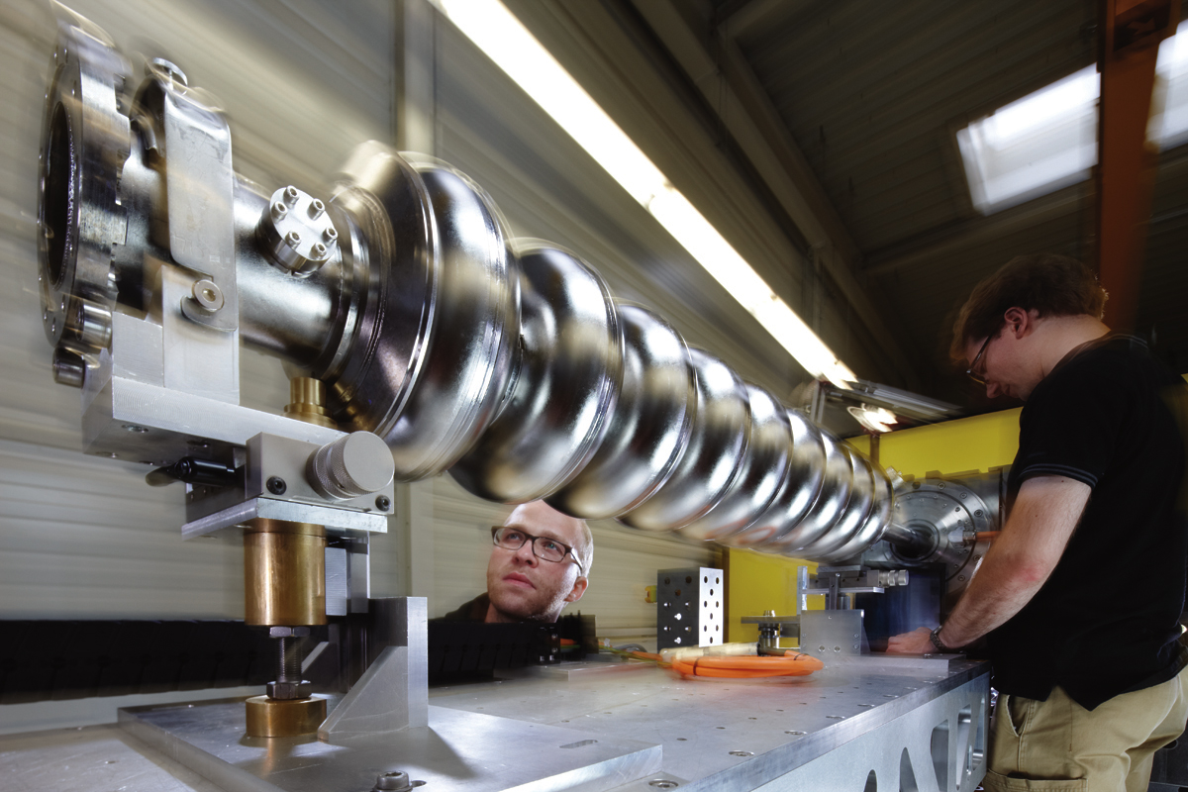
WP12
Innovative RF Technologies
This JRA focuses on the development of a range of technical solutions that has the potential to achieve significant performance increases in gradient, efficiency and beam quality of RF-based accelerator systems.
Several novel techniques in the field of normal and superconducting RF technology have been selected, presenting the highest impact potential and with the additional benefit of profiting from exchanges and communication between these two distinct communities.
Main R&D areas encompass:
  SRF Thin Films – C Antoine (CEA Saclay);
  High Gradient NC Cavities – W Wuensch (CERN)
  SRF HOM Beam Diagnostics – R Jones (Manchester University)
  RF Photocathodes – R Nietubyc (NCBJ)
Reducing the footprint, machine energy consumption and overall cost of linear accelerators are of primary importance for all accelerators being developed today.
Big Wins!

Slide 3












WP12 Collaborative Team
RF Photocathodes
SRF Thin Films
High Gradient NC
SRF HOM Beam Diagnostic

Slide 4
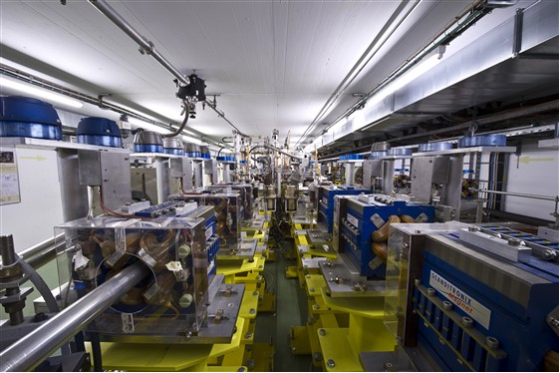
Fundamental Objectives
RF Photocathodes
Development of next generation advanced RF photocathodes, exploring revolutionary production techniques as lead deposition, diamond amplifier cathode and metallic photocathodes, enhancing the ability to reach fs response time, for more effective electron beam generation, capture and transport with high brightness and low intrinsic emittance.
SRF Thin Films
Exploitation of new superconducting materials, such as Nb₃Sn and the development of new nano and multi-layer thin films, each anticipated to break new ground in the performance of SC accelerator cavities, with the potential of achieving gradients well beyond present Nb technology.
High Gradient NC Cavities
Development of an efficient NC structure capable of high gradient operation (Eacc > 100 MV/m) but free from dangerous wakefield contributions.
SRF HOM Beam Diagnostics
Development of electronics for utilising Higher Order Mode (HOM) signals from accelerating cavities for precision beam position diagnostics in high-energy electron linear accelerators, with the goal of improving beam quality and stability.

Slide 5


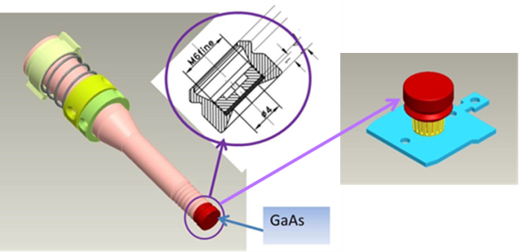
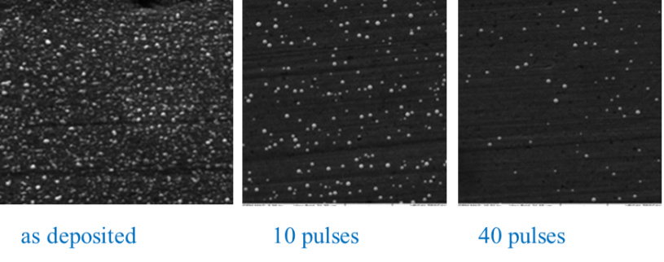
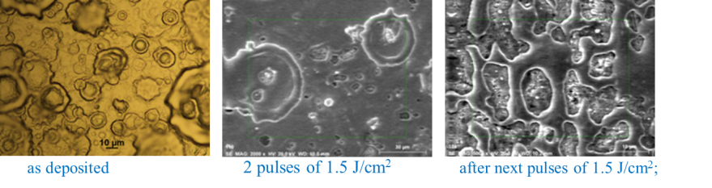
Pb Photocathodes
Pb surface processing optimisation to reduce a dark current and improve QE
Pb layer treatment with EUV radiation:
λ = 10 – 70 nm, 5 ns pulses, rep. 10 Hz
energy density/pulse ≈ 30 mJ/cm²
penetration depth ≈ 15 nm
Pb layer treatment with pulsed ion beams from IBIS Rod Plasma Injector:
Pb/Nb films of thickness 1 – 20 μm
treated with 1 μs Ar ion pulses of 1 – 6 J/cm²
Melting and recrystallization
Utilisation of standard photocathode/plug.
Standard ex-situ structural and morphological studies with SEM, XRF and XRD
Integrated stand for heat treatment, EUV irradiation and in-situ XRF-base purity and thickness diagnostics, QE and DC measurements
Measurements of resonance quality vs E_{acc} for electron gun with pure and Pb-coated plug.
Pb/Nb photocathode tests in HZDR SRF gun:
QE, lifetime, FE, DC and thermal emittance
Micro-droplets removal

Slide 6
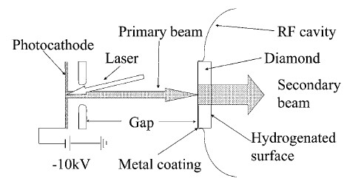
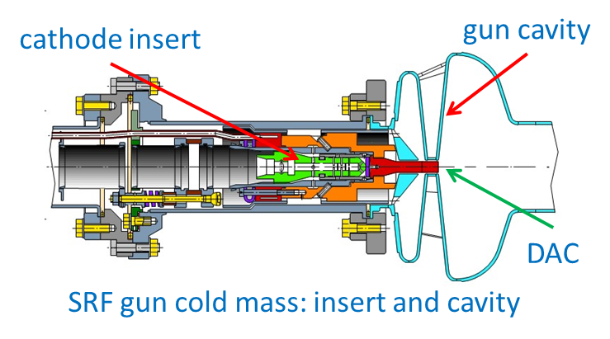
Diamond Amplified Cathode
Generation of high average currents (>100 mA) well above what is currently achievable with high QE multi-alkali photocathodes (Smedley et al BNL).
DAC is a very promising solution!
Steps towards DAC at SRF gun:
Physics and engineering design of a suitable cathode cell which contains the DAC.
Laboratory tests of beam properties.
Qualification of DAC in SRF gun at ELBE/HZDR and BERLinPro/HZB
Challenges:
Operation of DAC inside an SRF gun
Beam properties (thermal emittance, response time)
Field emission
Beam Current | Laser | Cathode
Low to medium | UV | Cs2Te Pb/Nb
High | green | CsK2Sb
Extremely high | green | DAC

Slide 7
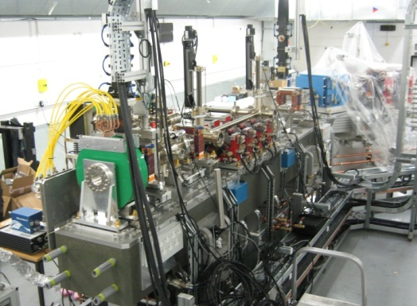
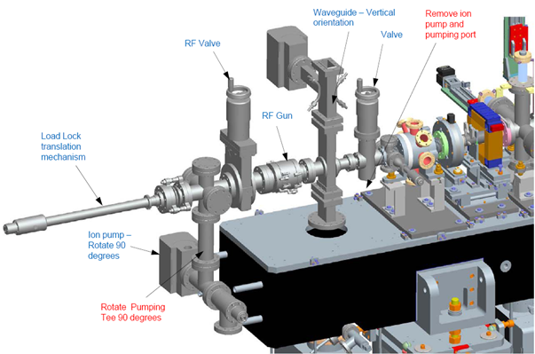
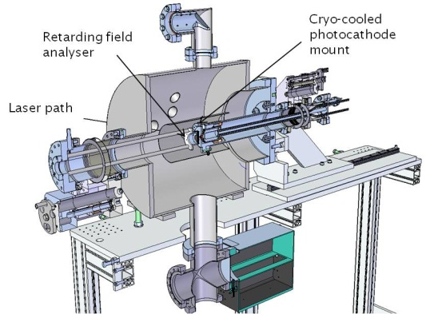
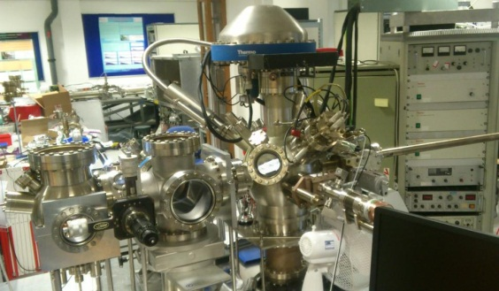
Metal Photocathodes
Metal PC materials (e.g. Ag, Cu, Mg, Nb, Pb, Zr) characterisation and evaluate surface preparation procedures.
ESCALABII and Multi-probe surface analysis:
  Compositional and chemical analysis
  Surface roughness evaluation
  Work function measurement
  Quantum efficiency measurements
Transverse Energy Spread Spectrometer (TESS) for:
  Transverse emittance measurements
  QE measurements
Cathode transfer system to allow rapid evaluation of candidate materials and procedures in the VELA test facility.
Improve cathode QE and reduce emittance, providing high brightness beams for future FEL applications.

Slide 8


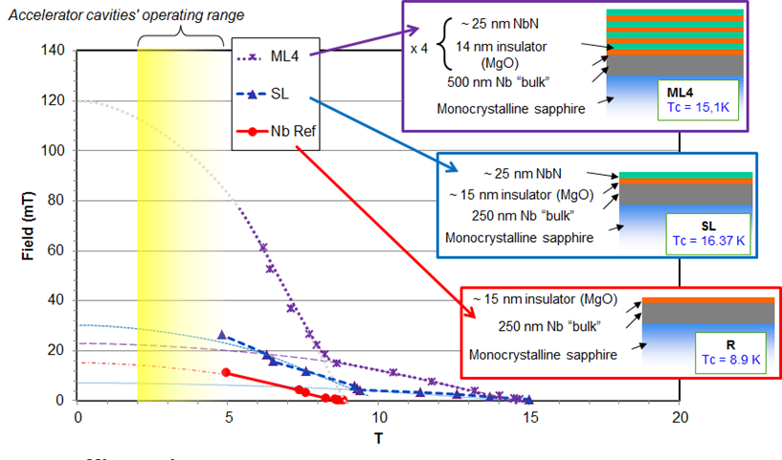
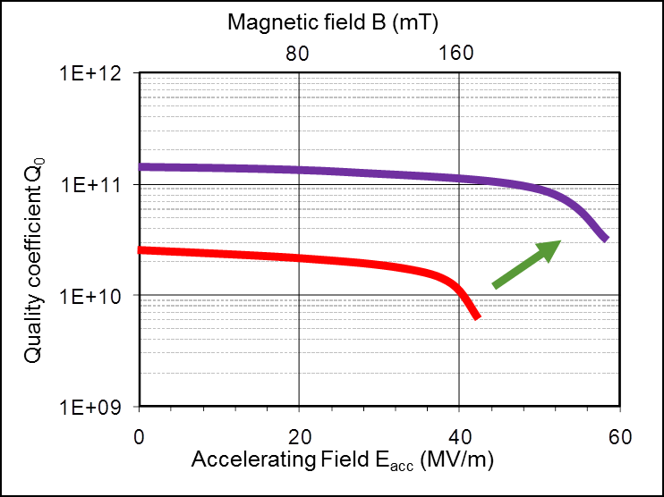
SRF Thin Films
Niobium on copper (µm):
  After ~20 years stagnation
  New revolutionary deposition
  techniques developed:
    HIPIMS, CVD, ALD
  Great expectations in cost reduction
  Improved performances c.f. bulk Nb
Higher Tc material (µm):
  Based on superheating model.
  Higher field and Qo expected
Higher Tc material (nm), multilayer:
  Trapped vortex model (Gurevich)
  Higher field and Qo expected
  ~200 x H_{c1} predicted
Specific characterization tools needed.
Better understanding of SRF physics needed.
Multi-layer
SRF Thin Film
Fundamental
Goal!
Bulk Nb
See C. Antoine (CEA) talk this afternoon
Notes:
We need some young physicist taking time to understand the work of theoretician and translating it into practical information

Slide 9
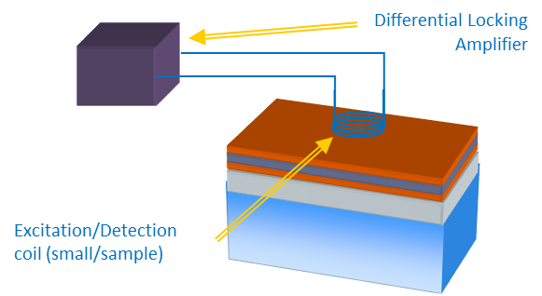
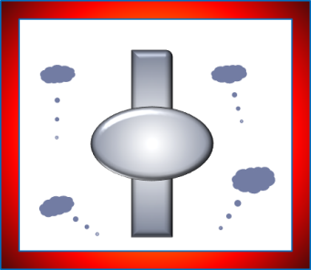
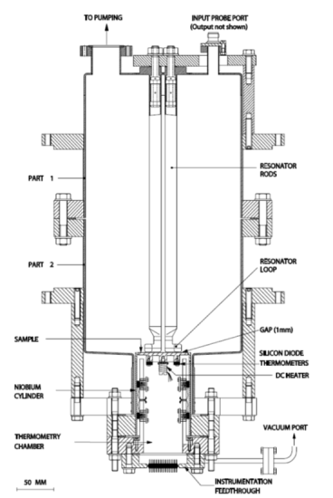
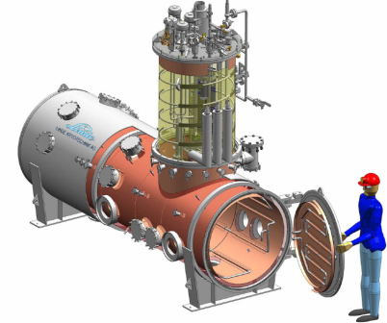
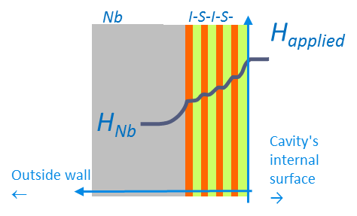
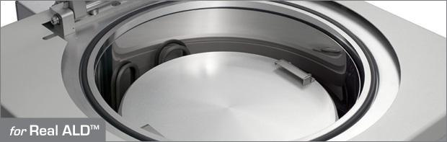
Thin Film R&D
CERN:
  HIPIMS: Energetic deposition => better film microstructure (bulk-like, high RRR)
  Nb₃Sn: Development of a thermal deposition set up.
INP Grenoble:
  Superconducting heterostructure deposition – CVD & ALD techniques.
  ALD utilised to develop multilayer NbN/insulator/NbN coatings.
CEA Saclay:
  Optimisation of multi-layers.
  Thin layers (d~λ) have higher H_{C1}
  Measure H_{C1} using magnetometry.
HZB-Berlin:
  Build an optimised RF testing resonator.
  Rs vs B characterisation.
  Investigate samples under external magnetic fields.
HoBiCaT

Slide 10
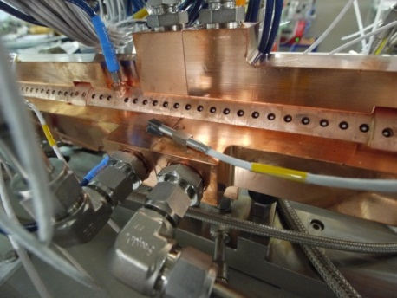
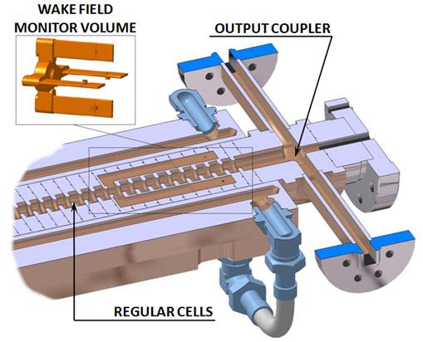
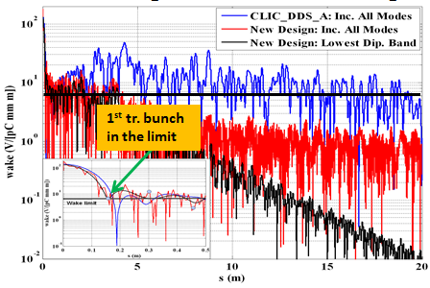
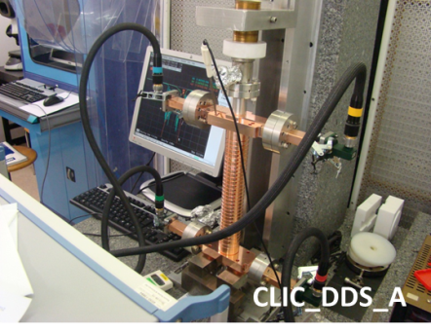
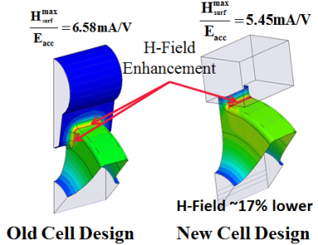
Wakefield Management
CLIC Damped Detuned Structure (DDS) wakefield suppression:
Strong detuning to provide moderate damping.
Incorporation of damping manifolds, interleaving neighbouring cell modes.
Assess perturbation sources (frequency errors, misalignment…) by means of combined RF (GdfidL) and beam dynamics (PLACET) simulations.
Fabricate and test a prototype damped DDS structure.
Wakefield Monitor:
Develop wide-band (2 GHz) front-end electronics for CLIC and SwissFEL.
Optimize signal/noise to reach theoretical µm-scale resolution.
Allow for spectral analysis to extract information about higher order misalignments (pitch, roll, bend), whilst also giving simple ‘operator’ signal.
Evaluating classical RF style option versus Electro-Optical approach with promising properties with respect to radiation damage, electromagnetic interference and bandwidth.

Slide 11

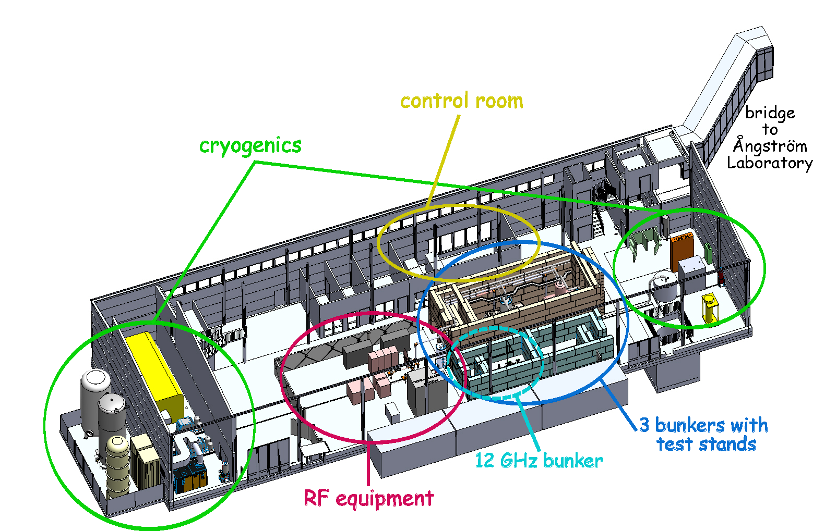
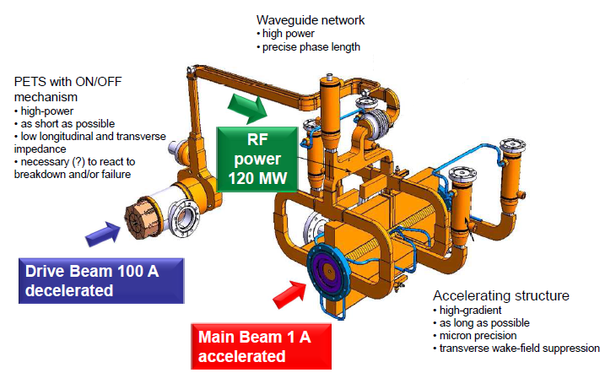
X-Band RF Power Source
Pulse compressor
Develop affordable and reliable technical design for RF testing of CLIC X-band accelerating structures:
  Modest power klystron used in ‘cluster’ configuration.
  Pulse compressor optimisation.
  Prototype and testing of sub-components.
RF Source
10 MW
some μs
1 kHz
20 MW – 200 ns
12 GHz
40 MW
200 ns
RF Source
10 MW
some μs
1 kHz
20 MW – 200 ns
Pulse compressor
To the structure

Slide 12
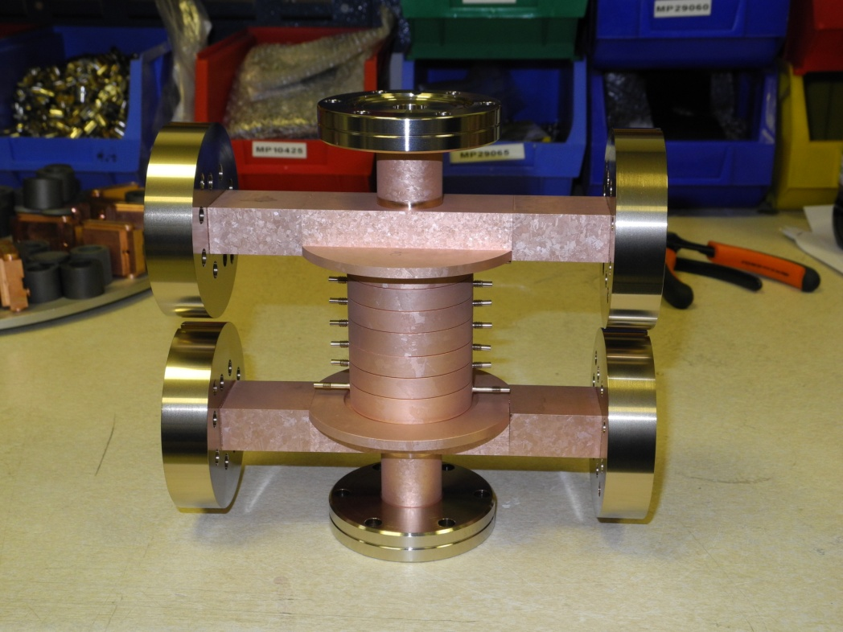
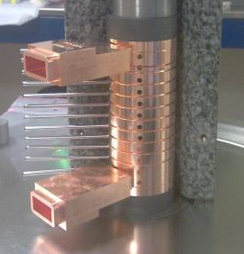
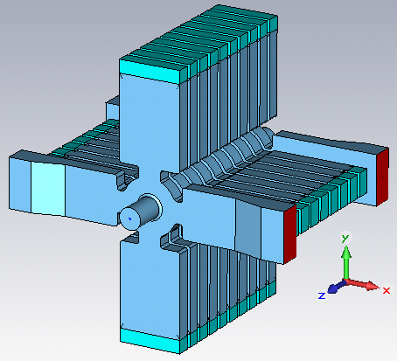
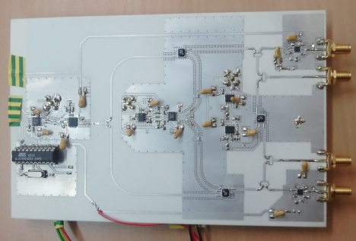
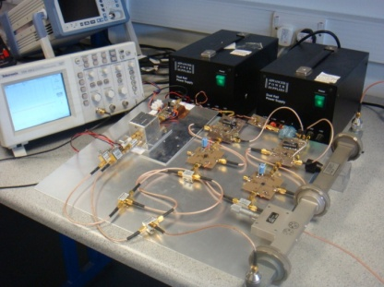
CLIC Crab Cavity System
To complete the design, evaluation and high gradient testing of a CLIC crab cavity. Complete the testing of the cavities developed pre-EUCARD2 and the development of a new ‘fully-damped’ cavity solution.
To understand and measure long-term phase stability in high power RF distribution and use this to develop an appropriate distribution scheme for the CLIC crab cavity system.

Slide 13
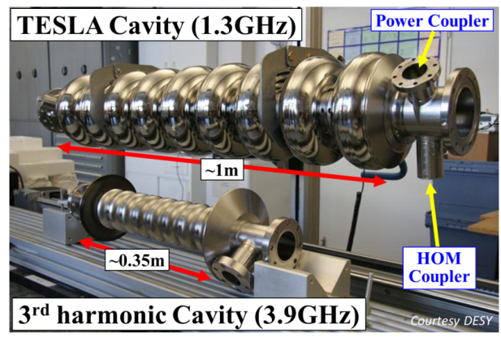
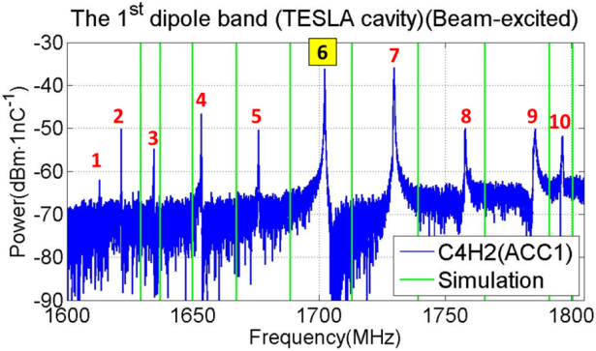
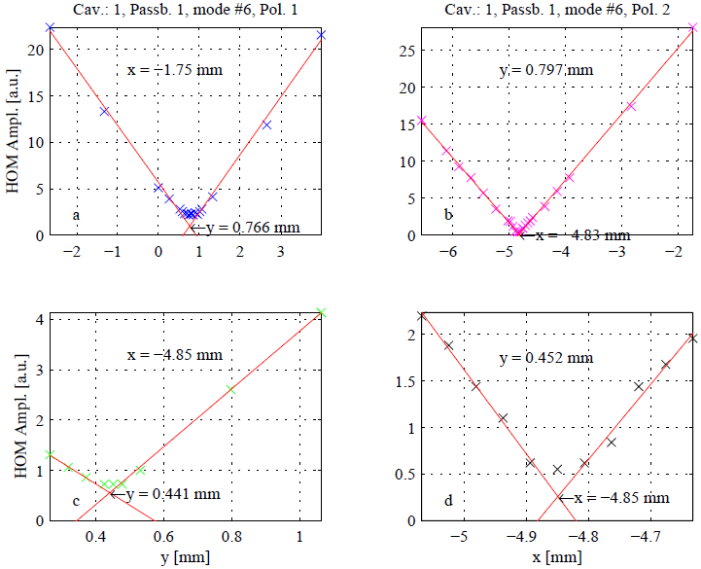
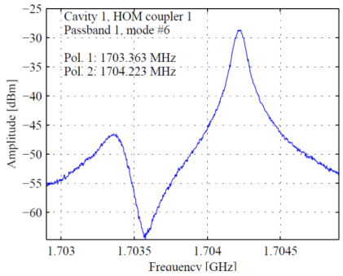
HOM Beam Diagnostic
HOM-based beam diagnostics for XFEL:
Reduced emittance dilution from transverse wakefields.
Direct, on-line measurement of beam phase wrt RF phase.
Align beam on cavity axis.
Measure beam position intrinsically.
Measure cavity alignment within cryo-module.
HOMBPM-electronics built for 1.3 GHz cavities in FLASH (SLAC, DESY):
Use 1 dipole mode at 1.7 GHz.
Used as operator tool for beam alignment.
Used for measurement of cavity alignment.
Demonstrated use as BPM:
  10 μm rms resolution.
Difficulty:
  Instability of calibration into BPM-signals (phase or frequency drifts?).
Notes:
for XFEL
Phase measurement
BPM for 3.9GHz, then for 1.3GHz

Slide 14
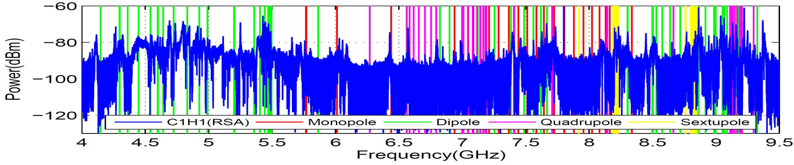
3.9 GHz System R&D
HOMBPM-Electronics for 3.9 GHz cavities in FLASH (EuCARD):
  Due to higher frequency and 4-cavity coupling, use bands of modes instead of single modes:
    Coupling modes around 5.4 GHz for high resolution
    Trapped modes around 9 GHz for localized measurement
    ~20 µm rms positional resolution achieved
3.9 GHz cavities in the European XFEL vs. FLASH:
  Significantly more challenging (8 coupled cavities c.f. 4) and higher frequency (4.5 MHz beam repetition rate c.f. 1 MHz)
  Demands extensive theoretical and experimental studies

Slide 15
Infrastructure Benefits
SRF Photocathodes:
  HZDR - ELBE
  HZB - Hobicat – BerlinPro
  VELA
SRF Thin Films:
  Materials analysis infrastructure at CEA, HZB and INPG
  Sputtering facility at CERN
High Gradient NC:
  SwissFEL
  CTF3
  HP test benches at CERN, CEA and Uppsala Univ.
SRF HOM Diagnostics:
  FLASH and XFEL

Slide 16
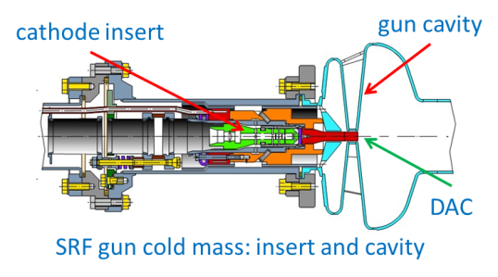


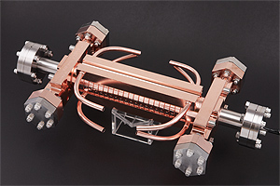
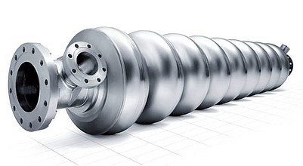
Conclusions:
Pushing the Envelope
Beam Generation:
  New photocathodes providing demonstration of highest beam intensities and smallest beam emittances.
Acceleration:
  Demonstration of the highest level of acceleration performance.
Beam Diagnostics/Control:
  Demonstration of high performance and low cost beam position diagnostic.
Integrated and balanced programme encompassing high performance capabilities across both SC and NC technologies.

