Slide 1
Review of WP7 results: High Field magnets R&D
G. de Rijk (CERN) and F. Kircher (CEA Saclay)
10th June 2013
CERN

Slide 2
Contents
  Introduction: The High Field Magnet work package
  Task 1: Coordination and communication
  Task 2: Support studies
  Task 3: High field model
  Task 4: Very high field dipole insert
  Task 5: High Tc superconductor link
  Task 6: Short period helical SC undulator
  Deliverable summary
  Lessons we learned
  Conclusions

Slide 3
EuCARD WP7 HFM: Superconducting High Field Magnets for higher luminosities and energies
Aim: Development of high field magnets for accelerator applications
Program start 1/4/09, 4 years; budget: total 6.4M€ , EU contrib. 2.2M€
1 management task, 1 studies task, 4 design/construction tasks
  High field model: build a 13 T, 100 mm aperture Fresca2 magnet (15 T ultimate)
  support studies for the 100 mm aperture magnet
  Very high field dipole insert: build a HTS insert coil (into Fresca2) to approach 20 T ( ΔB ~ 6 T)
  HTS link design study
  Build a Helical Undulator model
13 participant institutes: CERN, CEA-DSM-Irfu, CNRS-Grenoble, COLUMBUS, BHTS, KIT, INFN-Milano, Politechnika Wroclawska, SOTON, STFC-DL/RAL, Tampere University of Technology and Université de Genève

Slide 4
Collaborators
The HFM work-package was (and still is !) possible due to a large collaboration:
Task 1: F. Kircher, G. de Rijk
Task 2: H. Allain, B. Baudouy, P. Bielowka, P. Bogdan, S. Canfer, M. Chorowski, R. Flukiger, M. Grymajdo, F. Kircher, K. Kosinski, M. Matusiak, A. Milanese, S. Pietrowicz, J. Piglowski, J. Polinski, P. Pyrka, F. Rondeaux, E. Roszak, Strychalski, E. Todesco, R. van Weelderen, S. Wronka
Task 3: H. Bajas, M. Bajko, B. Baudouy, V. Benda, C. Berriaud, L. Bottura, S. Canfer, S. Caspi, S. Clément, M. Devaux, M. Durante, G. Ellwood, P. Fazilleau, P. Ferracin, P. Fessia, J. Feuvrier, M. Guinchard, J-E Muñoz Garcia, R. Gauthier, F. Kircher, C. Kokkinos, P. Manil, A. Milanese, J-F. Millot, L. Oberli, J-C Perez, S. Pietrowicz, J-M Rifflet, G. de Rijk, F. Rondeaux, B. Sailer, E. Todesco, A. Vande Craen
Task 4: X. Chaud, M. Devaux, F. Debray, M. Durante, J. Fleiter, P. Fazilleau, R. Flukiger, R. Heller, F. Hornung, T. Lécrevisse, E. Mossang C. Pes, J-M. Rey, J-M Rifflet, C. Senatore, M. Sorbi, A. Stenvall, P. Tixador, C. Trophime, B. Vincent, G. Volpini, G. Willering
Task 5: : A. Aubele, A. Ballarino, C. Beduz, B. Bordini, V. Cubeda, J. Fleiter, A. Gharib, G. Grasso, A. Hallbauer, G. Hurte, M. Sitko, M. Tropeano, Y. Yang,
Task 6: V. Bayliss, T. Bradshaw, G. Burton, A. Brummit, S. Canfer, J. Clarke, G. Ellwood, F. Hornung, B. Shepherd, O. Taylor, G. Volpini
ESAC: G. Ambrosio (Fermilab), S. Caspi (LBNL), P. Fabbricatore (INFN Genova),
A. Ghosh (BNL), Y. Iwasa (MIT), T. Nakamoto (KEK), L. Rossi (CERN)

Slide 5
Task 1: Coordination and communication
Over the 4 years of EuCARD:
Organisation of:
  11 collaboration meetings
  4 reviews by the ESAC (External Scientific Review Committee)
  Assisted some tasks to get started
  Reviewing of the deliverables after 2 and 3 years
  Budget follow-up and adjustments
Reporting:
  Status report presentation in EuCARD SCs and annual meetings (~3/yr)
  Produce 18 months reports (with the task leaders)
  Push for and finalise the delivery reports
From 2011 onwards:
  Closer following of the tasks:
    visit to main labs of the tasks
    monthly management (phone) meetings followed by ‘lobbying’
Very good collaboration between CERN and CEA; merci François !
5

Slide 6
Task 2: Support studies (1)
Macej Chorowski & Jarek Polinski (PWR) PWR, CEA, CERN
7.2.1 Radiation studies for insulation and impregnation (PWR with CEA and CERN)
Aim: Certify radiation resistance of coil insulation and impregnation
Situation in 2009:
Most work (outside ITER) on insulator rad resistance >15 years ago
Scattered literature
High dose expectations for HL-LHC low beta zones ( ≥50 MGy)
Work done in the 4 years:
Literature study
Identification of HL-LHC radiation dose situation
Inventory of insulator candidates for HL-LHC Nb₃Sn coils
Selection of irradiation test beam and conditions
Design and construction of irradiation cryostat
Design and construction of material property measurement equipment (mechanical cold test, electrical insulation cold test, thermal conductivity cold test)
Irradiations at Swierk (Pl) and material test (PWR & CEA)
6

Slide 7
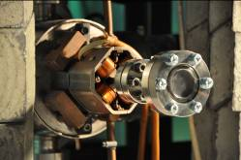
Irradiation set-up
designed and commissioned at PWR and transferred to NCBJ, Swierk
Accelerator 0.2 mm thick Ti window
Irradiation set-up

Slide 8
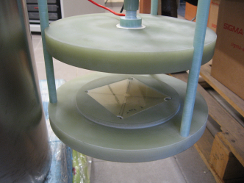
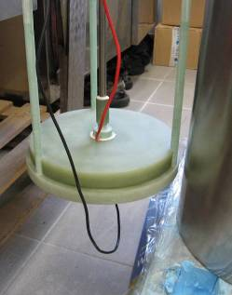
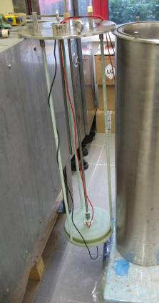
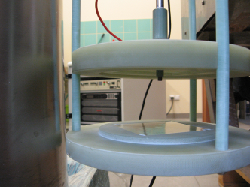
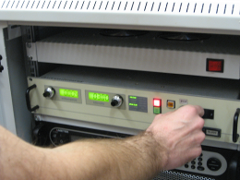
Electrical certification test cryostat at PWR
Electrical breakdown test in LN2 at 77K: equipment built at PWR.

Slide 9
Radiation certification electrical tests summary
4 material types irradiated with 6 MeV e- beam 50 MGy dose

Slide 10
Radiation certification mechanical tests
2 materials (Mix71 and LARP) irradiated (50 MGy)
2 materials (Mix237 and CE-epoxy mix) following by autumn 2013
@50MGy LARP mix reduces 50 %
but Mix 71 is unusable
10

Slide 11
Task 2: Support studies (6)
  7.2.2 Thermal studies (CEA with PWR and CERN)
  Aim: Make a heat deposition and heat removal model for the dipole Nb₃Sn model with experimental validation and determine the thermal coil design parameters for the dipole model magnet.
  Work done:
  Complete the thermal conductivity measurements from CARE/NED for input to the models at CEA (existing NED cryostat) and PWR (new cryostat)
  2D FE simplified heat transfer model of Fresca2 for cool-down scenarios studies and heat load studies as support to the task3 magnet design
  FE model with He 2-fluid model
11

Slide 12
Task 2: Support studies (7)
Results for the thermal task:
Models (2D & 3D) for Fresca2 with He I and II for cool-down and static heat load.
Heat transfer measurements for the various epoxies for coils
New He 2-fluid 3D model in FE
Streamlines and velocity fields for total, superfluid and normal components
12

Slide 13
Task 3: High field model (1)
Jean-Michel Rifflet (CEA) CEA, CERN, PWR
Aim: design, build and test a 1.5 m long, 100 mm aperture dipole with a design field of 13 T, using Nb₃Sn high current Rutherford cables.
  To prepare the technology Short Model Coils are being build with 14, 18 and 40 strand cable at CERN
The lifecycle of the project was accompanied by 4 working groups:
  cable design WG: cable and strand specification made
  Specification WG: magnet functional specification made
  Magnet pre-design WG: layout selection and conceptual design
  Magnet design WG: detailed design of magnet and tooling
The construction is progressing accompanied by the MDWG.
Magnet ready with 2 coil packs: summer 2014, with 4 coil packs: Q1 2015
In parallel CERN designed a new test station which is now under construction: it will be operation in September 2014
13

Slide 14
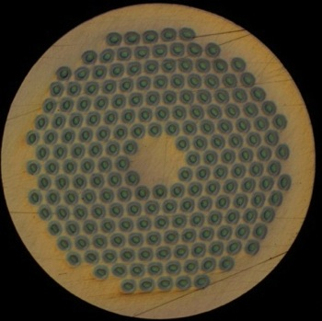
Task 3: conductor development
2 conductor types developed for this project: EU PIT, US RRP
PIT : development based on 1.25 mmNED strand
RRP: based on LARP strands
Strand diameter: 1 mm
Cu/Sc: 1.3 → 56% Cu
Strand #: 40
Bare width after cabling: 20.90 mm
Bare thickness after cabling: 1.82 mm
Braided insulation: 0.2 mm
Assumed growth during HT PIT (192) RRP(132/169)
  4% in thickness and 2% in width
Bare width after HT: 21.32 mm
Bare thickness after HT: 1.89 mm
Cable amount for 1 coil set (5) delivered, for a second set on order
PIT strand
RRP strand

Slide 15
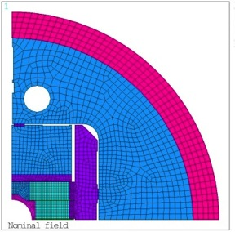
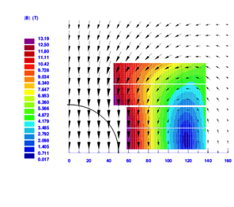
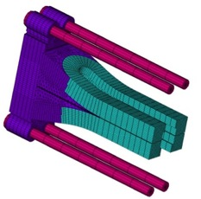
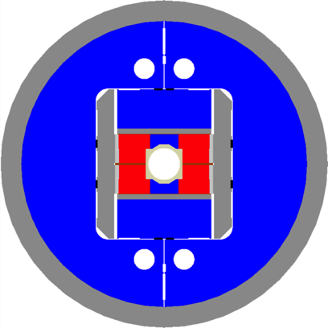
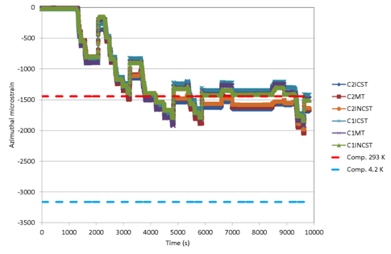
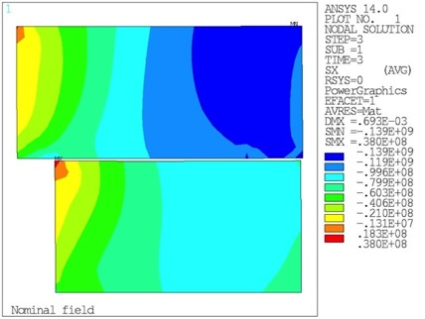
Task 3: magnet design
Done in 3 steps:
Studies to choose the coil and structure concepts
(very contested) ended June 2010
Conceptual design of the block coil with flared ends in a shell, bladder and keys structure , ended January 2011)
Detailed design , completed mid 2012
Dummy coil azimuthal strain vs. time
Straight section
15

Slide 16
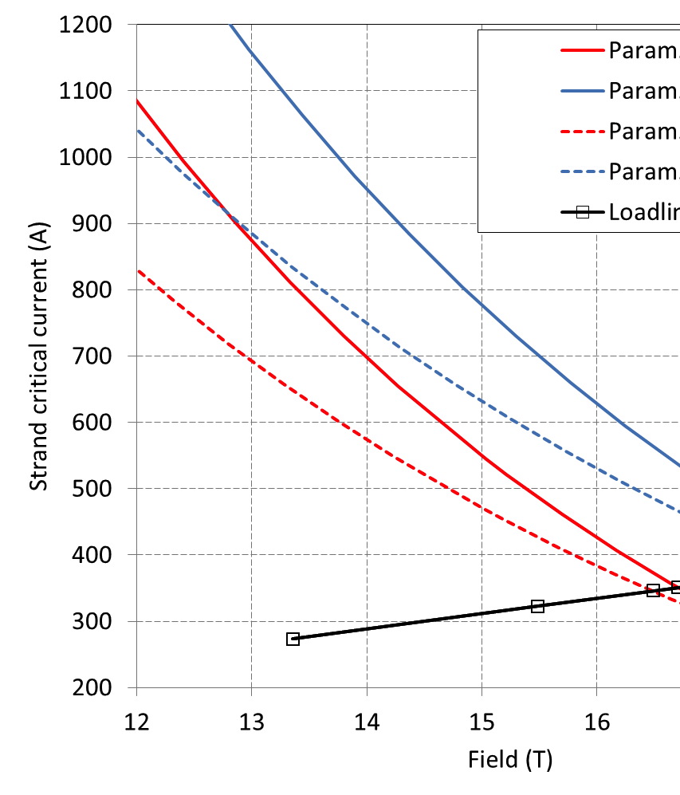
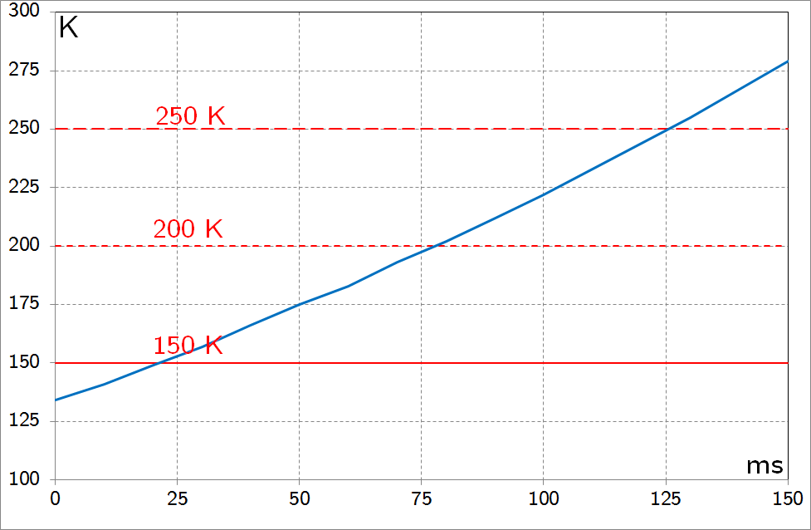
Task 3: magnet parameters
OD: 1.030 m; length: 2.255 m
Al shell, 65 mm thick, 1.6 m long
Bladder and key pre-load
Operational condition (13 T)
  I_{op}: 10.9 kA
  B_{peak_op}: 13.4 T, ~79% of I_{ss} at 4.2 K
  B_{bore_ss}: 16.0 T, ~72% of I_{ss} at 1.9 K
  B_{bore_ss}: 17.2 T;
15 T bore field (“ultimate”)
  86% of 1.9 K I_{ss}
.
Critical surface and loadline
Quench hot spot temperature
16

Slide 17
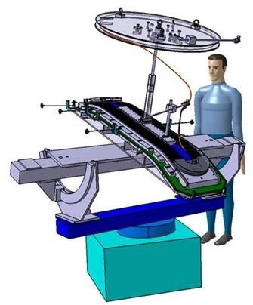
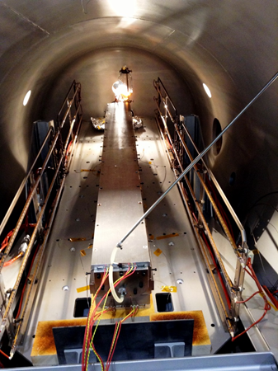
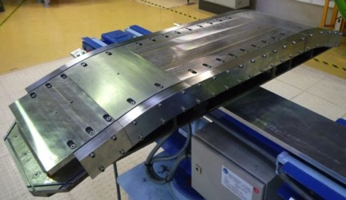
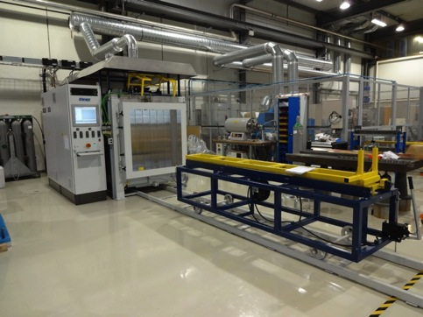
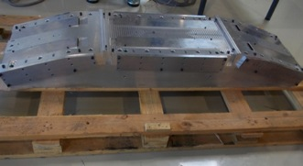
Task 3: coil manufacturing tooling
All tooling for coil manufacturing is designed Type 3-4 done, Type 1-2 on order
Winding table : operational
Reaction moulds: meanwhile we want a modification: will be implemented after the Cu coil: (split mould)
Impregnation moulds : final version
Reaction oven: operational
Impregnation tank: operational
17

Slide 18
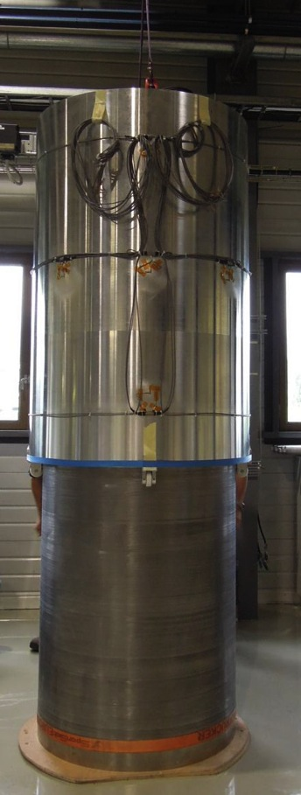
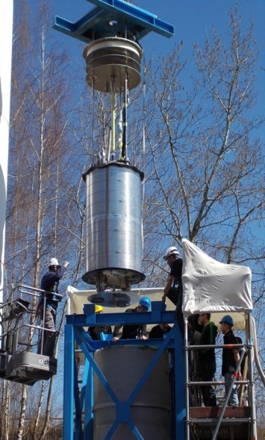
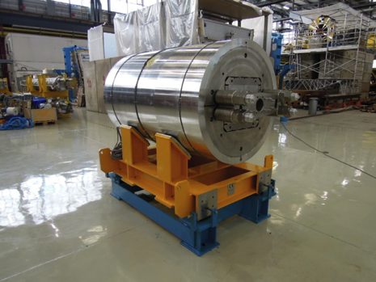
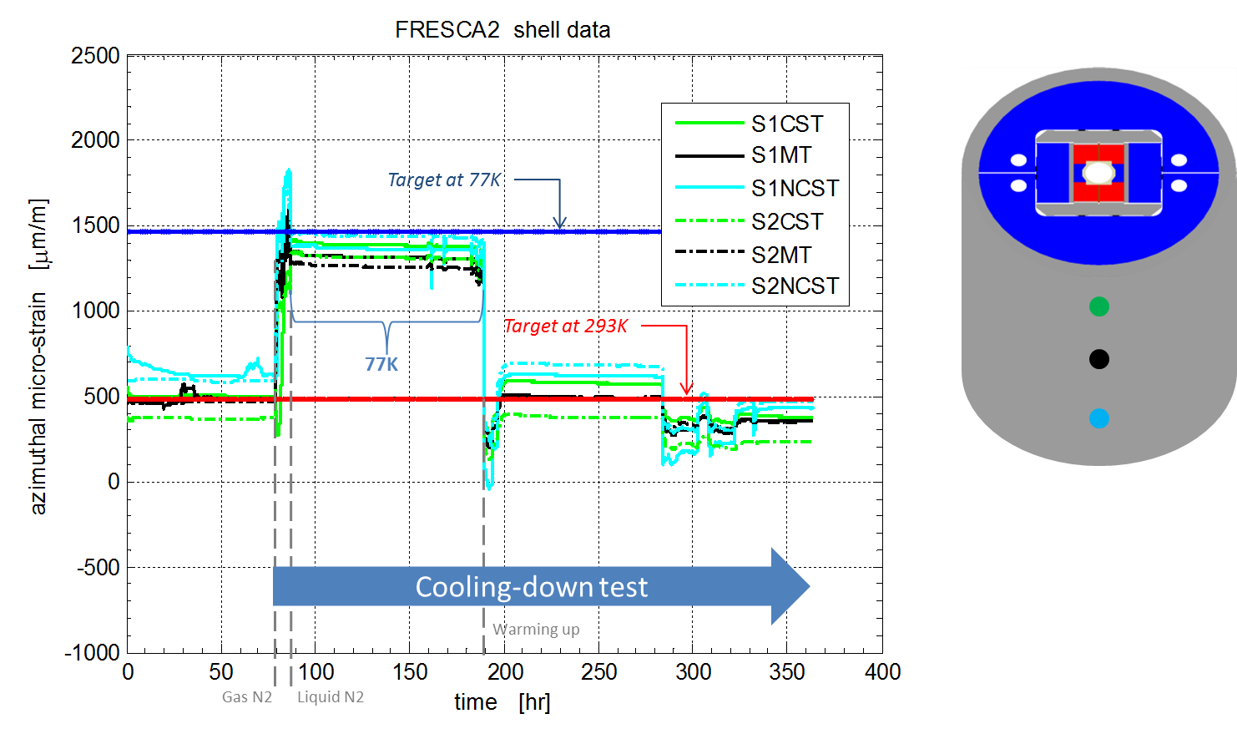
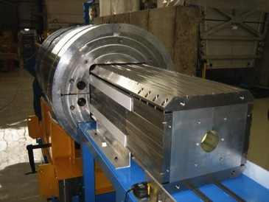
Task 3: magnet structure
Shell, Bladder and key structure
Structure completed
First test with Al coil dummy at 77K done
18

Slide 19
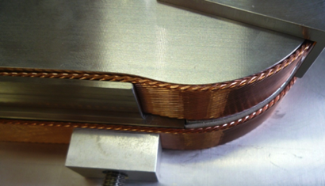
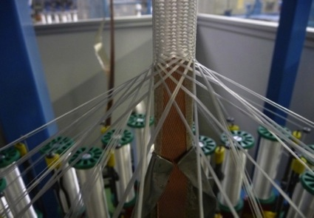
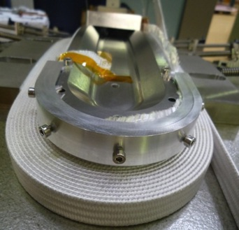
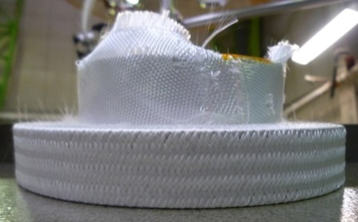
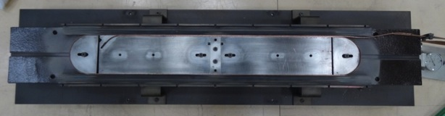
Task 3: coil manufacturing
Coil manufacturing development during the project:
Winding flared end coils
Layer jump winding test
Cable dilatation tests
Insulation braiding
Moulded inter coil shims
First Cu coil: 1 layer done 2nd next week
19

Slide 20
Task 3: 13 T Fresca2 dipole: conclusions
The dipole manufacturing is well underway:
Sufficient conductor in-house , more on order
Winding, reaction and impregnation tooling in-house for coil type 3-4 (one modification still needed)
Winding, reaction and impregnation tooling designed and partly ordered for coil type 1-2 (one modification still needed)
Coil manufacturing infrastructure operational (winding bench, furnace, impregnation tank)
Structure finished and mechanically tested at low temperature
1.9K tests station mostly designed, cryostat on order, outer vacuum tank exists
We need this magnet for : Cable tests for HL-LHC and HE-LHC, EuCARD1 insert test, EuCARD2 magnet test as insert, HE-LHC insert development:
full commitment of CERN and CEA to finish it and use it !
20

Slide 21
Task 4: Very high field dipole insert (1)
Pascal Tixador (CNRS Grenoble-INPG ) CNRS, CEA, KIT, INFN, TUT, UNIGE,PWR
Objective:
Design and realization of a high temperature superconductor (HTS) very high field dipole insert (6-7 T), which can be installed inside the 13 T Nb₃Sn dipole of task 3
NB: test of the two dipoles together is not part of the present EuCARD contract but will be done nevertheless...
Sub tasks:
7.4.1 Specification, characterization and quench modelling
7.4.2 Design, construction and test of solenoid insert coils
7.4.3 Design, construction and test of dipole insert coils
21

Slide 22
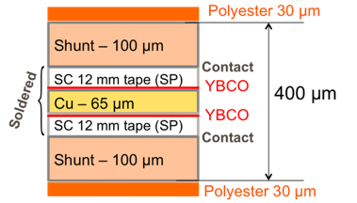
Task 4: Insert conductor
After 1 year new developments on I_{eng} YBCO
Thus conductor choice was adapted as the I_{eng} advantage of Bi-2212 was gone (I_{eng}>200A/mm² are needed)
Bi-2212: fragile, precise coil heat treatment (850°) can be cabled into a Rutherford cable
YBCO: tape, difficult cable concepts mechanically strong
High current cable:
2 core conductors wound together “2800 A cable”
Core conductor: 2 tapes: soldered face-to-face on a Cu strip
Two CuBe shunts added for extra mechanical strength
Conductor is on order delivery june 2013
Bi-2212
YBCO, Superpower
22

Slide 23
Task 4: magnet design
Completely new innovative design
Coil: 3 double pancakes with 2x2 tape cables, transposed per pole
Insert has to be self supporting,
Structure: e- beam welded steel pad , steel shrinking cylinder
23

Slide 24
Task 4: quench studies
The quench of HTS coils is problematic due to slow quench propagation speeds and thus slow voltage development and thus high temperature spots with high mechanical stress
Studies done:
quench propagation modelling
Quench tests with small solenoid coils
A solution was found to protect the insert , standalone and with the outsert
t_{decay} can be as low as 50 ms or even 20 ms with V≤800 V (low inductance)
T_{hot-spot} ≈70 K with V_{threshold}=100 mV (CuBe shunt)
The fast insert discharge (<50 ms) with the long Fresca2 time margin (~50 ms) makes the combination workable
24

Slide 25
Task 4: test coils
2 types were done or are being done
Solenoid test coils for quench tests and mechanical resistance tests:
Tested at High field facilities of KIT and Grenoble
Single pancake test at Grenoble in a 10T magnet to test the pancake coil type and to measure the field angle dependence of I_{eng}
25

Slide 26
Task 4: conclusions
The insert manufacturing is well underway:
Conductor is on-order: delivery this month
Coil manufacturing is prepared, a test coil will be wound this month
Test of the test-coil in July/August in Grenoble
Structure designed and critical assembly steps were tested
Insert should be ready by end of 2013
Stand alone test
Test inside Fresca2 in 2015
We need this insert for : EuCARD2 experience (despite the different cable) and HE-LHC magnet development:
full commitment of CNRS and CEA to finish the insert and test it
26

Slide 27
Task 5: High Tc superconducting link (1)
Amalia Ballarino (CERN) CERN, COLUMBUS, BHTS, SOTON
Aim: design and build a prototype 600A HTC link
Main achievements:
Development of a novel type, twisted-pair, cable with tape conductor and optimized for DC currents. Iop ∼1 kA Conductors: MgB₂, YBCO and BSCCO 2223. Cable geometry and cabling process accommodate for the three types of conductors
Validation of 2 m long cables at 4.2 K (Fresca). Iop up 2×4.2 kA @ 4.2 K and in self-field
Preparation of short (up-to 5m) multi-cable assembly (2×24 cables) as required for integration in the SC-Link for LHC P7
Quench tests performed on a full-scale 5 m long SC-Link at SOTON
Cabling of stacked, insulated and twisted conductor being at CERN, using the newly developed cabling machines
Deliverable – 20 m long superconducting link assembly with MgB₂ tape conductor (Columbus) fulfilled
27

Slide 28
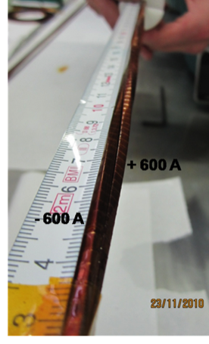
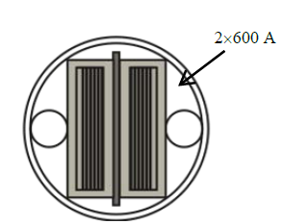
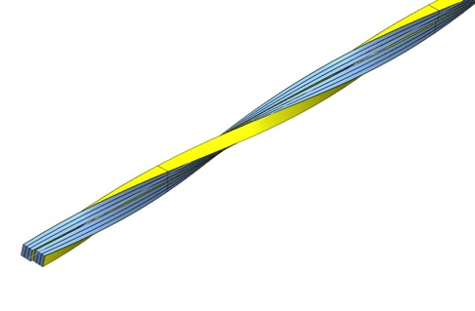
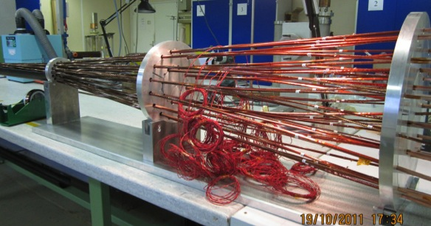
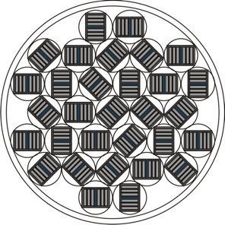
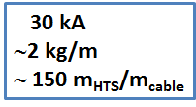
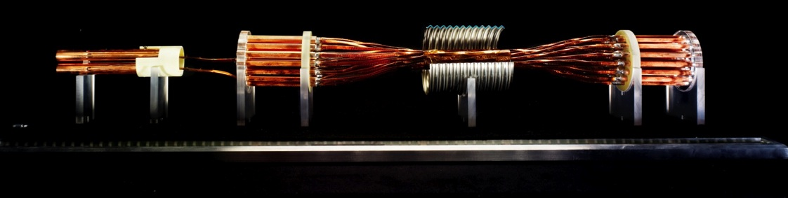
Twisted-pair cable (I_{op}  1000 A)
+ 600 A
- 600 A
Φ∼5.6 mm
Φ = 40

Slide 29
Task 5: High Tc superconducting link (3)
The 20m prototype link finished
SM18 link test station with NEXANS cryostat connected
29

Slide 30
Post Eucard-era and conclusions
Post EuCARD
Test at CERN of the Eucard deliverable (20 m long link)
Parallel development in collaboration with Columbus Superconductors of MgB₂ round wires for application to high-current cables (up to 20 kA)
Design assembly and test of 60 m a long SC-link system as required for integration in the LHC machine at Point 7
Development and test of high-current cables, multi-cable assemblies (Itot > 150 kA) and SC-links for application at LHC P1 and P5 (vertical transfer along ∼ 80 m)
SC-Links transferring the current from the surface to the LHC tunnel for the LHC Hi-Luminosity upgrade
Conclusions:
Very successful task, results will directly be applied to the LHC,
Important links with Industry and power transmission projects

Slide 31
Task 6: Short period helical undulator (1)
Short period undulator for the ILC positron source
Jim Clarke (STFC-DL) STFC (DL and RAL)
Period 11.5 mm , field >1 T
Aim :
fabricate and test a short helical undulator prototype using Nb₃Sn wire.
With: 11.5 mm period and winding bore of 6.35 mm, 300 mm long
Nb₃Sn usage for high current density and large thermal margin to go higher than the 1.15 T achieved for Nb-Ti

Slide 32
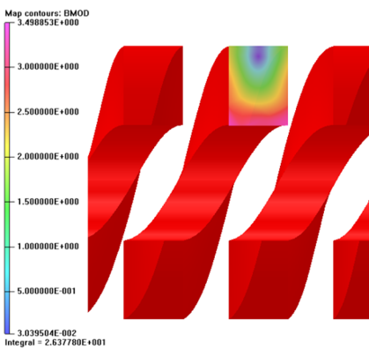
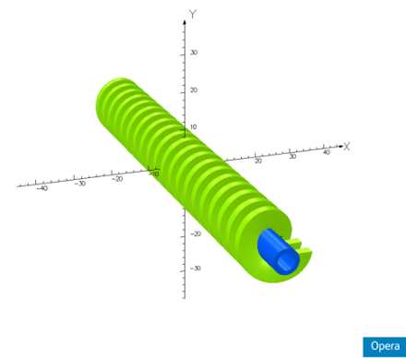
Task 6: design
Parameters:
215A
Beam tube ID: 4.7 mm
Winding ID: 6.35 mm
Field on axis: 0.86 T
Margin with this conductor: 30%
Iron former, (no separate beam-tube)
Insulation:
Alumina coated former ,
glass fibre braided around the strands
Charged epoxy impregnation

Slide 33
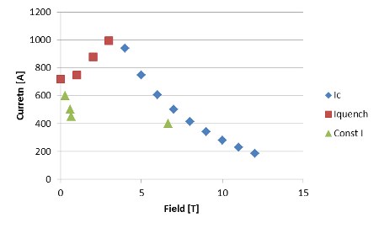
Task 6: conductor
The issue with the undulator is to find a strand with sufficient stability at low field
Nb3Sn is industrially produced for high field applications so low field properties are poorly known
Conductor characterization was done at KIT and CERN to find the best candidate
Selected Supercon strand 0.5 mm diam.
Conductor measurements
Stability measurement Supercon strand (CERN)

Slide 34
Task 6: construction
Construction was done at STFC/RAL
For all steps ,
Winding, reaction, impregnation, splicing, etc, tooling was developed in-house.

Slide 35
Results from undulator test (at LASA)
Resistance at room temperature:
Coil A - 15Ω
Coil B - 1400 Ω – not tested
Coil A quenched consistently
at 28-30A
Coil A 1.375μ Ω at small current in LHe
RRR ~3
Field measurements
at 25A
Inductance ~ 2.75mH
Undulator B: wire found broken in ends after ‘unpacking’
Notes:
The magnet was cooled down and test on January 31st and February 1st. During the energization, the QDS acted repeatedly when the current reached 28-30 A. We raised the quench threshold up to approximately 500 mV, and the QDS validation time to 50 ms, without any appreciable effect on the quench current. Than we changed the ramp rate from 1 A/s a 30 A/s, also in this case without any significant difference in the quench current.
Notes on Graph from Giovanni Volpini: - “At this moment we decided to record the voltage on the coil in order to investigate the nature of the problem (quench measurements were not foreseen at the beginning). The voltage was first recorded with a scope, and later, together with the current signal from the DCCT, with a couple of Agilent 34411 voltmeters, synchronized with an external clock. The is set in these tests at about 0.46 V. When (and if) threshold for detecting a quench exceeded for more than 50 ms, the power supply is switched off and the breaker is open. The breaker opens in about 150 ms. When the power supply is switched off, the capacitors discharge slowly on the resistance of the external circuit (Fig. 2.4 and Fig. 2.5). When the breaker opens, the current discharges on the external dump (a 45 mΩ resistor in series with a diode) . It may be noticed that when the voltage falls below the diode forward voltage drop, the current goes to zero.”

Slide 36
Task 6: conclusions
Two helical undulators were built.
Problems encountered:
Conductor instability at low field and high current: need to find a conductor even better optimized for these conditions (industry)
Wire breakage: new design needed for the ends
Insulation fragility: more development needed
Tolerances on grove dimensions and insulation thickness: need another iteration.
This task was crucial to do a step towards Nb₃Sn helical undulators and discover the issues. A continuation project should be started

Slide 37
Deliverable summary
.

Slide 38
Lessons we learned
Task 1: Next to the regular collaboration and task meetings immediately start to follow all the tasks in some detail, we started to do this at the end of year 2
Task 2: The description for the irradiation task was too vague as too little was known: we should better have limited ourselves to a study of the needs and making a plan for irradiations without actually doing them due to lack of time in 4 years. We were perhaps a bit too ambitious
Task 3: The task suffered 9 months effective delay due to the LHC incident at CERN. It takes 1.5 years longer than foreseen (4). We remark that making a completely new design takes more time than one thinks.
Task 4: We had to completely change the conductor choice: as a result it took a year more to do all the development steps, this includes the conductor development in the company and procurement.

Slide 39
Lessons we learned (2)
Task 5: The ideal task, moreover, we profited from the pressure from the LHC needs
Task 6: We learned (again) that we cannot simply adapt a Nb-Ti concept for Nb₃Sn, it is much more difficult. It also suffered from the turnover in personnel at STFC which is outside the influence of the project leaders but more linked to the general situation.

Slide 40
Conclusions
6 tasks
  Task 1: completed by 30/6/13
  Task 2: Deliverables completed
  Task 3: 1.5 years delay, design complete, construction well underway, full commitment to finish
  Task 4: 9 months delay, design complete, construction well underway, full commitment to finish
  Task 5: Deliverable completed
  Task 6: Deliverable completed
The collaboration will continue as ‘The HFM collaboration’ , an MoC is in preparation
  The HFM collaboration will accompany the completion of the magnet and the insert and take new initiatives
For HFMs EuCARD was a very successful venture, it made the required steps forward and forged a solid collaboration
All participating people can be proud of the work done !

