Slide 1
LHC Status;
CMAC , 14th March 2013
Steve Myers
(On behalf of the LHC team and international collaborators)

Slide 2
  09:00 - 10:00 Overview of 2012 LHC p-p operation
  10:00 - 10:30 Electron cloud scrubbing run and strategy for 2015
  11:00 - 11:30 Highlights and conclusions of the LHC operations workshop in Evian
  11:30 - 12:00 LHC beam instrumentation – performance, issues and plan
  12:00 - 12:30 Overview of the LHC p-Pb run in early 2013
  14:00 - 14:30 Injector performance during 2012/13
  14:30 - 15:00 LS1 activities in the injectors & expectation for 2015
  15:00 - 15:30 UFO update including 25 ns
  16:00 - 16:30 HL-LHC project overview
  16:30 - 17:00 High-field magnet progress
  17:00 - 17:30 HE-LHC studies and long-term plan

Slide 3
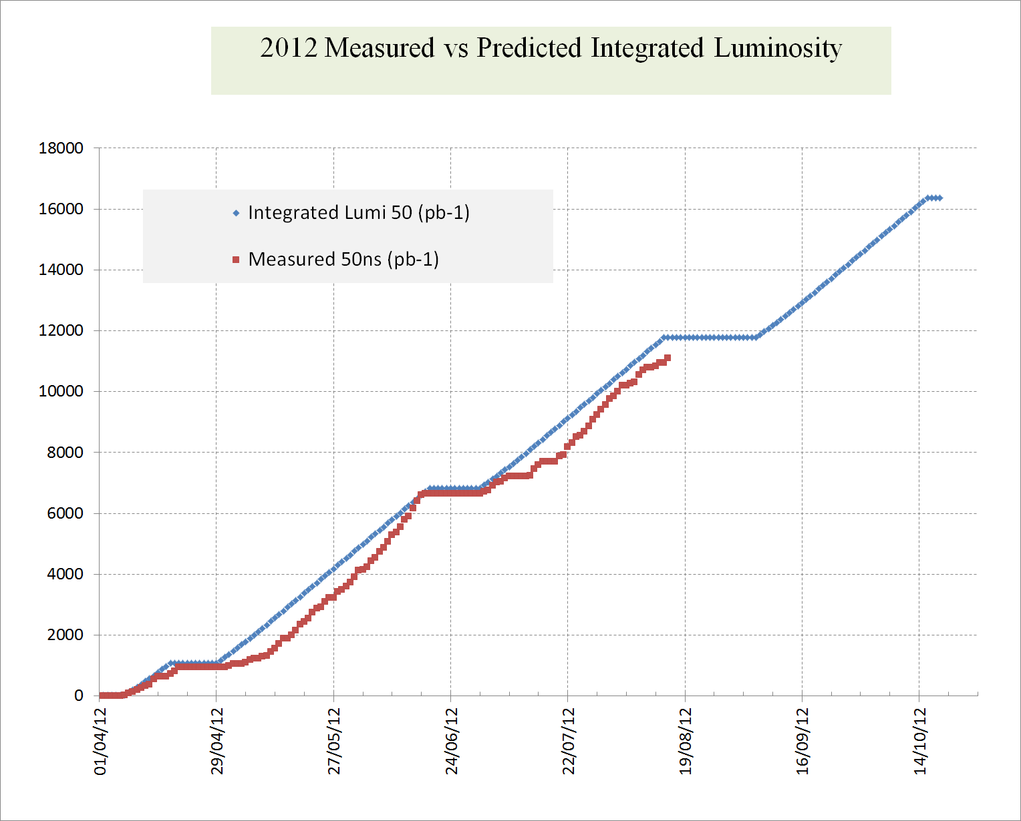
Where are were on Aug 16

Slide 4
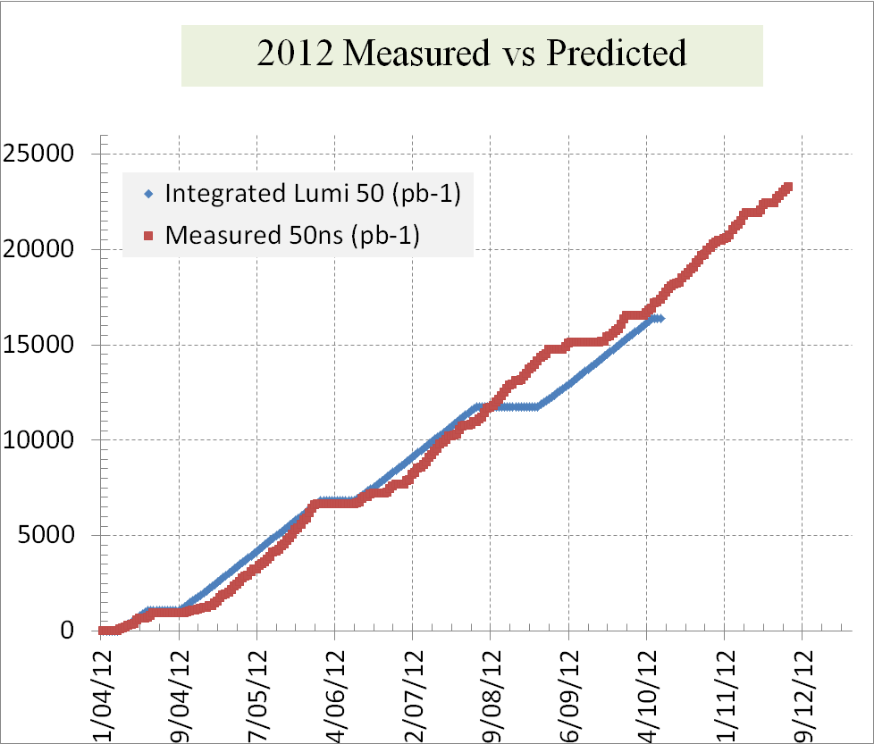
2012

Slide 5
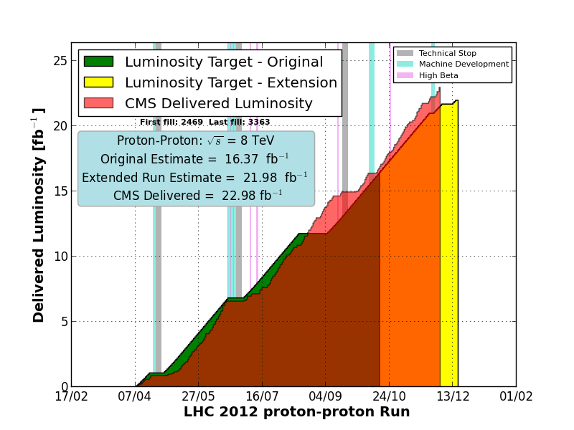
With the modified schedule

Slide 6
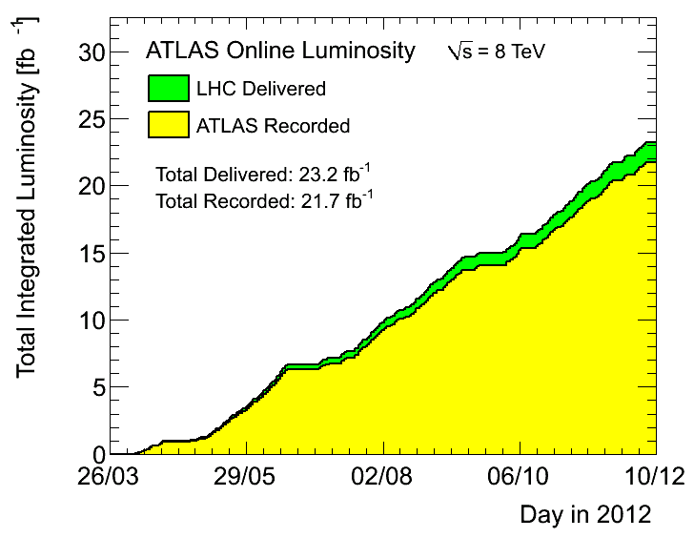
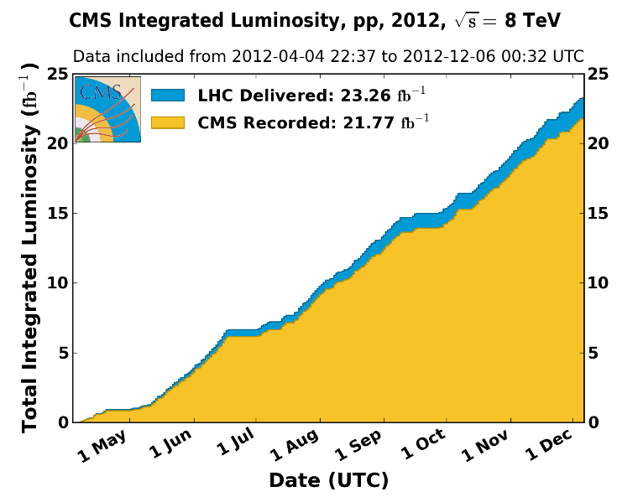
Total Luminosities 2012

Slide 7
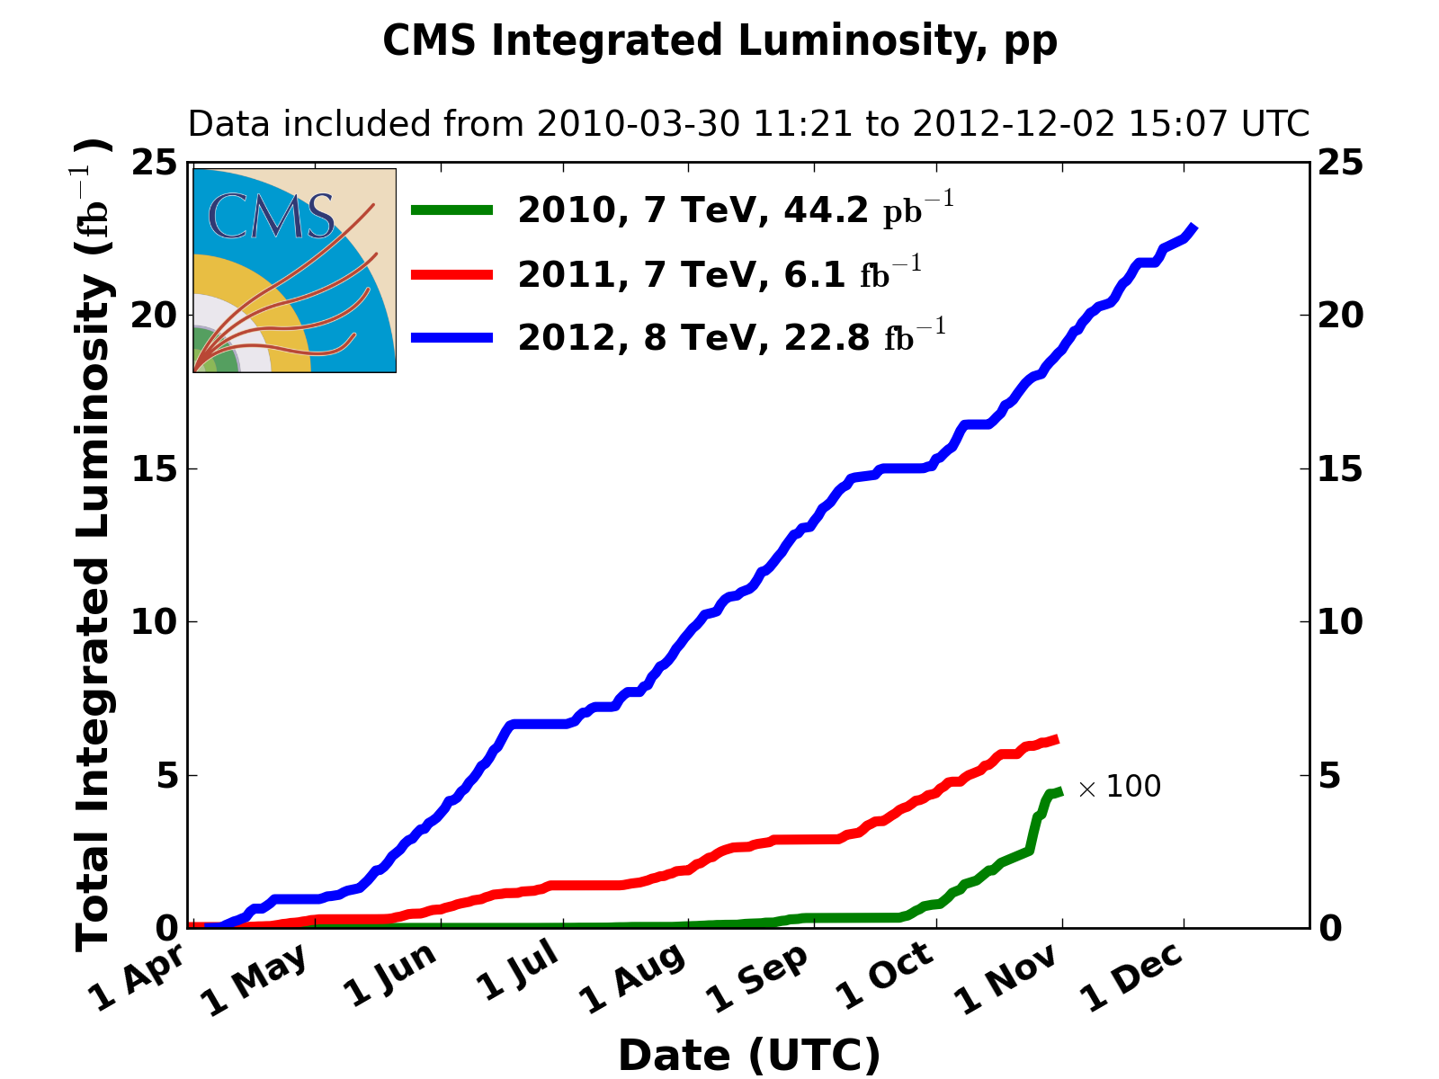
Last 3 years

Slide 8
The end of 2012
25 ns tests
    Electron cloud and vacuum (scrubbing)
    Crossing angle, aperture, beam-beam, min β*
    UFOs
    HOM heating

Slide 9
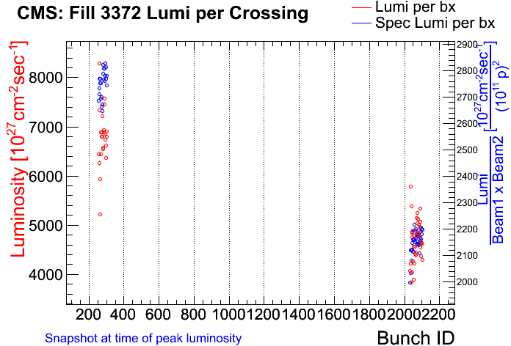
Injector High Brightness Beams
About 30 % gain in specific luminosity !
For 25ns operation, now seems possible 1.15E11 with emittance of 1.4µm at LHC inj.
High brightness beams from the injector chain
  Very interesting option for 2015 operation, both 50 ns and 25 ns beam spacing
Fill with one batch HB and 1 batch ‘standard’ 50 ns
  Emittance for HB beam ~ 1-1.2 um, standard 1.4-1.6 um.

Slide 10
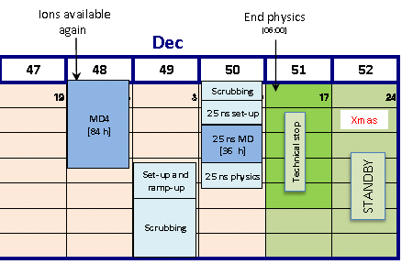
Scrubbing

Slide 11
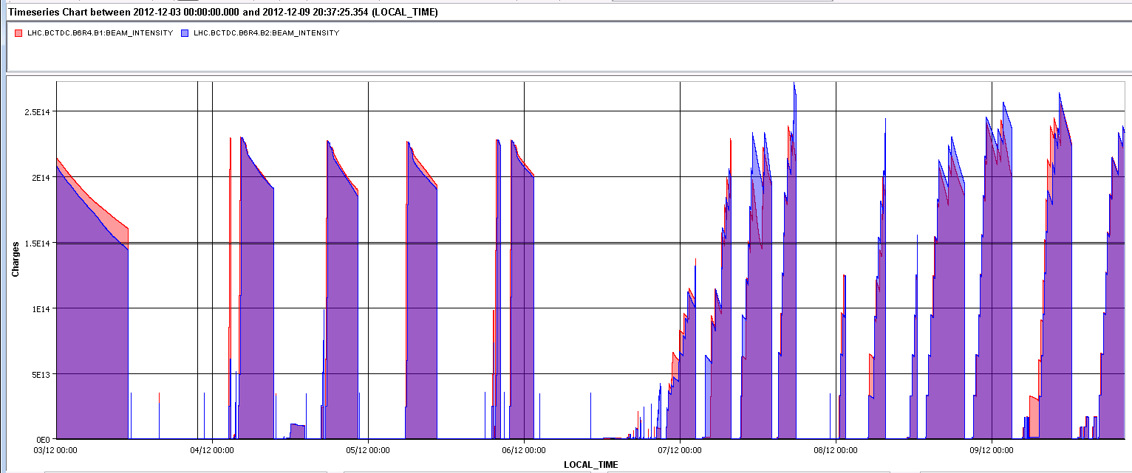
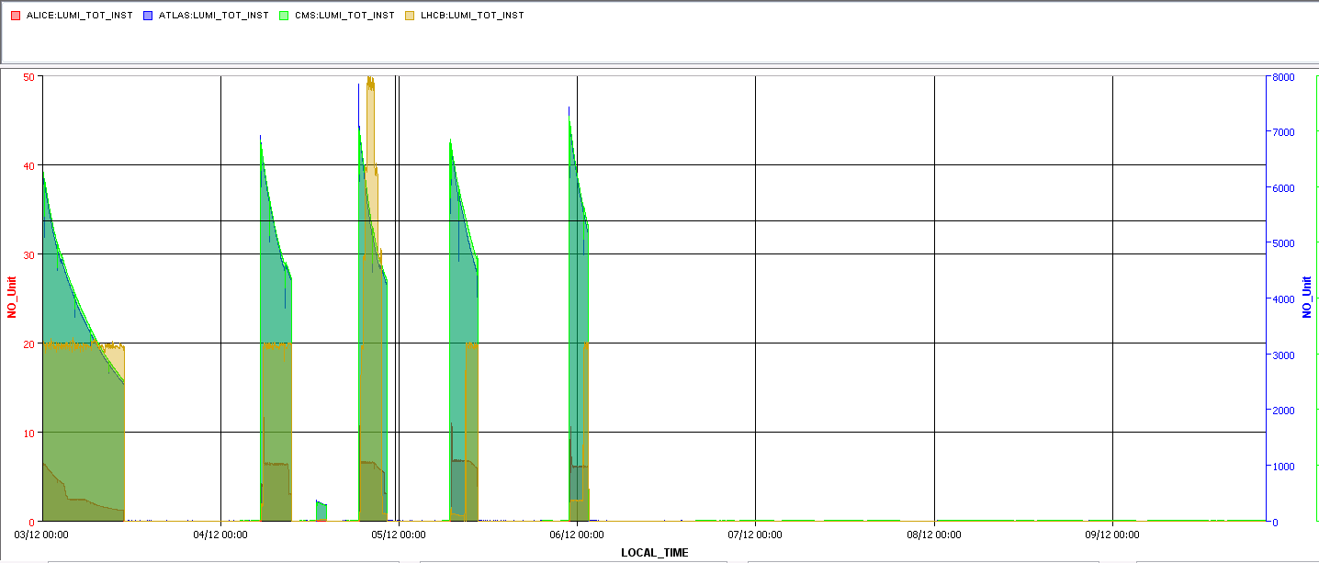
Beam currents and luminosity
25ns scrubbing
2.5e14
2e14
TDI HB RF TED
ATLAS & CMS 7e33 cm-2s-1
LHCb 1e33 cm-2s-1: all holding !
ALICE peak at 10e30 cm-2s-1, level at about 6.5

Slide 12
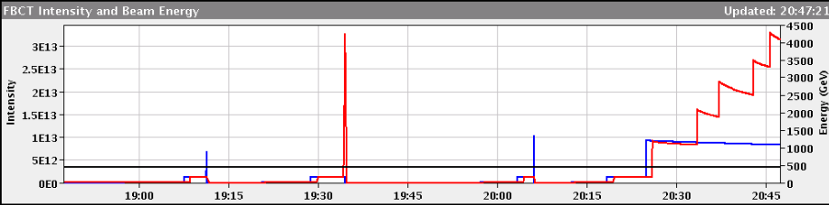
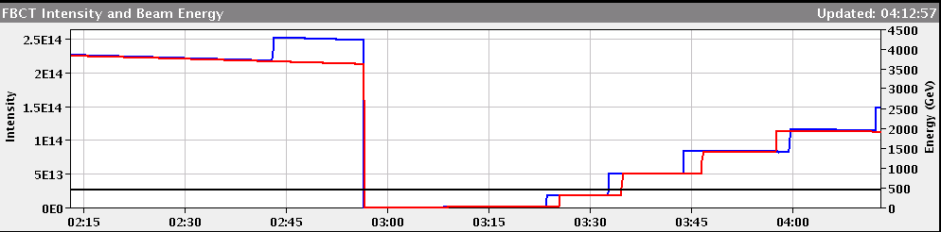
Beam quality evolution
Beam lifetime
Friday11 Dec
Sunday 10 Dec

Slide 13
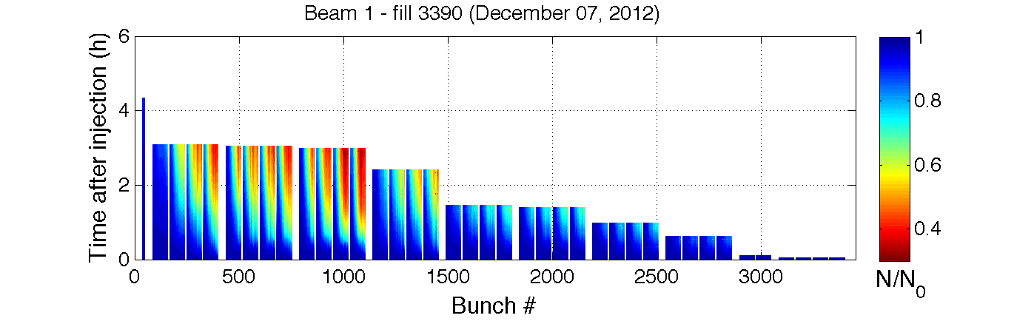
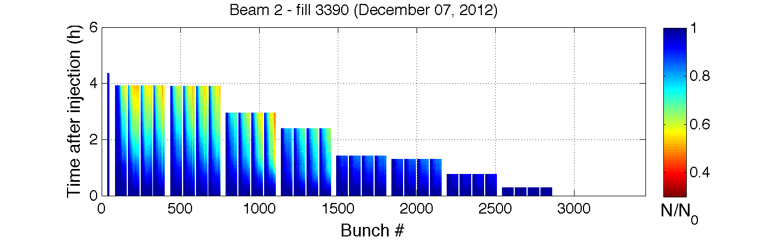
Beam quality evolution (preliminary)
Beam lifetime – Friday Dec. 7th

Slide 14
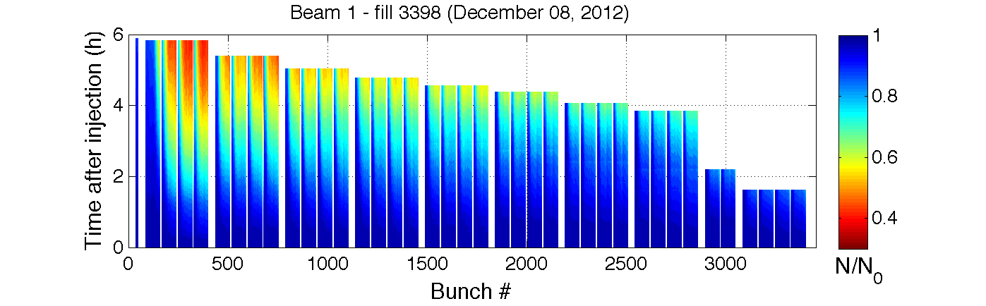
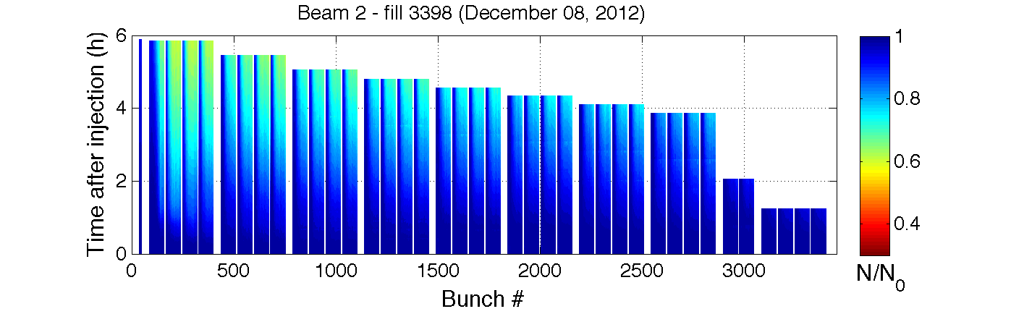
Beam quality evolution (preliminary)
Beam lifetime – Saturday Dec. 8th
Thanks to H. Bartosik

Slide 15
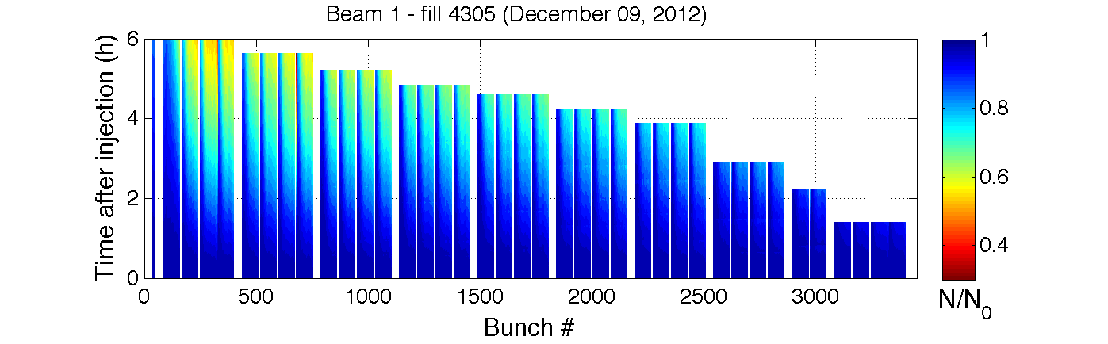
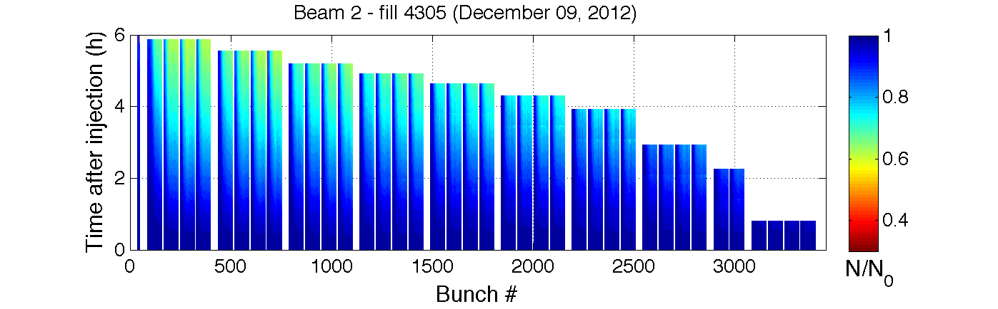
Beam quality evolution (preliminary)
Beam lifetime – Sunday Dec. 9th
Thanks to H. Bartosik
10/12/2012

Slide 16
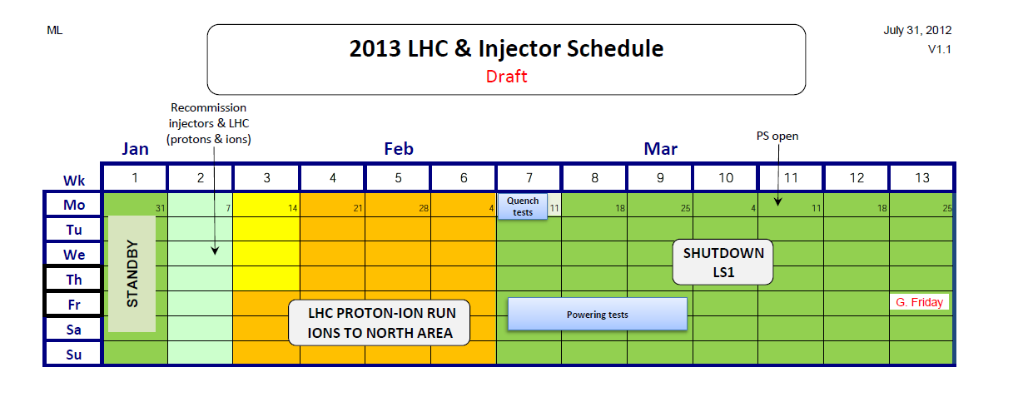

Slide 17
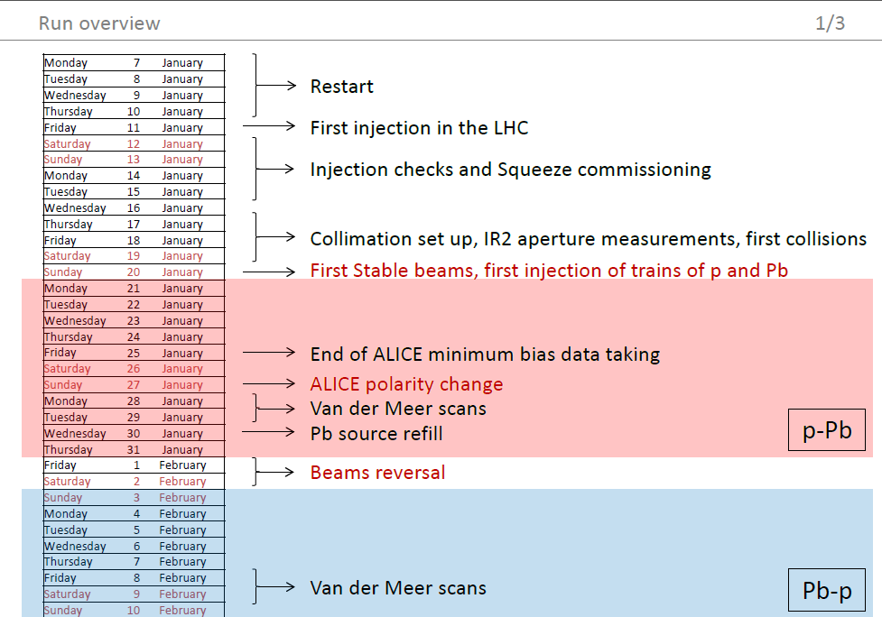

Slide 18
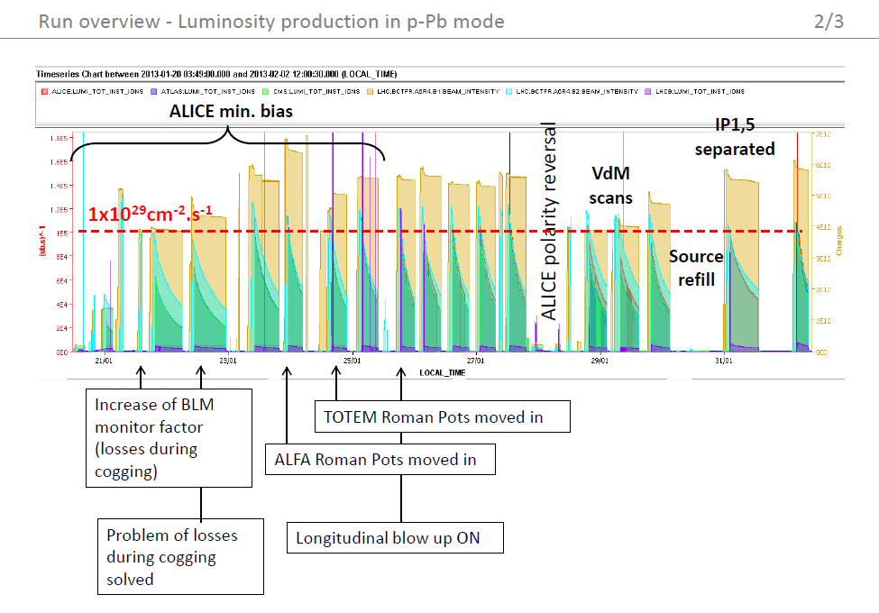

Slide 19
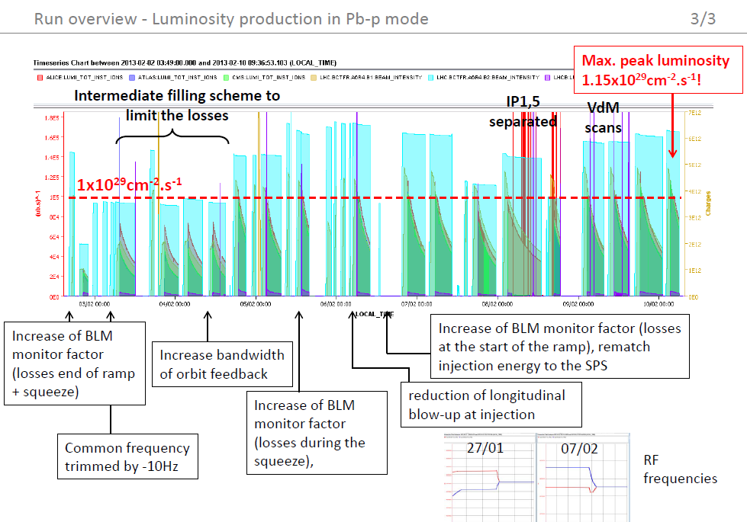

Slide 20
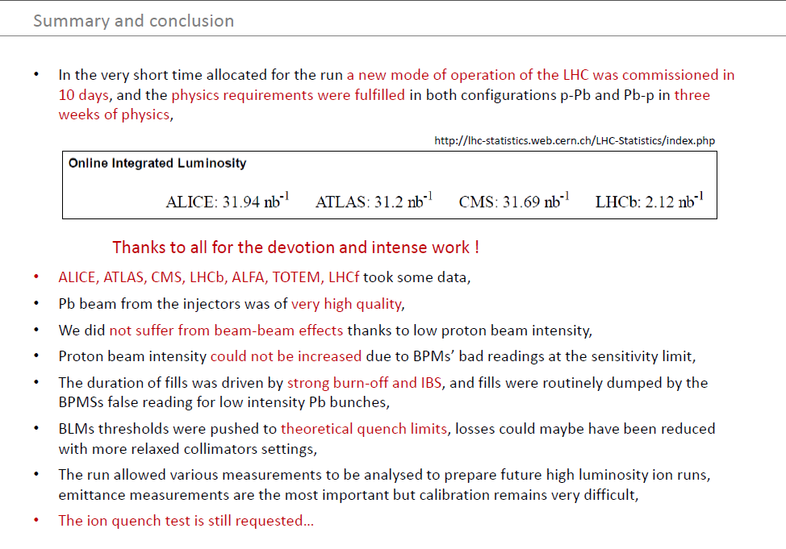

Slide 21
Summary
Integrated luminosity goal for 2012 exceeded
“Higgs” discovered
Proton-lead run a big success (2013)
LS1 well under way (2013)

Slide 22
  09:00 - 10:00 Overview of 2012 LHC p-p operation
  10:00 - 10:30 Electron cloud scrubbing run and strategy for 2015
  11:00 - 11:30 Highlights and conclusions of the LHC operations workshop in Evian
  11:30 - 12:00 LHC beam instrumentation – performance, issues and plan
  12:00 - 12:30 Overview of the LHC p-Pb run in early 2013
  14:00 - 14:30 Injector performance during 2012/13
  14:30 - 15:00 LS1 activities in the injectors & expectation for 2015
  15:00 - 15:30 UFO update including 25 ns
  16:00 - 16:30 HL-LHC project overview
  16:30 - 17:00 High-field magnet progress
  17:00 - 17:30 HE-LHC studies and long-term plan

Slide 23
SPARES

Slide 24
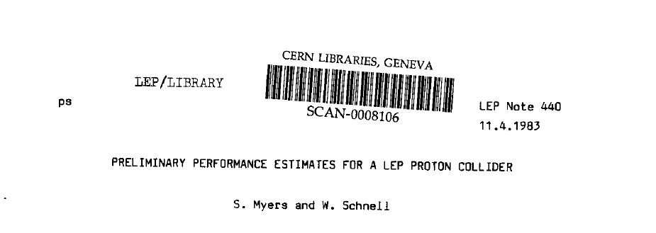
LHC 1

Slide 25
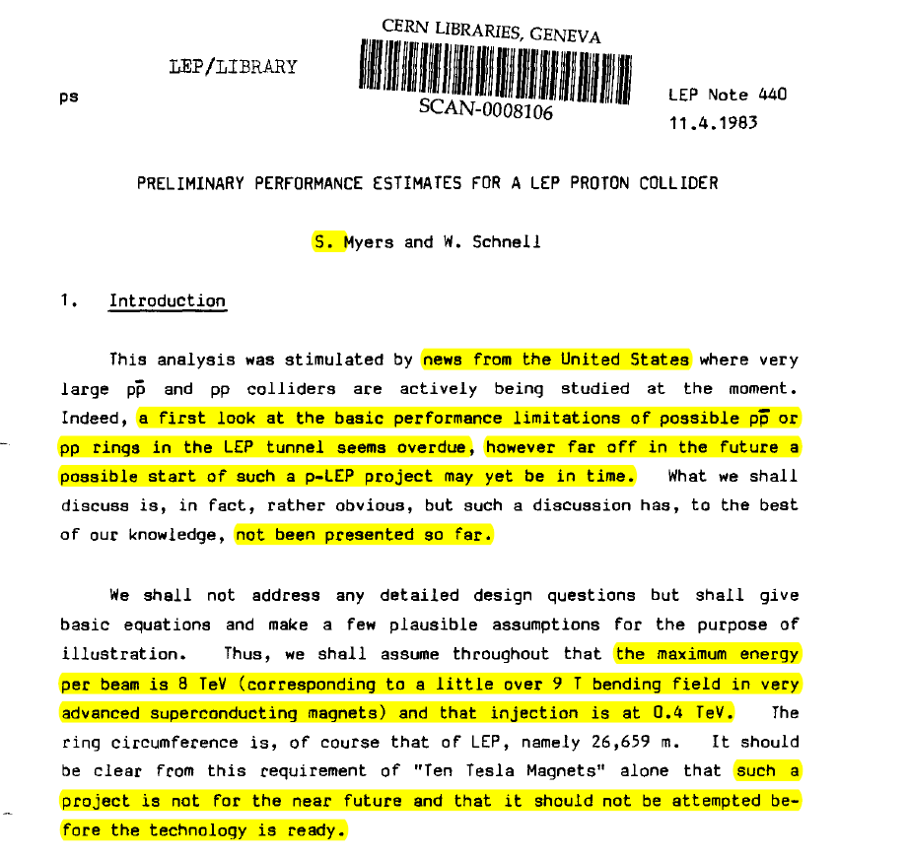

Slide 26
Comparison 25ns and 50ns

