Slide 2
High Field Magnet Program
Status and Plans
Presented by L. Bottura
TE-MSC
CERN-MAC-7, March 14th-15th, 2013

Slide 3
Outline
HFM program genesis and structure
FRESCA2 status and plans
DS 11 T MB status and plans
MQXF status and plans
Conductor procurement and R&D
Industry participation
Conclusions

Slide 4
Outline
HFM program genesis and structure
FRESCA2 status and plans
DS 11 T MB status and plans
MQXF status and plans
Conductor procurement and R&D
Industry participation
Conclusions

Slide 5
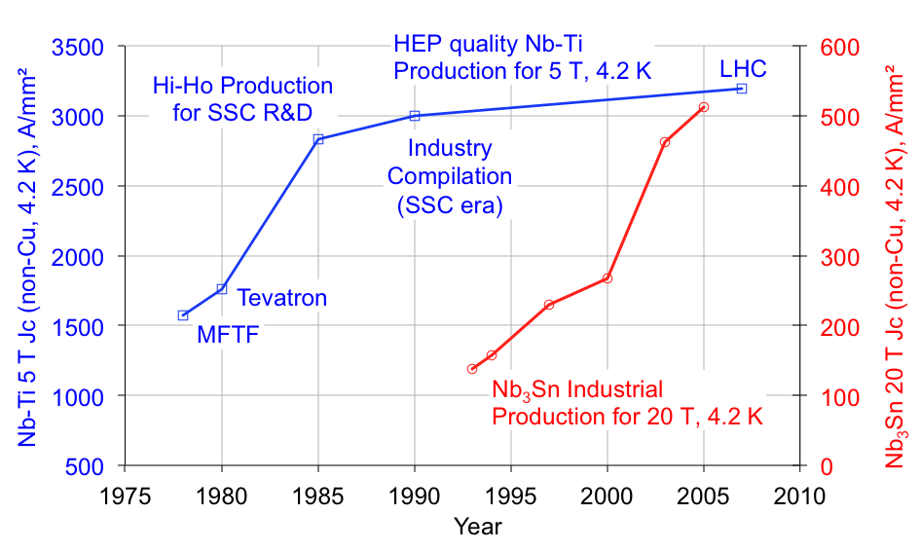
Nb₃Sn is mature for HEP
US-CDP start
Tevatron and SSC
By courtesy of J. Parrell (OST)

Slide 6

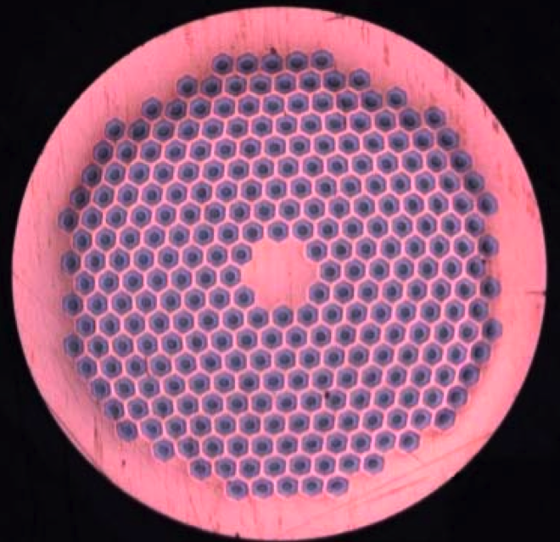
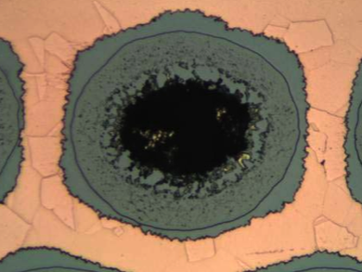
CERN HFM program genesis – 1
EAS
Started in 2004 with the FP6 Next European Dipole (NED) Joint Research Activity (JRA), aimed at the design and construction of a 100 mm bore, 13 T dipole
By 2006 the FP6 NED JRA became a conductor R&D, targeting a EU production of HEP-grade Nb₃Sn conductors (3 producers) with J_{C}(12 T, 4.2 K) ≈ 3000 A/mm² (and Dfil ≤ 50 m, RRR > 200, UL > 100 m)
Bruker-EAS (former SMI-EAS joint venture) delivered by 2010 approximately 17 km of 1.25 mm wire achieving J_{C}(12 T, 4.2 K) ≈ 2650 A/mm²
PIT-288 1.25 mm strand from SMI/EAS, showing a detail of a sub-element (HEX stack)

Slide 7
CERN HFM program genesis – 2
The successful FP7-EuCARD proposal of 2009 materialized in a collaboration (and funding) for the construction of the 100 mm bore, 13 T dipole FRESCA2 (by 2013)
Following the Chamonix LHC Performance Workshop 2010, proposal to develop a Nb₃Sn based 11 T dipole to make space for collimators in the LHC dispersion suppression region (G. de Rijk, A. Milanese, E. Todesco, CERN-sLHC-Project-Note-0019)
US-LARP (2005) and HL-LHC converged in May 2012 on an aperture definition of 150 mm for the IR quadrupole MQXF and a joint magnet R&D

Slide 8
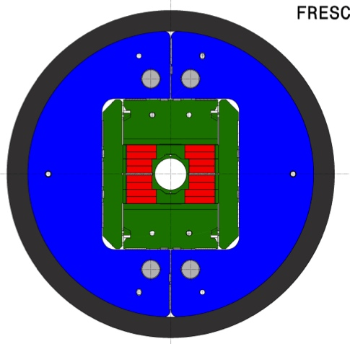

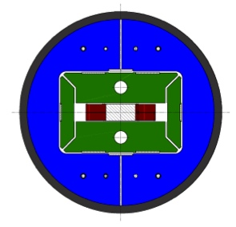
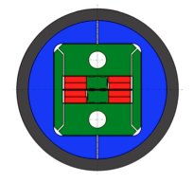
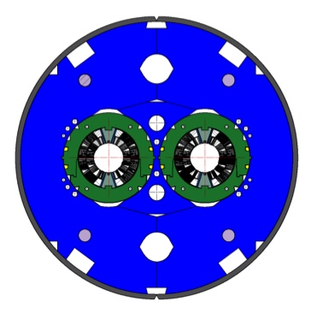

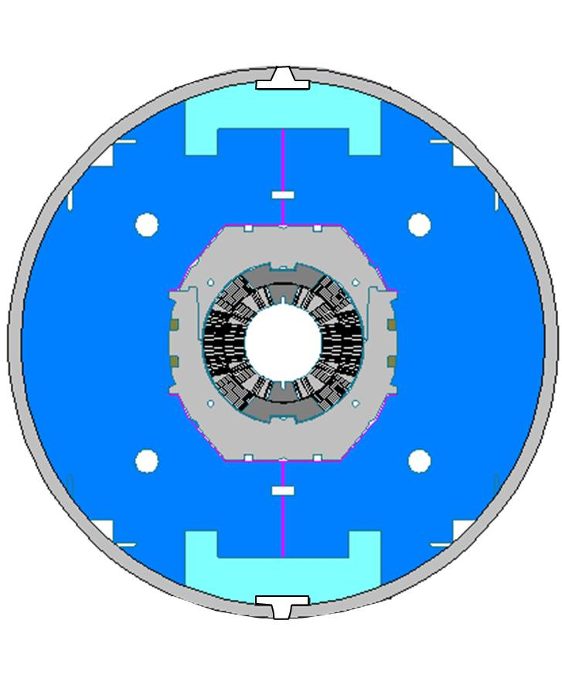
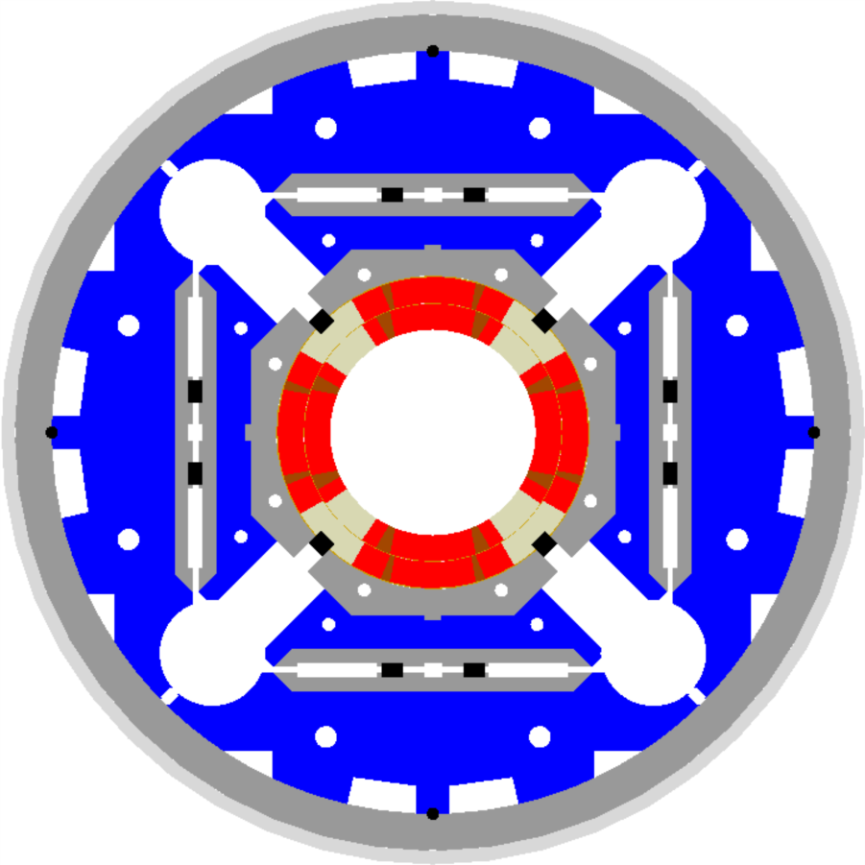

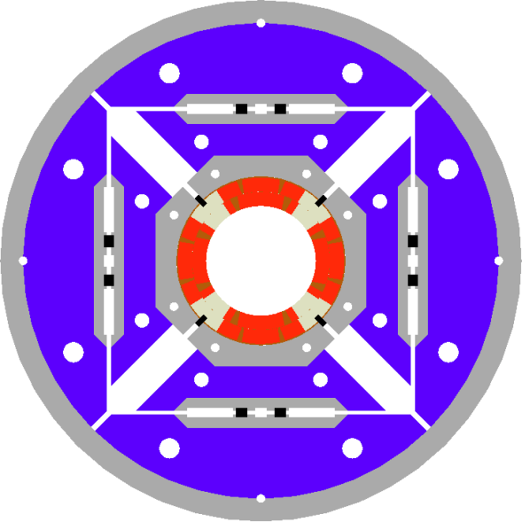


CERN HFM program structure
FReSCa2
Nb₃Sn Dipole
Short Model Coil
Race-track
Model Coil
11 T DS
Nb₃Sn Dipole
11 T DS
1-in-1
11 T DS
1-in-1
US-LARP
HQ
MQXF
2013
2014
2015
2016
2017
2018
2019
2020
2021

Slide 9
Outline
HFM program genesis and structure
FRESCA2 status and plans
DS 11 T MB status and plans
MQXF status and plans
Conductor procurement and R&D
Industry participation
Conclusions

Slide 10
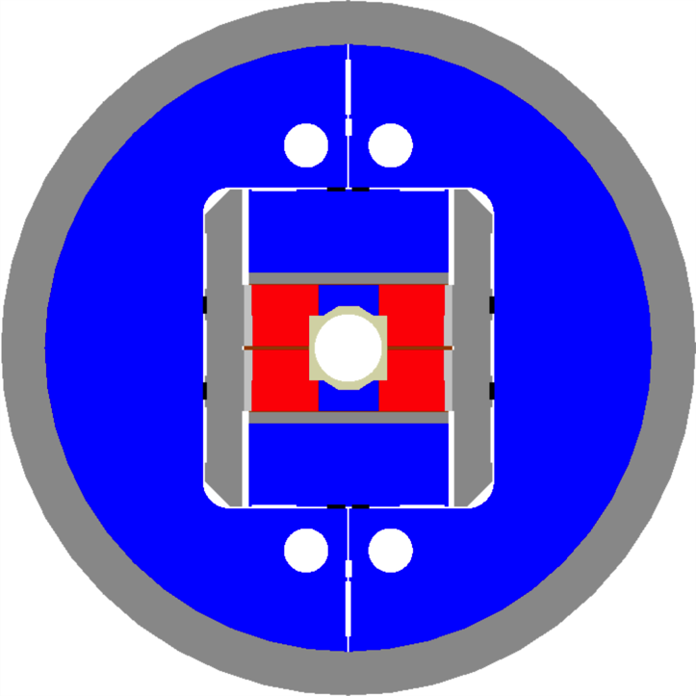
FRESCA2
Nb₃Sn dipole, 13 T and 100 mm clear bore
  Goal: test bed (new test station) and technology step towards fields in excess of 15 T
Built as a EU-FP7 collaboration
  coil fabrication at CEA Saclay,
  HT, impregnation structure and assembly at CERN
Block coils, flared end poles made by four double-pancakes
Bladder and key pre-load
Complete magnet in 2014, test in 2015, install as cable test station by 2016
J.C. Perez, TE-MSC/MDT

Slide 11
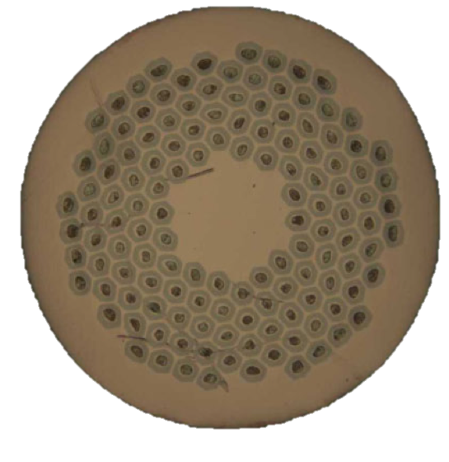
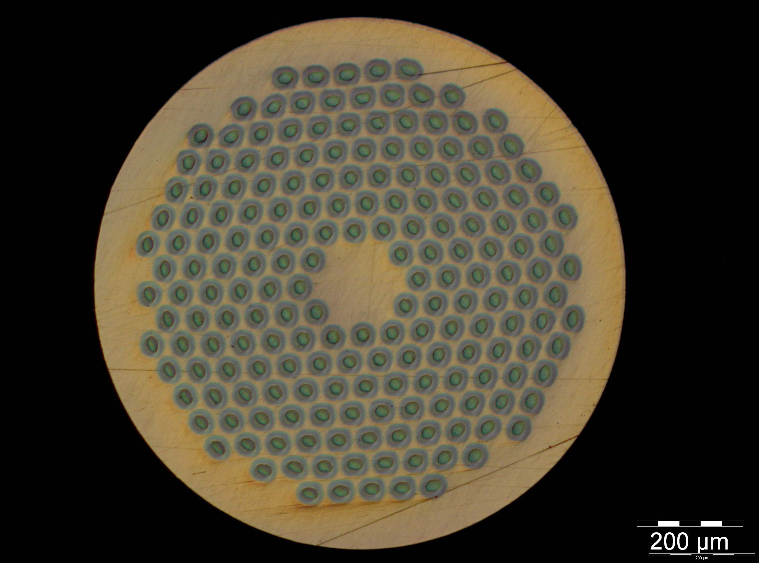


FRESCA2 Strands
Strand diameter: 1.0 mm
Cu:non-Cu: 1.25
Filament diameter: 58 μm
Number of filaments: 132
J_{C} (15 T. 4.2 K) > 1575 A/mm²
RRR > 150
UL > 400 m … 800 m
Ordered length 88 km
Strand diameter: 1.0 mm
Cu:non-Cu: 1.25
Filament diameter: 48 μm
Number of filaments: 192
J_{C} (15 T. 4.2 K) > 1350 A/mm²
RRR > 150
UL > 400 m … 800 m
Ordered length 84 km

Slide 12
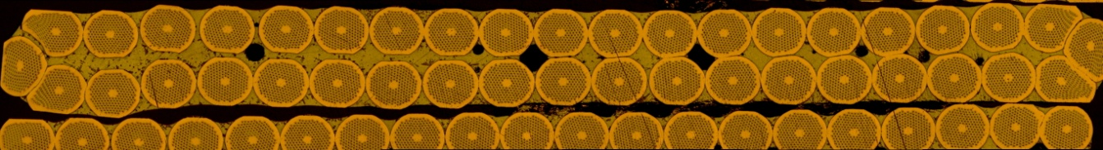
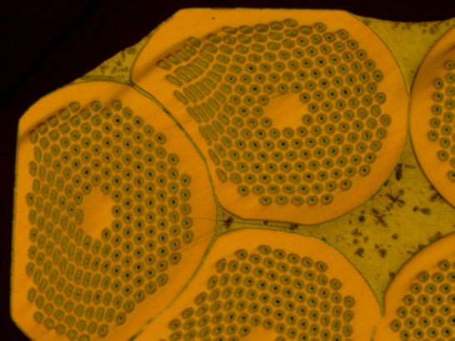
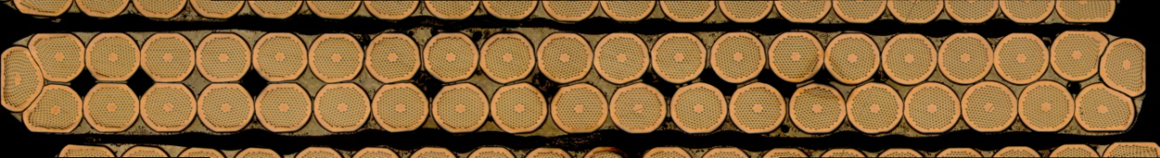
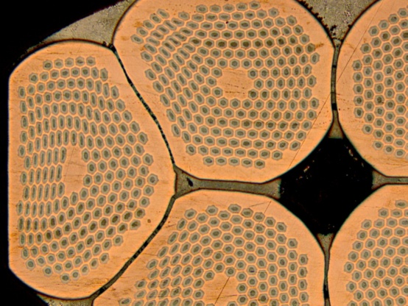
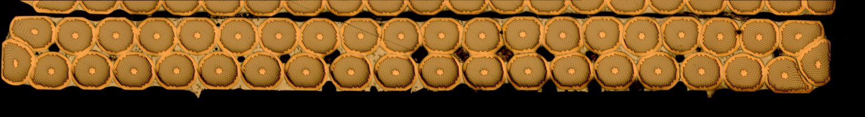
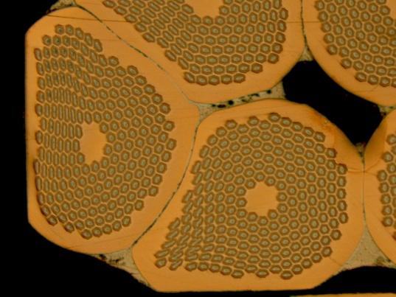
FRESCA2 Cable
Width of 21.4 mm Total compaction 85.6 %
Width of 20.9 mm Total compaction 87.5 %
Width of 20.4 mm Total compaction 89 %
L. Oberli, TE-MSC/SCD

Slide 13
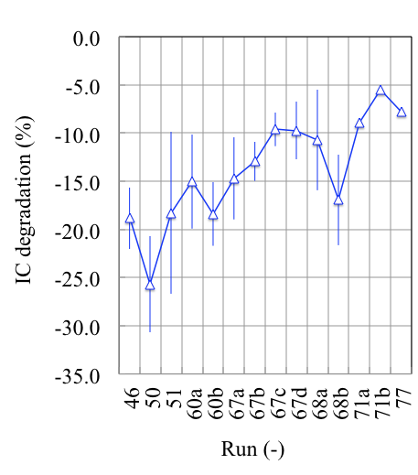
FRESCA2 cable R&D results
L. Oberli, Development of the Nb3Sn Rutherford Cable for the EuCard High Field Dipole Magnet FRESCA2, IEEE TAS, 23, 2013
L. Oberli, TE-MSC/SCD

Slide 14
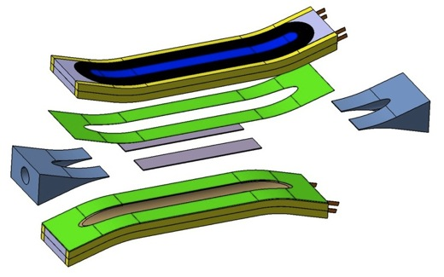
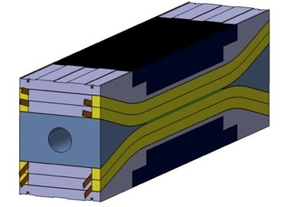
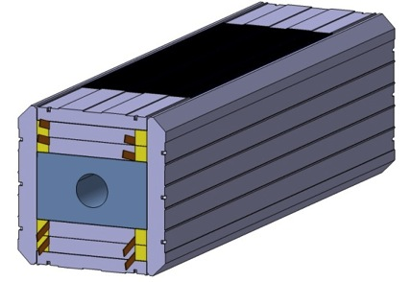
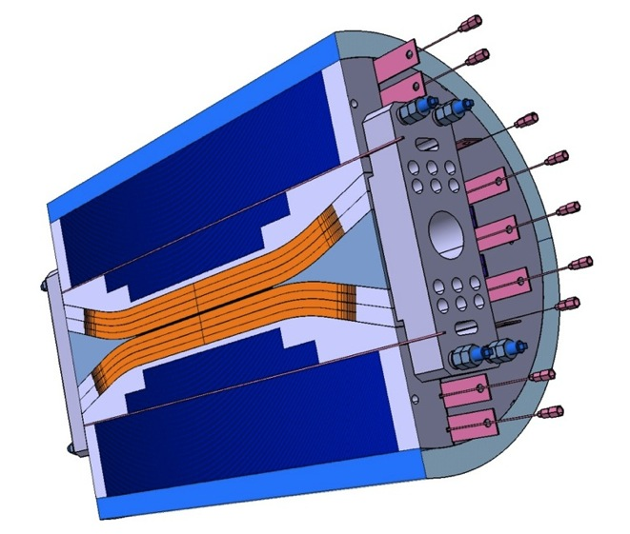
Magnet Design
Coil pack assembly
Coil assembly
Double pancakes
Al shell, iron yoke, tie-rods, end-plates, bladders
The final External Scientific Advisory Committee (held at CEA-Saclay, Feb 27th – Mar 1st) endorsed the design, with specific comments on
  Final choice of sliding/compliance of the Nb₃Sn coils during HT
  Validation/test of the mechanical concept for the flared ends
J.C. Perez, TE-MSC/MDT

Slide 15
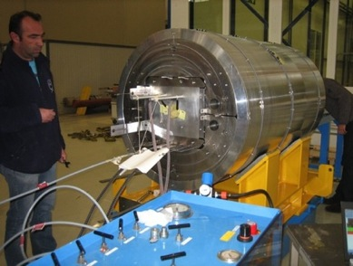
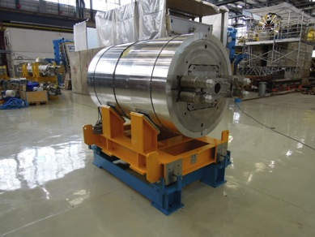
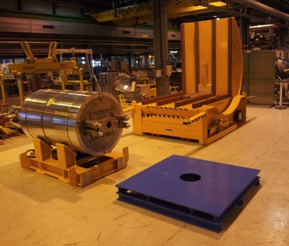
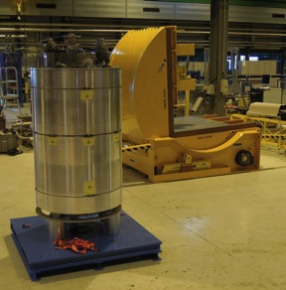
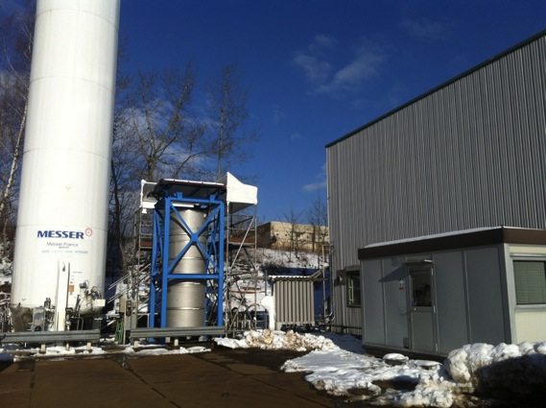
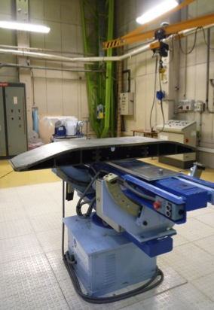
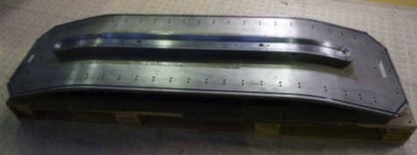
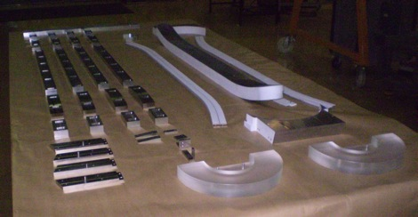
Present status
Magnet assembly in building180
Preparation for LN₂ tests in SM18
LN₂ test station ( SM18)
Winding preparation at CEA
LN2 mechanical test April 2013
First coil winding in April 2013 (Cu dummy)
J.C. Perez, TE-MSC/MDT

Slide 16
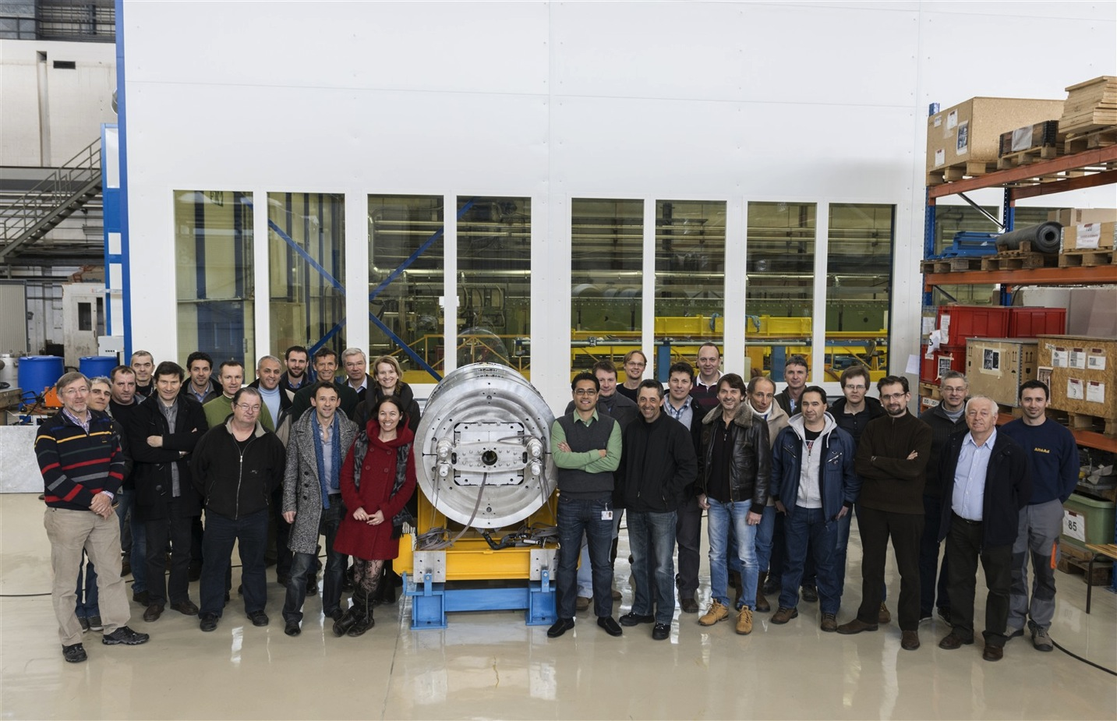
CERN Fresca2 Team

Slide 17
Outline
HFM program genesis and structure
FRESCA2 status and plans
DS 11 T MB status and plans
MQXF status and plans
Conductor procurement and R&D
Industry participation
Conclusions

Slide 18
DS 11 T dipole
Nb₃Sn twin-aperture dipole, 11.25 T at 11850 A, 60 mm bore
  Goal: substitute a LHC MB, leaving ≈3 m space for for warm collimators
CERN-FNAL R&D
  1m models at FNAL
  2 m models at CERN
Cos-θ coils, classical collar and yoke structure, geometry fits the LHC
Achieve reliably 11 T field performance in 2014, demonstrate accelerator quality by 2016
M. Karppinen, TE-MSC/MDT

Slide 19
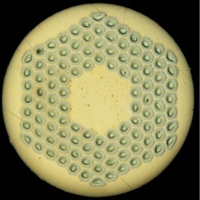
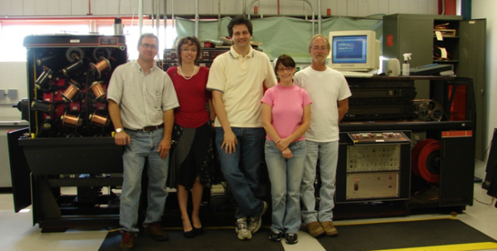

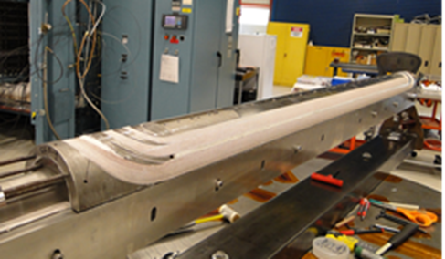
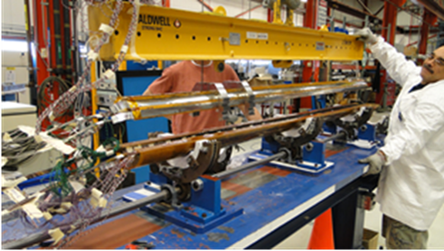
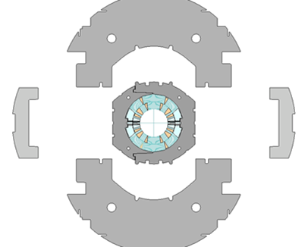
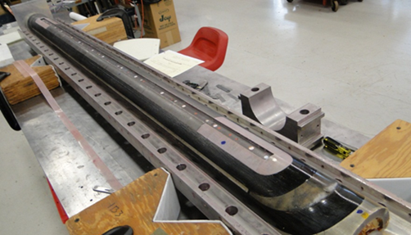
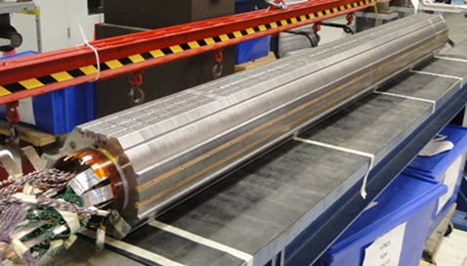
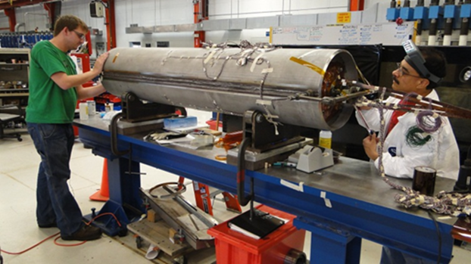

MBHSP01 – 2m demonstrator
40-strand cable fabricated using FNAL cabling machine
Coil fabrication
Collared coil assembly
Cold mass assembly
Magnet completed in record time – 18 month from start!
M. Karppinen, TE-MSC/MDT

Slide 20
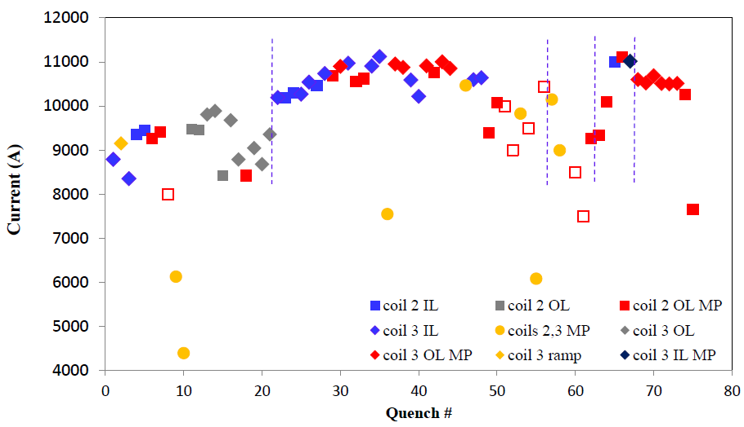
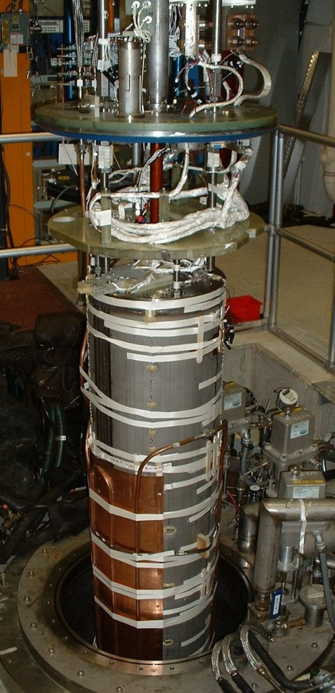
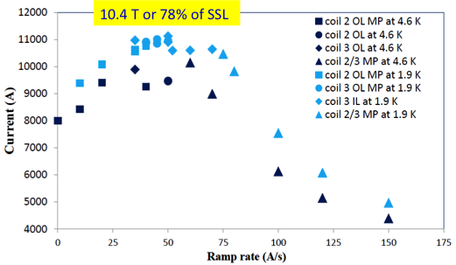
MBHSP01 performance
TC-1
TC-2
4.5 K
1.9 K
4.5 K
1.9 K
2.6-4.5 K
Limited quench performance:
Magnet reached 10.4 T @ 1.9 K at 50 A/s
Maximum steady state current 8 kA @ 4.6 K
Strong inverse ramp-rate dependence suggests conductor degradation in the outer layer, near the splice.
M. Karppinen, TE-MSC/MDT

Slide 21
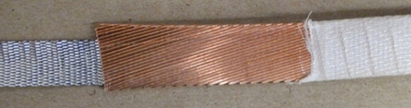
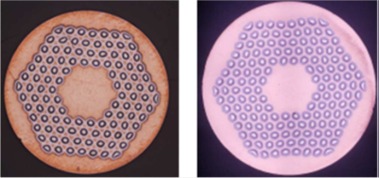
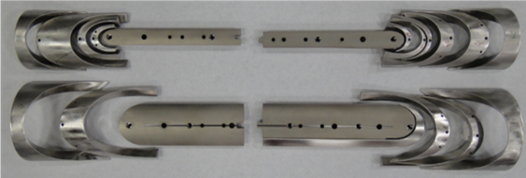
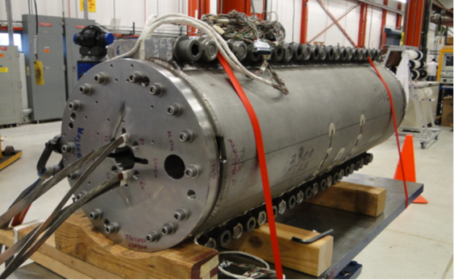
MBHSP02 and MBHSP03
Design: 1 m version of MBHSP01
Goals: demonstrate new R&D strand, cored cable, improved process, and reproducibility
Strand:
  MBHSP02 – R&D RRP-150/169 strand
  MBHSP03 – baseline RRP-108/127 strand
Cable: both models use 40-strand cable with 12 mm wide and 0.025 mm thick SS core
Coil: optimized end parts and process
Structure:
  MBHSP02 – modified MBHSP01 collar
  MBHSP03 – new collar
  reinforced bolted skin
MBHSP02 assembly completed in 6 months
MBHSP03 coil fabrication is in progress
40-strand cored cable
RRP 108/127 RRP150/169
Optimized end parts
MBHSP02 cold mass
MBHSP03 coil winding
M. Karppinen, TE-MSC/MDT

Slide 22
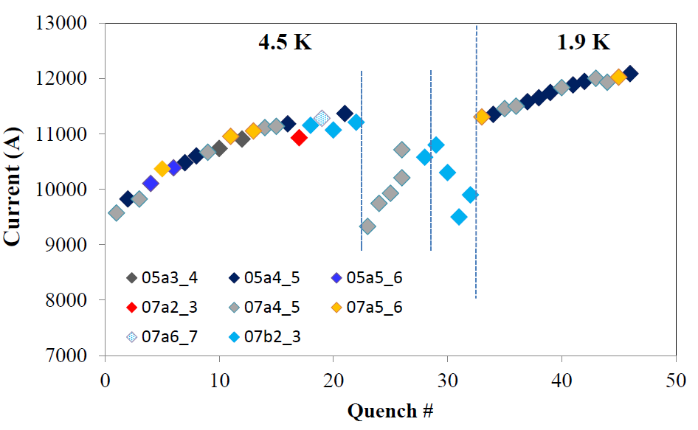
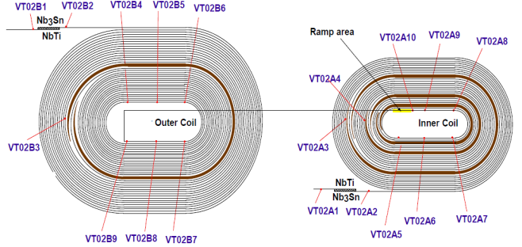
MBHSP02 Performance
12.5 kA: B0 = 11.4 T, Bp = 11.8 T, WP 80 %
M. Karppinen, TE-MSC/MDT

Slide 23
MBHSP02 RR dependence
At 4.5 K, 10 A/s quench in the region adjacent to splice (low field), all other quenches in the inner layer of coil #7 at 4.5 K
At 1.9 K no quenches in the low-field area
M. Karppinen, TE-MSC/MDT

Slide 24


CERN Construction Status
RRP Nb3Sn, 40 strands < 1 % I_{C} degradation
Cu-practice coil reaction
Cored cable fabrication validated
Coil fabrication tooling:
  Winding, curing, and reaction fully operational
  Vacuum impregnation system in commissioning
  CM assembly tools delivered/in procurement
Practice coil fabrication
  2 Cu-coils made
  1 Nb3Sn (ITER WST strand) wound and cured
  RRP-54/61 winding of the outer layer in progress
Magnet R&D topics:
  Cable insulation (braided S2-glass & Mica)
  Coil pre-loading concept (“pole-loading”)
  Magnet protection (inter-layer heater)
First 1-in-1 magnet (2 m) test Aug-13
Reacted coil with laser-sintered
stainless steel end spacers
M. Karppinen, TE-MSC/MDT

Slide 25
Outline
HFM program genesis and structure
FRESCA2 status and plans
DS 11 T MB status and plans
MQXF status and plans
Conductor procurement and R&D
Industry participation
Conclusions

Slide 26

MQXF
Nb₃Sn quadrupole, 140 T/m, 150 mm bore
  Goal: upgrade of the LHC IR quadrupoles
US-LARP – CERN collaboration
  US-LARP will build 4 m long models
  CERN will build 1.5 m long models
  Identical designs
Demonstrate gradient and field quality performance, long magnet by 2016
(in collaboration with US-LARP)
P. Ferracin, TE-MSC/MDT

Slide 27

US-LARP progress – LQ
90 mm aperture, 4 m long, 200 T/m target gradient Achieved in LQS01, surpassed by 10% in LQS01b
  Reproduced best TQ (short) models built with the same conductor (RRP 54/61)
Latest LQ model (LQS03) uses RRP 108/127 with a target of 240 T/m (same as TQS03 with 108/127)
First test achieved 208 T/m with fast initial training
Overall good result, but several open questions:
  Some results suggest a mechanical limitation
  Unreliable SG data prevents direct confirmation
  Low RRR may also be a contributing factor
A second assembly/test may help clarify these issues
Next in the plan: studies of quench protection limits
LQ in test at FNAL
G. Sabbi, LBNL

Slide 28

US-LARP progress – HQ
120 mm aperture, 1.5 m long, 3x TQ/LQ forces, energy
HQ01 series of tests is close to completion:
  184 T/m at 1.9K! Above 90 mm, 240 T/m scaling
  Fine preload tuning together with full alignment
  Encouraging data on stress & protection limits
  Issues with coil design and fabrication process
Several HQM (mirror) tests of single coils:
  Fast feedback on performance limits
  Reaches SSL, but training is slow
HQ02 assembly in progress
  Incorporates cored cables, coil design and process improvements
  However, new features are not uniformly implemented in all coils
Cable and parts are available for a third series of coils (HQ03)
HQ01 in test at CERN
G. Sabbi, LBNL

Slide 29
From HQ to MQXF
Larger aperture (from 120 mm to 150 mm) and OD
Helium vessel and cooling channels
Additional alignment, assembly, and other accelerator features
P. Ferracin, TE-MSC/MDT

Slide 30


Cable R&D and winding test
Cable R&D
  Preliminary cable parameters
    Width 17.8-17.9 mm
    Thickness: 1.5 mm
    Keystone angle: ~0.64 deg
Mechanical stability of first cable samples being checked with winding tests
L. Oberli, TE-MSC/SCD; P. Ferracin, TE-MSC/MDT

Slide 31




MQXF Magnetic analysis
First iteration of 2D/3D magnetic design
  4-blocks coil cross-section
  6-blocks ends and iron parts optimized for field quality and to reduce conductor peak field
P. Ferracin, TE-MSC/MDT

Slide 32



MQXF Mechanical design
Support structure optimized to
  Minimize stress in the conductor
  Bladder pressure
  Stress in the components
P. Ferracin, TE-MSC/MDT

Slide 33




MQXF Coil and Tooling design
First CAD model of short coil completed
Design of tooling in progress (end 2013)
Structure procurement and first coil winding beginning 2014
First assembly mid 2014
Short magnet test 2015
P. Ferracin, TE-MSC/MDT

Slide 34
Outline
HFM program genesis and structure
FRESCA2 status and plans
DS 11 T MB status and plans
MQXF status and plans
Conductor procurement and R&D
Industry participation
Conclusions

Slide 35





Nb₃Sn magnetization studies – 1
Magnetization measurement of Nb₃Sn strands, systematic study of magnetization (field quality) and flux jump (protection)
RRP
PIT
54/61
108/127
132/169
198/217
114
192
B.Bordini, D. Richter, TE-MSC/SCD

Slide 36


Nb₃Sn magnetization studies – 2
OST-RRP® has significantly larger magnetization than Bruker-PIT, and is much more prone to flux-jumps because of:
Larger sub-elements
Larger J_{C} at low field
Systematic measurement and analysis of several wire variants suggest that flux-jumps are suppressed at filament diameters in the range of 20…30 μm
B.Bordini, D. Richter, TE-MSC/SCD

Slide 37
Performance targets for Nb₃Sn
Performance
Peak field
Cost
J_{C} (kA/mm²)
Present specification:
Jc > 2.5 kA/mm²
D_{fil} < 30 μm
RRR > 150
1
1.5
Target performance:
Jc > 3 kA/mm²
D_{fil} < 20 μm
RRR > 100
2
2.5
PIT
3
3.5
target
Magnetization Field Quality
Stability
4
10
200
20
150
50
100
100
50
RRP
RRR (-)
D_{fil} (μm)
Stability Protection

Slide 38


3 EU contracts (≈ 15 km)
Luvata
NED program
1.25 mm
3000 A/mm²
40 μm
Bruker
Alstom
Test procurement (9 km)
Bruker
Bruker
Qualification order (10 km)
OST
FReSCa2 program
1 mm
2500 A/mm²
50 μm
Option PIT (5 km)
Bruker
Bruker
Pilot productions (15 km)
OST
Full production (18+45 km)
OST
+
Full production (45 km)
Bruker
OST
R&D material (30 +20 km)
OST
DS-MB program
0.7 mm
2450 A/mm²
50…30 μm
Qualification order (2x45 km)
Bruker
OST
OST
Pilot production (50+150 km)
Bruker
Full production (≈ 1000 km)
Bruker
MQXF program
0.85 mm
2450 A/mm²
40…30 μm
R&D Material (5×2) km)
OST
Prototype order (35×2) km)
2010
2011
2012
2013
2014

Slide 39





Further research in Nb₃Sn
Surprising results from irradiation tests on Nb₃Sn wires (no degradation of J_{C}), may lead to ideas for improved pinning at high field
A new scaling for the dependence of Nb₃Sn I_{C} on applied longitudinal strain
No I_{C} peak !
Measurement principle (Walter spring)
RRP +Ta 0.8 mm
RRP + Ti 0.8 mm
PIT +Ta
1 mm
IT +Ta
1.25 mm
Results of data modeling tests on a published database of I_{C} (B,T,ε) results
Ch Scheuerlein, R. Flukiger, TE-MSC/SCD
B.Bordini, TE-MSC/SCD
Strands irradiated

Slide 40

SMC Nb₃Sn conductor
12.6 T achieved in 2011 (SMC3 test)
L. Oberli, TE-MSC/SCD

Slide 41




Cable production (CERN)
40 strands cabling machine at CERN
FReSCa2 Cable
≈21
MQXF Cable
≈18
11 T DS MB Cable
≈15
Strands fed into the shaping rollers
L. Oberli, TE-MSC/SCD

Slide 42

Understanding cabling degradation
A data compilation
  FRESCA2 cable R&D (width compaction)
  VLHC cable R&D at FNAL (thickness compaction)
Lowest degradation obtained when the total compaction is in the range 85%...86%
FRESCA2
VLHC
Data by courtesy L. Oberli (CERN) and E. Barzi (FNAL)
L. Oberli, Development of the Nb3Sn Rutherford Cable for the EucCard High Field Dipole Magnet FRESCA2, IEEE-TAS, 23, 2013
E. Barzi, et al., Strand Critical Current Degradation in Nb3Sn Rutherford Cables, IEEE-TAS, 11, 2001

Slide 43
Outline
HFM program genesis and structure
FRESCA2 status and plans
DS 11 T MB status and plans
MQXF status and plans
Conductor procurement and R&D
Industry participation
Conclusions

Slide 44
Industrial action in support of HFM
Provision of services on the CERN site for prototyping and industrialization of Nb₃Sn magnets for HL-LHC
9 work-packages, total value corresponding to 20 FTEy
Several contracts with different contractors (3…5)
Contracts foreseen to enter into force between July 2013 and July 2014
For an initial period of two years, renewable up to three
2013
2014
2015
2016
Contract
signature
As from 1st April 2013
Contract
execution
As from 1st July 2013
Contract
execution
F. Savary, TE-MSC/LMF

Slide 45
Goals of the services
Start preparing the future series production of the Nb₃Sn magnets
Compensate, at least partially, the lack of CERN resources during the period of LS1
Anticipate technology transfer and industrialization, at an early stage of the project
Bridge the gap from ITER to the HL-LHC
F. Savary, TE-MSC/LMF

Slide 46
Outline
HFM program genesis and structure
FRESCA2 status and plans
DS 11 T MB status and plans
MQXF status and plans
Conductor procurement and R&D
Industry participation
Conclusions

Slide 47
Conclusions
The high field magnet program at CERN and associated laboratories has picked-up considerable speed in the past two years, developing along three main lines
  Completion of FRESCA2
  Development of a 15 m cartridge solution for the LHC DS collimator, based on 11 T dipole magnets,
  Development of the large aperture MQXF quadrupole required for the luminosity upgrade of the LHC
The program has a considerable impact, EU and worldwide, both in laboratories and industry
The promises are many, and the stakes are very high. It is now the time for Nb₃Sn to show whether it “has it”, and it is to us to “make this happen”

Slide 49

RMC configuration
Nb₃Sn racetrack model, 16 T peak, no bore
  Goal: intermediate step to qualify the fabrication of FRESCA2
Two configurations:
  2 double pancake coils
    I_{SS} (1.9 K) = 18.3 kA
    B_{peak} = 16.0 T
  1 double pancake coil
    Up to 20 kA,
    93% of I_{SS}(1.9 K)
J.C. Perez, TE-MSC/MDT

Slide 50

RMC
Horizontal Pad
Nb₃Sn Coil
Electrical connexion box
Vertical Pad
Laminated Yoke
Aluminium Shell
Longitudinal Rods
J.C. Perez, TE-MSC/MDT

Slide 51







RMC structure fabrication
Rolled AL 7175 cylinder production in Fr (Forgital)
All structure components machined in Spain have been delivered in March 2013
J.C. Perez, TE-MSC/MDT

Slide 52









RMC coil winding – 1
Layer jump Fresca2 type
Winding first layer
Winding second layer
Winding Completed
Al2O3 Plasma coated spacers
Reaction mold closed
Coil equipped with traces
Coil (Cu-dummy) wound in September 2012, heat-treated in November 2012
Several validation steps, relevant to FRESCA2: traces design, splicing, impregnation
J.C. Perez, TE-MSC/MDT

Slide 53



RMC coil winding – 2
First Nb3Sn wound in February 2013, heat treatment in March using the new heat treatment furnace recently installed in building 927
First mechanical assembly in May 2013 (using the copper coil)
First Nb₃Sn coil in May 2013
Cold powering test by the end of summer 2013 (18 months after kick-off)
RMC results are relevant and will be used for FRESCA2 construction
New vacuum impregnation system installed in March 2013
J.C. Perez, TE-MSC/MDT

Slide 54
11 T FNAL Milestones
1-in-1 Demonstrator test @FNAL Jun-12
1 m models
  Model #1 (cored RRP-151/169) Test @FNAL Feb..Mar-13
  Coil fabrication and cold mass assembly Feb..Jun-13
  Model #2 (cored RRP-108/127) Test @FNAL Jul..Aug-13
  2-in-1 assembly and Test @FNAL Sep..Oct-13
2-in-1 Demonstrator (2 m, cored RRP-108/127)
  Coils for aperture-1 Jul..Oct-13
  1-in-1 assembly and test @FNAL Nov-13..Feb-14
  Coils for aperture-2 Nov-13..Mar-14
  1-in-1 assembly and test @FNAL Q2-14
  2-in-1 assembly and test @CERN Q3-14
M. Karppinen, TE-MSC/MDT

Slide 55
11 T CERN Milestones
Practice coils (2 m)
  Practice coils #1-#2 (Cu) Jun..Sep-12
  Practice coil #3 (cored ITER Nb₃Sn) Oct..Nov-12
  Practice coil #4 (cored LARP RRP 54/61) Feb..Mar-13
2-in-1 Demonstrator (2 m)
  Coils for aperture-1 (cored RRP 108/127) Apr..Jun-13
  1-in-1 assembly and test Jul..Aug-13
  Coils for aperture-2 (cored RRP 132/169) Jul..Sep-13
  1-in-1 assembly and test Oct-13..Jan-14
  2-in-1 assembly and test Q1-14
  Coils for aperture-3 (cored PIT 114) Nov..Feb-14
  1-in-1 assembly and test Q2-14
5.5 m prototype magnet (Preliminary)
  Tooling commissioning Q4-13..Q2-14
  Practice coil (Cu) Q2-14
  Practice coil (Nb₃Sn) Q3-14
  Coils for aperture-1 & mirror tests Q1-15
  Collared coil Q2-15
  2-in-1 cold-mass and cryo-magnet Q3-15
  Cold test Q4-15
M. Karppinen, TE-MSC/MDT

Slide 56


HFM test station
To become operational in summer 2014
HFM test station being constructed in SM18
Test of the Fresca2 magnet
Insert test in Fresca2 and later other large HFM

Slide 57



HTS inserts
EuCARD
  6 T insert built with YBCO tapes
  Current density of 250 A/mm2
  Race-track, 20 mm aperture (no bore)
  self-supported for test in FReSCa-2
EuCARD2 (start mid 2013)
  5 T, 40 mm bore, accelerator quality HTS magnet
  10 kA-class HTS cable at 20 T
5 T cos-θ magnet design based on flat cable geometry
By courtesy of B. Auchmann, TE-MPE

Slide 58

A high current HTS (YBCO) cable
Roebel cables of punched HTS tapes, after an idea of W. Goldacker (KIT)
Manufacturing by IRL Ltd.
First test at liquid helium (4.3 K) and in high field (10 T) show a current carrying capacity of 4 to 10 kA
By courtesy of J. Fleiter, Ph. Denis, G. Peiro, A. Ballarino, TE-MSC/SCD

