Slide 1
HL-LHC Project Report to the
C-MAC
Showing material from all HL-LHC Work Package Leaders and Collaborators!
C-MAC Meeting 14-15 March 2013
Oliver Brüning BE-ABP CERN
1

Slide 2
HL-LHC Project Overview and main Goals:
Prepare the LHC for a total luminosity of ≈ 3000 fb⁻¹ ➔ Radiation and R2E
#Shielding and removing equipment from the tunnel
(Superconducting link and cold powering)
➔ Radiation hardness of magnets (lifetime)
#e.g. triplet and cleaning insertions
➔ Cryogenic and Cooling
System Upgrades for allowing a peak Luminosity of
L ≥ 5 10³⁴ cm⁻² s⁻¹
Consolidation activity for assuring running of the LHC up into mid 2030ies with up to 3000fb⁻¹

Slide 3
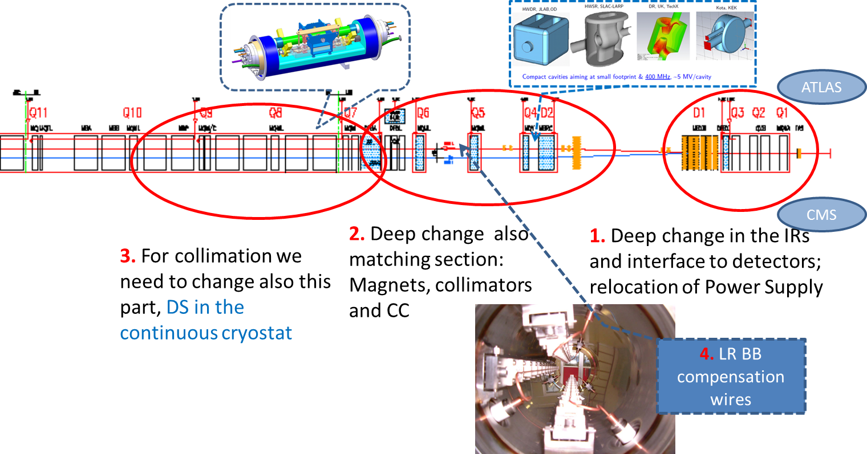
Changing 300x2 m both ATLAS & CMS
(recent requests from LHC-b & Alice to be examined)
In total > 1.2 km of LHC for all IRs!!

Slide 4
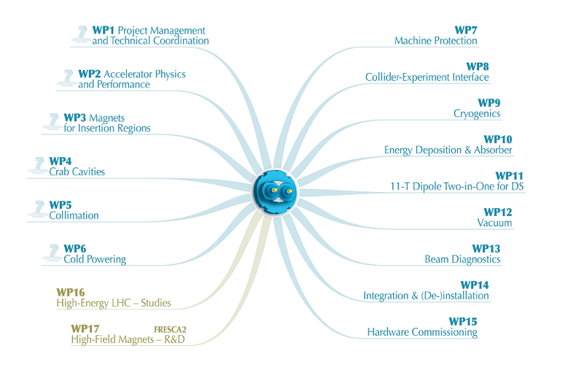
HL-LHC Structure
Oliver Brüning BE-ABP CERN

Slide 5
HL-LHC Committees and Regular Meetings
Steering Committee ➔ WP leaders and deputies
    Including international partners
HL-LHC Coordination Group ➔ assure coordination among the various entities (HL-LHC Project, Experiments & CERN management):
Parameter & Layout Committee ➔ most WP leaders and technical groups; approval of key parameters and installations
HL-Technical Committee: define the technical baseline of the project, asses the various technical systems proposed for the upgrade

Slide 6
HL-LHC Coordination Group (4)
  Coordination of Upgrade and Consolidation Plans (experiments & LIU & LHC) ✔
  Pile-up definition and limitations ✔
  Importance of luminous region size (length) and concept of ‘pileup density’➔ need for β* leveling and full crab compensation at start of run ✔
  Preparation for the European Strategy Meeting ✔

Slide 7
HL-LHC PLC (4)
Maintain coherent set of parameters and layout (3d):
-Goal of reviewing main HL IRs by summer
-Establish EDMS data base structure
Parameters agreed with Coordination Group Meeting:
-maximum of 140 events per crossing
    ➔ L = 5 10³⁴ cm⁻² sec⁻¹ for 25ns
    ➔ L = 2.5 10³⁴ cm⁻² sec⁻¹ for 50ns
    Pile-up density leveling
    ➔ Leveling options (β∗)?
    -goal for integrated annual luminosity:
    ➔ 250 fb⁻¹ per year
    -Total luminosity for HL-LHC project
    ➔ 3000 fb⁻¹ total
Oliver Brüning BE-ABP CERN

Slide 8
Main topics of first HLTC meetings (4):
  Mandate and composition ✔
  Project and Work package Breakdown Structure ✔
  Beam-Beam Long Range Wire Compensation ✔
  Halo removal via hollow electron lens ✔
  Cryogenics overall plans for the HL-LHC ✔
  Remote Manipulations and Diagnostics in radioactive areas

Slide 9
WP2-Accelerator Physics and Performance
Stephane Fartoukh

Slide 10
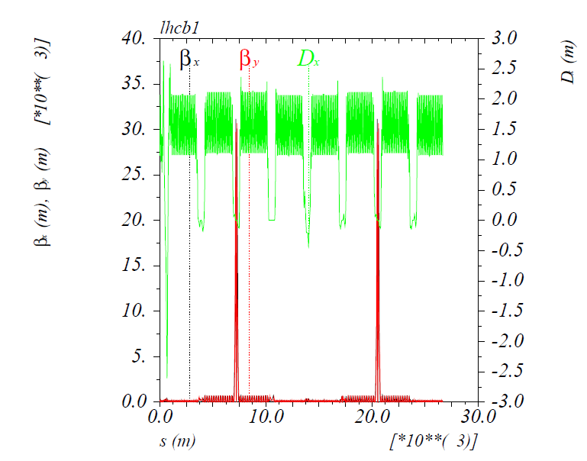
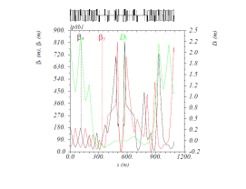
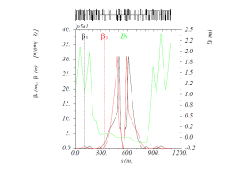
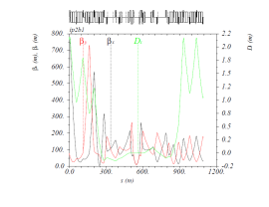
Optics & Layout
ATS (Achromatic Telescopic Squeeze) established as baseline, including LHCb desiderata for the new 150mm-140 T/m Nb3Sn inner triplet
→ β* ∼10 cm reached in MDs: CERN-ATS-2013-004 MD
LHCb: β*=3 m
ATLAS & CMS: β*=10 cm
β_{max}∼ 25 km !
β_{arc}∼ 800 m!
CMS
ATLAS
Alice: β*=10 m

Slide 11

Optics & Layout (3/4)
Crab-cavity
The main HL-LHC magnet shopping list (excluding corrector)
Equipment to be changed | New (old) Aperture [mm] | Separation [mm] (for 2-in-1) | Performance (T/m, T.m, MV,...)
TAS | 60 (34) | n/a | n/a
IT | 150 (70) | n/a | 140 T/m
D1 | 160 (80) | n/a | 40 T.m
TAN | 82/74 elliptical (52/52) | 145 | n/a
D2 | 105 (80) | 186 | 40 T.m
Crab-cavity | 80 | 194 | 12.5 MV⁽¹⁾ (per beam and IR side)
Q4 | 90 (70) | 194 | 400→ 500 T/m×m
Q5 | 70 (56) | 194 | 750 T/m×m
⁽¹⁾: For a full crabbing at β*=15 cm with 590 μrad crossing angle. Doubling Q7 might reduce by 30-40% the demand on the CC voltage (with higher β at Q4) but the feasibility and impact studies are still on-going.

Slide 12
Pile-up, leveling and beam-beam (1/2)
Guidelines from the experiments:
  140 pile up events (in average) per bunch crossing, over a luminous region of ∼5 cm r.m.s.
  → Leveling with β* becomes the preferred option
  but leading to a b-b tune shift of up to ΔQ_{bb}=0.033
  for 3 experiments (IR1, IR5 & IR8) running with a zero (IR1&IR5 with full crabbing) or very small (IR8) Piwinsky angle.

Slide 13
WP3-Magnets for Insertion Regions
Ezio Todesco

Slide 14
We are close to define a lay out of the insertion
LHC
Phase I
HL LHC

Slide 15
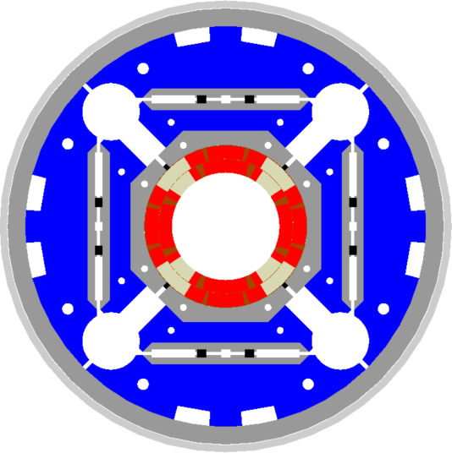
Limits to Hot Spot Temperature
Larger shielding has pushed us to choose 150 mm aperture to preserve performance
Main design features of the magnets are being selected
  Quadrupole design relies on LARP HQ model with 120 mm aperture
  Nb-Ti technology for other main magnets
  Superferric technology for high order correctors
Most urgent deadlines (2013)
  A layout up to Q4 to have radiation damage and heat loads in correctors, separation dipoles and Q4
  Having a baseline for powering, cooling and integration
  Finalize the choice of cable and cross-sections
Cross-section of the triplet
[G. Ambrosio, P. Ferracin]

Slide 16
WP4-Crab Cavities
Erk Jensen & Rama Calaga

Slide 17
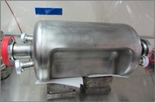
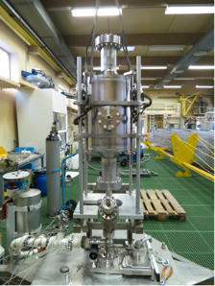
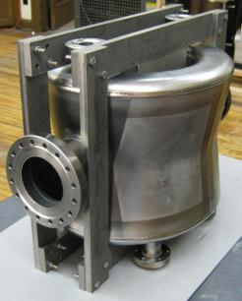
3 Crab Cavity prototypes:
RF-Dipole Nb prototype [ODU-SLAC]
4-rod in SM18 for RF measurements [Lancaster UK]
4-rod prepared for rinsing @ CERN
Concept of RF Power system
DQWR prototype (17-Jan-2013) [BNL]

Slide 18
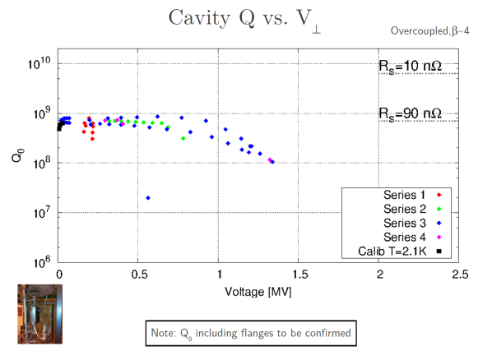
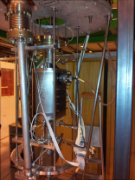
4-rod tests took place Nov 22-23, 2012
UK 4-Rod:
Limited processing (BCP only),
problems with vacuum leak, but got first measurements!
➔ repair, surface chemistry and water rinse in March, next cold test in SM18 in April
ODU RF-Dipole:
Waiting for JLab facility ➔ results foreseen by March
BNL ¼ wave:
Chemistry treatment completed, rinse by March, tests by April ➔ cavity shipped to CERN by summer

Slide 19
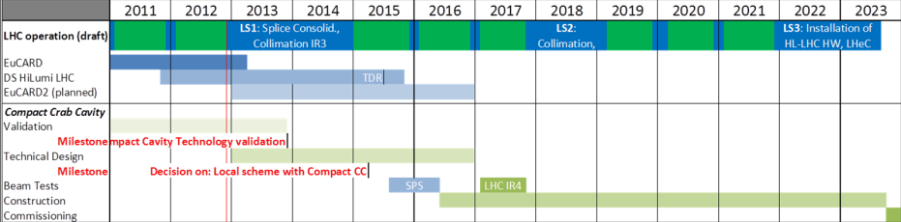
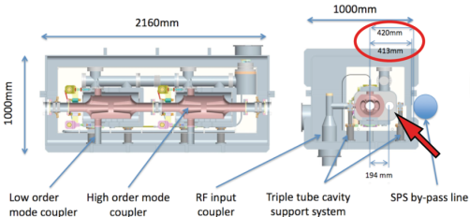
Crab Cavities - summary
Overall time-line
Preparation of SPS test progressing:
now
Engineering meeting took place at FNAL in Dec (https://cds.cern.ch/record/1517047)
Working group under A. Macpherson “Crab Cavity Technical Coordination” coordinates SPS tests (https://indico.cern.ch/categoryDisplay.py?categId=4482)

Slide 20

WP5-IR Collimation
Stefano Redaelli for the LHC Collimation Project team

Slide 21
Main Achievements
Set up simulations of multi-turn cleaning and physics debris for
HL-LHC optics layouts (ATS)
Define upgrade strategy for the physics debris absorption in
IR1 and IR5 in LS1, in collaboration with WP10 (TCL layouts)
Strong participation to beam studies at the LHC, to prepare
well the future upgrades
- Settings and hierarchy limits, impedance measurements, quench tests,
halo diffusion measurements, TCL cleaning in IR1/5…
Study limitations for ion operation, for ALICE luminosity upgrade.
Development and design for the dispersion suppressor collimation
Advanced collimation concepts:
hollow e-lens, crystal experiments
Development and beam tests for
new collimator materials
Organizing a project review at the end of May 2013 to finalize project priorities and upgrade strategy

Slide 22
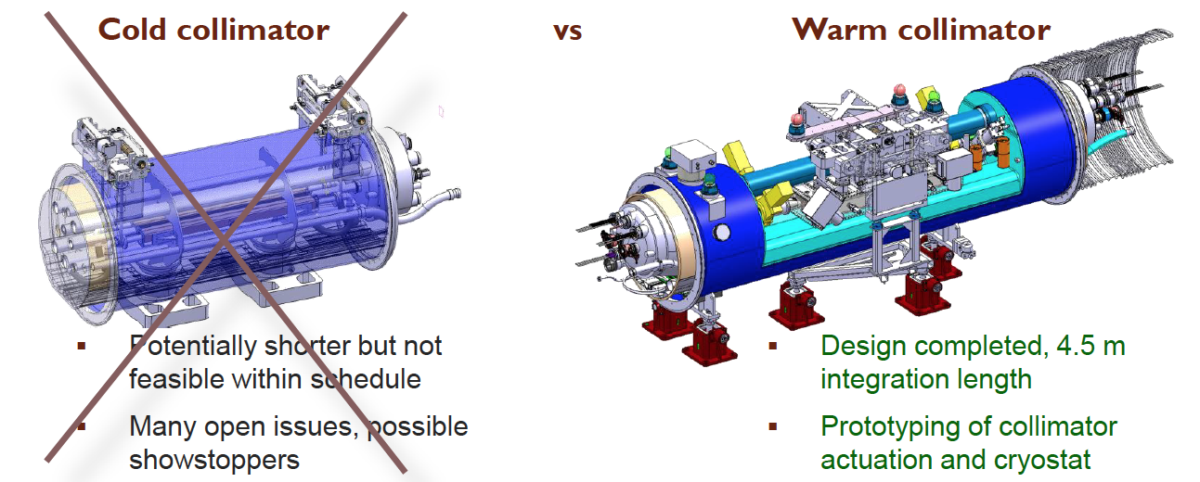
Technology choice for the DS collimator
Work of the Cold Collimator Feasibility Study team: concluded that the “warm” DS collimator with a by-pass cryostat is the best solution for the LHC.
R&D on cold collimation design will continue (EuCARD)

Slide 23
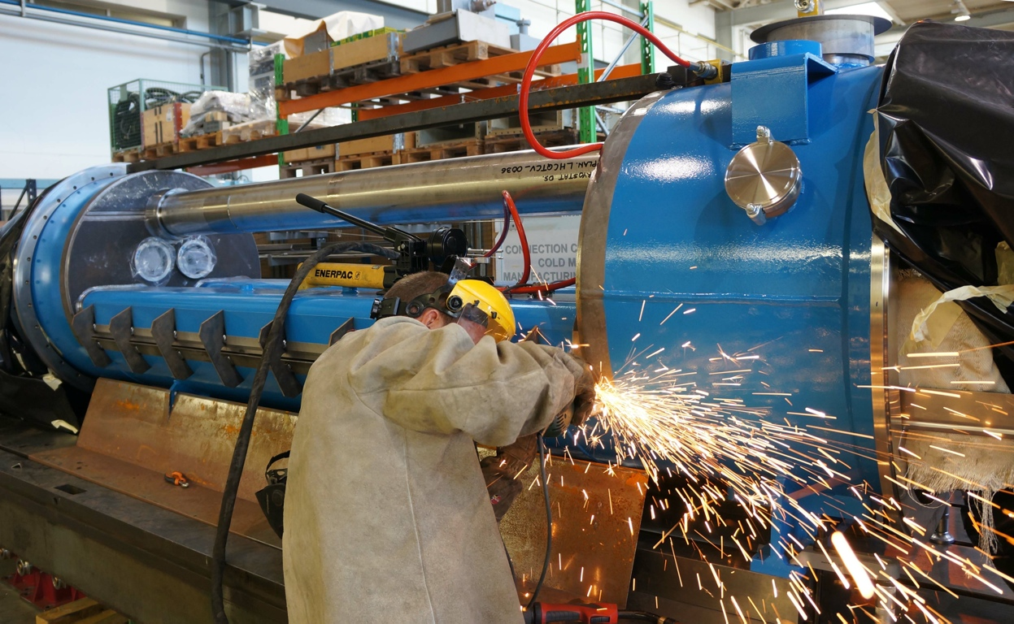
Prototyping of cryogenics bypass
Continued the prototyping of the by-pass crystostat (QTC) for the installation of a warm collimator in the cold dispersion suppressors (EN-MME, TE-MSC).

Slide 24
WP6-Cold Powering
Amalia Ballarino

Slide 25
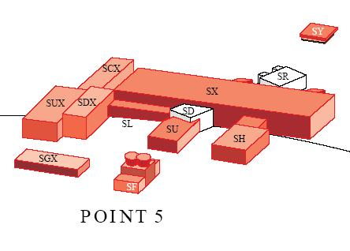
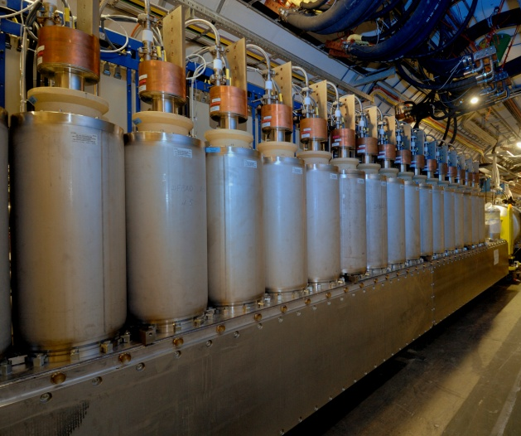
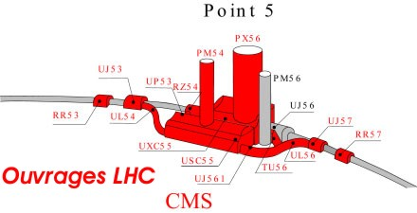
LHC P1 and P5
SC-Links with cables made from novel
High-Temperature Superconductors
transferring the current from
the surface to the magnets in the tunnel
Two links per point each about 300 m long
Up to ∼150 kA per link. Vertical transfer
along ∼ 100 m.

Slide 26
Main Achievements
New development of MgB₂ wires in close collaboration between CERN and Columbus Superconductors. Successful test at CERN in July 2012 of first Powder In Tube MgB₂ round wire with homogeneous superconducting properties.
MgB₂: low-cost novel superconductor with a critical temperature (39 K) sufficiently high to enable safe operation in He gas with generous temperature margin
(∼ 10 K).

Slide 27
Main Achievements
Conceptual study, design and commissioning at CERN of a test station enabling full characterization of 20 m-long SC-Links operated in He gas, in a variable temperature range, at currents of up to 20 kA (as proposed for the final system).
Elaboration of a) powering layouts for MQXF quadrupoles and of b) cryogenic cooling options for the cold powering system.
Preliminary conceptual study of electrical feedbox feeding
the current to the SC-Link.
Preliminary integration studies in LHC machine.

Slide 28
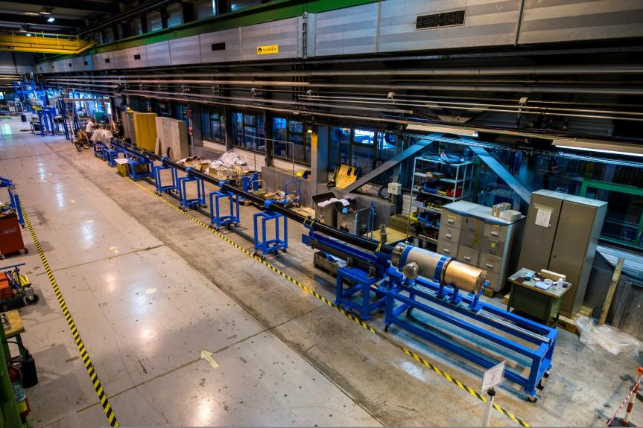
CERN SC-Link Test Station

Slide 29
WP7-Machine Protection
Rüdiger Schmidt, T.Baer, J.Wenninger, D.Wollmann, M.Zerlauth

Slide 30
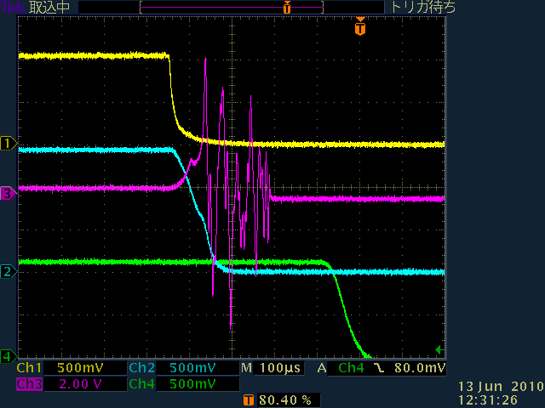
KEK Crab Cavity Abort
Crab cavity behaviour
after klystron power
abort:
Full voltage decay in 100µs
(≈ 1 LHC turn).
Crab cavity phase oscillation: 90° in ≈80µs.
Unclear: phase measurement with zero voltage.
Klystron power out
K. Nakanishi,
LHC-CC’10.
noise?
V_{c}²
Cavity phase
40°
Beam current
100µs
see also: K. Nakanishi et al., IPAC’10, WEPEC022

Slide 31
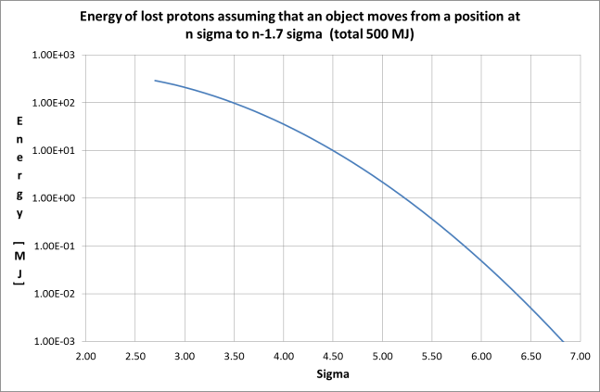
CC failure ➔Gaussian beam cut @ 1.7 σ
Assume that a collimator sits at 4 σ, and a fast failure happens cutting into the tails by 1.7 σ. The energy loss corresponds to 35 MJ.
For a collimator at 5 σ and a cut by 1.7 σ, the energy loss is ‘only’ 2.2 MJ.

Slide 32
Questions related to fast failures…..
Is it realistic to assume that crab cavities can produce very fast failures?
  Passive increase of τ for critical failures through LLRF and cavity design (available power, Qext,…) is vital for dependable MP
If particle free aperture between collimators and beam of, say, two sigma is required….
  Hollow electron lens for cleaning, or other halo cleaning techniques
  Dependable measurement & interlocks on tail population
Ideas for upgrade of protection systems
  Dependable & fast detection of failures at/close to cavities (within sub µs)
  Introduce direct links IR1/5-> IR6 for beam aborts?
  Additional abort gaps?
Other options
  Position of the collimator further outside (between 5.5 and 6.0 σ)
  Understand details of loss scenario, extract beam as fast as possible, possibly accept some damage to collimators if the probability is low (be aware of side effects)

Slide 33
WP8-Collider Experiment Interface
Helmut Burkhardt

Slide 34
Collider Experiment Interface - WP8
Recent (30 Nov. ’12) workshop, organized by L. Rossi, WP8 chair : H. Burkhardt and deputy : Daniel Lacarrère
Review of Accelerator Layout Change requests from LHC Experiments in LS2 & LS3 and their impact on the HL-LHC
Conclusions in form of executive minutes on indico and WP8 shared documents
with item list for follow up in WP8 in close collaboration with experiments and other WPs
Impedance and heating
Replacement of TAS and TAN devices
New TAS with larger aperture – Energy deposition
Small beam-pipes in the central part of the experiments, consequences of larger TAS
Quality of vacuum – Requirement for a very good vacuum around ALICE
Further collimators
Machine protection for crab cavities and larger TAS
Background and radiation from the machine in the experimental areas
Radiation Protection issues
Remote handling & Engineering (workshop planned 6 May, see indico )
One key point under study ( illustrated in next slide ) :
Consequences of the new 2× larger radius TAS and triplet apertures, combined with the reduced central beam pipes in the experiments

Slide 35
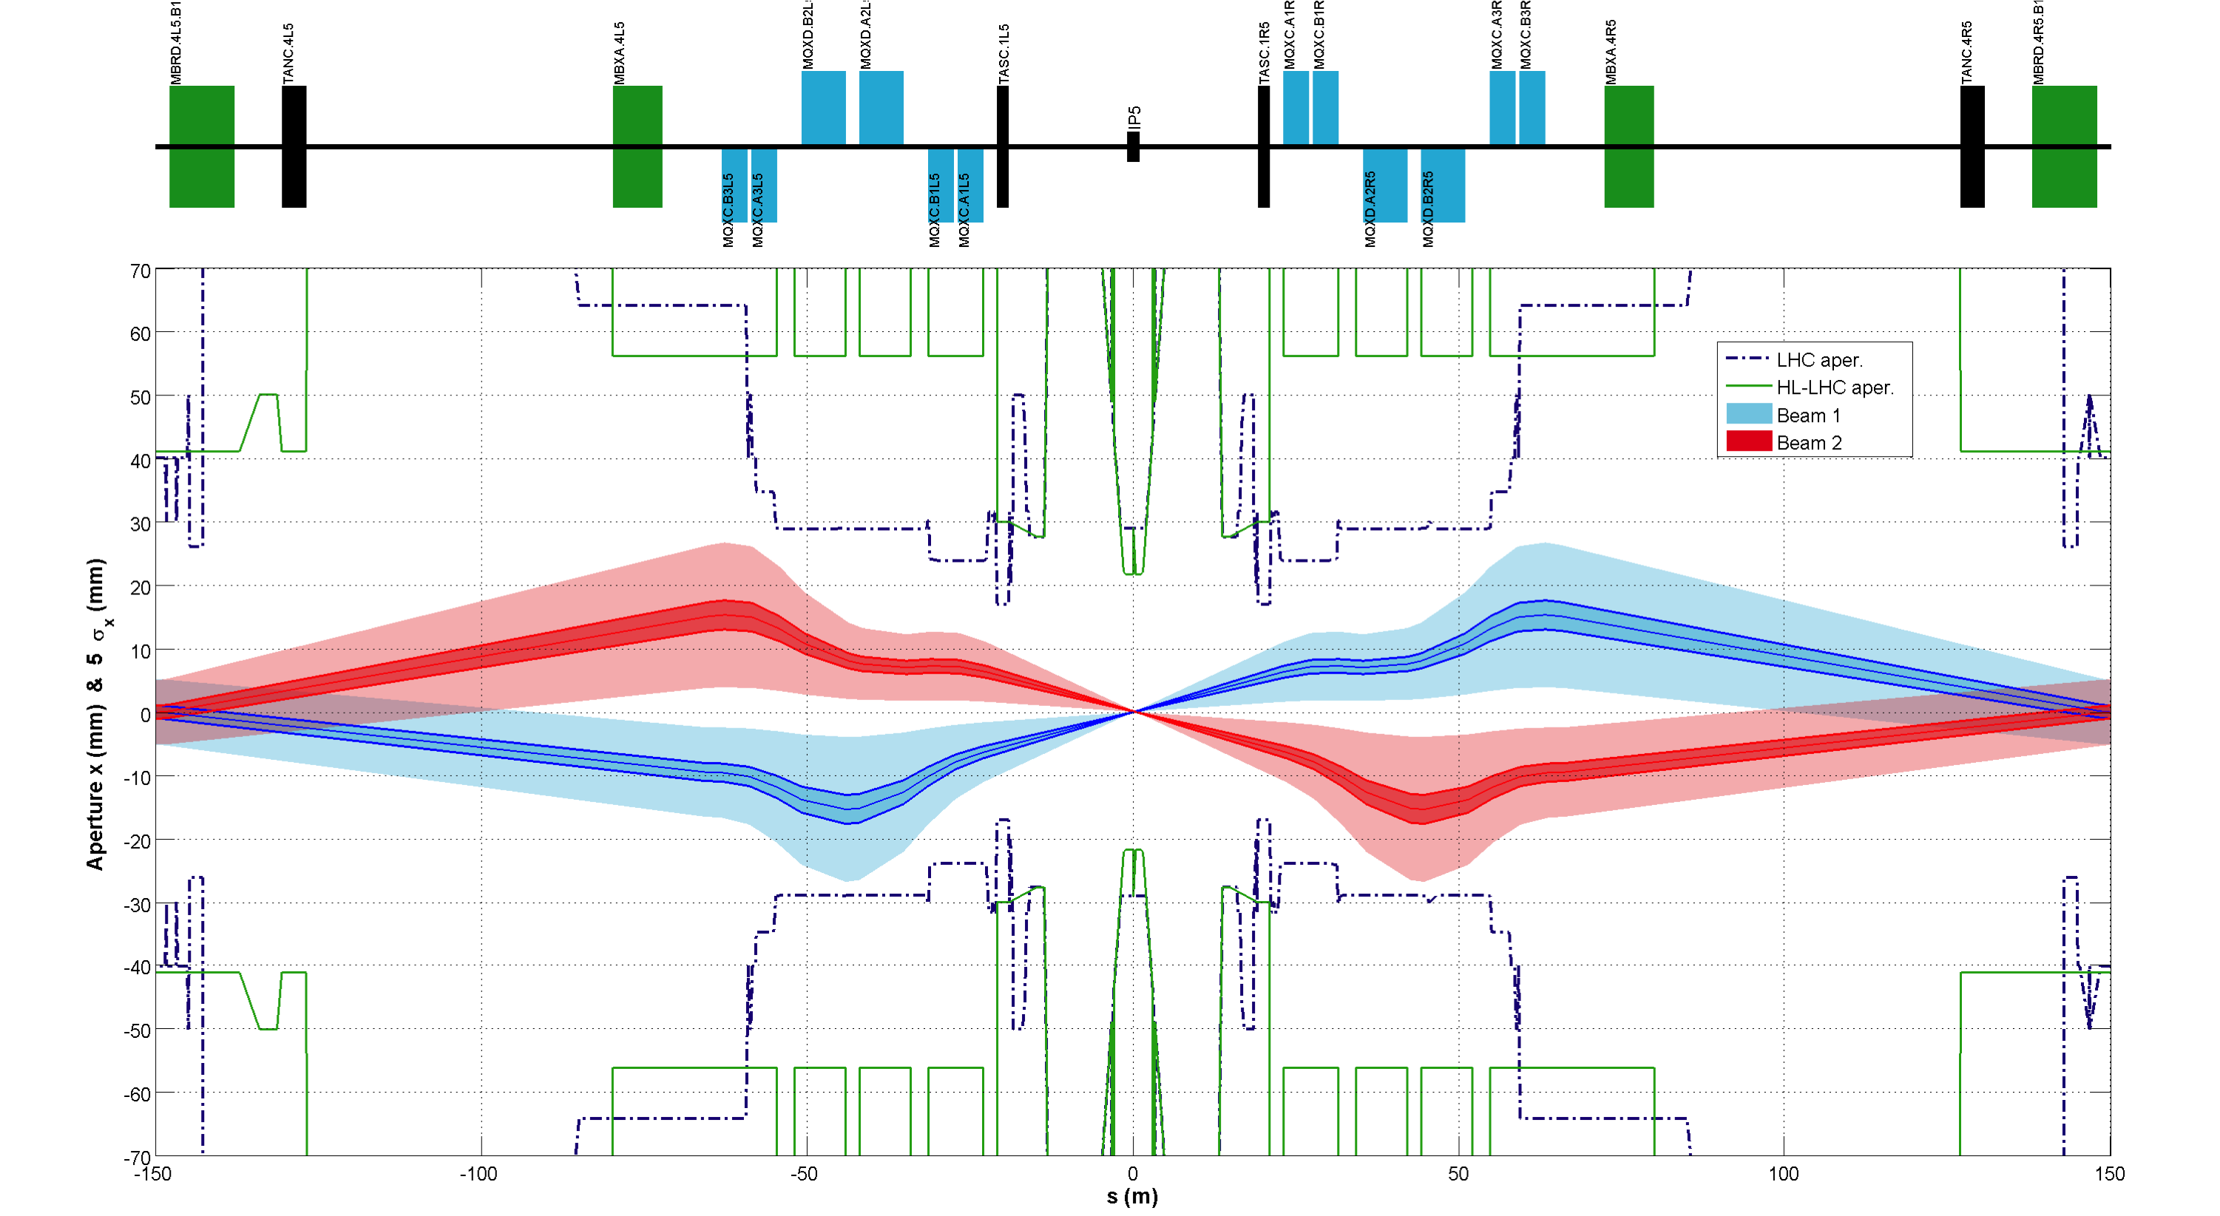
Beam envelope and apertures
F. Bouly / WP8

Slide 36
Example of off-momentum track reaching reduced chamber
F. Bouly / WP8

Slide 37
WP9-Cryogenics
Laurent Tavian

Slide 38
Overall HL-LHC layout
HL-LHC cryo-upgrade:
  2 new cryoplants at P1 and P5 for high luminosity insertions
  1 new cryoplant at P4 for SRF cryomodules
  New cooling circuits at P7 for SC links and deported current feed boxes
  Cryogenic design support for cryo-collimators and 11 T dipoles at P3 and P7

Slide 39
P1 & P5 layout 1: Matching section cooled with sector or inner-triplet cryoplants
MS cooled with sector cryoplants
MS cooled with IT cryoplants

Slide 40

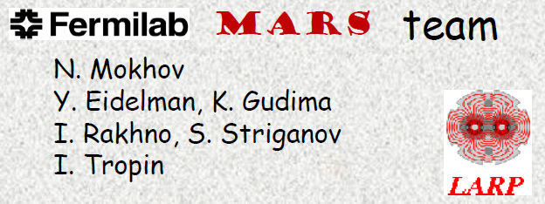


WP10-Energy Deposition & Absorber
team
&
Francesco Cerutti

Slide 41
DELIVERED
study of the 140mm Nb₃Sn case (power and dose deposition assessment)
  cold bore thickness-material effect (without beam screen)
  optics options (crossing plane, flat vs round, divergence, σ_{z}) and experimental vacuum chamber impact
  FLUKA-MARS intercomparison
  shielding strategies
benchmarking against operation (measured and predicted BLM patterns)
code physics developments
LHCb upgrade study (no TAS, but a D2 protection) [talks at the HL-LHC Coordination Group on Jan 14 and at the LMC on Mar 27]
study on the TCL collimator effectiveness in P5 and P1 [synergy with WP5]
dose to warm magnets in P7 and P3 (measurements, extrapolations and simulation validation)
[in the context of the collimation working group]
dose to the present triplet correctors [study just completed]

Slide 42
AHEAD
new comprehensive energy deposition study for the adopted 150mm quadrupole
aperture, including the downstream corrector package and 160mm D1
(Mar-May 2013) optics, layout and magnet specs are becoming available and being
collected right now (6 – nested – superconducting orbit correctors, 9 superferric high
order correctors)
Ions and DS collimators [to be discussed at the WP5 collimation review end of May]
Matching section layout (TCL6) and forward physics experiments in P1 and P5
[synergy with WP5 and WP8]
Further R&D on DPA limits at cryo temperatures
(Fermilab-Japan collaboration and CERN program on sample irradiation [R. Flukiger])

Slide 43
WP11-11 Tesla 2-in-1 Dipole Magnets for the Dispersion Suppressor
Mikko Karppinen

Slide 44
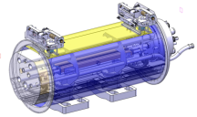
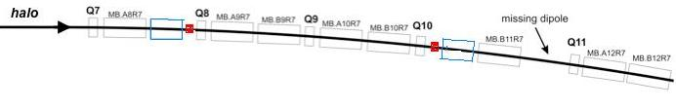
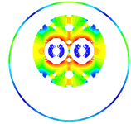
11 T Dipole for DS Upgrade
Create space for additional (cryo) collimators by replacing 8.33 T MB with 11 T Nb₃Sn dipoles compatible with LHC lattice and main systems.
119 Tm @ 11.85 kA
MB.B8R/L
MB.B11R/L
11 T Nb₃Sn
15,66 m (IC to IC plane)
LS2 2018: IR2
  4 MB => 4 x 5.5 m CM + spares
LS3 2022: IR1,5 and Point-3,7
  4 x 4 MB => 16 x 5.5 m CM + spares
5.5 m Nb₃Sn
3 m Collim.
5.5 m Nb₃Sn
5.5 m Nb₃Sn
5.5 m Nb₃Sn
3 m Collim
Joint development program between CERN and FNAL underway since Oct-2010.

Slide 45
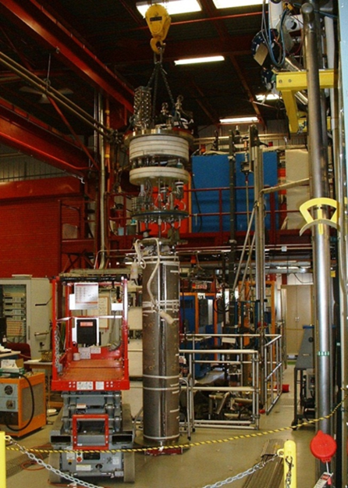
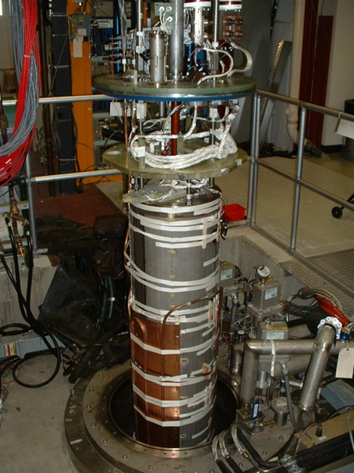
FNAL: 11 T Dipole Magnet Test
Magnet test at Vertical Magnet Test Facility (FNAL)
Test plan:
Temperature range 1.9-4.6 K
Quench performance
Magnetic measurements
Heater study
AC losses, splice resistance, coil RRR, etc.
Test status:
MBHSP01 – has been tested in June 2012 reached 10.4 T
Conductor degradation on the outer layer near the splice
➔ MBHSP02 – test in progress
Magnet installation in vertical dewar
(FNAL VMTF)
MBHSP01 mechanical and electrical connection to the Top Heat in IB1 (FNAL MTF)

Slide 46
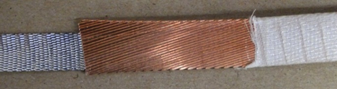
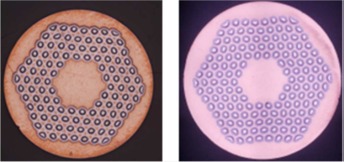
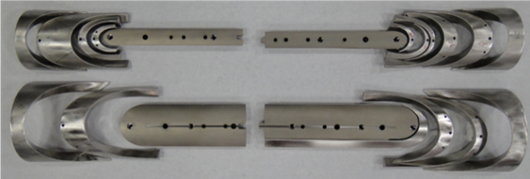
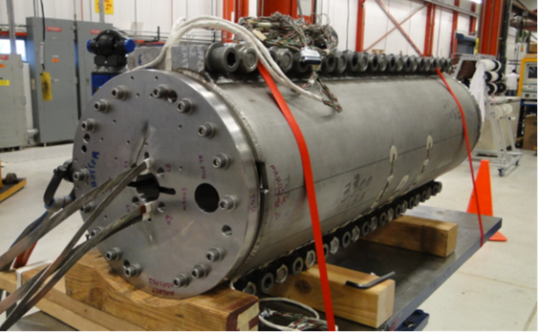
FNAL: MBHSP02 1-in-1 Demonstrator (1m)
Design: 1 m version of MBHSP01
Goals: demonstrate new R&D strand, cored cable, improved process, and reproducibility
Strand:
  MBHSP02 – R&D RRP-150/169 strand
  MBHSP03 – baseline RRP-108/127 strand
Cable: both models use 40-strand cable with 12 mm wide and 0.025 mm thick SS core
Coil: optimized end parts and process
Structure:
  MBHSP02 – modified MBHSP01 collar
  MBHSP03 – new collar
  reinforced bolted skin
MBHSP02 assembly completed in 6 months
MBHSP03 coil fabrication is in progress
40-strand cored cable
RRP 108/127 RRP150/169
Optimized end parts
MBHSP02 cold mass
MBHSP03 coil winding

Slide 47
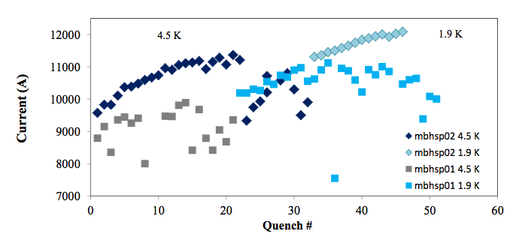
MBHSP02 Quench Performance
MBHSP02 passed 11 T field during training at 1.9 K with
I = 12080A on 5th March!

Slide 48
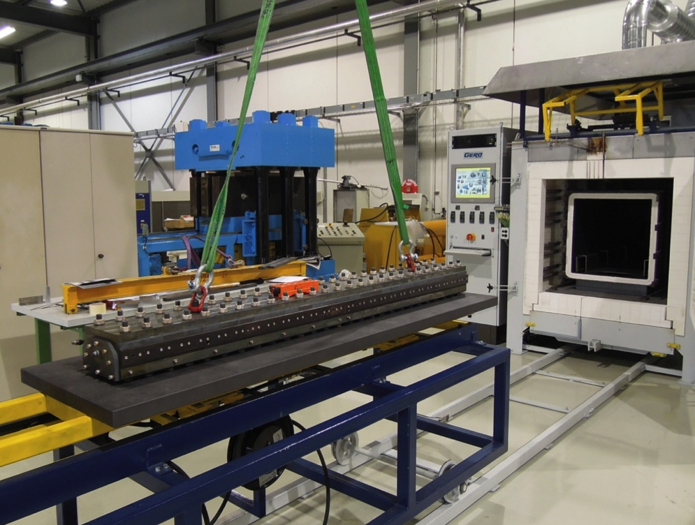
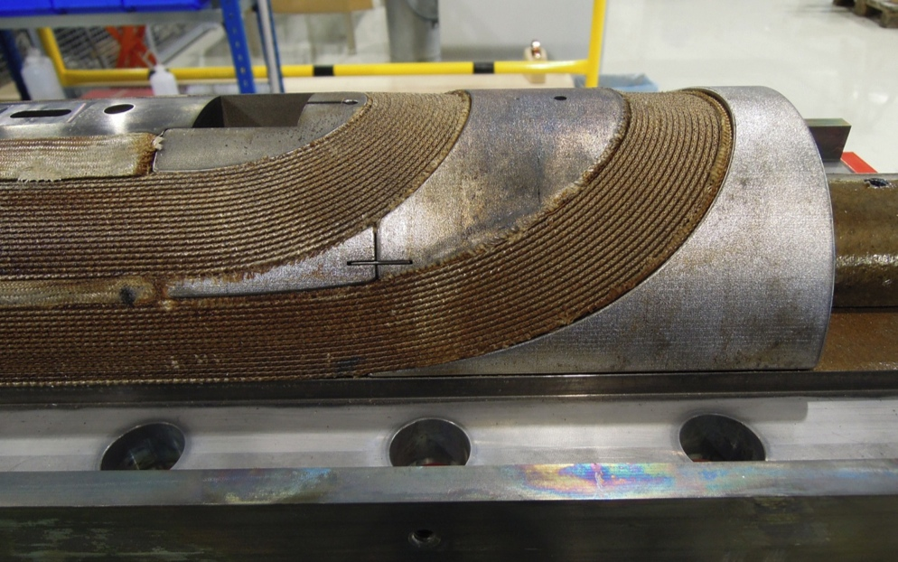
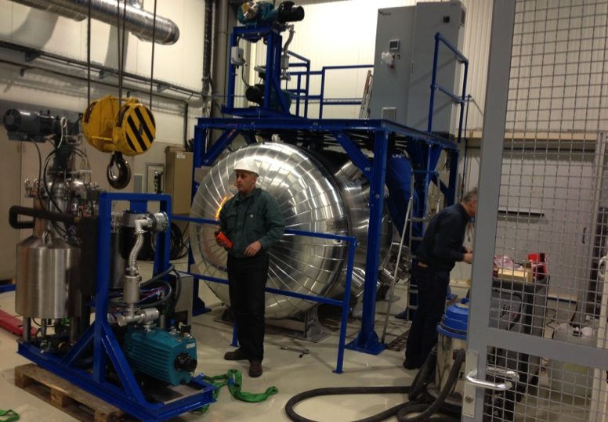
CERN Construction Status
Cu-practice coil reaction
Coil fabrication tooling:
  Winding, curing, and reaction fully operational
  Vacuum impregnation system being commissioned
Practice coil fabrication
  2 Cu-coils made
  1 Nb3Sn (low-Jc WST strand) wound and cured
  RRP-54-61 winding of the outer layer in progress
Magnet R&D topics:
  Cable insulation (braided S2-glass & Mica)
  Coil pre-loading concept (“pole-loading”)
  Magnet protection (inter-layer heater)
First 1-in-1 magnet (2 m) test Aug-13
Reacted coil with laser-sintered
stainless steel end spacers
Vacuum impregnation system

Slide 50
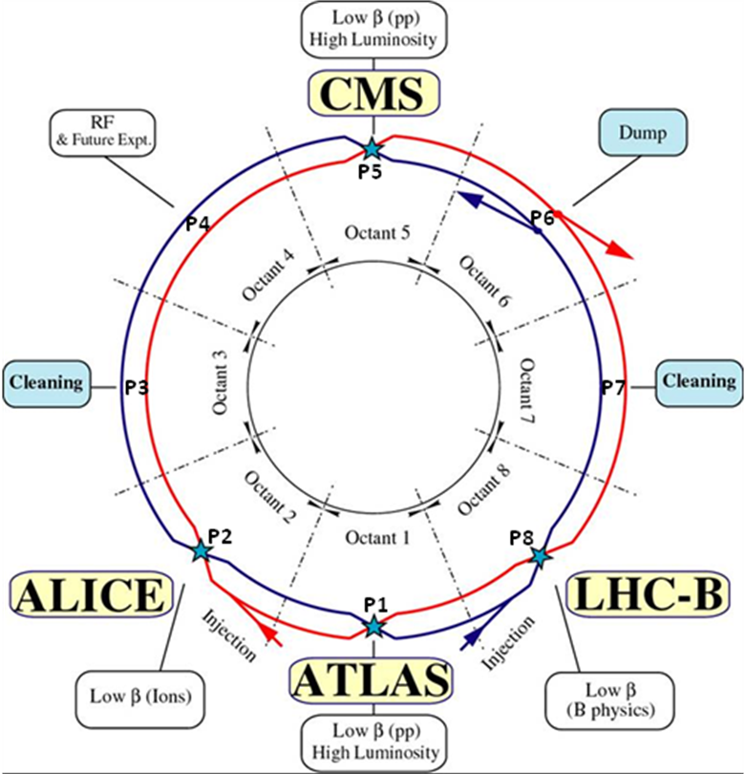
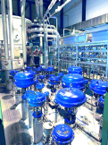
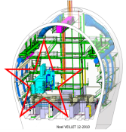
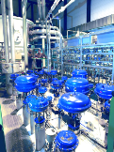
Cryogenic Upgrade
6.5 kW@4.5K cryoplant
2 x 18 kW @4.5K cryoplants for IRs

Slide 51
11 T Dipole for DS Upgrade
Create space for additional (cryo) collimators by replacing 8.33 T MB with 11 T Nb₃Sn dipoles compatible with LHC lattice and main systems.
119 Tm @ 11.85 kA
MB.B8R/L
MB.B11R/L
11 T Nb₃Sn
15,66 m (IC to IC plane)
LS2 2018: IR-1,5, and 2
  4 MB => 4 x 5.5 m CM + spares
LS3 2022: IR1,5 and Point-3,7
  4 x 4 MB => 16 x 5.5 m CM + spares
5.5 m Nb₃Sn
3 m Collim.
5.5 m Nb₃Sn
5.5 m Nb₃Sn
5.5 m Nb₃Sn
3 m Collim
Joint development program between CERN and FNAL underway since Oct-2010.

Slide 52
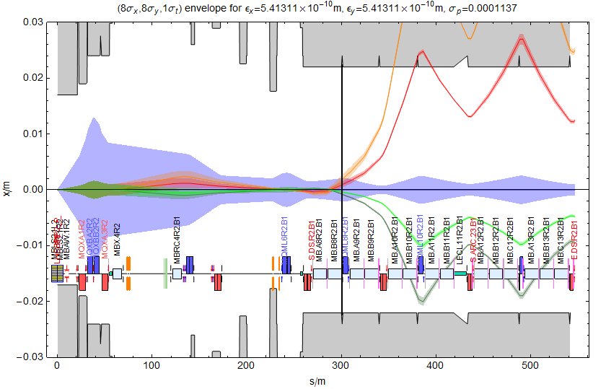
Secondary beams from Beam 1 in IR2
Cannot separate BFPP and main beam in warm area (eg by Roman pots a la TOTEM).

Slide 53
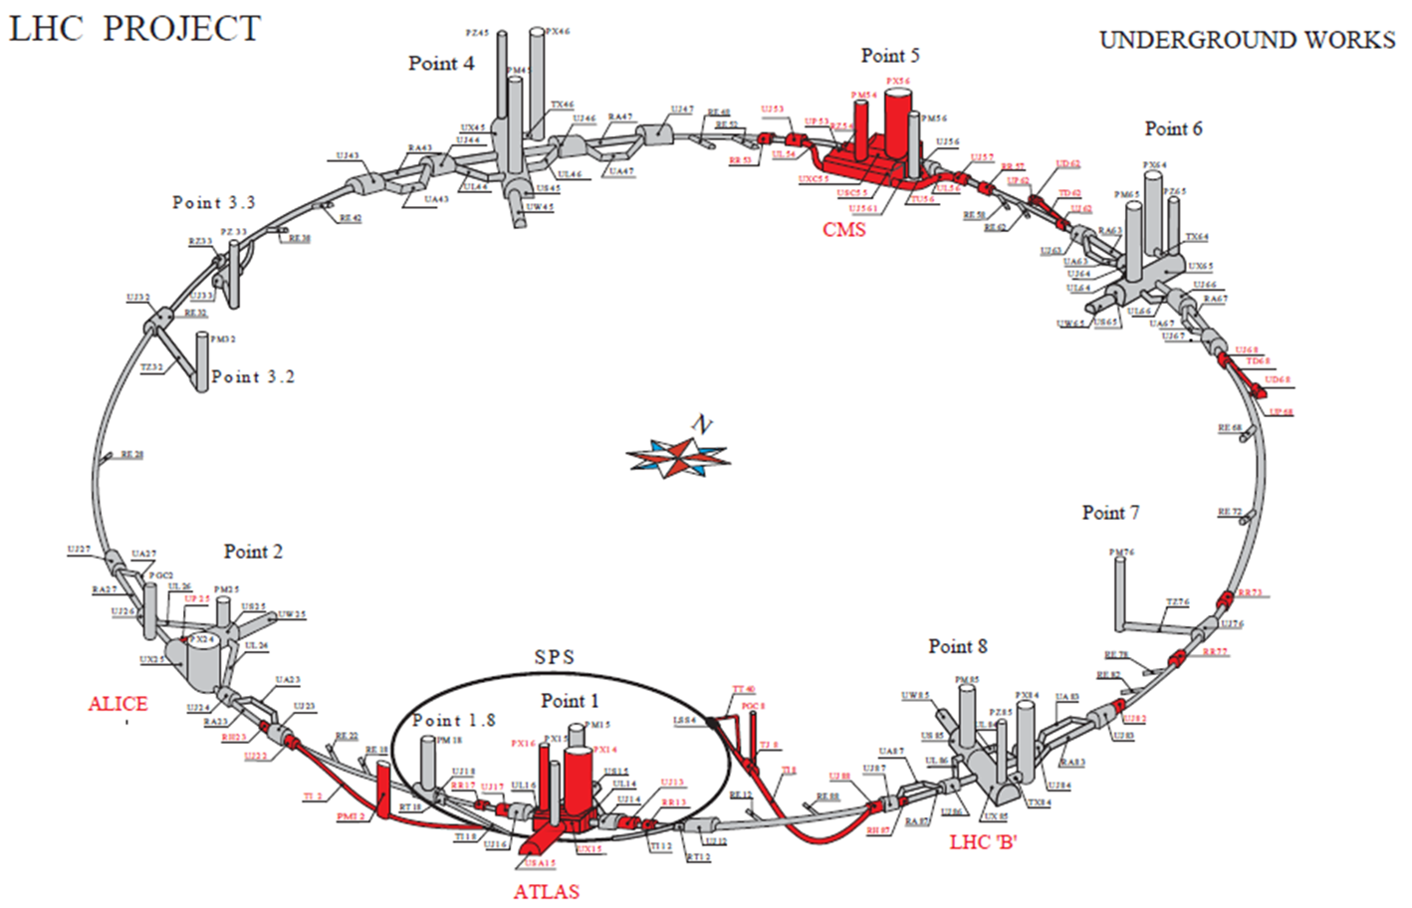
In total > 1.2 km of LHC !!

Slide 54
Main topics of first PLC meetings (4):
  Mandate and composition ✔
  Baseline parameters ✔
  Generation of a common Glossary with the experiments ✔
  Approval of triplet coil diameter of 150mm ✔
  Layout and optics ✔
  Triplet beam screen and vacuum ✔
  Cryogenics (current limitations ➔ IR and arcs) ✔
  Beam instrumentation (space reservations) ✔
  Crab cavity (layout and parameters) ✔
  Powering aspects and space requirements in the HL IRs

Slide 55
HL-LHC PLC
Other future topics:
-Survey needs in the IRs
-EDMS data base structure for HL-LHC
-Required corrector circuits
➔ (e.g. triplet, additional octupoles etc)
-Review of the HL-LHC Layout in the insertions
    TAS & TAN space, CC, space for additional components, Survey needs
-DS collimators
-IR3 and IR7 warm magnet consolidation options
-Places for higher harmonic RF system and new BI
-Current limitations (e.g. MKI, dump, TDI etc)
-Ion beam parameters during HL-LHC
Summer

Slide 56
HL-LHC Performance Estimates
‘Stretched’ Baseline Parameters following 2nd HL-LHC-LIU:
Parameter | nominal | 25ns | 50ns
N | 1.15E+11 | 2.2E+11 | 3.5E+11
n_{b} | 2808 | 2808 | 1404
beam current [A] | 0.58 | 1.12 | 0.89
x-ing angle [μrad] | 300 | 590 | 590
beam separation [σ] | 9.9 | 12.5 | 11.4
β* [m] | 0.55 | 0.15 | 0.15
ε_{n} [μm] | 3.75 | 2.5 | 3.0
ε_{L} [eVs] | 2.51 | 2.51 | 2.51
energy spread | 1.20E-04 | 1.20E-04 | 1.20E-04
bunch length [m] | 7.50E-02 | 7.50E-02 | 7.50E-02
IBS horizontal [h] | 80 -> 106 | 18.5 | 17.2
IBS longitudinal [h] | 61 -> 60 | 20.4 | 16.1
Piwinski parameter | 0.68 | 3.12 | 2.85
geom. reduction | 0.83 | 0.305 | 0.331
beam-beam / IP | 3.10E-03 | 3.3E-03 | 4.7E-03
Peak Luminosity | 1 10³⁴ | 7.4 10³⁴ | 8.5 10³⁴
Virtual Luminosity | 1.2 10³⁴ | 24 10³⁴ | 26 10³⁴
6.2 10¹⁴ and 4.9 10¹⁴
p/beam
sufficient room for leveling
(with Crab Cavities)
Virtual luminosity (25ns) of
L = 7.4 / 0.305 10³⁴ cm⁻² s⁻¹
= 24 10³⁴ cm⁻² s⁻¹ (‘k’ = 5)
Virtual luminosity (50ns) of
L = 8.5 / 0.331 10³⁴ cm⁻² s⁻¹
= 26 10³⁴ cm⁻² s⁻¹ (‘k’ = 10)
(Leveled to 5 10³⁴ cm⁻² s⁻¹
and 2.5 10³⁴ cm⁻² s⁻¹)
Events / crossing (peak & leveled L) | 19 -> 28 | 210 | 475 | 140 | 140
Oliver Brüning BE-ABP CERN
Notes:
50ns beam option provides HL-LHC performance levels at ultimate total beam currents; only the ‘large beta*’ option reaches beam-beam limit; IBS growth rates are a concern!; low beta option has 50% higher performance potential

Slide 57
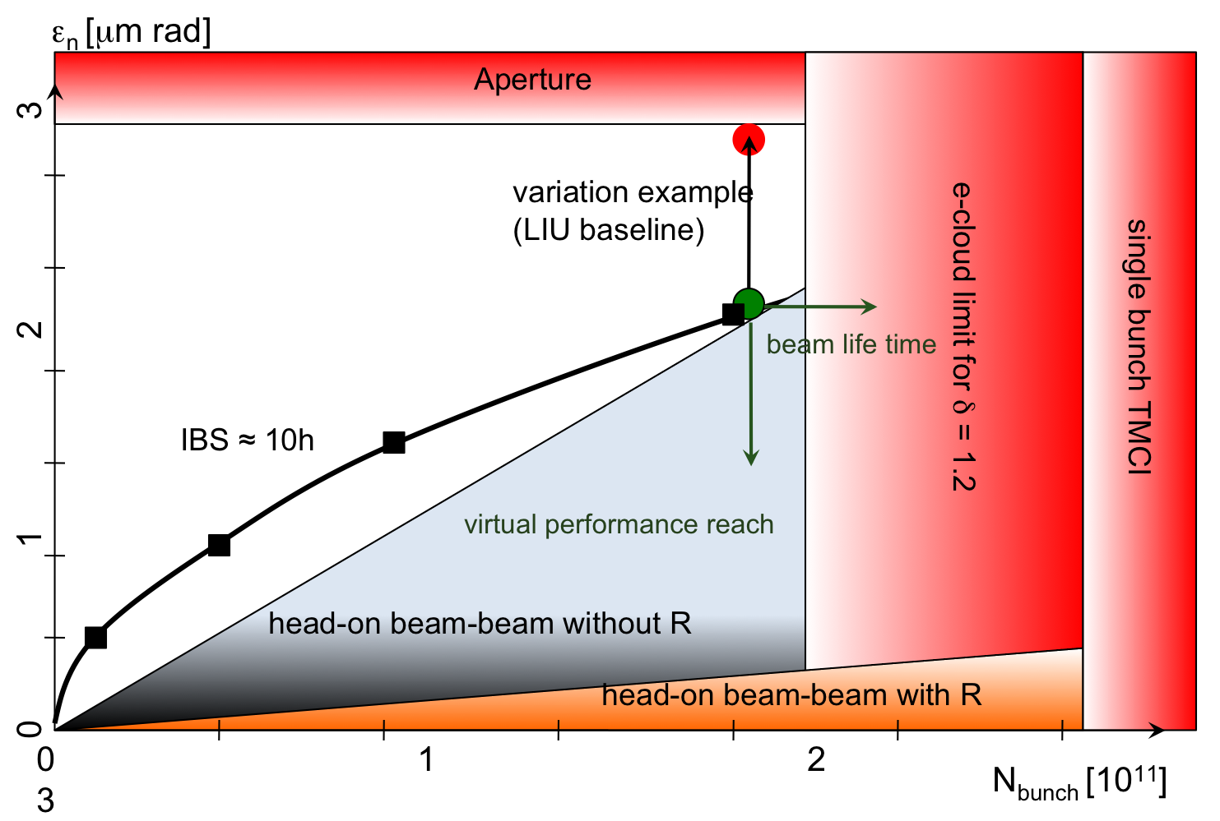
HL-LHC parameter space
1st HL-LHC PLC Meeting 3rd July 2012

Slide 58
WP2-Accelerator Physics and Performance
Reserve Transparencies

Slide 59
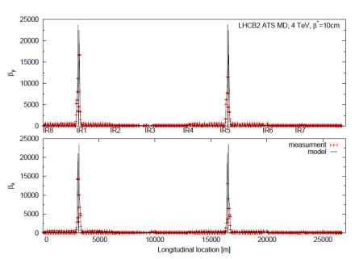
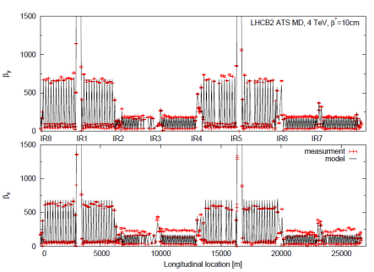
Optics & Layout (1/4)
WP2
The ATS (Achromatic Telescopic Squeeze) is now firmly established as baseline for the HL-LHC
β_{arc}∼ 800 m!
β_{max}∼ 25 km !
→ β* ∼10 cm reached in MD (with some β-beating) including a full chromatic correction,
thank to the ATS: CERN-ATS-2013-004 MD

Slide 60
Optics & Layout (4/4)
Choice of the crossing angle
590 mrad (12.5 σ) full X-angle
chosen for the baseline β*=15 cm
1’000 000 turns DA vs. crossing angle for various collision optics, round or flat (w/o field imperfections) assuming 25 ns HL-LHC beam parameters (N_{b}= 2.2E11 p/bunch, γε=2.5 μm)

Slide 61
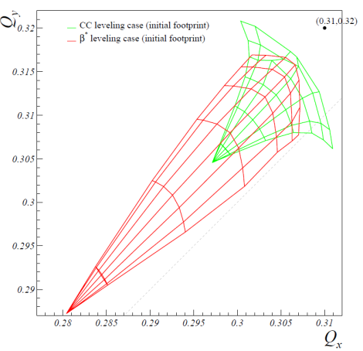
Pile-up, leveling and beam-beam (2/2)
Parameters | Leveling with c.-c. | Leveling with β*
# bunches | 2808
bunch charge [10¹¹] | 2.2
emittance [μm] | 2.5
r.m.s. bunch length [cm] | 7.5
full X-angle [μrad] | 590
initial β* [cm] | 15 | 72
c.-c. initial voltage [MV] | - 6.6 | 12.5
initial Piwinsky angle | 4.76 | 0
initial lumi loss factor | 0.21 | 1.0
levelled lumi [10³⁴cm⁻²s⁻¹] | 5.0
initial luminous region [cm] | 1.1 | 5.3
initial bb tune shift for 3 IRs (IR1, IR5 & IR8) | 0.016 (0.011+2×0.0025) | 0.033 (3×0.011)

Slide 62
WP3-Magnets for Insertion Regions
Ezio Todesco

Slide 63
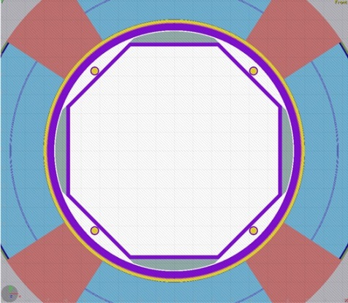
Main Magnet Features:
Target is maximal performance, robustness, simplicity
  Nb₃Sn chosen for having compact triplet
  Nb-Ti for the separation dipoles, Q4
Main ingredient: energy deposition studies
  Shielding needed for heat removal and protrecting against radiation damage
    20 MGy correspond to 4 mW/cm3, i.e. we will be in a situation similar to the LHC baseline thanks to a much larger shielding
Larger shielding has pushed us to choose 150 mm aperture to preserve performance
Energy deposition in the triplet
[F. Cerutti, L. Esposito]

Slide 64
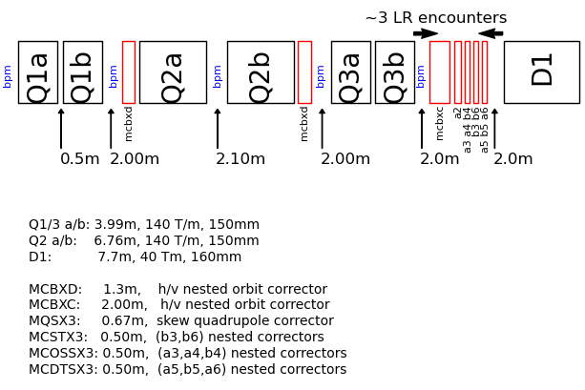
New Layout with 150mm Diameter Triplet

Slide 65
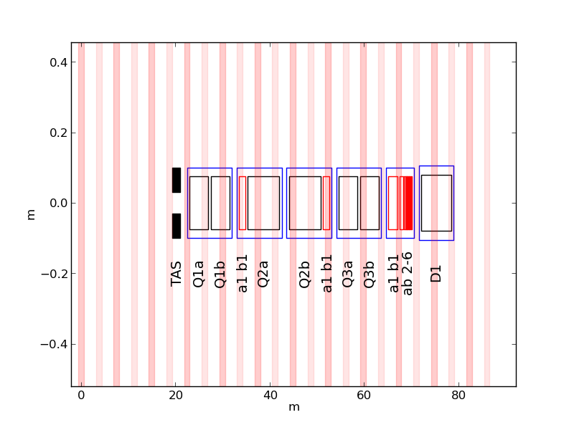
New Layout with 150mm Diameter Triplet

Slide 66



Magnets: IR

Slide 67
WP4-Crab Cavities
Reserve Transparencies

Slide 68
CC
BNL DQWR
ODU-SLAC RF Dipole
Lancaster 4-rod Design

Slide 69


CC

Slide 70



First action in addition to R&D
(LS1 - 2014)
Test Crab in SPS
Horizontal SC link in P7: RR with many 600 A EPCs in RR just downstream betatron cleaning
Cold box
In BA4

Slide 71
WP5-IR Collimation
Stefano Redaelli for the LHC Collimation Project team

Slide 72


Halo cleaning for HL-LHC optics
Setup of first multi-turn betatron cleaning
Debris from high luminosity
Setup of first complete loss maps with HL optics baseline (ATS for 15cm). Identified possible critical loss locations outside DS of IR7 -> need to improve the IR7 cleaning!
Simulation of physics debris losses for proton collisions.
A. Marsili, BE-ABP

Slide 73


Ions: collision debris cleaning in IR2
J. Jowett, BE-ABP
Proposed location for one dispersion suppressor collimators in cell 9 of IR2.
Ongoing: optimization of collimator material and length for ALICE luminosity upgrade.
Relying on 11 T dipole development for a possible installation in LS2.
Detailed comparisons ongoing against results of the LHC quench tests in Feb. 2013.

Slide 74
WP6-Cold Powering
Reserve Transparencies

Slide 75
Milestones
Demonstrate feasibility of the proposed cold powering system via the development of superconducting links and associated feedboxes and cold equipment. Develop and test a cold powering system incorporating SC-links operated in the horizontal and vertical configuration.
Choose the most promising SC technology (MgB₂ vs YBCO and BSCCO) on the basis of cost/performance characteristics.
Optimize and define cryogenic and electrical layout for cold powering system.
Finalize integration of SC-link in the LHC machine (define need for surface buildings and civil engineering for new shafts).

Slide 76

SC links

Slide 77

Magnet: MS Q7 with it’s DFB

Slide 78
Specific cryogenic studies and tests
(or what differs from the LHC design ?)
Cooling circuits for large heat deposition:
  on 1.9 K cold masses up to 10 W/m
  → heat extraction from SC cables and quench energy
  margin
  → Generic heat flow in magnet cross section
  on beam-screens up to 13-20 W/m (image current effect ?)
Cooling of HTS SC links and current feed boxes
Validation tests on SC link, crab-cavities, magnets, beam screens…
Reactivation of the Heat Load Working Group
Quench containment and recovery (cold buffering ?)
Large-length cable (150 m) for cold-compressor controls and drives
Large capacity (750-1500 W) sub-cooling heat exchangers
Larger turndown capacity factor on 1.8 K refrigeration cycle: up to 10?
From users to cryogenic infrastructure

Slide 79
WP7-Machine Protection
Reserve Transparencies

Slide 80
Progress and Issues
Coordination of Machine Protection related issues through expertise in LHC Machine Protection Panel (MPP).
LHC experience shows very well protected machine (several levels of redundancy) in absence of (very) fast kicker failures.
Identified list of main topics that are being addressed in view of HL-LHC
Crab cavities
  might require to operate with beams that have limited number of particles in the tails
Machine Protection for beams without tails (or very weak tails)
Modification of powering system and impact on machine protection
Fast vacuum valves (not coupled to HiLumi LHC)

Slide 81
MP implications of crab cavities
Machine protection needs to assume the worst case, in this case quenching of a one crab cavity in less than a turn
MPS response by dumping the beams not sufficient for very fast failure cases that take only few turns of less
For single cavity quench case, beam deflection leading to an amplitude of 1.7 σ, this requires, say, about 2 σ aperture margin

Slide 82
LHC Layout
Beam dump blocks
IR5:CMS
Signal to kicker magnet
IR4: RF + Beam instrumentation
IR6: Beam dumping system
IR3: Moment Beam Clearing (warm)
IR7: Betatron Beam Cleaning (warm)
IR2: ALICE
IR8: LHC-B
Failure with crab cavities
Assume trip of cavity in IR1 for beam 2. The beam starts to oscillate and risks to hit collimators in IR7.
IR1: ATLAS

Slide 83
Example: Gaussian beam with a collimator at 4 σ
99.9% of protons
collimator
collimator
Example: a collimator is positioned at 4 σ, and a crab cavity trips. The beam starts to oscillate with an amplitude of 1.7 σ. All particles beyond 2.3 σ are lost during a few turns.

Slide 84
Gaussian beam collimated at 2.3 σ
92.8% of protons
Assume that the total energy stored in the beam is 500 MJoule
Assume beam edge is close to the collimator at a position of 4.0 σ
Assume a trip of a crab cavity (or another fast failure)
Assume the that beam starts to oscillate with a maximum amplitude of 1.7 σ
Assume that all particles above 2.3 σ are lost => corresponds to energy deposition of 35 MJ

Slide 85
Questions related to fast failures…..
Is it realistic to assume that crab cavities can produce very fast failures?
  Passive increase of τ for critical failures through LLRF and cavity design (available power, Qext,…) is vital for dependable MP
If particle free aperture between collimators and beam of, say, two sigma is required….
  Hollow electron lens for cleaning, or other halo cleaning techniques
  Dependable measurement & interlocks on tail population
Ideas for upgrade of protection systems
  Dependable & fast detection of failures at/close to cavities (within sub µs)
  Introduce direct links IR1/5-> IR6 for beam aborts?
  Additional abort gaps?
Other options
  Position of the collimator further outside (between 5.5 and 6.0 σ)
  Understand details of loss scenario, extract beam as fast as possible, possibly accept some damage to collimators if the probability is low (be aware of side effects)

Slide 86
Other studies
Using diamond beam loss monitors for beam loss diagnostics + active protection, could gain in time between detection and dump by about 40 us
  Measurements and additional simulations to better understand quench behaviour of crab cavities should be undertaken
Accept asynchronous dumps + local damage (e.g. new collimator materials and/or spare surfaces) ?
Re-iterate (realistic) damage thresholds for different failure cases
  E.g. protection against magnet powering failures (cold D1 at β* ~ 15km, new insertion layout)
  Optics required to study failure scenarios
Absence of long range beam-beam kick during beam dump on the other beam => to be watched out, but seems to be less critical
Also to be addressed for higher beam intensity
  Injection protection (TCDI, TDI, injection lines,…)
  Dump protection (TCDQ,..)

Slide 87
WP9-Cryogenics
Reserve Transparencies

Slide 88



Collimation
First cold catcher tested FAIR 2011

Slide 89
WP11-11 Tesla 2-in-1 Dipole Magnets for the Dispersion Suppressor
Mikko Karppinen

Slide 90



MBHSP01 Quench Performance
TC-1
TC-2
4.5 K
1.9 K
4.5 K
1.9 K
2.6-4.5 K
Limited quench performance:
Magnet reached 10.4 T @ 1.9 K and 50 A/s
Max. steady state current was 8 kA @ 4.6 K
Strong inverse ramp-rate dependency points to conductor degradation on the outer layer near the splice.

Slide 91




11 T Dipole Design: FNAL + CERN
11.25 T at 11.85 kA with 20% margin at 1.9 K in
60 mm bore straight CM
Systematic field errors below the 10⁻⁴ level
6-block design, 56 turns (IL 22, OL 34)
14.85-mm-wide 40-strand Rutherford cable, no internal splice
Coil ends optimized for low field harmonics and minimum strain in the cable

Slide 92









FNAL: MBHSP01 – 1-in-1 Demonstrator (2 m)
40-strand cable fabricated using FNAL cabling machine
Coil fabrication
Collared coil assembly
Cold mass assembly
Magnet development and fabrication was done in record time – 18 month!

Slide 93
WP12-11 Vacuum
Roberto Kersevan

Slide 94
Main ACtivities
1) Increased synchrotron radiation (SR) fans due to the new orbits and higher magnet strenghts/gradients in the triplet areas (D2 to Q1) has been identified;
2) Need for additional shielding on the beam screen (BS) in order to reduce the power load generated by collision debris for the outgoing beam. FLUKA calculations show a peak power deposition in the Q1-Q2 area, making it mandatory the installation of a high-Z shield around the BS, or a thicker cold-bore on the Q1-Q2 SC magnets;
3) Increased internal diameter (ID) of the quadrupole triplet, fixed now at 150 mm for the coils. This calls for a new design of the BS. As a starting point a solution similar to the one proposed for the Phase-1 Upgrade has been evaluated;
4) SYNRAD+, a ray-tracing Montecarlo code, has been used to analyse the power deposition and calculate the photon-induced desorption profile in the triplet area (Q1 to D1, but including the radiation generated in D2 by the incoming beam);
5) Molflow+, a ray-tracing Montecarlo code, has been used to calculate the pressure profiles along the triplet area under a number of configurations: static vacuum, colliding beams, different pumping speed on the BS pumping slots;

Slide 95
Main Activities
6) The results of 4) and 5) have shown that the additional SR power generated by the off-axis beams is well within the limits of the cryogenic system.
- It should be noted that the mentioned photon flux is not going to contribute much to the dynamic gas load, even under the pessimistic assumptions of a high photon-to-molecule production rate coefficient, eta.
- For a unitary eta, the SR-induced outgassing rate would be 1.53E-7 mbar*l/s, distributed over a lenght of several meters, with effective pumping speeds of the BS pumping slots of ~670 l/s/m for H2. This would assure an average pressure better than the upper limit of 6.7E-10 mbar, which corresponds to the 100 hour beam lifetime from nuclear scattering on the residual gas;
7) Open issues and milestones: the vacuum group plans to develop a mock-up of the cold-bore and beam-screen before the end of 2013, in order to verify that the tight tolerances imposed by the need to maximize the space inside the BS for the HiLumi beams and their envelopes may be met. So far the magnet group has assumed a BS-to-CB clearance of only 0.5mm, which looks very challenging to meet if commercially available seamless tubes are used.
8) A decision on the use of special coating materials on the inside of the beam screen, such as amorphous-carbon, is left to tests which will be carried out after LS1 on the Coldex experiment in the SPS.

