Slide 2
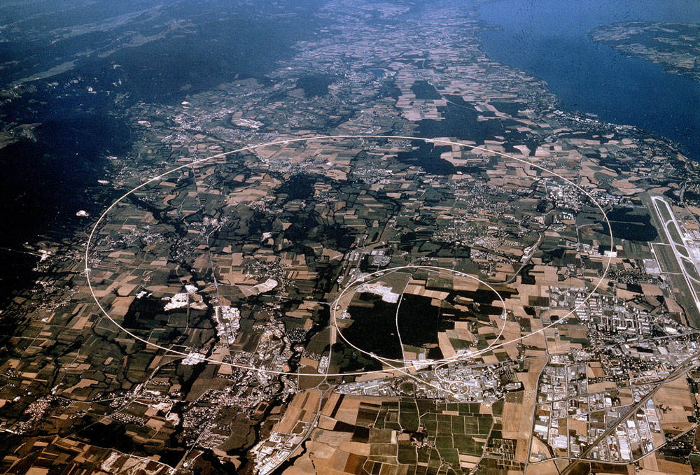
Communication of the European Strategy for Particle Physics
James Gillies, Camilla Jakobsson, Claus Madsen, Arnaud Marsollier,
Vanessa Mexner, Terry O’Connor. Brussels, April 2013

Slide 3
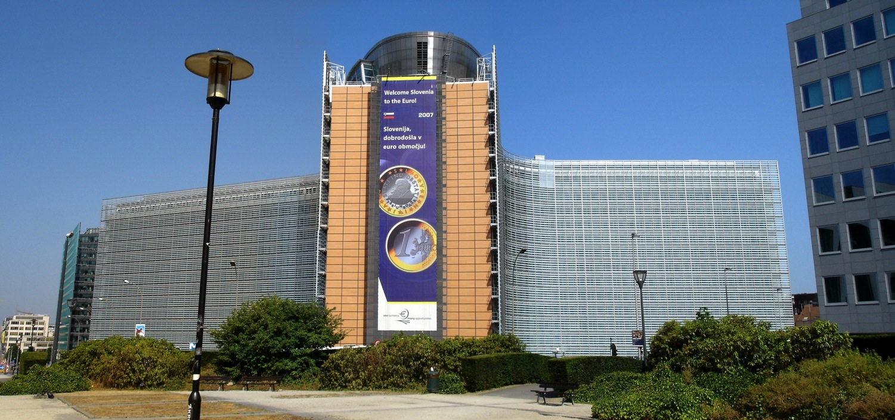
Timetable
CERN Council meeting scheduled for 30 May AM.
Wednesday 29 May
11:00-11:45: Media briefing at the Brussels press club.
12:15-14:15: Working lunch at European Parliament.
Afternoon: Presentation of talking point objects to Council delegates
18:30-19:30: Panel discussion, ‘What do we get from big science?’
19:30-21:00: Buffet dinner hosted by the European Commission.
Thursday 30 May
09:00-11:00: European strategy session of the CERN.
11:30-14:00: Working lunch with the competitiveness council.

Slide 4
Who is going?
Media briefing: President of Council, Director General, Scientific Secretary.
Parliamentary lunch: Invited STOA, ITRE other Euro MP’s with a stake in science. CERN represented by President’s group and committee chairs.
Panel discussion: Invited science Ministers, Commission, science and industry associations, parliamentarians. CERN represented by 10 members of Council and management.
Buffet dinner: Networking opportunity for Council members and panel discussion guests.
Working lunch: Representatives from Competitiveness council and the president’s group from CERN

Slide 5
Panel discussion
Moderator: Katya Adler
Panelists:
Prof. Agnieszka Zalewska, President of the CERN Council
Mr Robert Jan-Smits, Director-General for Research and Innovation of the European Commission
Dr Jan Van Den Biesen, Vice President Public R&D Programmes, Philips Research
Mr Seán Sherlock, Irish Minister of State with responsibility for Research and Innovation
Prof. Maria De Graça Carvelho, Member of the European Parliament

Slide 6
The talking points
Key area 1, Collaborative research:
Ping-pong particle accelerator
Key area 2, Medical & life sciences:
CMS crystals
Neurochip?
Key area 3, Energy & environment:
Solar panel
Key area 4, New technologies:
GEM detector?
Key area 5, Society & skills:
Discover the cosmos
Timepix chip or similar
RASNIK
More ideas for portable demos and good demonstrators?
Demonstrators:
PhD’s, students, teachers, inventors, Langton student, Chris Benvenuti (confirmed)

Slide 7

The Brochure
From the introduction...
“The ambition – to understand the mysteries of matter, space and time – was to advance fundamental research. That remains the ambition, outlined and extended in the strategy document at the heart of this brochure. But on such a scale, even the purest science delivers palpable results with sometimes profound consequences for social and economic wellbeing: the enterprise builds enduring partnerships that transcend national borders; it demands new solutions and it trains a new generation of scientists and engineers.”
On international cooperation…
“… But these machines began as research tools and the teams behind instruments such as CERN’s Large Hadron Collider have pioneered accelerator technology in ways that can only deliver more rewards. CERN leads a number of European Union framework projects calculated to advance skills, enhance standards and share protocols among the rest of the community; and to maintain the momentum of innovation.”
Energy and the environment
“…Beyond the laboratory sites, particle physicists and engineers have collaborated on new and unexpected ways to turn powerful science into power for the people. One of these is a technology originally dreamed up to make solar energy conversion more efficient. It was perfected at CERN in the service of the Large Electron Positron Collider and its successor the LHC, and has now once more found a place in the sun.”

Slide 8
Country information sheets

