Slide 2
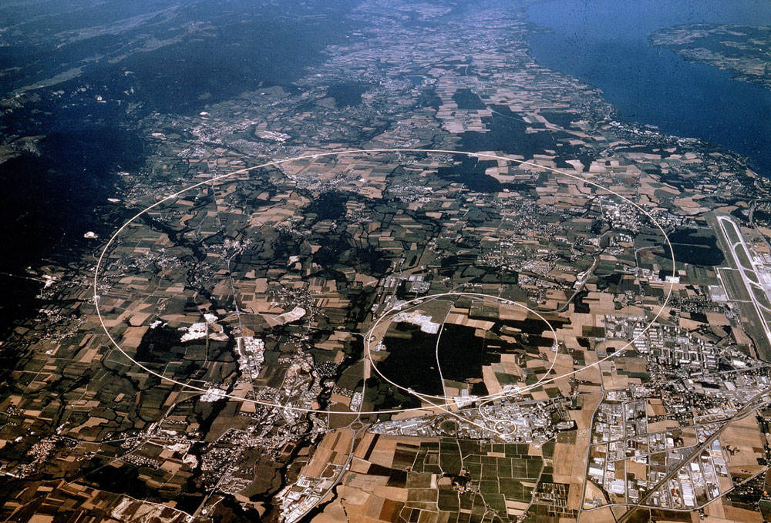
News from CERN
James Gillies, EPPCN, April 2013

Slide 3
News from CERN
National media visits started
MoU ready for signature (almost)
Upcoming press releases
Brussels event – separate presentation
LEP cavities – still getting there
TEDxCERN
Passport to the Big Bang
Open Days

Slide 4


National media visits
Last week… This week…

Slide 5
MOU
Agreement
between
The European Organization for Nuclear Research, an Intergovernmental Organization having its seat at Geneva, Switzerland (hereinafter referred to as “CERN”), represented by James Gillies, head of communication;
and
Agencia Estatal CONSEJO SUPERIOR DE INVESTIGACIONES CIENTÍFICAS (hereinafter referred to as CSIC), with Spanish Tax Code Number Q2818002D, domiciled at c/ Serrano 117, 28006, Madrid, Spain, hereby represented by Francisco Botella Olcina, in his capacity as Director of the Instituto de Física Corpuscular of CSIC, acting on behalf of this State Agency,

Slide 6
Upcoming press releases
LHCb on Bs measurement this week
ALPHA on g
ISOLDE ?
Passport to the Big Bang
Open Days

Slide 7
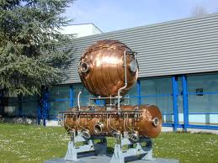
LEP cavities
Copper ones ready to go… we’ll be in touch…
N.B. two requests for research use.

Slide 8
TEDxCERN

Slide 9
TEDxCERN
13:45 Introduction George Smoot, Astrophisicist Auditorium & Webcast only
14:00-15:30 First session
Some Galaxies Maria Ferrante, Soprano
Welcome Sergio Bertolucci, Director of Research, CERN
The Universe: A Detective Story Hiranya Peiris, Cosmologist
What's the Matter We Can't See? TED-Ed / CERN Animation
Networking Chemistry Lee Cronin, Chemist
How to Discover a Planet from Your Sofa Chris Lintott, Astronomer
Seafloor Earthquakes Maya Tolstoy, Marine Geophysicist
Why All Good, and Some Bad, Research Is Improbable Marc Abrahams, Editor
Caffeine Maria Ferrante, Soprano Globe, Auditorium & Webcast
15:30 Break
16:00 I for one welcome our robot collaborators A conversation with Chris Lintott and Tara Shears Auditorium & Webcast only

Slide 10
TEDxCERN
16:15-17:45 Second session
DNA George Church, Geneticist
The Beginning of the Universe, For Beginners TED-Ed / CERN Animation
Gendered Innovations Londa Schiebinger, Historian of Science
Big data TED-Ed / CERN Animation
Science as Voyage Ian Foster, Computer Scientist
What happened to the anti-matter? TED-Ed / CERN Animation
How to make a Neural Network in your Bedroom Brittany Wenger, Scientist
Reach from the stars (Mars edition) Collège International de Ferney-Voltaire Choir Globe, Auditorium & Webcast
17:45 Break
18:15 What's Next George Smoot Auditorium & Webcast only

Slide 11
TEDxCERN
18:30-20:00 Third session
SESAME: A Scientific Source of Light in the Middle East Eliezer Rabinovici, Physicist & Zehra Sayers,Biophysicist
Consciousness & the Brain John Searle, Philosopher
What gives mass to fundamental particles? TED-Ed / CERN Animation
What the Higgs might mean for the fate of the Universe Gian Giudice, Theoretical Physicist
You're Never Too Young To Be a Research Scientist Becky Parker, Teacher
Particles in peace Yaron Herman, Piano & Bijan Chemirani, Percussionis Globe, Auditorium & Webcast
20:00 Webcast wrap up George Smoot Auditorium & Webcast only
20:00-22:30 Reception

Slide 12
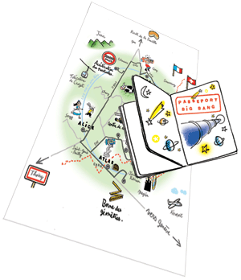
Passport to the Big Bang: June 2

Slide 13

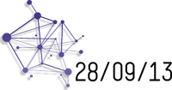
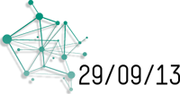
Open Days

Slide 14

Bosons and More

