Slide 1
Aluminum plate for foil stretcher

Slide 2
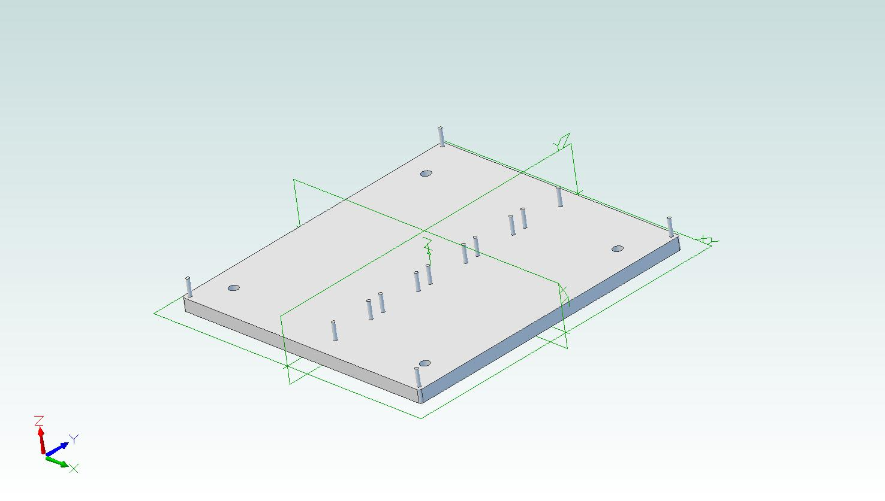

Slide 3
Status of the material: When i get the invoice address i will order it.
Status of the design: Ready
Status of machining: Paths for nc-machine is ready.
Status of the stretcher: Ready.

