Slide 1
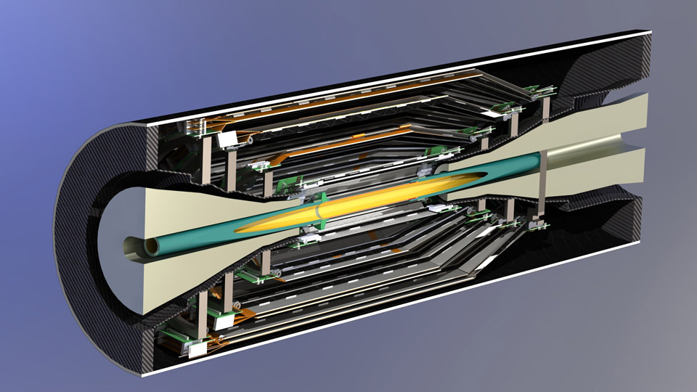

Status of the Silicon Strip Vertex Detector of the Belle II Experiment
Thomas Bergauer (HEPHY Vienna)
Vertex 2013 Lake Starnberg

Slide 2
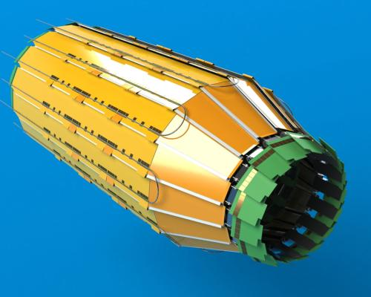
Belle and Belle II
Components
  Sensors
  Electronics
  Mechanics and Cooling
  Ladder assembly
  Mockups
Summary

Slide 3
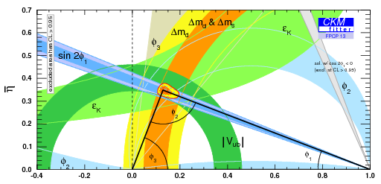
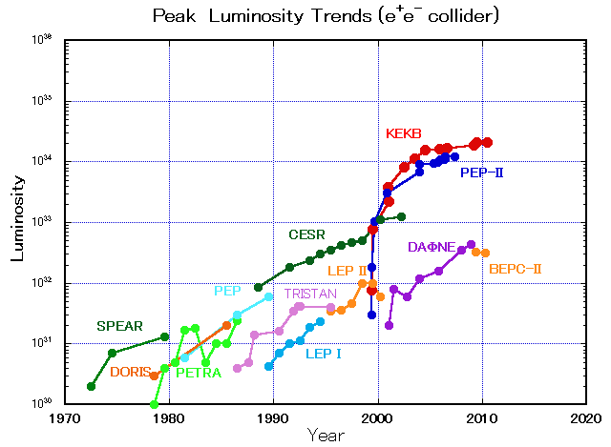
Belle I at the KEKB accelerator (1999-2010)
Belle I:
Measurements of CKM matrix elements and angles of the unitary triangle
CP & T & CPT test
Observation of direct CP violation in B decays
probe for new sources of CPV
KEKB accelerator:
Center of mass energy:
Y(4S) resonance (10.58 GeV)
High intensity beams (1.6 A & 1.3 A)
Integrated luminosity of 1 ab⁻¹ recorded in total
E.Kikutani / M. Masuzawa

Slide 4
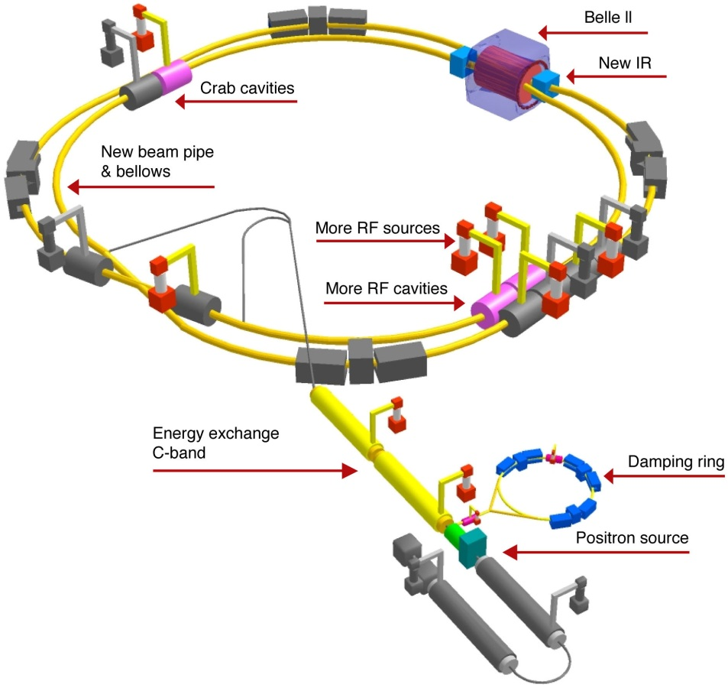
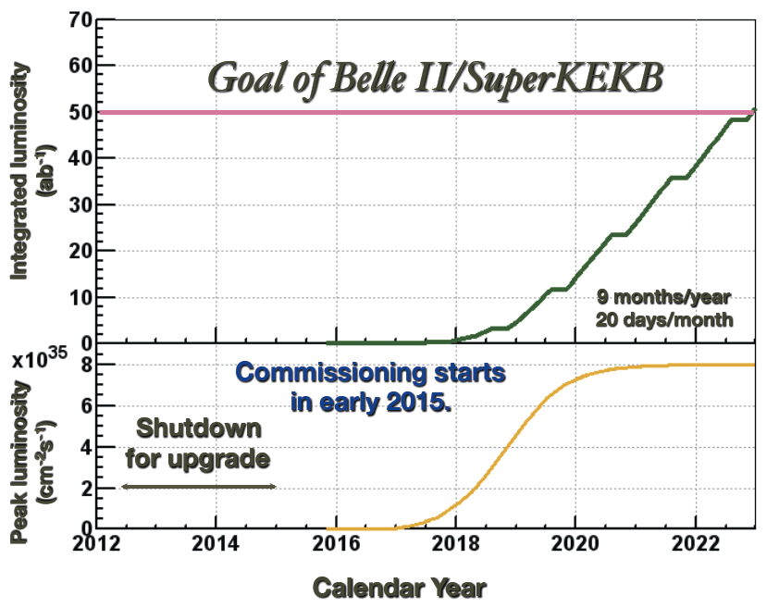
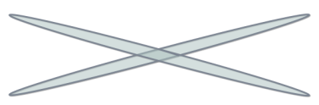


SuperKEKB/Belle II Upgrade: 2010–2015
40-fold increase in peak luminosity to 8×10³⁵ cm⁻²s⁻¹ → 1×10¹⁰ BB / year
50-fold increase in integrated luminosity until 2023 w.r.t. Belle I
Refurbishment of accelerator and detector required
  nano-beams with cross-sections of ~10 µm x 60 nm
  2 cm diameter beam pipe at interaction region
e⁺ 4GeV 3.6 A
e⁻ 7GeV 2.6 A
Crab cavities:
Redesign the lattices of HER & LER to squeeze the emittance

Slide 5
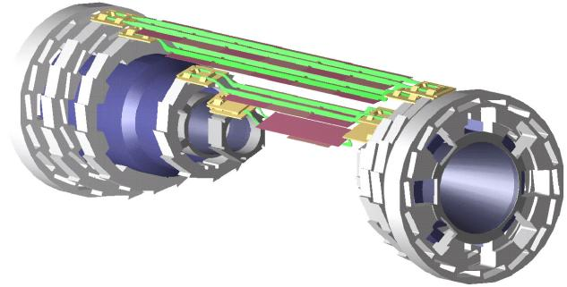
Belle Silicon Vertex Detector (SVD) until 2010
4 straight layers of 4" double-sided silicon detectors (DSSDs)
Outer radius of r~8.8 cm
  Acceptance angle 17°…150°
Up to three 4” sensors were
daisy-chained and read out
by one hybrid located outside
of acceptance region (VA1 chip)

Slide 6
Belle SVD limitations
Previous SVD limitations were
  occupancy
  (10%-18% in innermost layer)
  → need faster shaping or smaller detector elements
  dead time
  → need faster readout and pipeline
Belle II needs detector with
  high background tolerance
  pipelined readout
  robust tracking
  low material budget in active volume
Previous SVD is not suitable for Belle II !

Slide 7
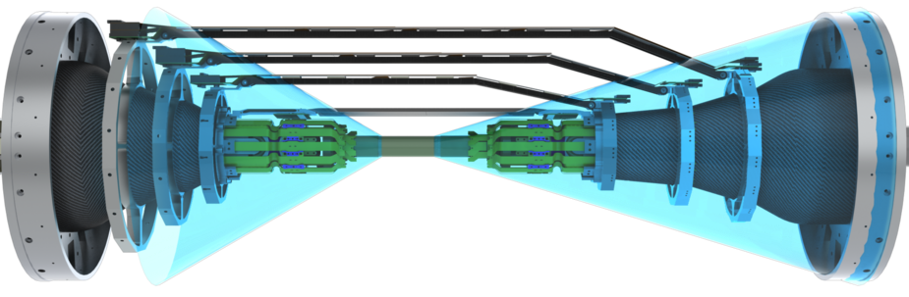
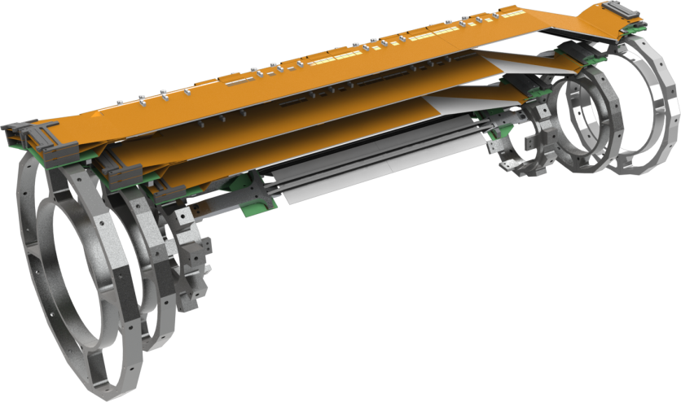
New Layout for Belle II SVD (2015-)
Four layers with 6” double-sided strip detectors at larger radii and forward part
Large, individually read out sensors
FE readout electronics inside acceptance region
Maintain low material budget
  Lightweight mechanics
    Thin cooling pipes (CO₂)
Fast readout
Layer 3 to 6: 4 layers of double-sided strip sensors
Layer 1-2:
Two layers of
DEPFET pixels
Layer | Radius | Ladders
6 | 135 mm | 16
5 | 104 mm | 12
4 | 80 mm | 10
3 | 38 mm | 7

Slide 8
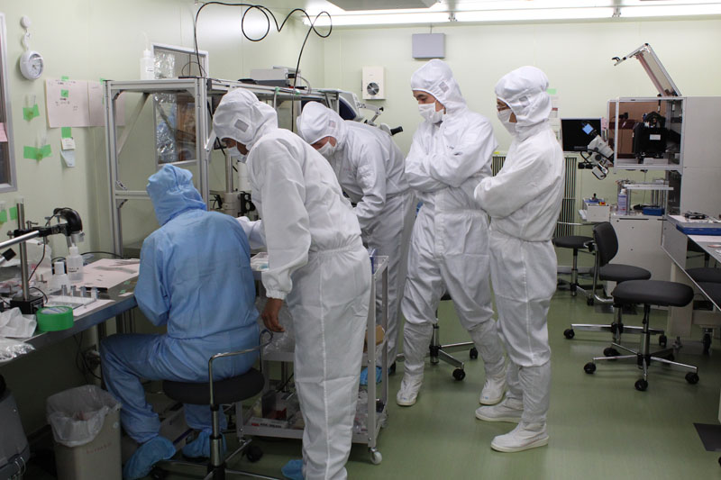
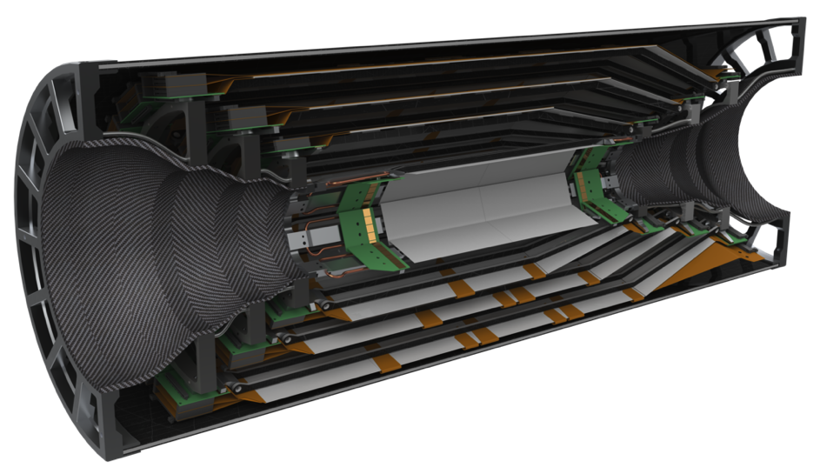
Current Status
Transition from R&D to production phase
Milestones defined by Belle II schedule
  SVD ladder assembly Nov. 2013 – Sept. 2014
  Ladder mount: Sept. 2014 – August 2015
  SVD ready by August 2015
  VXD (PXD+SVD) ready by January 2016
  VXD installation June 2016
Components
  Sensors
  Front-end and backend electronics
  Mechanics design
  CO₂ cooling
  Ladder assembly and lab infrastructure
  Mockups

Slide 9
Belle and Belle II
Components
    Sensors
  Electronics
  Mechanics and Cooling
  Ladder assembly
  Mockups
Summary

Slide 10

Double-sided strip sensors from 6” wafers
Sensor Properties:
Double-sided with perpendicular strips
AC-coupled readout with poly-silicon resistor
N-bulk, 300/320 micron thickness
Three layouts only:
  Rectangular small for layer 3 (HPK)
  Rectangular large for layers 4-6 (HPK)
  Trapezoidal for forward layers 4-6 (Micron)
 | Readout strips(p/Rφ) | Readout strips(n/z) | Readout pitch (p/Rφ) | Readout pitch(n/z) | Sensors # (+ spares) | Active area (mm²)
Large | 768 | 512 | 75 μm | 240 μm | 120+18 | 122.90x57.72 =7029.88
Trapezoidal | 768 | 512 | 50-75 μm | 240 μm | 38+6 | 122.76x(57.59+38.42)/2=5893.09
Small | 768 | 768 | 50 μm | 160 μm | 14+4 | 122.90x38.55 =4737.80

Slide 11
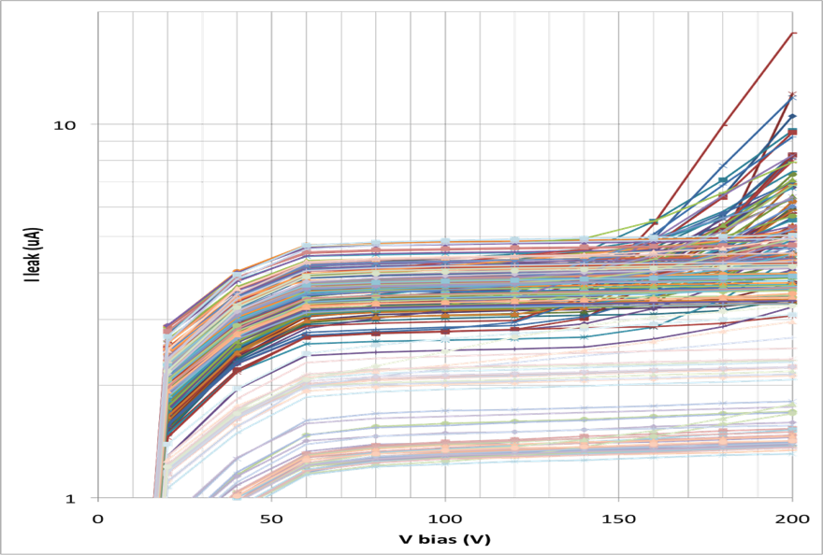
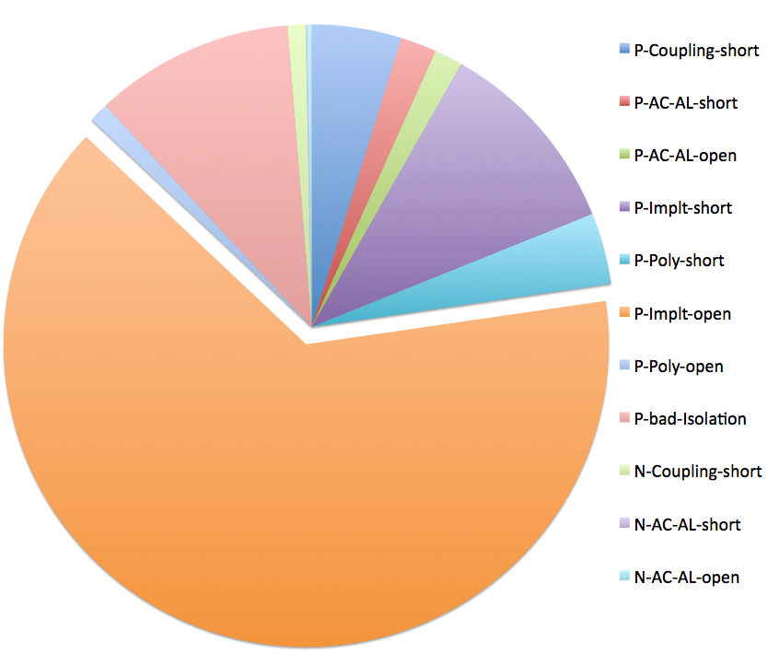
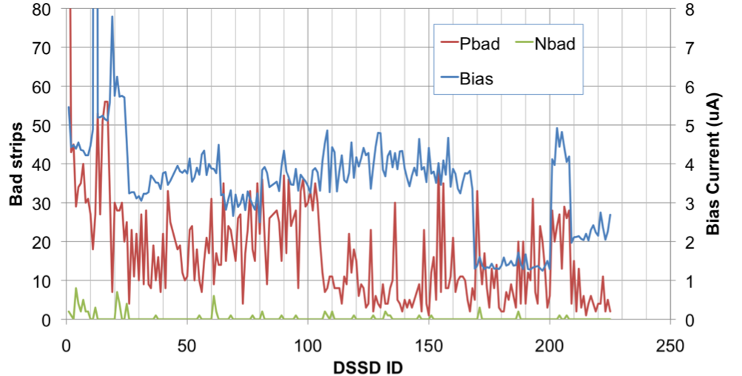
Rectangular sensors (HPK)
Small DSSDs
  Delivery of 24 pcs. scheduled for end of September
  Two mechanical samples available
Large DSSDs:
  Production finished
  150 pcs in hand
Large DSSD IV
Saw dicing
Laser dicing
Prototypes
Number of bad strips
Bad strip ratio =5%
P-implant open
Classification of bad strips (ID>26)

Slide 12

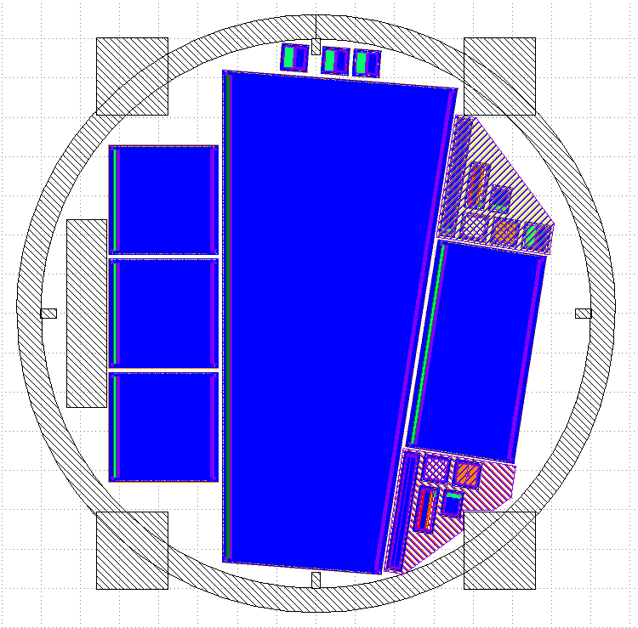
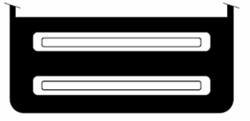
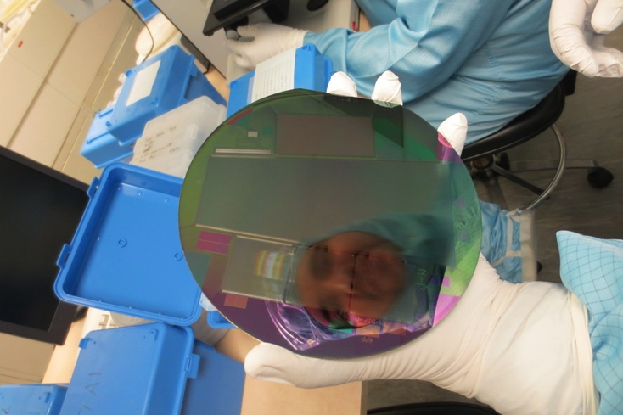
Trapezoidal Sensors for Forward Region
Atoll
Trapezoidal sensor for forward region
Different p-stop layouts on test sensors
Each layout type with four variants (narrow/half narrow/ wide / half wide)
  Testbeam and irradiation study to determine best structure
Common
Combined

Slide 13
eta distribution for atoll p-stop
Charge accumulation in unimplanted region

Slide 14
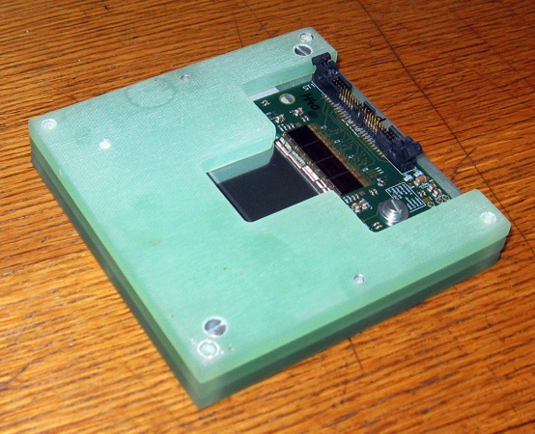
Signal-to-noise-ratios
Test sensors have been Gamma-irradiated with Co-60 (70 Mrad) in Mol (Belgium)
Tested before and after at CERN beam test (H6A 120 GeV hadrons)
Dark colors: non-irradiated, Light colors: irradiated
Atoll pattern (half-wide) performs best, both irradiated and non-irradiated
  Chosen for final sensor, 100 wafers currently being processed by Micron

Slide 15
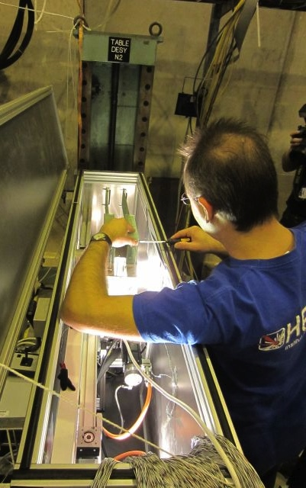
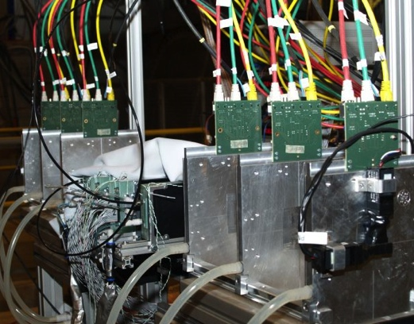
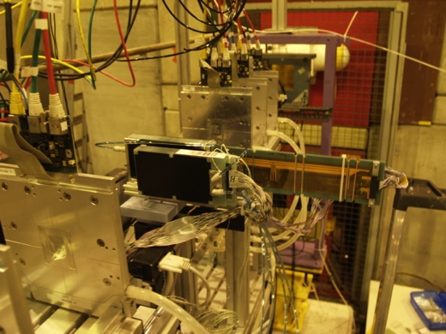
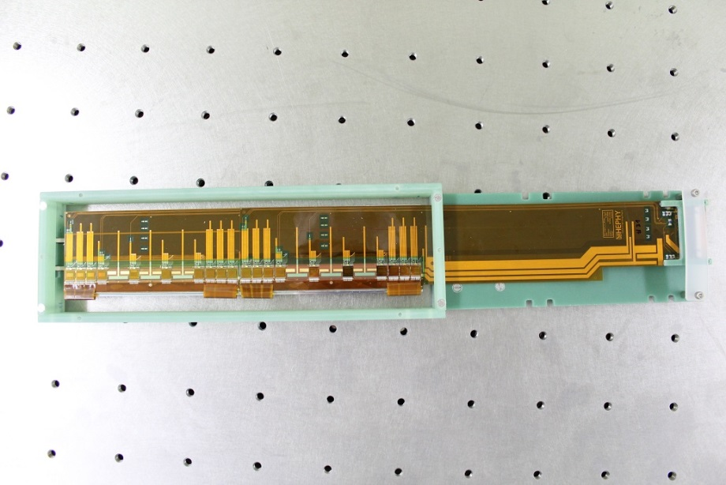
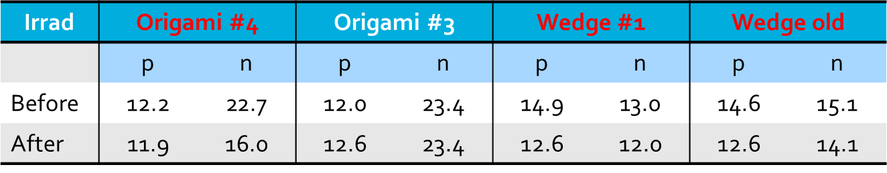
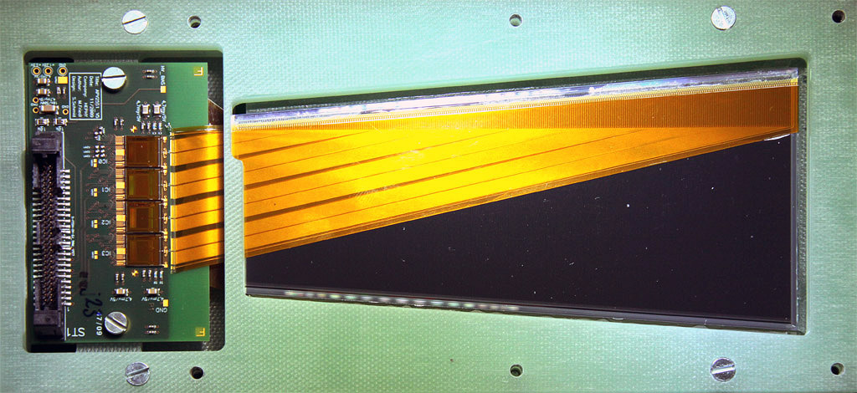
Beam test results
Performance of full modules verified in several beam tests at CERN (2008-2012)
  Including CO₂ cooling
  Using EUDET and own beam telescope
Double Origami module
FW wedge module

Slide 16
Belle and Belle II
Components
  Sensors
  Electronics
  Mechanics and Cooling
  Ladder assembly
  Mockups
Summary

Slide 17
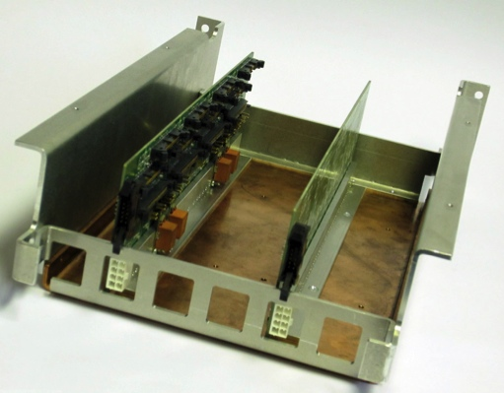
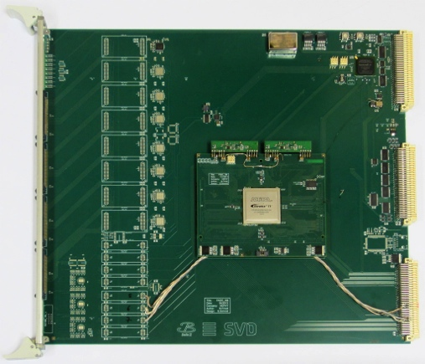
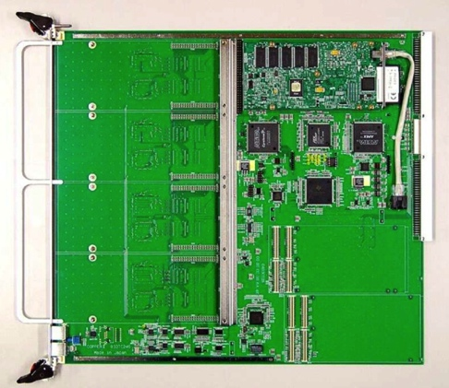
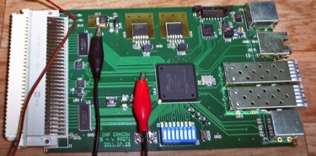
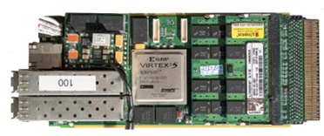
Readout System Concept
Crates on top of Belle II
Electronics Hut
Inside of SVD
Belle II DAQ system
Optical link (>20m)
48 FADC+PROC
~2m
cable
8 DOCK
boxes
COPPER
1748 APV25 chips
~10m
cable
48 FTB
Front-end hybrids
Rad-hard
DC/DC
converters
DatCon system
Analog level translation,
data sparsification and
hit time reconstruction
AMC board
PXD
Find RoI
DOCK
FADC+PROC
FTB
COPPER
AMC board

Slide 18
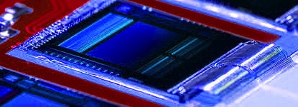
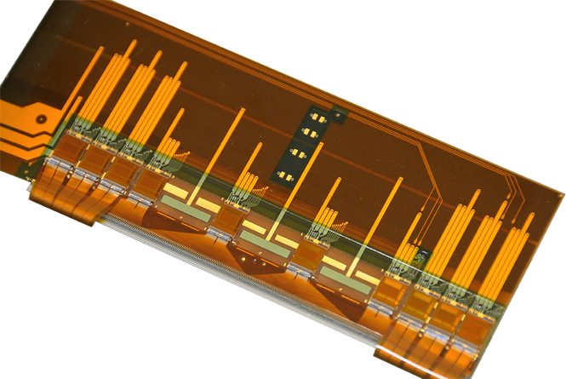
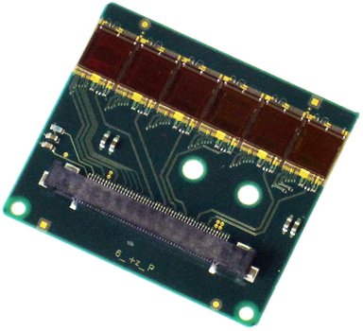
Readout Chip: APV25
Developed for CMS (LHC) by Imperial College London and Rutherford Appleton Lab
  70.000 chips installed
0.25 µm CMOS process (>100 MRad tolerant)
128 channels
192 cell analog pipeline
→ almost no dead time
50 ns shaping time → low occupancy
Multi-peak mode (read out several
samples along shaping curve)
Noise: 250 e + 36 e/pF
→ must minimize capacitive load!!!
Thinning to 100µm successful
APV25
Origami FE
FW+BW FE

Slide 19
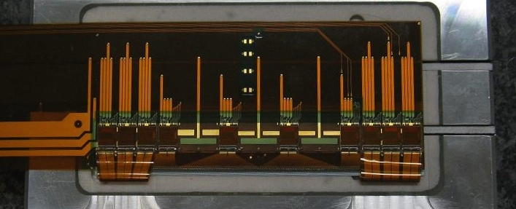
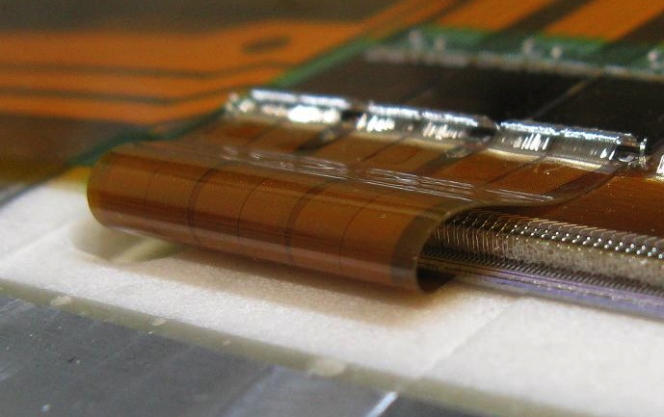
Origami Chip-on-Sensor Concept
Chip-on-sensor concept for double-sided readout
Flex fan-out pieces wrapped to opposite side (hence “Origami“)
All chips aligned on one side → single cooling pipe
APV25
Bonding wire
Airex
(Polymer foam)
DSSD

Slide 20
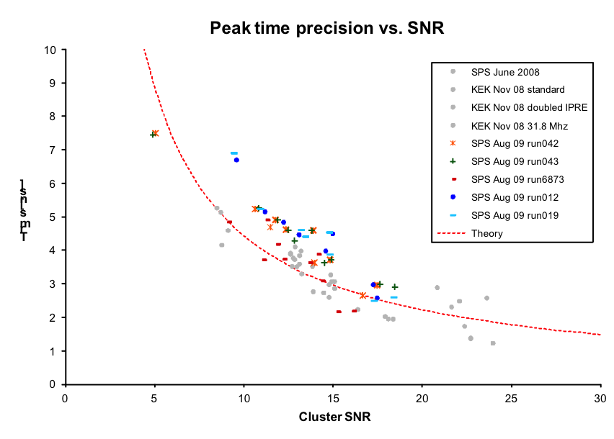
APV25 – Hit Time Reconstruction
Possibility of recording multiple samples (x) along shaped waveform (feature of APV25)
Reconstruction of
peak time (and
amplitude)
by waveform fit
  Using LUT in FPGA
Is used to
remove off-time
background hits
2...3 ns RMS
accuracy at
typical S/N
Measurement

Slide 21
Occupancy Reduction Belle -> Belle II

Slide 22
Belle and Belle II
Components
  Sensors
  Electronics
    Mechanics and Cooling
  Ladder assembly
  Mockups
Summary

Slide 23
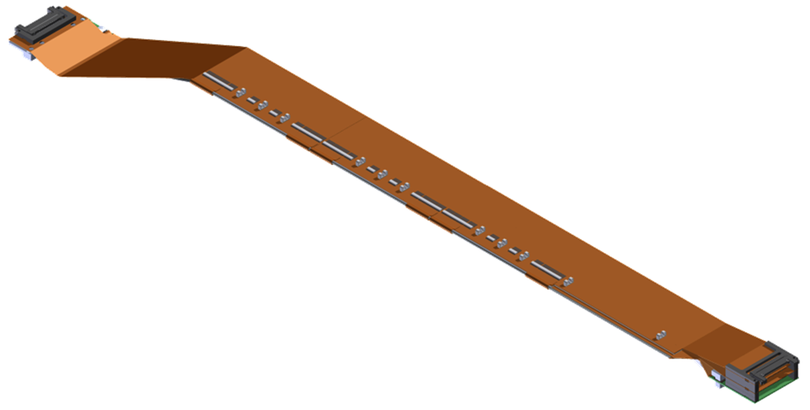
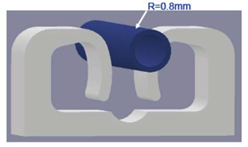
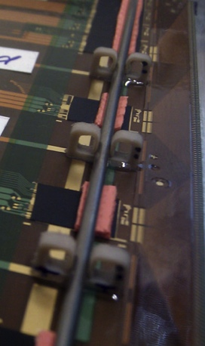
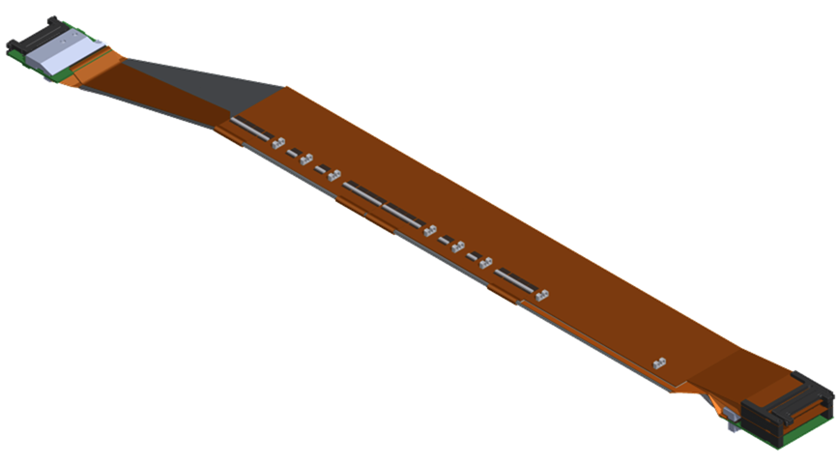
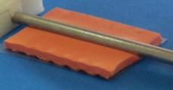
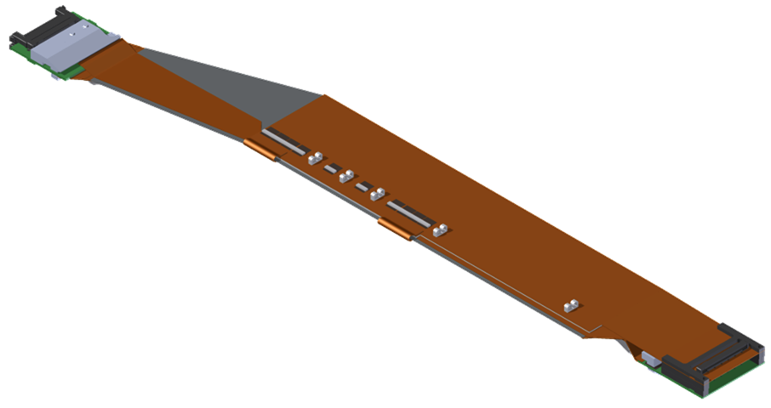
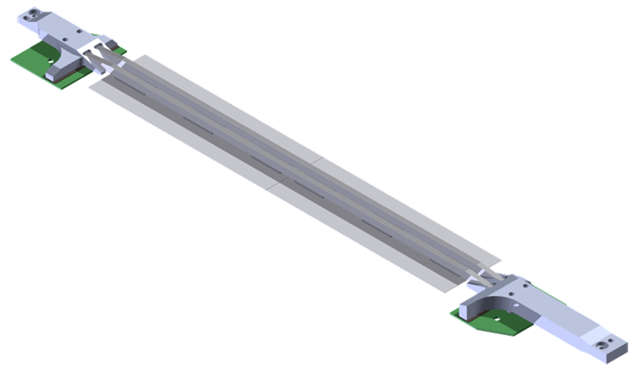
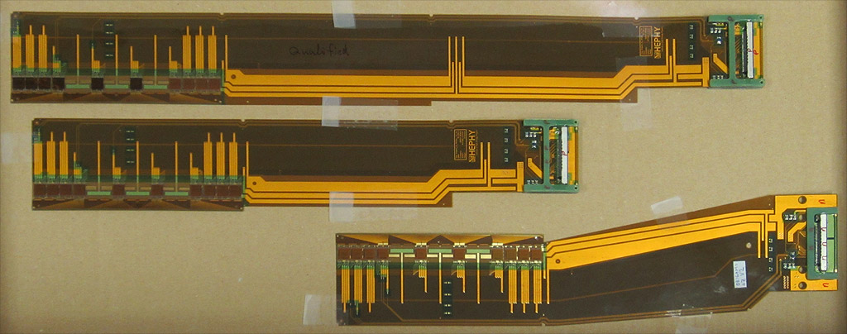
SVD Ladders
FW module
FW r/o
Clamp holding CO₂ pipe on APV
L6 Ladder
Origami module
BW r/o
L5 Ladder
Origami module
Cooling pipe
Thermally
conductive
gap pad
FW r/o
Origami module
L4 Ladder
L3 Ladder
BW r/o
BW module
Cooling pipe
Cooling pipe
  Pipe Outer ∅ 1.6 mm

Slide 24
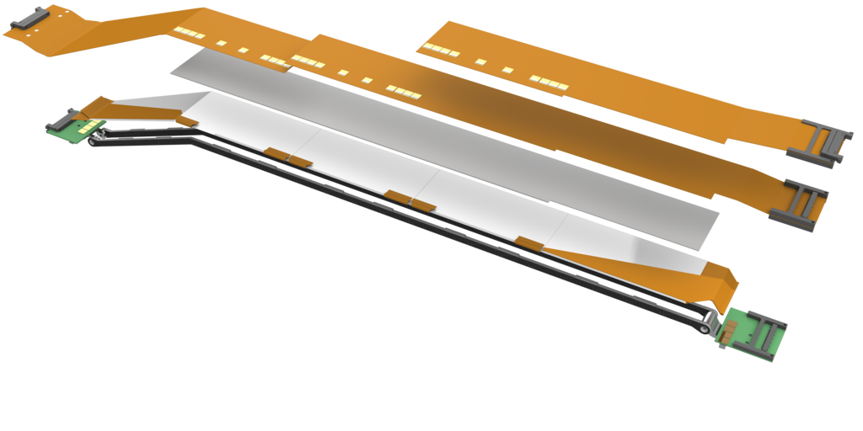
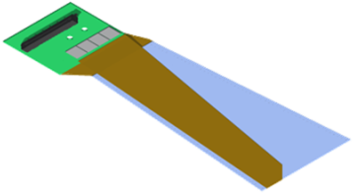
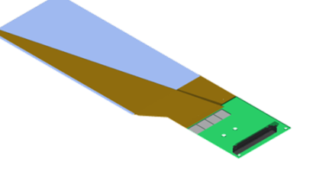
Ladder of Layer 6
Origami flexes
APV25 chips
PCB Hybrid
Possible separate modules:
Airex spacer
Silicon Sensors
Pitch adapters
FW module
BW module
Ribs
PCB Hybrid
Basic element “atomic unit” is one ladder
Only FW and BW module can be assembled independently
No single Origami module with one sensor possible

Slide 25
Material Budget of a ladder
Largest peak contribution by
  Cooling pipe
  Support ribs
Components:
Single cooling pipe
Thinned APV25 (100µm)
3-layer flex circuit
Connection to Strips:
  PA on top side
  wrapped PA for bottom
1mm Airex sheet
6” DSSD
CF support ribs
n-side
p-side
Average Material Budget: 0.59%X₀

Slide 26
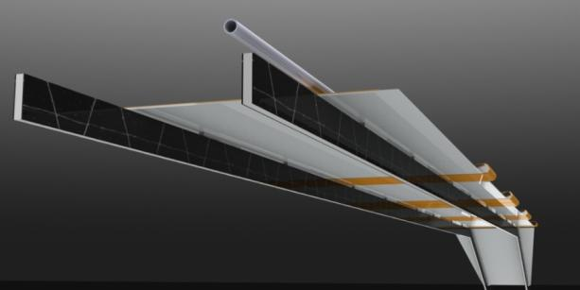
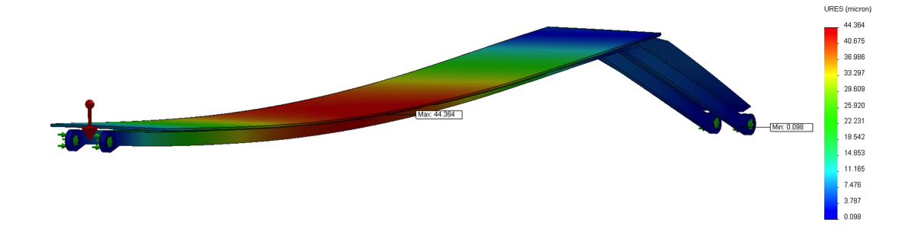
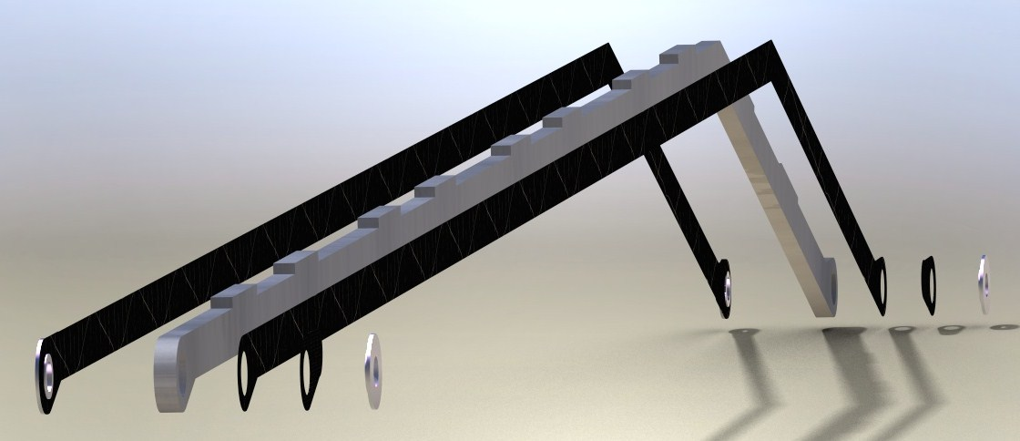

Support Ribs
Sensor
3mm Airex core with laminated 0.15mm CF sheets
Very stiff, yet lightweight thanks to the sandwich construction
Sag max. 44 μm
Support Ribs
Sag max. 66 μm

Slide 27





CO₂ cooling system
IBBelle Prototype “MARCO” (Multi-Purpose Apparatus for Research in CO₂)
  Power ~ 1 kW
Based on concept by NIKHEF (B. Verlaat)
CO₂ plant shared with PXD
Development in collaboration between PXD group (MPI), CERN and NIKHEF
Ladder production sites uses small open (blow) CO₂ system
Control cabinet with touch screen
Accumulator
1.6 m
Vienna open CO₂ system
1.2 m
1.3 m
Liquid pumps

Slide 28
Belle and Belle II
Components
  Sensors
  Electronics
  Mechanics and Cooling
  Ladder assembly
  Mockups
Summary

Slide 29

SVD ladder assembly flow
Three modules types:
  Forward (FW)
  Backward (BW)
  Origami
Ladder assembly sites:
Layer | Institute
3 | Melbourne (AUS)
4 | TIFR India @ IPMU
5 | HEPHY Vienna (AT)
6 | Kavli IPMU (Japan)
FW & BW | INFN Pisa (possibly)

Slide 30






Assembly Jigs
Huge number of different jigs
(up to 17) necessary:
XYZθ-stage
Sensor jig
Assembly base
Assembly bench

Slide 31

Alignment of Jigs
Using linear bushings (+0/-13µm) & precision pins (g6)
Assembly base & bench are reference
  All linear bushings are fixed bearings → high precision holes (H7)
All other jigs are aligned to them, e.g. Sensor jig
Aligned bearing
Linear Bushing
Sensor Jig
Fixed bearing
Assembly Bench
Precision Pin
Assembly Base

Slide 32






Ladder assembly equipment
Coordinate Measurement machines (Mitutoyo)
Glue dispensing robots
  CMM used as glue robot in Vienna
Fully-automatic wire bonders
(lot of) manpower and ideas
Automatic wire bonder
Choonpa Co. REBO-7W
IPMU(borrowed KEK)
Automatic wire bonder
Delvotec 6400
HEPHY, TIFR)
CMM modified for
Glue dispersion
(HEPHY)
CMM
Mitutoyo QV606
(IPMU)
Travelling trolley for vacuum tube
CMM
Mitutoyo Euro-C776
(HEPHY)

Slide 33















Ladder assembly procedure
alignment
w/ XYZθ-stage
Two weeks per ladder expected
Bonding/glue-curing interlaced
DSSD
Assembly-jig
…
Finish
Animation of (simplified) procedure

Slide 34
Belle and Belle II
Components
  Sensors
  Electronics
  Mechanics and Cooling
  Ladder assembly
  Mockups
Summary

Slide 35




Mockup IR-PXD-SVD
mockup study
@ KEK

Slide 36

Going real!
Mockup IR-PXD-SVD

Slide 37


PXD+SVD Testbeam @ DESY
Test of “full” VXD
  2 Layers DEPFET
  All 4 layers of SVD (one sensor per layer only)
  Inside PCMAG superconducting magnet
  MARCO CO₂ cooling plant
  Full readout chain
4 weeks beamtime at DESY TB24 in January 2014
  Connectivity test end of June in Vienna to test connection between SVD FADC, FTB, DataCon
  Installation in zone starting end of November 2013

Slide 38
Belle and Belle II
Components
  Sensors
  Electronics
  Mechanics and Cooling
  Ladder assembly
  Mockups
Summary

Slide 39

Summary
SuperKEKB will be the highest luminosity machine in the world
Belle II detector will consist of new,
enlarged Silicon Vertex Detector
  2 layers DEPFET Pixels (PXD) and
  4 double-sided strip layers (SVD)
Strip Detector (SVD)
  Double Sided Strip Detectors
    Optimal p-stop geometry identified by SNR measurements before and after irradiation
  Chip-on-sensor readout scheme, named Origami, for outermost three layers for low material budget, using CF ribs and CO₂ cooling
  Readout with hit time reconstruction for improved background tolerance
  Mass production of ~50 ladders starts this fall, SVD ready by 2015

Slide 40
Backup Slides follow
The End.

Slide 41


Belle Detector (1999–2010)
Aerogel Cherenkov counter
n=1.015~1.030
SC solenoid
1.5 T
3.5 GeV e⁺
CsI(Tl)
16 X₀
TOF counter
8 GeV e⁻
Central Drift Chamber
small cell +He/C₂H₅
Si vertex detector
4 layers DSSD
µ / K_{L} detection
14/15 lyr. RPC+Fe

Slide 42
Belle II Detector
K_{L} and muon detector:
Resistive Plate Counter (barrel outer layers)
Scintillator + WLSF + MPPC (end-caps, inner 2 barrel layers)
EM Calorimeter:
CsI(Tl), waveform sampling (baseline)
(opt.) Pure CsI for end-caps
Particle Identification
Time-of-Propagation counter (barrel)
Prox. focusing Aerogel RICH (fwd)
electron (7GeV)
Beryllium beam pipe
2cm diameter
Vertex Detector
2 layers DEPFET + 4 layers DSSD
positron (4GeV)
Central Drift Chamber
He(50%):C2H6(50%), Small cells, long lever arm, fast electronics

Slide 43

Spatial Resolution of the Belle II Detector
Notes:
Slide 2 on the PXD – MC simulation to define the thickness of the DEPFET sensor

Slide 44
Sensor Types and Vendors
Layer | # of Ladders | Rect. Sensors [narrow] | Rect. Sensors [wide] | Wedge Sensors | APVs
6 | 16 | 0 | 64 | 16 | 800
5 | 12 | 0 | 36 | 12 | 480
4 | 10 | 0 | 20 | 10 | 300
3 | 7 | 14 | 0 | 0 | 168
Sum: | 45 | 14 | 120 | 38 | 1748

Slide 45

HPK Pinholes

Slide 46




Sensor Parameters
Rectangular Sensors
Trapezoidal Sensors

Slide 47


Current Barrel Layout
Layer | Sensors/ Ladder | Origamis/ Ladder | Ladders | Length [mm] | Radius [mm] | Slant Angle [°]
3 | 2 | 0 | 7 | 262 | 38 | 0
4 | 3 | 1 | 10 | 390 | 80 | 11.9
5 | 4 | 2 | 12 | 515 | 104 | 16
6 | 5 | 3 | 16 | 645 | 135 | 21.1
Origami
Cooling Tubes
Slanted Sensors
Hybrid Boards

Slide 48


Origami Prototype Modules
Single Origami module (layer 4)
Double Origami module (layer 5)

Slide 49

Material budget
DSSD+ Origami | Rib | DSSD | Airex sheet | Origami | CO2 Cooling | 100 μm Glue | Total
HPK+1ORIGAMI | 0.035 | 0.340 | 0.055 | 0.133 | 0.037 | 0.033 | 0.593
HPK+2ORIGAMI | 0.035 | 0.340 | 0.055 | 0.266 | 0.037 | 0.033 | 0.733
Micron | 0.035 | 0.320 | 0.055 | 0 | 0 | 0.011 | 0.421
Micron+ORIGAMI | 0.035 | 0.320 | 0.000 | 0.133 | 0 | 0.033 | 0.576
PA/PE/PB/SMD/ are neglected.
Thickness of epoxy glue in ladder assembly is assumed to be 100 μm, or, 0.033 % X₀.

Slide 50


Breakdown of material budget
Origami +Z flex
Glue
Origami CE flex(length 450mm)
Airex
Origami −Z flex
…Three Cu layer FLEX
(Taiyo Co.)
PF2
DSSD
PF1
PA1
Ribs…
Airex foam sandwiched by
Carbon fiber ribs
PA2
PB2
Ribs
L6 ladder explosion view
Glue…Araldite 2011
PB1

Slide 51
Comparison VA1TA – APV25
VA1TA (SVD)
Commercial product (IDEAS)
Tp = 800ns (300 ns – 1000 ns)
no pipeline
<10 MHz readout
20 Mrad radiation tolerance
noise: ENC = 180 e + 7.5 e/pF
time over threshold: ~2000 ns
single sample per trigger
APV25 (Belle-II SVD)
Developed for CMS by IC London and RAL
Tp = 50 ns (30 ns – 200 ns)
192 cells analog pipeline
40 MHz readout
>100 Mrad radiation tolerance
noise: ENC = 250 e + 36 e/pF
time over threshold: ~160 ns
multiple samples per trigger possible (Multi-Peak-Mode)

Slide 52
Status of Belle II Readout Electronics
Pre-production is driven by DESY beam test (January 2014)
  first version of all boards to be used there
Design is done; most parts of hardware exist already
✓
✓
✓
Ready and tested
✓
✓
✓
PCBs ordered,
expected soon
✓
✓
✓
PCB being designed
✓
✓

Slide 53
Cooling Boundary Conditions
Power dissipation per APV: 0.40 W
1 Origami sensor features 10 APVs
heat amount [W] | APV | pipe | end-ring | cone (L3/4) | cone (L5+6) | cable | Origami | hybrid | total
end-ring (FWD) | 92.8 | 20.0 | 7.0 | 18.9 | 13.8 | 29.2 |  | 13.3 | 195.0
end-ring (BWD) | 92.8 | 15.0 | 9.1 | 32.2 | 6.8 | 29.2 |  | 13.3 | 198.4
Origami (L6) | 94.0 | 19.6 |  |  |  |  | 7.4 |  | 121.0
Origami (L5+4) | 68.0 | 20.0 |  |  |  |  | 5.2 |  | 93.2
total | 347.6 | 74.6 | 16.1 | 51.1 | 20.6 | 58.4 | 12.6 | 26.6 | 607.6
Total SVD power dissipation: 607 W

Slide 54

Baseline Schedule
set up production sites and build prototypes
Start of SVD assembly
SVD ready

Slide 55






Mechanics
Carbon Fiber Cones
rib
End rings
With integrated
Cooling channels
insert
APV25 cover
Individual rings for L5, L6
Combined L3+4 end rings
End mount
BWD
Kokeshi pin
= origin of ladder

Slide 56


Glue Dispension
Varying pressure
Bonding
region
Y
Varying curing time
Bonding
region
(0,0)
X

Slide 57

Idea of Ladder Mount Stage
Rotation axis
with encoder
SVD cone and end ring on the CFRP rod
Coordinate measurement
PRELIMINARY!!!
Ladder mount arm
16 September 2013

