Slide 1

Novel Powering Schemes for Pixel and Tracking Detectors
Lutz Feld
RWTH Aachen University
22ND INTERNATIONAL WORKSHOP ON VERTEX DETECTORS
16-20 SEPTEMBER 2013, LAKE STARNBERG

Slide 2
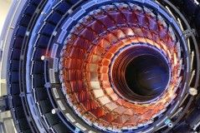
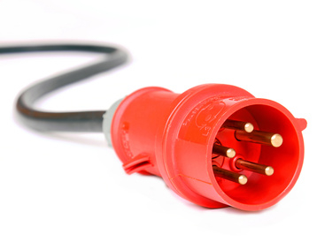
Outline
The Power Challenge
Powering Options
  Serial Powering R&D
  DC-DC Powering R&D
Implementation of DC-DC powering into the CMS Pixel System
  System design
  System test results
Summary

Slide 3
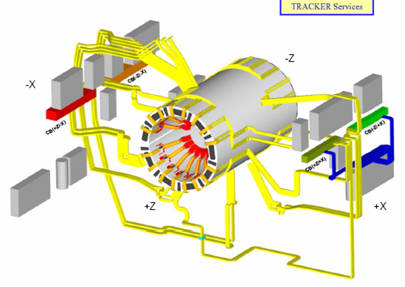
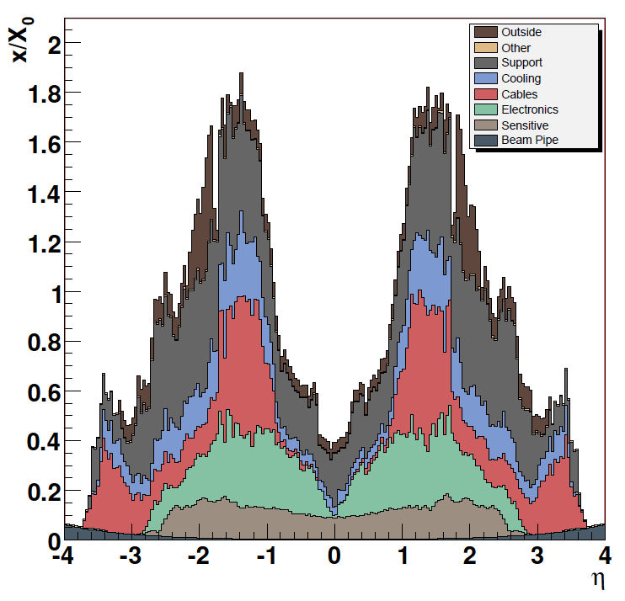
Powering today
Example: CMS tracker
~15’000 modules in
~2000 power groups
ASICs supplied at 2.5V and 1.25 V
front-end power: 33 kW
total current: 15 kA
cable length ~50m
loss in cables: 34 kW
cable channels fully used
29 racks with up to 6 crates
of power supply modules
CMS Tracker cable routing
cables
50% power lost in cables
CMS Tracker material budget

Slide 4
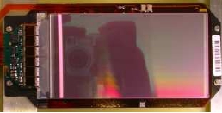
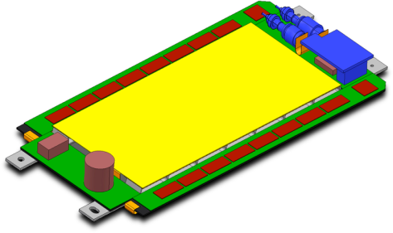
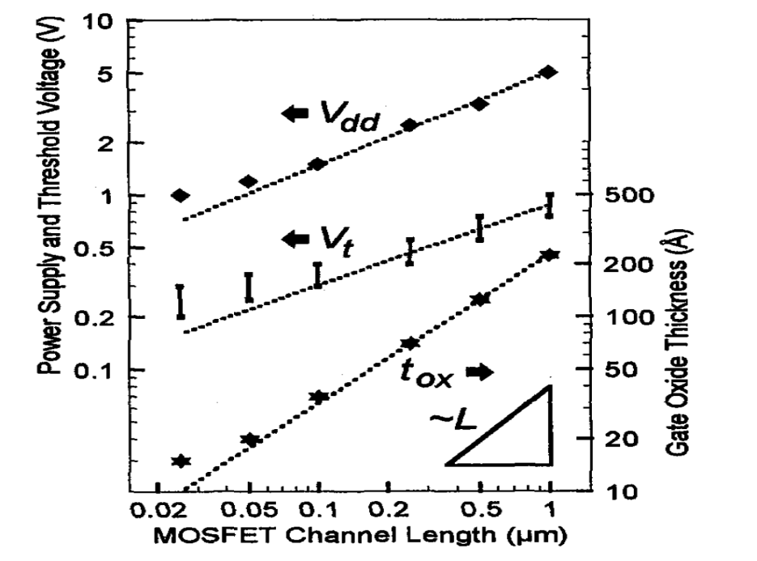
The Power Challenge
higher channel density
  pattern recognition
  resolution
more functionality
  hit correlation (triggering)
  A/D conversion
  sparsification
  …
higher speed
technology scaling
  250 nm → 130 nm → 65nm → …
  decreasing power per transistor
  2.5V → 1.5V → 0.9V → …
  decreasing voltage margins
upgradePS
today
6.1x11.7cm²
768+768 channels
P(FE-ASICs)=3.6W
50mW/cm²
4x10cm²
2000+33000 ch.
P(FE-ASICs)=4W
100 mW/cm²
[Y. Taur, VLSI-TSA, 1999]

Slide 5
Implications at the System Level
again CMS tracker as example:
front-end power 35kW →70kW
front-end supply voltage 2.5V → 1.25V
front-end current increases by factor 4
cable losses increase by factor 16
cannot increase conductor cross-section to compensate
should rather be reduced to improve material budget
need a novel powering scheme which
is able to provide more power
at a lower current
with sufficient voltage control at modules
with sufficient slow control features
with sufficient fault tolerance
with minimal extra material

Slide 6
Possible Solutions
add circuitry to each ASIC so that it can be supplied with 2.5V or higher
  e.g. 2:1 charge pump
  is widely used for CPUs
  adds passive components next to each ASIC
  switching noise may interfere with signal read-out
add circuitry so that a number of modules can be supplied with 2.5V or higher
  e.g. DC-DC converter (charge pump or buck converter)
  fewer components than in 1.
  switching noise still an issue but further away from signal path
cascade modules
  derive required voltages from the same current flowing through a chain of modules
  rather different from today’s powering scheme
implemented in several ASICs
(ATLAS FE-I4, CMS CBC, …)
not covered in this talk

Slide 7
Power Distribution Options
Conventional Powering
well established
excessive cable losses
PS
module
module
P = U·I = (rU) ·(I/r)
→ supply power at higher voltage i.e. lower current
→ cable loss P_{loss}=R·I² is reduced by factor r²!
thinner and less cables
material budget reduction
DC-DC Powering r=conversion ratio
system design is kept simple and close to current systems
only one new component
switching noise is a concern
PS
DC-DC
module
DC-DC
module
Serial Powering r=number of modules in chain
no switching
each module has different ground potential
modules in a chain are coupled, need safety features
PS
shunt
shunt
module
module

Slide 8
Serial Powering in more Detail
current determined by biggest load in the chain
load variations in a module can affect the whole chain
read-out and control signals must be AC or opto coupled
apart from this, additional components are small ICs
with many modules in the chain the gain factor r can be quite high (e.g. 10-20)
current source
bypass shunt
shunt regulator
module
bypass shunt
shunt regulator
module
bypass shunt
shunt regulator
module

Slide 9
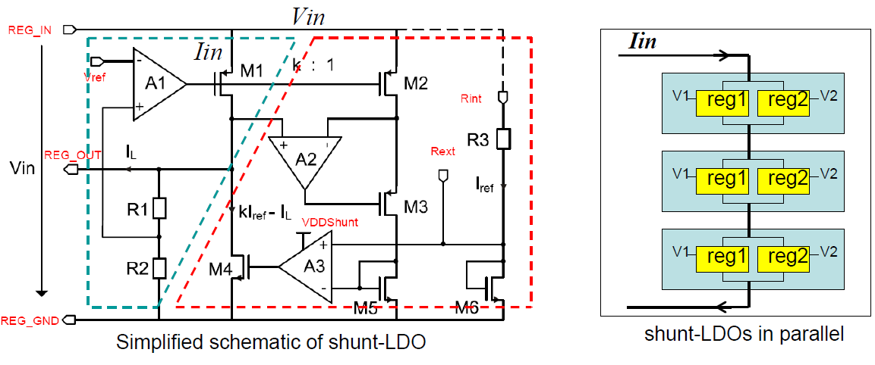
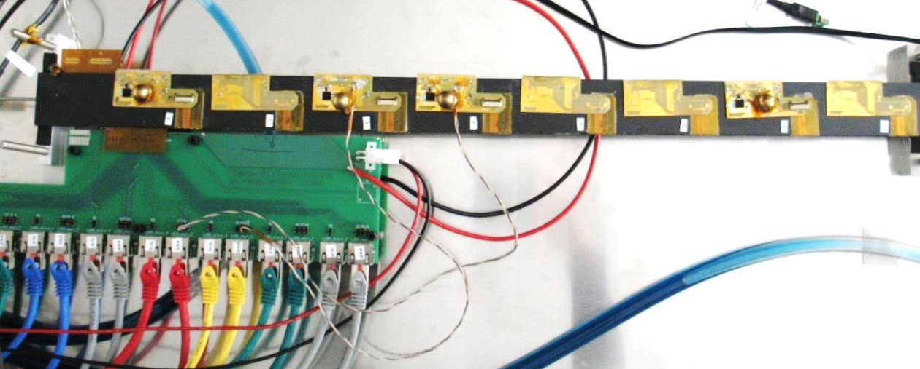
Serial Powering: ATLAS Pixel
serial power chain of 4 modules on a stave
Module 8
Module 6
Module 5
Module 2
End of stave card
ShuLDOs can be operated in parallel
→ different voltages can be supplied
LVDS + NTC
Power cable
Faulty TABs – not used
shunt
LDO
Stability test: make module noisy by lowering the threshold
 | Noise (e⁻)
Noisy module | Module 8 | Module 6 | Module 5 | Module 2
No noisy module | 131.2 | 145.1 | 144.6 | 130.8
Module 8 | --- | 149.1 4 | 148.4 3.8 | 133.3 2.5
Module 6 | 134 2.8 | -- | 147.4 2.8 | 134.2 3.4
Module 5 | 134.5 3.3 | 150 4.9 | -- | 134.2 3.4
measured noise increase of max 5e⁻ on the other modules in the chain is not of concern
[thanks to Laura Gonella for the Bonn group]

Slide 10
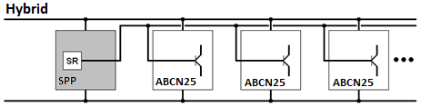
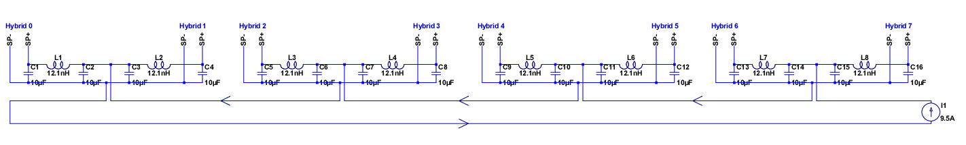
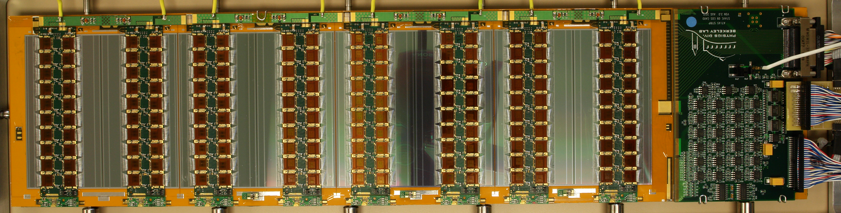
Serial Powering: ATLAS Strips
Distributed SP Architecture
  Shunt transistors within ABCN25 FE ASIC, 20 per hybrid
  One control block per hybrid (SPP chip or commercial parts)
Three short (8 hybrid) prototypes built
  Some with protection circuitry (SPP chip commercial parts)
  Good results in “Chain of Modules” Configuration
Longer (24 hybrid) prototype to follow in the coming months
  With integrated protection from SPP chip
Distributed SP Architecture (within the hybrid)
0V
2.5V
5V
7.5V
10V
[thanks to Peter Phillips (RAL)]

Slide 11
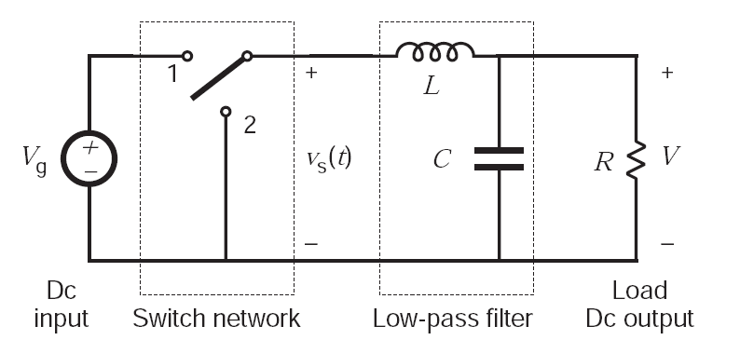
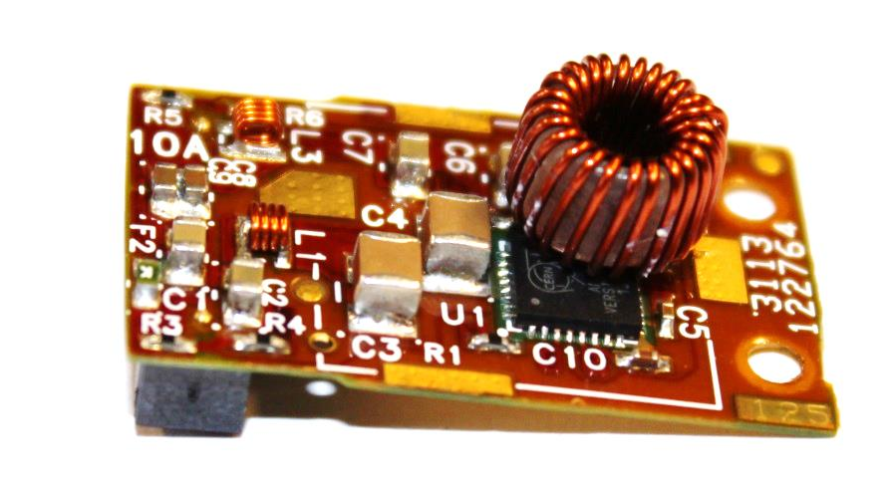
DC-DC Powering: Buck Converters

Slide 12
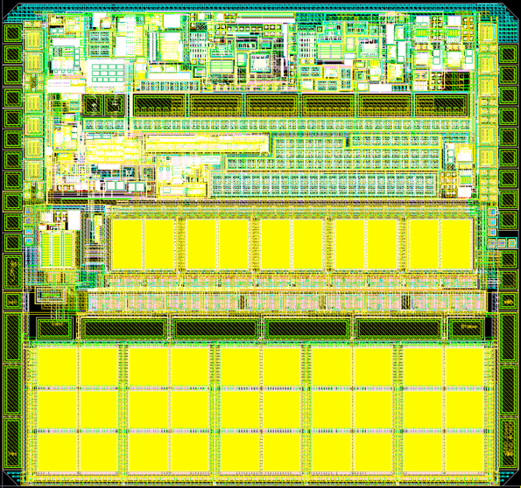
Converter ASIC Development at CERN
several iterations: AMIS4/5, FEAST
developed by CERN-PH-ESE (St. Michelis, F. Faccio)
radiation-tolerant design in AMIS I3T80 0.35µm CMOS technology (ON Semiconductor): TID above 200Mrad,
displacement damage up to 7e14 1MeV neutrons/cm²
I_{out} < 3A, more is possible with proper cooling
V_{in} < 12V
f_{s} configurable from 1MHz to 3.5MHz
V_{out} adjustable from 1.2V to 4V
control
circuits
T1
T2
AMIS5
[Stefano Michelis, TWEPP 2012]
CMS phase-1 pixel system
Vin=10V, L=460nH, Vout=2.5V, f=1.7MHz
[2012 JINST 7 C01072]

Slide 13
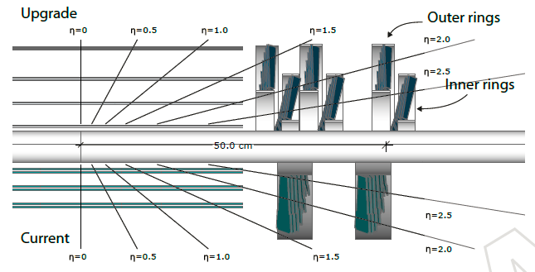
CMS Pixel Upgrade
current pixel detector specified for LHC design luminosity of 1⋅ 10³⁴ cm⁻²s⁻¹
LHC planning: ~ 2⋅10³⁴ cm⁻²s⁻¹ between 2015 and 2018
→ pixel detector would have 50% dead time (at 50 ns bunch crossing interval)
→ CMS plans to exchange pixel detector in shutdown 2016/17
new pixel detector
  4 barrel layers, 2x3 disks
  (now 3 layers, 2x2 disks)
  new read-out ASIC
  less material inside tracker
  acceptance
  factor 1.9 more channels
  factor 1.9 increase in
  power consumption
cable plant must be re-used: heat load
would increase by factor 4
→ need a new powering scheme!

Slide 14
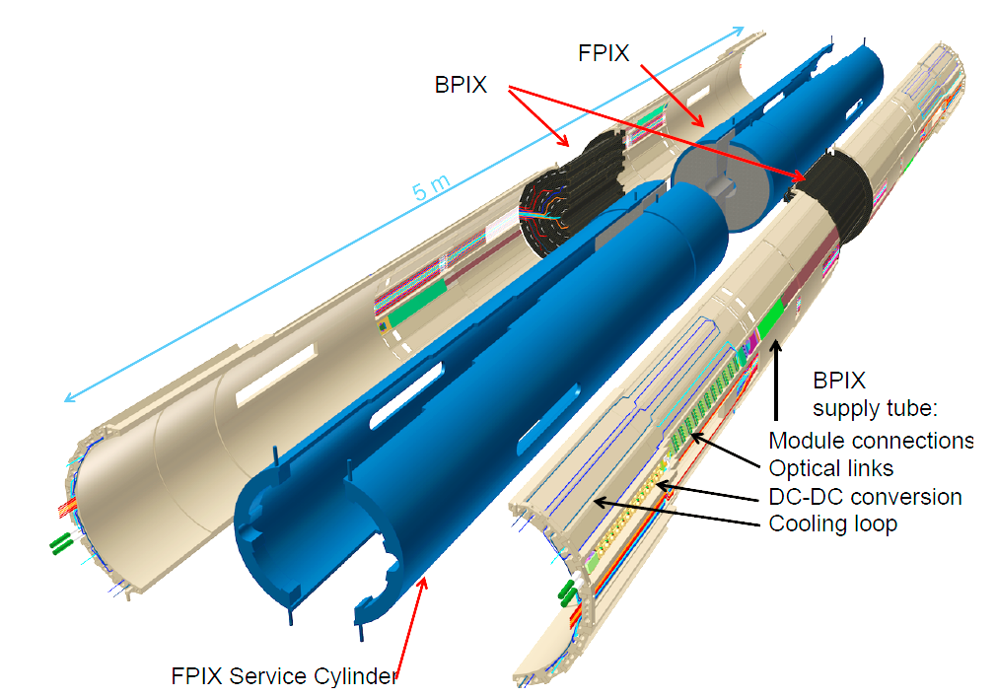
Implementation into the CMS Pixel system

Slide 15
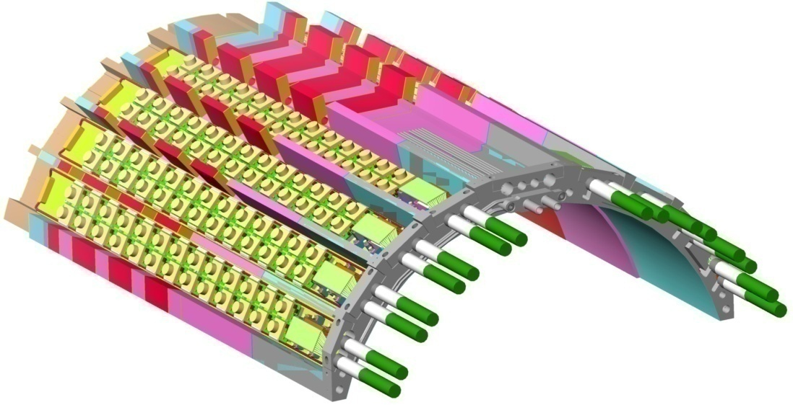
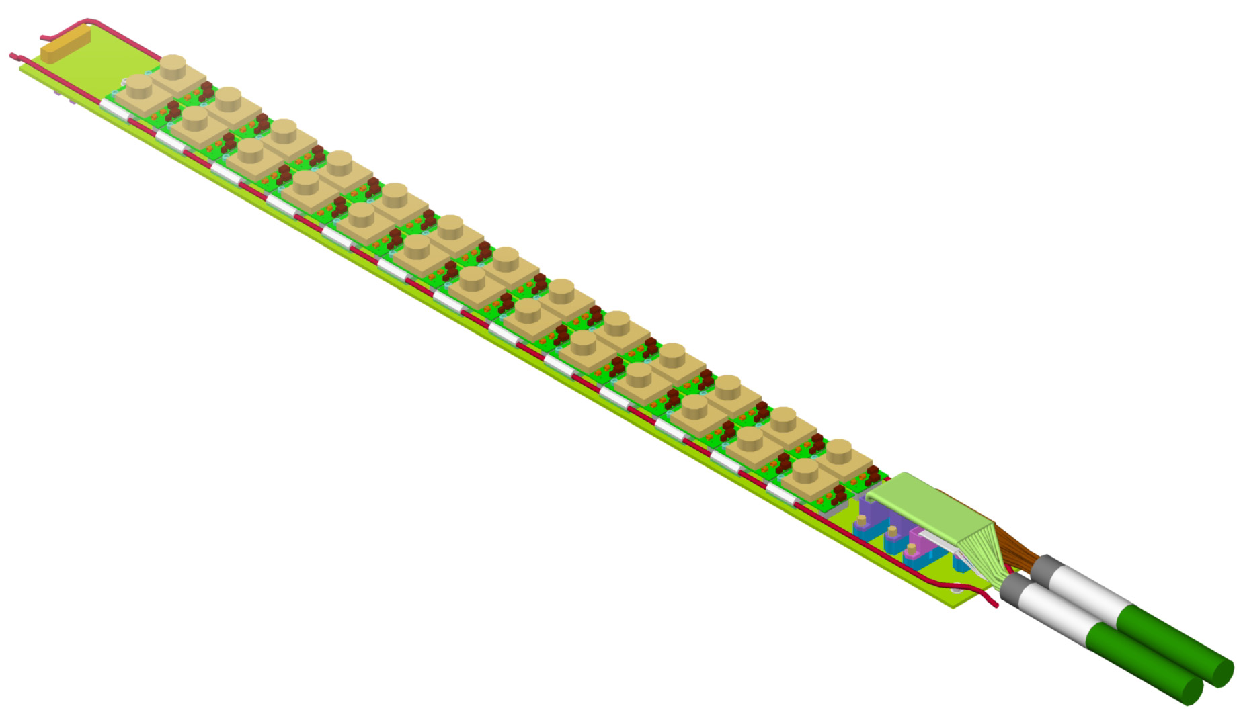
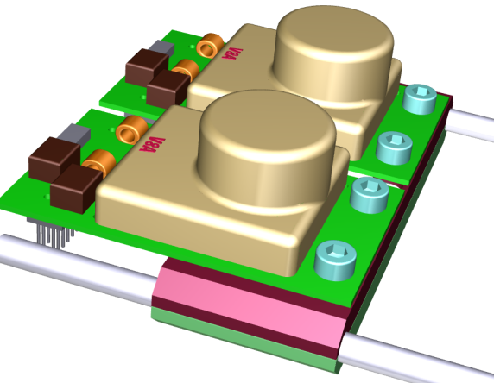
Implementation into the CMS Pixel system
”analogue
converters”
(2.4V)
layer 1
”digital
converters”
(3.0V)
layer 4
served by cable 1
layer 2
layer 3
served by cable 2
13 converter pairs per bus board
6 - 7 pairs powered from one power supply
each converter pair serves 1 - 4 pixel modules
I_{out} < 3A per converter
cable 1
cable 2

Slide 16
System integration issues
DC-DC converters are a new component → no working experience
→ unclear which control and protection features are essential
chosen approach:
  converters switch off in case of over-temperature and under-voltage and switch back on when conditions are again fine, output current is limited
  solid state fuse to disable converters with excessive current permanently
  converters can be dis-/enabled and status is read via slow control communications
  no remote sensing → voltage drops need careful attention
no electromagnetic interference with pixel modules (and the rest of CMS)
single event upsets in converter ASIC at some low level must be tolerated
‘bus board’ needed to distribute (large) currents to and from converters
tight space constraints
converters should be accessible/replaceable
cooling needed (1-2W per converter)

Slide 17
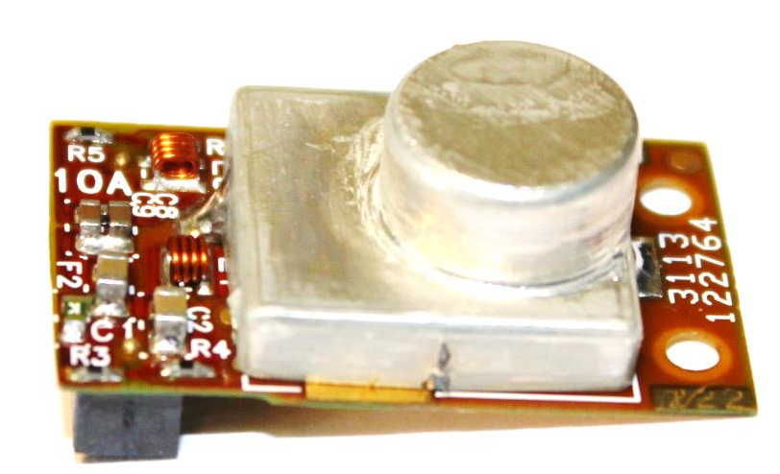
DC-DC Converter Development
based on CERN ASICs AMIS4/5, and soon FEAST
V_{in} =10V
V_{out} = 3.0V or 2.4V
switching frequency f_{s} = 1.5MHz
2-layer PCB
pi-filters at in- and output
AC_PIX_V10 A with AMIS5: 2.8cm x 1.7cm
Toroidal plastic core inductor L = 450nH
Shield (0.3mm plastic with 30µm Cu + 1µm Sn)
has 3 functions:
shield magnetic emissions
cooling contact for the coil
segregation of “noisy“ parts from output filters
with shield; total weight ~3g
100 DC-DC converters have been built so far

Slide 18
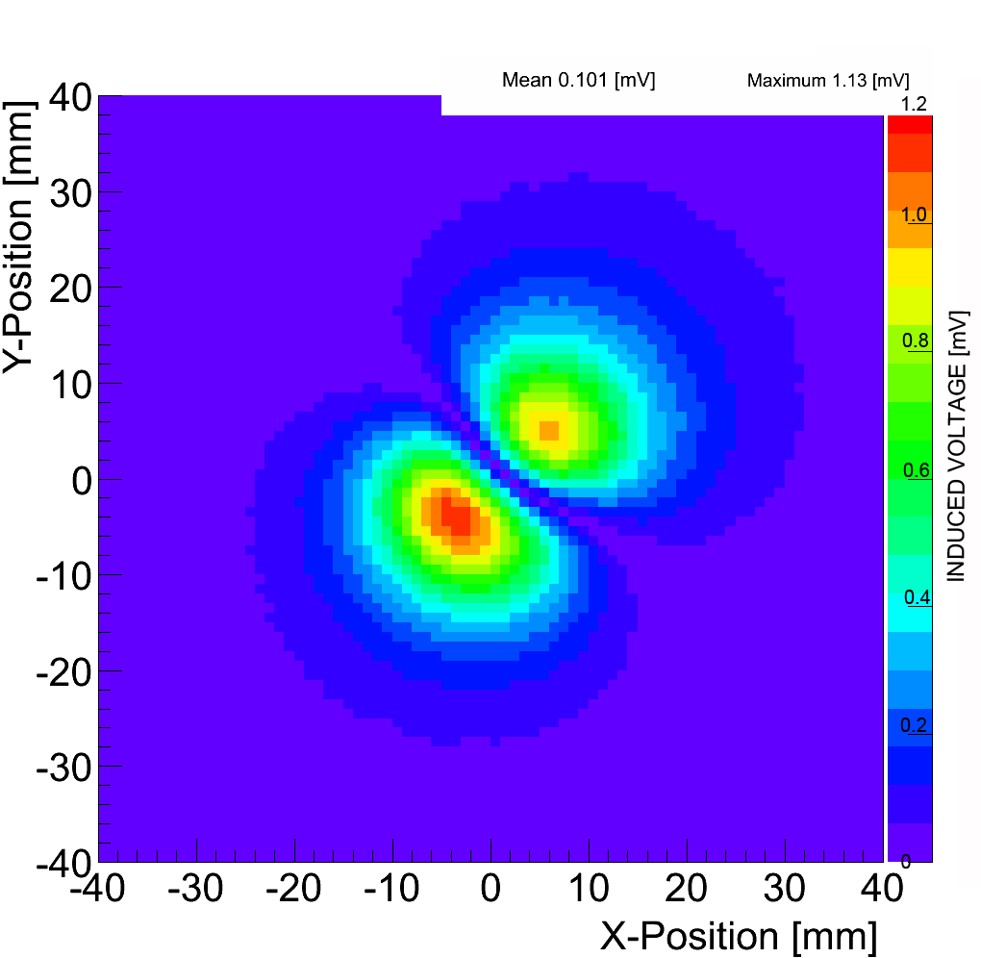
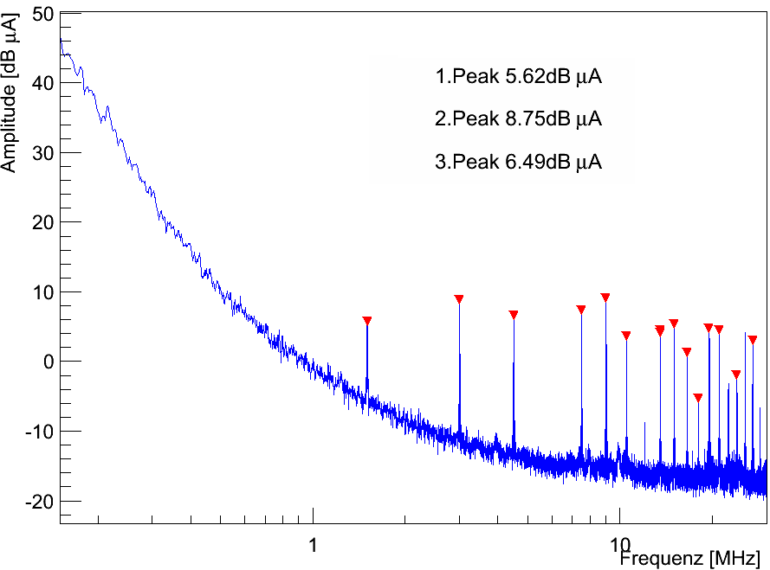
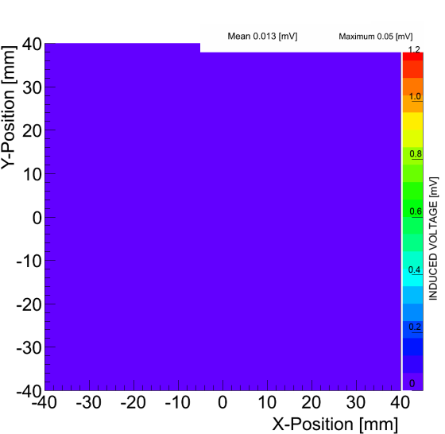
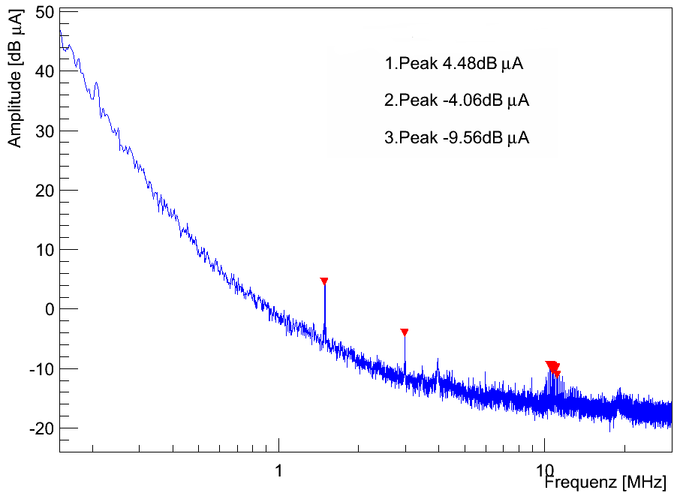
Effectiveness of Shield
B-field, measured with pick-up probe
above coil/shield
Common Mode output noise spectrum,
measured with spectrum analyzer
No shield
No shield
pick-up probe voltage (mV)
With shield
With shield
pick-up probe voltage (mV)
Strong reduction of magnetic emissions and output noise

Slide 19
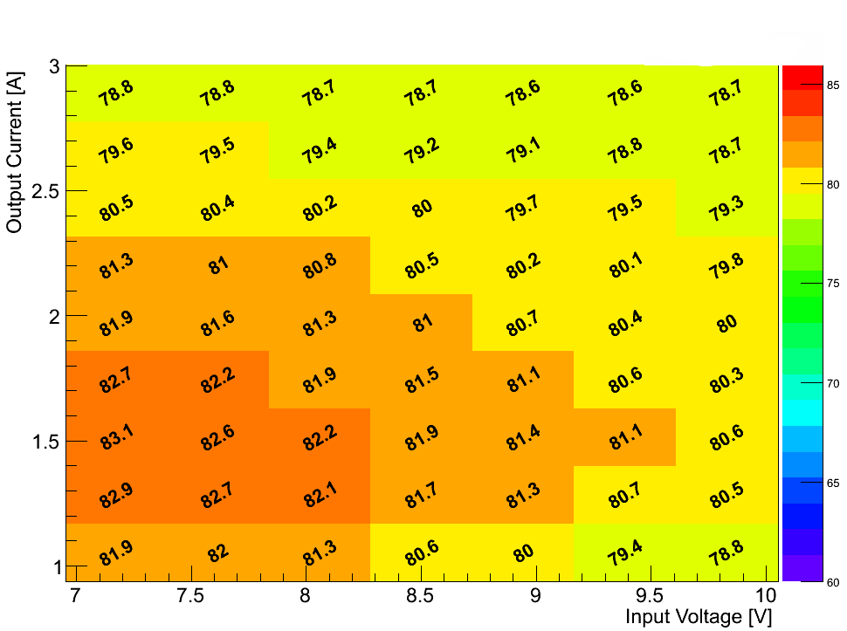
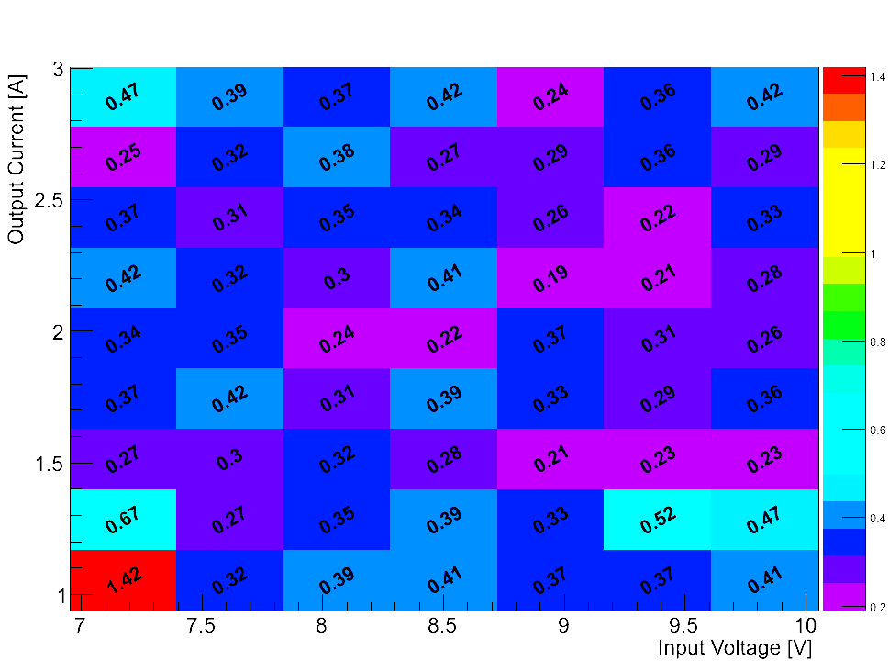
Efficiency
Mean efficiency [%] of 5 converters
V_{out}= 2.5V
Standard deviation [%] from 5 converters
V_{out}= 2.5V
very good and uniform efficiency around 80%

Slide 20
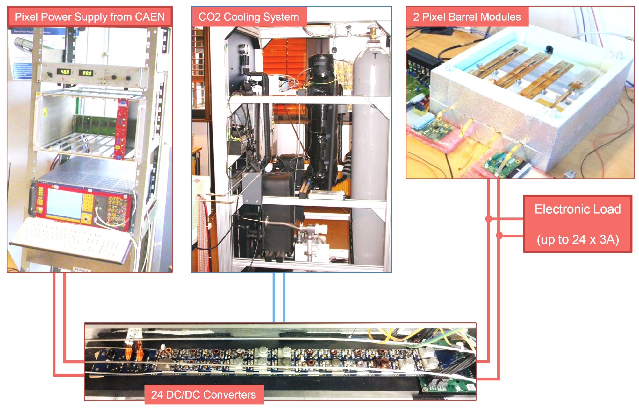
System tests with 24 converters and 2 pixel modules
50m
2m

Slide 21
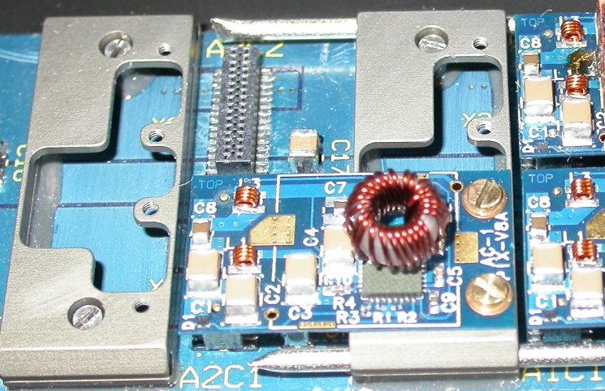
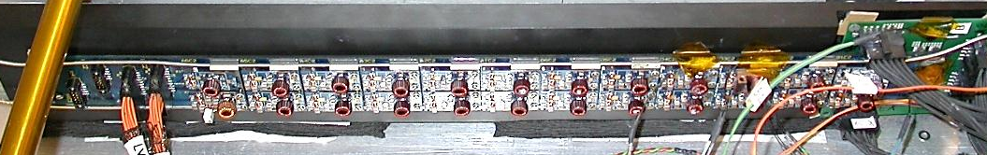
Cold Test
two-phase CO₂ cooling system at -20°C
fully equipped bus board (24 converters)
pipes are thin: 1.7/2.0 mm in lab;
1.8/2.2mm in CMS
programmable load can be
applied to each converter
Aluminium cooling bridges
Protoype bus board with 24 DC-DC converters

Slide 22
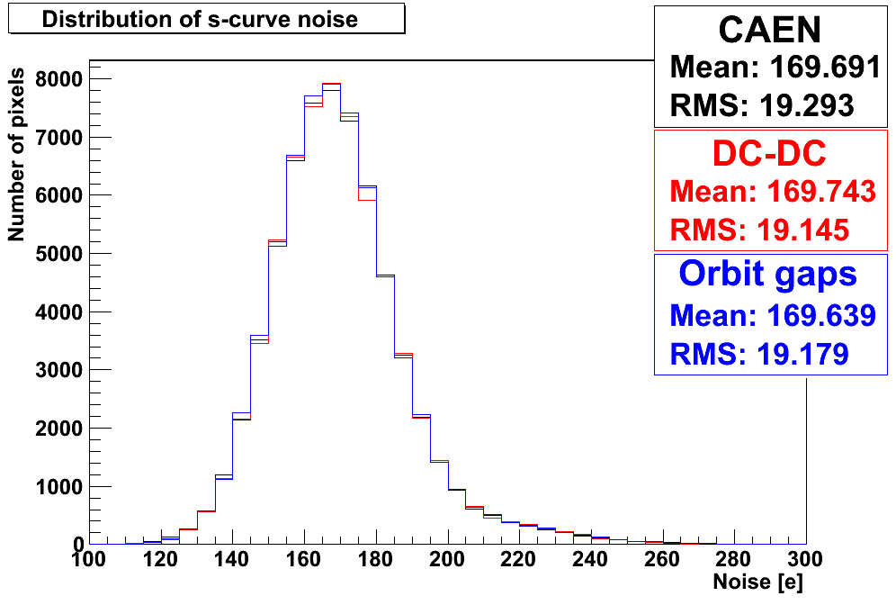
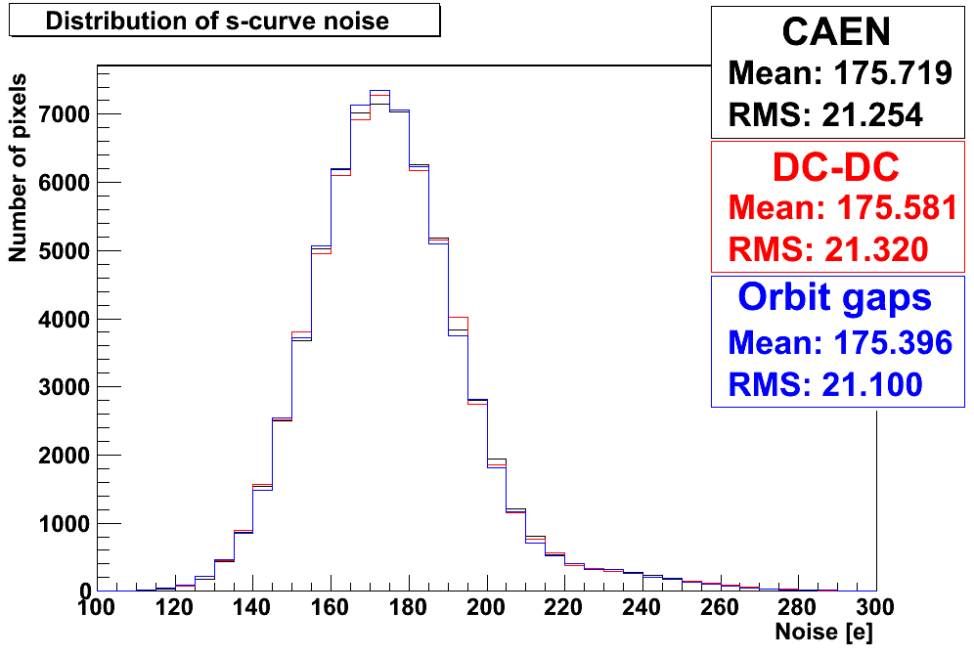
Module noise with 24 converters running
Two pixel modules operated by
standard power supply
Module 1
a pair of converters with
24 converters operating in parallel
Load changes as expected from LHC orbit gaps
→ drop from 2A to 0A for 3µs every 89µs
Module 2
DC-DC converters do not
increase pixel module noise

Slide 23

Summary
future pixel and strip tracking systems need improved powering schemes to cope with
  increasing granularity
  extended functionality
  decreasing ASIC supply voltage
different options available:
  charge pump in each ASIC
  DC-DC converters to power single or multiple modules
  serial powering of modules
all options have been shown to work in small systems (typically 4 modules)
serial powering under study for ATLAS pixel and strips
DC-DC powering under study for CMS pixel and strips, CMS HCAL, ATLAS strips, LHCb, Belle II, Panda
system integration has to be carefully analyzed and studied and should guide the choice of an appropriate powering scheme
DC-DC powering of CMS pixel detector described in detail as a case study

Slide 24
Additional Material

Slide 25
DC-DC Converter Requirements for CMS Pixel Upgrade
radiation hardness: 2x10¹⁴n_{eq}/cm², 100 kGy for 500 fb⁻¹
magnetic field tolerance: 3.8T
input voltage 10V
output voltage 2.4V / 3.0V
conversion ratio 3:1 – 4:1
max output current 3-4A
efficiency at least 75%
size of converter: 30x20x14 mm³
converter need to be cooled
slow control features: enable, power good
protection features: over-temperature, over-current, under-voltage
stability against fast load variations (orbit gaps)
material budget uncritical (z=2000-2300 mm, r=190 mm)
1184 converters in pixel system
1800 converters to be produced
commercially
not available
typical and
achievable
what is
needed?
project
specific

Slide 26
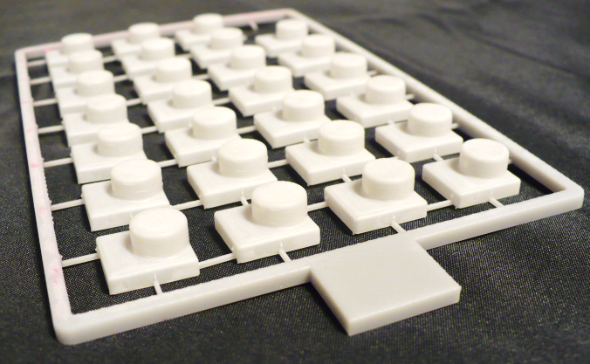
The Shield
0.3mm plastic galvanically coated with 30µm Cu + electro-less 1µm Sn
two methods are considered for the body:
  rapid prototyping
  injection molding

Slide 27
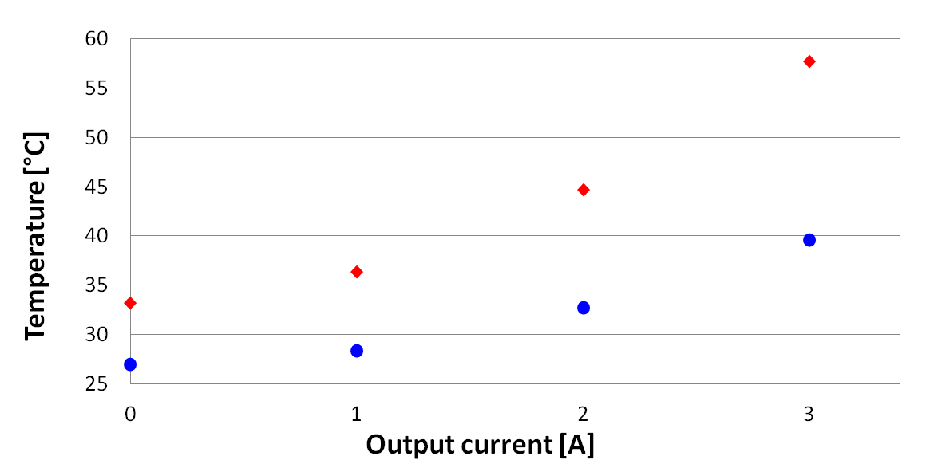
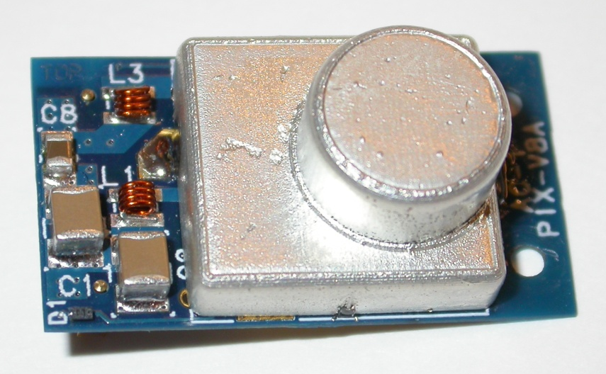
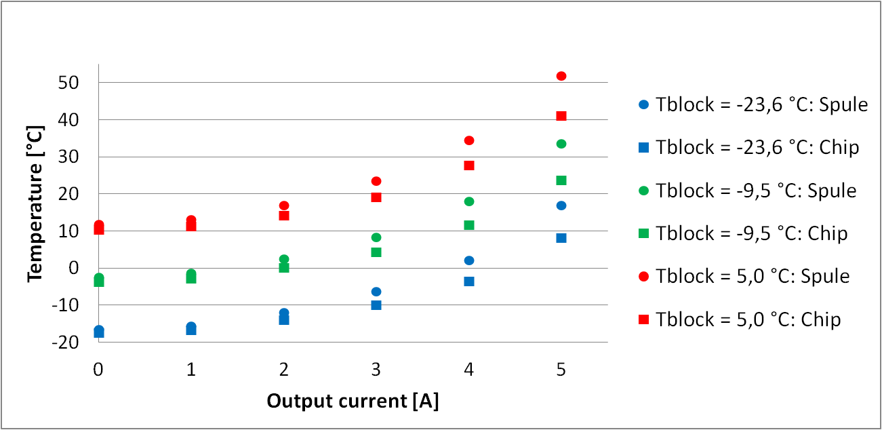
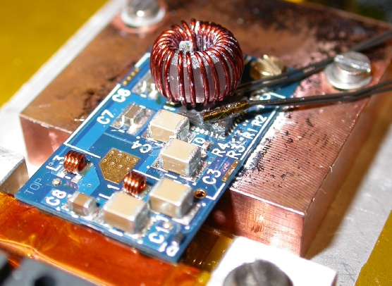
Thermal Performance
Coil temperature
- without shield
- with shield
Cooling block
temperature:
• Coil temperature
○ Chip temperate
+5°C
-10°C
-24°C
good thermal performance even beyond 3A

Slide 28
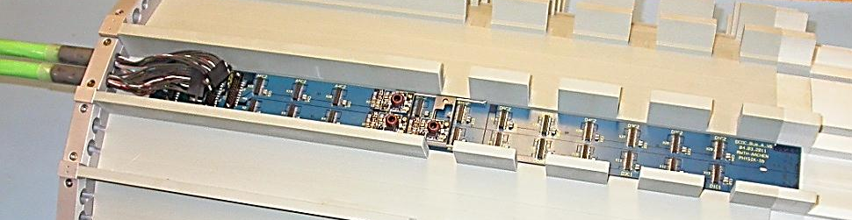
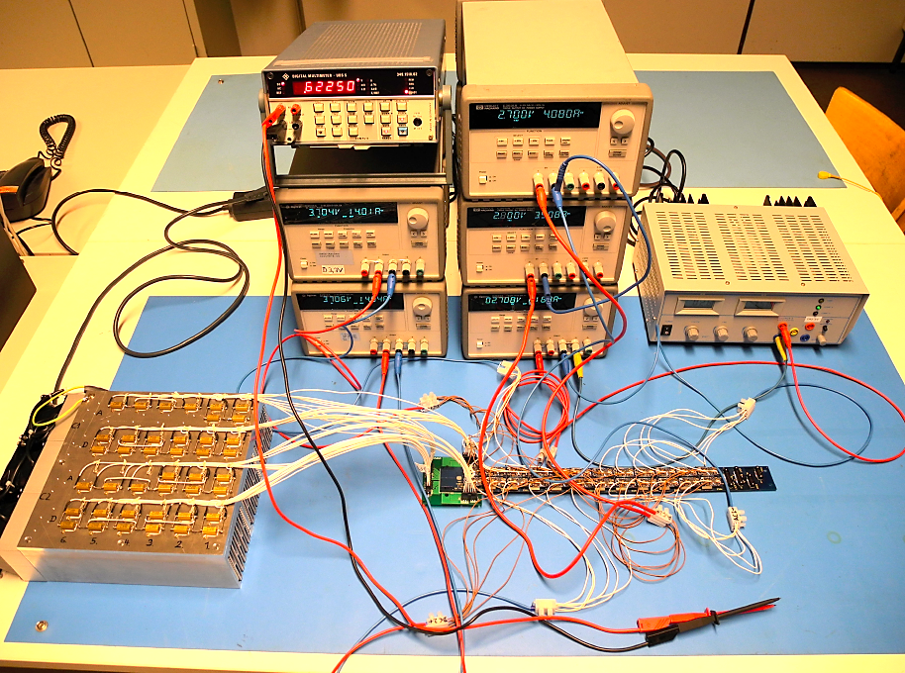
DC-DC Bus Board Design and Tests
Input and output voltages,
control signals
8 Cu layers a 70µm
Protoype for 24 converters studied
Voltage drops to be well understood (no remote sensing!)
  Reasonable agreement with calculation
  No degradation after 120 thermal cycles between -10°C and +40°C under load
488mm x 40mm x 1.6mm
Calculation Measured before TC Measured after TC

Slide 29
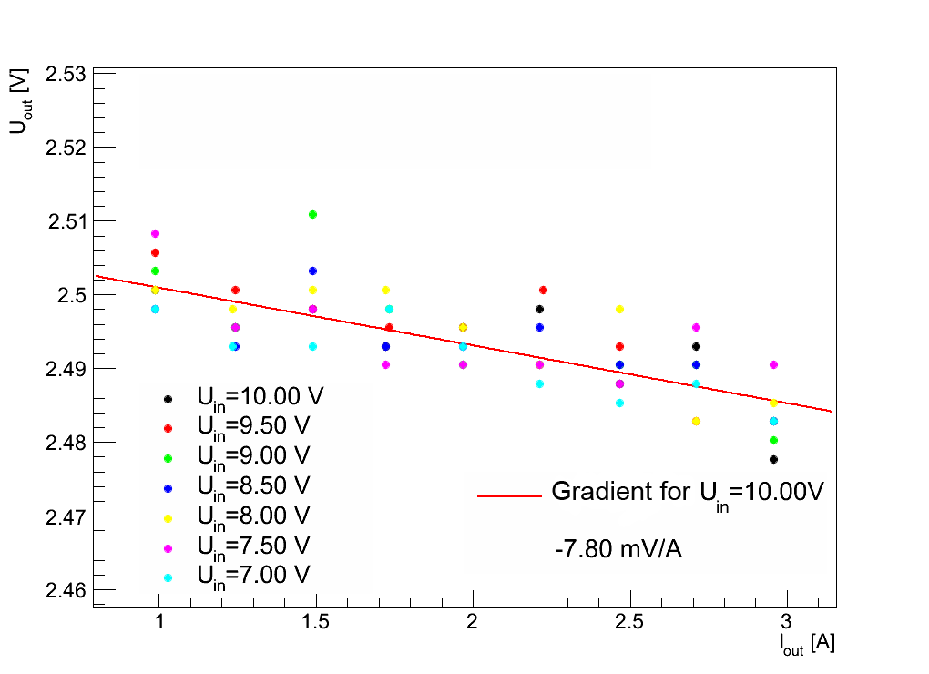
Load Regulation
output voltage stable against load changes

Slide 30
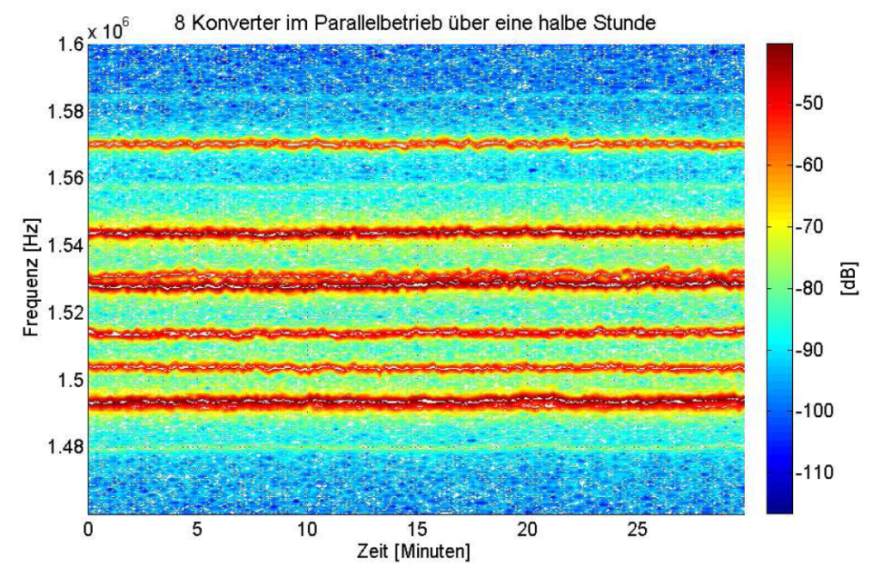
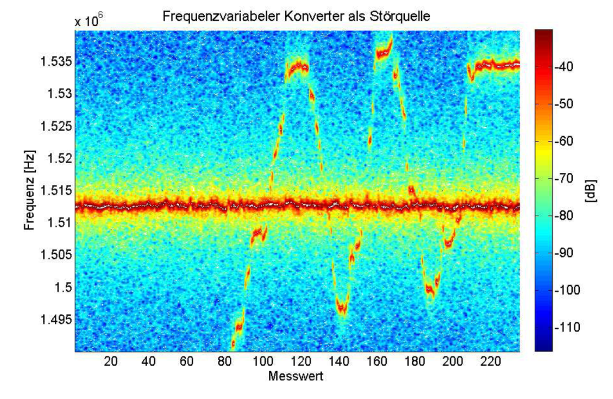
Synchronization of Converters
oscillators can lock to each other and cause large transients
coupling of DC-DC converters on common power line might increase input noise
simulations show that synchronous switching should be tolerable
still we would like to check:
  did not observe locking or frequency change , even when a close-by frequency was imposed on input cable (740mV_{pp}) or radiated by an external coil (~10mW)
f_{s} of 8 converters vs. time
converter frequency crossing
Frequency [Hz]
Frequency [Hz]
Intensity [dB]
Intensity [dB]
Measurement number
Time [min]

Slide 31
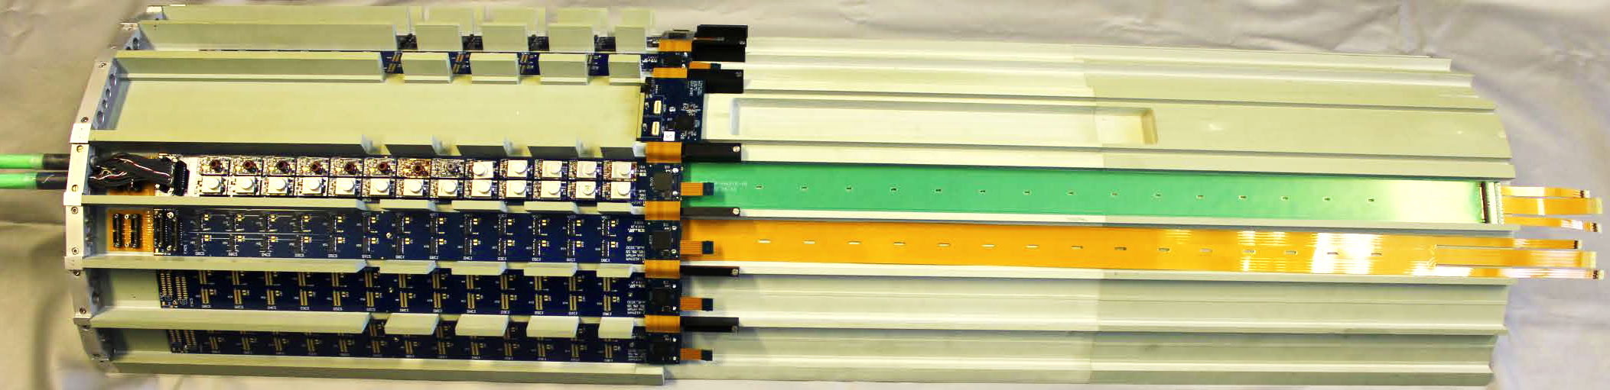
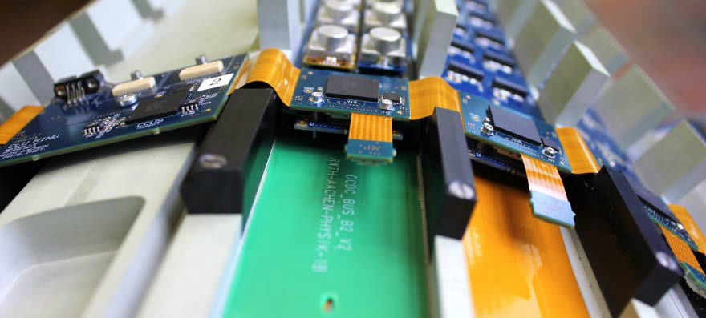
Mock-up of Supply Tube

Slide 32
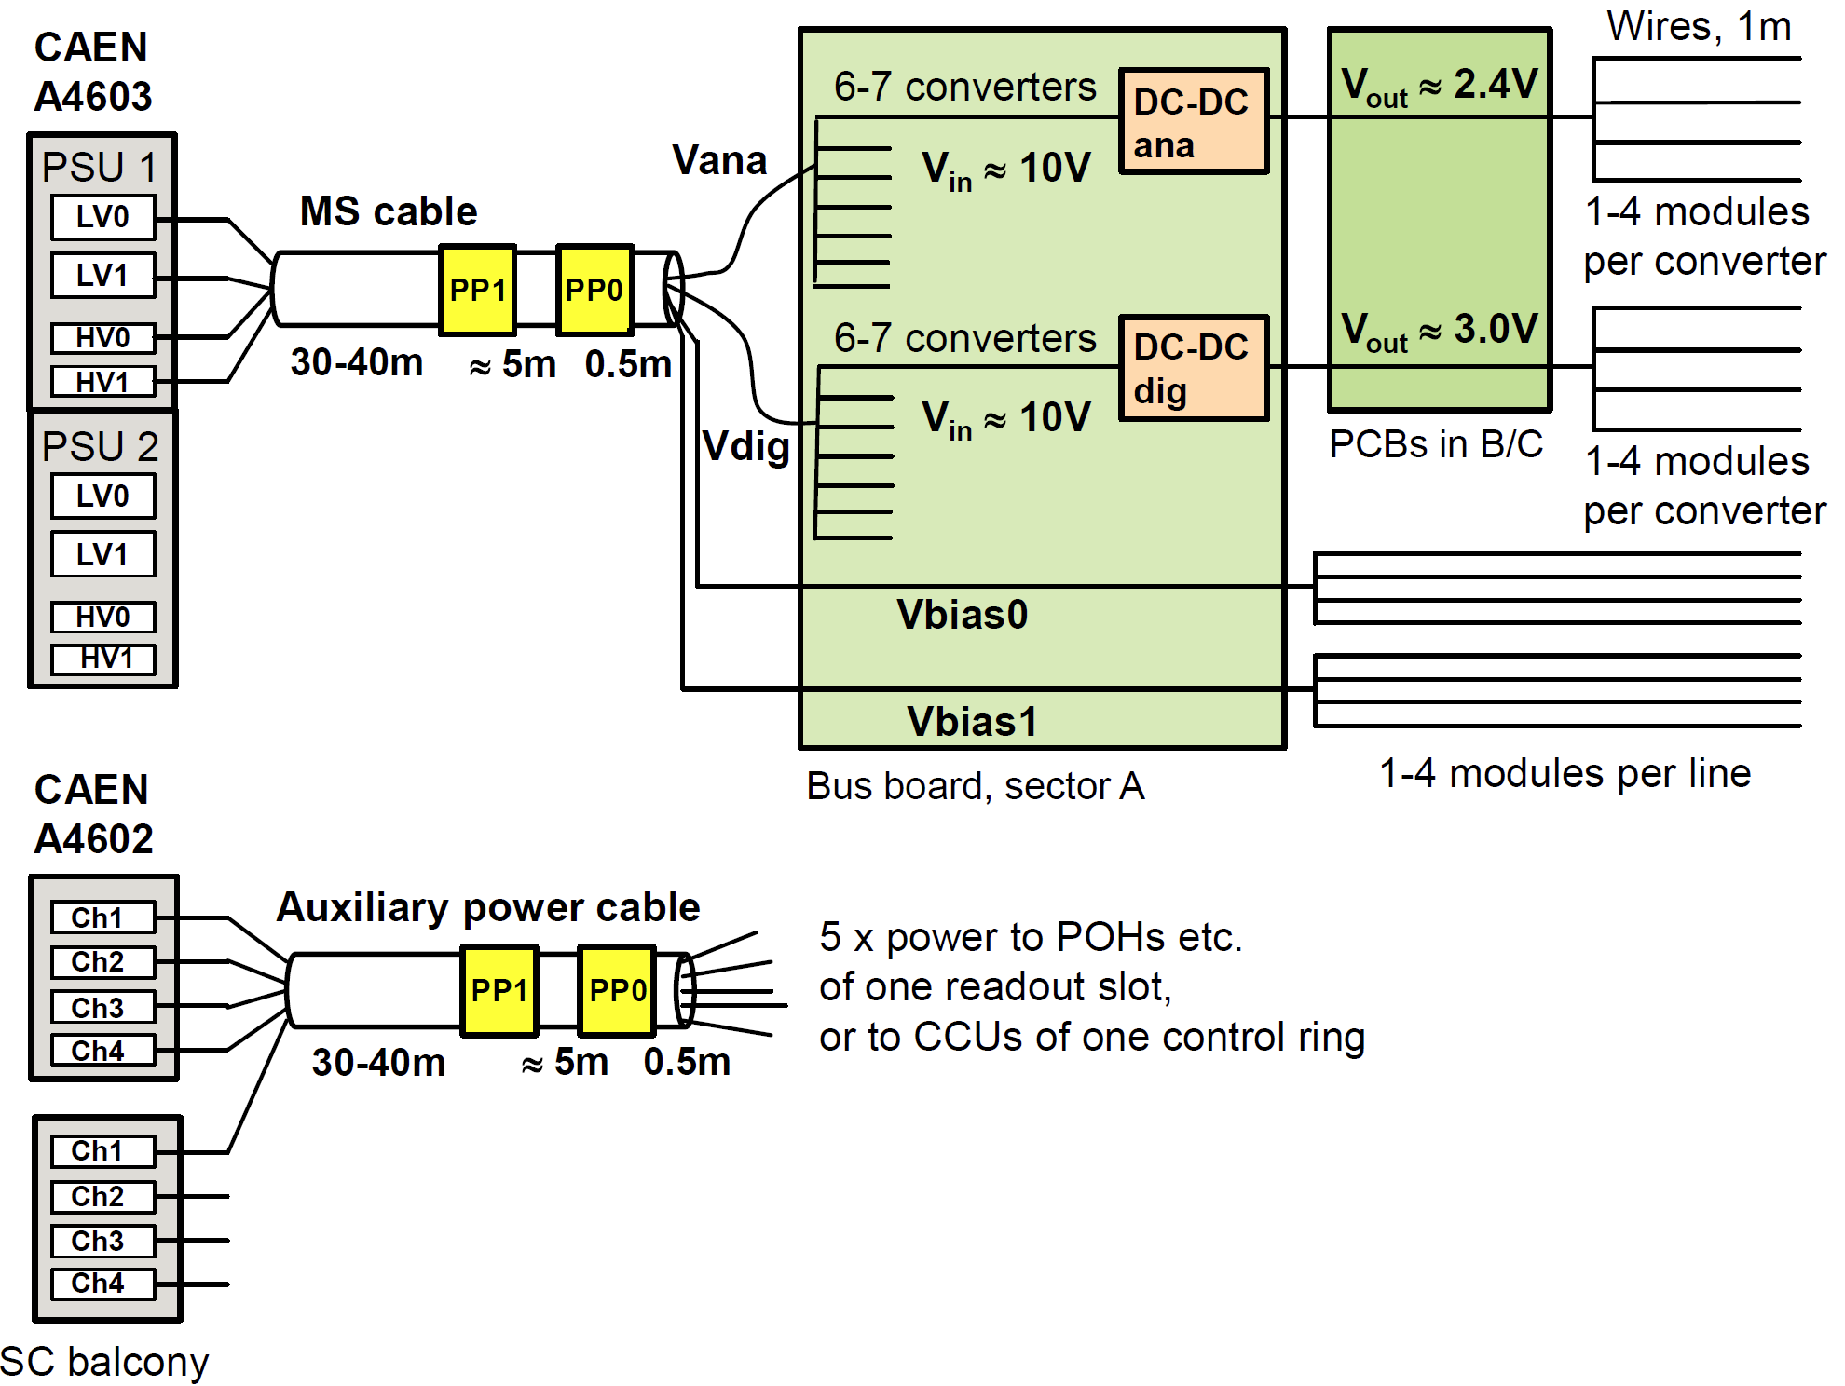
CMS Pixel Power Distribution

