Slide 1
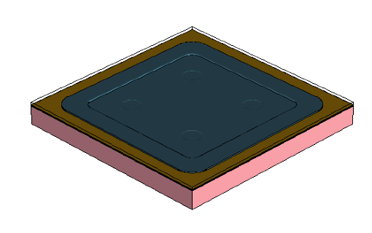
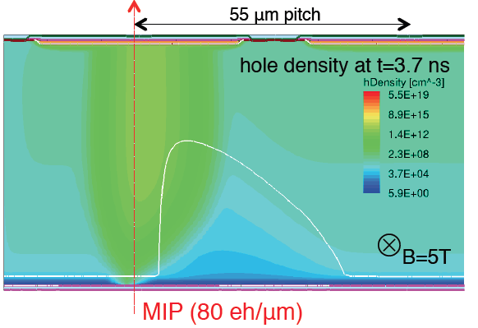
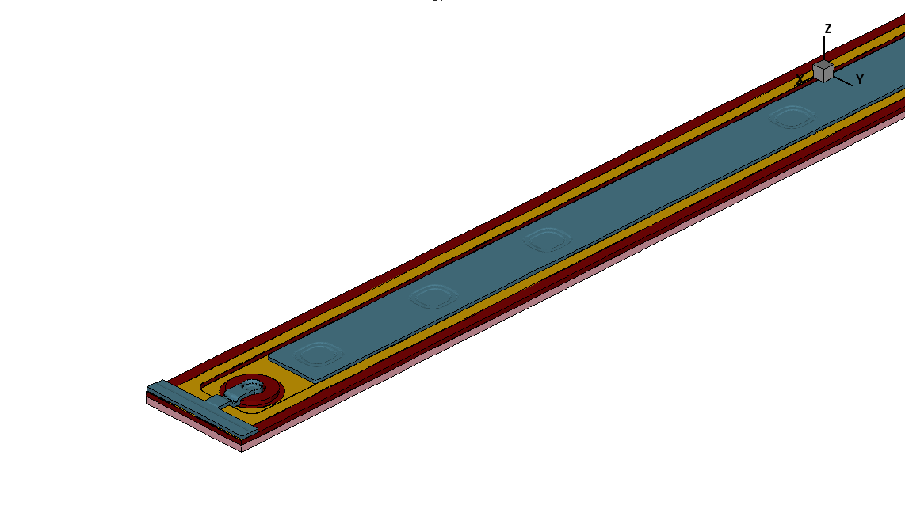


TCAD Simulation of Silicon radiation detectors using commercial simulation products
Mathieu Benoit,
PH-LCD, CERN

Slide 2
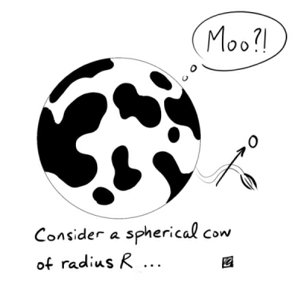
Outline
Short summary of theory of Finite-Element / Difference Method (FEM) in Silicon TCAD simulation
  Numerical methods
  Existence of the solution
  Work Flow
Comparison of main commercial TCAD simulation software
  Physics
  Functionality (user friendliness)
Example of TCAD simulation
  Space-Charge Sign Inversion (SCSI)
  Double peak in inverted sensors
  Charge multiplication
  P-Spray Insulation
  Magnetic Field effects
  Charge-Sharing in pixel sensors
Conclusion
Warning this talk might contains bavarian spherical cows

Slide 3
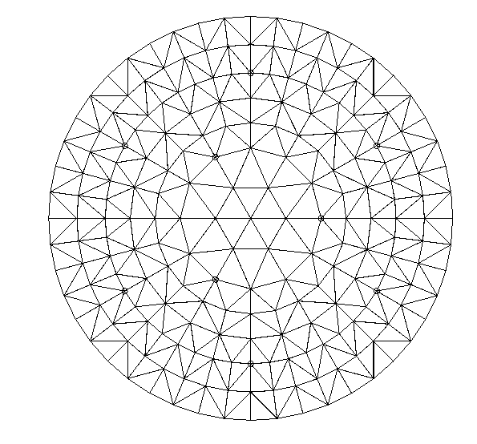
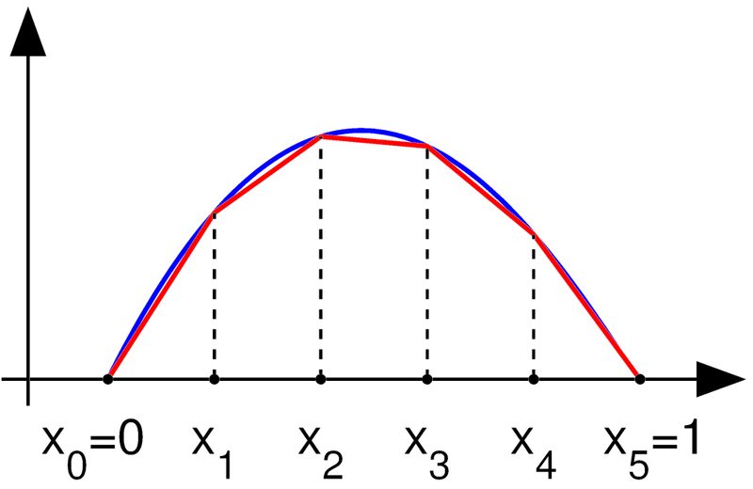
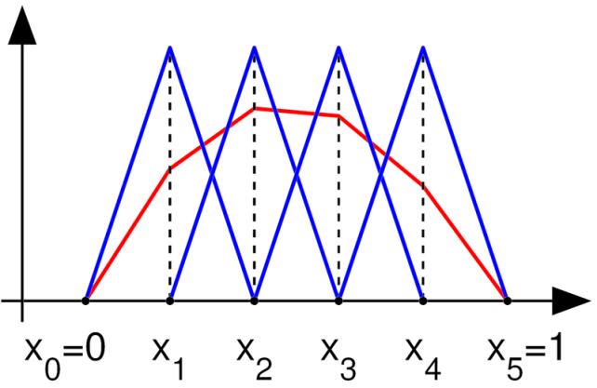
TCAD simulation principles
Discretization of the Domain
Approximated solution to the equation to solve
Aproximation of the solution space using test function

Slide 4
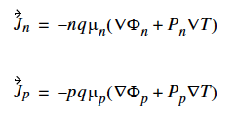
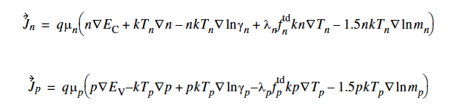
TCAD simulation principles :
Beyond the standard model !
It is possible for the main TCAD simulation to perform simulation at higher orders of Boltzmann Transport Equation :
  The thermodynamic model
    Continuity equation only
    Transport Time >> Energy Relaxation time
  The hydrodynamic model
    Energy balance taken into account
    Modelize Carrier Heating, Velocity overshoot

Slide 5
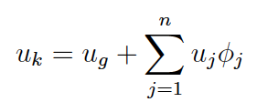
TCAD simulation principles
The exact solution to the equation needs to be definable as :
n can be infinite (or not, ex: simple diode etc)
In FEM, n is fixed by the number of degrees of Freedom (nDOF)
  nDOF is fixed by the mesh defined in your geometry

Slide 6
TCAD simulation workflow
« Old-school » process simulation
Hard-coded pixel geometry when defining processing steps
Possibility for limited parametrization
Device Simulation Conditioning
Reduce Complexity (symmetry, dead area removal)
Remesh for Device simulation (reduce oxide/nitride mesh, increase bulk)
Process Flow simulation
Work with GDSII files provided by your favorite vendor
Abstract description of the process
Device Simulation
Electric Field, Ramo Potential
Capacitance
Transient Behavior
Thermal/Mechanical Stress Simulation
Simple description of the geometry and doping using an editor
Define geometry (Shape,material)
Define doping profile (parametric description)
Post-Processing
Extract Profiles ( E(x,y,z) , etc)
Extract Values (Breakdown, Depletion Potential )

Slide 7
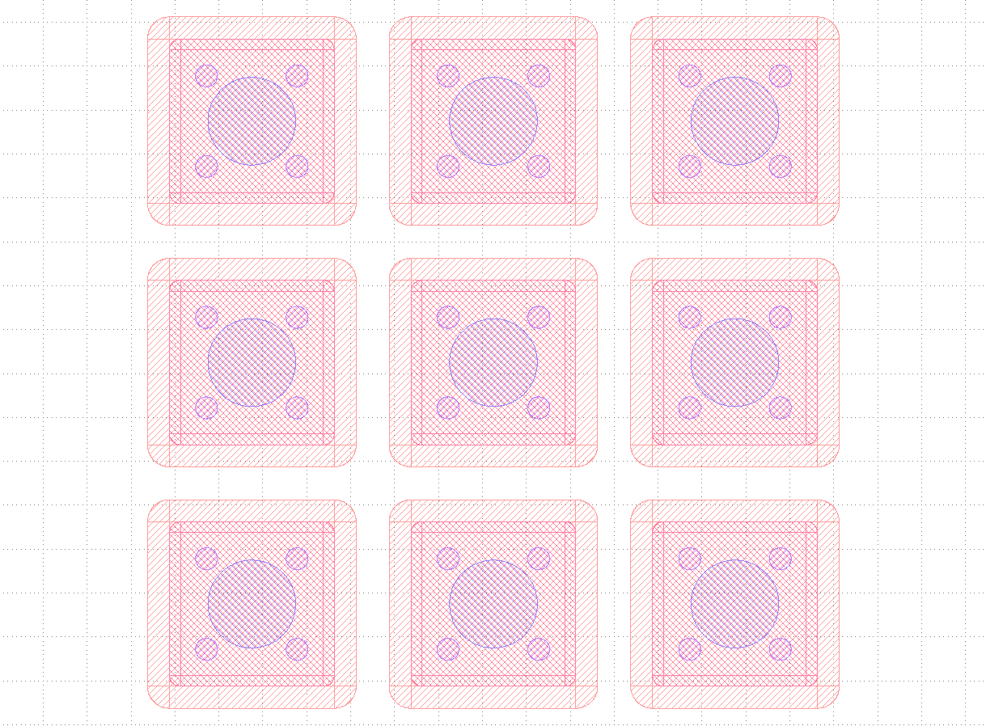
Process Flow Simulation
Process Flow simulation allows for more automated studies of different geometries
  Generate mask using your favorite software (pyGDS, Cadence, etc)
  Use GDSII mask to define geometry
  Use abstract and parametric description of the process
    Implantation, lithography, deposits, annealing etc…
Takes Advantage of multiplication of available CPU/RAM in the HEP Community
  Chose a set of geometrical/Process/Electrical parameter to scan
  Launch simulation in parallel using LSF Infrastructure
Timepix 3x3 Pixel Mask set generated using pyGDS
Structure Generated using process Flow

Slide 8
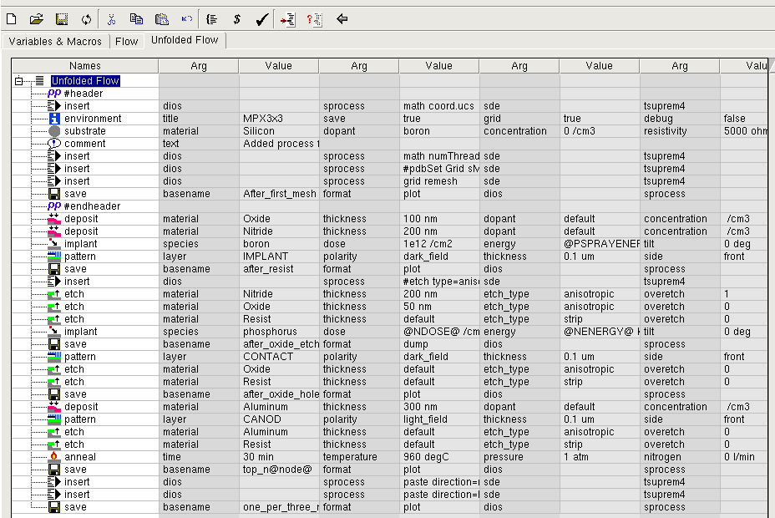
Process Flow Simulation

Slide 9
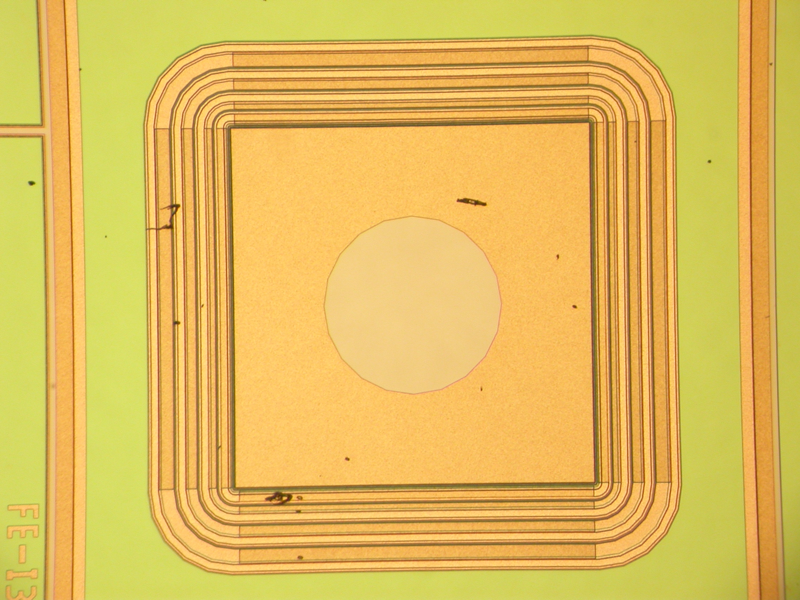
Importance of meshing properly
Meshing in the first main problem you will encounter when doing TCAD simulation
Determination of the perfect mesh is not an exact science (a lot of trial and error ! )
  Upper limit of mesh size set by device feature size (implants , electrodes)
  Lower limit of mesh size set by computational limits (RAM, computing time)
  Meshing algorithm available in software packages also have internal limitation (!!!)

Slide 10
Physics (Device Simulation)
Physics | Models
Mobility | Concentration-dependent mobility (fit to experimental data), Parallel field dependent mobility (fit to experimental saturation velocities)
Generation recombination and trapping | Modified concentration dependent Shockley-Read-Hall Generation/recombination (for treatment of defects)
Impact ionization | Selberherr’s Impact ionization model
Tunneling | Band-to-band tunnelling, Trap-Assisted tunneling
Oxide physics | Fowler-Nordheim tunnelling, interface charge accumulation

Slide 11
Generation/Recombination
Modified Shockley-Read-Hall G/R
  A sum of SRH contribution by each trap
  Γ is the degeneracy of the trap, n_{i} the intrinsic concentration of carriers

Slide 12
Generation/Recombination
Transient behaviour of traps
σ_{n,p} is trap capture cross-section
v_{n,p} is thermal velocity
n_{i} is intrinsic concentration
F_{tA,TD} the probability of ionization
N_{tA,TD} space charge density
electron
emmision
hole
capture
hole
emmision
electron
capture
Electron
capture
Electron
emmision
Hole
capture
Hole
emmision

Slide 13
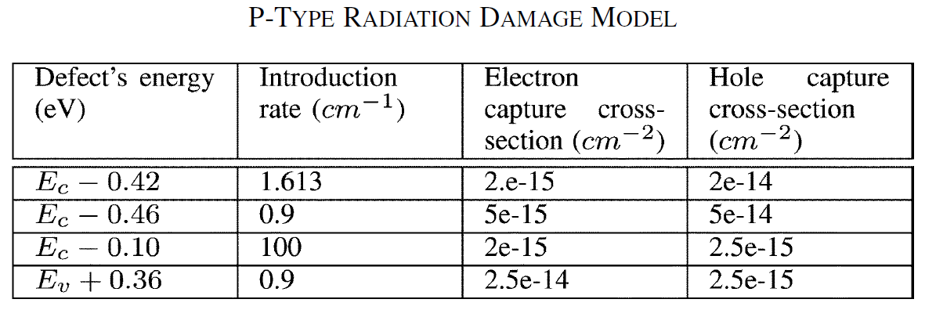
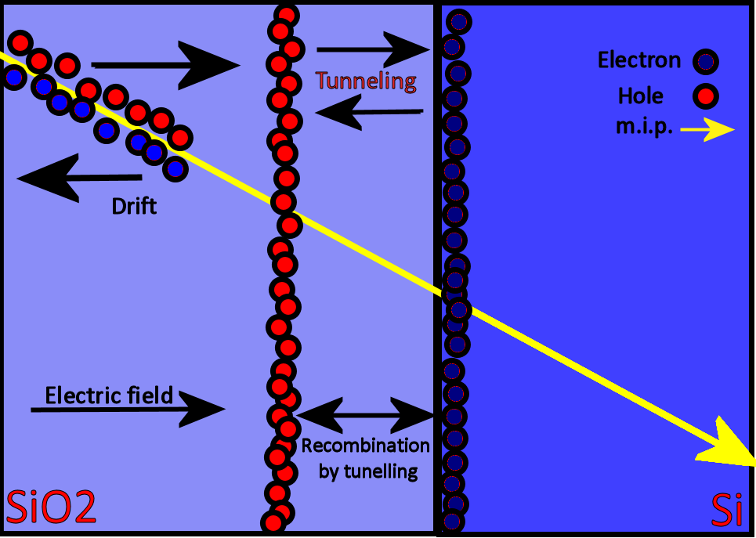
Radiation damage
Non-ionizing
Energy loss
D. Menichelli, M. Bruzzi, Z. Li, and V. Eremin, “Modelling of observed double-junction effect,” Nucl. Instrum. Meth. A, vol. 426, pp. 135–139, Apr. 1999.
F. Moscatelli et al., “An enhanced approach to numerical modeling of heavily irradiated silicon devices,” Nucl. Instrum. Meth. B, vol. 186, no. 1-4, pp. 171–175, Jan. 2002.
F. Moscatelli et al., “Comprehensive device simulation modeling of heavily irradiated silicon detectors at cryogenic temperatures,” IEEE Trans. Nucl. Sci., vol. 51, no. 4, pp. 1759–1765, Aug. 2004.
M. Petasecca, F. Moscatelli, D. Passeri, G. Pignatel, and C. Scarpello, “Numerical simulation of radiation damage effects in p-type silicon detectors,” Nucl. Instrum. Meth. A, vol. 563, no. 1, pp. 192–195, 2006.
Ionizing
Energy loss

Slide 14
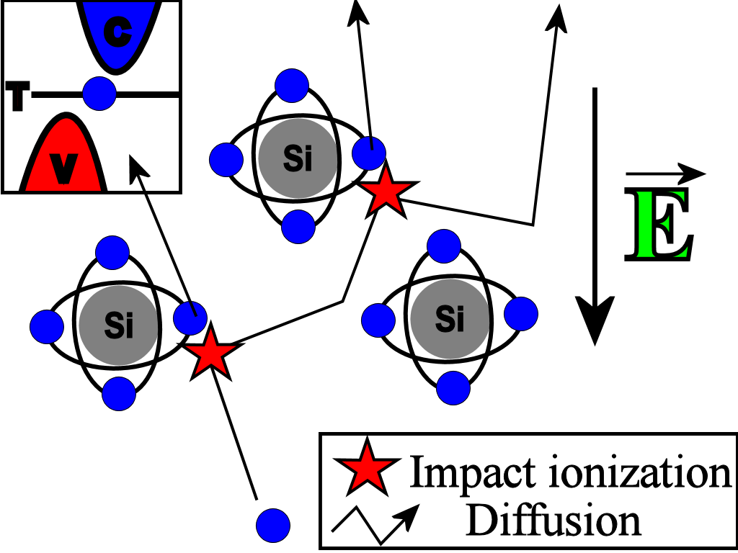
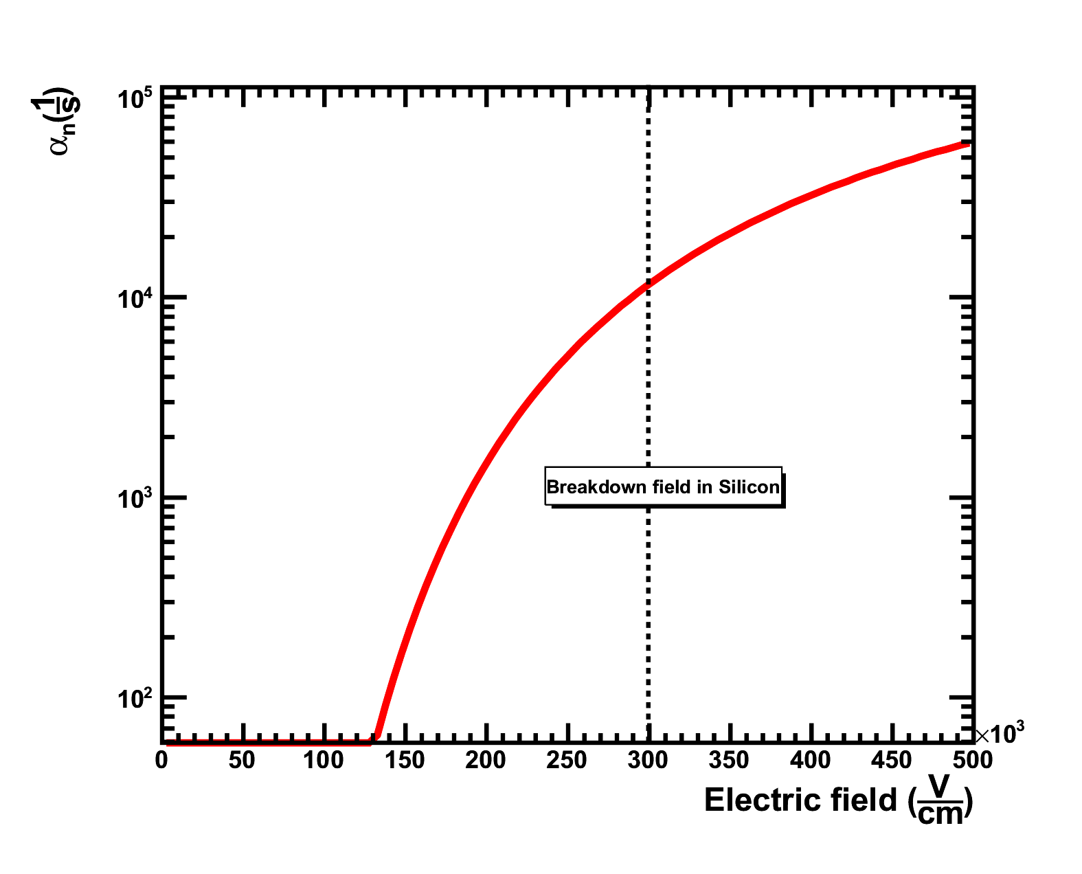
Impact ionization
Selberherr, S., "Analysis and Simulation of Semiconductor Devices", Springer-Verlag Wien New York, ISBN 3-211-81800-6, 1984.

Slide 15
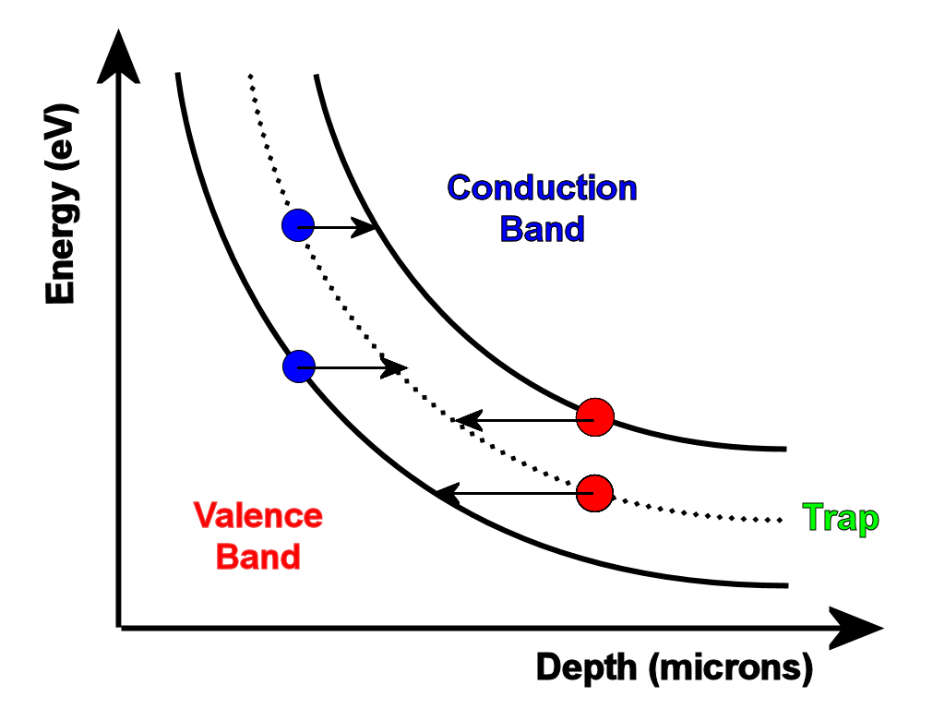
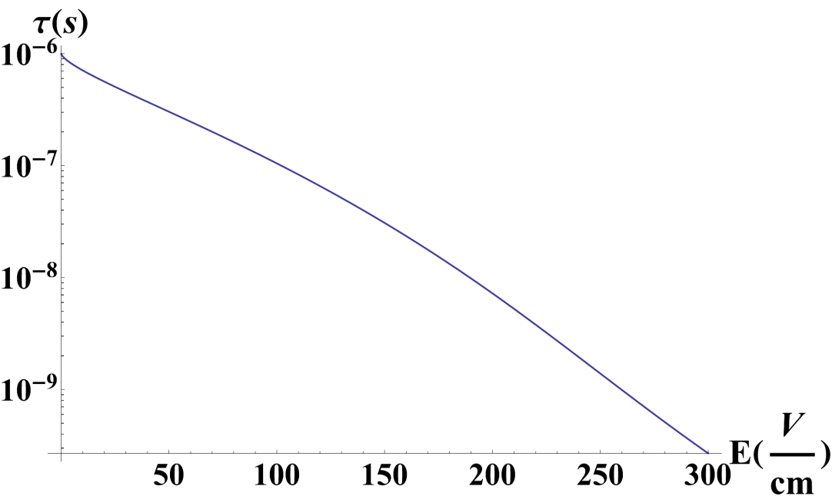
Phonon-assisted trap-to-band tunnelling
Hurkx, G.A.M., D.B.M. Klaasen, M.P.G. Knuvers, and F.G. O’Hara,
“A New Recombination Model Describing Heavy-Doping Effects
and Low Temperature Behaviour”, IEDM Technical Digest(1989): 307-310.

Slide 16
Numerical methods and convergence
The second major issue you will encounter when doing TCAD simulation is convergence
  In practice most problems will have large non-linearities due to the model used for G/R -> Newton method
  More complex solver must be used to obtain solution in practice
  A good initial solution is needed for all practical purposes
Poisson Equation
solution at Vbias=0 (Linear)
Poisson Equation + n/p
solution at Vbias=0
Poisson Equation + n,p
solution at Vbias=0
Poisson Equation + n,p
solution at Vbias=dV
(…)
Poisson Equation + n&p
solution at Vbias=Vfinal

Slide 17
Comparison of main commercial TCAD software packages
SILVACO TCAD Suite | Sentaurus TCAD Suite
http://www.silvaco.com/ Silvaco Data Systems was founded in 1984 by Dr. Ivan Pesic. The initial product, UTMOST, quickly became the industry standard for parameter extraction, device characterization and modeling. In 1985 Silvaco entered the SPICE circuit simulation market with SmartSpice. In 1987 Silvaco entered into the technology computer aided design (TCAD) market. By 1992 Silvaco became the dominant TCAD supplier with the ATHENA process simulator and ATLAS device simulator. Educational prices available on request from Silvaco | http://www.synopsys.com/Tools/TCAD/Pages/default.aspx Formely ISE TCAD, bought by Synopsis Synopsys is a world leader in electronic design automation (EDA), supplying the global electronics market with the software, IP and services used in semiconductor design and manufacturing. Synopsys' comprehensive, integrated portfolio of implementation, verification, IP, manufacturing and FPGA solutions helps address the key challenges designers and manufacturers face today, such as power and yield management, system-to-silicon verification and time-to-results. These technology-leading solutions help give Synopsys customers a competitive edge in bringing the best products to market quickly while reducing costs and schedule risk. Synopsys is headquartered in Mountain View, California, and has more than 60 offices located throughout North America, Europe, Japan, Asia and India. Available from EUROPractice
Disclaimer : I do not have any link with any of the company producing TCAD software. Recommandation here are strictly personal based on my experience with both software during my work in HEP

Slide 18
Comparison of main commercial TCAD software packages
SILVACO | Sentaurus
Athena : 2D SSUPREM4 based process simulator ATLAS : 2D (and basic 3D) device simulation VICTORYCELL : GDS based 3D process simulation VICTORYPROCESS : 3D Process simulation VICTORY DEVICE : 3D device simulation Virtual Wafer Fab : wrapper of the different tool in a GUI | Sprocess : 2D/3D SSUPREM4 based process simulation Sdevice : 2D and 3D device simulation SnMesh : Adaptativ meshing tool for process and device simulation SWB : Sentaurus WorkBench, GUI controling simulation process flow, parametrization etc..

Slide 19

SENTAURUS
Advantages | Inconvenients
3D Simulation built-in Seemless transition from 2D to 3D Excellent user interface Support for LSF (lxbatch !!!) Parallel 3D solver (takes advantage of modern multi-core CPU) Adaptative meshing and clever 3D meshing algorithm | User support very slow ~1-2 months for an answer Syntax of the simulation protocol is a bit more tedious than for equivalence in the competitor (learning curve steeper) Set of example smaller and less relevant for HEP than the competitor

Slide 20
SILVACO
Advantages | Inconvenients
Simple scripting language make it easy to start real work within a short time Extensive litterature supporting the validity of the software Very responsive user support: Email exchange directly with the engineers Custom patches produced following our needs | More complex parametric simulation planification (Design-Of-Experiment) GUI rather old and in need of a rejuvenation No parallel solver for 3D device simulation No 3D process simulation without the purchase of an expensive supplementary licence Meshing methods not adapted to 3D simulation

Slide 21

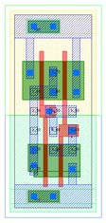
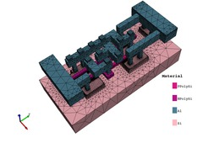
A new player in the market
« Cogenda is a vendor of Technology Computer Aided Design (TCAD) software. Our core expertise is the TCAD simulation of semiconductor fabrication processes and devices. As well as developing simulation software, Cogenda provides a wide range of technical services, which includes integration of TCAD tools in customer's workflow, technical consultation, reference deck calibrated to process and outsourced TCAD simulation. We provide custom development service to customers with special TCAD needs. If the physical models you are looking for do not exist in TCAD simulators yet, we will implement and calibrate the models for you If you are building a TCAD team from a group of novices, we will provide practical and theoretical training courses in TCAD software and semiconductor device physics. »
Fully parallelized Process/Device Simulation
Coded from scratch
Provide python code for all physics models
GDS to Process Simulation Interface
Limited coding needed for standard use
source : http://www.cogenda.com/

Slide 22
Common aspects
All software allow for redefinition of any constants, input parameters of the models used , ex :
  Lifetime, cross-section , bandgap, impact ionization coefficient etc…
Many (not all) models can be redefined using the internal C interpreter, ex :
  Redefined impact ionization ,mobility dependence on T,E,N_{A/D,}etc
All software are sold as compiled software with no access to source code, however :
  Both software are extensively used in the industry with a lot of success translating in a major contribution to the improvement of the microelectronics
  Both software are extensively documented with references provided :
    SILVACO ATLAS Manual -> 898 pages
    SENTAURUS DEVICE Manual -> 1284 pages

Slide 23
TCAD Simulation capabilities
TCAD is suitable for simulation of complex structure
  Guard rings , punch-trough
  E-Field distribution in presence of complex doping profiles
Transient simulation
  Apply a stress to a DC-Stable system and let it relax back to equilibrium (ie. Virtual TCT)
AC Analysis (CV Curves, inter-pixel/strip capacitance)

Slide 24
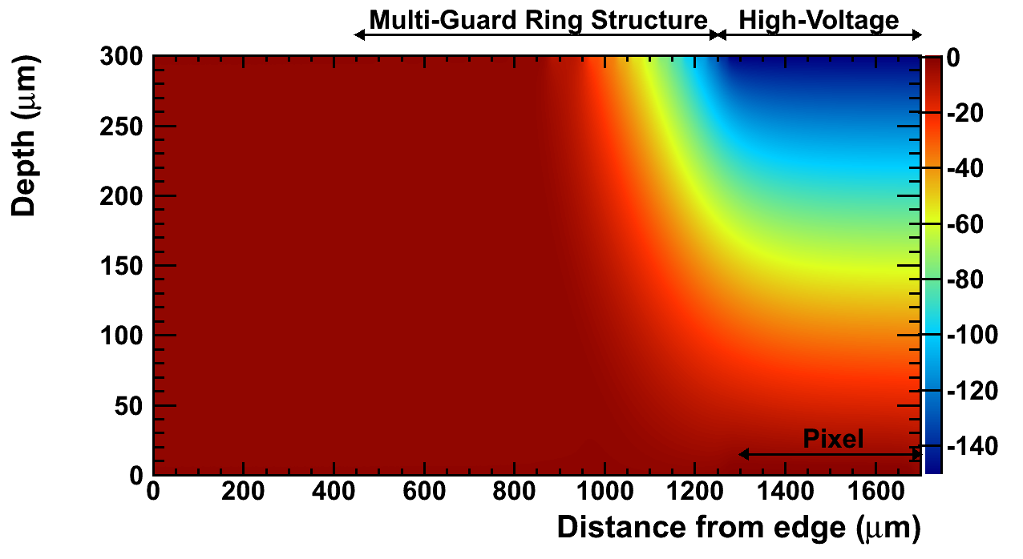
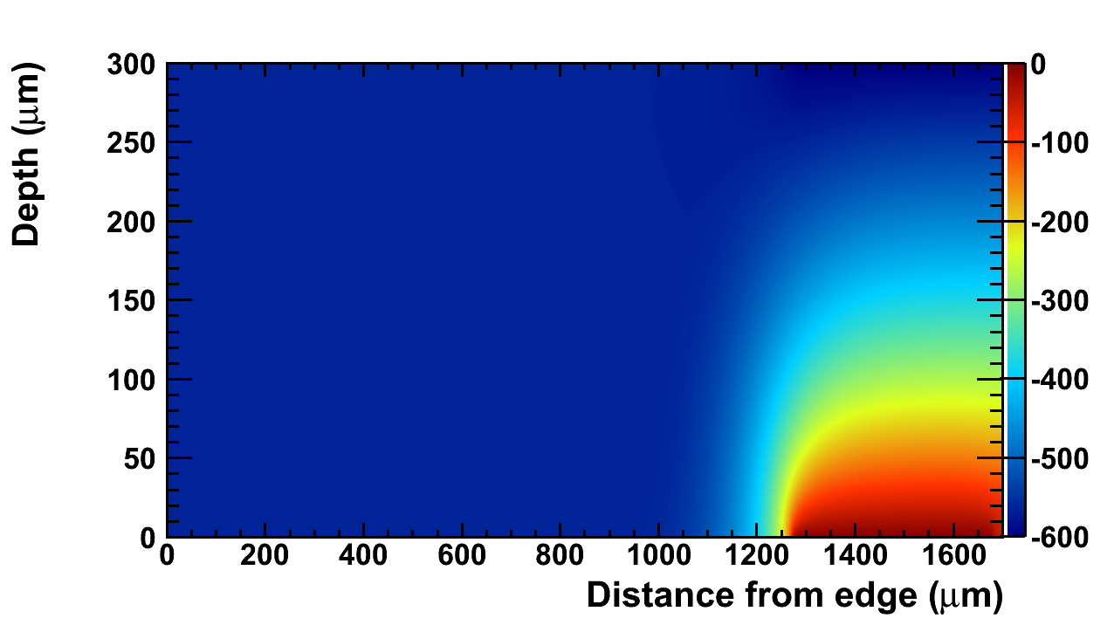
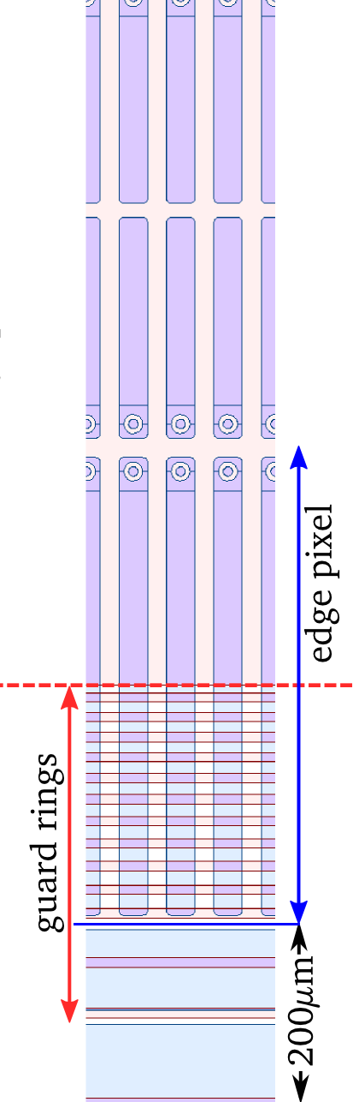
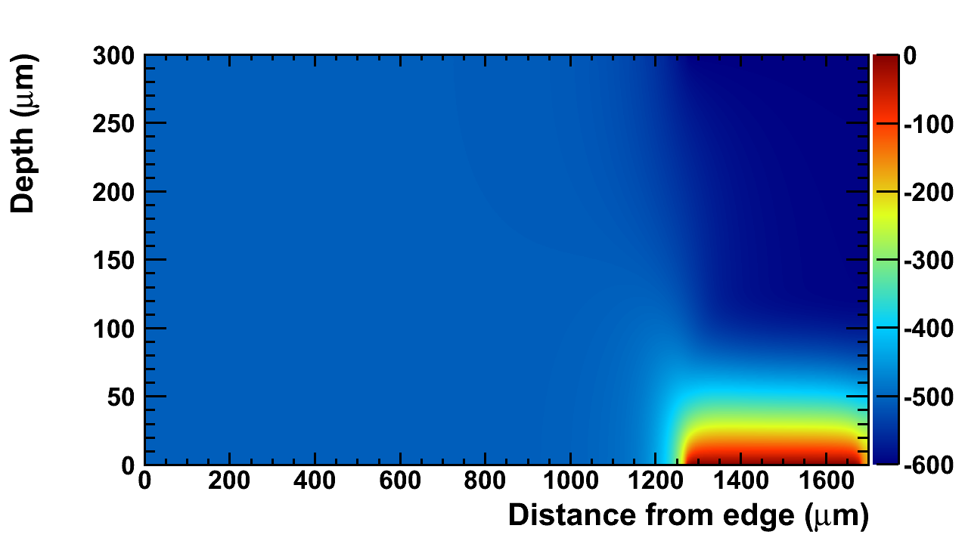
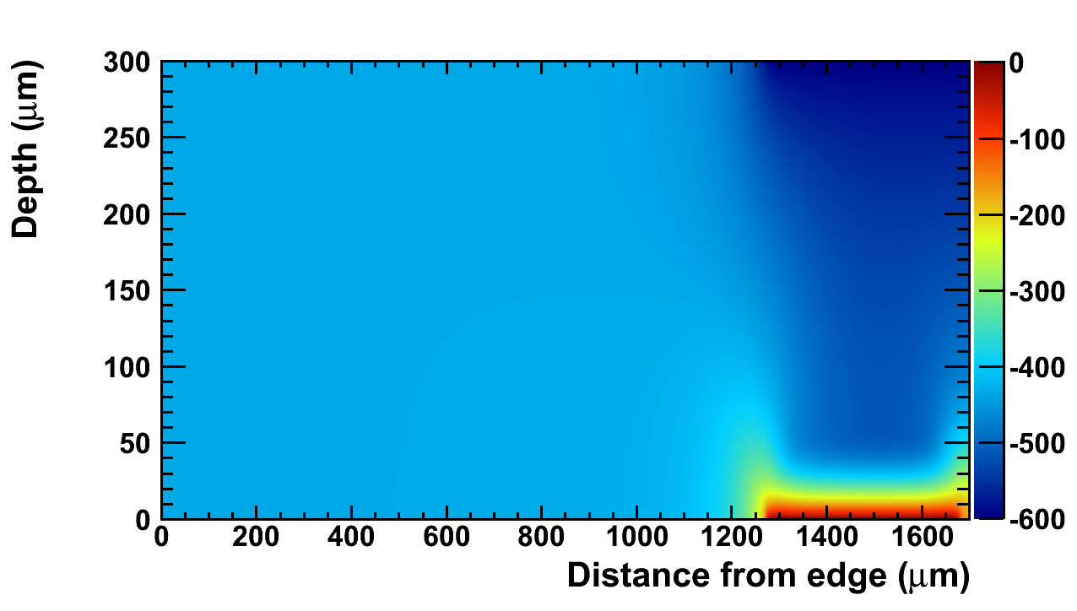
ATLAS Guard Ring Simulation and Space-Charge Sign inversion (SCSI)
0 n_{eq}/cm²
Voltage (V)
1e14 n_{eq}/cm²
Voltage (V)
1e15 n_{eq}/cm²
Voltage (V)
Voltage (V)
5e15 n_{eq}/cm²
Simulation of Radiation Damage Effects on Planar Pixel Guard Ring Structure for ATLAS Inner Detector Upgrade
by: M. Benoit, A. Lounis, N. Dinu
Nuclear Science, IEEE Transactions on, Vol. 56, No. 6. (08 December 2009), pp. 3236-3243, doi:10.1109/TNS.2009.2034002

Slide 25
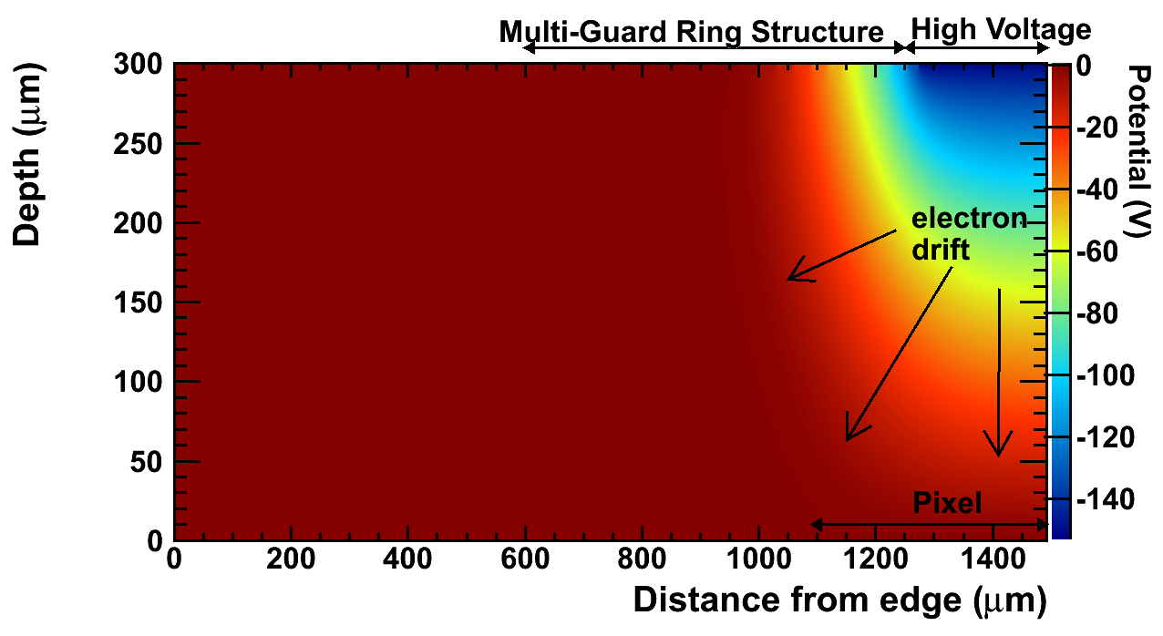
ATLAS Guard Ring Simulation and Space-Charge Sign inversion (SCSI)
0 n_{eq}/cm²
Voltage (V)
1e14 n_{eq}/cm²
Voltage (V)
1e15 n_{eq}/cm²
Voltage (V)
Voltage (V)
5e15 n_{eq}/cm²
Simulation of Radiation Damage Effects on Planar Pixel Guard Ring Structure for ATLAS Inner Detector Upgrade
by: M. Benoit, A. Lounis, N. Dinu
Nuclear Science, IEEE Transactions on, Vol. 56, No. 6. (08 December 2009), pp. 3236-3243, doi:10.1109/TNS.2009.2034002

Slide 26
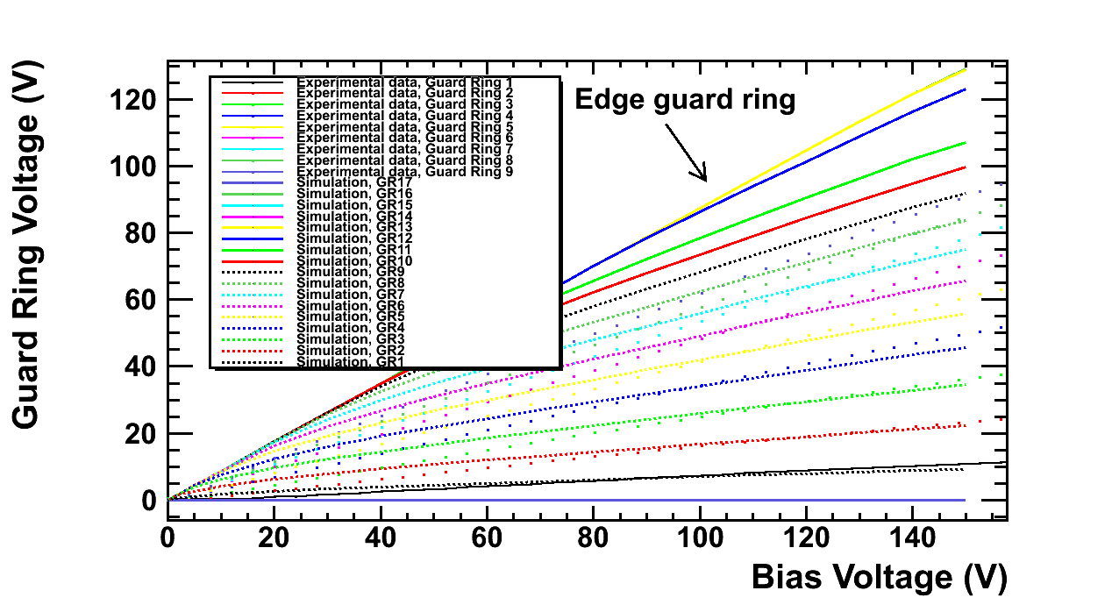
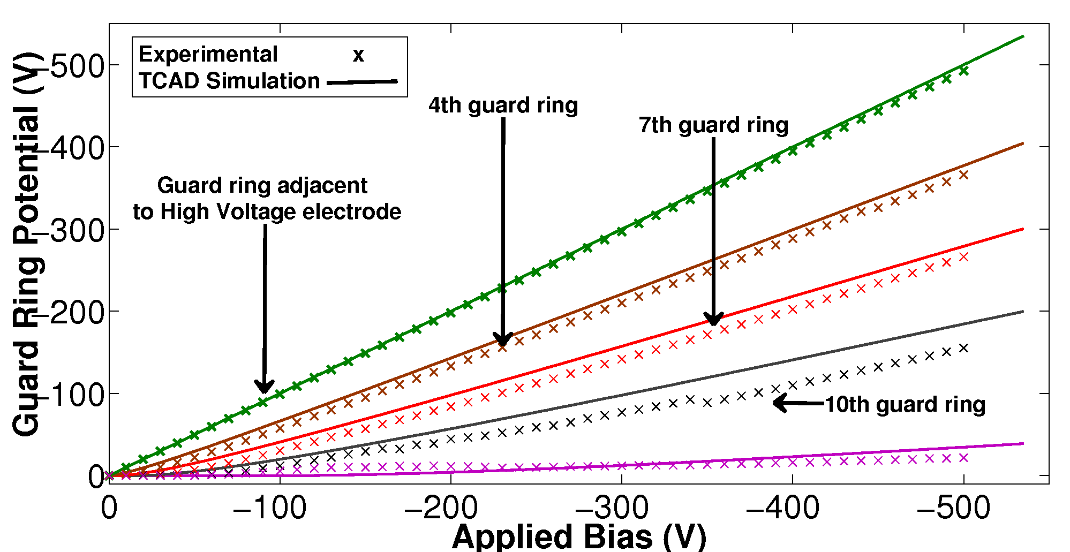
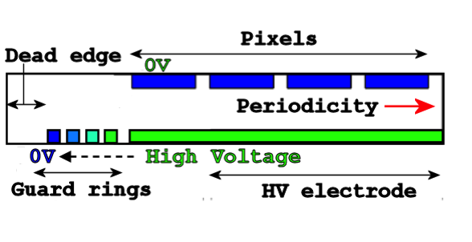
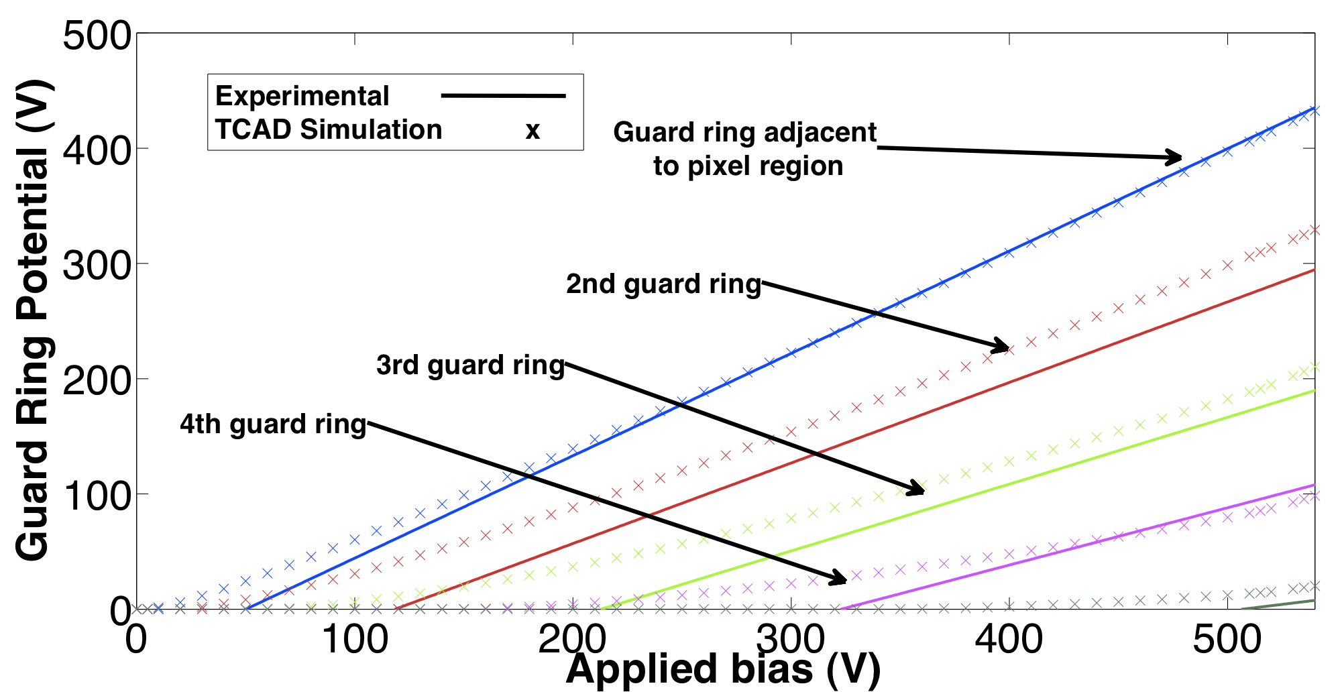
ATLAS GR : Measurement vs Simulation
small GR n-in-p
n-in-n
Very good agreement between simulation and data when using adequate technological parameters!
Large GR n-in-p

Slide 27
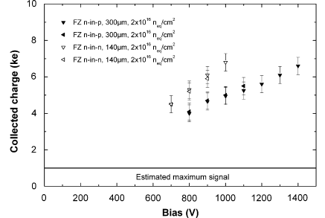
Charge multiplication in silicon planar sensors
Measurements performed on diodes irradiated to sLHC fluence show anomalous charge collection
The idea has been to use the radiation damage model in TCAD and include the impact ionization and trap-to-band tunnelling into the simulation to see if these physical effects can reproduce the observed behavior
Expected signal , thin and thick sensors
G. Casse and al., “Evidence of enhanced signal response at high bias voltages in pla- nar silicon detectors irradiated up to 2.2x10e16 neq cm-2,” Nucl. Instrum. Meth. A , j.nima.2010.04.085,, vol. In Press, Corrected Proof, pp. –, 2010.
M. Mikuz, V. Cindro, G. Kramberger, I. Mandic, and M. Zavrtanik, “Study of anoma- lous charge collection efficiency in heavily irradiated silicon strip detectors,–,j.nima, 2010.

Slide 28
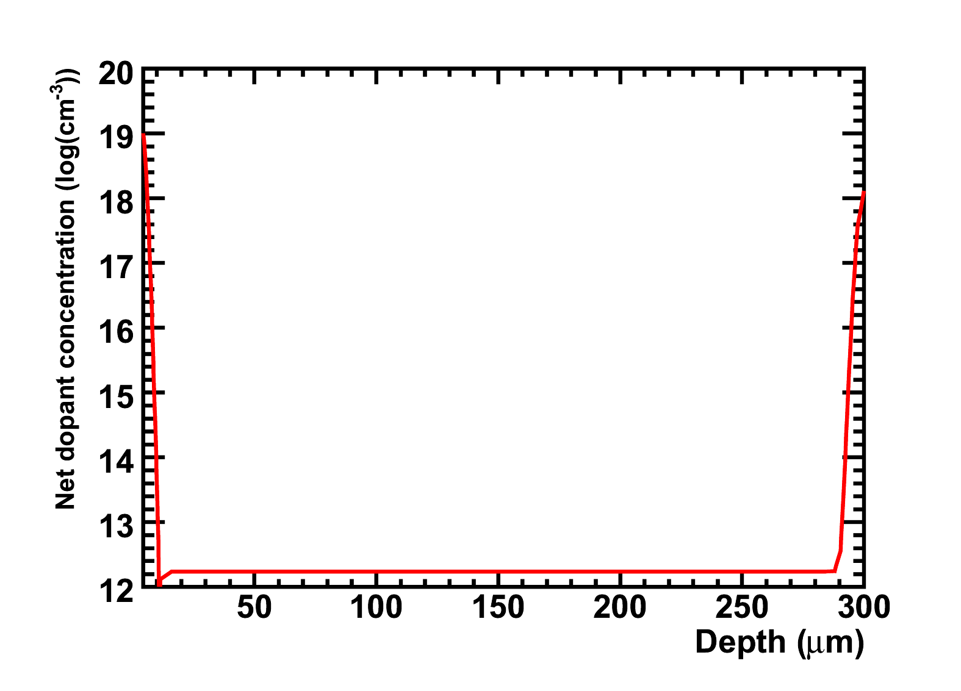
An example : 1D heavily irradiated n-in-p diode
A simple 1D p-type diode, n readout
Neff = 1.74e12/cm3
140 and 300 microns thickness
2KΩcm resistivity, high implant peak concentration (1e17-18/cm3)
To simulate the CCE curve of the irradiated detector, We:
  1. Generate a mip-like charge distribution with a 1060nm laser, 0.05W/cm2
  2. Perform transient simulation over 25ns for each bias
  3. Numerical integration of resulting current minus pedestal
  4. Numerical integration of available photocurrent
  5. CCE= Qpulse / Qphotocurrent

Slide 29
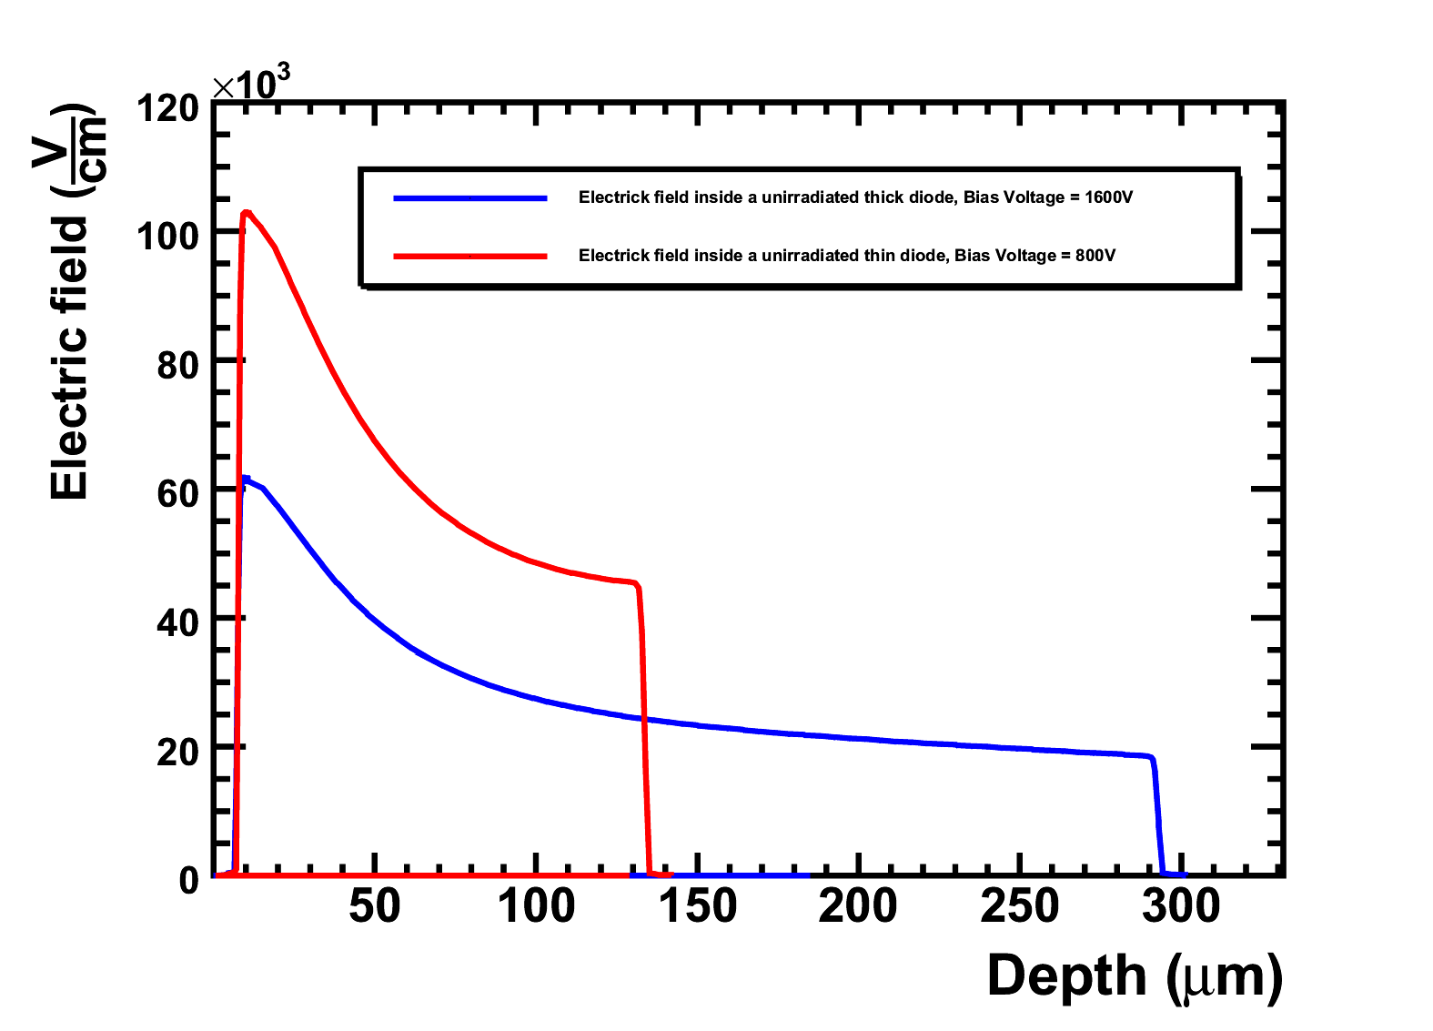
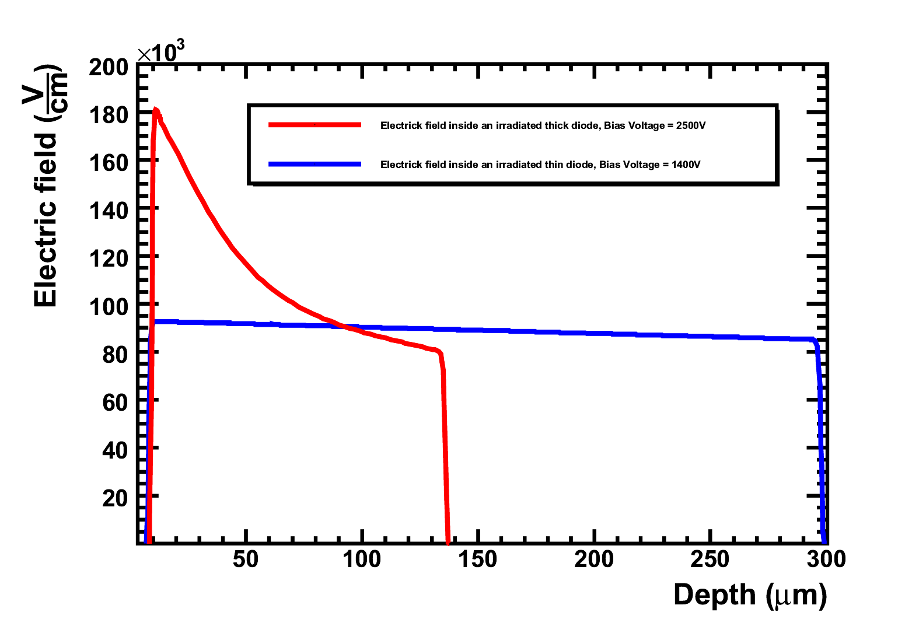
Electric field profiles
Electric field before hard junction breakdown.
800V
Unirradiated
1400V
1e16 n_{eq}/cm²
2500V
1600V
Sensor can be biased to HV after irradiation without
reaching hard breakdown allowing multiplication in the
high electric field produced by this bias

Slide 30
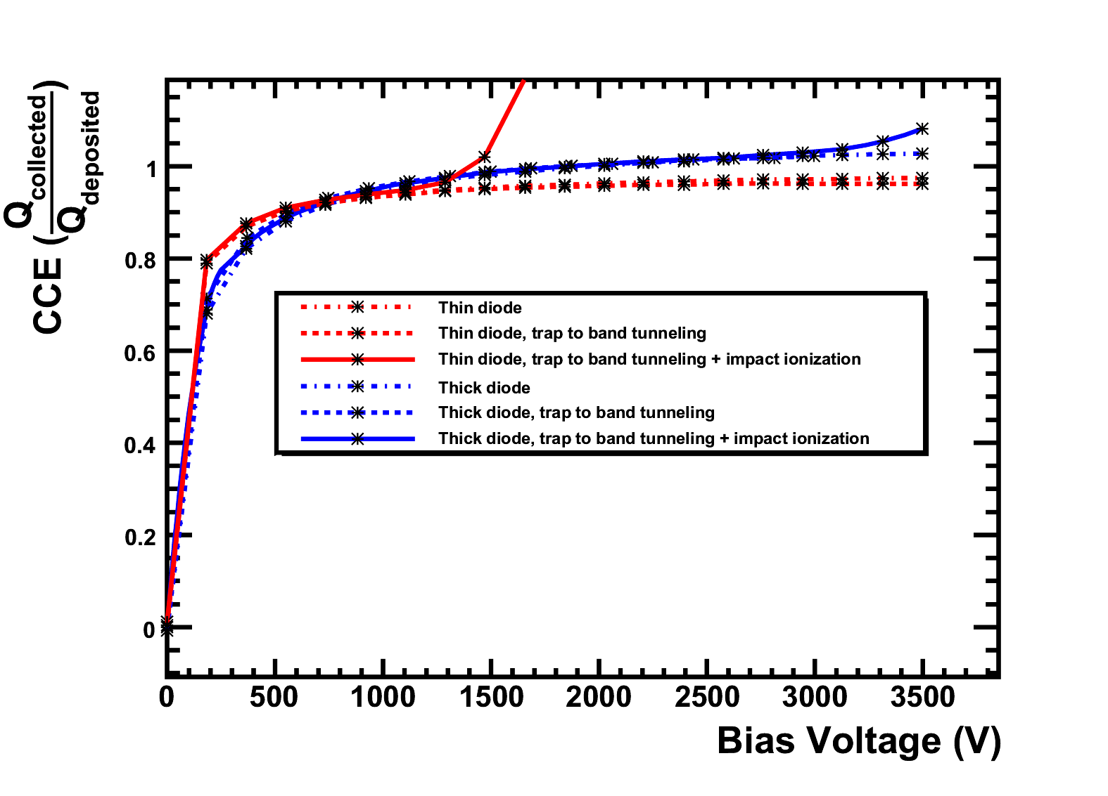
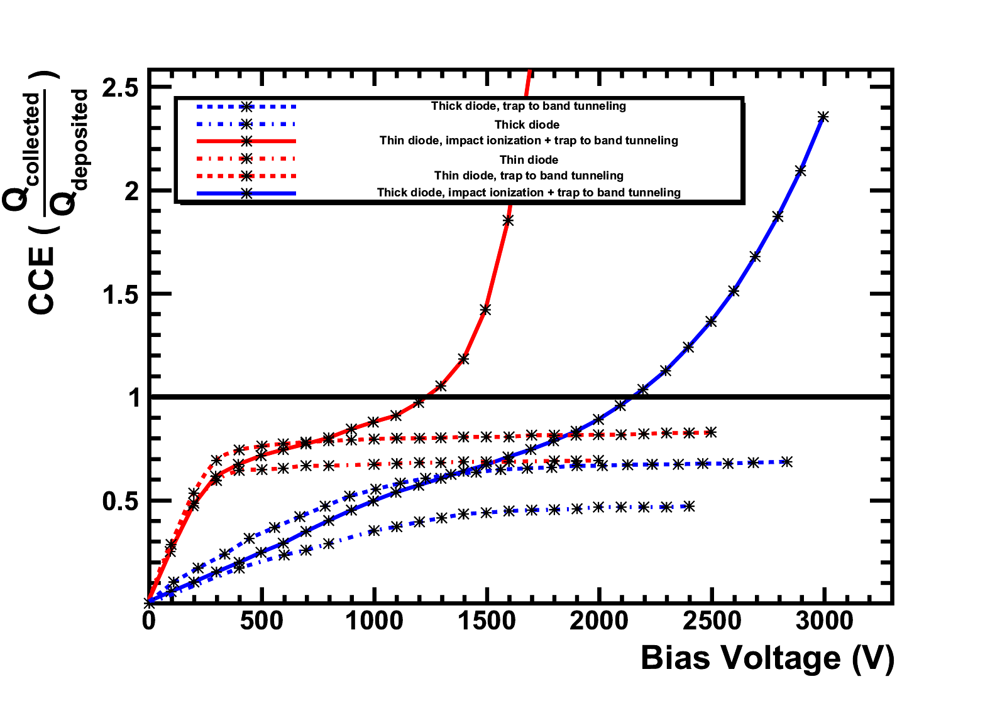
Charge collection efficiency
1e16 n_{eq}/cm²
Unirradiated
Unirradiated diode unaffected by TTBT and II
are off. However, they both contribute to CCE after
irradiation because of the presence of the > 200kV/cm field
Simulation of charge multiplication and trap-assisted tunneling in irradiated planar pixel sensors
by: M. Benoit, A. Lounis, N. Dinu
In IEEE Nuclear Science Symposuim & Medical Imaging Conference (October 2010), pp. 612-616, doi:10.1109/NSSMIC.2010.5873832

Slide 31
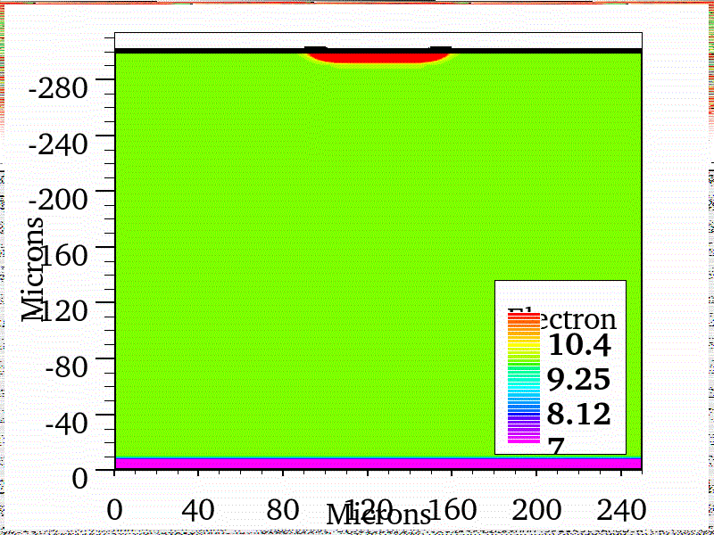

Charge multiplication in silicon planar sensors
Particle
Eye Candy : Visualization of Charge multiplication in a N-in-P Strip Detector

Slide 32
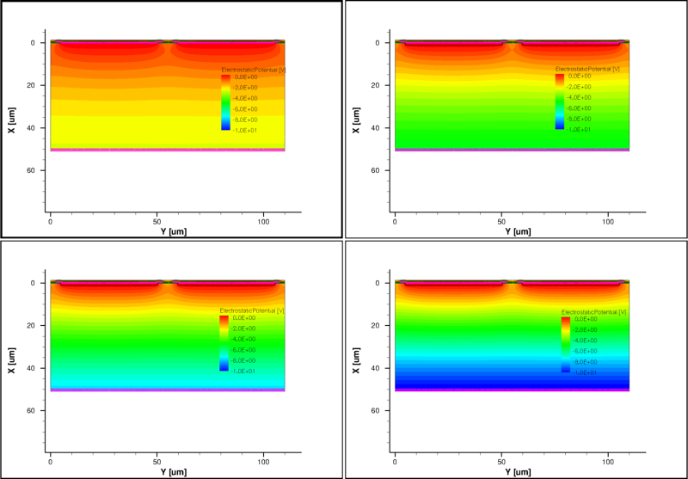
Device Simulation: Potential distribution
50 um thin sensor are foreseen for the CLIC Vertex Detector. The thickness, combined to 4-5T Magnetic field, calls for operating the sensor at saturation of carrier mobility. TCAD was use to observe the variation of the Electric Potential in the sensor in different biasing conditions. These distribution are then use as an input for digitization in Monte-Carlo simulations
-2.5V
-5V
-7.5V
-10V
Potential Distribution in a 50 um thick Timepix n-in-p sensor

Slide 33
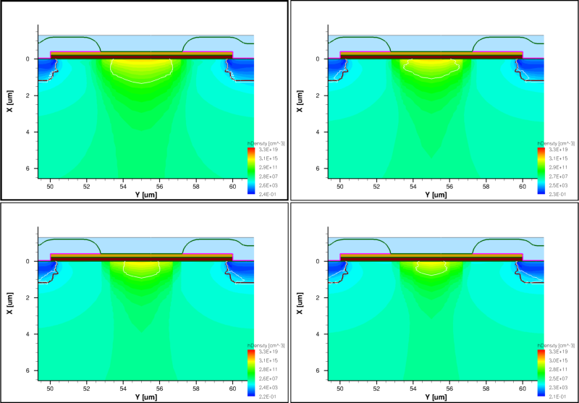
P-spray insulation
Pixel
Pixel
P-Spray (or p-stop,moderated p-spray) is an important parameter in the design of radiation hard sensors. TCAD can be used to optimize process parameters to maximize insulation while keeping breakdown high (E< 300kV/cm at Channel stopper junction).
Channel stopper
-2.5V
-5V
-7.5V
-10V
Channel stopper in n-in-p Timepix Pixel sensor for various biasing conditions (Hole Concentration represented)

Slide 34
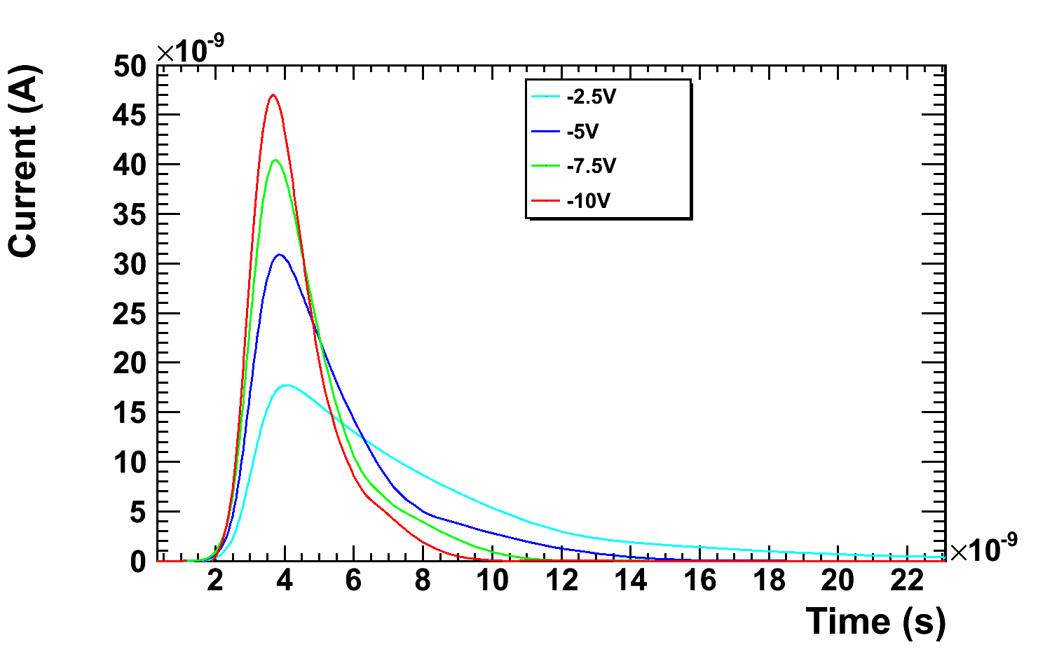
Pulse Shape and Rise time
Pulse shape and rise time can be of interest for chip designers. CLIC performed Transient TCAD simulation for 50um thin sensors to investigate pulse shape and rise time in sensor foreseen for CLIC Vertex detectors
50 um thick sensors, 55um pitch (Timepix) , 45um electrodes

Slide 35
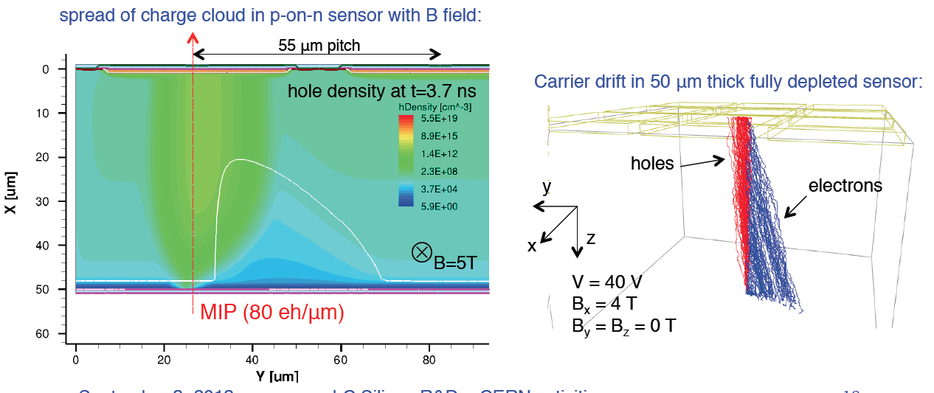
Magnetic Field Effects
In CLIC, combination of high Magnetic Field and thin sensors can lead to large Lorentz angle , TCAD was used to estimate the magnitude of these effects for various operation condition. Monte-Carlo Charge transport combined with Electric field obtained from TCAD was used to estimate clustersize and shapes

Slide 36
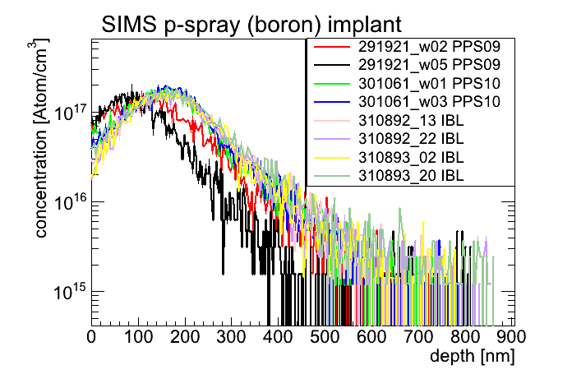
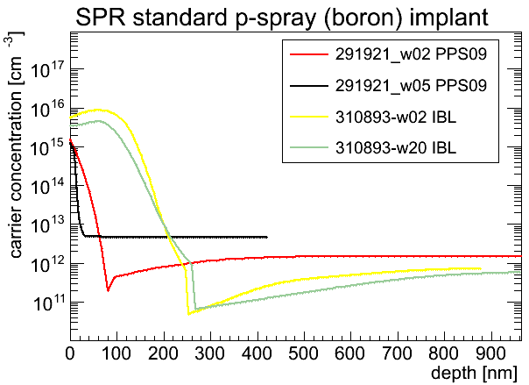
From measurements to prediction
TCAD softwares offer a large parameter space to fit measurements
Optimization packages are available within the softwares to fit data to simulation by varying a few parameters
Knowing well the characteristics of the simulated structures is very helpful to produce quantitative results
  Doping/Active dopant profile
  Mask design and processing parameters

Slide 37
Conclusion
TCAD simulation proves to be a powerful tool for studying the behavior of rather complex semiconductor structure
  Qualitative results reproducing main aspects of radiation damage can be performed easily
  Further work with test structure and extensive characterization is needed to produce more quantitative results
Commercial TCAD software are mature products that have proven the usefulness
  Large user base
  Fast, well coded software, ready to use by a non-programmer
  Careful and detailed tuning of radiation damage model, secondary and tertiary semiconductors by the HEP community would be a wonderful addition to the TCAD toolbox
Thank you !

Slide 38
Publications
[1] M. Benoit, A. Lounis, and N. Dinu, “Simulation of charge multiplication and
trap-assisted tunneling in irradiated planar pixel sensors,” in IEEE Nuclear Science Symposuim & Medical Imaging Conference. IEEE, Oct. 2010, pp. 612–616. [Online]. Available: http://dx.doi.org/10.1109/NSSMIC.2010.5873832
[2] J. Weingarten, S. Altenheiner, M. Beimforde, M. Benoit, M. Bomben, G. Calderini, C. Gallrapp, M. George, S. Gibson, S. Grinstein, Z. Janoska, J. Jentzsch,
O. Jinnouchi, T. Kishida, A. La Rosa, V. Libov, A. Macchiolo, G. Marchiori,
D. Münstermann, R. Nagai, G. Piacquadio, B. Ristic, I. Rubinskiy, A. Rummler,
Y. Takubo, G. Troska, S. Tsiskaridtze, I. Tsurin, Y. Unno, P. Weigel, and T. Wittig,
“Planar pixel sensors for the ATLAS upgrade: Beam tests results,” Apr. 2012.
[Online]. Available: http://arxiv.org/abs/1204.1266
[3] M. Benoit, J. Märk, P. Weiss, D. Benoit, J. C. Clemens, D. Fougeron, B. Janvier,
M. Jevaud, S. Karkar, M. Menouni, F. Pain, L. Pinot, C. Morel, and P. Laniece,
“New concept of a submillimetric pixellated silicon detector for intracerebral
application,” Nuclear Instruments and Methods in Physics Research Section A:
Accelerators, Spectrometers, Detectors and Associated Equipment, Aug. 2011.
[Online]. Available: http://dx.doi.org/10.1016/j.nima.2011.08.027
[4] G. Calderini, M. Benoit, N. Dinu, A. Lounis, and G. Marchiori, “Simulations of
planar pixel sensors for the ATLAS high luminosity upgrade,” Nuclear Instruments and Methods in Physics Research Section A: Accelerators, Spectrometers, Detectors and Associated Equipment, Apr. 2010. [Online]. Available: http://dx.doi.org/10.1016/j.nima.2010.04.082
[5] M. Benoit, A. Lounis, and N. Dinu, “Simulation of charge multiplication and
trap-assisted tunneling in irradiated planar pixel sensors,” CERN, Geneva, Tech.
Rep. ATL-UPGRADE-INT-2010-002, Oct. 2010.
[6] ——, “Simulation of radiation damage effects on planar pixel guard ring structure for ATLAS inner detector upgrade,” Nuclear Science, IEEE Transactions on, vol. 56, no. 6, pp. 3236–3243, Dec. 2009. [Online]. Available:
http://dx.doi.org/10.1109/TNS.2009.2034002
[7] L. A. Hamel, M. Benoit, B. Donmez, J. R. Macri, M. L. McConnell, T. Narita, and
J. M. Ryan, “Optimization of Single-Sided Charge-Sharing strip detectors,” in
Nuclear Science Symposium Conference Record, 2006. IEEE, vol. 6, Nov. 2006, pp. 3759–3761. [Online]. Available: http://dx.doi.org/10.1109/NSSMIC.2006.353811
[8] A. Lounis, D. Martinot, G. Calderini, G. Marchiori, M. Benoit, and N. Dinu,
“TCAD simulations of ATLAS pixel guard ring and edge structure for SLHC
upgrade,” CERN, Geneva, Tech. Rep. ATL-COM-UPGRADE-2009-013, Oct. 2009.
[9] M. Benoit and L. A. Hamel, “Simulation of charge collection processes in
semiconductor CdZnTe -ray detectors,” Nuclear Instruments and Methods in Physics Research Section A: Accelerators, Spectrometers, Detectors and Associated
Equipment, vol. 606, no. 3, pp. 508–516, Jul. 2009. [Online]. Available:
http://dx.doi.org/10.1016/j.nima.2009.04.019
[10] M. Benoit, A. Lounis, and N. Dinu, “Simulation of guard ring influence on the
performance of ATLAS pixel detectors for inner layer replacement,” J. Inst., vol. 4, no. 03, 2009. [Online]. Available: http://www.iop.org/EJ/abstract/-search=66292014.1/1748-0221/4/03/P03025
Thesis (in english) :Étude des détecteurs planaires pixels durcis aux radiations pour la mise à jour du détecteur de vertex d'ATLAS

Slide 39
Simulation of detector behaviour : MC Charge Transport
Monte-Carlo approach to simulation of charge transport of e/h in Silicon (Home code)
Drift in E Field
Diffusion (Random walk, smearing)
Trapping
Temperature effects
From TCAD : Ramo Potential
From TCAD : Electric field
CCE
Charge sharing
Angular, temperature dependence
From Geant4, other: energy deposition along track
From TCAD/ANSYS : Temperature distribution
Trajectories

Slide 40
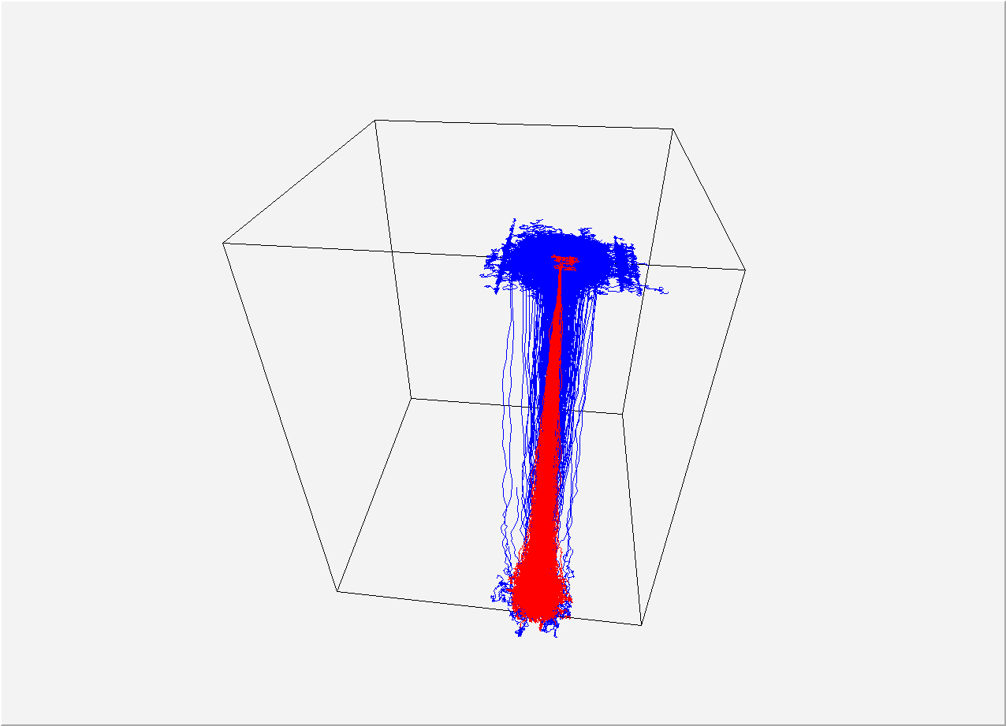
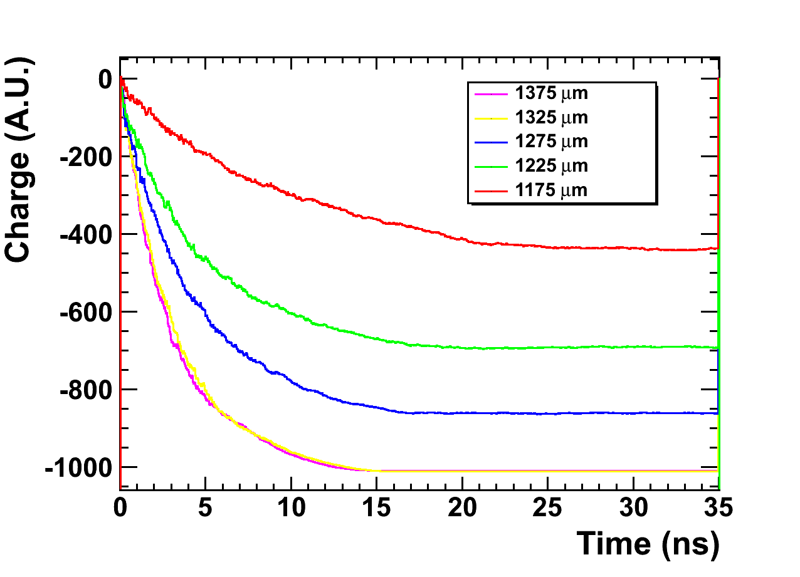
Simulation of detector behaviour : MC Charge Transport
MC Charge transport act as a middle man between TCAD simulation and simple digitisation.
It provides a “fast” method to obtain important value regarding the sensor, taking advantage of TCAD data
The MC should be use as a basis to provide data on expected shape of parameterization functions used in further digitization
Another approach is to directly use MC parameters and fit them to experimental data
(More time consuming)

Slide 41
Simulation of detector behaviour : GEANT4 simulation and digitization calibration
The final goal of the simulation is to produce a fast digitizer reproducing well the behaviour of prototypes, usable in full detector simulation
Use Test Beam telescope data to compare real DUT and Simulated DUT to validate the digitizer
Incorporate chip effects into the simulation at this level
  Counter accuracy
  timing accuracy
  Noise, jitter of the DAC
  Threshold
  Crosstalk
  Non-linearity in the analog acquisition chain
  Inefficiency in the Digital buffers etc
  SEE succeptibility
Telescope (sim and data) are a good benchmark for clustering algorithm

Slide 42
Simulation of detector behaviour : GEANT4 simulation and digitization calibration
Using a detailed GEANT4 framework reproducing a well know telescope setup (EUDET), we can compare and tune the digitizer to represent well prototype behaviour by comparing real data and simulation in the reconstruction and analysis framework of the telescope
EUDET Telescope + DUT data
Analysis plots:
Charge collection,
Cluster size
Efficiency
ILCSoft reconstruction
EUDET Telescope + DUT Simulation

Slide 43
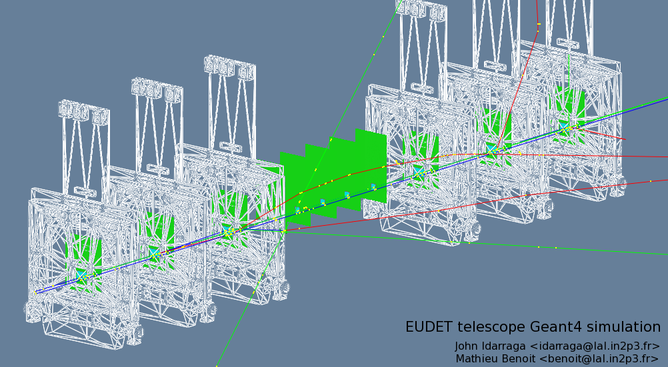
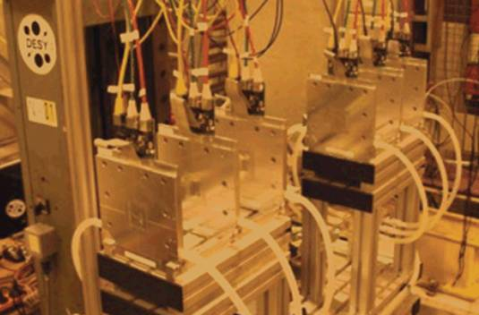
Example

Slide 44
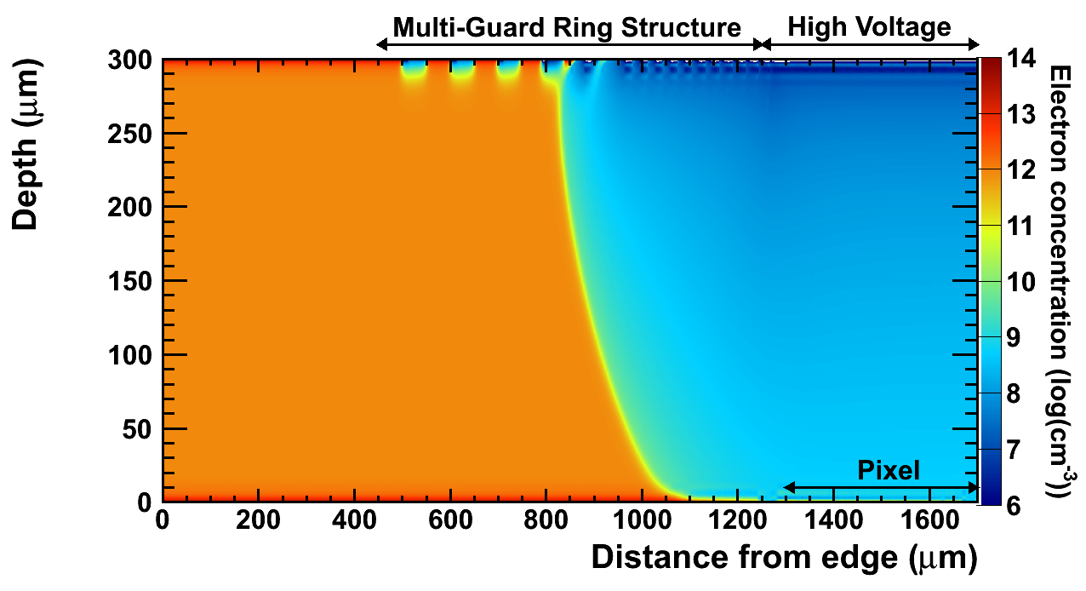
Tricks for meshing properly
Paradoxally, One need a good idea of the solution to guide the meshing algorithm
  Mesh length not more that ¼ of feature length (ex : Junction, electrodes, high E Field area)
  Mesh length must be adjusted to the characteristic length of physical phenomenom important locally in the model (inversion channels , charge multiplication by impact ionization )
It is much more dangerous to reduce mesh size to save time than to add too many nodes
Convergence study are eventually the best method to see how mesh influence the solution

Slide 45
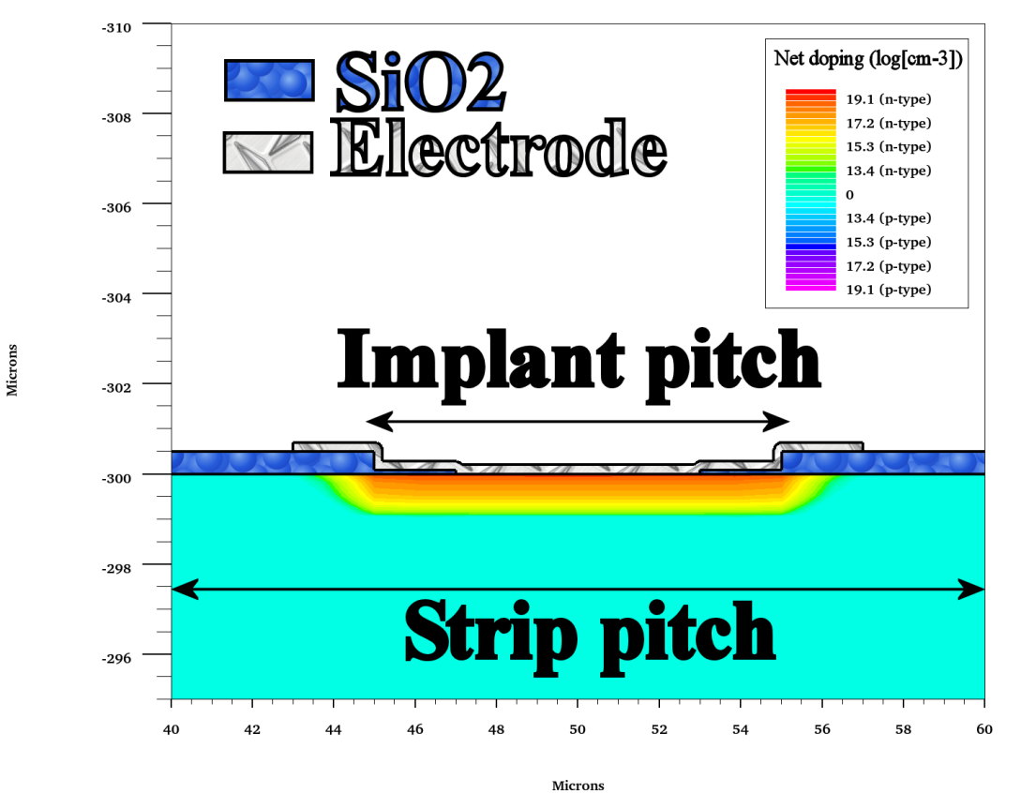
2D simulation : Strips with various doping profile and geometry
A set of n-in-p strip sensor with different strip and implant pitch , and with different intermediate strip pitch was studied
Strip pitch (μm) | Implant width (μm)
80 | 60
80 | 25
80 | 6
100 | 70
100 | 33
100 | 10
40 | 27
40 | 15
40 | 6

Slide 46


2D simulation : Strips with various doping profile and geometry
Each sensor was biased at 2000V, and simulated for a fluence of 10^{14,15,16} n_{eq}/cm²
Moderate p-spray insulation between strips
Classical implantation for n strip implant
Drive-in 100 min @ 900C

Slide 47


2D simulation : Leakage current
Leakage from different strip pitch not influenced by the pitch
Hard breakdown of the junction at the strip extremity lower for small implant pitch/ strip pitch ratio
α =1.9e-17A/cm
Contribution from Trap-to-band tunelling and impact ionization visible in leakage current about 1e15 n_{eq}/cm²

Slide 48










2D simulation : Electric field (at 10¹⁴ n_{eq}/cm²)
Strip
pitch
40 µm
80 µm
100 µm
30 µm depth represented
Implant
width = 6 µm
15 µm
27 µm
6 µm
25 µm
60 µm
10 µm
33 µm
70 µm

Slide 49









2D simulation : Electric field (at 10¹⁵ n_{eq}/cm²)
Strip
pitch
40 µm
80 µm
100 µm
30 µm depth represented
Implant
width = 6 µm
15 µm
27 µm
6 µm
25 µm
60 µm
10 µm
33 µm
70 µm

Slide 50










2D simulation : Electric field (at 10¹⁶ n_{eq}/cm²)
Strip
pitch
40 µm
80 µm
100 µm
30 µm depth represented
Implant
width = 6 µm
15 µm
27 µm
6 µm
25 µm
60 µm
10 µm
33 µm
70 µm

