Slide 1
Weekly CENF meeting
19 Feb 2013

Slide 2
Project status
Project presented to the SPSC (15/1)
LOI presented to the DG and distributed to the enlarged CERN management + others (11/2)
Research Board presentation (4/3)
Goal : Council approval June 2013
Detailed engineering and procurements have to start now!

Slide 3
Project Organization
Central office (interface to experiments, CERN and general infrastructure WPs, to the outside, steering of the overall project/schedules and the central budgets)
A set of general infrastructure WPs (agreed with departments and project office)
3 sub-projects with their internal organization
  Primary beam
  Secondary beam
  Detectors facilities
Central office composition (PL + Deputy, 3 sub-projects coordinators)

Slide 4
meetings
Weekly general meeting (probably Thursdays afternoon)
Weekly project office meeting (s)
Ad hoc sub-projects working meetings
General meetings with experiments still to be dedefined (early Thusdays afternoons?)

Slide 5
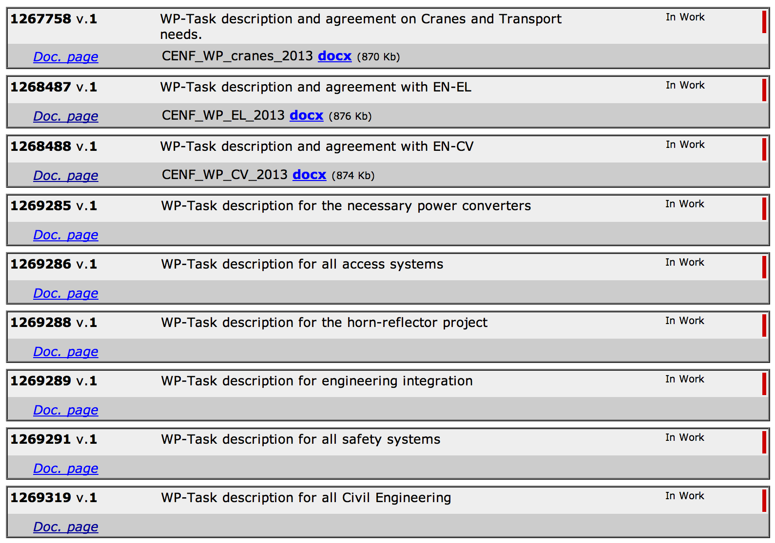
Possible WPs

Slide 6
Critical items to be started before June
TT20 instrumentation
Junction cavern engineering
3/4 critical magnets power converters
Extraction magnets design and construction
Detailed CE drawings and specs for near and far facility + construction permits
Environmental study for primary and secondary beams + carotage+ construction permits

Slide 7
resources
Cap : 100M for contracts/investments, 25M/year
+ CERN manpower and FSUs to be discussed case by case (CERN priorities to be established)
Some of the resources might go to the CERN consolidation plans
We need urgently to indicate the financial needs for commitments before July 2013
We have to investigate the possibility of specific in-kind contributions

Slide 8
To CERN consolidation plans (examples)
TT20 instrumentation
EHN1 as a new test beam facility (near facility + infrastructure)
Beams interlock and access systems
Various roads to be constructed

Slide 9
Example of possible in-kind
Standard Fe shielding blocks
Graphite target and hadron absorbers blocks
Secondary and primary beam civil engineering detailed studies
…
…

Slide 10
Today’s discussion
Junction cavern
Carotages layout
List of very critical and urgent items
List of necessary ad-hoc meetings

