Slide 1
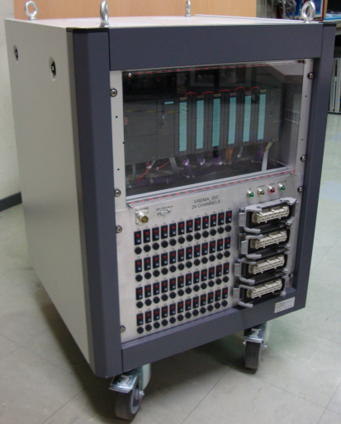
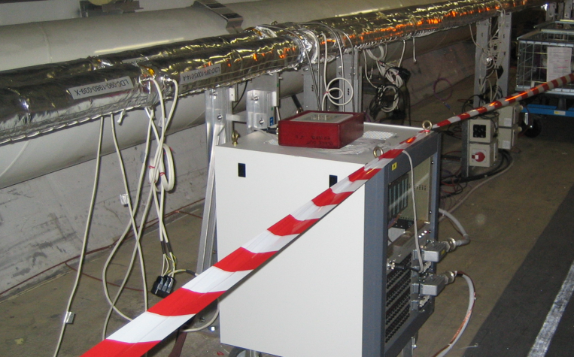
Introduction to the
New Hardware and Software of the
Bake-out Rack
Sebastien Blanchard TE/VSC
Interlocks, Controls and Monitoring Section

Slide 2


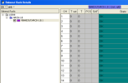

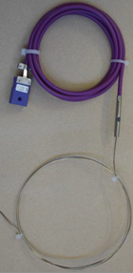
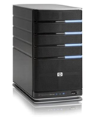
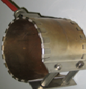
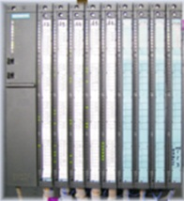


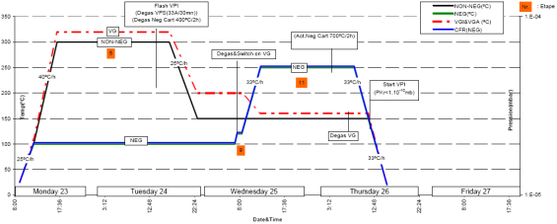
Bake-out Rack, What is it?
Output Interlocks
(Clients)
Input Interlocks (Clients)
Remote
User
8 Additional Temperatures for interlocks
Hardware V.2 Only
Ethernet
“Labs”
Hardware V.2
Programmable
Logical Controller(PLC)
With Power Relays for
24 Regulation Channels
SMS Notification
Ethernet
“Labs”
Hardware V.2
PVSS
Server
PID Regulation
Thermocouple
Heater
Profibus
“Machine”
Touch
Panel
Outgassing Bake-out
or NEG Activation Bake-out
Master PLC
Local User
Bake-out Recipe/Program
NS

Slide 3
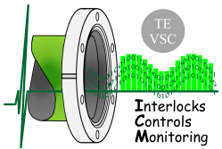
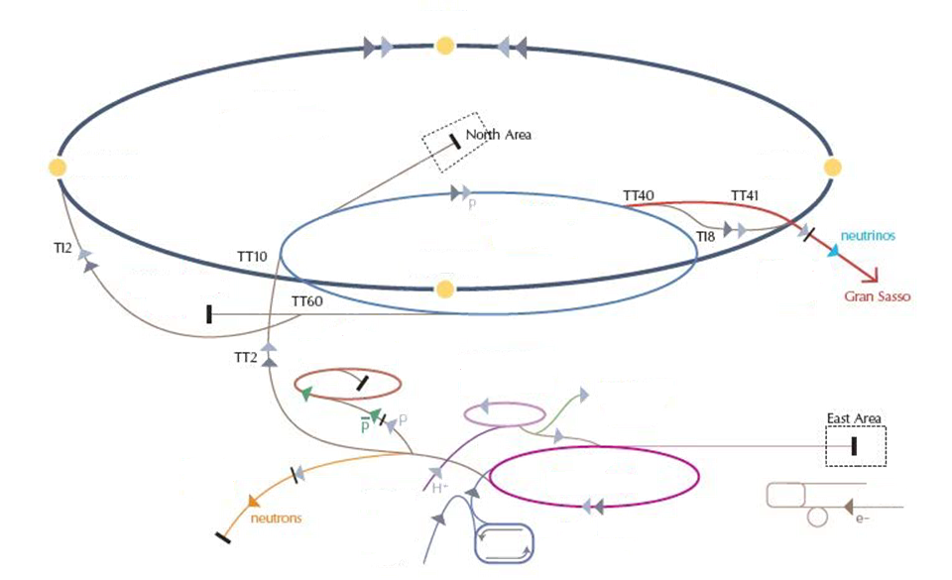
PLC Bake-out Racks, Where?
TOTAL: 103 Bake-out Racks (PLC), first in 2002
LHC : LSS & Experiments
SPS:
Beam Diagnostics
AD
ISOLDE : Rexebis
Vacuum Labs
&Test Benches
(Bldg 113, 30, 169, 867, 101,…)
Booster : Ion Pumps & Septa
PS:
Ion Pumps & Septa
CTF
LEIR
NS

Slide 4


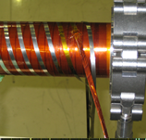

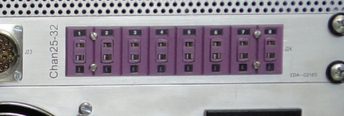

Bake-out Rack
Hardware V.2 and New Software, Why?
Ultra High Vacuum
&
Bake-out
Fragile
Equipment
Specific
Heating System
Main New features :
  SAFETY :
  8 Additional Thermocouple channels for Control & Interlock
  Power Cut System: if ‘Error’ Power Relays Circuit Breaker is switched Off
  PERFORMANCE :
  New parameterized PID regulation with auto-tune system
  FLEXIBILITY :
  Number of Recipes/Programs from 6 to 12
  Old Software version is more than 10 years old
NS

Slide 5
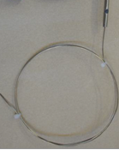



Safety system
Example:
Heater
TC
TC
uncoupled!
Unexpected Event!
If $\left|ProcessValue −SetPoint\right|>50℃$
Then “Stop Channel”
Other Safety functionalities :
  Heater Power Limitation (Software limitation, % of the Max Heater Power)
  Fuse (Hardware limitation)
NS

Slide 6
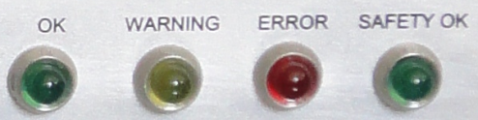
Safety Levels (New Software)
Default Safety Level !
Channel Status (Error Code) |  |  |  |  |  |  |  | ACTION
 |  |  |  |  |  |  |  | LEVEL 1 Safety OFF Power Cut OFF |  | LEVEL 2 Safety ON Power Cut OFF |  | LEVEL 3 Safety OFF Power Cut ON |  | LEVEL 4 Safety ON Power Cut ON
OK |  |  |  |  |  |  |  | N/A
Power 0% |  |  |  |  |  |  |  | N/A
Power 100%
Control Channel Warning
∆T > 15ºC
∆T > 25ºC
TC Open Cable or PV > 900ºC |  |  |  |  |  |  |  | STOP CHANNEL
Control Channel Interlock (Error)
Power 100% (>10 min.) |  |  |  |  |  |  |  | N/A |  | (Switch OFF channel power command)
Control Channel Interlock overshoot (> 10 min.) |  |  |  |  |  |  |  |  |  |  |  | SHUT DOWN ALL CHANNELS POWER RELAYS
∆T > 50ºC
External Interlock 1 or 2
∆T = │Set Point - Process Value │
 | : No Error/Warning
 | : Warning
 | or |  | : Error
Why shutting down all power relays?
In case of a ‘short circuit’ power relay or a cabling inversion, stopping channel will not stop the heater involved
Stopping only one channel may induce dangerous thermal constraints (Ex: Sector Valves)
PLC is always power supplied, local control (touch panel) and remote access are still available during a power relays shutdown.
SMS
Notification
NS

Slide 7
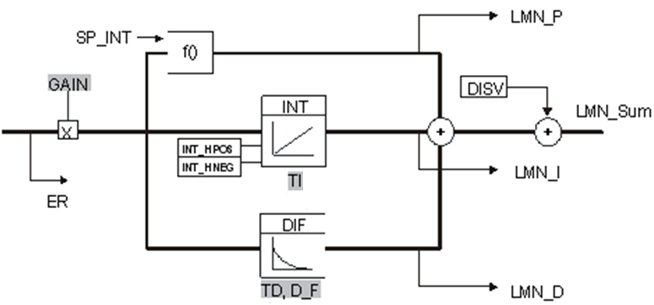

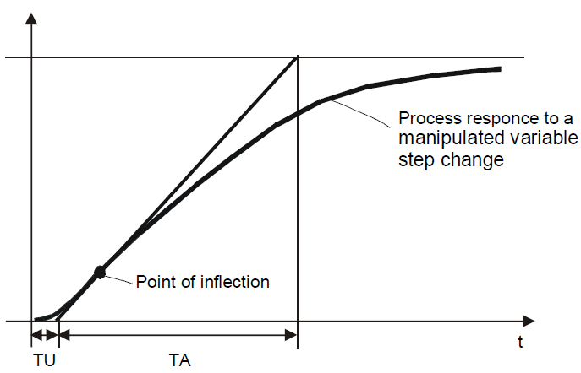
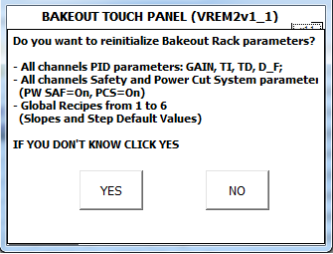
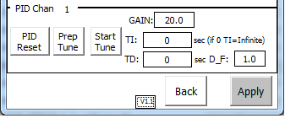
New Software : New Regulation
PID ALGORITHM
Following values can be parameterized by user
GAIN proportional gain
TI integral time (second)
TD derivative time (second)
D_F derivative factor
(Old software only Proportional GAIN and Derivative factor)
AUTO TUNE
Tune Request:
Using the point of inflection, the lag time (TU) and process time constant (TA)
the software automatically set the PID parameters.
Use ‘Auto Tune’ only for specific bake-out systems
DEFAULT VALUES
Don’t worry!
If you don’t want to parameter the rack,
default values (compatible with Standard Bake-out)
are re-initialized when PLC CPU restarts
Touch Panel: PID Parameters
Touch Panel: Re-Init Panel
NS

Slide 8
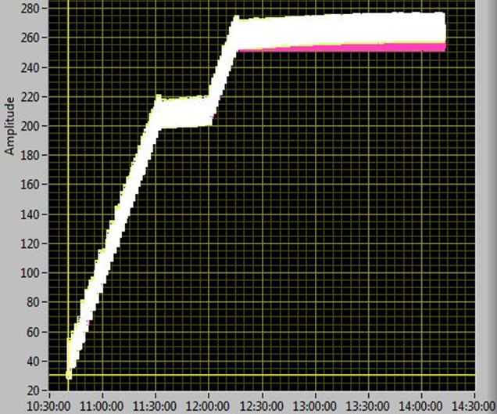
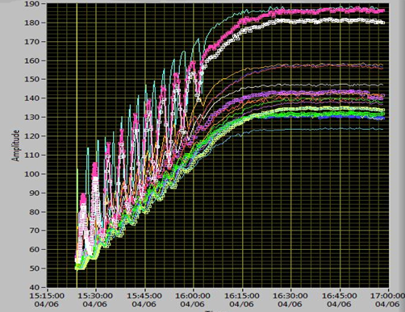
New Software : Specific Heating system
Thin Polyimide Heater Tests with Old and New Software
New Software
And correct PID
parameters
Old Software
Monitoring Temperatures
all along the Chamber
Monitoring Temperatures
all along the Chamber
Temperature (ºC)
Temperature (ºC)
Courtesy: Yannick Riva / Bernard Henrist
Regulation Performance Improved :
  Less oscillations during step transitions
  Better homogeneity (Old Max∆T> 60ºC New Max∆T < 20ºC)
NS

Slide 9
Last Slide
  Conclusion:
  Software:
  Old and new versions of the Bake-out rack, Touch Panel & PVSS interfaces are very similar
  New functionalities → You can choose to use it or not.
  By default the bake-out rack is parameterized in the higher safety level!
  Hardware:
  All Racks Hardware V.1 and V.2 will migrate to the new software before LS1
  Acknowledgements:
  N. Zelko (Specifications, Tests and Validation)
  Y. Riva / B. Henrist (Tests with Thin Polyimide Heaters)
  L. Kopilov / M. Mikheev / H. Pereira (SCADA/PVSS development)
  Reminder Next Week - 2 Practical Sessions (only registered persons)
  Tuesday 2013-01-22, 2pm
  Thursday 2013-01-24, 2pm
  Documentation:
  Specifications: https://edms.cern.ch/document/1234501 (Released)
  User’s Guide: https://edms.cern.ch/document/1240938 (In Work)
NS

Slide 10
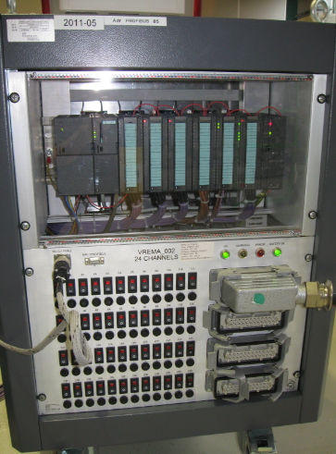
Spare Slides
PLC (Siemens)
PC Connector
Status LEDs
Touch Panel
Connector
Heaters Connectors
Heaters Output
switches and LEDs

Slide 11
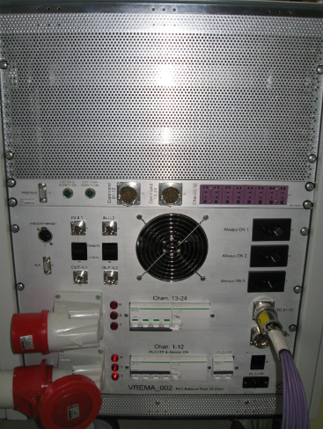
Spare Slides
Remote Power Relays
Satus LEDs
Remote Power Relays
command
Profibus
Connector
Control/Interlock Thermocouples
Ethernet
Connector
230Vac Outlet
Thermocouple connectors
Input Interlocks
Output Interlocks
PLC
Power Supply
400Vac Power
Supply
Circuit Breaker

Slide 12
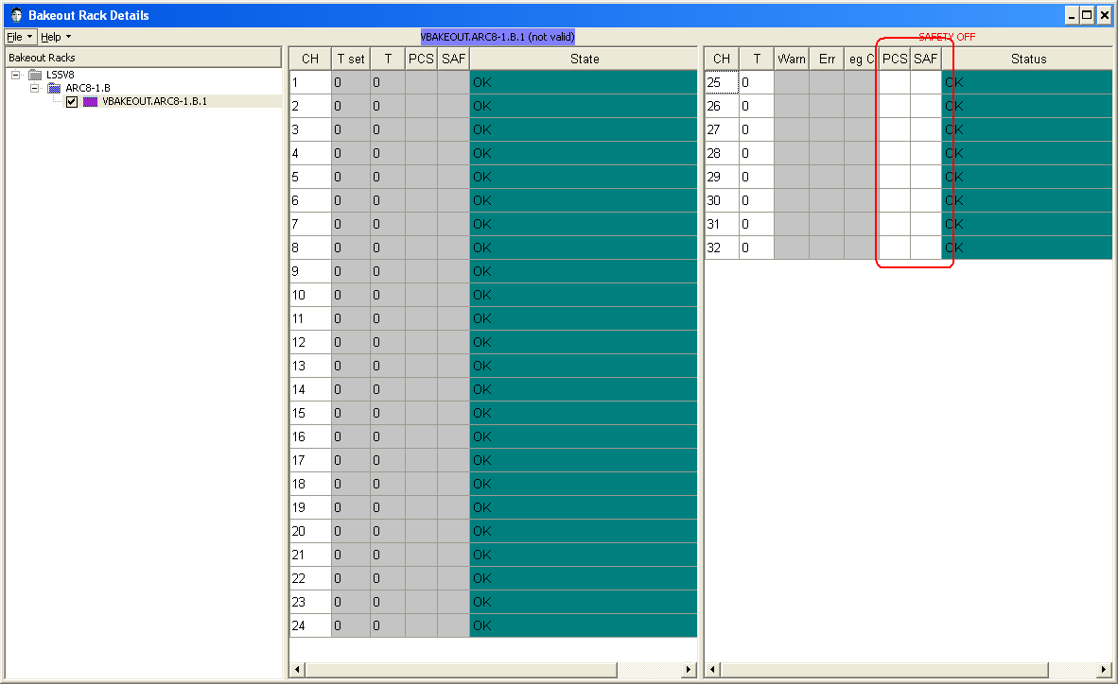
Spare Slides
PVSS Panel :

