Slide 1

Optical Data Transmission in High Energy Physics
TALENT Summer School 2013
3.-14.06.2013
Tobias Flick
University Wuppertal

Slide 2
Outline
Fiber Optical Communication: Technology and Components
Motivation for optical communication in high-energy physics (HEP)
Requirements of HEP experiments on optical components
Optical links in ATLAS inner detectors
Summary / Outlook

Slide 3
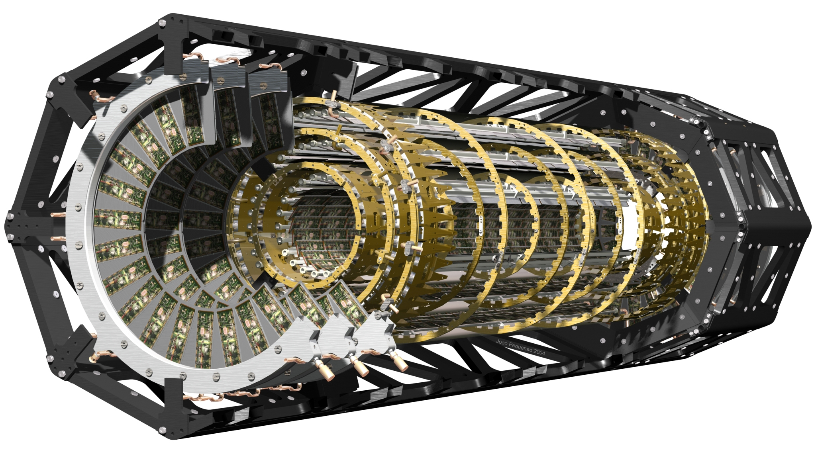
Detector Readout – What is needed?
High-energy physics detectors search for known and unknown particles.
  Rare processes need to be discovered (large statistic needed → high speed, collision rate)
  Clean particle tracks (no un-needed material)
Collision rate at LHC: 40 MHz
Many channels, e.g. ATLAS: ~10⁸
High precision: innermost sub-detectors have more channels (more challenging in terms or readout)
A lot of radiation: High radiation resistance needed!
How to get all the recorded data out?
  High bandwidth
  Low material budget
  No electrical disturbing allowed
→ Fiber optical communication!

Slide 4
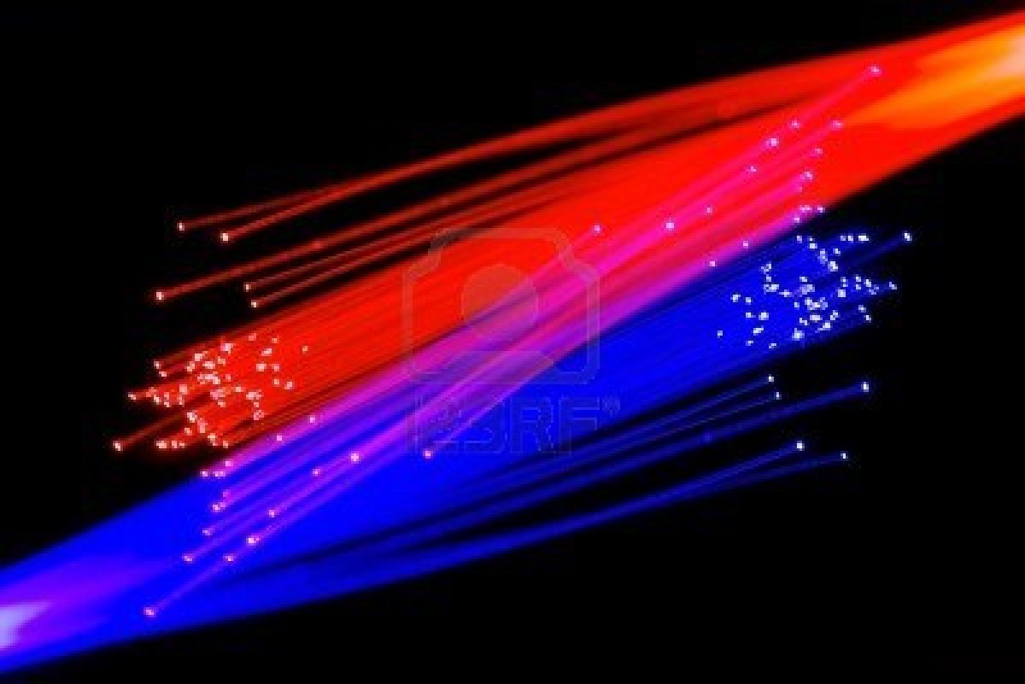
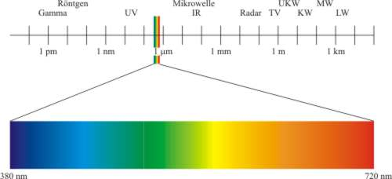
Fiber Optical Communication Systems
Fiber optic data transmission systems send
information over fiber by turning electronic
signals into light.
Light refers to more than the portion of the electromagnetic spectrum that is near to what is visible to the human eye.
The electromagnetic spectrum is composed of visible and near-infrared light like that transmitted by fiber, and all
other wavelengths used to
transmit signals such as AM an
FM radio and television.

Slide 5

Fibre Optics Transmission Properties
Optical communication offers several advantages
  Low Attenuation (loss of signal)
  Very High Bandwidth (THz)
  Small Size and Low Weight
  No Electromagnetic Interference
  Low Security Risk
Elements of optical transmission
  Electrical-to-optical converters
  Optical media
  Optical-to-electrical converters
  Digital signal processing, repeaters and clock recovery…
Good for physics experiments

Slide 6
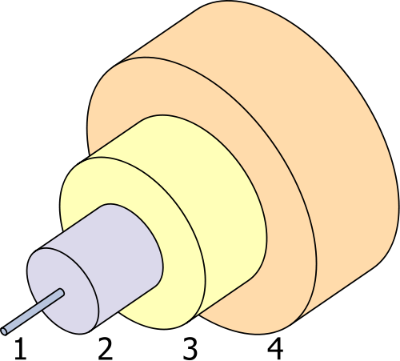
Fiber Optical Communication – Optical Fibers
Optical fibers (fiber optics) are long, thin strands of very pure glass (silica-based).
Core diameter in the order
of a human hair.
Fibers are arranged in bundles
(optical cables) and used to
transmit signals over long
distances.
High bandwidth capability.
Long distances can be bridged.
1: Core: 8-100 µm diameter
2: Cladding: 125 µm dia.
3: Buffer: 250 µm dia.
4: Jacket: 400 µm dia.

Slide 7
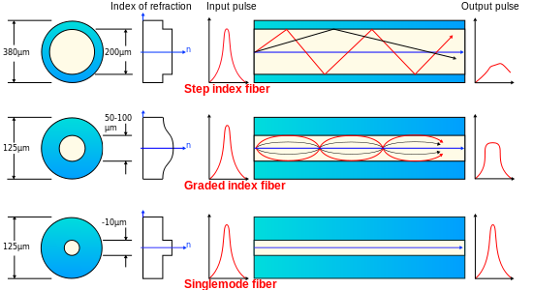
Optical Fiber Types
Multi Mode :
  Step-index – Core and Cladding material has uniform but different refractive index.
  Graded Index – Core material has variable index as a function of the radial distance from the center.
Single Mode:
  The core diameter is almost equal to the wave length of the emitted light so that it propagates along a single path.

Slide 8

Optical Fiber Properties
To give perspective to the incredible capacity that fibers are moving towards, a 10-Gb/s signal has the ability to transmit any of the following per second:
  1000 books
  130,000 voice channels
  16 high-definition TV (HDTV)channels or
  100 HDTV channels using compression
  techniques.
  (an HDTV channel requires a much higher bandwidth than today’s standard television).
BUT: Transmission over fiber is limited by attenuation and dispersion.
  Attenuation is a loss of light inside the fiber.
  Dispersion is due to wave travel properties inside the fibers.

Slide 9
Attenuation
Signal attenuation (loss) is a measure of power received with respect to power sent.
Silica-based glass fibers have losses of about 0.2 dB/km
(i.e. 95% launched power remains after 1 km of fiber transmission).
Drawback on fibers: if only a little section develops a high attenuation, the whole fiber is lost.
Signal attenuation within optical fibers is usually expressed in the logarithmic unit of the decibel (dB).
The decibel is defined for a particular optical wavelength as the ratio of the output optical power P_{o} from the fiber to the input optical power P_{i} into the fiber (Po  Pi)

Slide 10
Fiber Attenuation: Absorption
The optical power is lost as heat in the fiber. Loss mechanism is related to both the material composition and the fabrication process for the fiber.
The light absorption can be intrinsic (due to the material components of the glass) or extrinsic (due to impurities introduced into the glass during fabrication).
Intrinsic absorptions can be due to electron transitions within the glass molecules (UV absorption) or due to molecular vibrations (infrared absorptions).
Major extrinsic loss is caused by absorption due to water (as the hydroxyl or OH⁻ ions) introduced in the glass fiber during fiber pulling by means of oxyhydrogen flame.
  The lowest attenuation for typical silica-based fibers occurs at wavelength 1550 nm, about 0.2 dB/km, approaching the minimum possible attenuation at this wavelength.

Slide 11
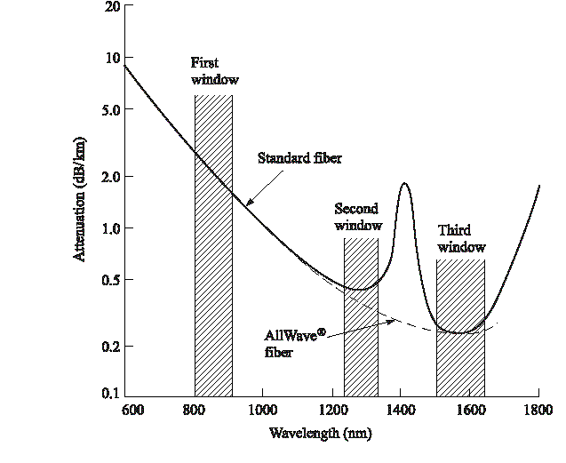
1400nm OH⁻ Absorption Peak
1st window: 850 nm, attenuation 2 dB/km
2nd window: 1300 nm, attenuation 0.5 dB/km
3rd window: 1550 nm, attenuation 0.3 dB/km
OH⁻ absorption (1400 nm)
OFS AllWave fiber: example of a “low-water-peak” or “full spectrum” fiber. Prior to 2000 the fiber transmission bands were referred to as “windows.”

Slide 12
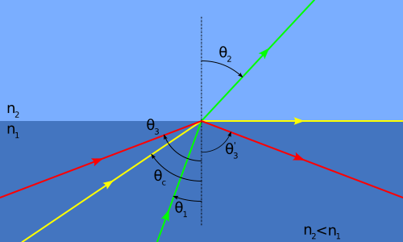
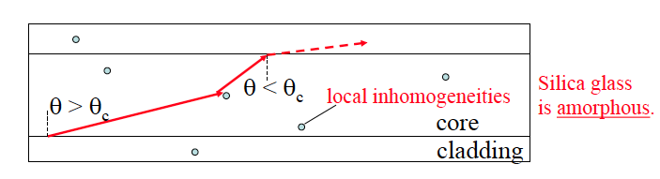
Fiber Attenuation: Scattering Loss
Scattering results in attenuation (in the form of radiation)
as the scattered light may not continue to satisfy the
total internal reflection in the fiber core: θ_{c}=arcsin(n₂/n₁)
Rayleigh scattering results from random inhomogeneities
that are small in size compared with the wavelength.
These in-homogeneities exist in the form of refractive index fluctuations which are frozen into the amorphous glass fiber upon fiber pulling. Such fluctuations always exist and cannot be avoided !
Rayleigh scattering is the dominant loss in today’s fibers.

Slide 13
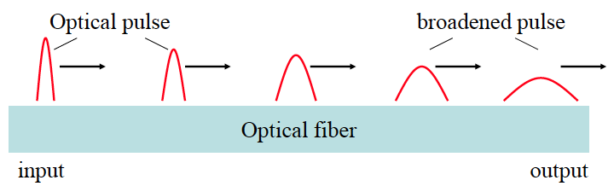
Fiber Dispersion – Pulse Broadening
Fiber dispersion results in optical pulse broadening and hence digital signal degradation.

Slide 14
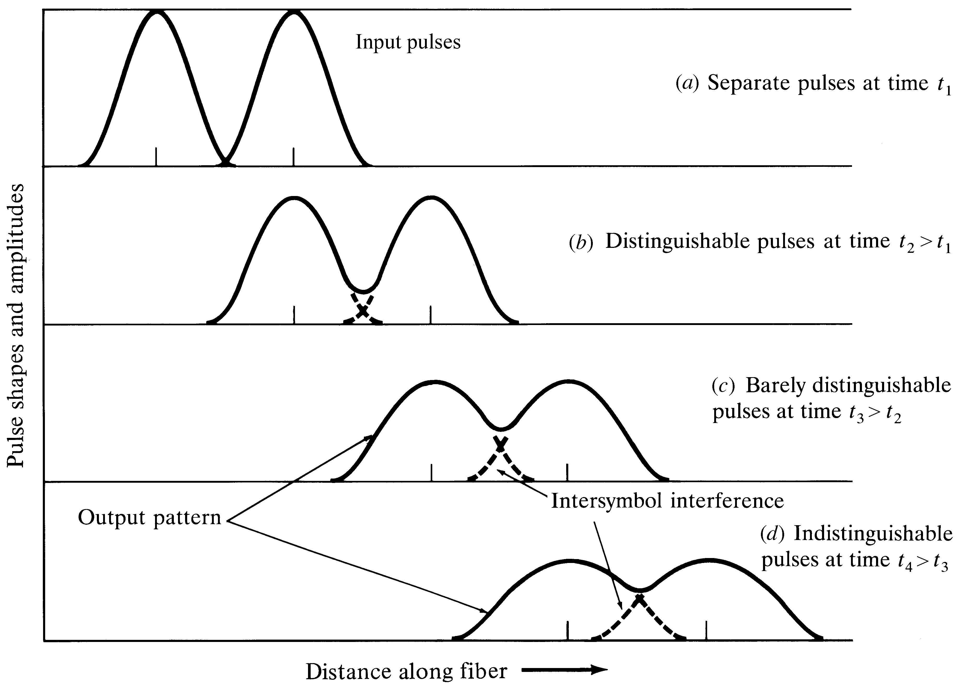
Fiber Dispersion – Bit Errors
Pulse broadening limits transmission capability.
Detection threshold
Inter symbol
interference
Signal distorted

Slide 15
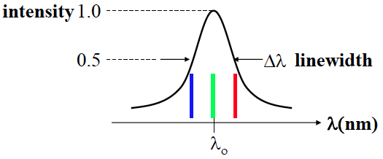
Chromatic Dispersion
Chromatic dispersion (CD) may occur in all types of optical fiber. The optical pulse broadening results from the finite spectral line width of the optical source and the modulated carrier.
*In the case of the semiconductor laser Δλ corresponds to only a fraction of % of the centre wavelength λ₀. For LEDs, Δλ is likely to be a significant percentage of λ₀.

Slide 16
Spectral Line Width
Real sources emit over a range of wavelengths. This range is the source line width or spectral width.
The smaller the line width, the smaller is the spread in wavelengths or frequencies, the more coherent is the source.
An ideal perfectly coherent source emits light at a single wavelength. It has zero line width and is perfectly monochromatic.
Light Sources | Line Width (nm)
Light-emitting diodes | 20-100
Semiconductor laser diodes | 1-5
Nd:YAQ solid state lasers | 0.1
HeNe gas lasers | 0.002

Slide 17
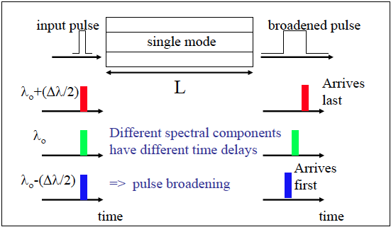
Chromatic Dispersion
Pulse broadening occurs because there may be propagation delay differences among the spectral components of the transmitted signal.
Different spectral components of a pulse travel at different group velocities

Slide 18
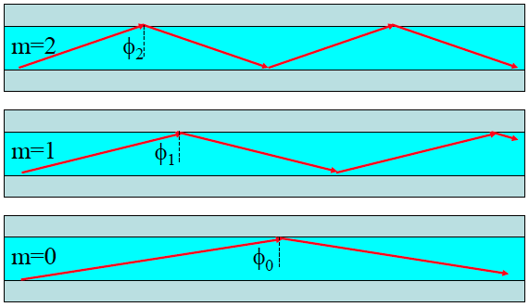
Modal Dispersion in Multimode Fibers
When numerous waveguide modes are propagating, they all travel with different velocities with respect to the waveguide axis.
An input waveform distorts during propagation because its energy is distributed among several modes, each traveling at a different speed.
Parts of the wave arrive at the output before other parts, spreading out the waveform. This is thus known as multimode (modal) dispersion.
Multimode dispersion does not depend on the source linewidth (even a single wavelength can be simultaneously carried by multiple modes in a waveguide).
Multimode dispersion would not
occur if the waveguide allows only
one mode to propagate - the
advantage of single-mode
waveguides!

Slide 19
How does dispersion restrict the bit rate?
As soon as pulses overlap due to broadening, the information can not be recovered properly.
When this happens depends on bandwidth and length of the transmission as well as on refractive index of the core, cladding, and many more parameters.
Bit rate - distance product: The Modal Bandwidth
  If a system is capable of transmitting 10 Mb/s over a distance of 1 km, it is said to have a BRD product of 10 MHz km
  Note: the same system can transmit 100 Mb/s along 100m, or 1 Gb/s along 10m, …
  Fiber specifications are due to the BRD-product:
Transmission Standards | 100 Mb Ethernet | 1 Gb Ethernet | 10 Gb Ethernet | 40 Gb Ethernet | 100 Gb Ethernet
OM1 (62.5/125) | up to 2000 m | 275 m | 33 m | Not supported | Not supported
OM2 (50/125) | up to 2000 m | 550 m | 82 m | Not supported | Not supported
OM3 (50/125) | up to 2000 m | 550 m | 300 m | 100 m | 100 m
OM4 (50/125) | up to 2000 m | 1000 m | 550 m | 150 m | 150 m

Slide 20
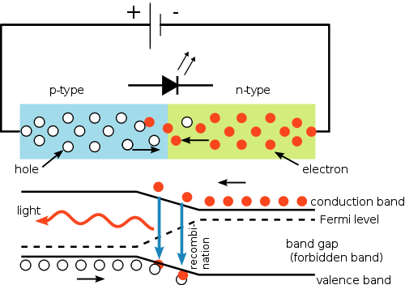
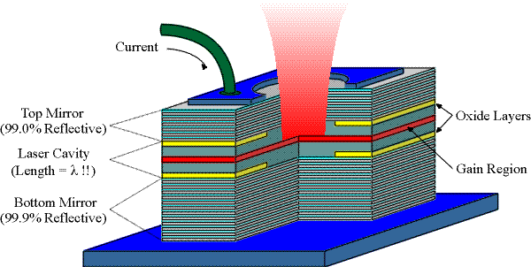
Transmitters
Electrical-to-Optical Transducers
  LED - Light Emitting Diode is inexpensive, reliable but can support only lower bandwidth (incoherent light)
  LD – Laser Diode provides high bandwidth and narrow spectrum (coherent light).
LED
Laser Diode
Vertical Cavity Surface Emitting Laser (VCSEL)

Slide 21
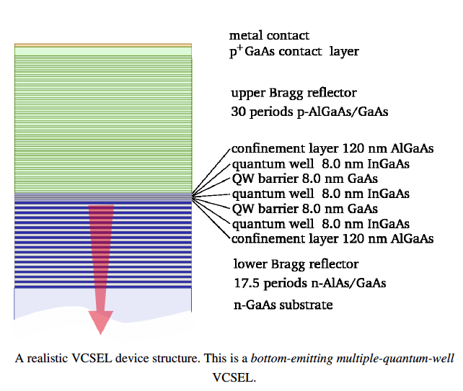
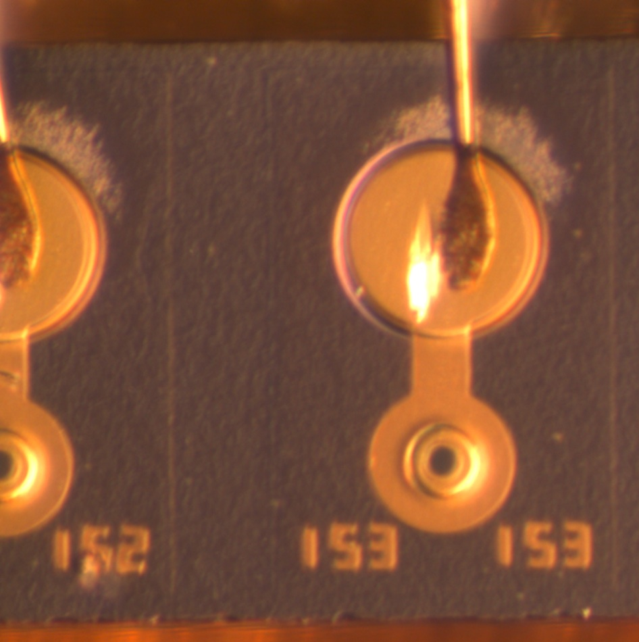
Vertical Cavity Surface Emitting Laser: VCSEL
Semiconductor laser diode with beam emission perpendicular from the top surface
Advantage:
  VCSELs can be tested on wafer-level
  Higher production density possible
  Multi channel structures possible
Structure: Distributed Bragg Reflector on top and bottom as mirrors (reflectivity > 99%) from p- and n-type materials
Gain region in between the mirrors (quantum wells) in which free photons are “pumped”
Typical wavelengths of 650nm-1300nm
Materials: GaAs or AlGaAs

Slide 22
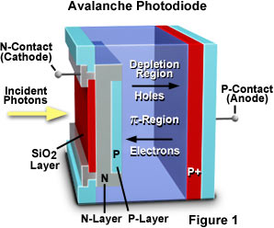
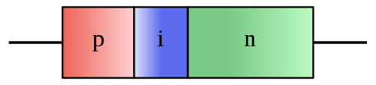
Receivers
Optical-to-Electrical Transducers
  PIN Diode - Silicone or InGaAs based p-i-n Diode operates well at low bandwidth.
  Avalanche Diode – Silicone or InGaAs Diode with internal gain can work with high data rate.
Hamamatsu

Slide 23
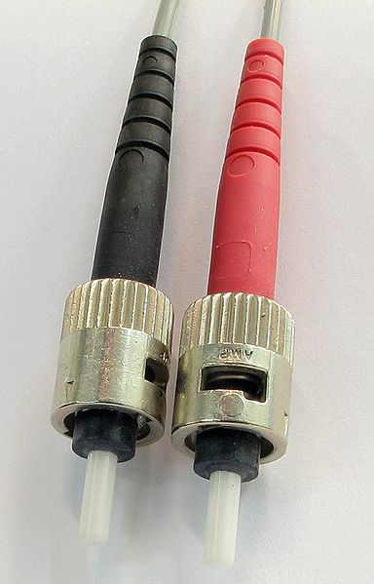
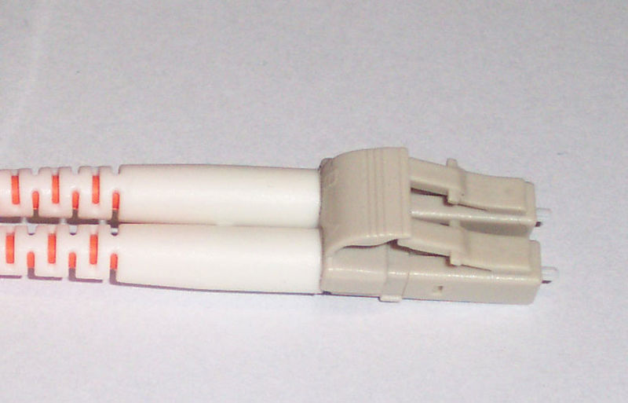
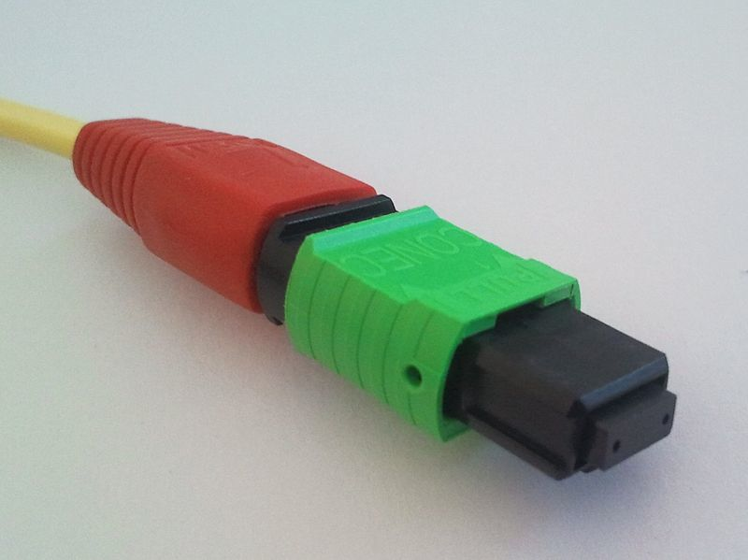
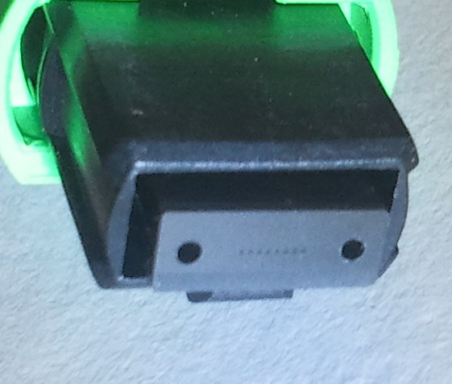
Connection Techniques
Fibers are terminated by connectors, which can be connected together (to extend the fiber path) or to lasers or PIN diodes. Connectors introduce and additional attenuation (or insertion loss).
Fibers can also be spliced together. Splice connections provide lower attenuation, but they are fixed and cannot be opened.

Slide 24
Optical Data Transmission in HEP
Optical communication provides great advantages to high-energy physics experiments:
  High bandwidth
  Small size
  No electromagnetic interference (crosstalk)
  Ground decoupling between on- and off-detector system
Additional high-energy requirements on optical transmission components in physics experiments:
  Low material budget
  Low power consumption
  High radiation hardness

Slide 25
Typical Link Structure
Front-end: inside the detector
  Needs steering and control
  Registers data / hit information to be sent out
Transmitters / receivers
Fiber path
Transmitters / receivers
Off-detector electronics
  Receives physics data for processing
  Generation of timing and control data
FE-Electronics
TX
RX
RX
TX
Off.Det.
Readout
Electonics

Slide 26
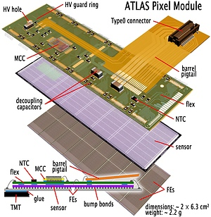
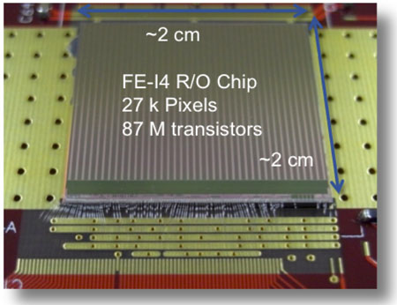
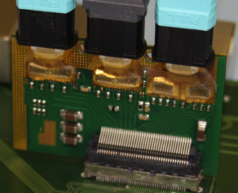
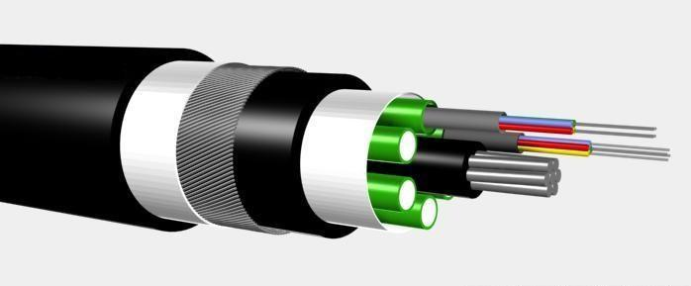
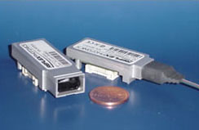
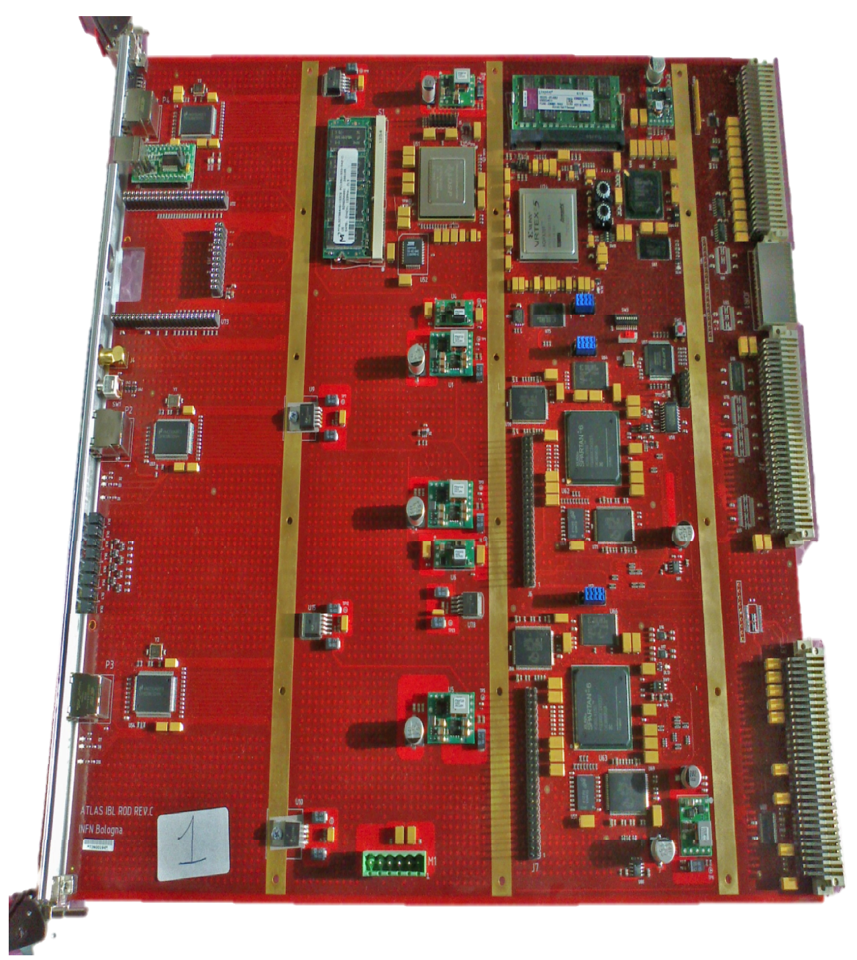
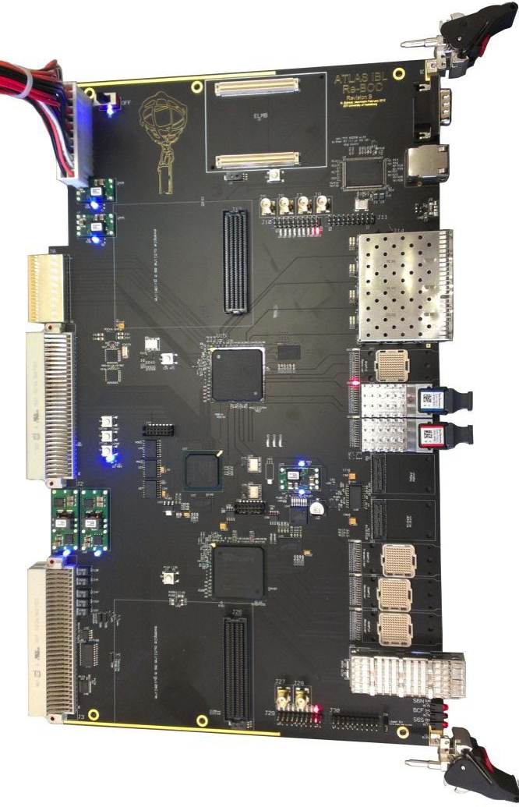
ALTAS Inner Detector Links
Modules
Optical converters
Fibers
Optical converters
Readout cards
FE-Electronics
TX
RX
RX
TX
Off.Det.
Readout
Electonics

Slide 27
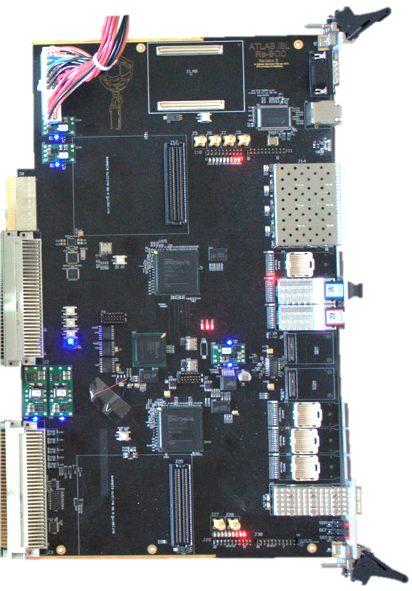
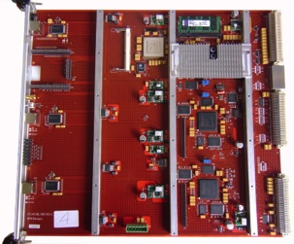
ATLAS IBL Readout Structure
VME crate
SBC
Ethernet
TIM
16 modules
2 optoboards
Optical
BPM
2 FE-I4
DORIC
BOC
ROD
Timing
Control and steering
VDC
TX
Control &
data handling
IBL stave
RX
Optical
8b10b
Event building
IBL optobox
on ID endplate
ROS
S-Link
electrically
Optically

Slide 28
On-detector Optical Components
The optoboard serves as optical converter inside
the detector.
Radiation hard components used (ASICs, optical
components, passive components).
Design is optimized for operation in the detector
(space, cooling, …)
  2x laser (VCSEL) and 1x PiN diode array
  providing 8 used channels each.
Custom made ASICs to
  Receive timing and control data in one stream,
  decode it and send it to the modules in 2 streams.
  Drive the laser diodes.
Compact board connected to the modules via electrical cables
Advantages using an optoboard:
  Can be placed away from the hottest area in terms of radiation. This also relaxes the fiber radiation hardness requirement.
  Termination point for the optical cables (fragile!), so no optical fibers on the detector modules.
  Cooling lines can be provided.
  Connectors can be bigger due to board location.

Slide 29
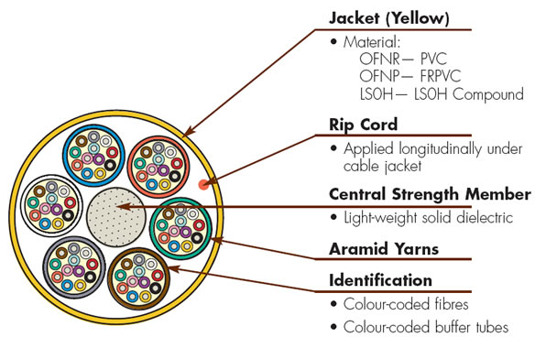
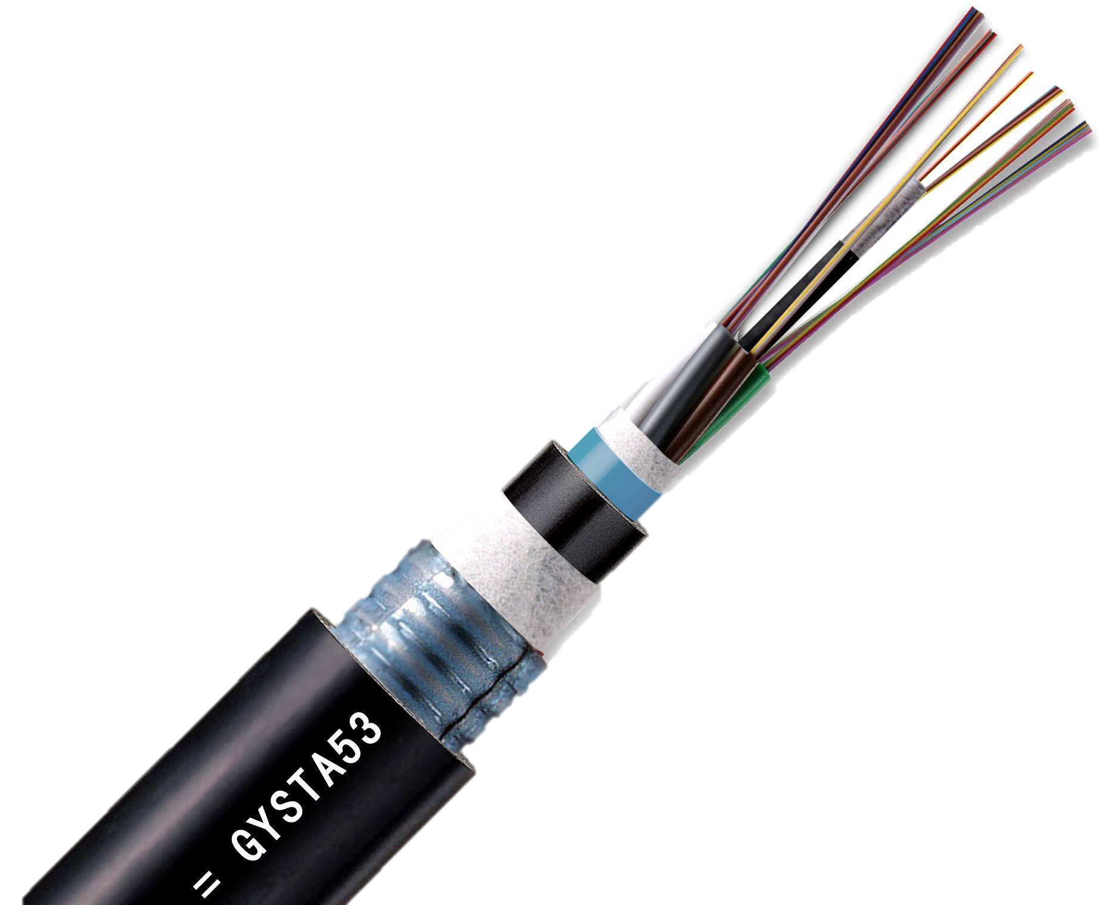
Fibers
The fibers inside the detector must withstand irradiation
  Radiation induced attenuation (RIA) must be low and under control. Use of special material and fabrication techniques (fiber pulling, temperature, etc.) needed to manufacture radiation hard fibers -> special product!
Fiber cables reflect detector geometry to reduce jacket material
Bandwidth must meet the detector readout bandwidth (normally low w.r.t. communication industry, i.e. 160 Mb/s for ATLAS pixel detector)
Connectors on both ends
  Commercial connectors off-detector
  Non-magnetic connectors on-detector, space and material budget constraints

Slide 30
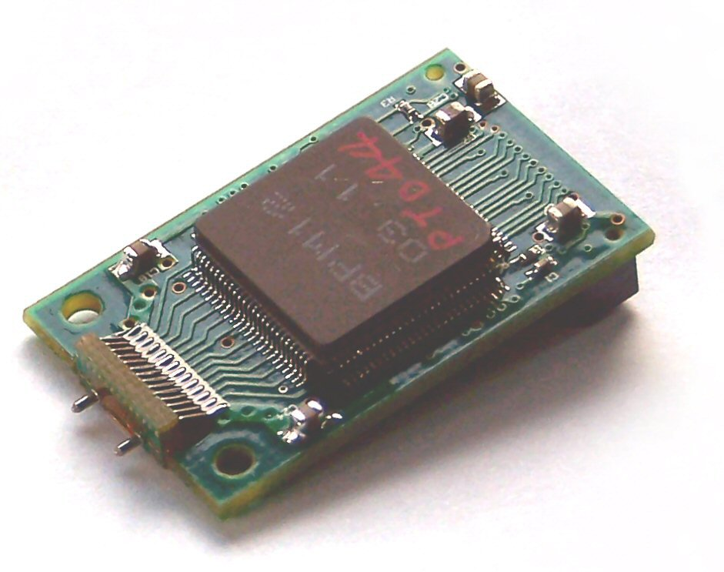
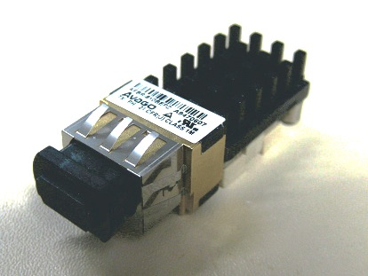
Off-detector Components
Optical components located on the readout hardware as plugins.
Custom made plugins used in the past
→ not reliable enough
Now commercial solutions investigated.
Off-detector components have less
constraints as they are placed in a location
with enough space, no radiation, good
cooling and power capability.
Optics and electronics are separated, to
have both produced the best way. Each
components can be exchanged separately if needed.
Optical components are expert work!

Slide 31

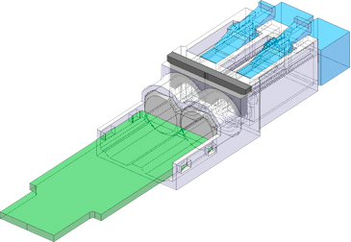
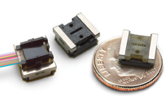
Versatile Link Project
Front-End VTRx | Fibre | Back-End TRx
EE laser, 1310nm | SM | LR-SFP+ TRx
VCSEL, 1310nm |  | SNAP12’like Rx
InGaAs PIN, 1310nm |  | Opto Engine Rx
VCSEL, 850nm | MM | SR-SFP+ TRx
GaAs PIN, 850nm |  | SNAP12’like Tx,Rx, TRx
InGaAs PIN, 850nm |  | Opto Engine Tx, Rx, TRx
F. Vasey et al

Slide 32
Conclusion
Optical communication provides all the needed features to read out detectors in high-energy physics.
  High bandwidth
  low performance loss with time
  electrical decoupling
Loss of signals needs to be under control (attenuation and dispersion)
Radiation hardness mandatory for use inside the innermost region of the detector We can take advantage of the experience in industry.
Use commercial devices wherever possible.

Slide 33
Material
John M. Senior, ‪Optical fiber communications, principles and practice, ‪Prentice Hall, 1992‬, ISBN ‪0136354262, 9780136354260‬
Gerd Keiser, ‪Optical fiber communications‬, McGraw-Hill, 2000‬, ISBN‬ ‪0072360763, 9780072360769‬
Prof. Murat Torlak, Fiber Optic Communication, Lecture at UT Dallas, http://www.utdallas.edu/~torlak/courses/ee4367/lectures/FIBEROPTICS.pdf
Dr. Andrew Poon, Course on Photonics and Optical Communications, Hong Kong University, http://course.ee.ust.hk/elec342/

