Slide 1

Pixel detectors in High Energy Physics experiments: present systems and upgrade plans
Petra Riedler/CERN

Slide 2
Outline
A short historical excursion
Present pixel systems at LHC
  ATLAS
  CMS
  ALICE
Future pixel systems
  Upgrades: ATLAS, CMS, ALICE
  NA62
  STAR
  CLIC

Slide 3

Thanks
to many colleagues who provided me with material for this presentation:
Paula Collins
Dominik Danheim
Leo Greiner
Roland Horisberger
Flavio Marchetto
Heinz Pernegger
ALICE ITS team
And apologies to those who I might have forgotten in this list!

Slide 4

Disclaimer
This presentation is a very personal view on the world of pixel detectors.
It is not intended as a complete summary. And if you can read this your eye-sight is definitely better than mine.

Slide 5
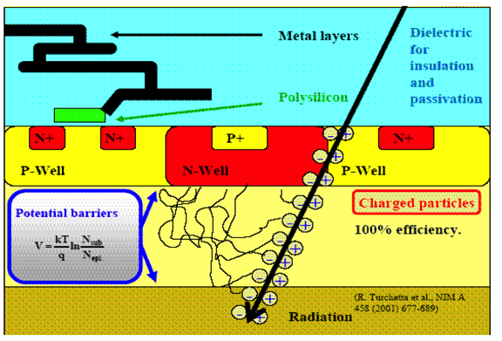
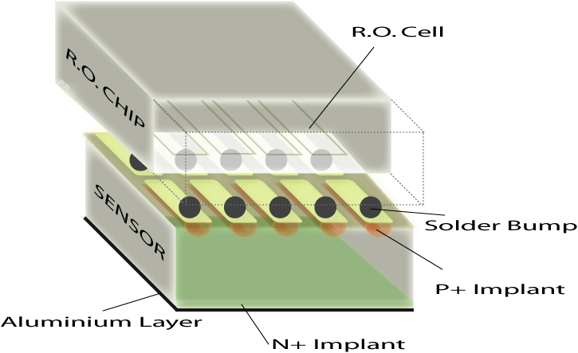
The “World of Pixels” …
Monolithic Pixels
Charge generation volume integrated into the ASIC
Hybrid Pixels
Sensor and ASIC are independent units
See talk by I. Peric
“Monolithic Pixel Detectors”
June 3, 2013
See talk by T. Fritzsch
“Microintegration of Electronics”
June 3, 2013

Slide 6
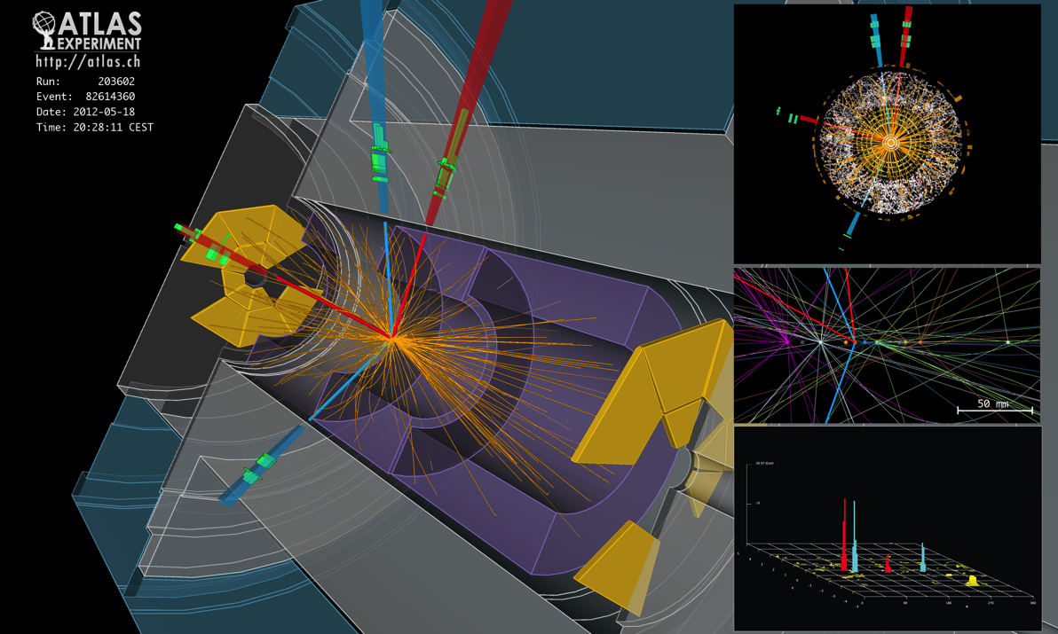
…and why use them in HEP experiments
ATLAS Experiment © 2012 CERN
Event display of a H -> 4e candidate event

Slide 7
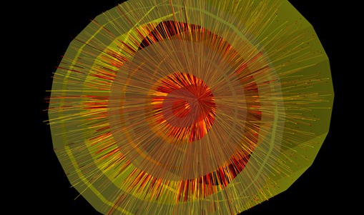
© 2010 CERN
Events recorded by the ALICE experiment from the first lead ion collisions, at a centre-of-mass energy of 2.76 TeV per nucleon pair.

Slide 8
Pixel Detectors in HEP Experiments
Are high granularity tracking detectors which provide unambiguous and precise hit information in the harsh environment close to the interaction point.
Position resolution down to few microns
Unambiguous hit information in high track density region
Improved primary and secondary vertex resolution
Fast readout (depending on technology)
High level of radiation hardness (again technology dependent)
Pixels are used at the heart of the trackers in ALICE, ATLAS and CMS and are key elements for the upgrades.

Slide 9
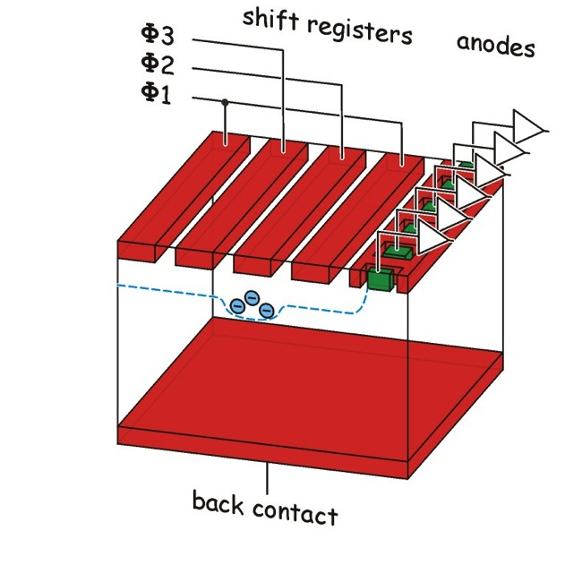
Short Historical Excursion
CCD (1969 Bell Labs)
First use of “pixel”-like silicon detector in a physics experiment (SLD/SLAC and NA11/32, from ~1981)
Charges are shifted through potential wells to the edge of the detector to the anodes
Small pixel sizes (O(10 µm), matrix readout slow, low radiation tolerance

Slide 10
…moving on to the late 80’s
1980 first application of planar technology to produce silicon sensors (strips) >> produce highly segmented silicon sensors (prerequisite for hybrid pixel detectors)
1987/88 First pixel prototype sensors for SLAC/SSC, Shapiro and Galema, no special pixel electronics yet
1989 LAA project, CERN, first development of dedicated pixel electronic, no bump bonding yet
~1987-90 first monolithic detectors proposed
1990 Omega D chip and sensor, first hybrid pixel detector, tested in testbeam, CERN

Slide 11
Key ingredients for pixels
Main ingredients required for first silicon pixel detectors (after planar process allowed to produce pixel sensors):
VLSI (Very Large Scale Integration) technology to produce complex ASICs (Application Specific Integrated Circuit) – Hybrid, Monolithic
Interconnect technology based on flip-chip bonding (connections of ~20µm between each sensor pixel cell and the corresponding readout cell in an ASIC) - Hybrid
“recent” development (from ~1990)

Slide 12
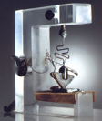
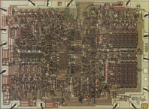
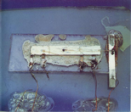

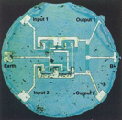
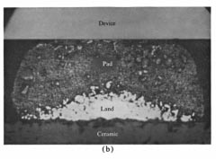
Short Historical Excursion
www.chiphistory.com
www.chiphistory.com
http://smithsonianchips.si.edu/
www.chiphistory.com
http://smithsonianchips.si.edu/
1947
1958
1959
1961
1970
Flip chip bonding:
Controlled collapse chip connection – C4 by IBM ~1969 (e.g. mainframe computers)
Studies in automotive for voltage regulators (GM Delco)
Miller, IBM, 1969

Slide 13
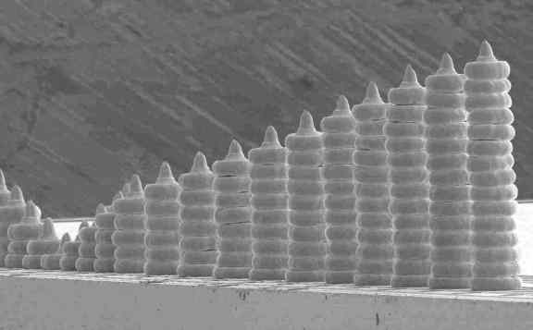
Flip Chip Bonding
The great wall of bump bonds by N. Ishikawa, Fujitsu Ltd.
See talk by T. Fritzsch
“Microintegration of Electronics”
June 3, 2013

Slide 14
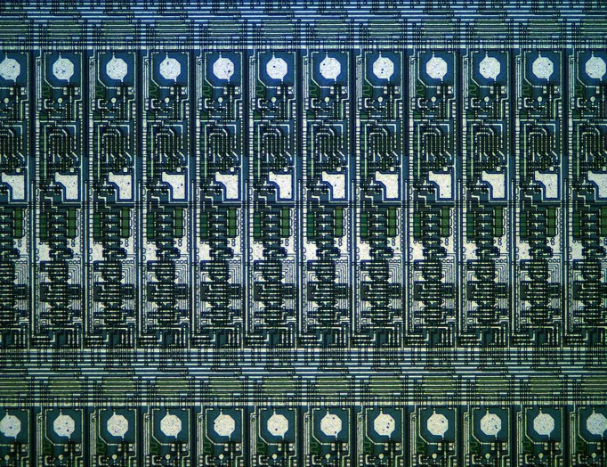
Omega 2 and Omega3
Early 1990s, CERN’s RD19 collaboration develops the Omega2 and Omega3 chips
Omega2:
16 col x 63 row
cell size 500 x 75 µm²
overall sensitive area 8.0 x 4.7 mm²
Omega3:
16 col x 127 row
cell size 500 x 50 µm²
overall sensitive area 8.0 x 6.4 mm²

Slide 15
First use in WA94/97 and NA57
Study of the strange and multi-strange particle production in Pb-Pb collisions at the CERN SPS
1992 the first fully operational hybrid silicon micropattern detector was succesfully tested in a fixed target experiment environment
  WA94 heavy ion experiment at the OMEGA spectrometer of the CERN SPS
  WA94 pre-decessor of the WA97/NA57 heavy ion experiment
[A hybrid silicon pixel telescope tested in a heavy ion experiment”, Nucl. Instr. and Meth. A 332 (1993) 188-201)]
beam
Λ
p
π⁻

Slide 16
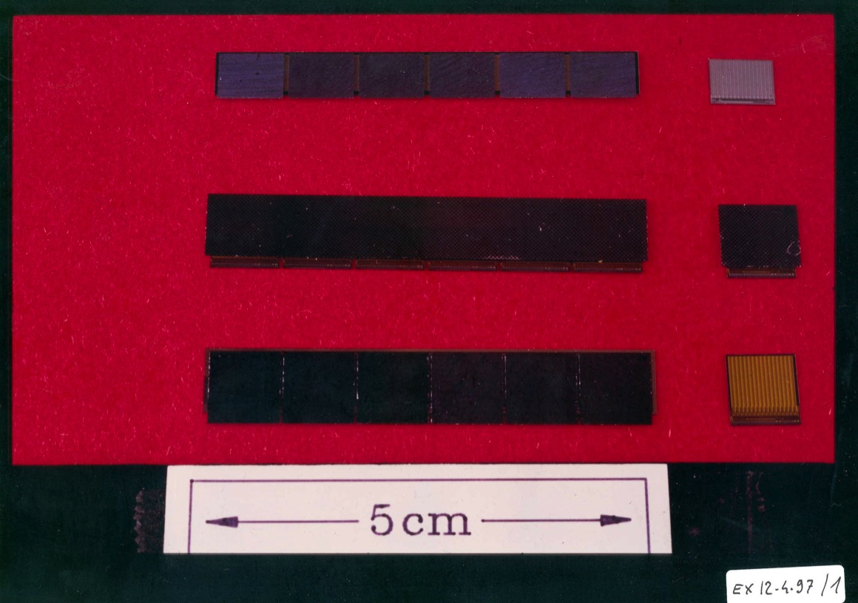
Omega 2 and 3 Ladders
6 readout ASICs connected to 1 silicon pixel sensor
Omega 2
Omega 3
Omega 3

Slide 17
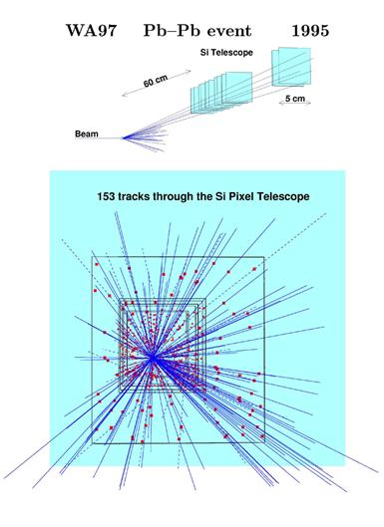
© 1995 CERN

Slide 18
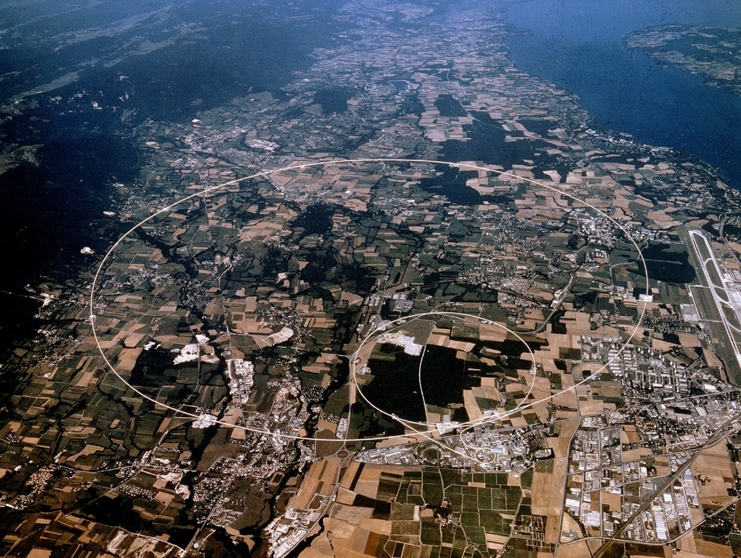
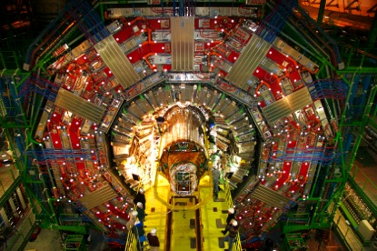
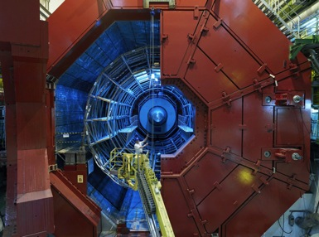
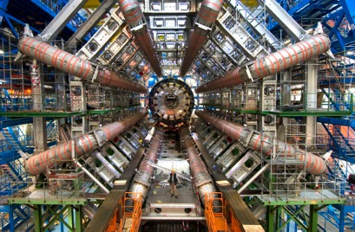
Pixel Detectors at LHC
CMS
ALICE
ATLAS

Slide 19
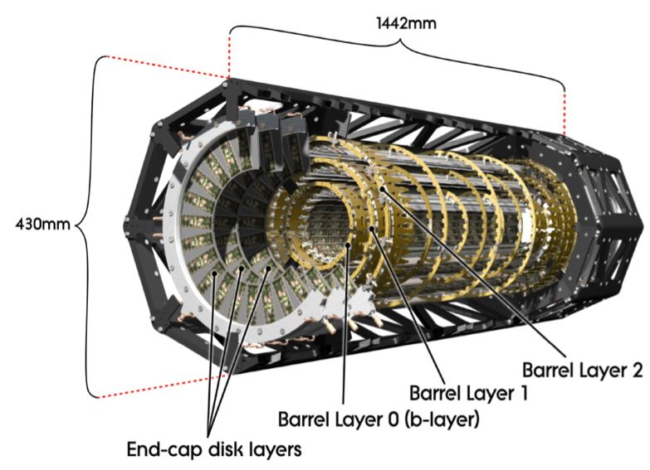
ATLAS Pixel Detector
Three barrel layers:
  R= 5 cm (B-Layer)
  R=9 cm (Layer-1)
  R=12 cm (Layer-2)
  1456 barrel modules
Two endcaps:
  three disks each
  288 forward modules
80 million channels
sensitive area of 1.7 m²
Three precise measurement points up to ⏐η⏐<2.5:
  RΦ resolution:10 μm
  η (R or z) resolution: 115 μm
Environmental temperature about -10 ºC
2 T solenoidal magnetic field.

Slide 20
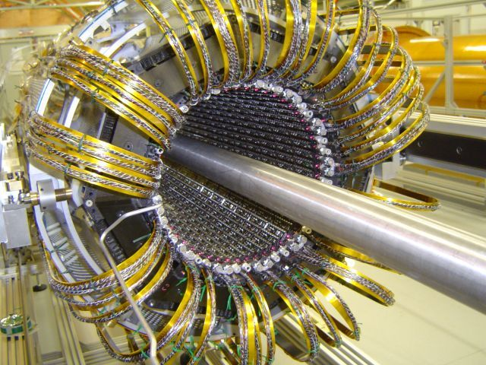
ATLAS Pixel Detector

Slide 21
ATLAS Pixel Module
Sensor
  47232 n-on-n pixels with moderated p-spray insulation
  250 μm thickness
  50 μm (RΦ) × 400 μm (η)
  328 rows (x_{local}) × 144 columns (y_{local})
16 FE chips
  bump bonded to sensor
Flex Hybrid
  passive components
  Module Controller Chip
  to perform distribution of commands and event building.
Radiation-hard design:
  Dose >500 Gy
  NIEL >10¹⁵ n_{eq}/cm² fluence

Slide 22
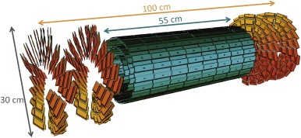
CMS Pixel Detector
Three barrel layers:
R=4.4 cm
R=7.3 cm
R=10.2 cm
Forward disks:
2 forward disks on either side
66 mio. channels
Area ~1 m2
1440 modules
15840 readout chips
Environmental Temperature: -8°C
4T magnetic field
NIM A, 2013
http://dx.doi.org/10.1016/j.nima2013.04.001

Slide 23
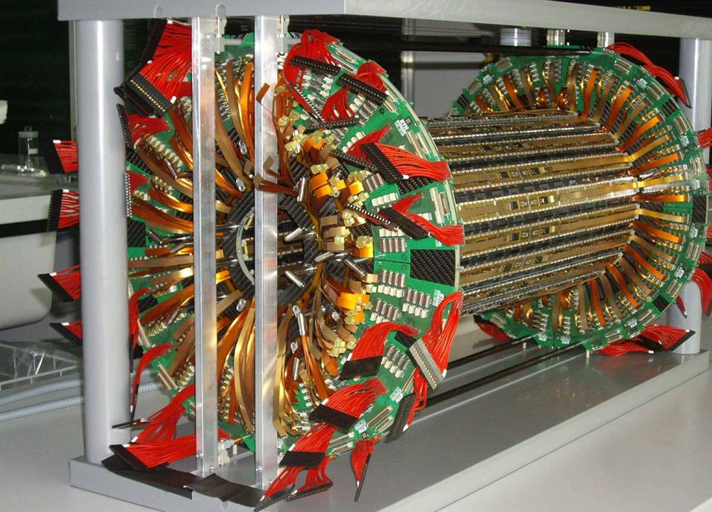
CMS Pixel Detector

Slide 24
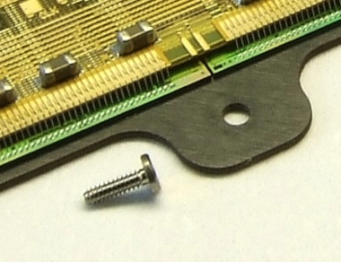
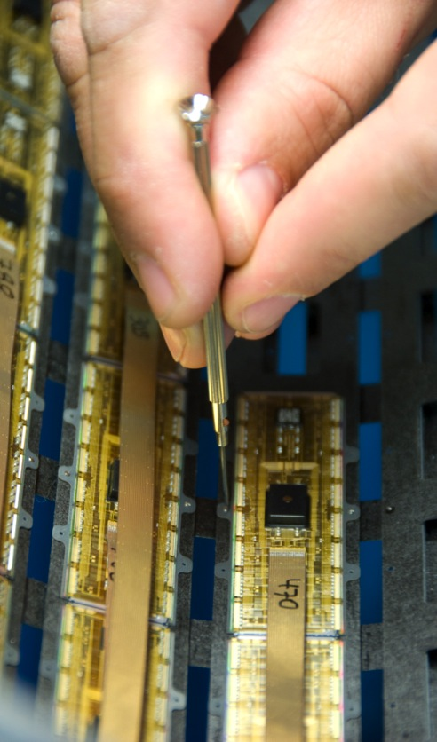
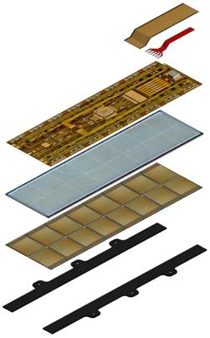
CMS Pixel Module
Kapton signal cable
21 traces, 0.3mm pitch
Alu-power cable
6 x 250μ ribbon
High Density Print
3 Layers, 48μ thick
N-in-n Silicon Sensor
t=285μ
100μ x 150μ pixels
16 x Readout Chips
(CMOS) 175μ thick
4160 pixels/chip
SiN base strips
250μ thick, screw holes

Slide 25
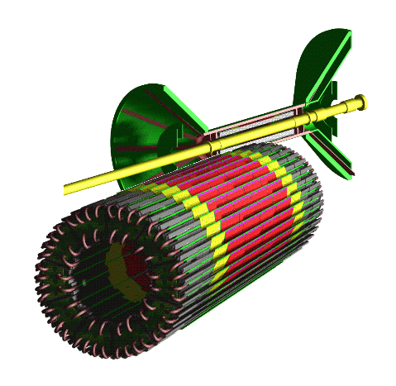
ALICE Pixel Detector
Two barrel layers:
R= 3.9 cm
R= 7.6 cm
No forward disks
9.8 mio channels
Area 0.21 m²
120 modules
1200 pixel chips
Environmental temperature ~ 27°C
0.5 T magnetic field

Slide 26
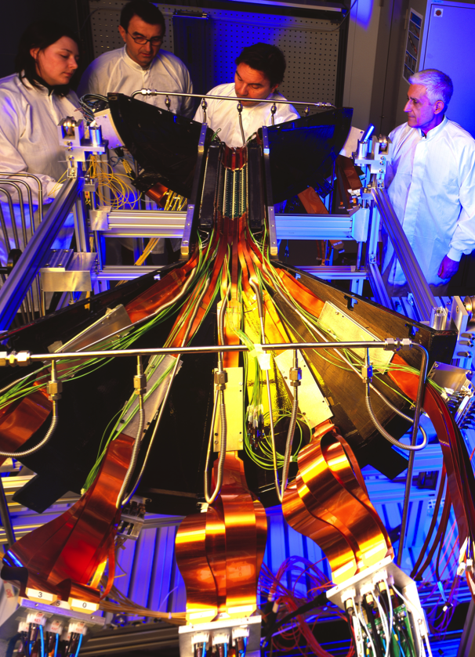
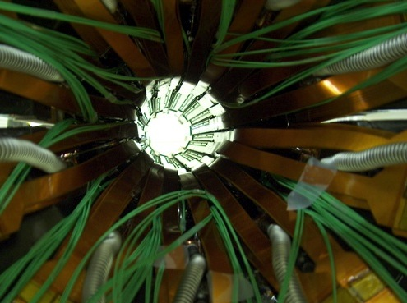
ALICE Pixel Detector

Slide 27
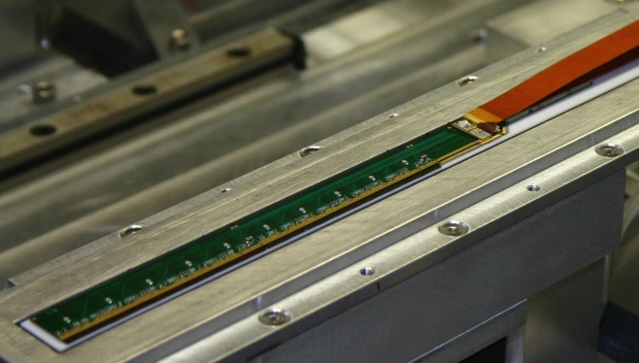
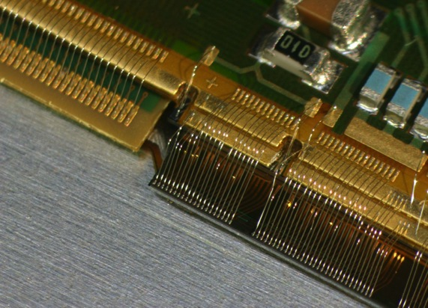
ALICE Pixel Module
2 p-in-n sensors
200 µm thick
70 mm x 14 mm
Pixel size: 50 µm x 425 µm
5 ASICs connected to one sensor
8192 pixels/chip
Chips thinned to 150 µm
Multi-chip module
    3 ASICs
    max. height: 5 mm
Multilayer Al flex cable
1200 pixel chips
9.83 x 10⁶ pixels
1.14% X₀ per layer

Slide 28
Spatial Resolution
 | [μm] | pixel cell size z x Rφ [μm²]
ALICE | 100 (z); 12 (Rφ) | 425 x 50
ATLAS | 115 (z); 10 (Rφ) | 400 x 50
CMS | ~ 15-20 | 150 x 100
Intrinsic resolution
CMS and ATLAS have analog information
ALICE uses binary readout
Operated in magnetic field:
  ALICE: 0.5 T
  ATLAS: 2 T
  CMS: 4T
Different sensor thicknesses (200-285 µm)

Slide 29
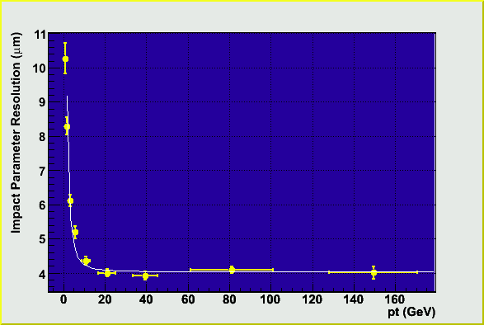
Impact Parameter Resolution
σ_{b} ≈ σ_{detector resolution} ⊕ σ_{multiple scattering}
σ_{multiple scattering} dominated
σ_{detector} _{resolution} dominated

Slide 30
Sensor and ASIC Thickness…..
 | Si sensor [μm] | X0 [%] | ASIC [μm] | X0 [%]
ALICE | 200 | 0.21 | 150 | 0.16
ATLAS | 250 | 0.27 | 180 | 0.19
CMS | 285 | 0.30 | 180 | 0.19
X0 (Si) = 9.36 cm

Slide 31
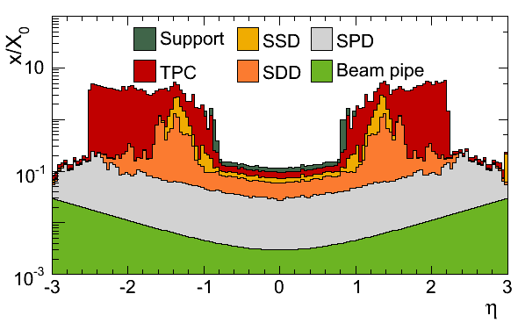
..enter into the material budget
Example: ALICE
… but are not the only contributions!
Support, services, cooling need to be optimized in terms of material budget.
Yes, the pixel contribution is small, BUT: it also the closes layers to the IP which are crucial for the impact parameter resolution.

Slide 32
Radiation Levels …..
 | TID [kGy] | Fluence 1MeV n eq. [cm⁻²] | Time
ATLAS Pixel* | 500 | 1 x 10¹⁵ | 10 years
ATLAS Strips | 100 | 2.0 x 10¹⁴ | 10 years
CMS Pixels | 840 | 3 x 10¹⁵ | 10 years
CMS Strips | 70 | 1.6 x 10¹⁴ | 10 years
ALICE Pixel | 2.7 | 1 x 10¹³ | 10 years
LHCb VELO | 50 | 1.3 x 10^{14**} | 1 year
ATLAS and CMS values cited for innermost layers for pixels and strips for 500 fb⁻¹
* averaged (B-layer to be replaced)
** inner part, inhomogeneous irradiation

Slide 33
…impact on technology choices
 | Sensor [μm] | ASIC | Temp.
ALICE | P-in-n | 0.25 µm | ~27°C
ATLAS | N-in-n ox | 0.25 µm | -10°C
CMS | N-in-n | 0.25 µm | -8°C

Slide 34
Future Pixel Detectors
Many new projects using pixel detectors in production and being planned. Pixels are increasingly important for new projects and upgrades of existing ones:
  ATLAS IBL
  STAR vertex detector
  NA62 Gigatracker
  Belle upgrade
  ATLAS pixel upgrade
  CMS pixel upgrade
  ALICE inner tracker upgrade
  ILC/CLIC
  …
Hybrid pixels AND monolithic pixels
Some of them taking place right now!

Slide 35
Experimental Requirements
Requirements drive the technology choice:
  Radiation levels (10¹¹n_{eq} (ILC/CLIC) – 10¹⁵/¹⁶n_{eq} (SLHC))
  Pixel size
  Readout speed
  “Added” functionality, eg. trigger information
  Material budget
  Cost …
…technology decisions for the upgrades at LHC in LS2 will be taken now!

Slide 36
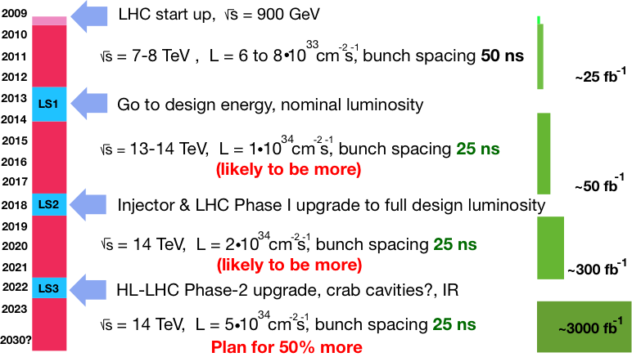
LHC Upgrade Schedule

Slide 37
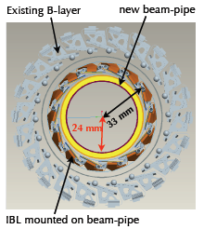
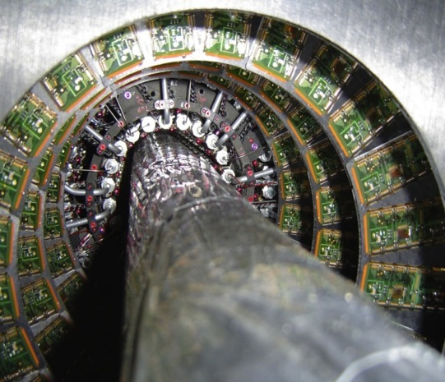
ATLAS IBL – LS1
New pixel layer around smaller, new beam pipe (r=24 mm, was 29 mm)
IBL mounted on beampipe
14 staves arraged at average r=33 mm
Radiation levels: ~5 x 10¹⁵ n_{eq} cm⁻²

Slide 38
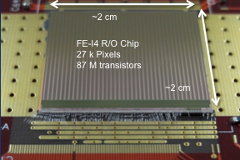
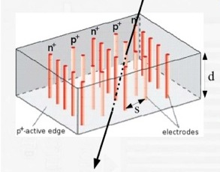
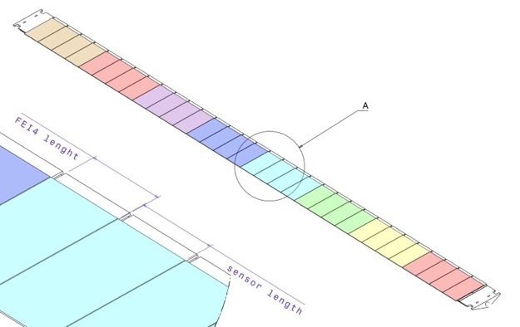
ATLAS IBL
Based on hybrid pixel detectors
New FE (FE-I4) in 0.13 µm CMOS technology (intrinsically more radiation resitant)
  19 x 20 mm², 26880 channels
Pixel size reduced: 50 µm x 250 µm
2 sensor types per stave:
  Double chip planar sensors (200 µm thick, n-in-n ox, reduced edge region by guard rings shifted underneath pixels)
  Single chip 3D sensors (250 µm thick, vertical electrodes through the bulk)
Each stave:
  8 single chip modules (3D) and 12 double chip modules (planar)
  12 mio channels
Reduced material budget: ~1.9 % X₀
3D
Planar
3D

Slide 39
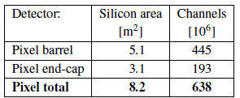
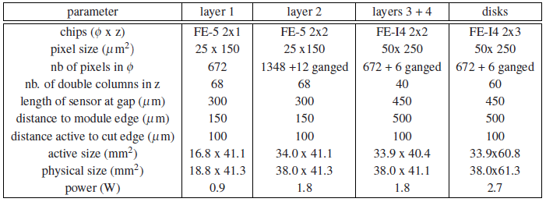
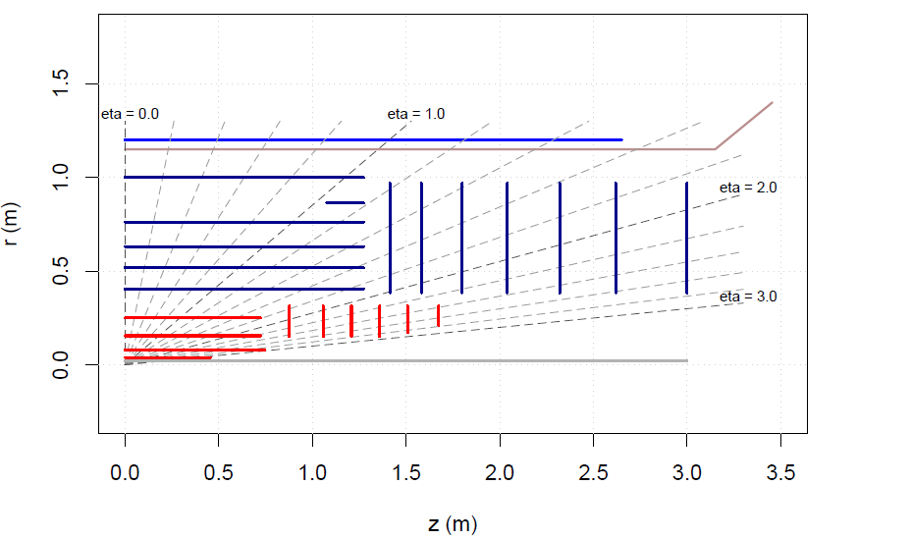
ATLAS Phase II
All new silicon tracker
  Radiation levels will increase up to 2-3 x 10¹⁶ n_{eq} cm₋₂
  4 barrel layers, 6 x 2 forward disks
  Smaller pixel size (O (25 µm))
  Robust tracking, by having at least 14 silicon hits everywhere
Long Barrel Strips
Short Barrel Strips
Forward Strips
Barrel pixel
Forward pixel

Slide 40
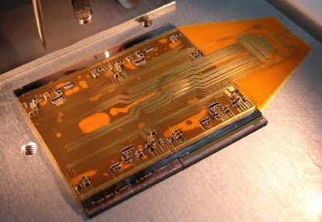
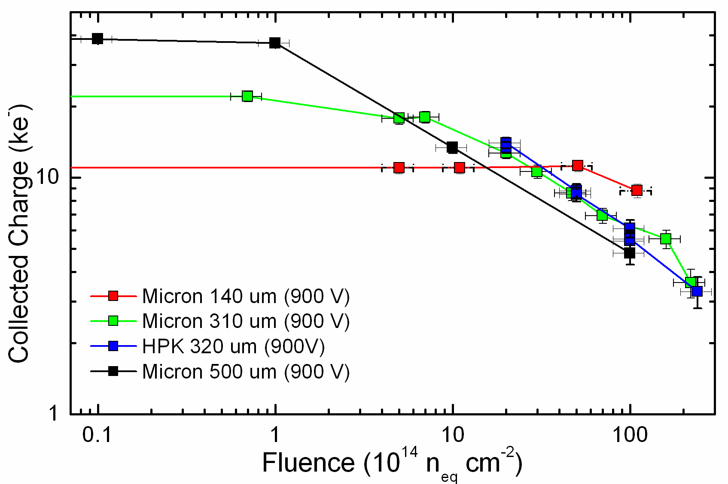
ATLAS Phase II Pixels
Prototypes being developed to optimize:
Radiation hardness, small pixel size, large area coverage, minimize material,….
Pixel sensors in several technologies proved to high doses (planar/3D/diamond shown to 2×10¹⁶n_{eq}/cm²)
IBL pixel (50×250µm) OK for outer pixel layers, but can go down to 25µm×125µm pixels with 65 nm CMOS
Larger area sensors for quads/sextuplets modules
Quad module prototype

Slide 41
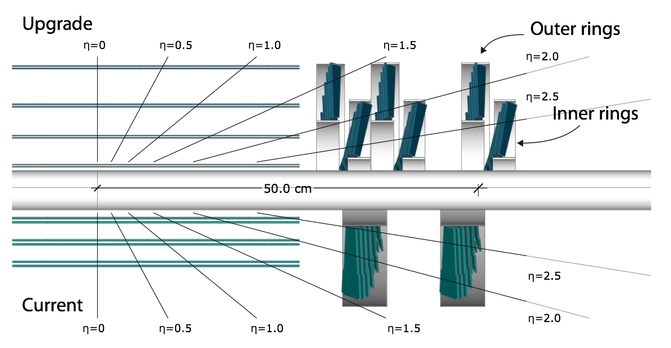
CMS Pixel Upgrade
Pixel upgrade planned for phase II based on hybrid pixels:
Smaller pixels, higher granularity
Radiation hardness
Reduce material budget

Slide 42
CMS Pixel Upgrade
Parameter of Pixel System
# layers (tracking points)
beam pipe radius (outer)
innermost layer radius
outermost layer radius
pixel size (r-phi x z)
In-time pixel threshold
cooling
material budget X/X₀ (η=0)
pixel data readout speed
1st layer module link rate (100%)
ROC pixel rate cabability
Present
3
29.8 mm
44 mm
102 mm
100μ x 150μ
3400 e
C₆F₁₄ (monophase)
6%
40MHz (analog coded)
13 M pixel/sec
~120 MHz/cm²
Upgrade
4
22.5 mm (LS1)
29.5 mm
160 mm
100μ x 150μ
1800 e
CO₂ (biphase)
5.5%
400Mb/sec (digital)
52 M pixel/sec
~580 MHz/cm²
79 mio pixels (barrel) + 44 mio pixels (forward)

Slide 43
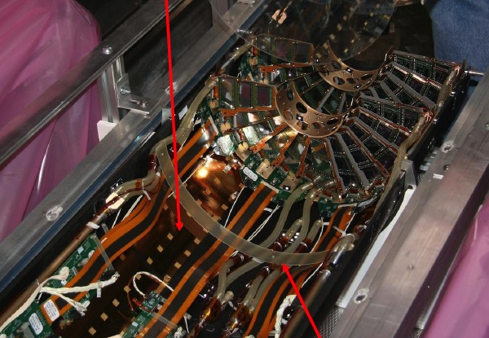
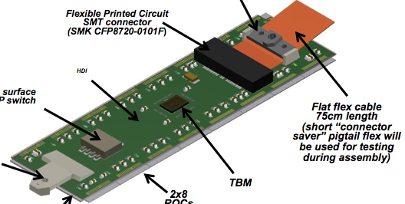
CMS Pixel Upgrade
FPIX with space for 3rd disk
In LS1 install 2 assemblies with 4 new pixel modules (2 blades) each (Pilot-run)
Present FPIX allows partially equipped 3rd disk with new ROC & digital readout system
Cooling by old C₆F₁₄ monophase cooling, use existing extra cables & fibers
Integration and operations of new pixel system in CMS under LHC conditions
Study performance of new ROC
Installation in the experiment in summer 2014

Slide 44
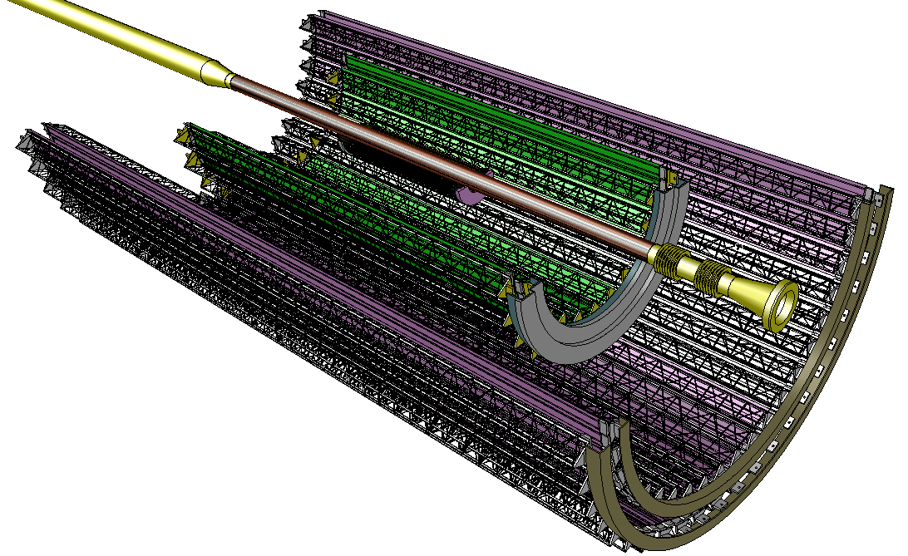
ALICE Inner Tracker Upgrade
All pixel tracker (presently pixel-drift-strips) based on monolithic silicon pixel detectors for LS2
7 layer barrel tracker, no forward disks
~ 10 m²
Layer | Radius [cm] | +/- z
1 | 2.2 | 11.2
2 | 2.8 | 12.1
3 | 3.6 | 13.4
4 | 20 | 39.0
5 | 22 | 41.8
6 | 41 | 71.2
7 | 43 | 74.3
Inner barrel
Outer barrel

Slide 45
ALICE Inner Tracker Upgrade
Cell size for inner barrel layers: 20μm (r,φ) x 20μm (z); can be relaxed for outer barrel layers (< O(100 µm)) >> pointing resolution ~ 4 µm
Binary readout
Material Budget X/X₀ /layer ~ 0.3%, up to ~ 0.8% for the outer layers
  power density < 300 mW / cm²
Readout rate and bandwidth
  Interaction rate (Pb-Pb): 50 kHz (LOI), 100kHz (design value)
  Interaction rate (pp): 500 kHz
  Data throughput < 200 Mbit / sec × cm² (innermost layer) and < 6Mbit/sec x cm² (outer layers), total data throughput 200 Gbit/s
Removal/insertion during winter shutdown (all services on one side (A))
Radiation tolerance to: ~700 krad and 10¹³/cm² 1 MeV n_{eq} (safety factor 4)

Slide 46
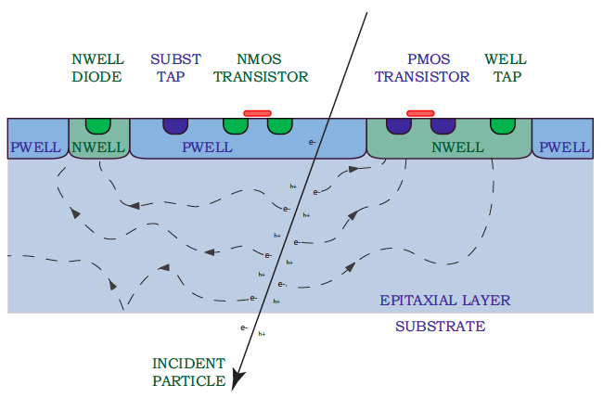
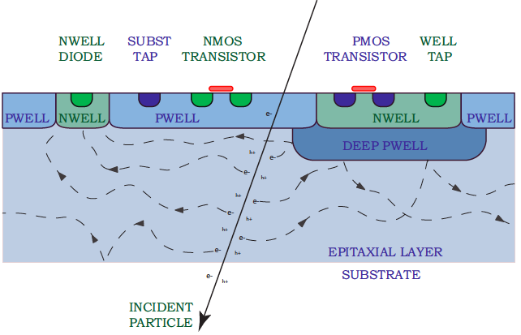
ALICE Inner Tracker Upgrade
Monolithic silicon pixel detectors based on wafers with high resistivity (1-2 kΩcm) epi layer (~ 20 µm thick)
0.18 µm CMOS technology offered by TowerJazz (improved radiation resistance confirmed by test-structures)
Special quadruple-well available to shield PMOS transistors (allows in-pixel truly CMOS circuitry)
R&D on chip architecture ongoing
Figure Stanitzki, M. (2010). Nucl. Instr. and Meth. A doi:10.1016/j.nima.2010.11.166

Slide 47
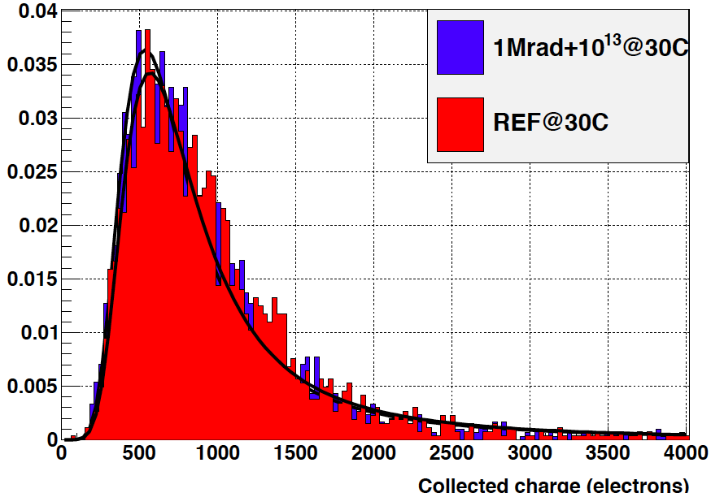


ALICE Inner Tracker Upgrade
Prototype chips developed in 0.18 µm process: MIMOSA32, Explorer
Engineering run with different architectures submitted in March 2013
Charge in seed pixel
Signal to Noise Ratio
Equivalent noise charge
after 1 Mrad+10¹³ n_{eq}
MPV ~ 20-25
Detection eff. ~99.8%

Slide 48


ALICE Inner Tracker Upgrade
Module:
15 mm x 30 mm chip, 50 µm thin
Al flex cable (2 layers)
Laser soldered BGA type connections between flex and chips
Ultra-light support structure (CF)
Diffent cooling concepts under study (PI tubes, PI microchannels, Si microchannels)
See talk by C. Gargiulo
June 3, 2013

Slide 49

NA62 – Gigatracker GTK
Measure O(100) K⁺→π⁺νν events with ~10% background at the CERN SPS in two years of data taking (2014)
π/K/p (~6% K+)
  Precise momentum and direction measurement of kaon and pion
  Precise timing measurement to associate the outgoing pion to the correct incoming parent kaon
3 GTK pixel stations
Hybrid pixels: 1 sensor+10 FE chips
18000 pixels/station

Slide 50


NA62 - GTK
Pixel size: 300 µm x 300 µm
Precise timing information: σ(t)~ 150 ps rms on single track
Material budget per station: 0.5% X₀ to preserve beam divergence for precise downstream measurement and to limit beam hadronic interactions
High and non-uniform rate (~1.5 MHz/mm² in hot center, ~0.8-1.0 GHz total)
High fluence levels: ~2 10¹⁴ n_{eq} cm⁻² in 100 days (~1 year)
Operation in beam vacuum
Estimated power dissipation per readout chip ~ 2W/cm²
Microchannel cooling (~ 130 µm Si)
See talk by A. Mapelli
“Microtechnologies for particle detectors”
June 4, 2013

Slide 51

CLIC
CLIC e⁺e⁻ linear collider:
  √s up to 3 TeV, L=6×10³⁴cm⁻²s⁻¹
  156 ns bunch trains, 312 bunch crossings each
  20 ms gaps between trains
  trigger-less readout
  power pulsing
Time structure of collisions
(not to scale)
20 ms
312 bunches
Large background hit rates from Beamstrahlung
in vertex and forward regions:
  2-3% maximum pixel occupancy / train
  (incl. clustering + safety factors)
  →Time stamping with ~10 ns accuracy,
  to reject background
Moderate radiation exposure:
  NIEL: < 10¹¹ n_{eq}/cm²/y
  TID: < 200 Gy / year
156 ns
e⁺
e⁻
June 3, 2013
TALENT Summer School - CERN
51

Slide 52


CLIC
Efficient tagging of heavy quarks through precise determination of displaced vertices:
Single point resolution: σ_{SP}~3 μm
  Small pixels ~25x25 μm, analog readout
Material budget: X ⪅ 0.2% X₀ / layer
  Low-power ASICs (~50 mW/cm²) + air-flow cooling
  50 µm sensor + 50 µm ASIC
VXD parameters | CLIC
Material X/X0 (90º) | ~1% (5-6 layer)
Pixel size | 25 x 25 μm²
# pixels | ~2 G
Time slicing resol. | ~10 ns
Avg. power/pixel | <~0.3 μW

Slide 53

CLICpix
DAC output
discriminator
65 nm CMOS hybrid r/o chip,
targeted to CLIC vertex detectors
Demonstrator chip produced with
fully functional 64 x 64 pixel matrix
25 μm pixel pitch
Simultaneous 4-bit time (TOA) and
energy (TOT) measurement per pixel
→ Front-end time slicing < 10 ns
Selectable compression logic:
  pixel, cluster + column-based
→ Full chip r/o in less than 800 μs
(at 10% occup.) with 320 MHz r/o clock
power pulsing scheme
→ P_{avg}< 50 mW/cm²
25 μm
leakage compensation
+ return to baseline circuit
Preamp
14 μm
CLICpix
demonstrator chip
P. Valerio

Slide 54

STAR HFT at RHIC
Direct topological reconstruction of Charm (200 GeV Au-Au collisions)
  Detect charm decays with small cτ, including D⁰ → K π
Installation: December 2013
3 sectors installed May 8, 2013
HFT – Heavy Flavor Tracker
SSD – Silicon Strip Detector
  r = 22 cm
IST – Inner Silicon Tracker
  r = 14 cm
PXL – Pixel Detector
  r = 2.5, 8 cm

Slide 55
STAR HFT at RHIC
Monolithic silicon pixel detectors
Pointing resolution | (12 ⊕ 19 GeV/p⋅c) μm
Layers | Layer 1 at 2.5 cm radius Layer 2 at 8 cm radius
Pixel size | 20.7 μm X 20.7 μm
Hit resolution | 6 μm
Position stability | 6 μm rms (20 μm envelope)
Radiation length per layer | X/X₀ = 0.37%
Number of pixels | 356 M
Integration time (affects pileup) | 185.6 μs
Radiation environment | 20 to 90 kRad / year 2*10¹¹ to 10¹² 1MeV n eq/cm²
Rapid detector replacement | ~ 1 day
356 M pixels on ~0.16 m² of Silicon

Slide 56

STAR HFT at RHIC
Air cooling
Thinned silicon sensors (50 μm thickness)
MAPS (Monolithic Active Pixel Sensor) pixel technology
  Sensor power dissipation ~170 mW/cm²
  Sensor integration time <200 μs (L=8×10²⁷)
Quick detector installation or replacement (1 day)
carbon fiber sector tubes (~ 200 µm thick)
Ladder with 10 MAPS sensors (~ 2×2 cm each)
Aluminum conductor Ladder Flex Cable
20 cm

Slide 57

STAR HFT at RHIC
ULTIMATE chip (IPHC Strasbourg)
Reticle size (~ 4 cm²)
  Pixel pitch 20.7 μm
  928 x 960 array ~890 k pixels
Power dissipation ~170 mW/cm² @ 3.3V
Integration time 185.6 μs
In pixel CDS
Discriminators at the end of each column (each row processed in parallel)
2 LVDS data outputs @ 160 MHz
High Res Si option – significantly increases S/N and radiation tolerance.

Slide 58
Summary
Silicon pixel detectors gain increasing importance in HEP experiments. All upgrades of LHC experiments consider or have already decided to use pixel detectors.
Present pixel systems in HEP experiments are based on hybrid pixel detectors. The new generation of pixel detectors will see hybrid and monolithic pixel detectors.
Severe challenges lie ahead to achieve higher granularity, low mass and to sustain high radiation environment and data rates.
Pixels are very popular outside HEP experiments (not only in your camera..) – see the next talk!
See talk by M. Campbell
“Hybrid pixels – from HEP to imaging and other applications and back again”

Slide 59
SPARE

Slide 60
The upgrade of the ALICE Inner Tracker
Performance - 1
Layout A (7 pixel layers)
σ_{rφ} = 4 µm | σ_{z}=4 µm
X/X₀ | 0.3 %
Layout B (3 pixel + 4 strip layers)
σ_{rφ} = 4 µm (pixel), 20 µm (strips) | σ_{z}=4 µm (pixel), 830 µm (strips)
X/X₀ | 0.3% (pixel), 0.8 % (strips
~3x

Slide 61
The upgrade of the ALICE Inner Tracker
Performance - 1
Tracking efficiency
Momentum resolution
Layout A (7 pixel layers)
Layout B (3 pixel + 4 strip layers)

