Slide 2
The use of social media in your science communication
Kate Kahle, CERN Social Media Manager
TALENT Summer School

Slide 3
Overview
Social media, the basics:
  what, why and tips
Social media for your science
  audience, messages, interactions
Impact
  Measuring, managing and maximising

Slide 4
Social Media:
the basics

Slide 5
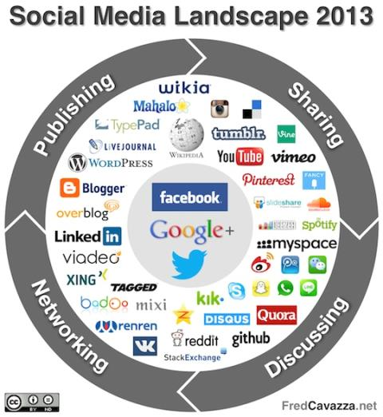
What is social media?
Virtual communities and networks to create, share, and exchange information and ideas.

Slide 6
Why use social media?
On a personal level | On a professional level | On an organisation level
Stay in touch with friends and family e.g. via Facebook | Build a professional network e.g. via LinkedIn, Twitter | Send out breaking news or report live from events e.g. via Twitter
Get immediate access to breaking news e.g. via Twitter | Blog about your research and interests e.g. via Wordpress, Twitter | Inspire the public with images and video e.g. via Facebook, YouTube
View interesting or amusing content e.g. via YouTube, Flickr, Wikipedia | Take part in discussions as an expert e.g. Google+ Hangouts, Twitter | Respond to questions and comments e.g. via Google+ Hangouts, Twitter, Facebook

Slide 7
Basic tips

Slide 8
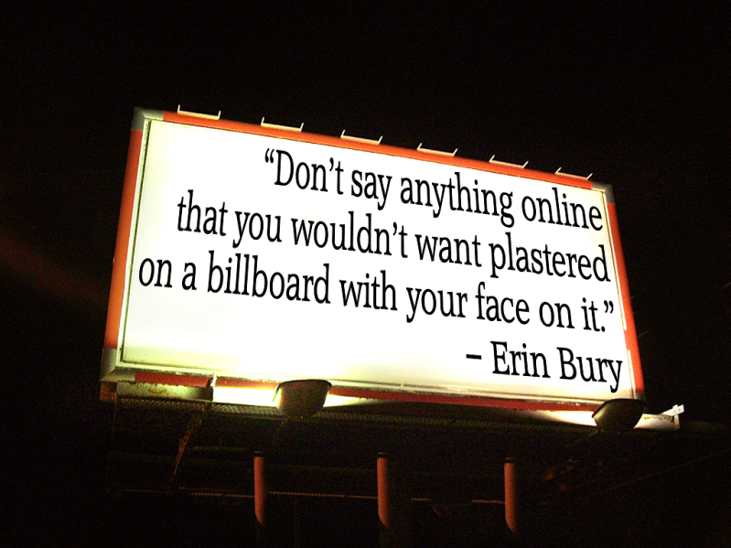
Source: http://www.maylor.net/2012/05/16/my-top-3-tips-for-using-social-media/

Slide 9
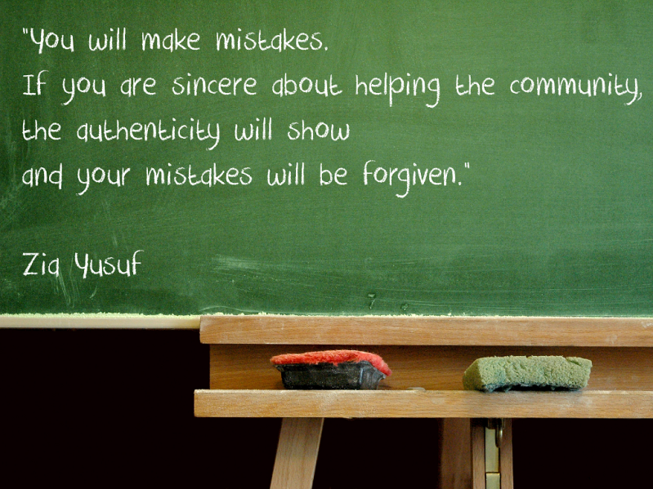
Source: http://www.maylor.net/2012/05/16/my-top-3-tips-for-using-social-media/

Slide 10
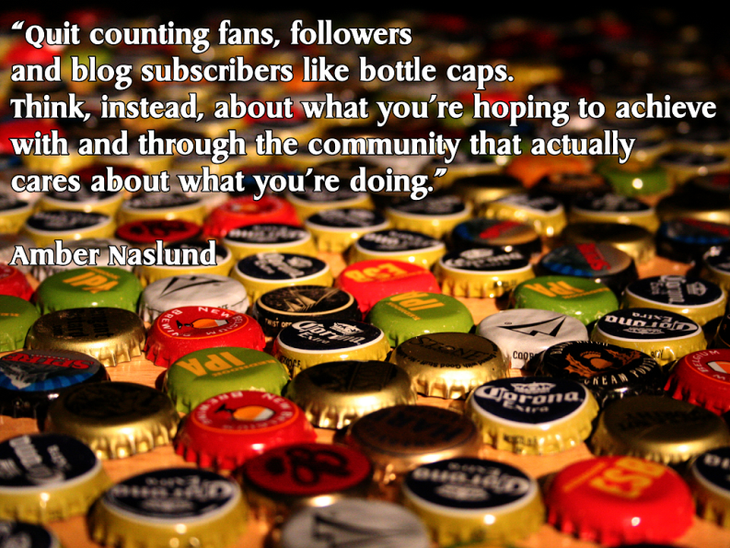
Source: http://www.maylor.net/2012/05/16/my-top-3-tips-for-using-social-media/

Slide 11
Social media for
your science

Slide 12
Social media for your science
On a personal level | On a professional level | On an organisation level
Stay in touch with friends and family e.g. via Facebook | Build a professional network e.g. via LinkedIn, Twitter | Send out breaking news or report live from events e.g. via Twitter
Get immediate access to breaking news e.g. via Twitter | Blog about your research and interests e.g. via Wordpress, Twitter | Inspire the public with images and video e.g. via Facebook, YouTube
View interesting or amusing content e.g. via YouTube, Flickr, Wikipedia | Take part in discussions as an expert e.g. Google+ Hangouts, Twitter | Respond to questions and comments e.g. via Google+ Hangouts

Slide 13
Who do you want to reach?
Possible audiences
Colleagues
Scientists/engineers in your field
Scientists/engineers in other fields
Students and educators
Funding bodies
Friends and family
Interested public
Uninterested public

Slide 14
What are your key messages?
Your work is:
exciting
inspiring
cutting edge
multicultural
producing interesting results
just one of your many interests

Slide 15
What are your options?
Blogging (e.g. Wordpress)
Regular posts
Responding to comments
Micro-blogging (e.g. Twitter)
Sharing links
Discussing topics
Answering questions
Live chats (e.g. Google+ Hangouts)
Discussing topics
Answering questions

Slide 16
Impact

Slide 17
Measuring your impact
Blogging (e.g. Wordpress)
Page views
Comments
Micro-blogging (e.g. Twitter)
Retweets
Replies
Followers
Live chats (e.g. Google+ Hangouts)
Viewing figures
Comments

Slide 18
Managing your impact
Dealing with comments
Replying takes time but can be rewarding for all concerned
Save time by linking to existing resources
Don’t feed the trolls
Comment policy e.g.
“CERN welcomes your comments and will moderate comments using these guidelines:
Please keep comments relevant. Irrelevant, inappropriate or offensive comments may be deleted.
Stay on topic. Other readers expect the comments about a post to deal with the topic at hand.”

Slide 19
Maximising your impact
Do | Don’t
Be human | Be robotic
Interact | Be “me centric”
Handle debates and criticisms constructively | Post or encourage offensive comments
Show your passion | Overpost
Be aware of scientific jargon | Condescend, dictate
Communicate creatively, using photos and video | Spam
Respect copyright | Share private or confidential information
Contribute regularly | And … don’t forget your day job!

Slide 20
Be sure to follow:
Platform | Website | Twitter | Facebook | Google+ | YouTube
CERN | cern.ch | EN: @CERN FR: @CERN_FR | fb.com/cern | +CERN | youtube.com/ CERNTV
CERN Jobs | cern.ch/jobs | @CERN_JOBS | fb.com/CERNjobs | – | youtube.com/ CERNJOBSTV
ATLAS | atlas.ch | @ATLASexperiment | fb.com/ ATLASexperiment | +ATLAS Experiment | youtube.com/ TheATLASExperiment
CMS | cern.ch/cms | @CMSexperiment | fb.com/ CMSexperiment | +CMS Experiment | youtube.com/ CMSExperimentTV
ALICE | cern.ch/alice | @ALICEexperiment | fb.com/ ALICE.EXPERIMENT | +ALICE Experiment | youtube.com/aliceatlhc
LHCb | cern.ch/lhcb-public | @LHCbExperiment | – | +LHCb Experiment | –

Slide 21
Thank you

