Slide 1
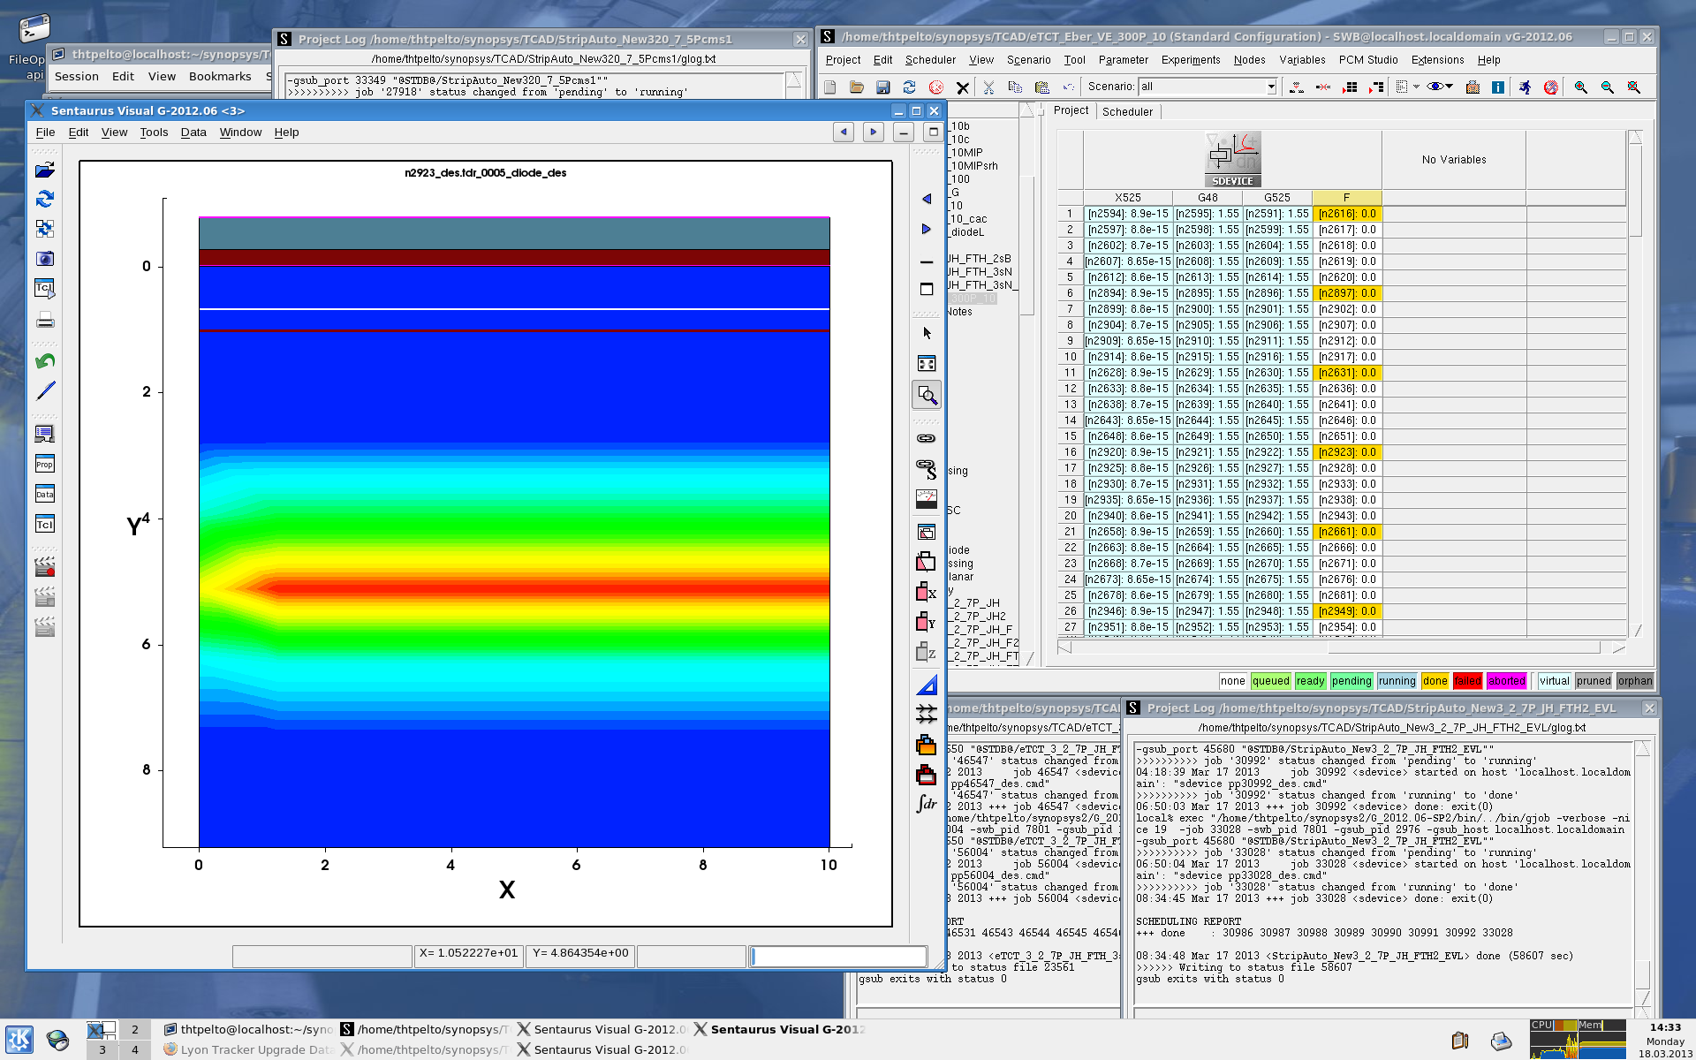
Simulations of irradiated detectors: E(x) & parameterization
RD50 Simulation Working Group Meeting
March 27th - 28th 2013
T. Peltola¹⁾ , J. Härkönen¹⁾
¹⁾Helsinki Institute of Physics, CMS Tracker Project.

Slide 2
Outline
Status of irradiated Si detector simulations with Synopsys TCAD
  Results of E(x) simulations
  Parameters and parameterization
  p-type device: EVL and Petasecca defect models
SiBT measured and simulated p-type detector CCE
Future plan / work in progress
  edge-TCT

Slide 3
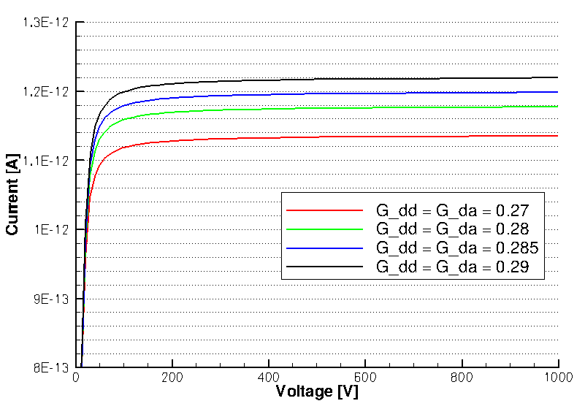
Tuning of EVL-defect model: G_{DD}, G_{DA}
Current cannot be introduced by adding the suggested "trap" E = E_{C} - 0.65eV
Current introduction rates G_{DD} and G_{DA} modified to match experimental value of leakage current
n-type device,
1 μm x 1 μm x 300 μm
α (290K)= 4·10⁻¹⁷ A·cm⁻¹
Ф =10¹⁴ cm⁻²
I = V·α·Ф ~ 1.2·10⁻¹² A
EVL:
Type of defect | Activation energy, eV | Trapping cross section, cm² | Introduction rate, cm⁻¹
Deep donor (DD) | E_{V} + E_{DD} = 0.48 | s_{e} = s_{h} = 4e-14 | G_{DD} = 1
Deep acceptor (DA) | E_{C} - E_{DA} = 0.525 | s_{e} = s_{h} = 4e-14 | G_{DA} = 1
Modified:
Type of defect | Activation energy, eV | Trapping cross section, cm² | Introduction rate, cm⁻¹
Deep donor | E_{V} + E_{DD} = 0.48 | s_{e} = s_{h} = 4e-14 | G_{DD} = 0.285
Deep acceptor | E_{C} - E_{DA} = 0.525 | s_{e} = s_{h} = 4e-14 | G_{DA} = 0.285

Slide 4
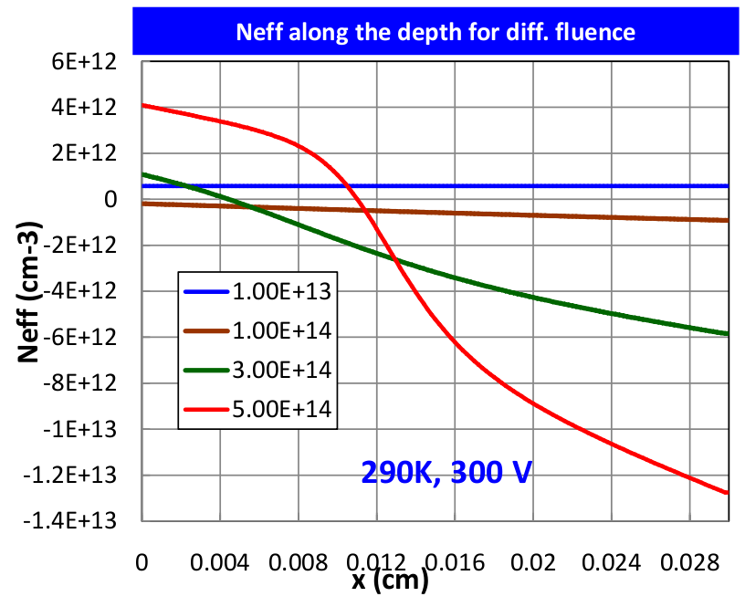
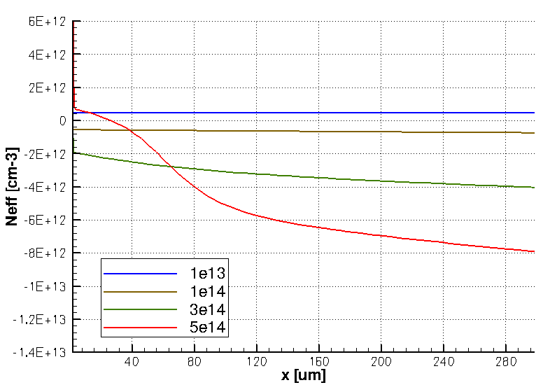
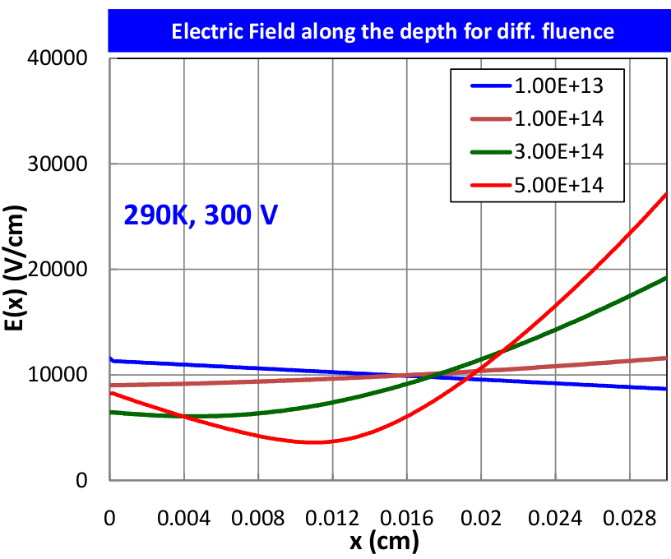
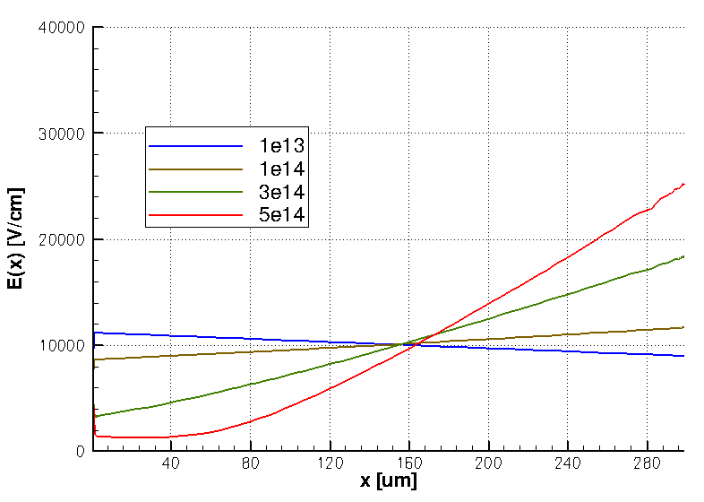
Tuning of G_{DD} , G_{DA}: N_{eff} , E(x)
G_{DD} and G_{DA} = 0.285
Synopsys model not matching with Eremin’s simulation:
No double peak behaviour at Φ = 3e14 cm⁻²
~90 μm difference in N_{eff} sign change at
Φ = 5e14 cm⁻²
The missing bulk generated current level is not compensated by simply tuning G_{DD}, G_{DA} at Φ > 1e14 cm⁻²
290K, 300V
Neff conc. simulated by V. Eremin
Neff conc. simulated on Synopsys-TCAD
G_{DD} and G_{DA} = 0.285
290K, 300V
E(x) simulated by V. Eremin
E(x) simulated on Synopsys-TCAD

Slide 5
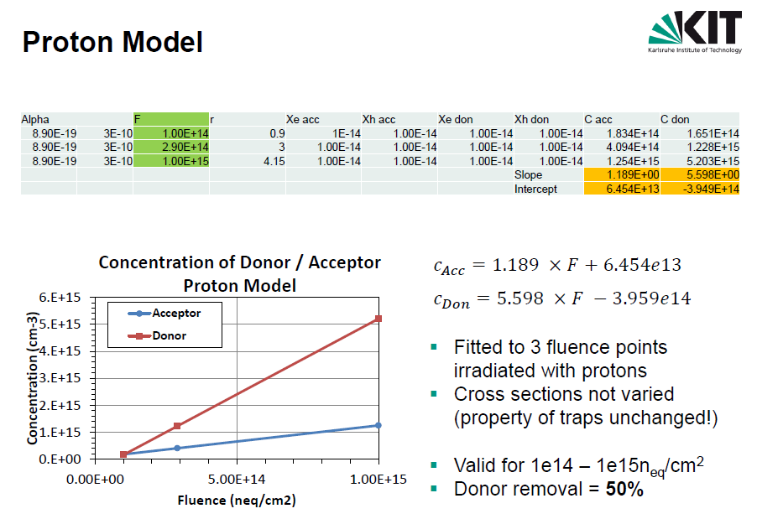
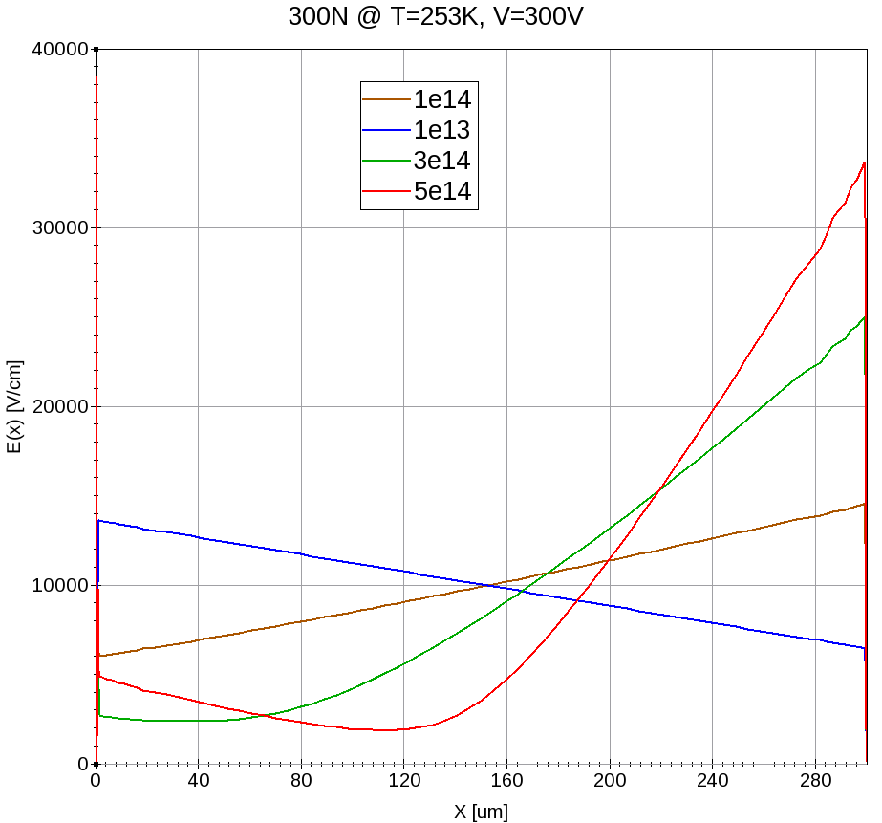
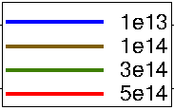
Tuning of EVL-defect model: Defect concentrations
EVL defect model, tuned to T = 253 K by Robert Eber, KIT
Type of defect | Activation energy, eV | Trapping cross section, cm² | Introduction rate, cm⁻¹ | Acceptor/donor conc. cm⁻³
Deep acceptor | E_{C} - E_{DA} = 0.525 | s_{e} = s_{h} = 1e-14 | G_{DA} = 1.189 | 1.189*F + 6.454e13
Deep donor | E_{V} + E_{DD} = 0.48 | s_{e} = s_{h} = 1e-14 | G_{DD} = 5.598 | 5.598*F – 3.959e14
Method produces correct leakage current & DP behaviour
253K, 300V

Slide 6
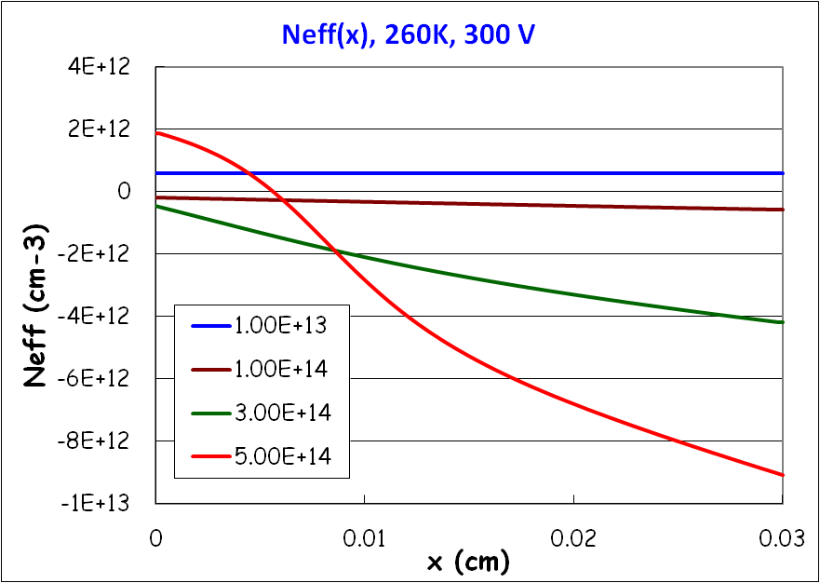
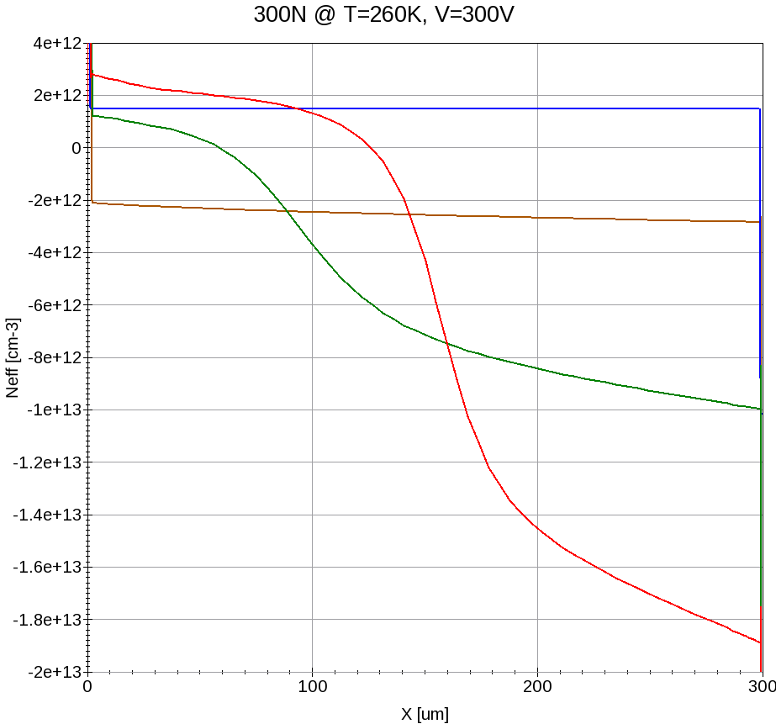
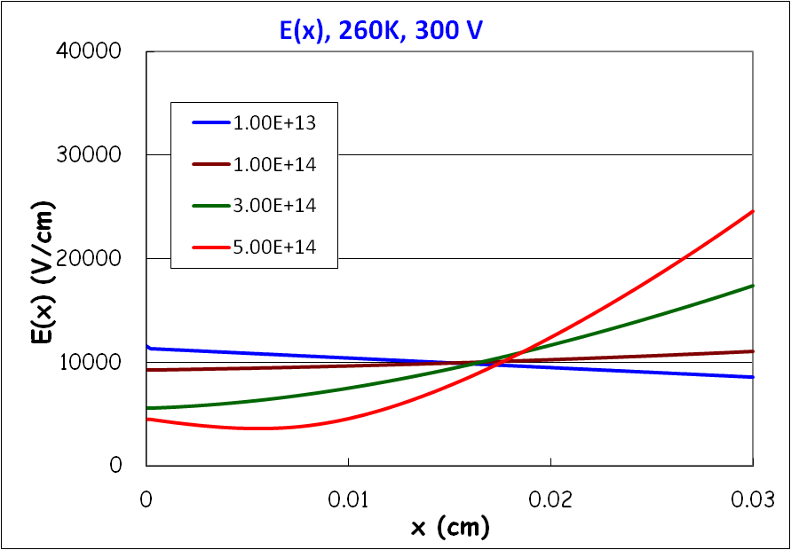
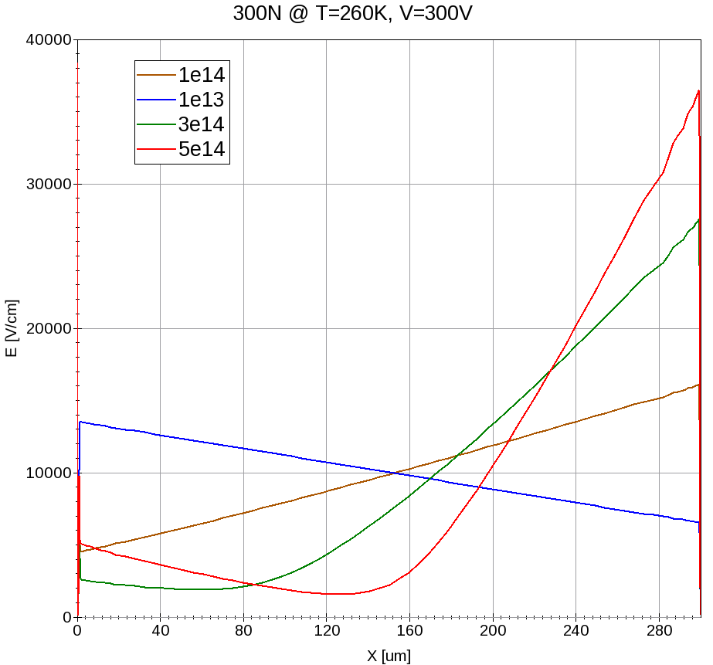
Tuning of defect concentrations: N_{eff} , E(x)
V. Eremin
Synopsys
260K, 300V
Synopsys model differences with Eremin’s simulation:
Double peak behaviour already at Φ = 3e14 cm⁻²
~60 μm difference in N_{eff} sign change at
Φ = 5e14 cm⁻²
Amplitude differences of N_{eff} and E(x)
s_{e} = s_{h} = 0.9e-14 cm²
V. Eremin
Synopsys
s_{e} = s_{h} = 0.9e-14 cm²
260K, 300V

Slide 7
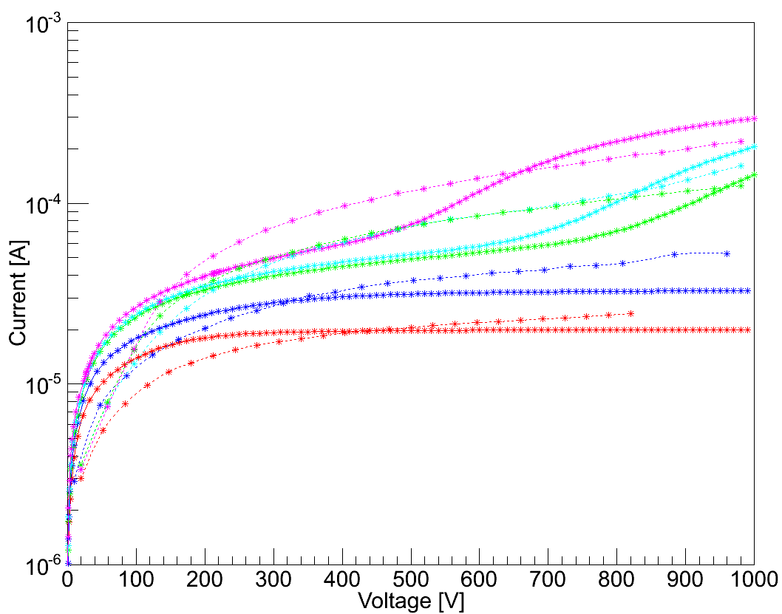
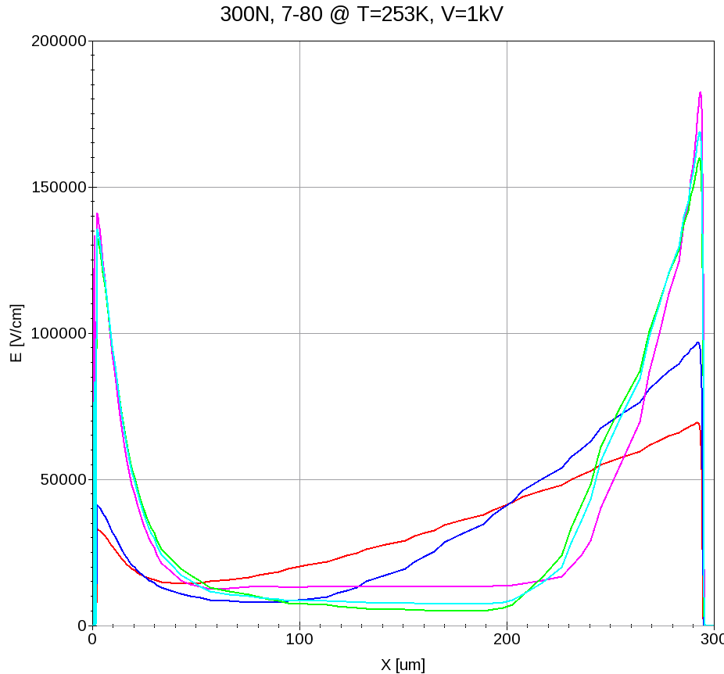

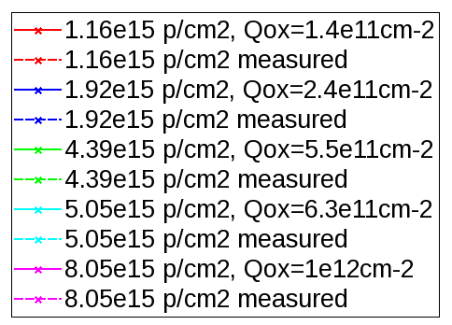
Tuning of defect concentrations: Leakage currents
Fluence conversion to simulator input
IV data from VTT 24GeV irradiated minisensors
Part of the fluence region > 1e15 n_{eqv} cm⁻²
300N @ T = -20°C
Improved match with measurement by Q_{ox}(Φ)
Good agreement even at high fluencies
Hardness factor | 24 GeV proton fluence [cm⁻²] | 1 MeV n_{eqv} fluence [cm⁻²]
0.56±0.01 [1] | 1.16e15 | (6.50±0.12)e14
0.56±0.01 | 1.92e15 | (1.08±0.02)e15
0.56±0.01 | 4.39e15 | (2.46±0.04)e15
0.56±0.01 | 5.05e15 | (2.83±0.05)e15
0.56±0.01 | 8.05e15 | (4.51±0.08)e15
E(x) of the simulated fluencies
Simulated and measured leakage currents
253K
253K
[1] D. Bechevet et al. NIM A 479 (2002) 487-497.

Slide 8
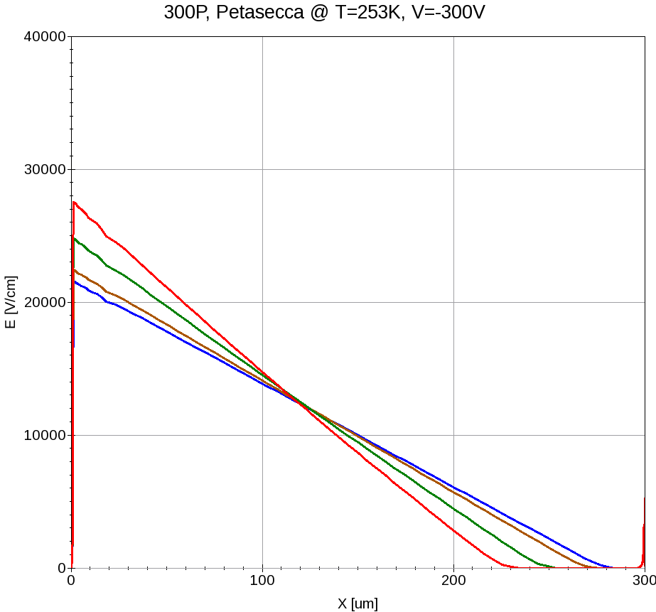
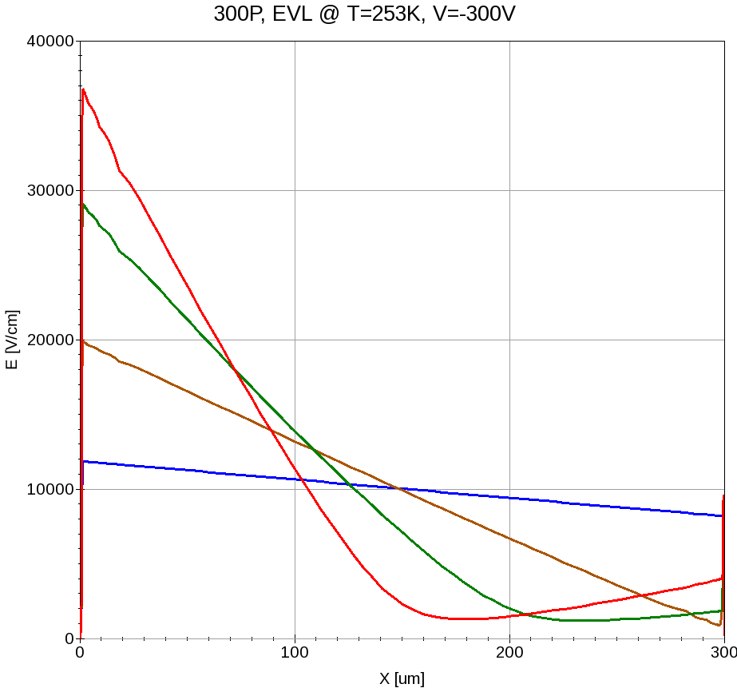
P-type detector: Petasecca & EVL models
Three-level defect model for p-type @ T = 290 K [2]
Level [eV] | σ_{n} [cm⁻²] | σ_{p} [cm⁻²] | Introduction rate [cm⁻¹]
E_{C} - 0.42 | 2e-15 | 2e-14 | 1.613
E_{C} - 0.46 | 5e-15 | 5e-14 | 0.9
E_{V} + 0.36 | 2.5e-14 | 2.5e-15 | 0.9
[2] M. Petasecca et al.
NIM A 563 (2006) 192-195
E_{V} + 0.36 level was not found to contribute to the performance of an irradiated detector
Effective Petasecca defect model for p-type, modified to match leakage current @ T=253K
Type of defect | Activation energy, eV | Trapping cross section, cm² | Introduction rate(253K), cm⁻¹
Deep acceptor | E_{C} - E_{DA} = 0.42 | s_{e} = 2e-15, s_{h} = 2e-14 | G_{DA} = 10.818
Deep acceptor | E_{C} - E_{DA} = 0.46 | s_{e} = 5e-15, s_{h} = 5e-14 | G_{DA} = 7.305
Petasecca model
Modified EVL-model
Expected DP behaviour observed only with EVL-model
253K, -300V
253K, -300V

Slide 9
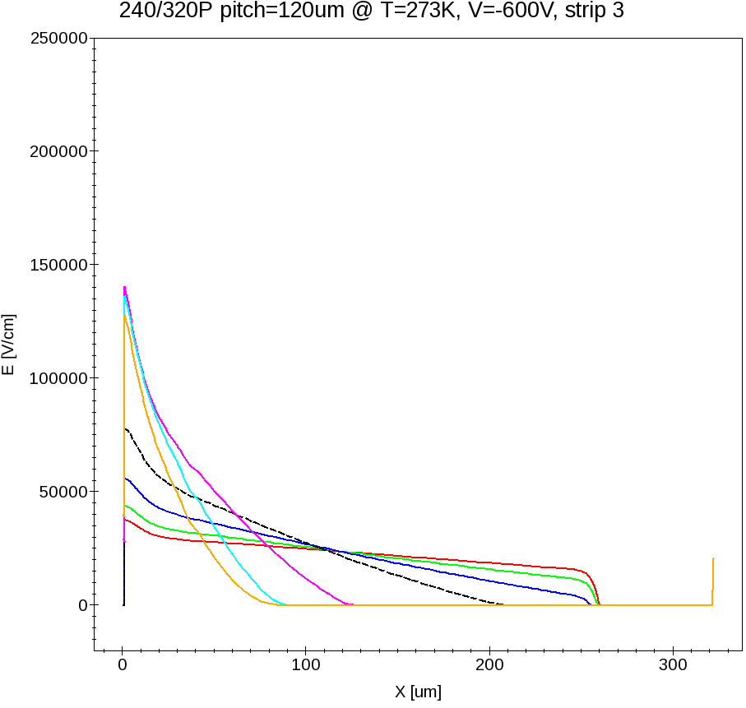

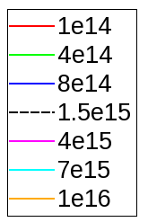
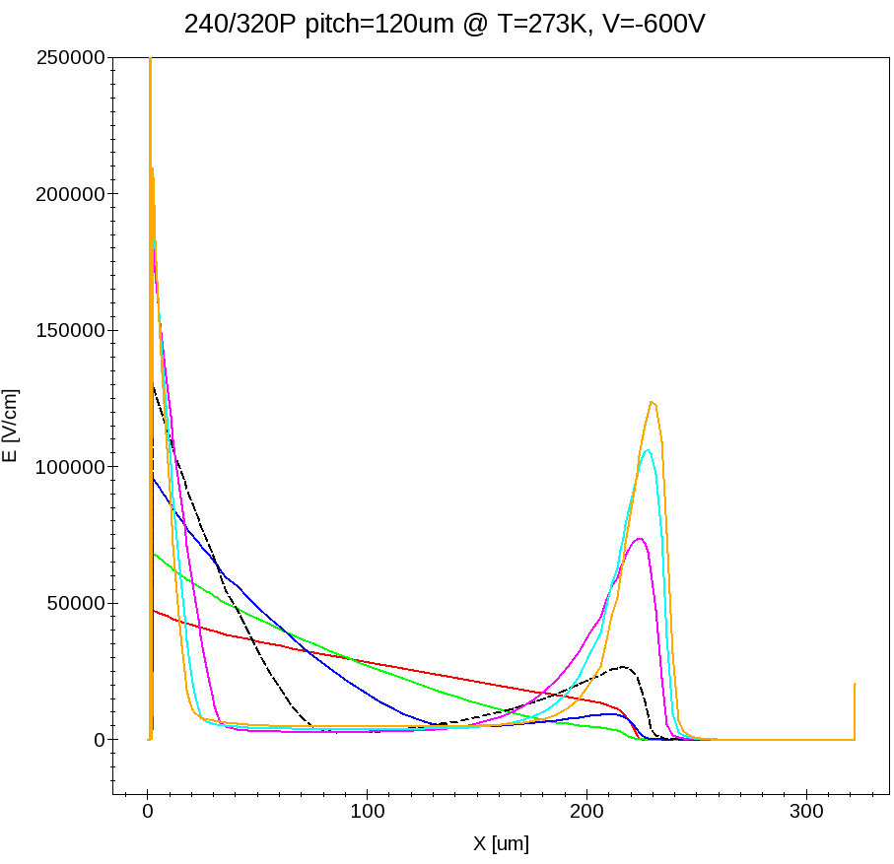
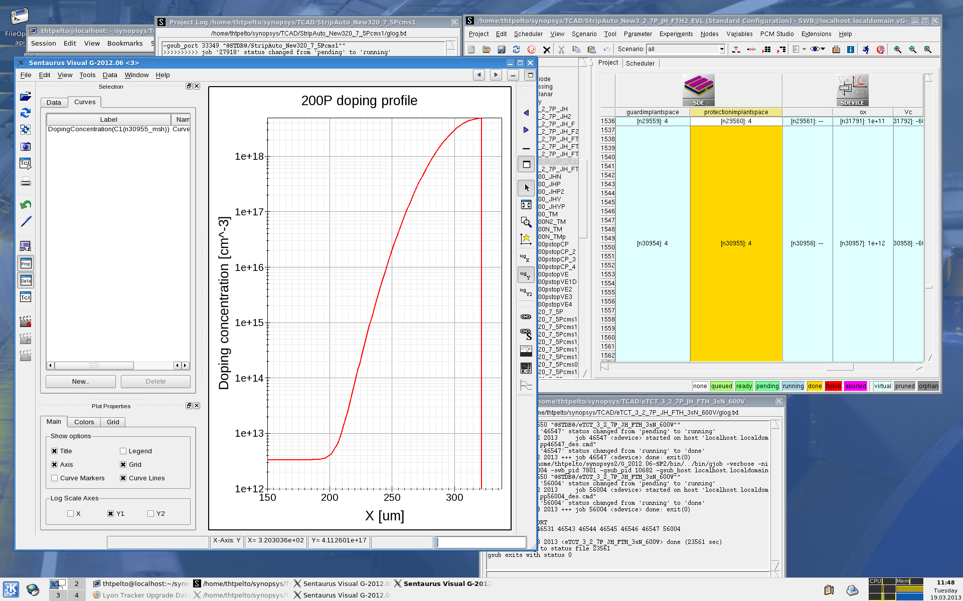
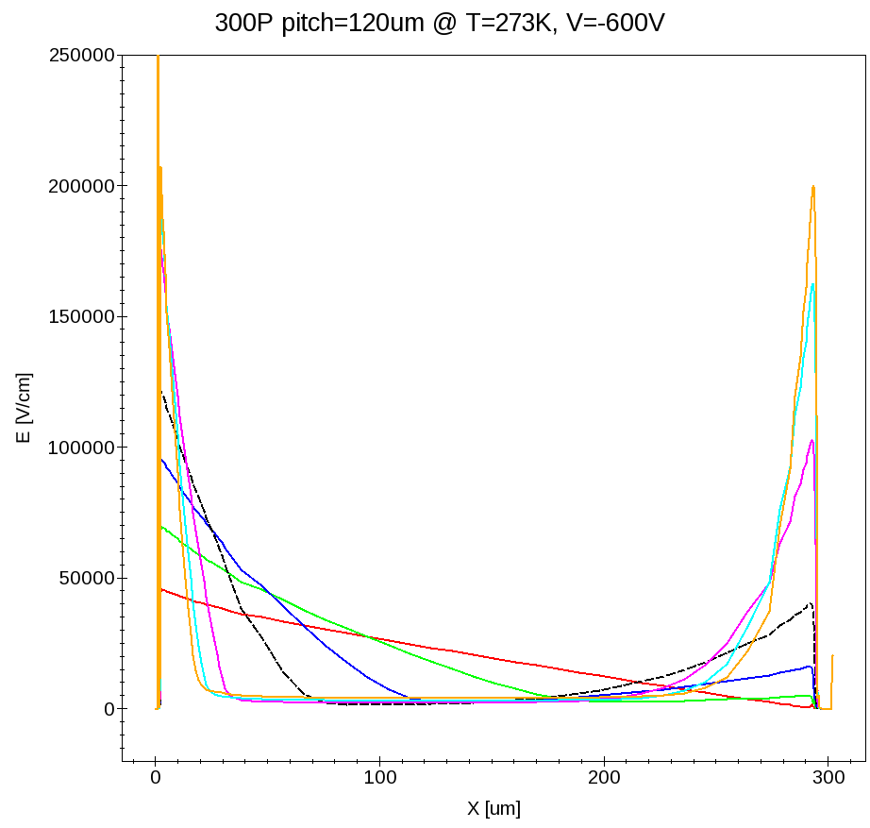

P-type MSSD: Petasecca & EVL models
5-strip structure
5-120 region
w_{p} = 14 μm
N_{p} = 5e16 cm⁻³
T=273K
F = 1e14 – 1e16 cm⁻²
Petasecca
Petasecca
Electric field distributions @
y = center of the strip 3:
Leakage current matching:
Petasecca tuning @ T=273K
Level, eV | Introduction rate (273K), cm⁻¹
E_{C} - 0.42 | G_{DA} = 7.733
E_{C} - 0.46 | G_{DA} = 4.314
Modified EVL
Modified EVL
Modified EVL tuning @ T=273K
Level, eV | Trapping X section, cm²
E_{C} - 0.525 | s_{e} = s_{h} = 1.3e-14
E_{V} + 0.48 | s_{e} = s_{h} = 1.3e-14

Slide 10
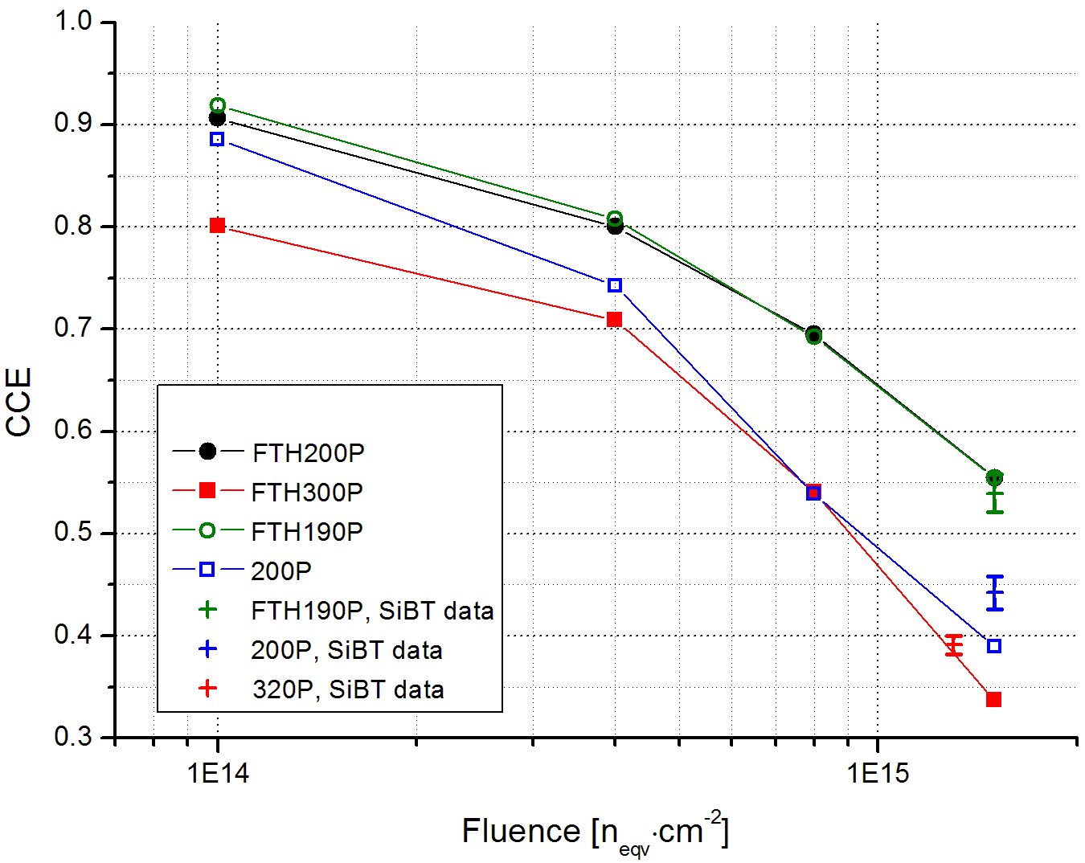
P-type MSSD: SiBT CCE data
5-120 region, T = 273 K
FTH300P and 320P active area ≈ 290 μm
Simulated results matching with measured CCE of FTH190P and 320P
Difference in CCE of 200P due to definition of deep diffusion doping profile?
Measured and simulated CCE vs Φ
Simulated deep diffusion doping profile

Slide 11
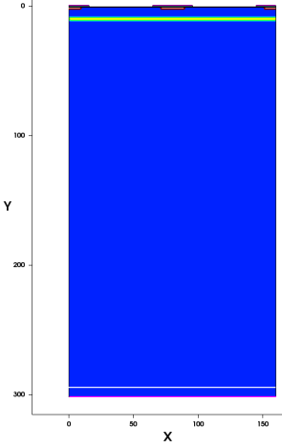
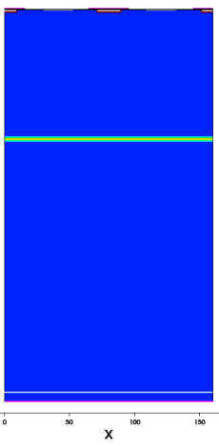
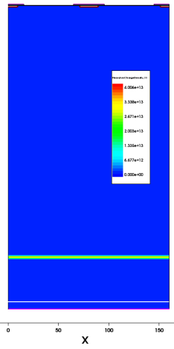
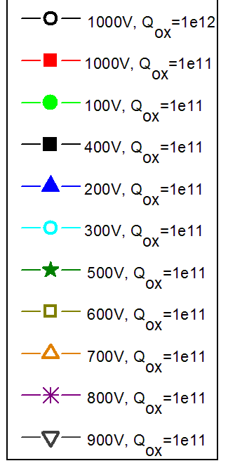
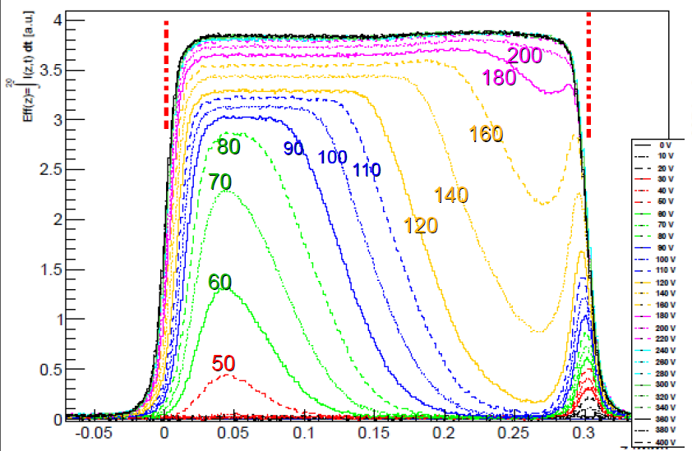
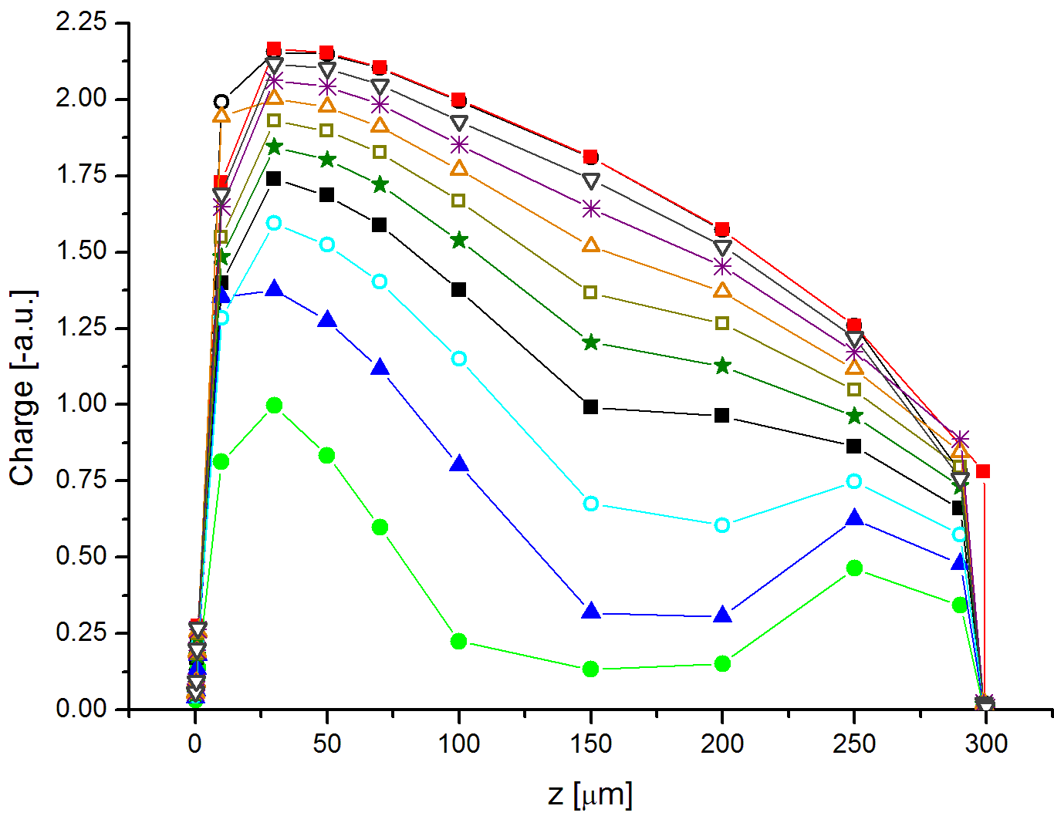
Work in progress: edge-TCT
MIP trajectories in 300N device:
Goal: extract electric field from drift velocity measurements using eTCT
Collected eTCT generated charges as a function of injection distance
First MSSD simulations produce matching behaviour with measurement
10 μm
100 μm
mip direction
250 μm
Irradiated 300N eTCT pulses, F = 1e15 cm⁻²,
T=-20°C
FZ320N nonirr. eTCT-measurement (M. Fernandez 2013). V_{fd} ~ 210 V
V_{fd} ~ 800 V

Slide 12
Summary
Tuning of defect concentrations succesful way to modify EVL-model for Synopsys-TCAD
  Double peak formation
  Correct leakage currents
  Promising CCE results compared with SiBT data
Petasecca model for p-type device does not produce the expected double peak
First edge-TCT simulations match the measured behaviour

