Slide 1

Double Electric field Peak Simulation of Irradiated Detectors Using Silvaco
Ashutosh Bhardwaj, Kirti Ranjan, Ranjeet Singh*, Ram K. Shivpuri
Center for Detector & Related Software Technology (CDRST)
Department of Physics and Astrophysics,
University of Delhi (DU), Delhi,
RD50 Simulation Group meeting, CERN, Geneva
27-28 march, 2013

Slide 2
Overview
RD50 Simulation task
Present Approach
Parameters for simulation
Simulation Results
Summary

Slide 3
The set of parameters used in simulations:
Detector thickness -------------------------------------------------------- d=0.03 cm
Concentration of shallow donors (phosphorus) ---------------------N_{SD} = 6e11 cm⁻³
Two level trap model
Bulk generated current calculated from
Single level model
Effective energy of current generating level----------------- E_{j} – 0.65 eV
Effective cross-section of current generating level --------- σ_{j} = 1e-13cm²
Introduction rate of current generating level ---------------- G_{j} = 1 cm⁻¹
Simulations by different groups are compared for
Effect of temperature variation : T = 290K & 260K
Effect of irradiation flux variation : 1e13, 1e14, 3e14, 1e15, 3e15 cm⁻² at V=300V
Effect of bias voltage : 200V, 300V, 500V, 1000V at F = 5e14cm⁻² & 1e15cm⁻²
RD50 Simulation Task
Type of defect | Activation energy, eV | Trapping cross section, cm² | Introduction rate, cm⁻¹
Deep donor | E_{DD} - E_{V} = 0.48 | σ_{e} = σ_{h} = 1e-15 | G_{DD} = 1
Deep acceptor | E_{DA} - E_{V} = 0.595 | σ_{e} = σ_{h} = 1e-15 | G_{DA} = 1
Not available in simulation as separate current level
Vladimir provided data for E(x), n(x), p(x), Neff (x) for different fluence at different temperature & at different bias voltages.

Slide 4




Our Approach…based on
“Simulation of Heavily Irradiated Silicon Pixel Sensors and Comparison with Test Beam
Measurements” by V. Chiochia et al., IEEE NSS 2005
EVL – 1: Trap levels given by Eremin (no bulk generation current level)
EVL – 2: Trap levels given by Eremin and Bulk current generated by varying cross-section
EVL – 3: Trap levels given by Eremin and Bulk current generated by varying cross-section and electric field position adjusted by varying the hole to electron cross-section ratio.
EVL – 4: Trap levels given by Eremin and Bulk current generated by varying cross-section and electric field position adjusted by varying the hole to electron cross-section ratio & ratio of the introduction rates changed to fix the peak electric field

Slide 5
EVL-4 simulations (with correct value of leakage current)
Simulations at 290K
Trap introduction rate=0.9
Acceptor(σ_{n} =4e-14, σ_{p}=4e-14),
Donor (σ_{n} =4e-14, σ_{p} =4e-14)]
τ₀ = 1e-5 sec
Trap levels are same as given in V. Eremin’s proposed simulation task.
Additional bulk current is generated by increasing x-section of the trap levels from 1e-15cm⁻² to 4e-14cm⁻² such that simulated leakage current match with experimental observed current (Sigma-n = Sigma-p = 4x10⁻¹⁴ cm⁻²)
(for 1x1x300um³ structure with α(290K)=4x10⁻¹⁷ A/cm at φ= 1x10¹⁴ n_{eq}/cm²
Leakage current increment (w.r.t. without irradiation level) ~ 1.2x10⁻¹² A)
Electric Field profile is further tailored by decreasing trap introduction rate to 0.9.
Acceptor Introduction rate = Donor Introduction rate = 0.9.
This parameterization is used to match results from Eremin’s data for φ= 1x10¹⁴ n_{eq}/cm² and T=290K. The same values are used for all fluence and temp.

Slide 6
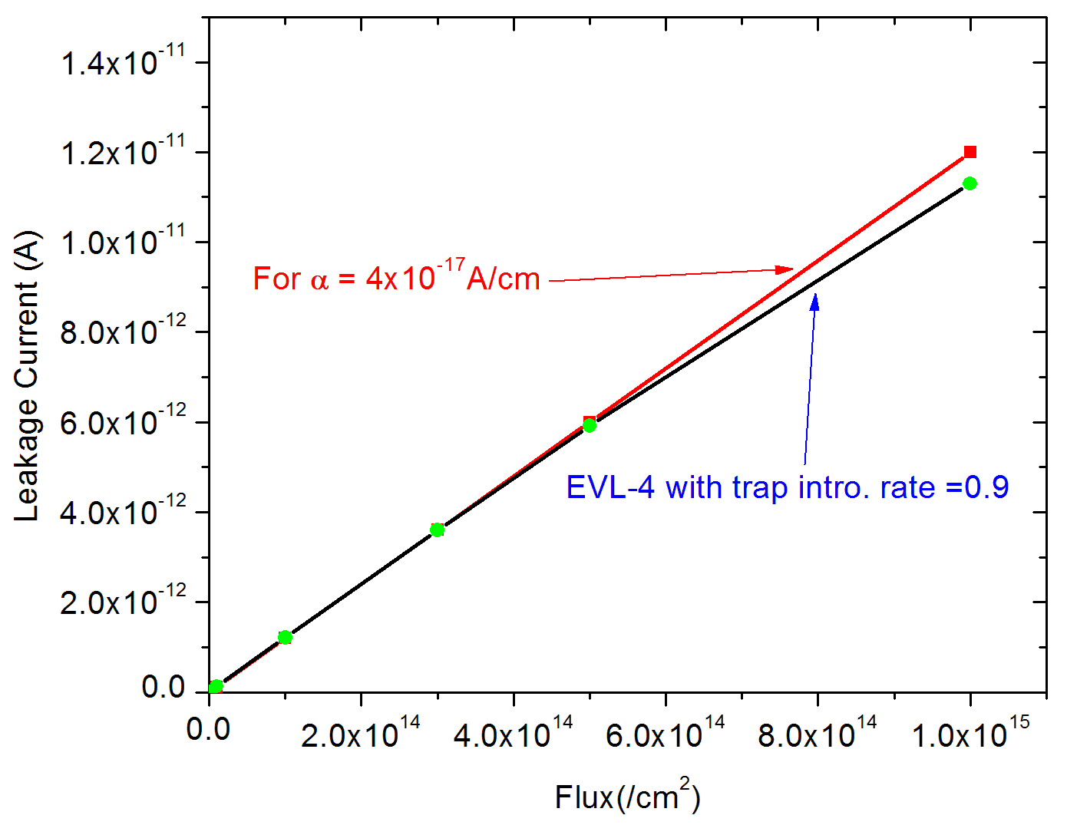
Leakage current for different flux
Reverse Bias – 300V, Temp – 290K
Good agreement between
Experimental value of current
with EVL-4 simulation model

Slide 7
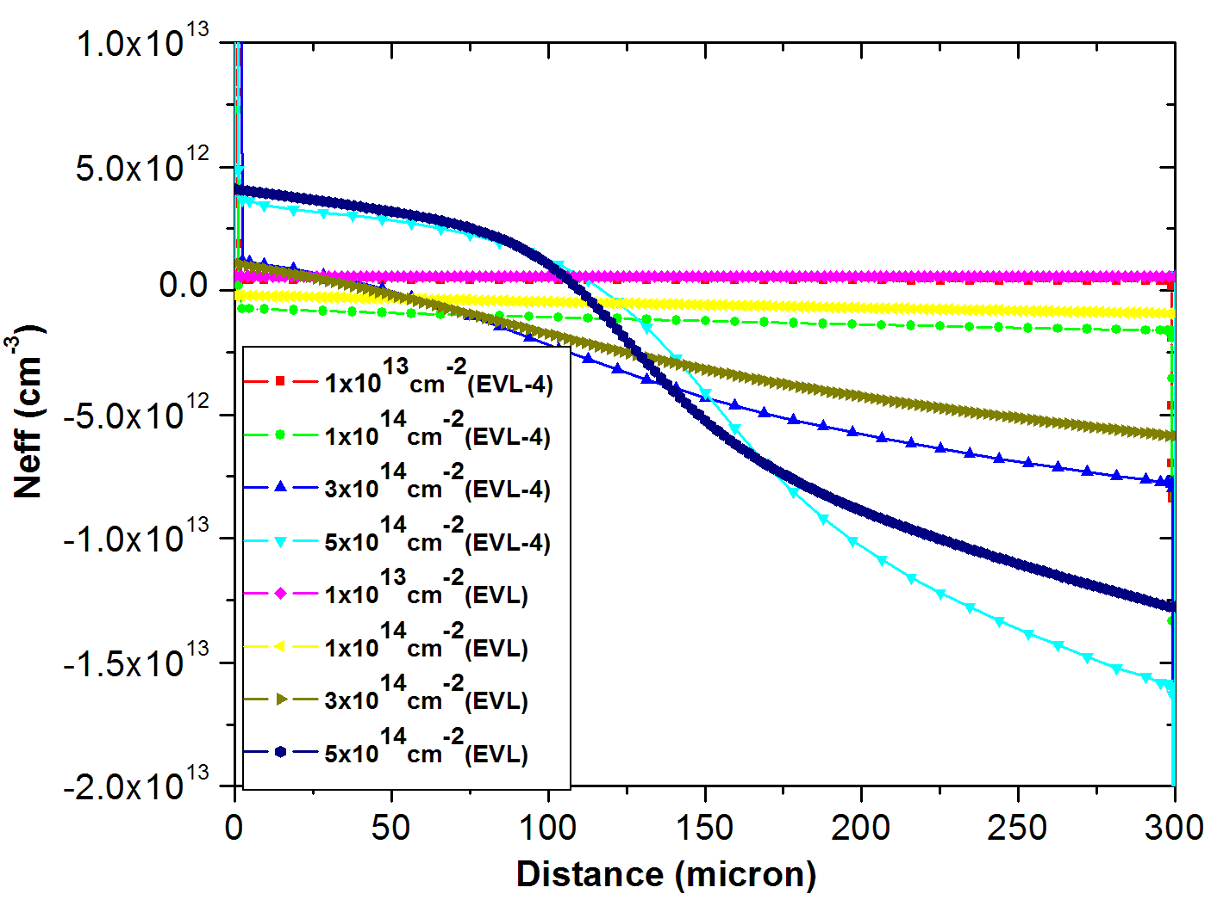
Neff for different flux (EVL-4 & EVL)
Temp - 290K
Bias – 300V
Similar behavior of Neff for EVL and EVL-4

Slide 8
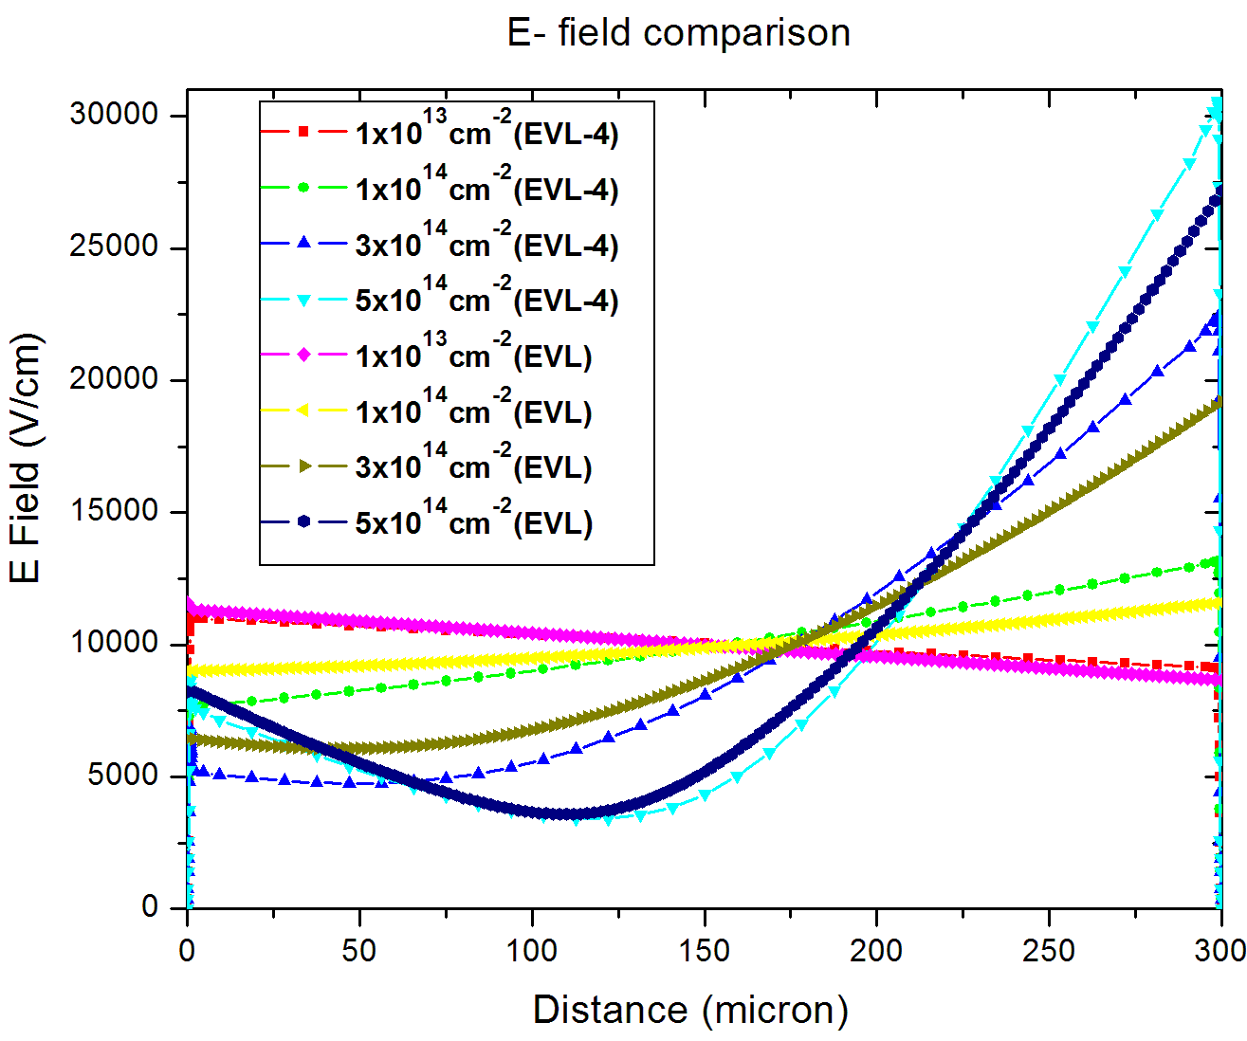
E field for different flux (EVL-4 & EVL)
Temp - 290K
Bias – 300V
Similar behavior of E field for EVL and EVL-4
Double Peaks is visible

Slide 9
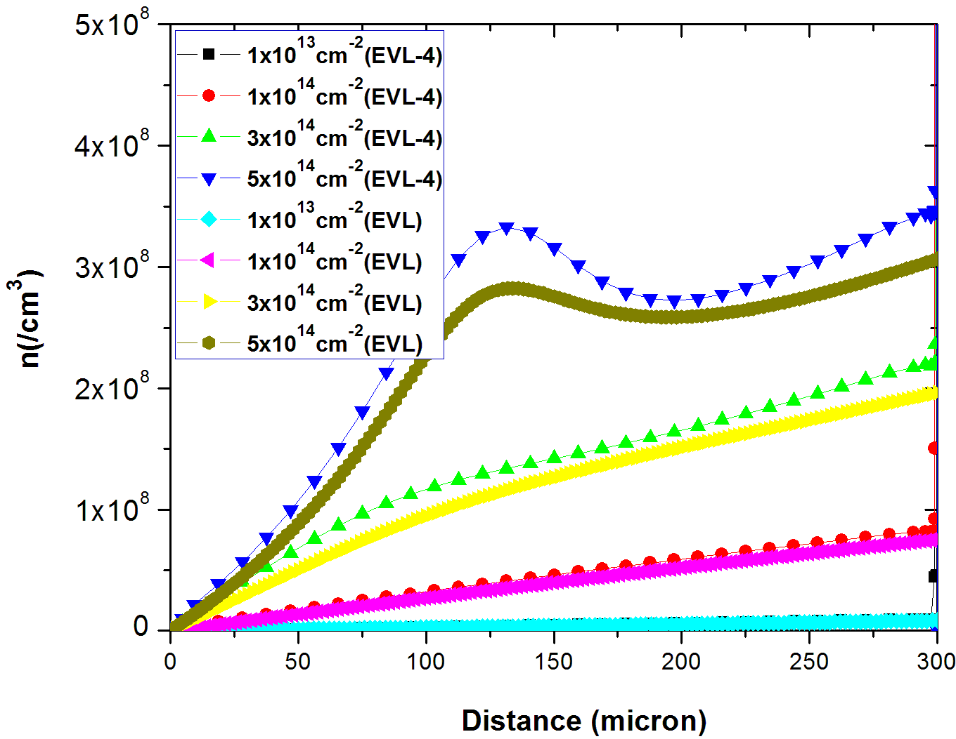
n conc. for different flux (EVL-4 & EVL)
Temp - 290K
Bias – 300V
Good agreement for EVL and EVL-4
n & p conc. strongly depend on carrier life time. We have used 1x10⁻⁵sec for e & h lifetime

Slide 10
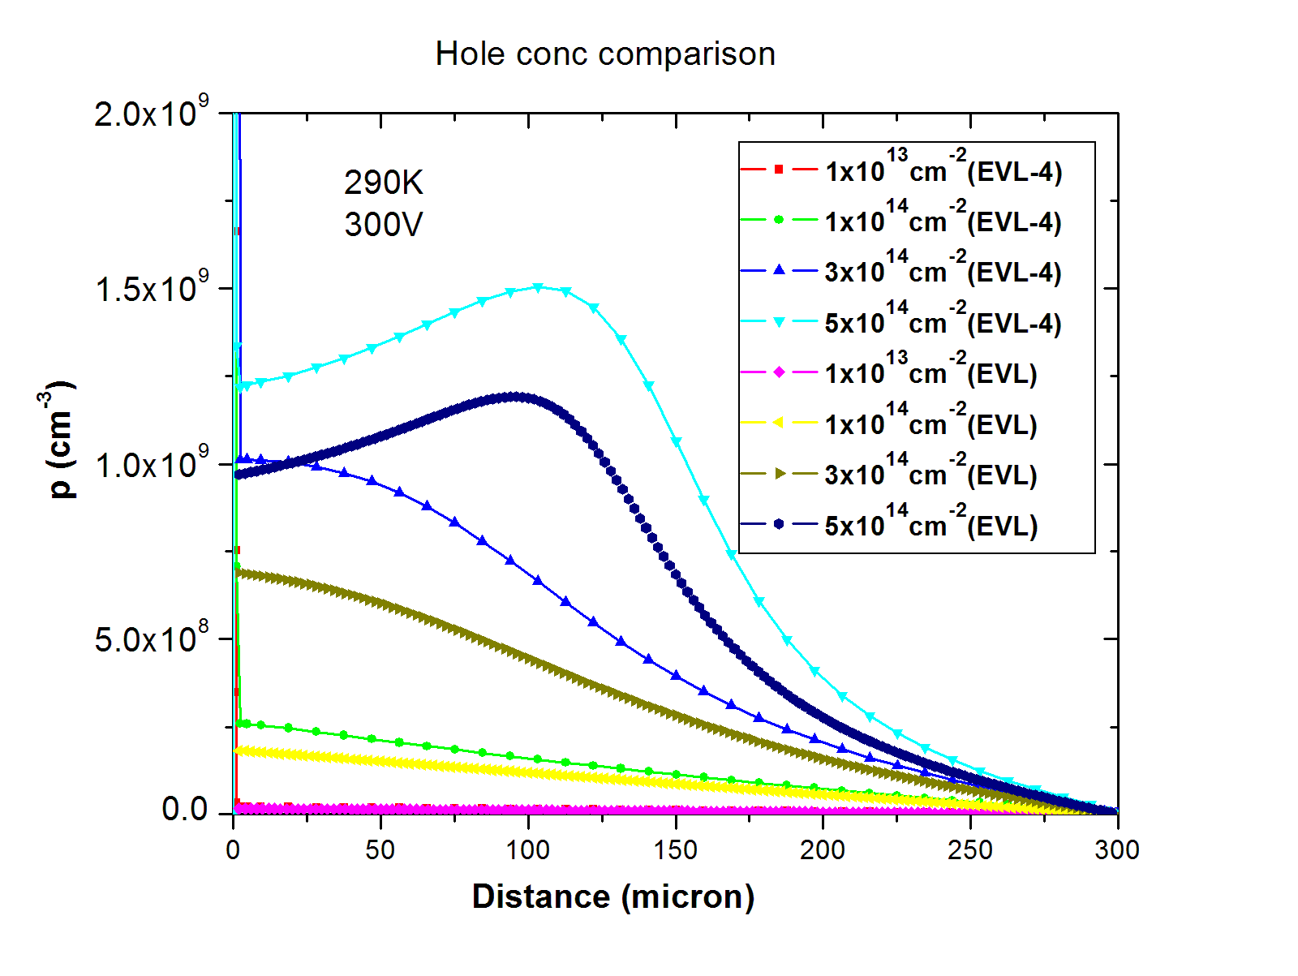
p conc. for different flux (EVL-4 & EVL)
n & p conc. strongly depend on carrier life time. We have used 1x10⁻⁵sec for e & h lifetime

Slide 11
Results for EVL-4 (Bias Variation)
Flux – 5x10¹⁴cm⁻²
Reverse Bias – 200V, 300V, 500V, 1000V
Temp – 290K

Slide 12
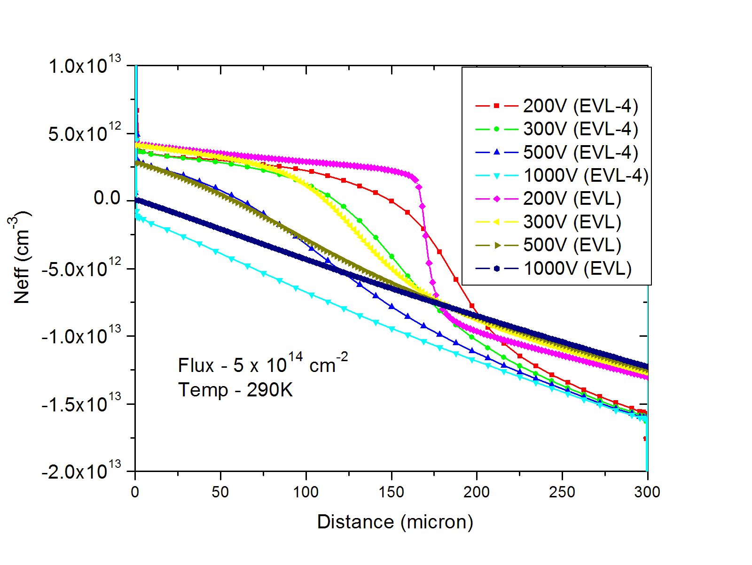
EVL -4 : Neff for flux = 5x10¹⁴cm⁻² (Bias variation)
A sharp transition in Neff is present in EVL data for 200 V, whereas EVL-4 has gradual transition from Donor dominated region to Acceptor dominated region (around 160 micron).

Slide 13
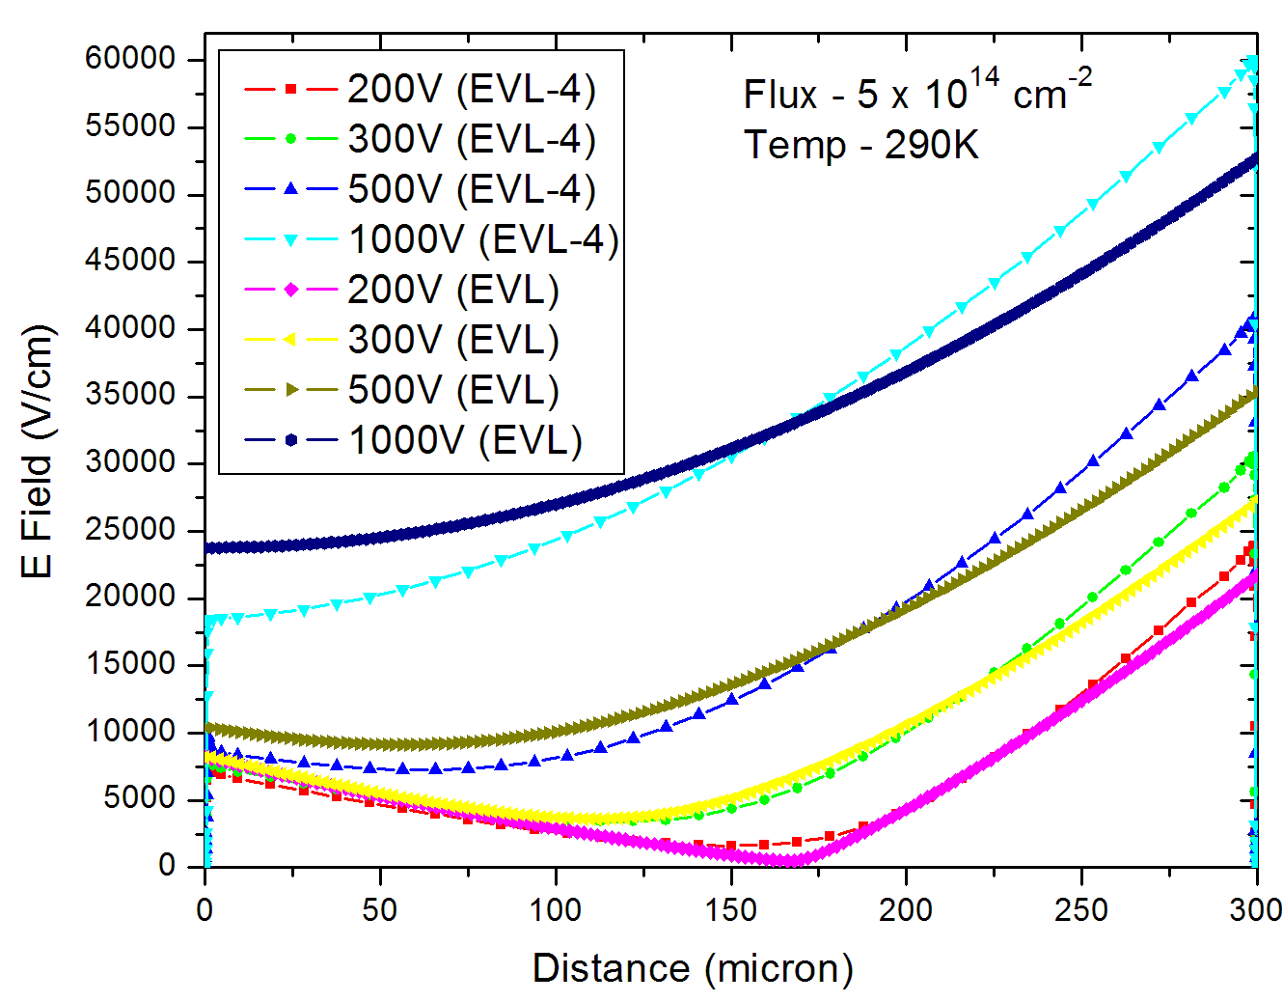
EVL -4 : E Field for flux = 5x10¹⁴cm⁻² (bias variation)
Similar behavior for E field for EVL and EVL-4, except for sharp transition in 200 V in EVL

Slide 14
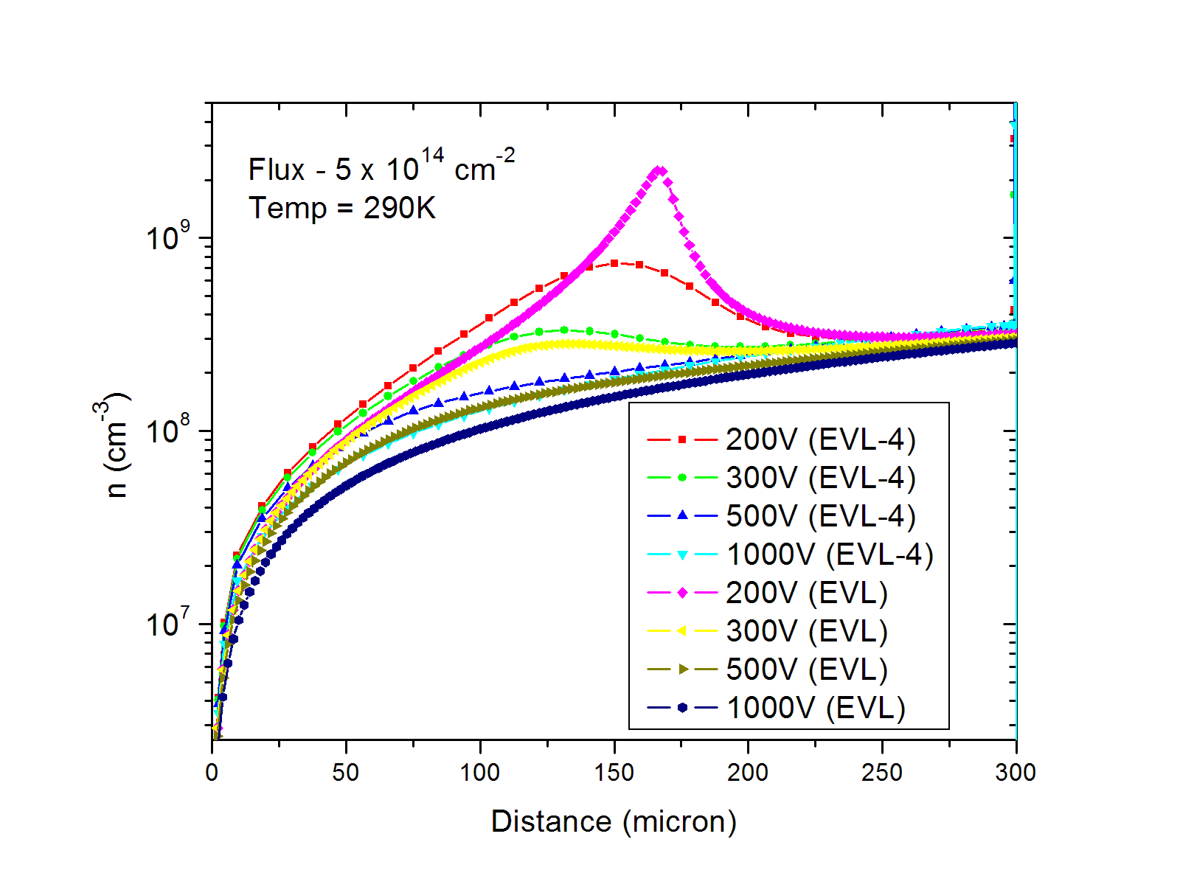
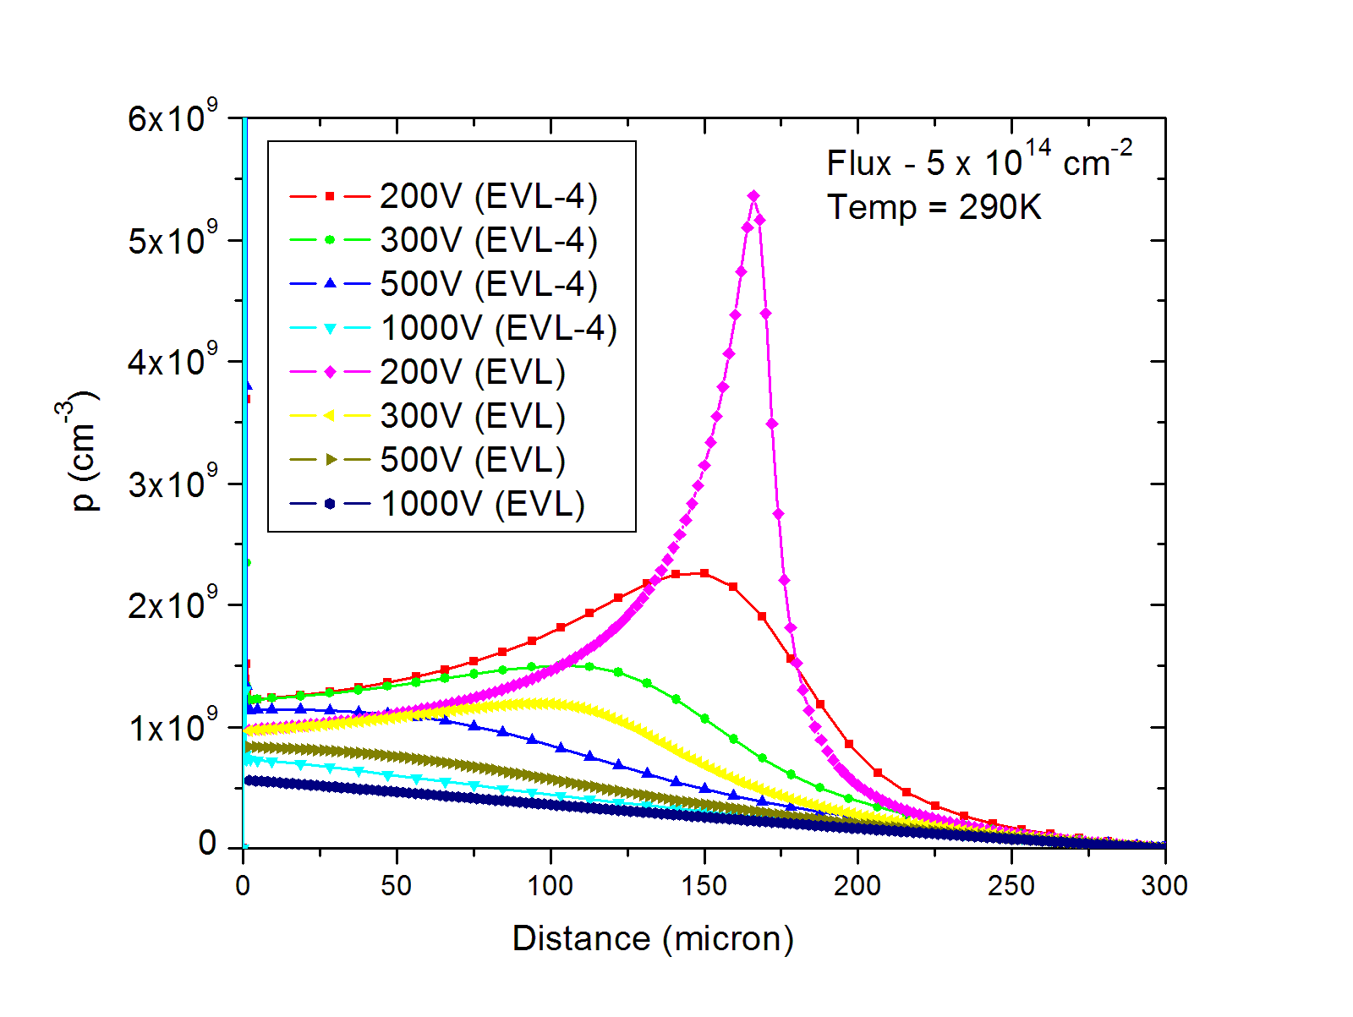
EVL -4 : n and p conc. for flux = 5x10¹⁴cm⁻² (bias variation)
Extra peak
Sharp peaks in n and p conc. are present in EVL data, whereas EVL-4 have gradual transition (for 200V) from Donor dominated region to Acceptor dominated region (around 160 micron from top)

Slide 15
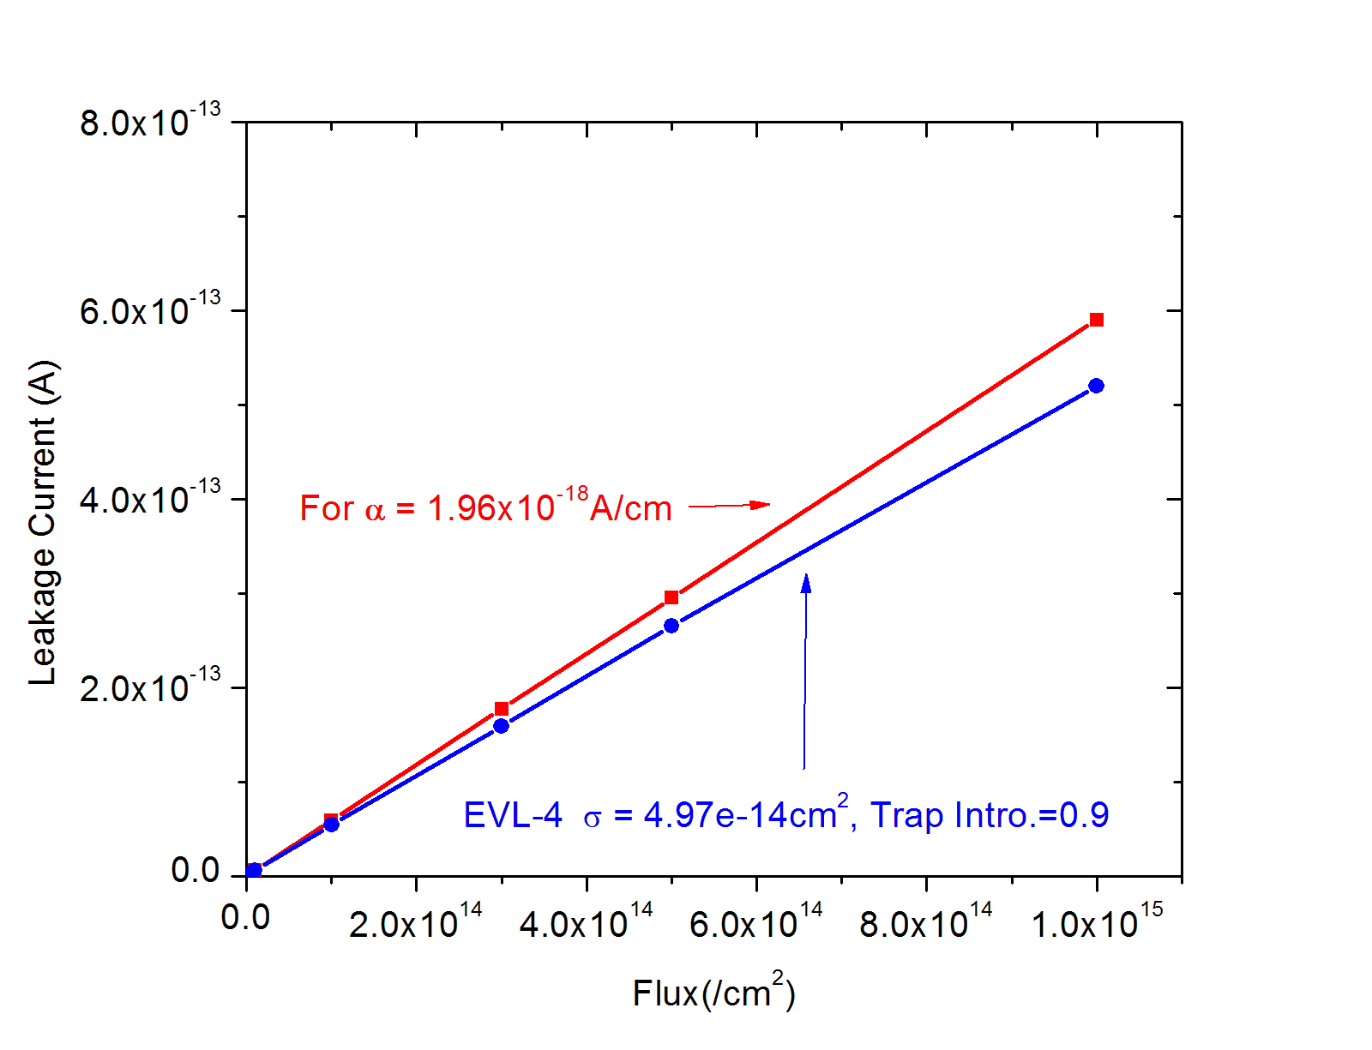
Results for EVL-4
Flux – vary, Reverse Bias = 300V, Temp = 260K
Simulations at 260K
Trap introduction rate=0.9
Acceptor(σ_{n} =4.97e-14, σ_{p}=4.97e-14),
Donor (σ_{n} =4.97e-14,
σ_{p} =4.97e-14)
τ₀ = 1e-5 sec
Simulated Leakage current
is ~ 10% below the experimental
results

Slide 16
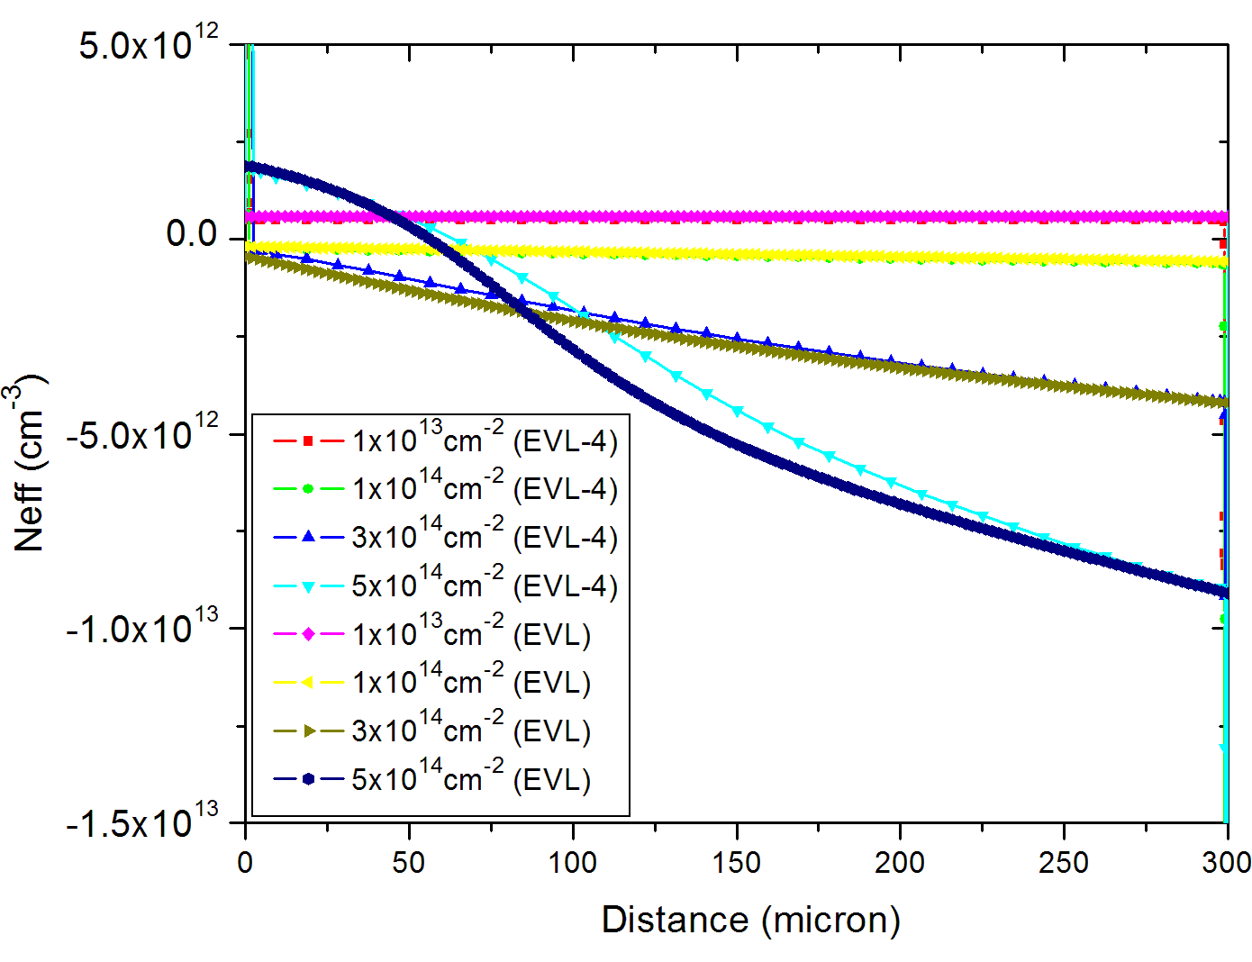
EVL -4 : Neff for different flux at 260K
Temp - 260K
Bias – 300V

Slide 17
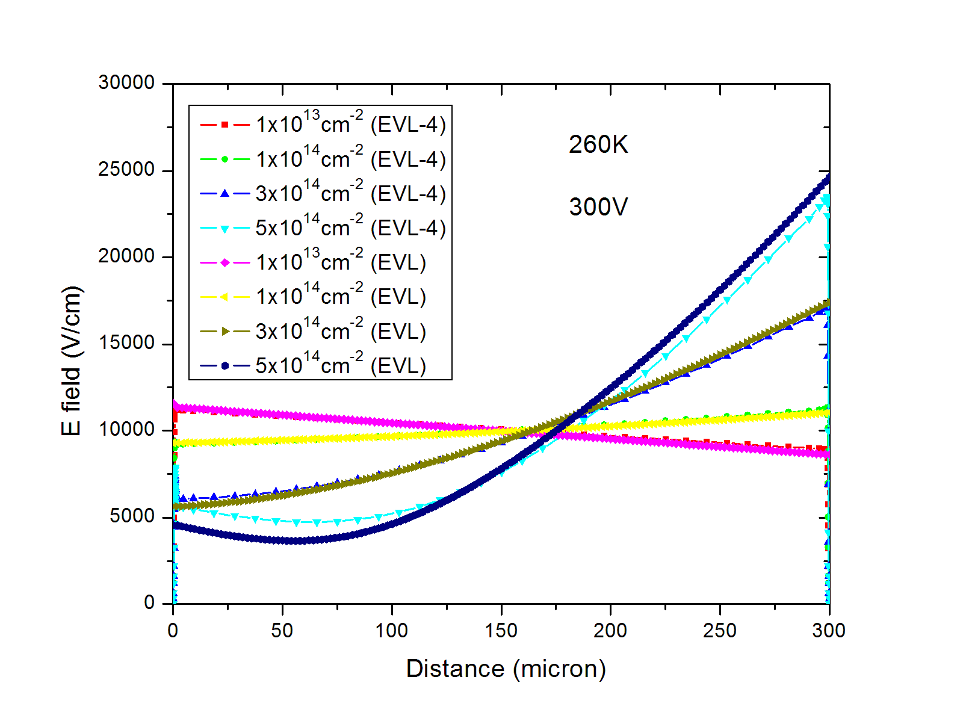
EVL -4 : E Field for different flux at 260K
Temp - 260K
Bias – 300V
similar behavior for electric fields at 260K also

Slide 18
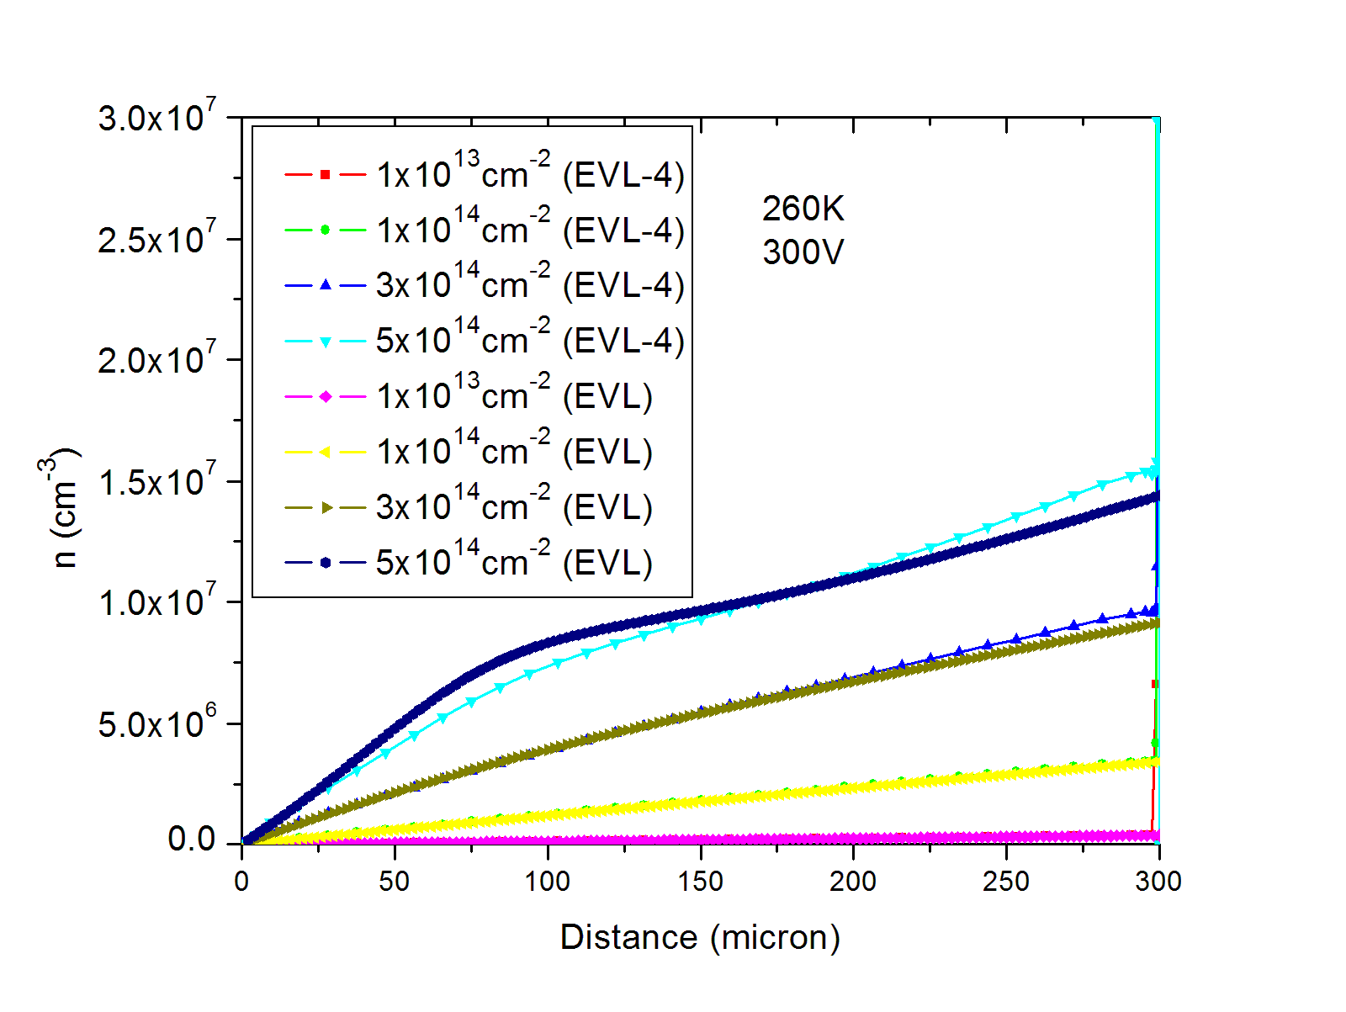
EVL -4 : n conc. for different flux at 260K
Temp - 260K
Bias – 300V

Slide 19
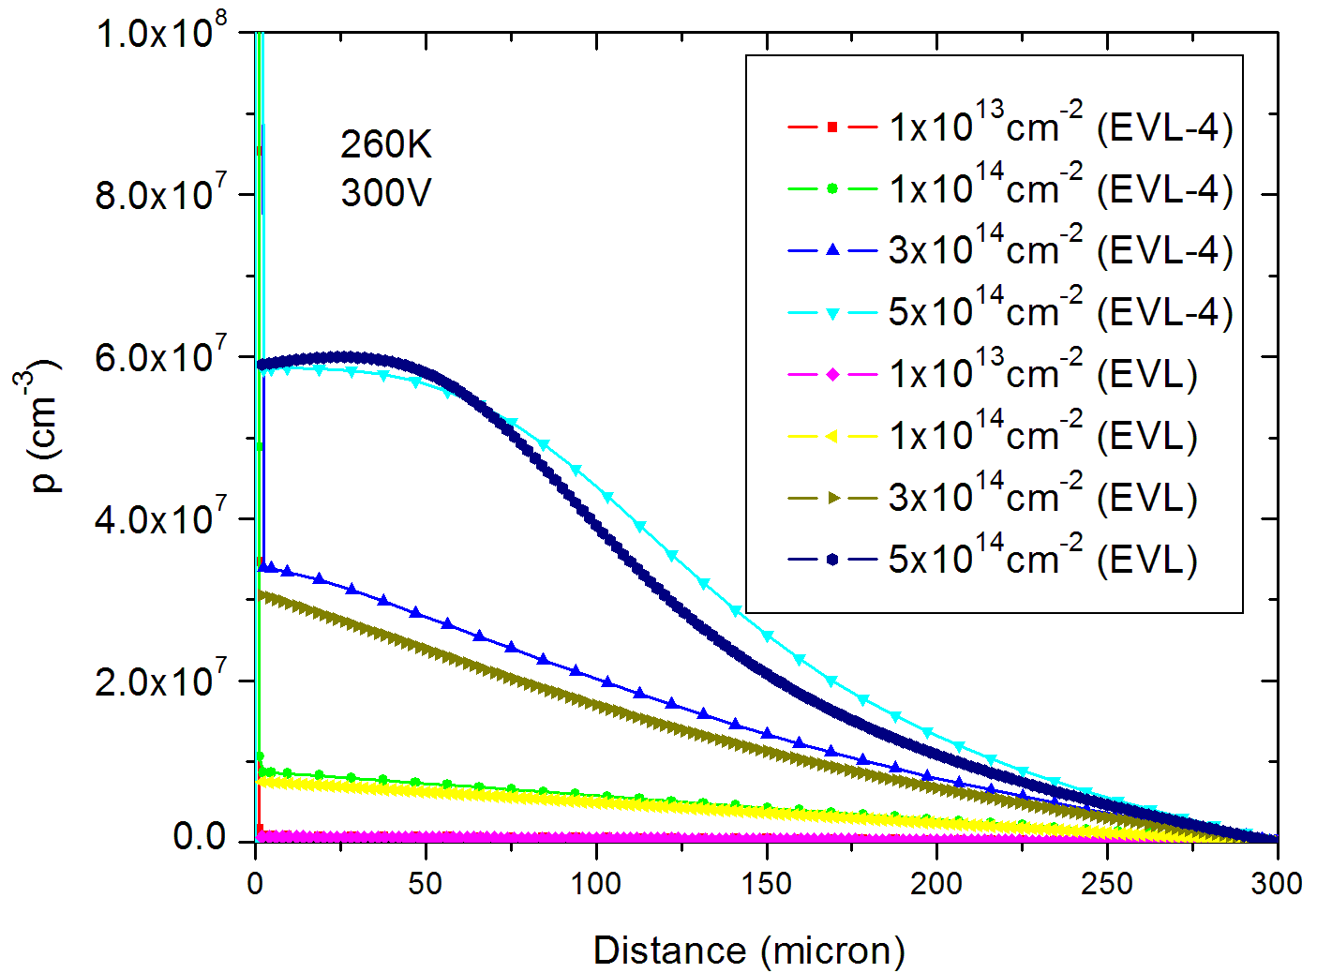
EVL -4 : p conc. for different flux at 260K
Temp - 260K
Bias – 300V

Slide 20
Summary and future outlook
Atlas does not have any provision to generate bulk current though a trap which do not contribute to space charge. All the traps which generate current also contribute to the space charge and hence to electric field.
Leakage current tuning for Temp = 290K, flux = 1x10¹⁴cm² is carried out by increasing the e/h capture cross-section to 4x10⁻¹⁴cm² .
The trap introduction rate is decreased to 0.9 in EVL-4 by comparing electric field profile in EVL-2.
A good agreement was obtained for N_{eff}, E field and n conc. for different fluences at temp = 290K and Bias = 300V, while simulated p conc. is ~20% higher than EVL model simulations.
For flux = 5x10¹⁴cm⁻², a good agreement is obtained at 300V and 500V but for Bias = 200V, our results are different from EVL data set, particularly around 160 micron below p⁺.
For, data set at Temp = 260K, a good agreement is obtained between EVL and EVL-4 model, though leakage current is slightly less than experimental value
Further tuning of the results can be achieved by changing the e/h capture cross section ratio or/and the ratio of donor/acceptor introduction ratio or/and even by changing the carrier life time !

