Slide 1
Approach of JSI to field modeling
Gregor Kramberger
(more details 19th RD50 CERN, Vertex 2012 proceedings)

Slide 2
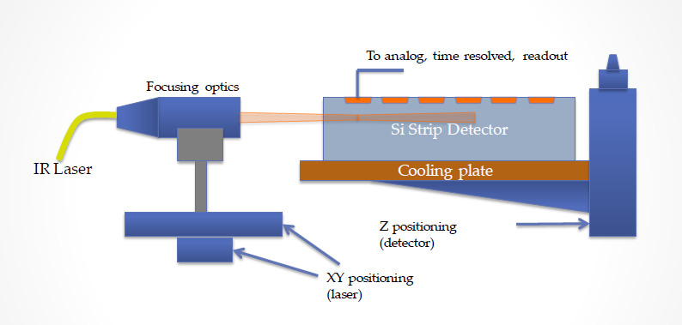
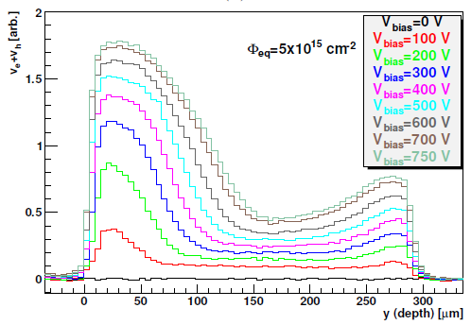
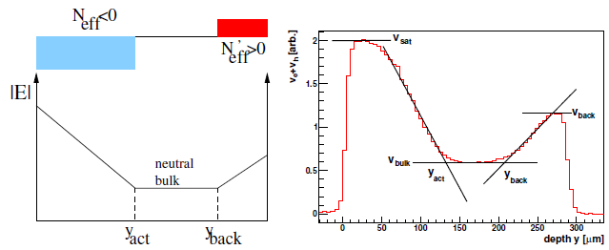
1.) Extract the limited number of field parameters from Edge-TCT measurements
G. Kramberger et al., IEEE TNS, VOL. 57, NO. 4, AUGUST 2010, 2294
1e16 cm⁻², 800 V

Slide 3
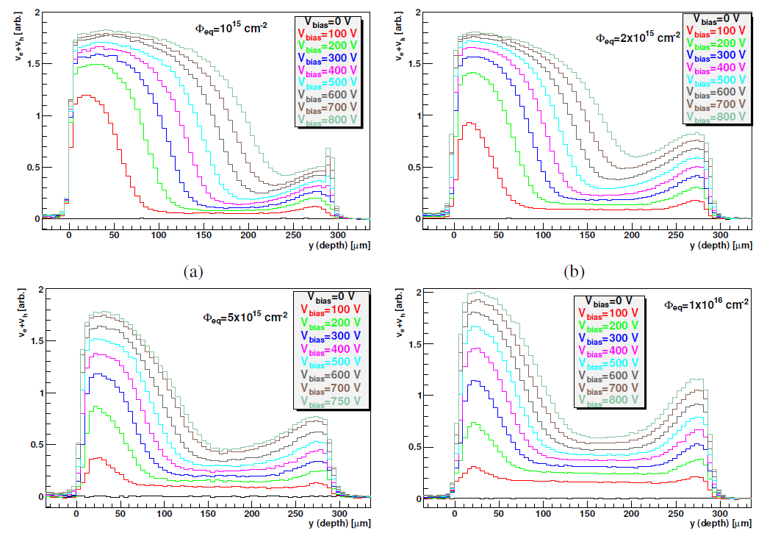

Slide 4
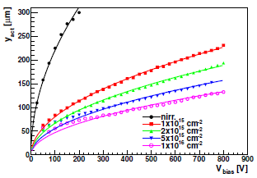
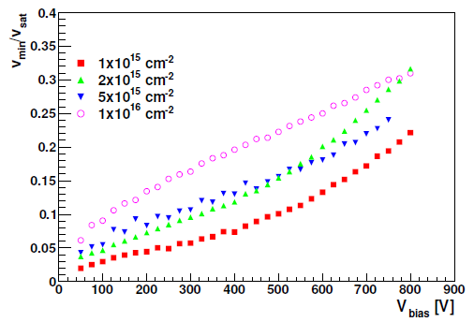
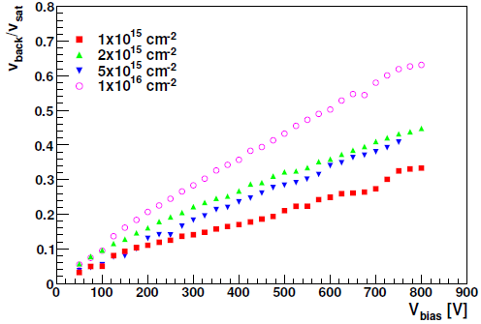
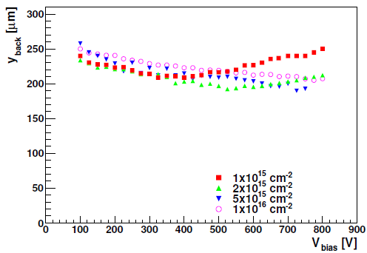
An example: evolution of parameters with bias voltage for N-P strip sensor (ATLAS07) after neutron irradiation and 80 min annealing at 60C
neutron irr.
neutron irr.

Slide 5
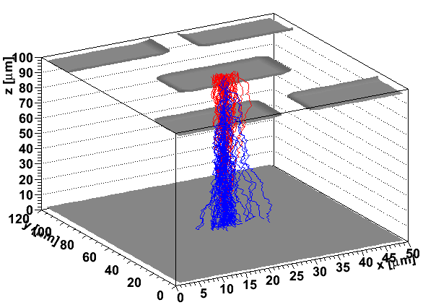
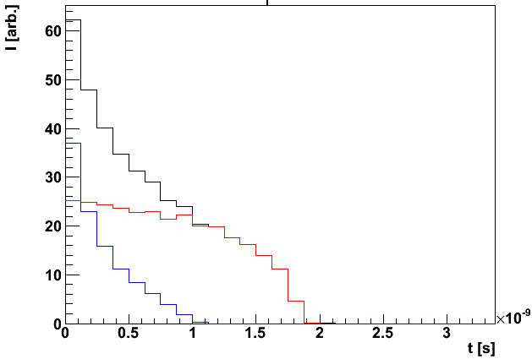
2.)Use the parameters in the custom software simulator
      Poisson equation solver in 2D and 3D
      drift simulator includes diffusion, impact ionization, charge sharing
Induced current
pos
neg
sum

Slide 6
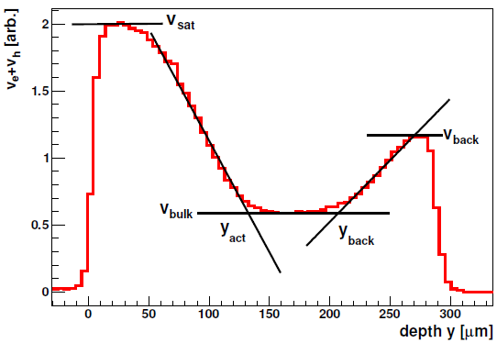
3.) Simulate the Edge-TCT measurements and look for agreement
    fine tune Neff(x) at different detector regions (seems that linear dependence works quite fine)
    look for trapping times dependence on fluence,field,T at high fluences
4.) Look at the CCE measurements with ⁹⁰Sr electrons

