Slide 1

Summary of Simulation Work for HPK Campaign
Ranjeet Singh, Ashutosh Bhardwaj, Kirti Ranjan
Center for Detector & Related Software Technology (CDRST)
Department of Physics and Astrophysics,
University of Delhi (DU), Delhi, INDIA
RD-50 Simulation group meeting
27-28 March 2013

Slide 2
Contents
Introduction
Simulations for p-type MSSD,s
  For non-irradiated MSSDs
  For irradiated MSSDs
Simulation for n-type
  With P-stop isolation structure
  With P-spray isolation structure
Diode Simulation
  non-irradiated Diodes
  irradiated Diodes
Summary

Slide 3
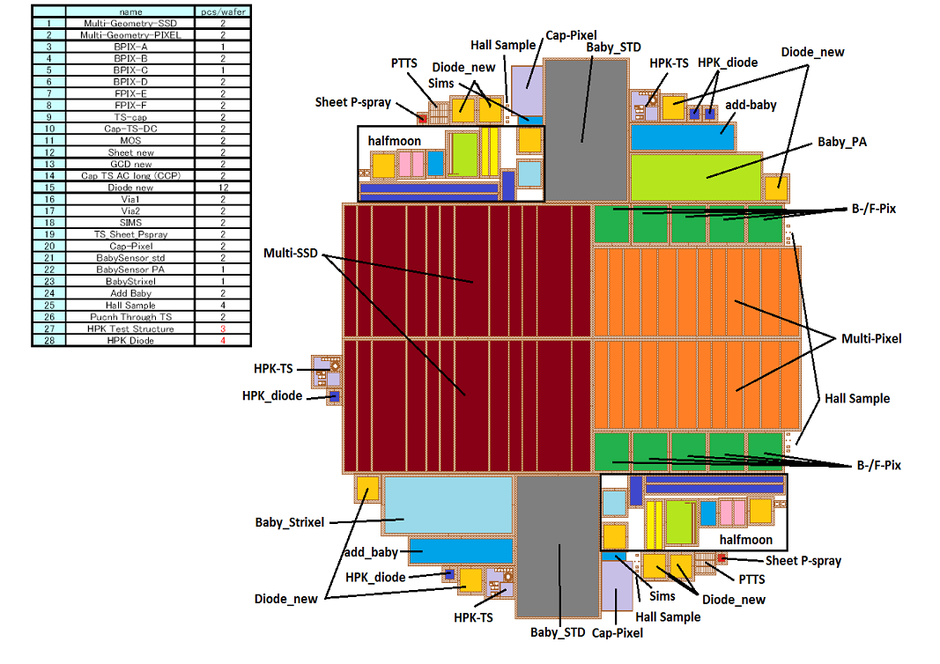
The CMS HPK campaign & motivations
Most of the volume of a future Tracker will be equipped with planar silicon sensors
  A survey of available silicon materials has been started
  One wafer layout has been developed and the various materials are processed with this mask by the same producer, which allows well defined comparisons
  Investigation of the properties of several layout options for strip, strixel and pixel sensors is going on
  A well defined measurement plan has been worked out and participating institutes have been inter-calibrated to guarantee comparable measurements
  For the test wafers a producer was chosen
  that can provide the large quantity and high
  quality we need → “HPK campaign”
  Measurements are
  complemented by device simulations
HPK wafer layout

Slide 4





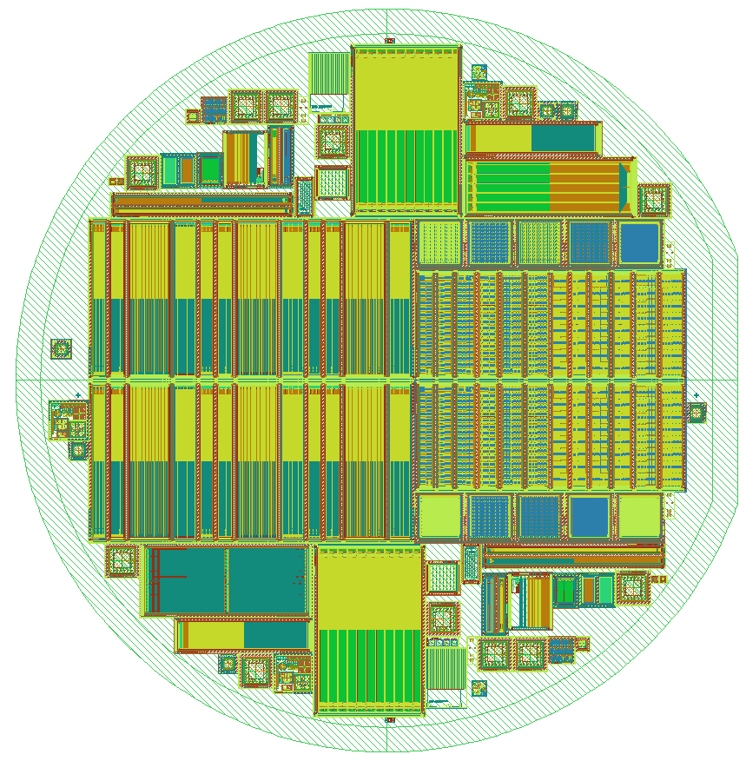











17 institutes currently involved in HPK campaign
Bari
Firenze

Slide 5
Simulations for p-type of MSSD
(Non-irradiated & Irradiated)

Slide 6
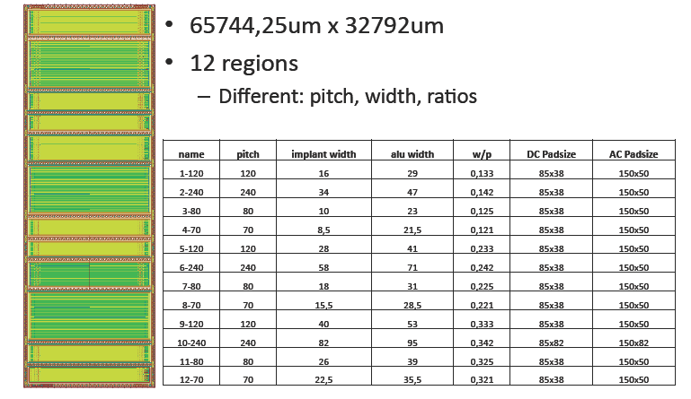
12 Configurations of Multi-SSD in HPK
Strip length = 3.0490 cm
Experimental results of C_{int} taken from Lyon Tracker Upgrade Database http://ikcms02.fzk.de/probe/lyon2/login.php
P⁺-N⁻-N⁺ configuration chosen for these results.
For each design, three separate results for non-irradiated sensors and one result for irradiated sensor is given.

Slide 7
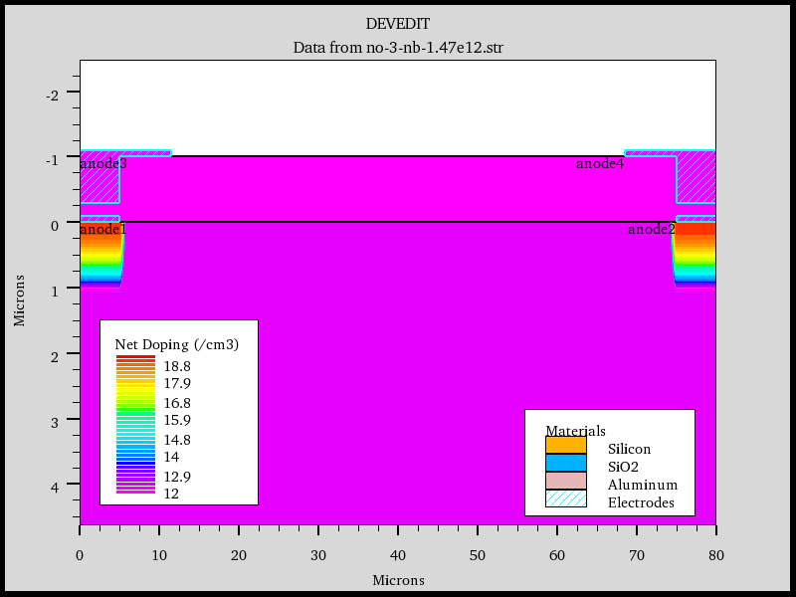
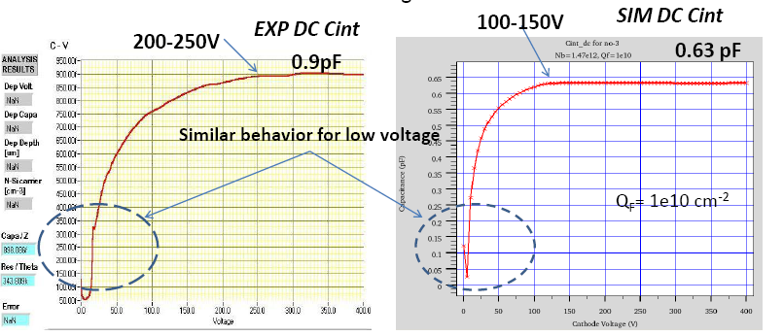
Simulation of C_{int} for Multi-SSD – Previous Results
First results on C_{int} comparison was shown in Sensor Upgrade Meeting – “MSSD Simulation Results “ on 17 Feb. 2011
P⁺-N⁻-N⁺ configuration
Two P⁺ neighboring strips
C_{int} results were ~ 30% lower than experimental values
AC-ELECTRODES
Metal-Overhang
https://indico.cern.ch/getFile.py/access?contribId=1&resId=0&materialId=slides&confId=125774
SiO₂
DC-ELECTRODES
TWO HALF-STRPS
Si-Substrate

Slide 8
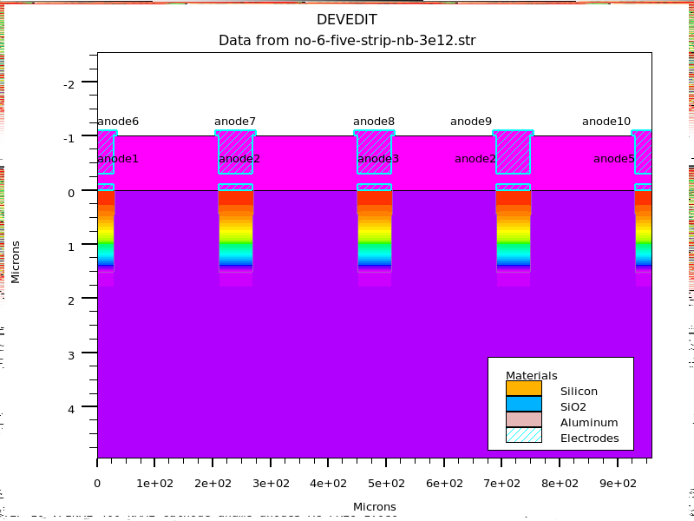
Simulation of C_{int} for Multi-SSD
Simulated Structure – zoomed region
Instead of Two adjacent half- P⁺ neighboring strips, we have considered five strips in which C_{int} is evaluated by sending AC signal to central electrode and measuring it w.r.t. two adjacent strips (which are dc-shorted).

Slide 9
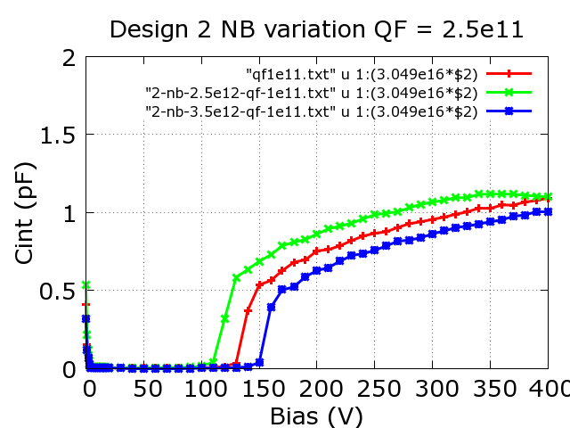
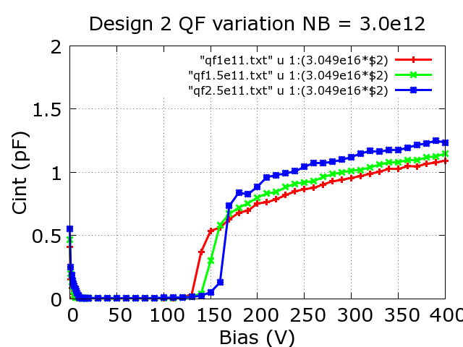
Simulation of C_{int} for Multi-SSD
We also performed “sensitivity studies” for Substrate Doping Concentration (N_{B}), Metal Overhang Width(W_{MO}), Oxide Thickness (t_{ox}) , Junction Depth (X_{J}), Coupling Oxide Thickness, Strip pitch (P), Strip Width (W), Surface charge density (Q_{f}).
We varied N_{B} (range: 1.0x10¹² cm⁻³ - 5.0x10¹² cm⁻³ ) and Q_{f} (range: 1x10¹⁰ cm⁻² - 2x10¹² cm⁻² ) keeping other parameters fixed (which have minor impact).
2.5x10¹² cm⁻³
2.5x10¹¹ cm⁻²
3.0x10¹² cm⁻³
1.5x10¹¹ cm⁻²
1.0x10¹¹ cm⁻²
3.5x10¹² cm⁻³
slop of Cint curve
was used to fix Q_{F}
Rise point of Cint curve
was used to fix N_{B}
We compared various set of (N_{B} , Q_{f}) for one structure, keeping other parameters fixed. Once we compared it with one design, we kept the same values of N_{B} and Q_{f} for all other designs.

Slide 10
Simulation Parameters – Same for all 12 configurations
1.Substrate Doping Conc. (N_{B}) = 3.0x10¹² cm⁻³
2. Surface Charge Density (Q_{f}) = 1.0x10¹¹ cm⁻²
3. Temp = 21deg C corresponding to 294 K.
4) n+ implant of 30 micron from the back side
5) Junction depth of 1.5 micron
6) Strip length for normalization = 3.0490 cm
7) Total device depth is 320 micron.
8.) Frequency = 1MHz
2. Other than Width and Pitch, nothing else is changed in 12 Configurations.

Slide 11
Non Irradiated
In all the plots shown on next page :
Colors – Red, Blue and Green show the three C_{int} measurements
Color – Magenta show the simulated result

Slide 12
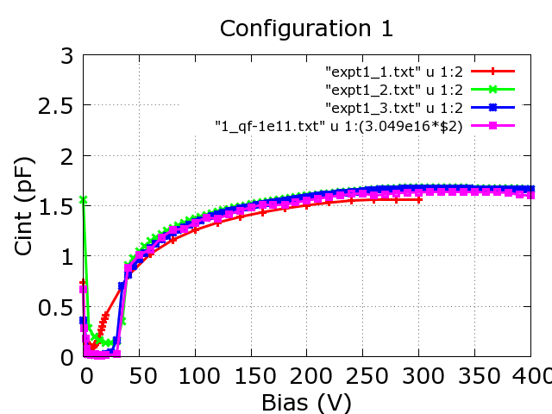
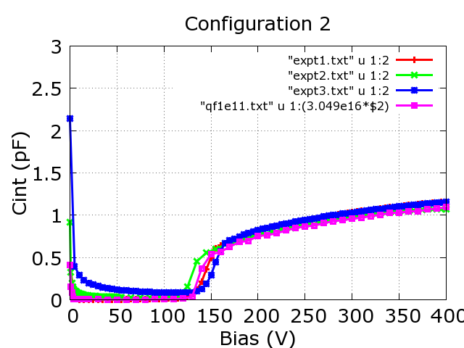
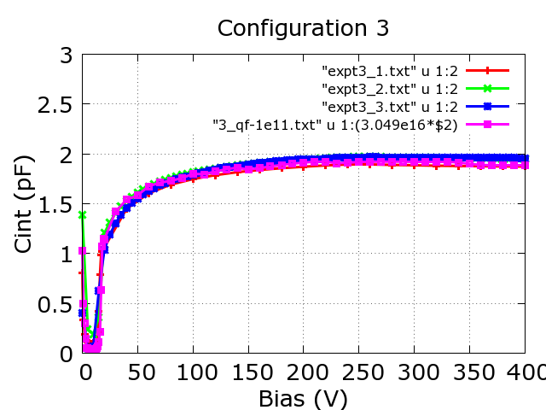
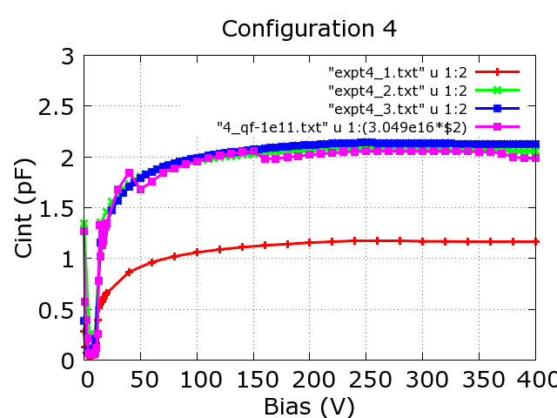
Non Irradiated MSSD
– Red, Blue and Green show the three Cint measurements
Magenta show the simulated result
Excellent agreement
Excellent agreement
Excellent agreement
Excellent agreement
One of the Expt. result
A good agreement was obtained for other detectors also

Slide 13
Simulations for irradiated p-type MSSDs
Nb=3e12 cm⁻², and QF=1e11 cm⁻²
(Measurements by Marco Meschini, The sensors have been irradiated at a fluence of 5e14 neq/cm² with annealing of 24h at 25°C + 5h at 20°C + 10 minutes at 60°C )
C_{int} simulation using the following radiation damage model:
1. T = -20 degC ( 253.15 K)
2. Use of improved EVL model
(“Simulation of Heavily Irradiated Silicon Pixel Sensors and Comparison with Test Beam Measurements”, Vincenzo Chiochia, et. al., 2004 IEEE Nuclear Science Symposium, October 18-21 2004, Rome, Italy.)
A.) Donor: E_{V} + 0.48 eV; introduction rate, gint = 9.25; sigma e = 1e-15 cm² and sigma h = 0.25 e-15 cm²
B.) Acceptor: E_{C} - 0.525 eV; introduction rate, gint = 3.7; sigma e = 1e-15 cm² and sigma h = 0.25 e-15 cm²
But simulations with EVL model parameters also gave similar results

Slide 14
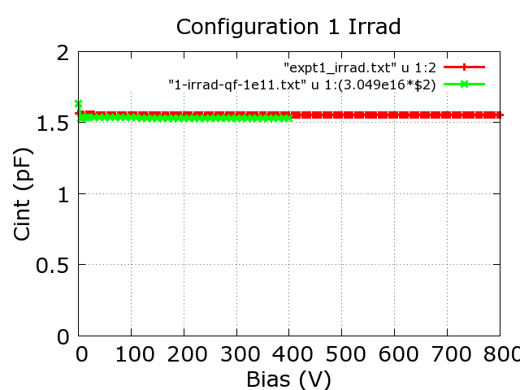
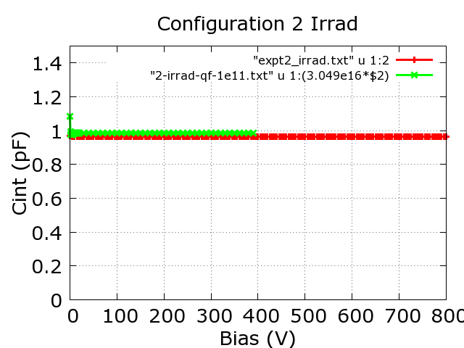
Irradiated MSSD
Red Color – Measurement
Green – Simulated Result
Excellent agreement
Excellent agreement
Similar agreement was obtained for other detectors also
A good agreement between experimental and simulation results was observed.
These results were presented in 20th RD50 Workshop on Radiation hard semiconductor devices for very high luminosity colliders (30 May 2012 to 01 June 2012 (Europe/Zurich) Bari )

Slide 15
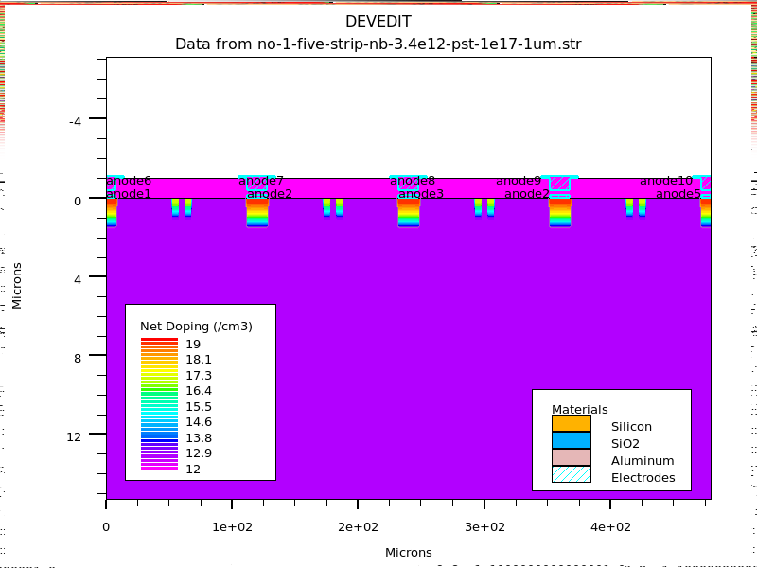
Simulation of C_{int} for Multi-SSD with Double P-stops
Double P-stops
4µm wide separated by 6µm
Simulated Structure – zoomed region
Instead of two adjacent half- n⁺ neighboring strips, we have considered five strips in which C_{int} is evaluated by sending AC signal to central electrode and measuring it w.r.t. two adjacent strips (which are shorted).

Slide 16
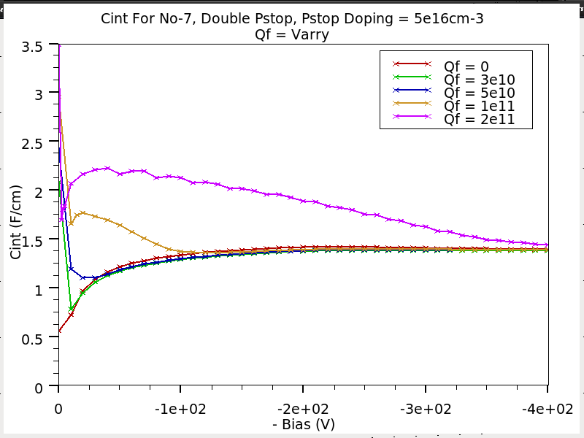
Effect of Q_{F} on C_{int}
For QF = 0
No initial bump !
For Q_{F} = 3x 10¹⁰ cm⁻²
Initial dip in Cint along with slow rise and finally plateau region
For Q_{F} = 5x 10¹⁰ cm⁻²
Small initial bump (Initial dip have gone)
For Q_{F} = 1x 10¹¹ cm⁻²
Large initial bump which decrease to plateau
Finally, for Q_{F} = 2x 10¹¹ cm⁻²
--- Initial bump have spread upto ~ 350V and it look like that there is no initial bump but only a slow decrease in Cint !

Slide 17
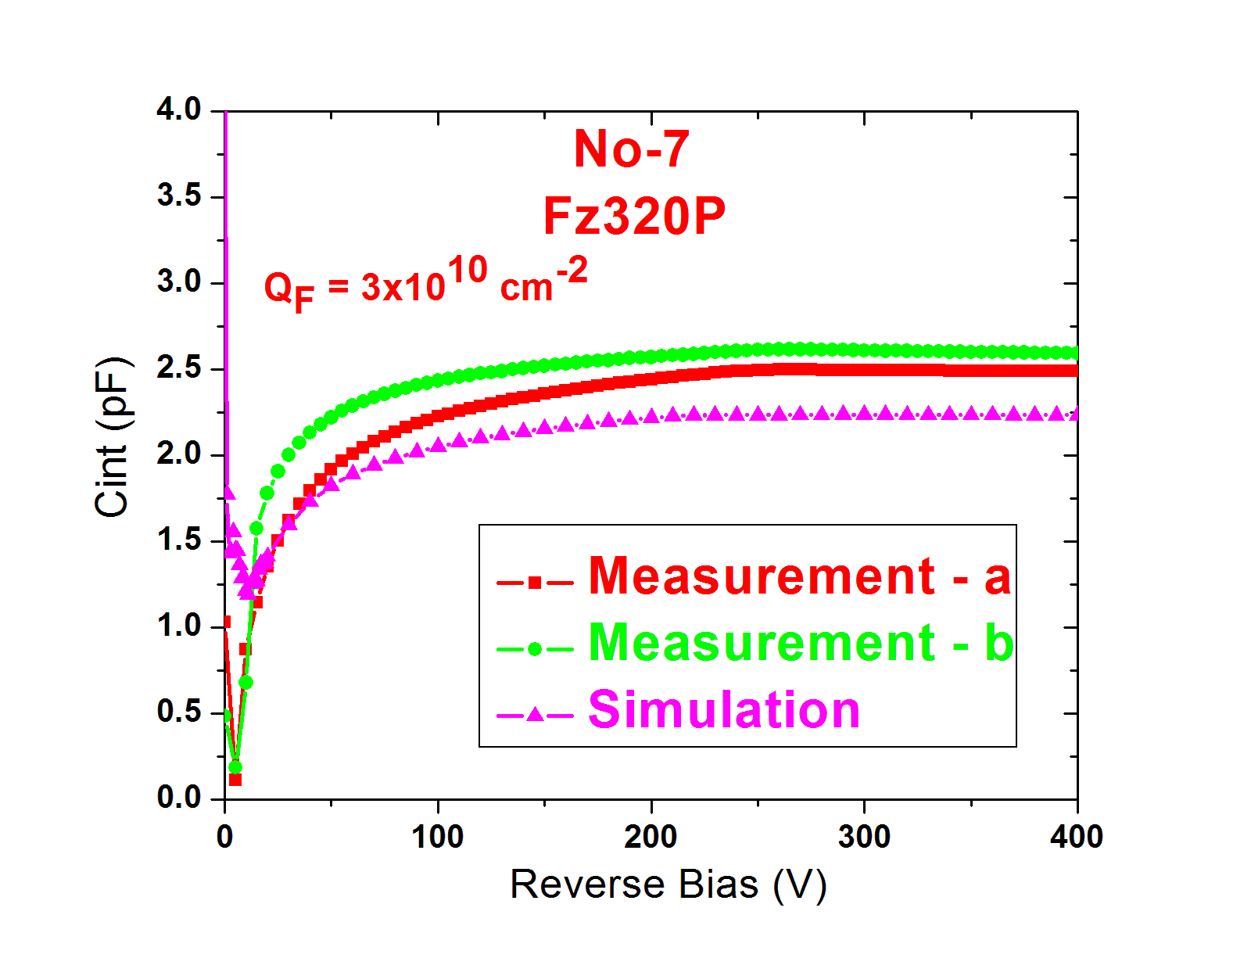
C_{int} Simulations for Pstop Isolation structure
No initial bump

Slide 18
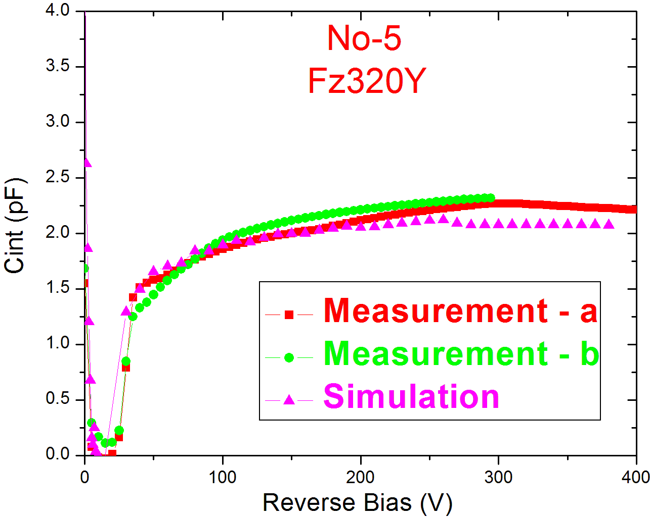
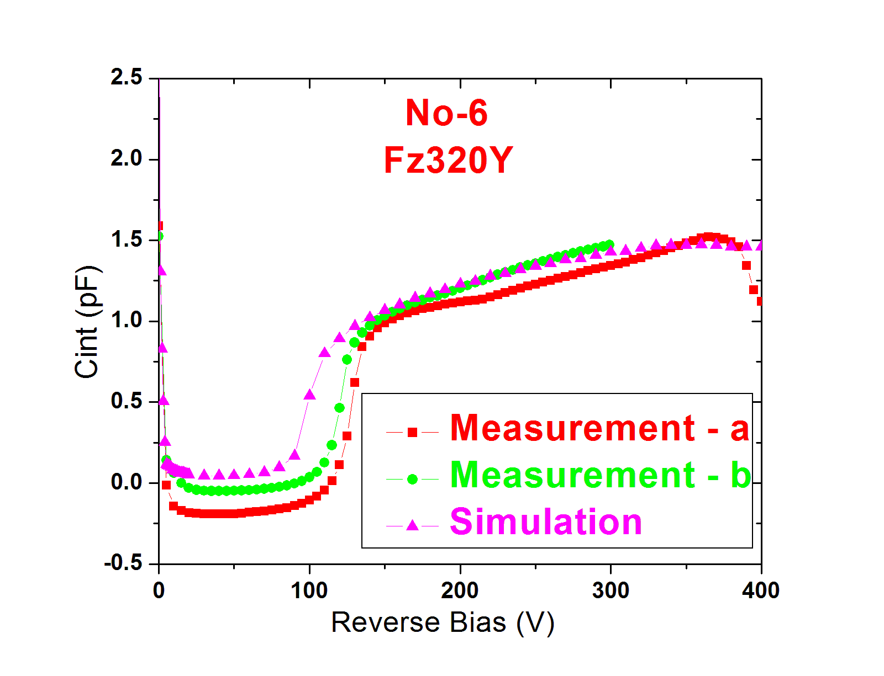
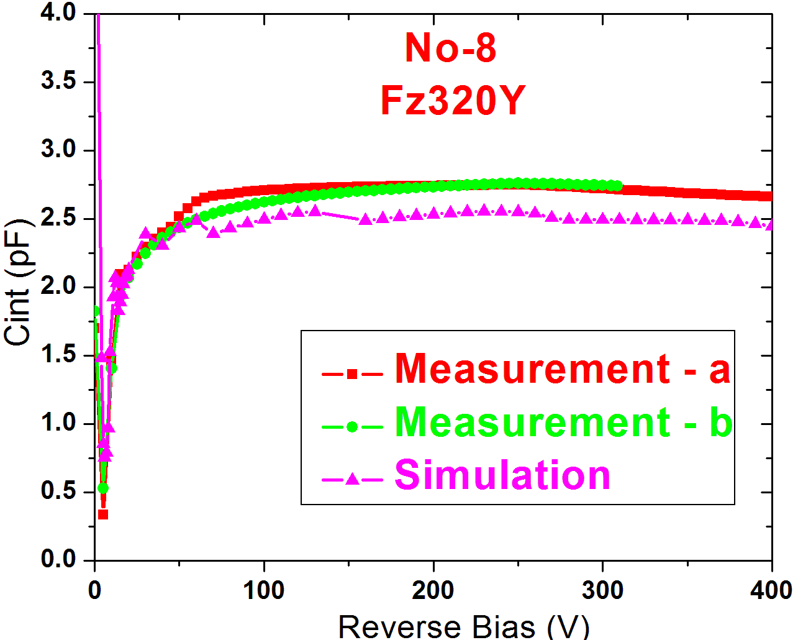
C_{int} Simulations for Pspray isolation structure
Simulation vs. Measurement for FZ320Y
  All 12 N⁺-P⁻-P⁺ configurations (non-irradiated)
  For FZ320Y, Peak P-spray doping density =
  4x10¹⁶cm⁻³, P-spray doping depth = 0.2µm
  Only FIRENZE Probe station measurements
  are used for comparison

Slide 19
FZ 320 N Diode L
(non-irradiated)

Slide 20
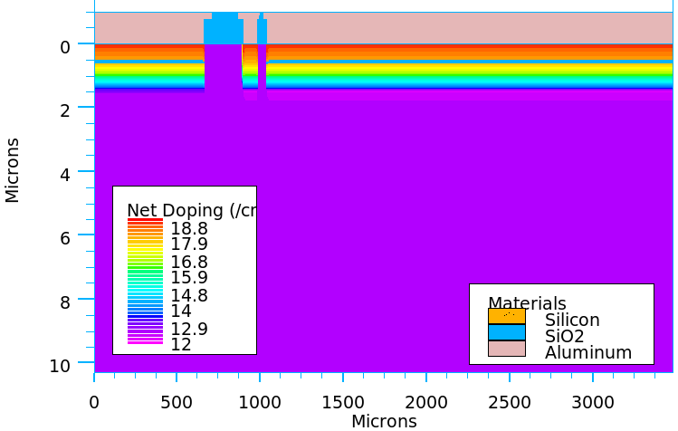
Simulation structure
For Large Diode
Guard
Periphery
Diode center
Periphery
Diode center
Guard
mm
Total implant area mm x mm
mm
Total implant area 4.893 mm x 4.893mm
Zoomed view
Zoomed view

Slide 21
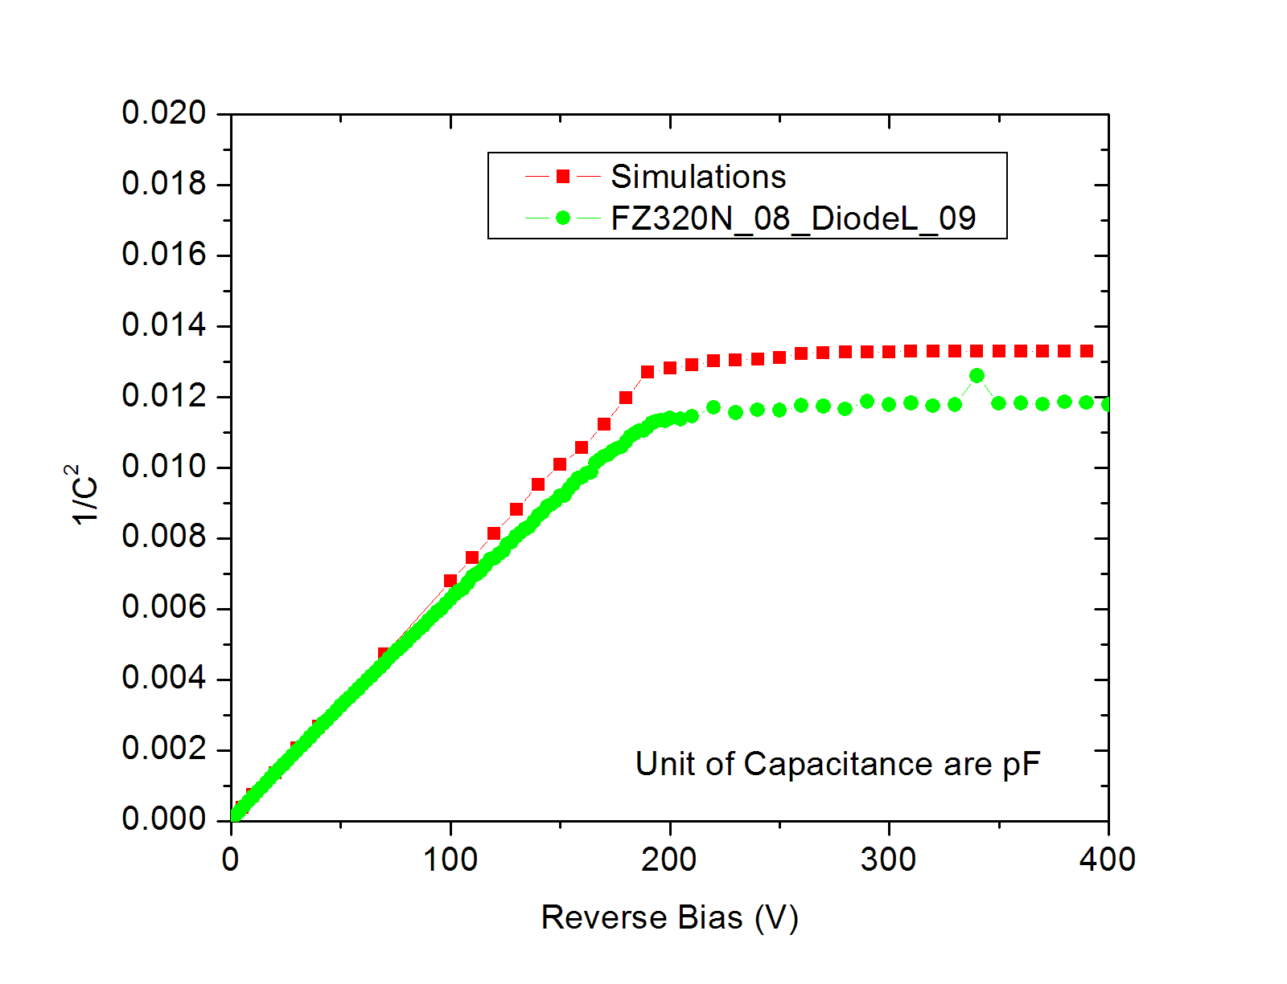
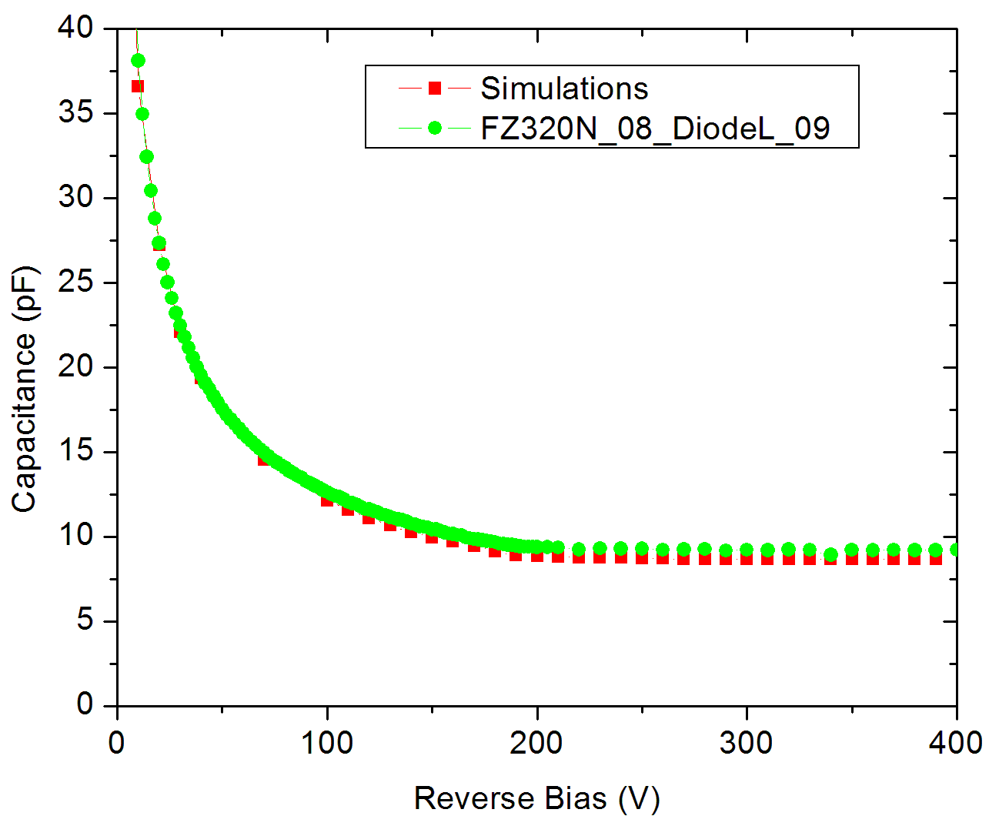
CV comparison for large diode
Slightly lower Capacitance
for simulations?
(pF⁻²)
Full depletion ~ 200V for measurements and simulations

Slide 22
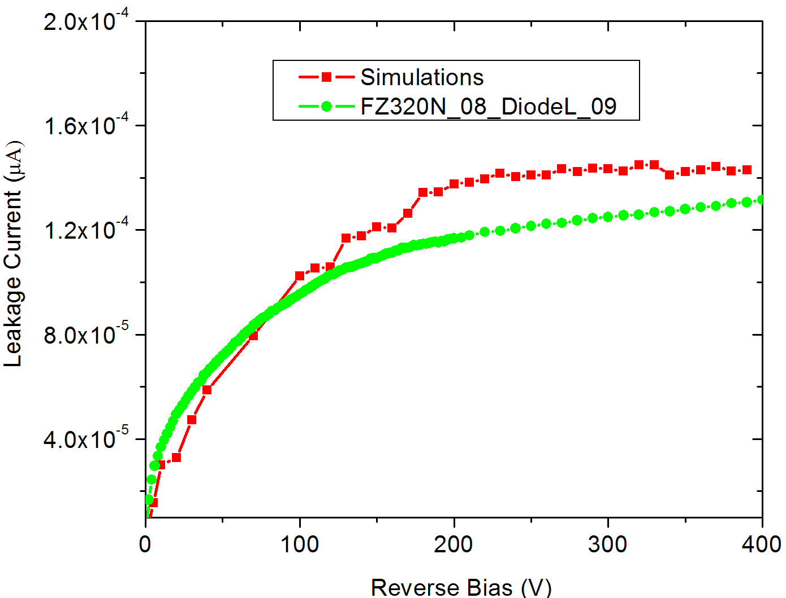
IV comparison
293K

Slide 23
Irradiated diode simulations

Slide 24
Irradiation Simulations
Three flux irradiation data( 1.1e14cm⁻², 5e14cm⁻² and 1e15cm⁻²) for large diode
(Thanks to Robert Eber for data and alpha calculator link!)
For flux = 1.1e14cm⁻² and 1e15cm⁻² , Annealing time = 50.23 Hours
For flux = 5e14cm⁻² , Annealing time = 33.16 Hours
Irradiation parameterization is carried out by using two trap model (Modified EVL)
The following parameters are used in two trap model
A.) Donor: E_{V} + 0.48 ev; introduction rate (gint) = 9.25; Sigma e =1e-14 cm² and
Sigma h = 1.5e-14 cm2
B.) Acceptor: E_{C} - 0.525 ev; introduction rate (gint) = 3.7; Sigma e = 1e-14 cm² and
Sigma h = 1.5e-14 cm²

Slide 25
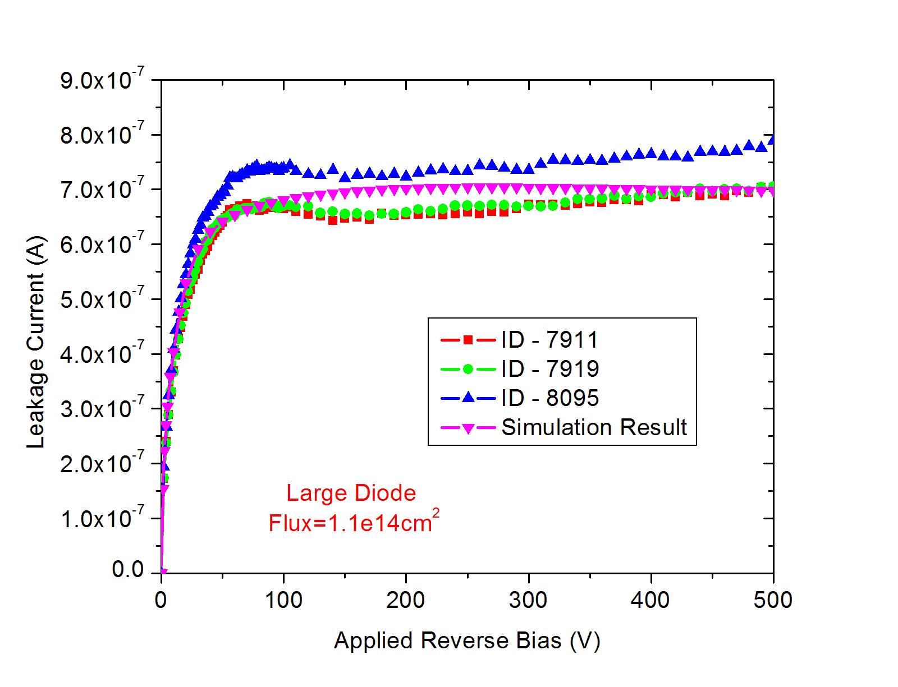
IV comparison for Large diode (FZ320N)
Flux = 1.1e14 cm⁻²
Temp = 253K
Simulation & Measured values are ~ 10%

Slide 26
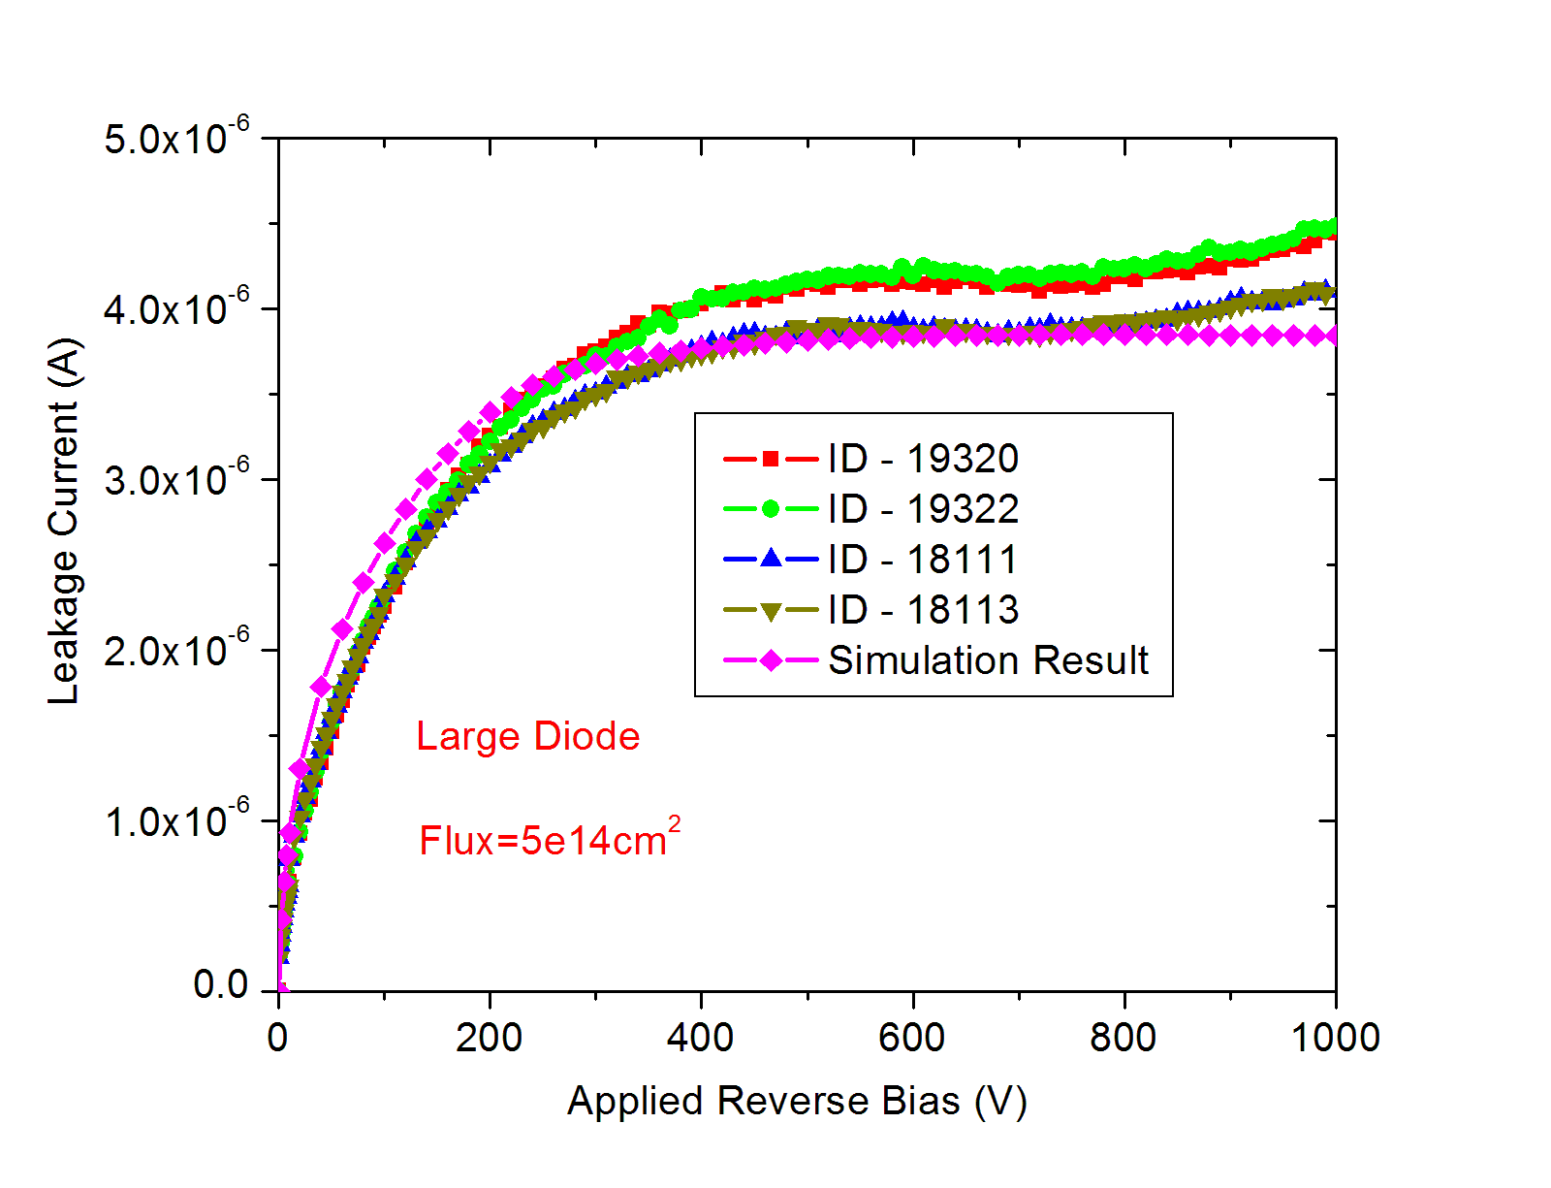
IV comparison for Large diode (FZ320N)
Flux = 5e14 cm⁻²
Temp = 253K
Simulation & Measured values are ~ 10%

Slide 27
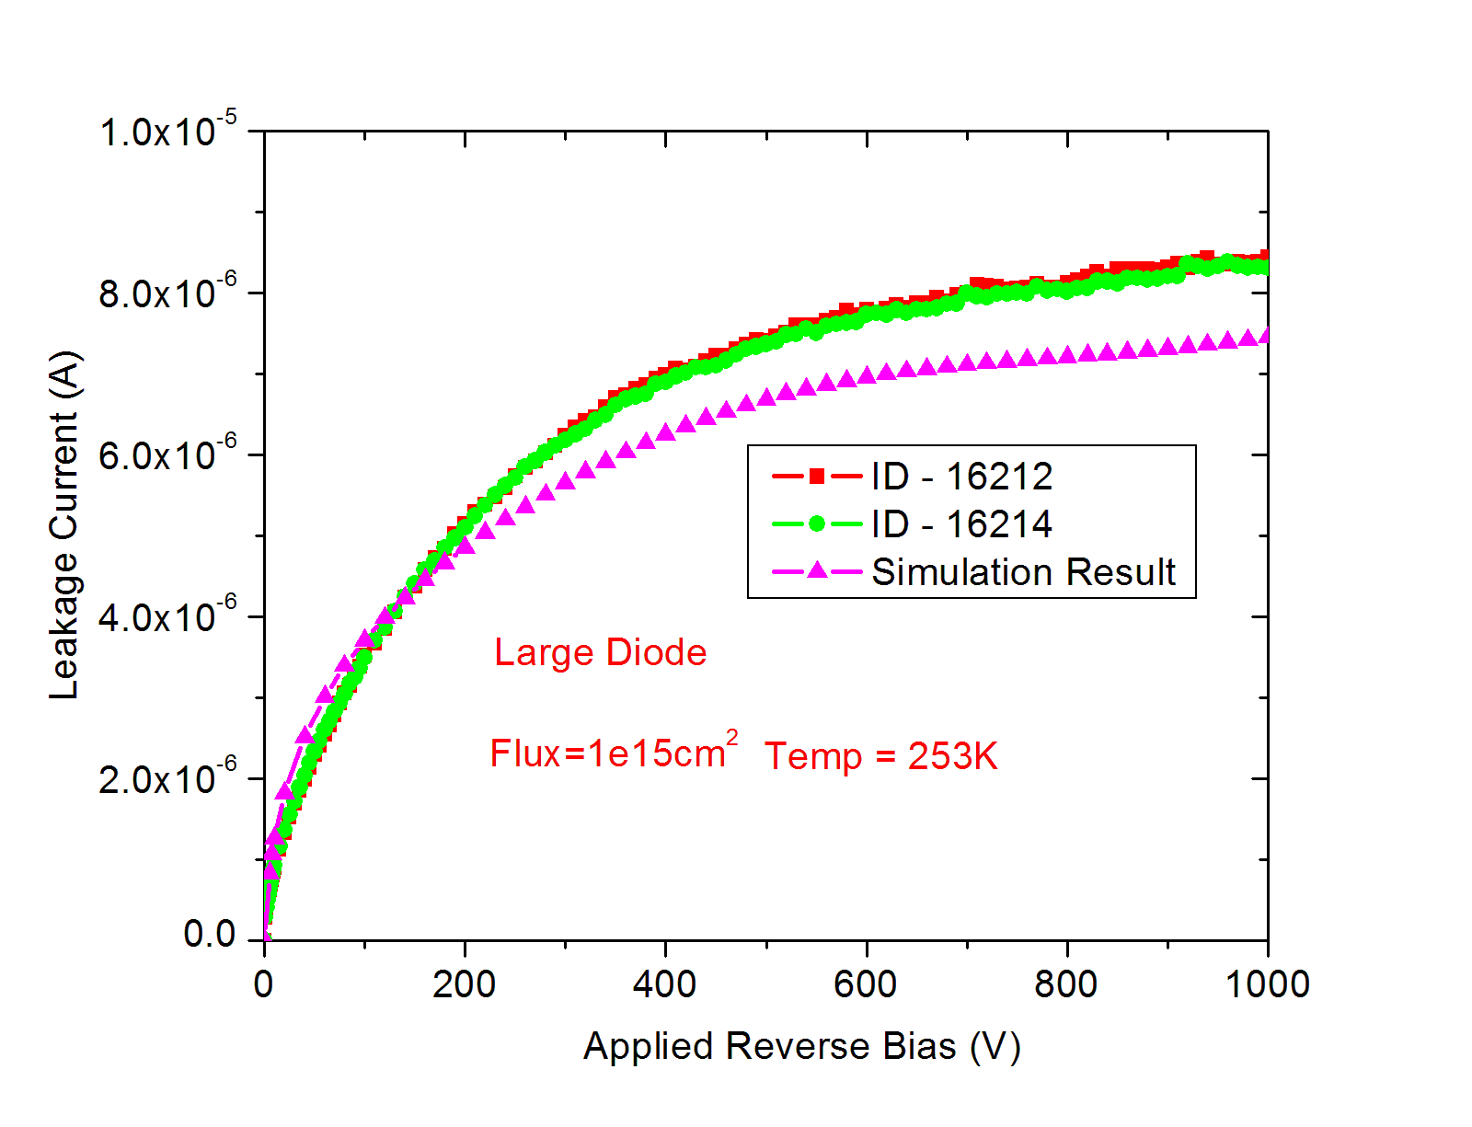
IV comparison for Large diode (FZ320N)
Flux = 1e15 cm⁻²

Slide 28
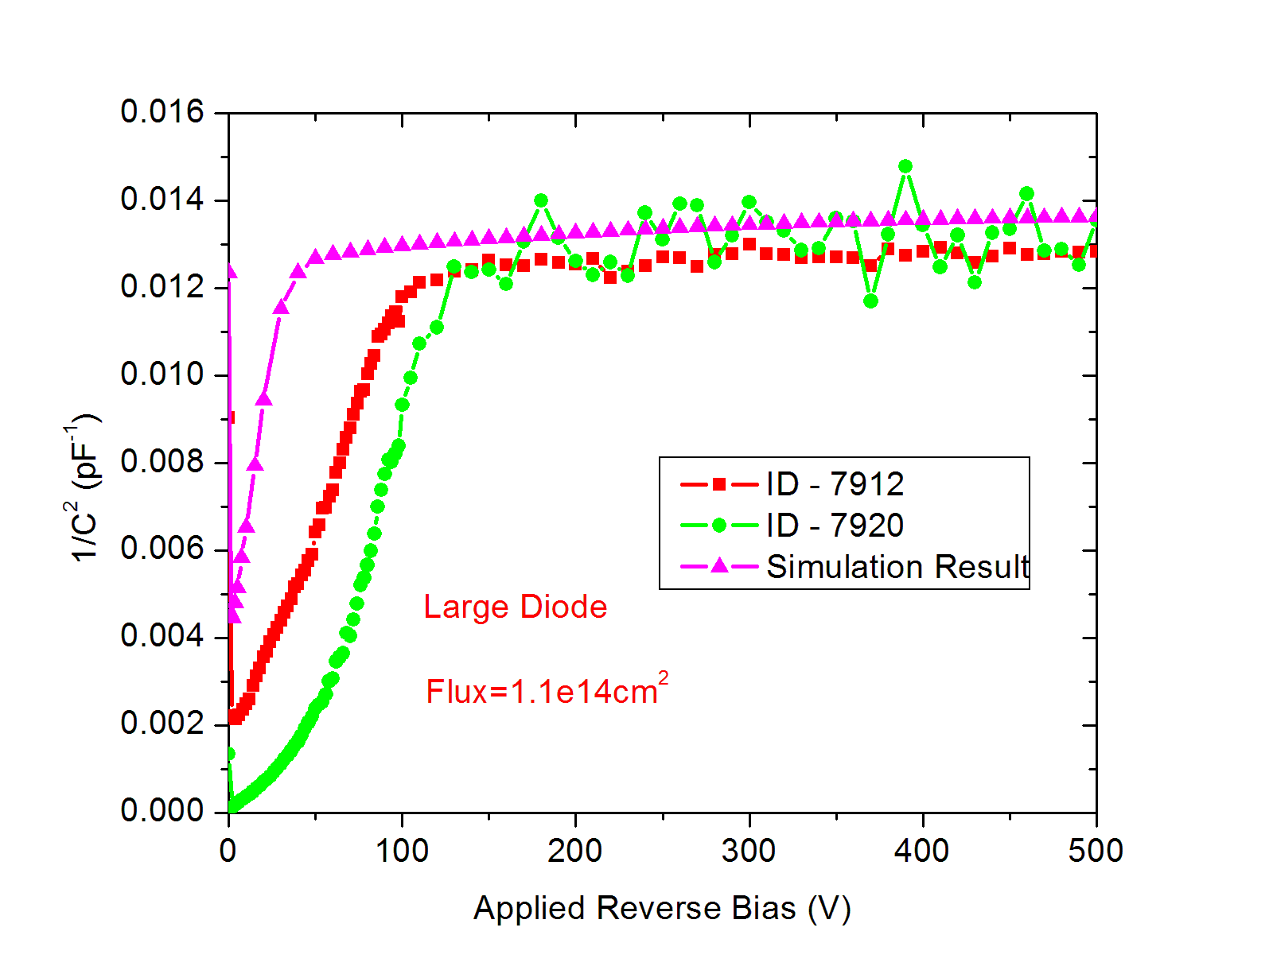
CV comparison for Large diode (FZ320N)
Flux = 1e14 cm⁻²
Significantly different V_{FD}

Slide 29
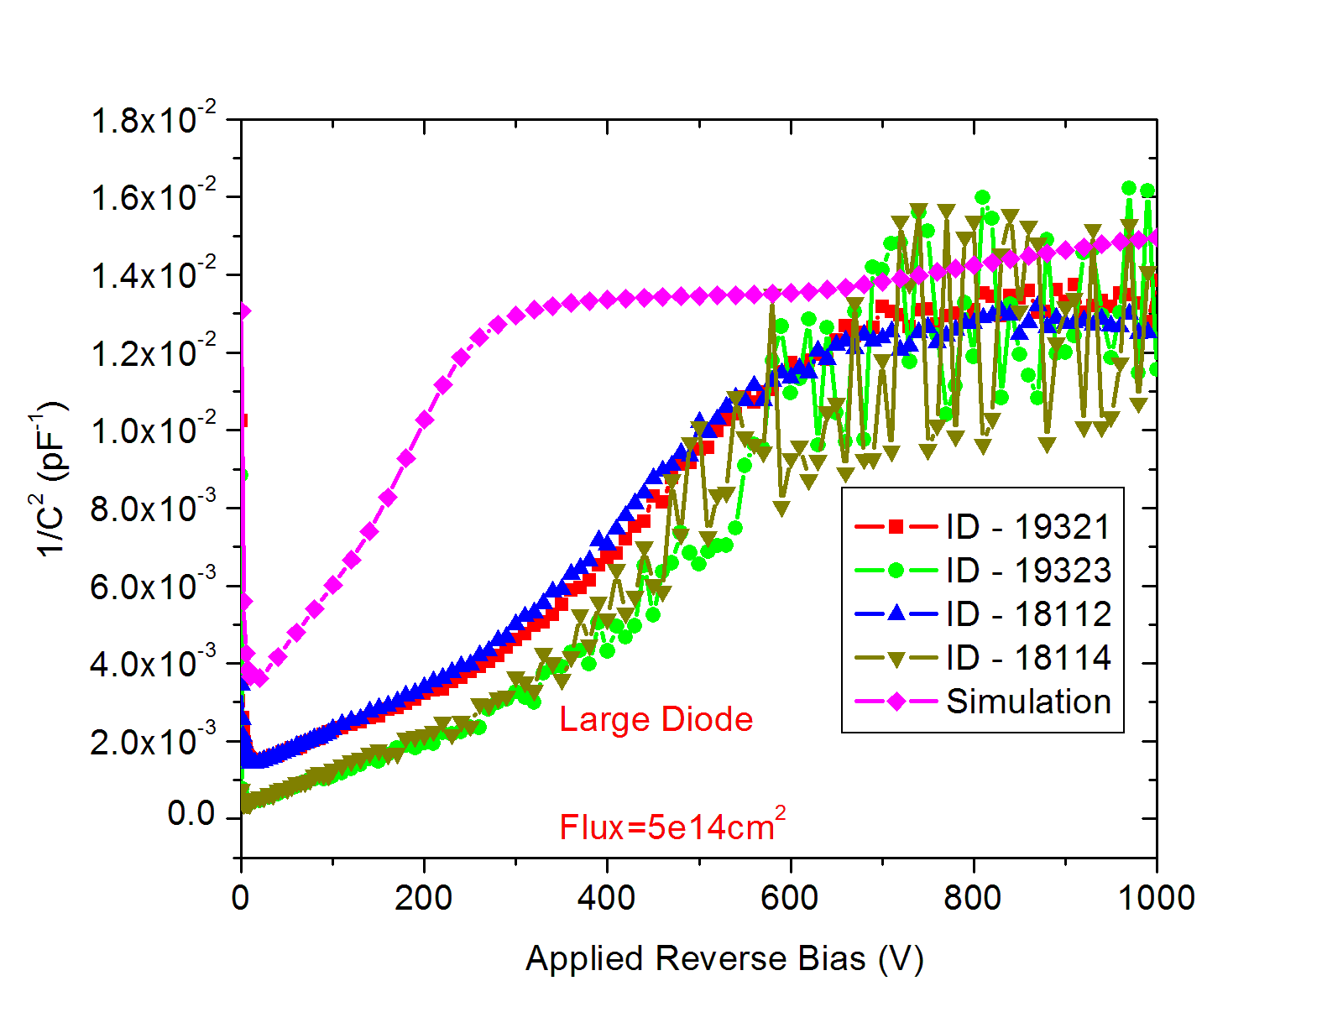
CV comparison for Large diode (FZ320N)
Flux = 5e14 cm⁻²
Significantly different V_{FD} for Simulations and Experiments

Slide 30
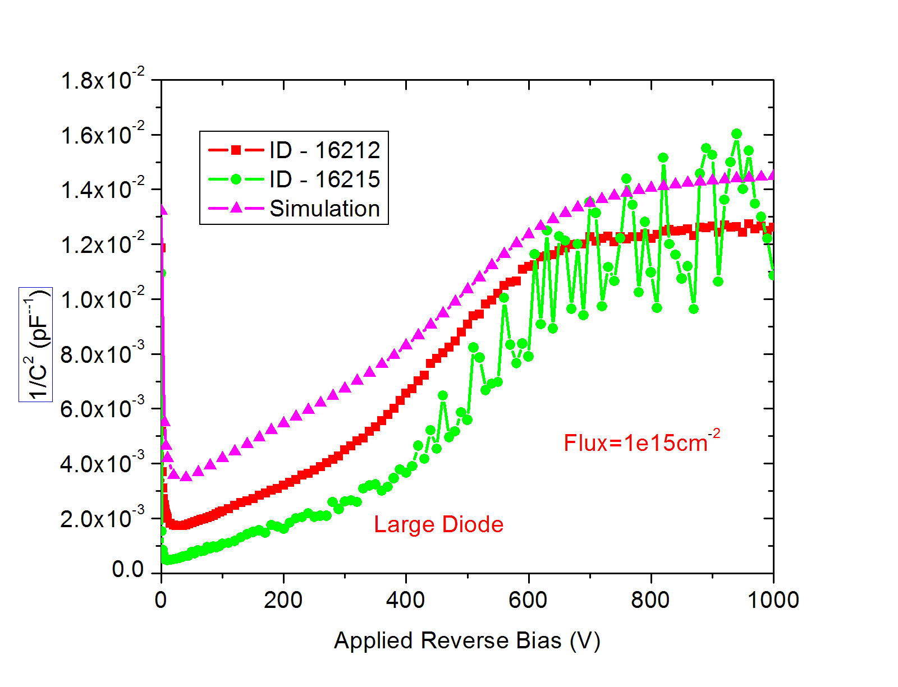
CV comparison for Large diode (FZ320N)
Flux = 1e15 cm⁻²
Similar V_{FD} for Simulations and Experiments

Slide 31
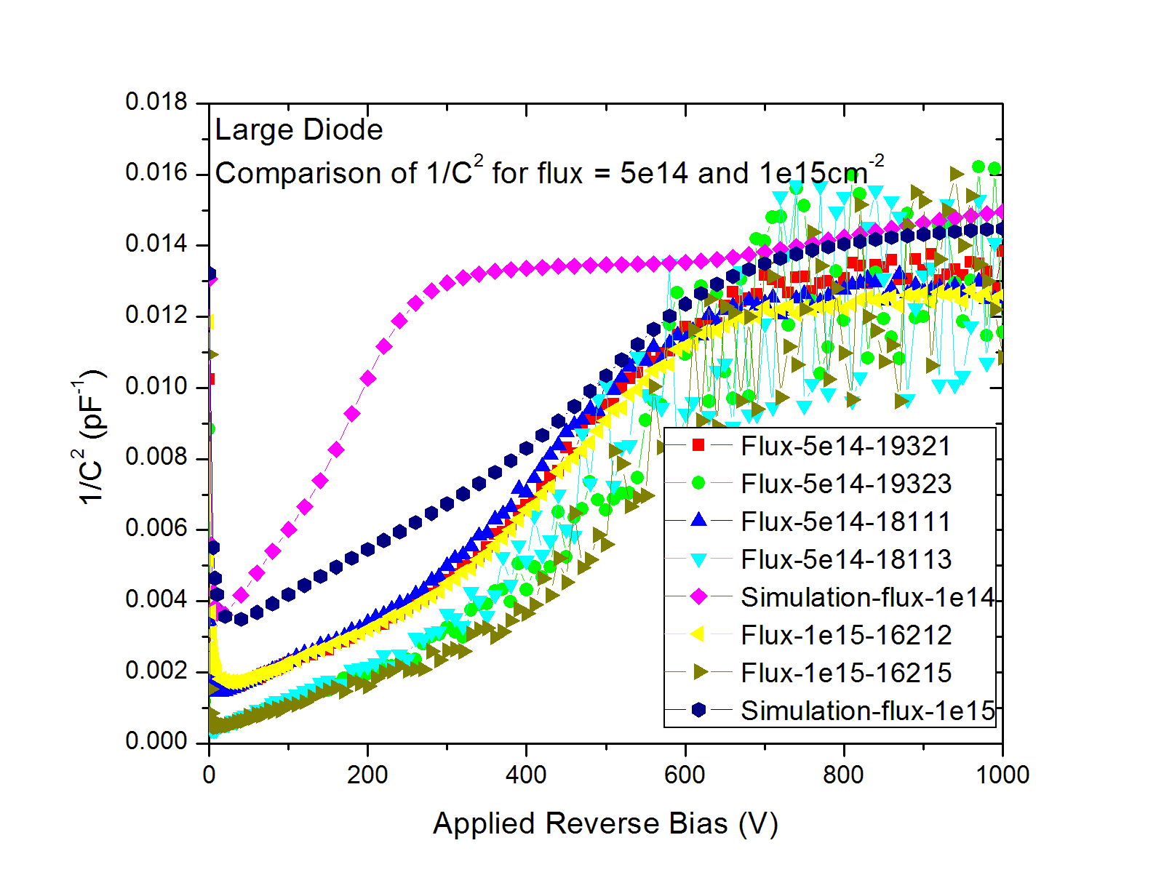
CV comparison for Large diode (FZ320N)
Flux = 5e14 cm⁻² & 1e15 cm⁻²
F=5e14cm-2 Simulation
F=1e15cm-2 Simulation
V_{FD} for Simulations increases with flux as trap density is taken proportional to flux but for measurements it saturates quickly
No way to incorporate this effect in simulations!

Slide 32
IV & CV comparison for Large diode Flux = 1e14 cm⁻²
Full Depletion Voltage using CV ~ 110V
Full Depletion Voltage using IV ~ 50V
Full depletion voltage is considerable different for IV and CV plots !
How to reproduce it !

Slide 33
IV & CV comparison for Large diode Flux = 5e14 cm⁻²
Full Depletion Voltage using IV ~ 270V
Full Depletion Voltage using CV ~ 680V
Full depletion voltage is considerable different for IV and CV plots !

Slide 34
IV & CV comparison for Large diode Flux = 1e15 cm⁻²
Full Depletion Voltage using CV ~ 660V
Full Depletion Voltage using IV ~ 660V (Difficult to say) ?
Full depletion voltage is considerable different for IV and CV plots !

Slide 35
Summary/Future plan
Simulation results of C_{int} of n-type MSSD of HPK are in good agreement for all the designs for both non-irradiated and irradiated Sensors.
Simulation study for C_{int} of n⁺- p⁻- p⁺ MSSD with double P-stops has been carried out. Most of the simulated C_{int} values are within 20% of the experimental values. Simulation indicate presence of the of Oxide charge density ~ 3e10cm⁻²
CV and IV comparison is done between simulation and measurements for large non-irradiated as well as irradiated diodes.
-- CV & IV comparison for Non-irradiated Diode seems good
-- Leakage current is tuned with Tau0=1.6x10⁻²sec.
-- CV and IV comparison for irradiated diodes can be carried out by two trap model.
-- Leakage current for irradiated diodes is reproduced well.
-- Full depletion voltage obtained by CV plots is significantly lower for flux = 1e14 cm-2 and flux =5e14cm-2.
Full depletion voltage obtained from measurements by IV and CV plots are inconsistent but consistent in simulation plots.
Simulations for TCT and CCE are in progress.

Slide 36

Thanks!

Slide 37
Backups!

Slide 38
Dimensions from masks for DiodeL
Diode center
22.5µm
12.5µm
17µm
2.4465mm
Total implant area 4893mm x 4893mm
90µm
660µm
Implant
Guard
Periphery

