Slide 2
POTENTIAL OF THE
WIDEBAND TRANSVERSE DAMPER
G. Kotzian on behalf of HBTFB team
G. Kotzian, LIU-2013, April 12, 2013

Slide 3
HBTFB - High Bandwidth Transverse Feedback
Wideband feedback system (GHz bandwidth)
Intra-bunch GHz transverse feedback system
Help stabilize beam against Ecloud and TMCI effects
Under development with LARP
supported by:
US-LARP
CERN SPS LIU Project
BPM
Kicker
Beam
Active closed loop
GHz Feedback
Analog
Front
End
ADC
Signal
Processing
DAC
Analog Back
End
Power Amp
transverse
position
pre-processed
sampled
position
“slices”
calculated
correction data
correction
signal
pre-distortion
drive signal

Slide 4
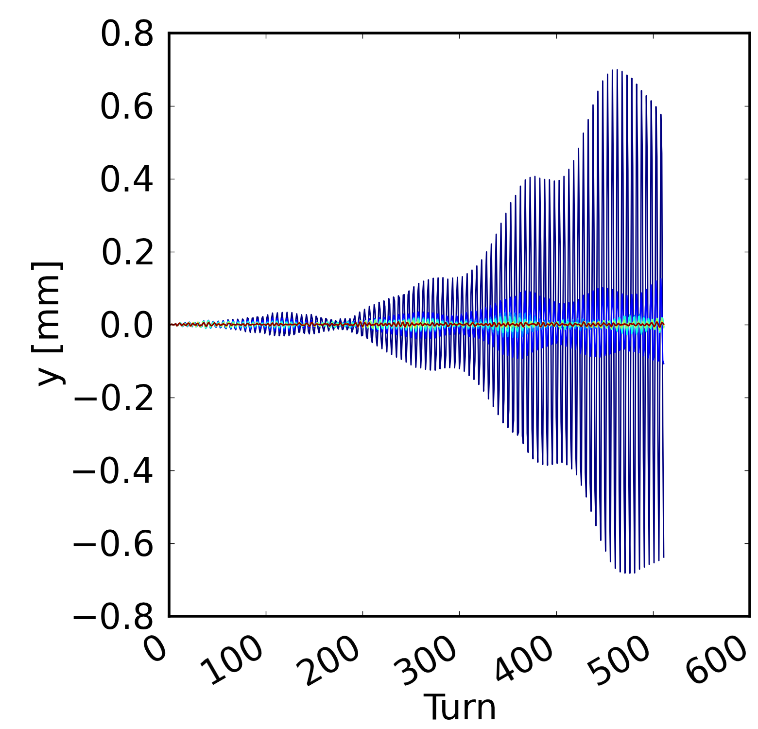
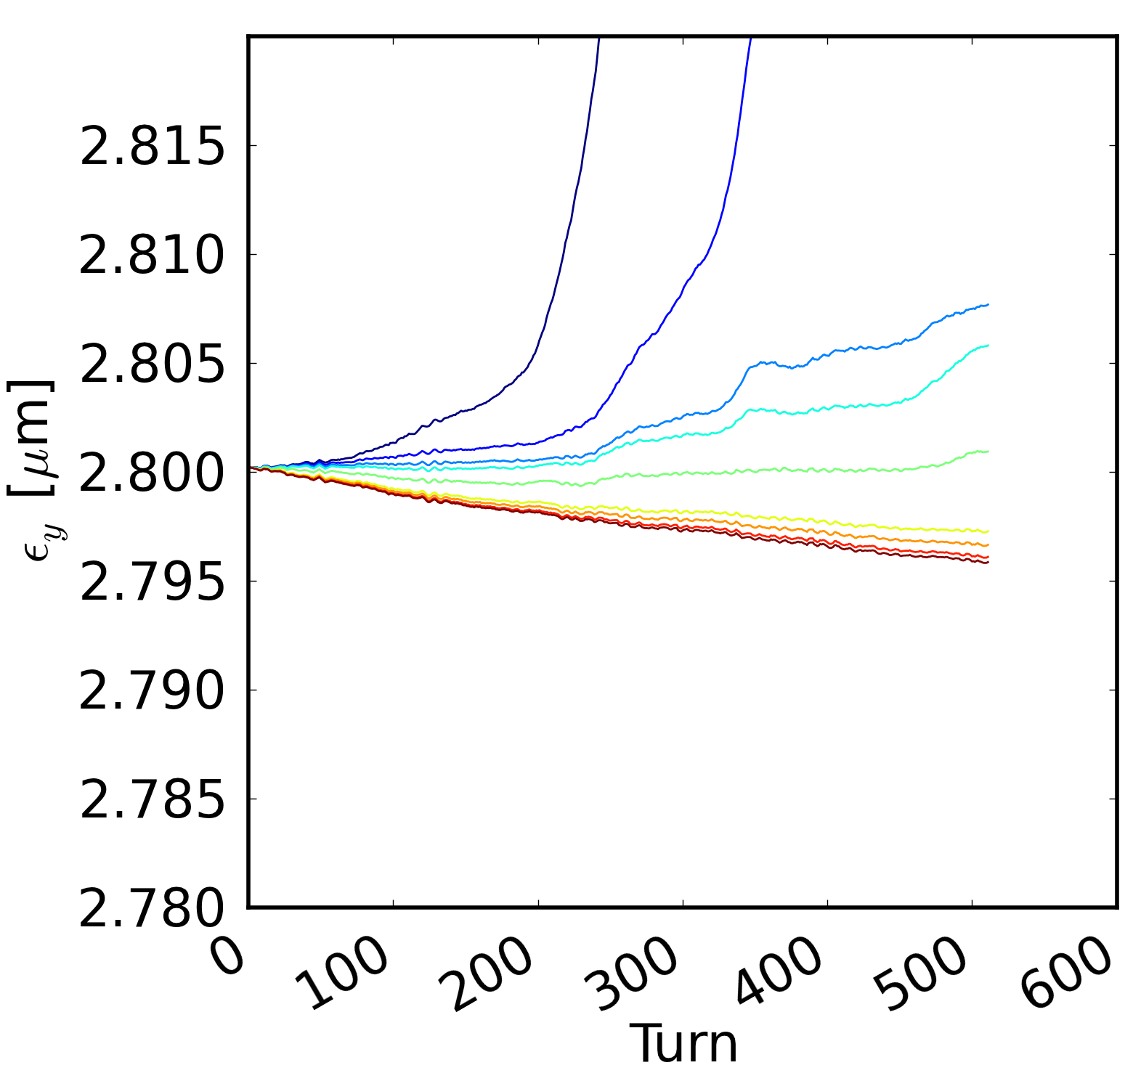
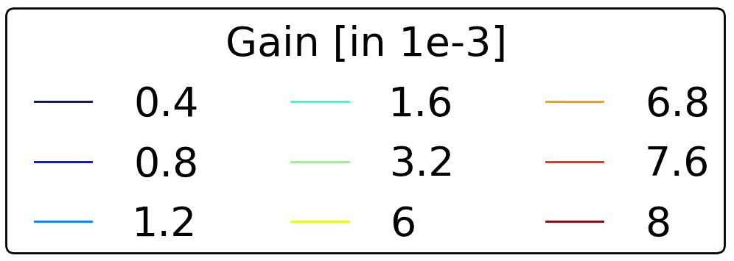
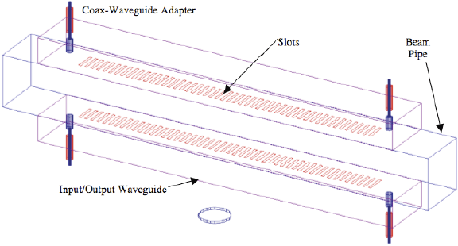
Achievements in 2012
(K. Li et.al.)
Simulations
Beam-feedback interaction (K. Li et.al.)
  Study fundamental behaviour of beam
  in the presence of feedback
  Macro-particle simulation, based on realistic components
  and actual SPS prototype hardware
Aperture studies (H. Bartosik et.al.)
  For pick-up/kickers to be installed in LSS3
Kicker studies (LNF-INFN, LBL, and SLAC collaboration)
  Kicker design and structures
  Impedance estimates
  Slotted kicker/cavities/stripline
R&D and Hardware development efforts for “demonstrator”
  Timing and synchronisation master oscillator
Beam Excitation System (open loop)
  3.2 GS/sec. arbitrary waveform generation, 15k-turns.
Feedback Demonstrator (1 bunch, closed loop)
  3.2 GS/sec Feedback Demo processor (FPGA based)
  General purpose test bed, based on expandable platform
  16 independent control filters (16 tap FIR) for each of 16 bunch “slices”
  Allow machine measurements and experiments using the SPS
Real-time (hardware) equalizers, for BPM front-end and kicker (K. Pollock et.al.)
Proof-of-principle orbit suppression with attenuators (U. Wehrle, G. Kotzian)
MDs and measurements with beam at constant energy (injection@26 GeV)
(H. Bartosik et.al.)
(LARP and CERN)
(J. Cesaratto et.al.)
Image: McGinnis, D. Proc. PAC 1999.

Slide 5
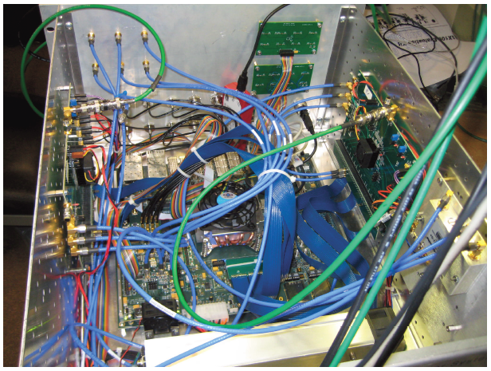
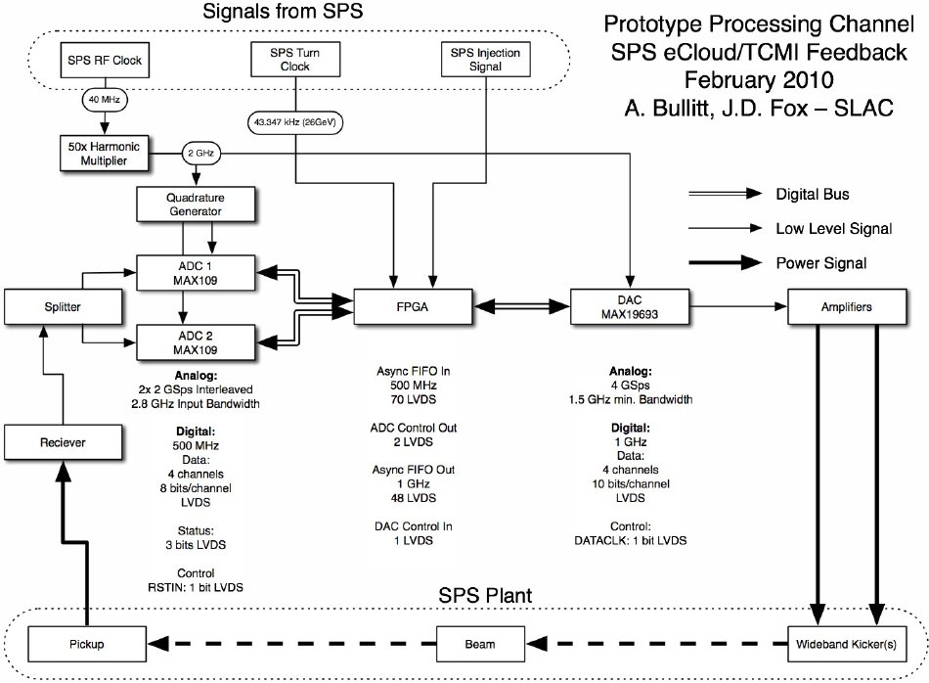
Highlights – Feedback Demonstrator Hardware
MDs and measurements with beam (26 GeV)
Driven motion studies
  Excite the beam through tailored excitation
  Control on selected modes by sweeping frequency (chirps)
  Characterization of the response of the combined beam-feedback system
Feedback studies of naturally unstable or marginally stable beams
  Make the beam unstable with negative chromaticity (mode zero excited)
  Find feedback settings to suppress the instability and show
  that beam becomes unstable with FB off

Slide 6
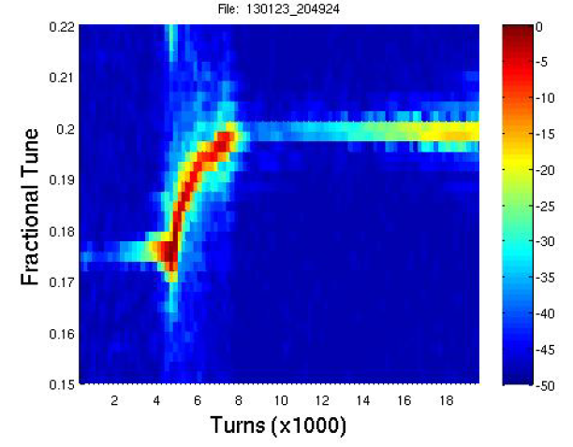
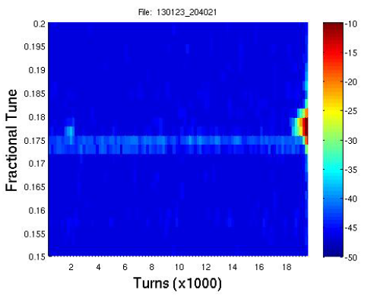
Preliminary Results (1)
single bunch, 26 GeV, charge ~1E11
These studies use a 200 MHz stripline pickup as kicker.
Chromaticity ramped down
(close to zero)
Chromaticity ramped down
(close to zero)
File: 130123_204924
File: 130123_204021
Instability
Fractional Tune
Tune shift due to Beam loss
Fractional Tune
Feedback switched OFF
Feedback off
Feedback active
Instability
Turns (x1000)
Turns (x1000)
Feedback stabilizes the bunch up to 18k turns!
Data analysis ongoing …

Slide 7
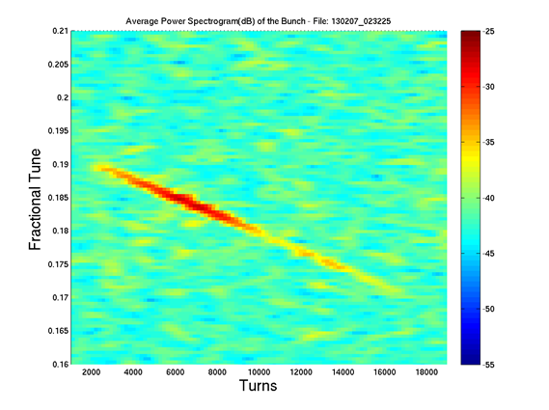
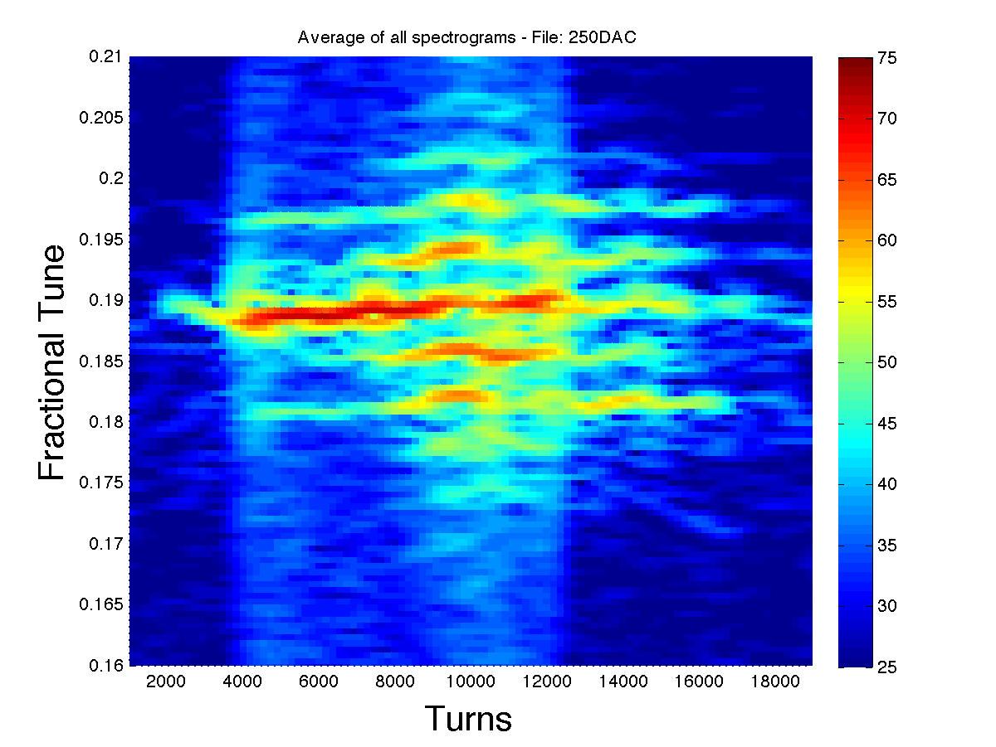
Preliminary Results (2)
O. Turgut, “SPS FB MD results overview”
Joint LARP CM20/HiLumi Meeting, April 8-10, 2013
https://indico.fnal.gov/conferenceDisplay.py?confId=6164
Closed loop grow/damp tests:
Negative ➔ positive ➔ negative feedback
applied for several 1’000 turns
gain = +64
Feedback “gain”
gain = +16
Feedback “gain”
-16
-16
-16
-16
Frequency
Sweep
0.19 – 0.17
Frequency
Sweep
0.19 – 0.17
Turns
Turns
Note the different response of the beam for different positive feedback gains.
Many modes got excited with higher gain in positive feedback.

Slide 8
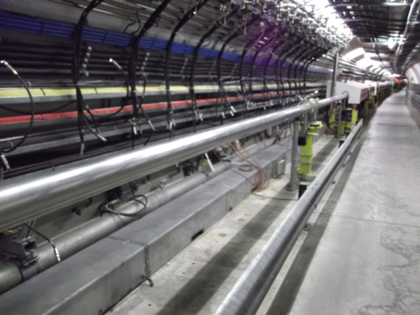
Work planned during LS1
Learn from data taken with “quick prototype” demonstrator
Complete the analysis of MD data
Continue simulation studies for feedback system characterisation
Specification of wideband feedback
Required performance (power, bandwidth, technical components)
Kicker design report (spring 2013)
Expand 1 bunch prototype
Multi-bunch operation ➔ 48 bunches seems feasible on this platform
Technology R&D
Design and build wideband strip-line pickup (CERN RF group)
Wideband kicker prototype for SPS installation (decision to be taken
on slot line)
New wideband 10 (?) -1000 MHz RF power amplifiers, with acceptable
phase response ➔ contact to industry
Module for orbit offset rejection with programmable attenuators
Installation
Cabling being done for new pickup and kicker during LS1
Reshuffling of equipment in LSS3 to prepare for new kickers+pickup
(E. Montesinos et al.)
  Kickers → dispersion suppressor Pickup → close to QD.31910

Slide 9
Roadmap
Today
go / no-go
phase 3:
Year 1
Year 2
Year 3
Year 4
Year 5
Year 6
Year 7
2011
2012
2013
2014
2015
2016
2017
2018
Phase 1:
demonstrator
power amplifiers for phase 2 tendering (s)
new pick-up design and construction
kickers design and construction
Phase 2:
phase 2 beam tests
Phase 3:
implementation
from May 2012
W. Hofle

Slide 10
Recent Publications (2012)
C. Rivetta, J. Cesaratto, J. Fox, M. Pivi, K. Pollak, O. Turgut, S. Uemura, W. Hofle, K. Li., BROAD-BAND TRANSVERSE FEEDBACK AGAINST E-CLOUD OR TMCI: PLAN AND STATUS, 52nd ICFA Advanced Beam Dynamics Workshop on High-Intensity and High-Brightness Hadron Beams, HB2012
K. Li, J. Cesaratto, J. D. Fox, M. Pivi, C. Rivetta, G. Romulo, Instabilities Simulations with Wideband Feedback Systems: CMAD, HeadTail, Warp, Proceedings of ECLOUD 2012: 5th International Workshop on Electron-Cloud Effects, La Biodola, Elba, Italy
J. Cesaratto, et al., Excitation of Intra-bunch Vertical Motion in the SPS - Implications for Feedback Control of Ecloud and TMCI Instabilities, Proceedings IPAC12
S. De Santis, et al., Study of a Wideband Feedback Kicker for the SPS, Proceedings IPAC12
M. Venturini, et al., Analysis of Numerical Noise in Particle-In-Cell Simulations of Single-Bunch Transverse Instabilities and Feedback in the CERN SPS, Proceedings IPAC12
C. Rivetta, et al., Feedback System Design Techniques for Control of Intra-bunch Instabilities at the SPS, Proceedings IPAC12
C. Rivetta, et al., Reduced Mathematical Model of Transverse Intra-bunch Dynamics, Proceedings IPAC12
J. Fox et al., A 4 GS/s Synchronized Vertical Excitation System for SPS Studies – Steps Toward Wideband Feedback, Proceedings IPAC12
M. Pivi, et al., Simulation Code Implementation to Include Models of a Novel Single-bunch Instability Feedback System and Intra-beam Scattering, Proceedings IPAC12

Slide 11
HBTFB Team
CERN – G. Arduini, H. Bartosik, W. Höfle, G. Iadarola, G. Kotzian, K. Li, G. Rumolo, B. Salvant, U. Wehrle, C. Zannini
SLAC – J. Cesaratto, J. Dusatko, J. D. Fox, S. Johnston, J. Olsen, M. Pivi, K. Pollock, C. Rivetta, O. Turgut
LNF-INFN – A. Drago, S. Gallo, F. Marcellini, M. Zobov
LBNL – M. Furman, S. De Santis, Z. Paret, J.-L. Vay, M. Venturini
KEK – M. Tobiyama

