Slide 1
Principals of fast injection and extraction
R. Apsimon

Slide 2
Why do we need injection and extraction systems?
All modern accelerators consist of multiple stages
  Particle source
  Linac
  Damping/storage rings
  …
Need to get beam from one stage to the next
  Injection and extraction systems
  Beam transported along beam transfer lines

Slide 3
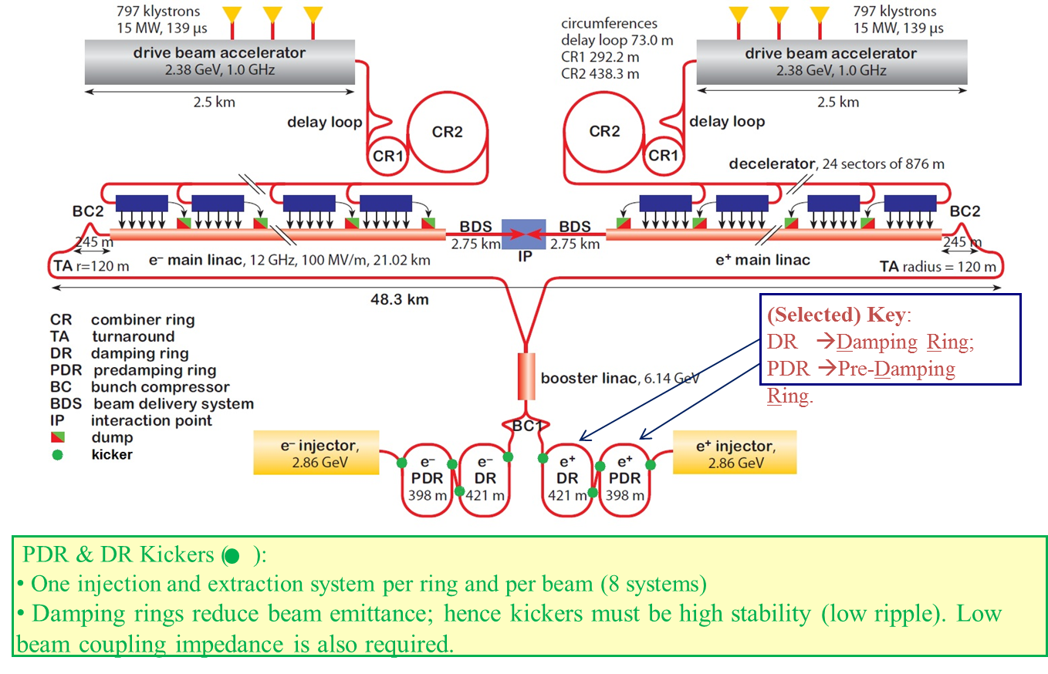
Example: CLIC main beam
Each green dot represents the location of an injection or extraction system for the CLIC main beam line.

Slide 4
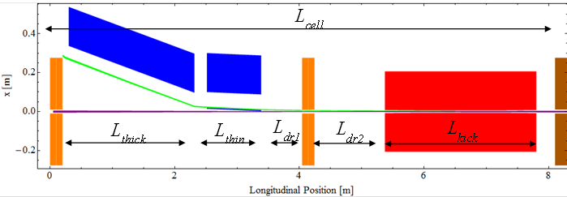
Fundamental principal: Injection
Injected beam (green) travels along the injection transfer line.
Septum magnets (blue) are used to reduce the angle of the injected beam.
Defocussing quadrupole (middle) further reduces the angle of the beam.
The kicker (red) does the final change to the injected beam angle.
At the end of the kicker the position and angle of the injected beam are the same as for the stored beam (purple).

Slide 5
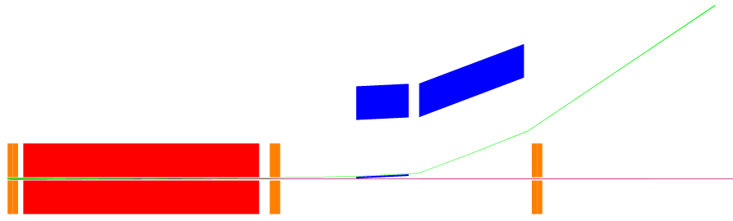
Fundamental principal: Extraction
L_{kick}
L_{drift}
L_{sep1}
L_{sep2}
Extracted beam (green) is deflected off the nominal orbit by the kicker (red).
Defocussing quadrupole (middle) increases beam deflection.
Septum magnets (blue) give large deflection to the extracted beam.
Extracted beam is then transported along the extraction beam transfer line to the next stage of the machine.

Slide 6
Kicker and septum magnets
Kickers
  Can be switched on and off very fast
    < 1 revolution of damping ring
  Can only deliver relatively small deflection angles
Septum magnets
  Very low magnetic field observed by stored beam
  High magnetic field observed by extracted beam
  Can deliver large deflection angles
  Very slow response times
    Typically operated in DC mode or < ~100Hz
Kicker and septum magnets don’t affect stored beam
  (to 1st order…)

Slide 7
Design of injection and extraction systems [1]
Injection
  Reflect order of elements and treat as extraction
    Injection beam parameters not yet known
  Injected beam must match stored beam
    Prevents beam instability
Injection and extraction
  Systems must be optimised over a large number of parameters…
  Aperture requirements are typically for a 5σ beam (+ errors)

Slide 8
Design of injection and extraction systems [2]
Local constraints
  ≤ ½(kicker aperture) @ end of kicker
  ≤ ½(quad aperture) @ defocussing quad
  ≥ thin septum thickness @ thin septum
  ≥ thick septum thickness @ thick septum
  ≥ outer quadrupole radius @ final quad
  β_{x}, β_{y}, α_{x}, α_{y}, D_{x} matched @ start of cell
  β_{x}, β_{y}, α_{x}, α_{y}, D_{x} matched @ end of cell

Slide 9
Design of injection and extraction systems [3]
Global constraints
  Horizontal and vertical tunes matched
  Chromaticity matched
  Rematch optics in damping ring
    Changes when matching tunes
Physical constraints
  Injection and extraction cells must be symmetrical
    Kickers and septum magnets need to fit in both cells
  Minimise cell length
    Minimises beam instability through collective effects

Slide 10
Types of kicker
V
Electrostatic kicker
- Each strip pulsed with equal and opposite charge
- No termination so no current flow
Only electric field
BEAM
-V
R_{load}
I
V
Electromagnetic kicker
- Each strip pulsed with equal and opposite charge
- Terminated to ground, so current flow
Electric and magnetic fields
BEAM
-V
I
R_{load}
Ferrous material
R_{load}
V
Ferrite loaded kicker
- Same as electromagnetic kicker but surrounded by ferrous material (e.g. steel)
- Produces much stronger magnetic field
BEAM
-V
R_{load}

Slide 11
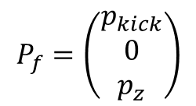
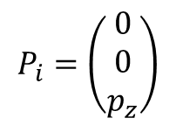
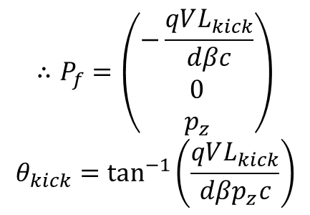

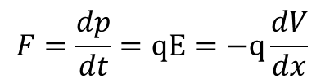
Types of kicker: Electrostatic stripline
Each stripline is charged to equal and opposite potentials
  No termination at other end of kicker; hence electrostatic
  Particles accelerated transversely over potential gradient:
Initial momentum Final momentum
$$P_{i}=\left(\begin{matrix}0 \\ 0 \\ p_{z}\end{matrix}\right)$$
$$P_{f}=\left(\begin{matrix}p_{kick} \\ 0 \\ p_{z}\end{matrix}\right)$$
$$F=\frac{dp}{dt}=qE=−q\frac{dV}{dx}$$
$$∴P_{f}=\left(\begin{matrix}−\frac{qVL_{kick}}{dβc} \\ 0 \\ p_{z}\end{matrix}\right)$$
$$θ_{kick}=\tan^{−1}\left(\frac{qVL_{kick}}{dβp_{z}c}\right)$$
$$∴p_{kick}=−q\frac{V∆t}{d}$$
$$∆t=\frac{L_{kick}}{βc}$$
For a static homogeneous field

Slide 12
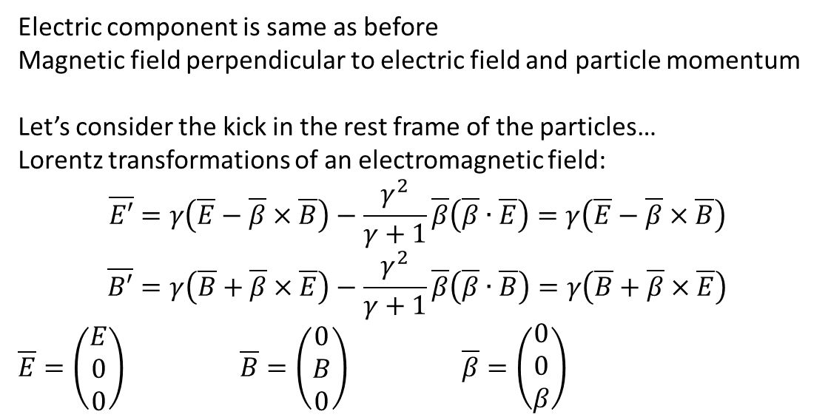
Types of kicker: Electromagnetic stripline [1]
Each stripline is charged to equal and opposite potentials
  Charged from DOWNSTREAM end of kicker
    Otherwise electric and magnetic components of kick cancel each other!
  Termination resistors at upstream end of each stripline
Electric component is same as before
Magnetic field perpendicular to electric field and particle momentum
Let’s consider the kick in the rest frame of the particles…
Lorentz transformations of an electromagnetic field:
$$\overline{E′}=γ\left(\overline{E}−\overline{β}×\overline{B}\right)−\frac{γ^{2}}{γ+1}\overline{β}\left(\overline{β}∙\overline{E}\right)=γ\left(\overline{E}−\overline{β}×\overline{B}\right)$$
$$\overline{B′}=γ\left(\overline{B}+\overline{β}×\overline{E}\right)−\frac{γ^{2}}{γ+1}\overline{β}\left(\overline{β}∙\overline{B}\right)=γ\left(\overline{B}+\overline{β}×\overline{E}\right)$$
$\overline{E}=\left(\begin{matrix}E \\ 0 \\ 0\end{matrix}\right)$ $\overline{B}=\left(\begin{matrix}0 \\ B \\ 0\end{matrix}\right)$ $\overline{β}=\left(\begin{matrix}0 \\ 0 \\ β\end{matrix}\right)$

Slide 13
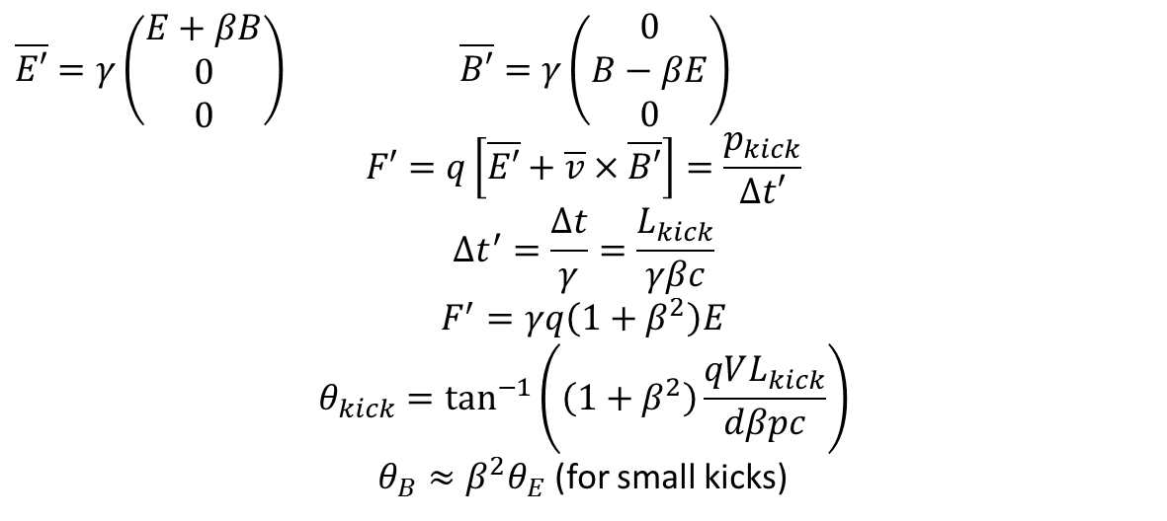
Types of kicker: Electromagnetic stripline [2]
$\overline{E′}=γ\left(\begin{matrix}E+βB \\ 0 \\ 0\end{matrix}\right)$ $\overline{B′}=γ\left(\begin{matrix}0 \\ B−βE \\ 0\end{matrix}\right)$
$$F′=q\left[\overline{E′}+\overline{v}×\overline{B′}\right]=\frac{p_{kick}}{∆t′}$$
$$∆t^{′}=\frac{∆t}{γ}=\frac{L_{kick}}{γβc}$$
$$F^{′}=γq\left(1+β^{2}\right)E$$
$$θ_{kick}=\tan^{−1}\left(\left(1+β^{2}\right)\frac{qVL_{kick}}{dβpc}\right)$$
$θ_{B}≈β^{2}θ_{E}$ (for small kicks)
In ultra-relativistic limit (β=1), it is clear that the electric and magnetic kicks are equal.
This kicker design can deliver up to twice the kick as an electrostatic kicker for the same voltage and design.
However it is

Slide 14
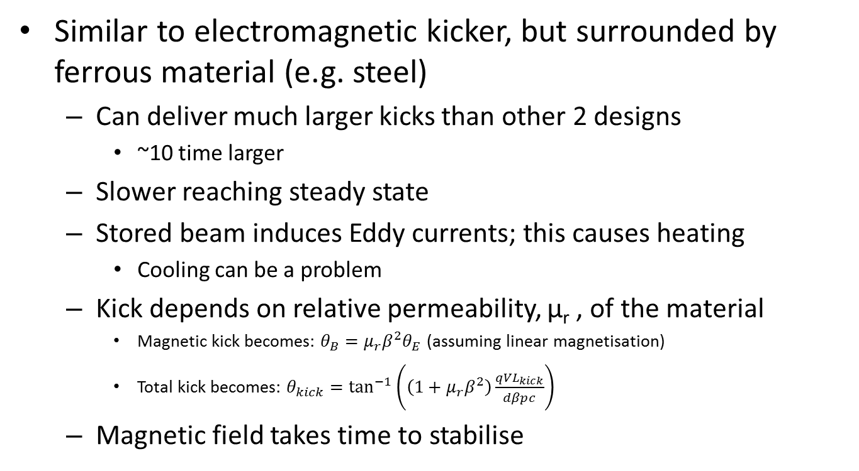
Types of kicker: Ferrite loaded kicker
Similar to electromagnetic kicker, but surrounded by ferrous material (e.g. steel)
  Can deliver much larger kicks than other 2 designs
    ~10 time larger
  Slower reaching steady state
  Stored beam induces Eddy currents; this causes heating
    Cooling can be a problem
  Kick depends on relative permeability, μ_{r} , of the material
    Magnetic kick becomes: $θ_{B}=μ_{r}β^{2}θ_{E}$ (assuming linear magnetisation)
    Total kick becomes: $θ_{kick}=\tan^{−1}\left(\left(1+μ_{r}β^{2}\right)\frac{qVL_{kick}}{dβpc}\right)$
  Magnetic field takes time to stabilise

Slide 15
Septum magnets
2 main types of septa:
  Electrostatic septum
    Septum thickness typically ≤100μm
  Magnetic septum
    Septum thickness typically 2 – 20 mm
    Can be DC or pulsed (typically < ~100Hz)
    Many different designs, but concept is the same

Slide 16
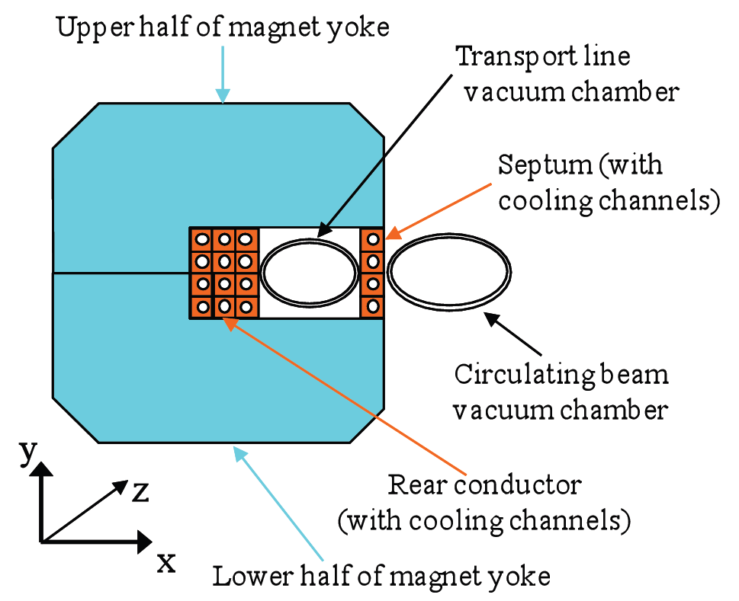
Basic diagram of septum magnet

Slide 17
Septum magnet: design challenges
Low leakage field
  In the “zero-field” region there will be some residual field
    High-order multipole fields experienced by stored beam
    Can cause beam instability and reduce dynamic aperture
Good field homogeneity in field region
  Reduces beam jitter on injected or extracted beam
    Can lead to luminosity loss, emittance growth and beam instabilities

Slide 18
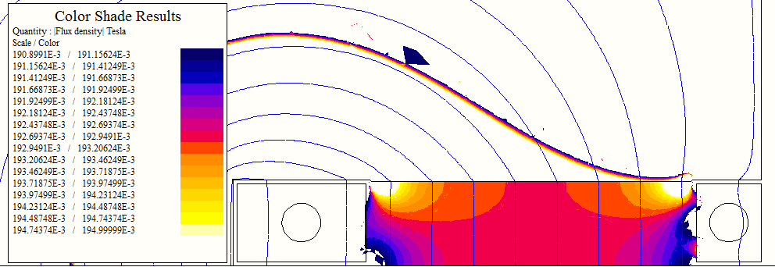
CLIC damping ring septum
Field homogeneity
For good field region, homogeneity ~±1x10⁻⁴
Need 2x10⁻⁵ so still optimisation to be done…

Slide 19
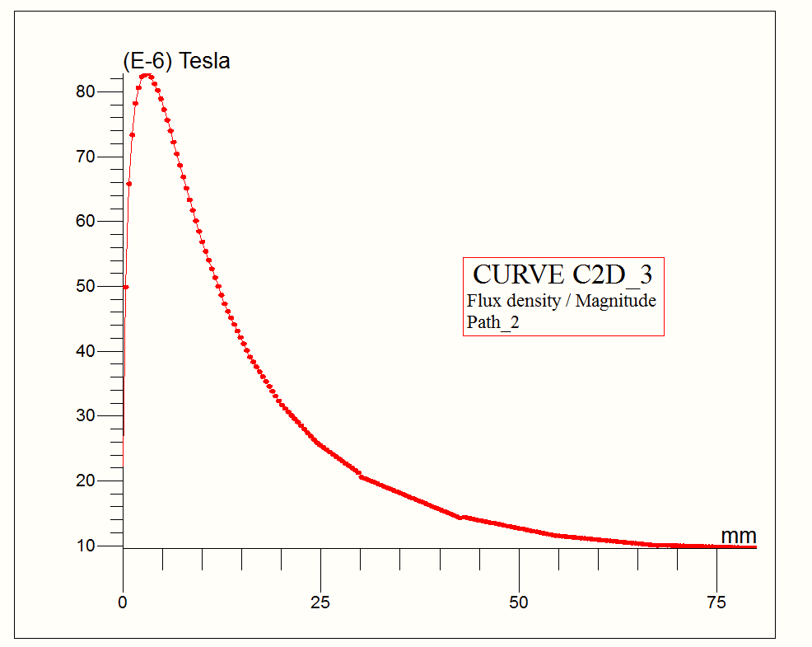
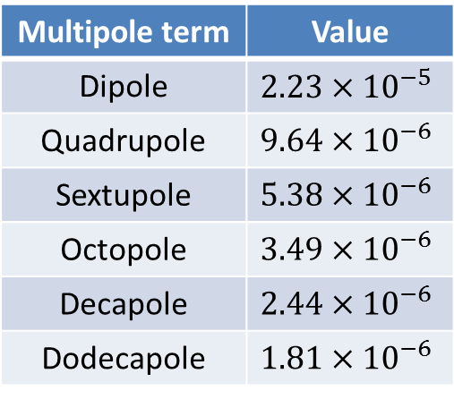
CLIC damping ring septum
Leakage field
Multipole term | Value
Dipole | $$2.23×{10}^{−5}$$
Quadrupole | $$9.64×{10}^{−6}$$
Sextupole | $$5.38×{10}^{−6}$$
Octopole | $$3.49×{10}^{−6}$$
Decapole | $$2.44×{10}^{−6}$$
Dodecapole | $$1.81×{10}^{−6}$$

Slide 20
Practical issues: cooling
Magnet coil and cooling pipes all inside septum
  Cooling water flow rate limited
    Too fast will damage septum magnet
  Higher magnetic field needs more current
    This means more current density in septum
    Needs more cooling pipes; further increase current density…
      This means more leakage field
      This also means less field homogeneity
    This sets limit on field strength for a given design

Slide 21
Forces on kickers and pulsed septa
Force typically ~10kN when beam passes
  Huge stresses can damage kickers and septa
    Metal fatigue
    Warping the conductors and aperture
  Special damping springs used to stabilise

Slide 22
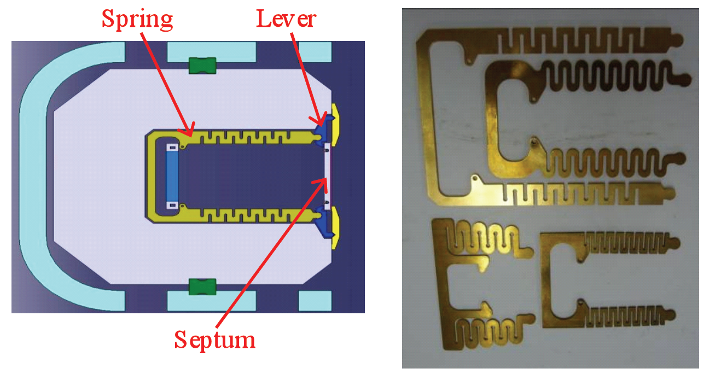
Septum magnet damping springs

Slide 23
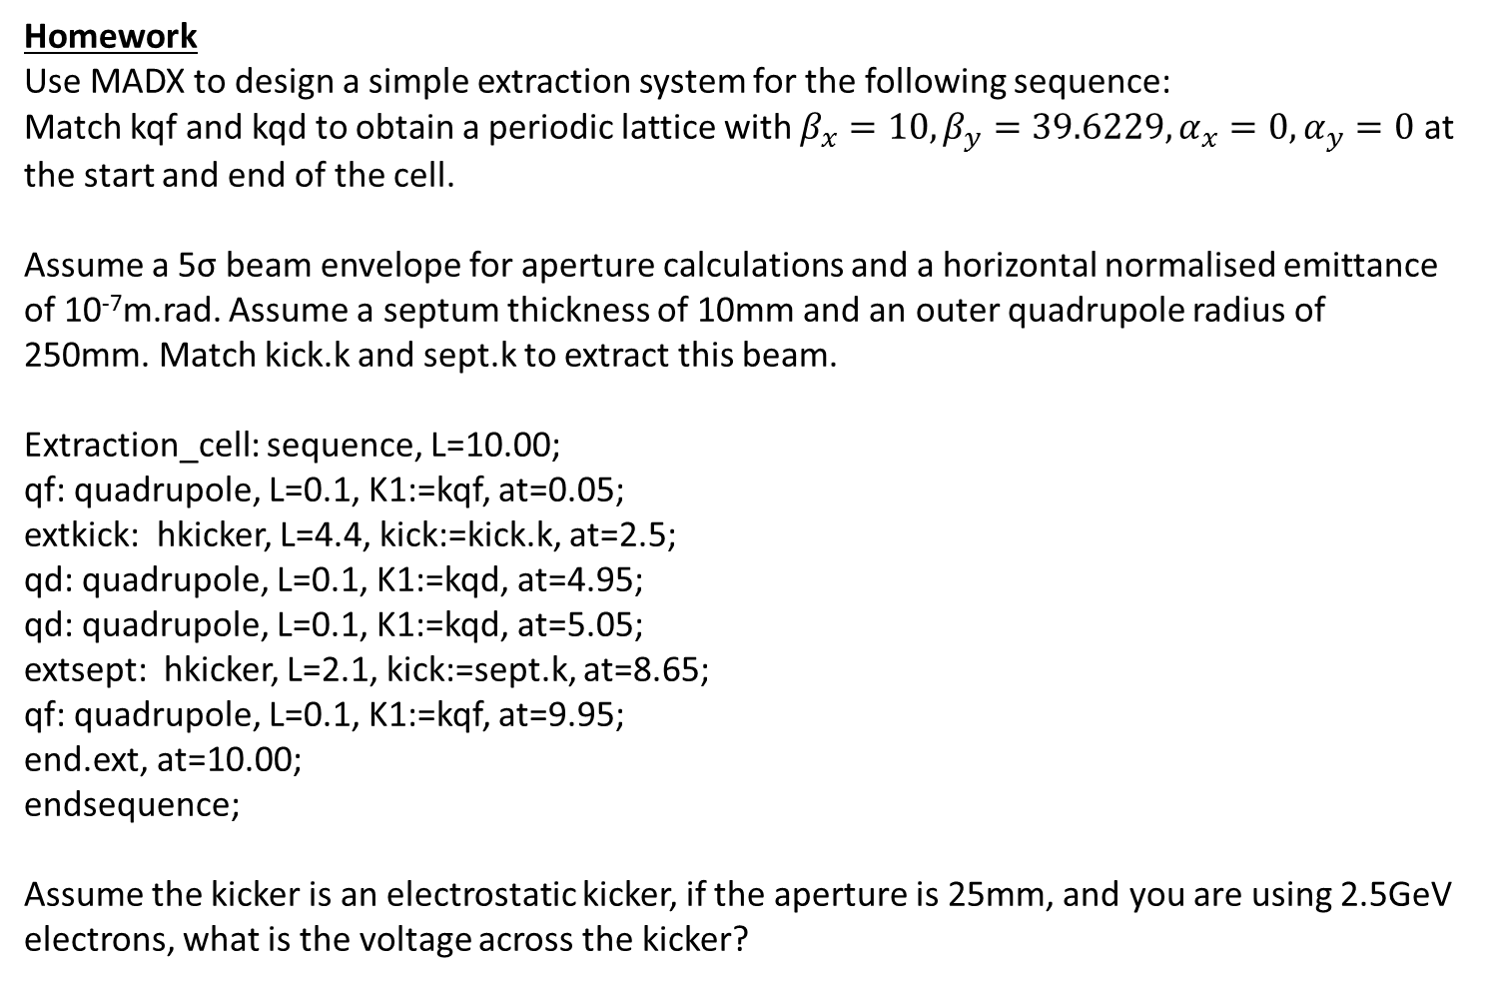
Homework
Use MADX to design a simple extraction system for the following sequence:
Match kqf and kqd to obtain a periodic lattice with $β_{x}=10, β_{y}=39.6229, α_{x}=0, α_{y}=0$ at the start and end of the cell.
Assume a 5σ beam envelope for aperture calculations and a horizontal normalised emittance of 10⁻⁷m.rad. Assume a septum thickness of 10mm and an outer quadrupole radius of 250mm. Match kick.k and sept.k to extract this beam.
Extraction_cell: sequence, L=10.00;
qf: quadrupole, L=0.1, K1:=kqf, at=0.05;
extkick: hkicker, L=4.4, kick:=kick.k, at=2.5;
qd: quadrupole, L=0.1, K1:=kqd, at=4.95;
qd: quadrupole, L=0.1, K1:=kqd, at=5.05;
extsept: hkicker, L=2.1, kick:=sept.k, at=8.65;
qf: quadrupole, L=0.1, K1:=kqf, at=9.95;
end.ext, at=10.00;
endsequence;
Assume the kicker is an electrostatic kicker, if the aperture is 25mm, and you are using 2.5GeV electrons, what is the voltage across the kicker?

Slide 24
For further information you can read the following papers:
Kickers: http://arxiv.org/ftp/arxiv/papers/1103/1103.1583.pdf
Septum magnets: http://arxiv.org/ftp/arxiv/papers/1103/1103.1062.pdf
These papers deal with the kickers and septum magnets in a lot more depth that I can during this lecture.

