Slide 2
Manuel Martin Marquez
Introduction to R and
in-Database Analytics using ORE
http://data-analytics.web.cern.ch

Slide 3
Outline
Introduction and Environment
R Language Basics
Plotting in R
Oracle R Enterprise (ORE)
In-Database analytics with ORE
http://data-analytics.web.cern.ch

Slide 4
Introduction and Environment
R is an open source version of S
  http://cran.r-project.org
Framework that provides:
  Statistical and Data Analysis methods
    Linear and non linear modeling
    Classical Statistical
    Classification
    Time-series analysis
    hadoop
  Powerful graphical capabilities
http://data-analytics.web.cern.ch

Slide 5
Introduction and Environment
R is highly extensible via Packages
  Huge number of packages on CRAN repositories
    http://cran.r-project.org/web/packages/available_packages_by_date.html
http://data-analytics.web.cern.ch

Slide 6
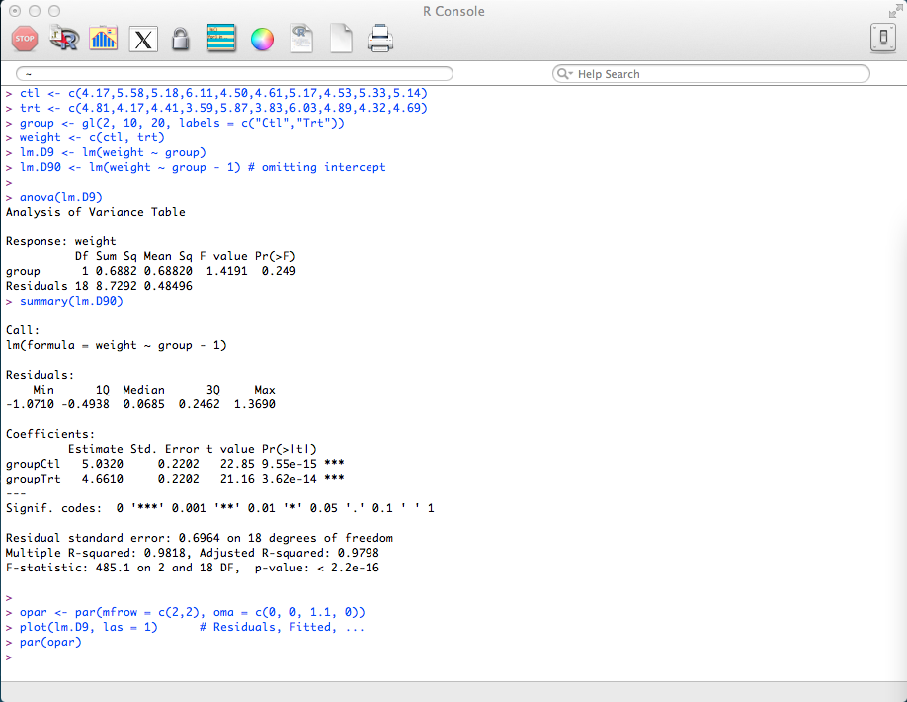
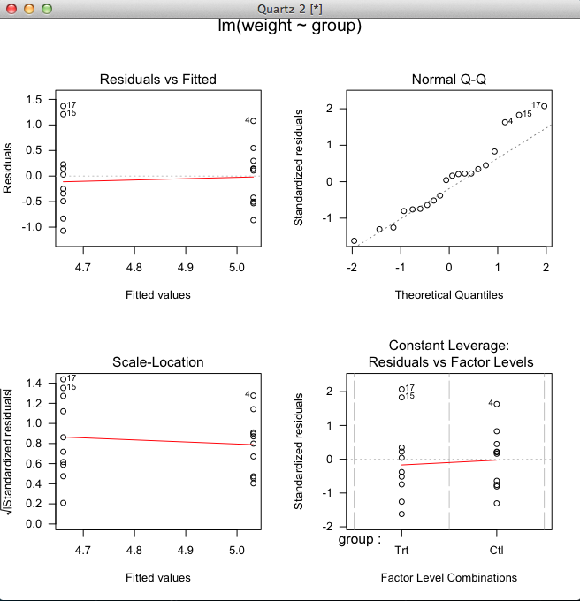
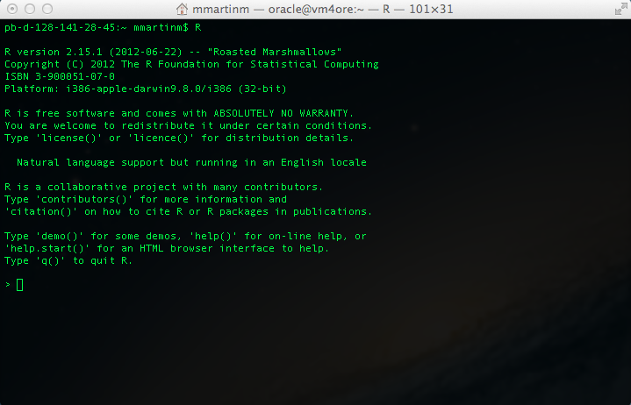
Introduction and Environment
R Environment
http://data-analytics.web.cern.ch

Slide 7
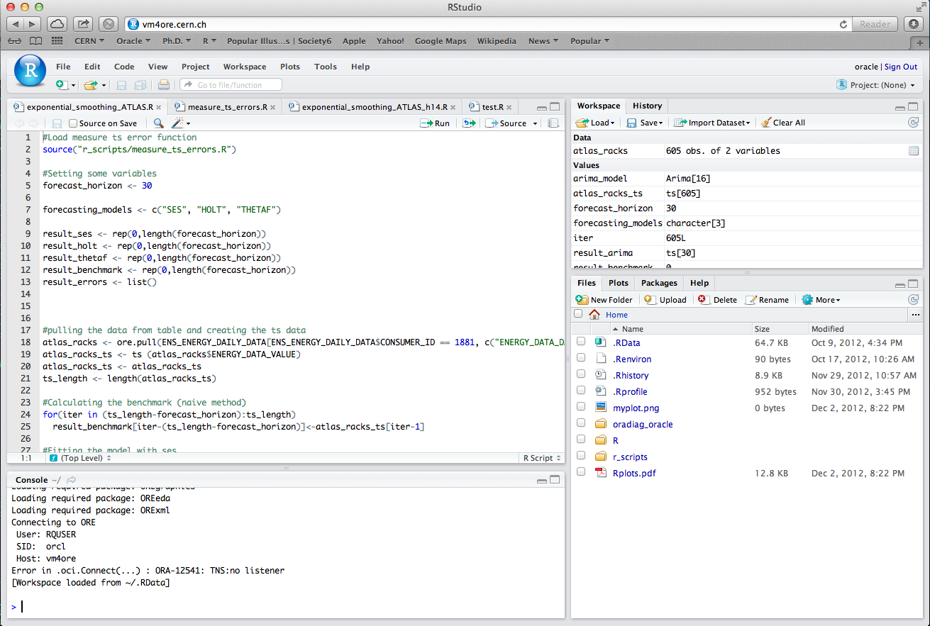
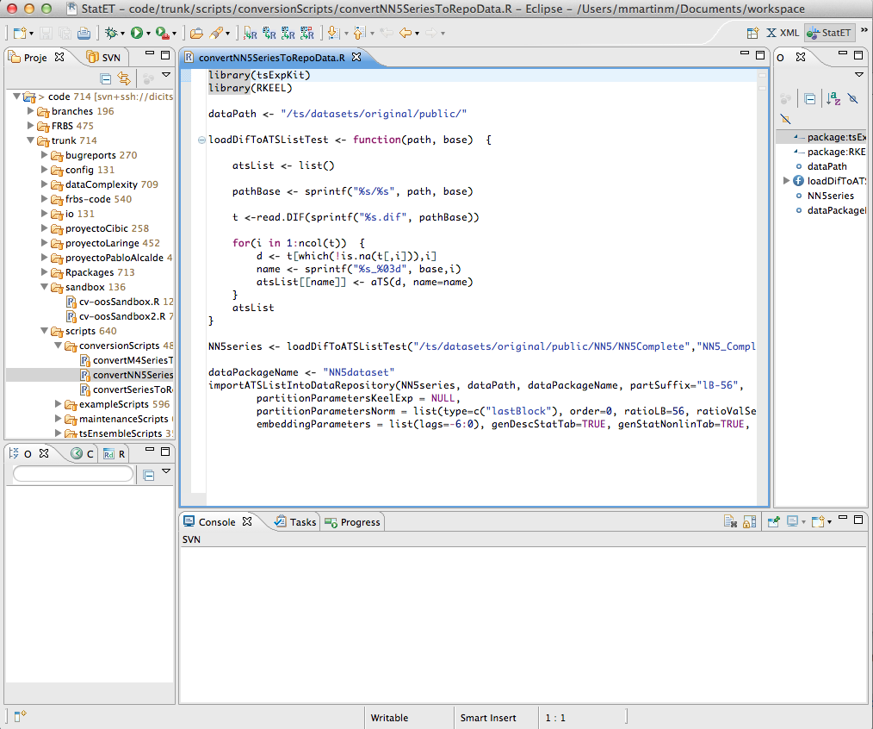
Introduction and Environment
Other tools: Rstudio and statET
http://data-analytics.web.cern.ch

Slide 8
R Language Basics: Objects
Basics object
Vectors and Matrices
x <- "a" # Character
x <- 2 # Integer
x <- 2.5 # Numeric
x <- 2 + 0+4i # Complex
x <- true # Logical (true/false)
x <- c("a", "b", "c” ) # Character
x <- 0:10 # Integer
x <- vector("numeric", length = 10) # Numeric
x <- c(2+2i,1+4i) # Complex
x <- rep(true, 10) # Logical
m <- matrix(ncol= 10, ncol= 10) # Empty Matrix
http://data-analytics.web.cern.ch

Slide 9
R Language Basics: Objects
Lists: Vector that contains elements of different class
Factors: Represent categorical data
l <- list(1, "a", false, 1 + (0+2i))
l <- list(1:10, rep(false,5))
# Access to list members
l[[1]]
f <- factor(c("Male", "Female", "Female", "Male"),
levels = c("Male", ”Female"))
# Content of factor
[1] Male Female Female Male
Levels: Male Female
http://data-analytics.web.cern.ch

Slide 10
R Language Basics: Objects
Data Frames: List of vectors of equal length.
id <- c(1,2,3,4)
name <- c("A", "B", "C", "D")
age <- c(10,20,30,40)
region <- factor(c(”GE", “VD", “GE", “FR"),
levels = c(”GE", “VD,”FR"))
# Creating the data frame based on the vectors
df <- data.frame(id=id, name=name, age=age, region=region)
summary(df)
id name age region
Min. :1.00 A:1 Min. :10.0 GE:2
1st Qu.:1.75 B:1 1st Qu.:17.5 VD:1
Median :2.50 C:1 Median :25.0 FR:1
Mean :2.50 D:1 Mean :25.0
3rd Qu.:3.25 3rd Qu.:32.5
Max. :4.00 Max. :40.0
http://data-analytics.web.cern.ch

Slide 11
R Language Basics: Vector operations
Vectors and Matrices:
# Vector Operations
x <- c(1, 2, 3, 4)
y <- rep(10, 4)
x + y
11 12 13 14
x/y
0.1 0.2 0.3 0.4
x > 2
FALSE FALSE TRUE TRUE
x == 2
FALSE TRUE FALSE FALSE
# Matrix Operations
x <- matrix (1:4, 2, 2)
y <- matrix (rep(10, 4), 2, 2)
x * y
[,1] [,2]
[1,] 10 30
[2,] 20 40
x %*% y
[,1] [,2]
[1,] 40 40
[2,] 60 60
http://data-analytics.web.cern.ch

Slide 12
R Language Basics: Functions
Functions:
myMean <- function(x)
{
sum(x)/length(x)
}
# Calling the created function
myMean(x)
0.103
http://data-analytics.web.cern.ch

Slide 13
R Language Basics: Looping Functions
Looping Functions: Q: How can I use a loop to … ? A: Don’t. Use one of the apply functions.
  - apply: Applies a function to sections of an array and returns the results in an array
  - tapply: Applies a function to elements in a list or a vector and returns the results in a list.
  - sapply: Applies a function to elements in a list and returns the results in a vector, matrix
  or a list (tries to return the simpler object).
m <- matrix(c(1:10, 11:20), nrow = 10, ncol = 2)
apply(m, 1, mean)
6 7 8 9 10 11 12 13 14 15
apply(m, 2, mean)
5.5 15.5
http://data-analytics.web.cern.ch

Slide 14
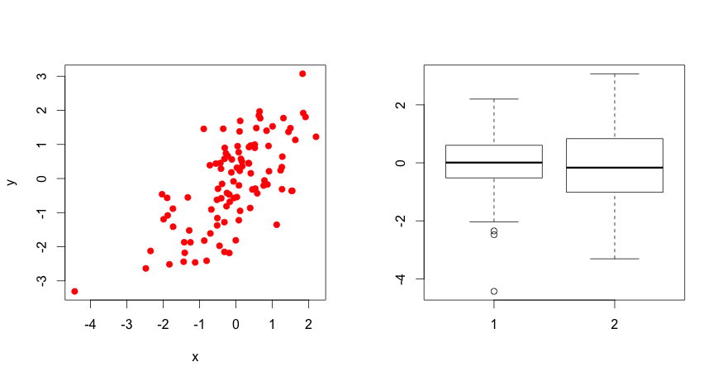
Plotting in R: Base Plotting Functions
Basic Functions:
  plot: make a plot which type depends on the class of the object.
  boxplot, barplot, hist: different plots.
  lines: add lines to a plot (connects two dot).
  text: add text labels to a plot using x, y coordinates.
  point: add point to a plot.
  title: add title annotations
  axis: add axis ticks/labels
x <- rnorm(100)
y <- x + rnorm(100)
plot(x, y, col = "red", pch = 19)
boxplot(x, y)
http://data-analytics.web.cern.ch

Slide 15
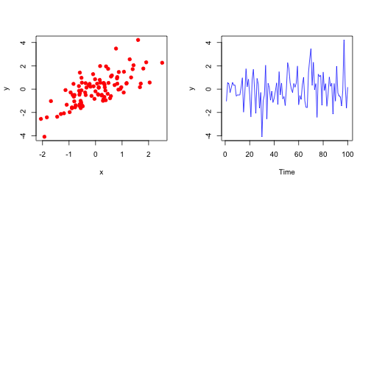
Plotting in R: Graphic Parameters
Par Function: specify global graphics parameters
  pch: plotting symbol.
  lty: line type.
  lwd: lines width.
  col: the plotting color
  las: orientation of the axis labels.
  font: font to use for the plot text.
  mfcol, mfrow: specify the layout of the plots.
x <- rnorm(100)
y <- x + rnorm(100)
par(mfrow = c(2, 2))
plot(x, y, col = "red", pch = 19)
y <- ts(y)
plot(y, col = "blue", pch = 1)
http://data-analytics.web.cern.ch

Slide 16
Plotting in R: Graphic Devices
Graphic Devices: Exporting graphics
  pdf
  postscript
  xfig
  png
  bipmap
pdf(file = "figure.pdf", height = 4, width = 3 * 4)
x <- rnorm(100)
y <- x + rnorm(100)
par(mfrow = c(2, 2))
plot(x, y, col = "red", pch = 19)
y <- ts(y)
plot(y, col = "blue", pch = 1)
dev.off()
http://data-analytics.web.cern.ch

Slide 17
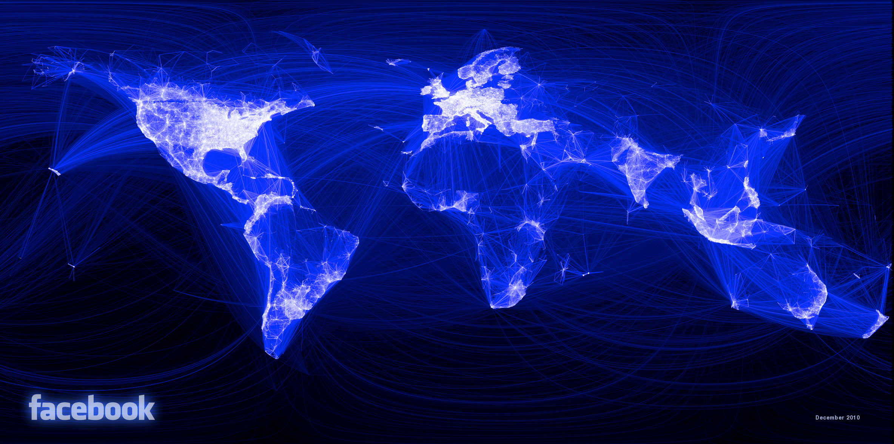
Plotting in R: Examples
http://data-analytics.web.cern.ch

Slide 18
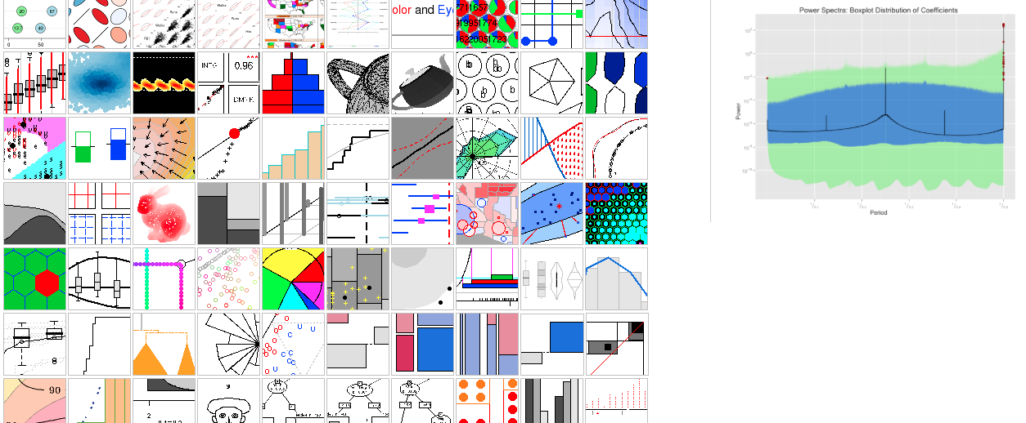
Plotting in R: Examples
Gallery and Sources
http://data-analytics.web.cern.ch

Slide 19

Use Case:
Samsung Galaxy S III
  Predict the users’ activity based on the accelerometer information.
http://data-analytics.web.cern.ch

Slide 20
Oracle R Enterprise: Introduction
Set packages, libraries and SQL extensions that:
  Improves the parallelism and scalability
  Allows in-database analytics using R
http://data-analytics.web.cern.ch

Slide 21
Oracle R Enterprise: Introduction
ORE packages
http://data-analytics.web.cern.ch

Slide 22
Oracle R Enterprise: Persistency
R vs ORE persistency
http://data-analytics.web.cern.ch

Slide 23
Oracle R Enterprise: Trans. Layer
The transparency layer allows
  Create, Delete and Join tables
  Column and Row selection
# Column selection
df_consumers <- ENS_CONSUMERS[,c("CONSUMER_ID”, "CONSUMER_NAME", "CONSUMER_DESCRIPTION")]
# Row Selection
df_lhc <- df[df$CONSUMER_NAME=="LHC",]
# Joining Tables
df_energy <- ENS_ENERGY_DAILY_DATA
df_join <- merge (df_consumers, df_energy, by.x="CONSUMER_ID", by.y="CONSUMER_ID")
http://data-analytics.web.cern.ch

Slide 24
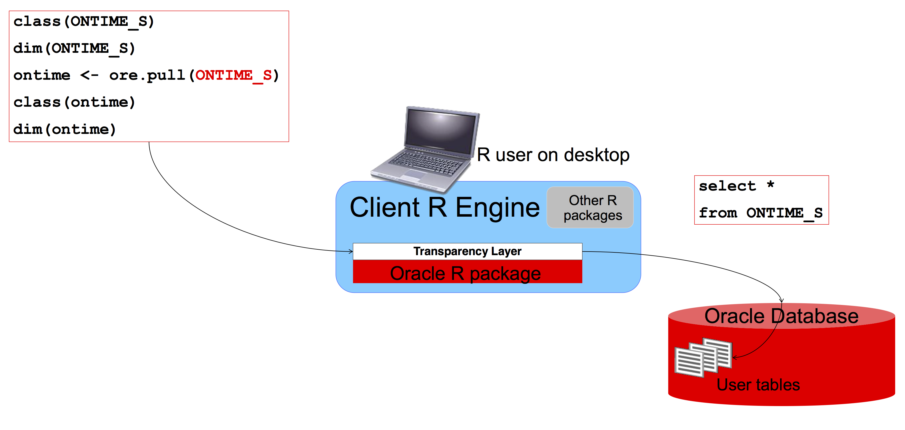
Oracle R Enterprise: Pulling Data
Pull data into R (transparency layer)
http://data-analytics.web.cern.ch

Slide 25
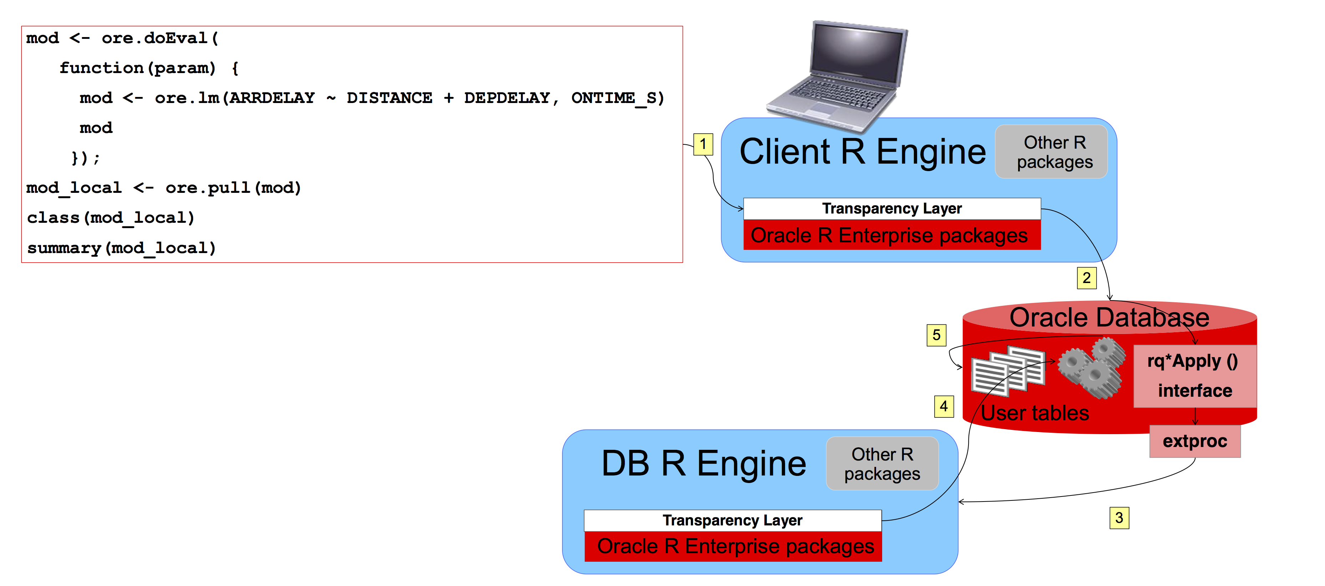
Oracle R Enterprise: In-database
Embedded R Scripts (R interface)
http://data-analytics.web.cern.ch

Slide 26
Oracle R Enterprise: In-database
Embedded R Scripts (SQL interface)
http://data-analytics.web.cern.ch

Slide 27
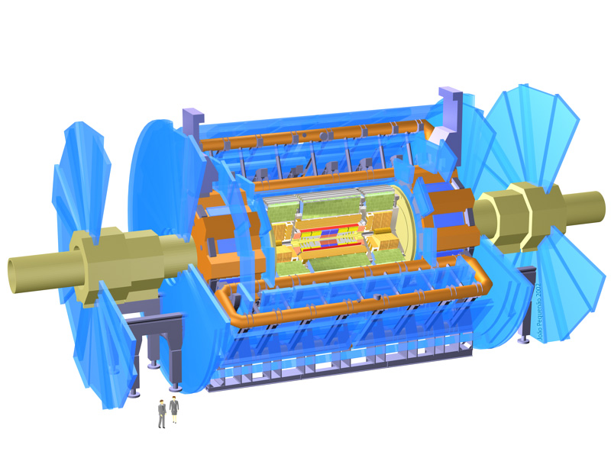
ORE Use Case
Forecasting power consumption for ATLAS’ Racks.
http://data-analytics.web.cern.ch

Slide 28

http://data-analytics.web.cern.ch

