Slide 1


Nuclear Reaction Mechanisms in Heavy Ion Collisions
Joint Institute for Nuclear Research, Dubna, Russia
Nasirov A.K.¹
Lecture III
¹Permanent position in Institute of Nuclear Physics, Tashkent, Uzbekistan

Slide 2
Content
Introduction
Main mechanisms of heavy ion of collisions at low energies.
Dinuclear system is a basic transition stage between entrance channel and formation of reaction products.
Is it possible to control competition between quasifission and complete fusion in heavy ion collisions.
Conclusions

Slide 3
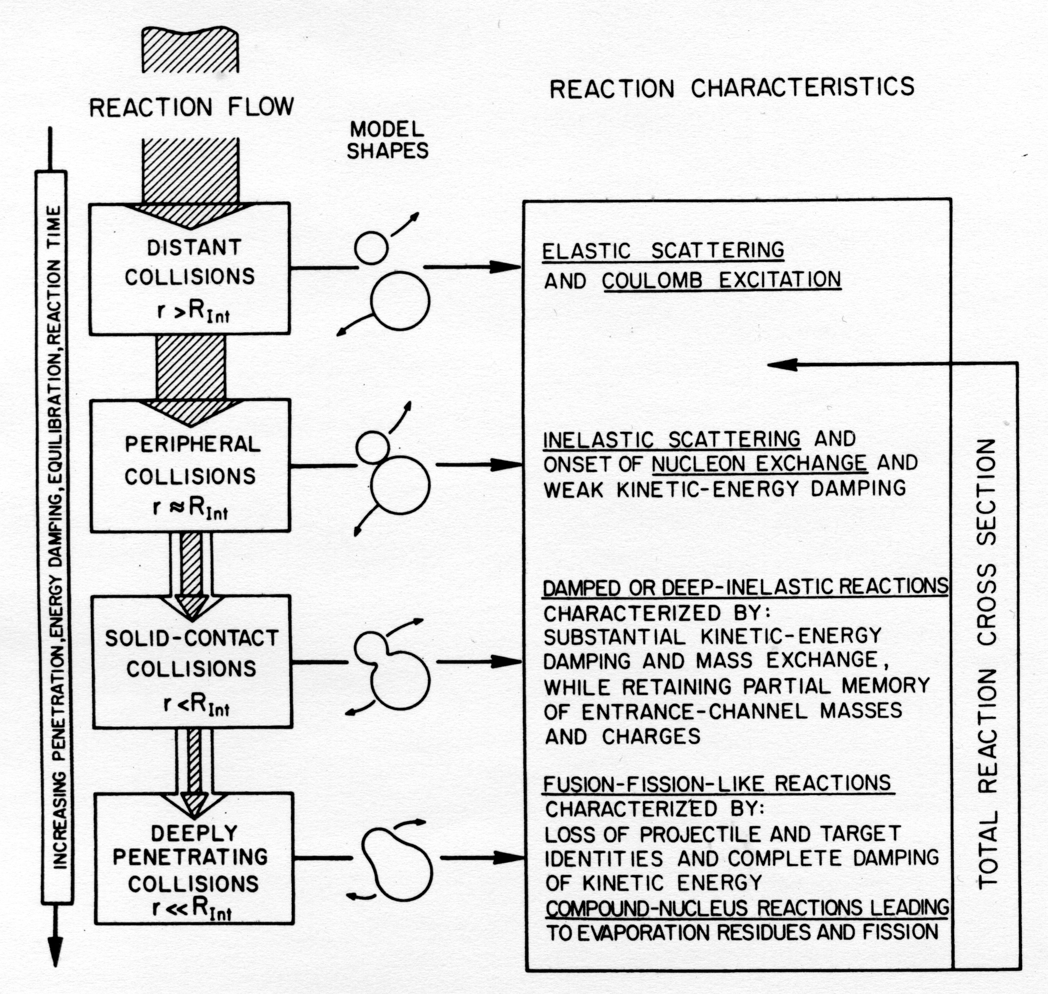
Evaporation
residues
Super heavy elements

Slide 5
?

Slide 7
Experimental study of the difference in the fusion mechanism in reactions leading to the same compound nucleus

Slide 8
Partial cross capture sections

Slide 10
Difference in formation of the evaporation residues in “hot” and “cold” fusion reactions.

Slide 12
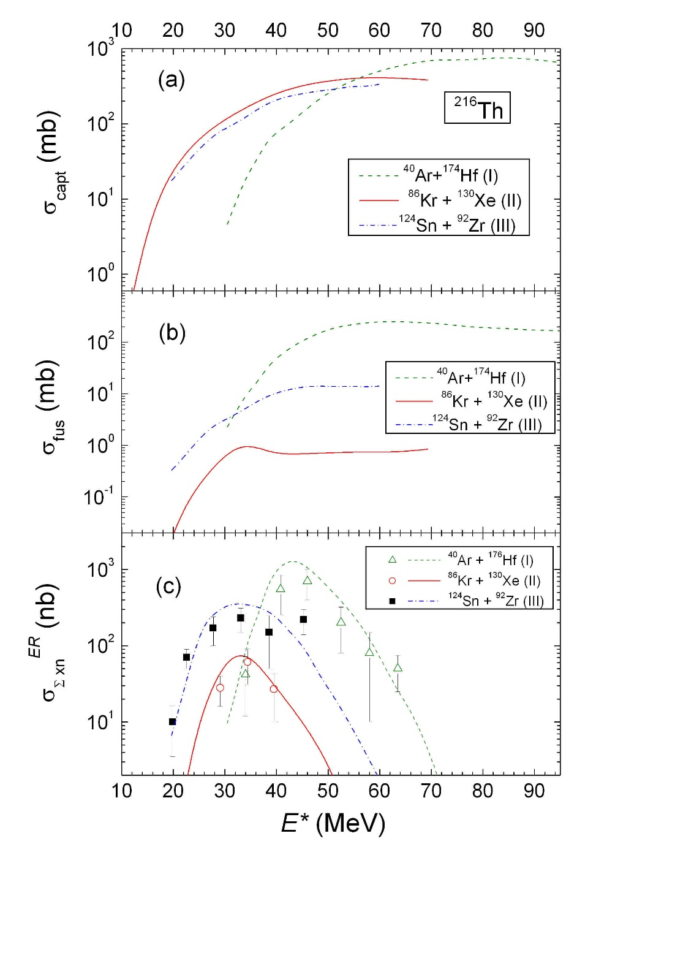
The role of the entrance channel and shell structure of reactants at formation of the evaporation residues in reactions leading to the same compound nucleus ²¹⁶Th: a) Capture b) Complete fusion c) Evaporation residues cross sections.

Slide 13
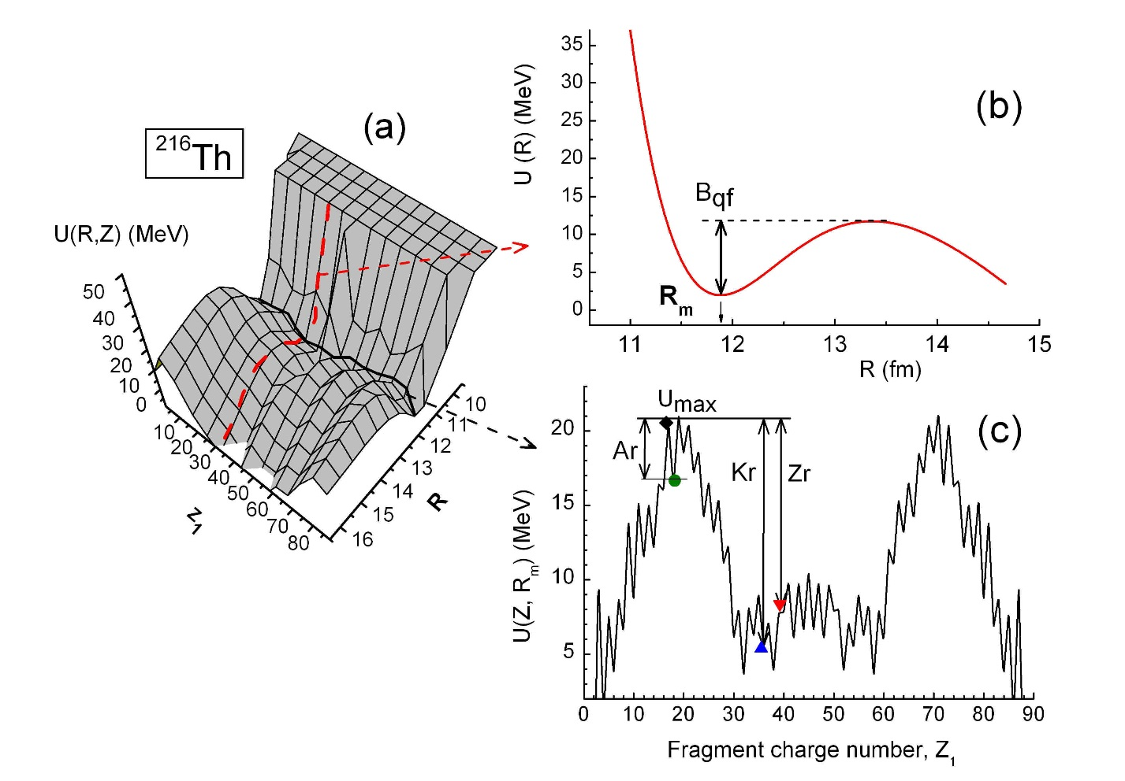
Driving potential U_{driving} ( c ) for reactions ⁴⁰Ar+¹⁷²Hf, ⁸⁶Kr+¹³⁰Xe, ¹²⁴Sn+⁹²Zr leading to formation of compound nucleus ²¹⁶Th :
Due to peculiarities of shell structure
B_{fus} (Kr) > Bfus (Kr)
and, consequently,
σ_{fus} (Kr+Xe) < σ_{fus}(Zr+Sn)
U_{driving}=B₁+B₂-B₍₁₊₂₎+V( R )

Slide 14
Angular momentum distribution for the complete fusion σ_{fus}^{(L)} (E_{lab}) as a function of momentum and and beam energy for reactions leading to formation of ²¹⁶Th.
G. Fazio, et al., Journal of the Physical Society of Japan 388, 2509 (2003).

Slide 15
Classification of the nuclear reactions in heavy ion collisions
Early studies of reaction mechanisms between heavy ions have shown that, in a Wilczynski diagram, a definite evolution towards negative scattering angles with increasing energy loss is present, so that the scattering angle was used as an estimate of the interaction time. As usual three regions can be distinguished:
the elastic or quasi-elastic component,
the partially damped region where the nuclear forces bend the trajectories toward smaller scattering angles and
the fully relaxed component, where negative angle scattering (or orbiting), fusion-fission and symmetric fragmentation may occur.

Slide 16
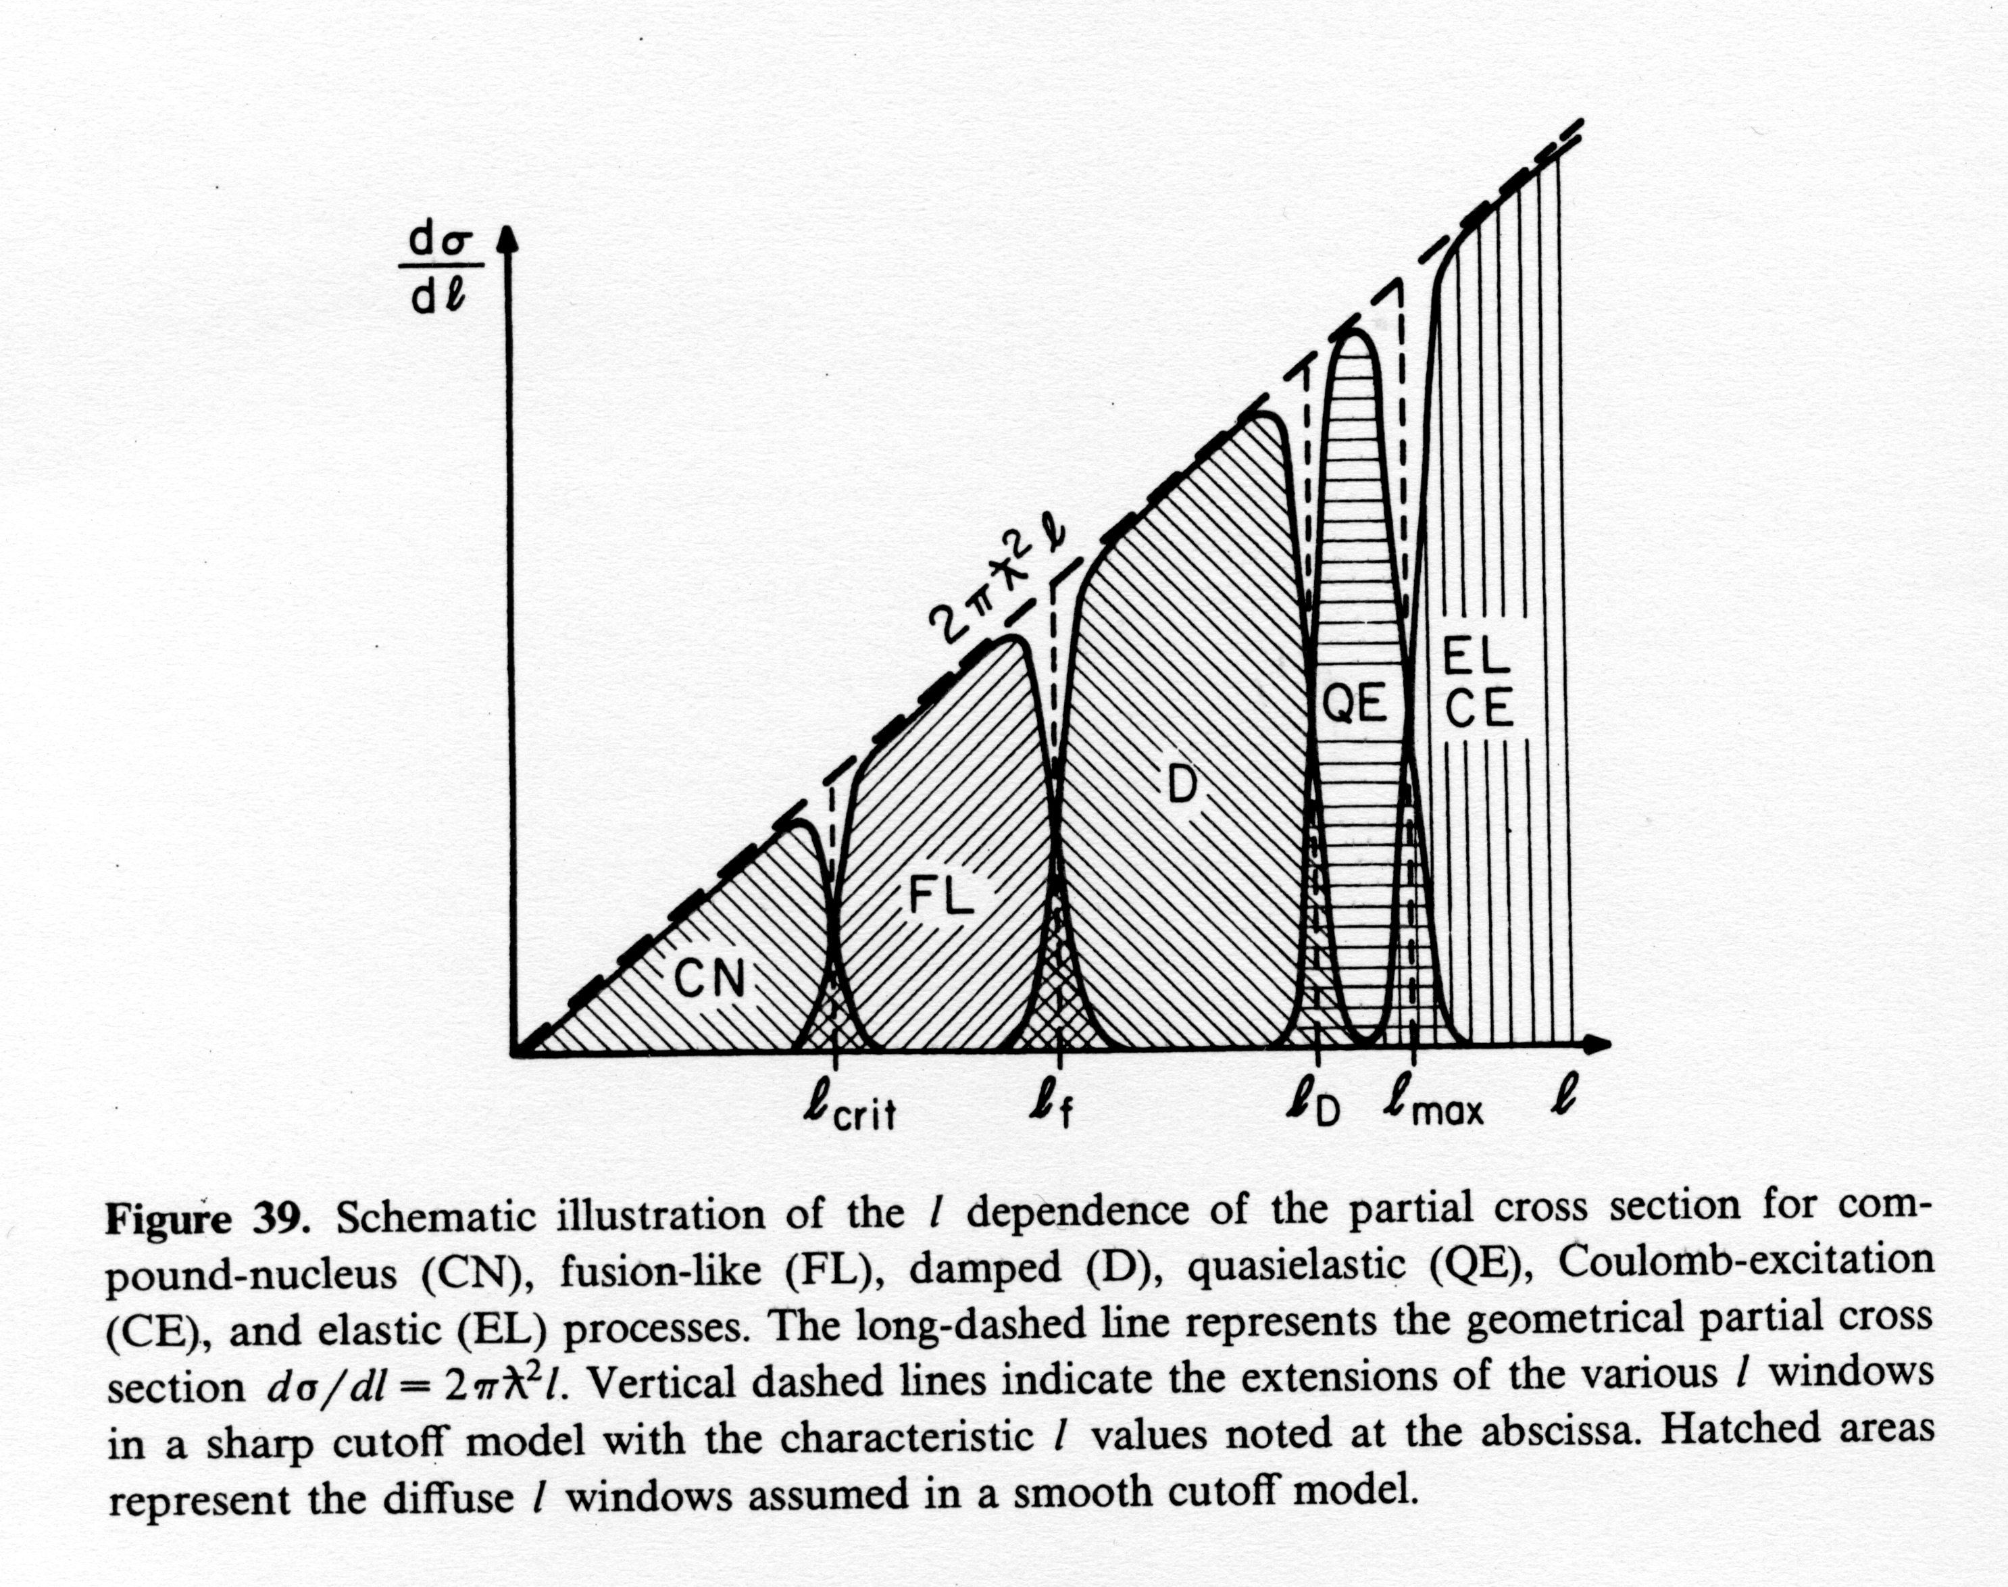
Partial cross sections of compound nucleus (CN), fusion-like (FL), damped (D), quasielastic (QE), Coulomb excitation (CE) and elastic (EL) processes.

Slide 17
Partial cross sections of compound nucleus (CN), fusion-like (FL), damped (D), quasielastic (QE), Coulomb excitation (CE) and elastic (EL) processes.

Slide 18
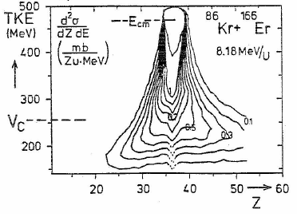
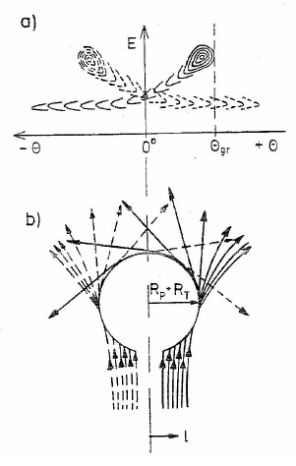
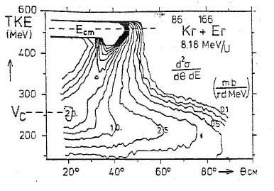
Deep inelastic collisions : macroscopic view
diffusion effects on nucleons
concept of dinuclear system
angular dependence of energy loss
Wilczynski

Slide 19
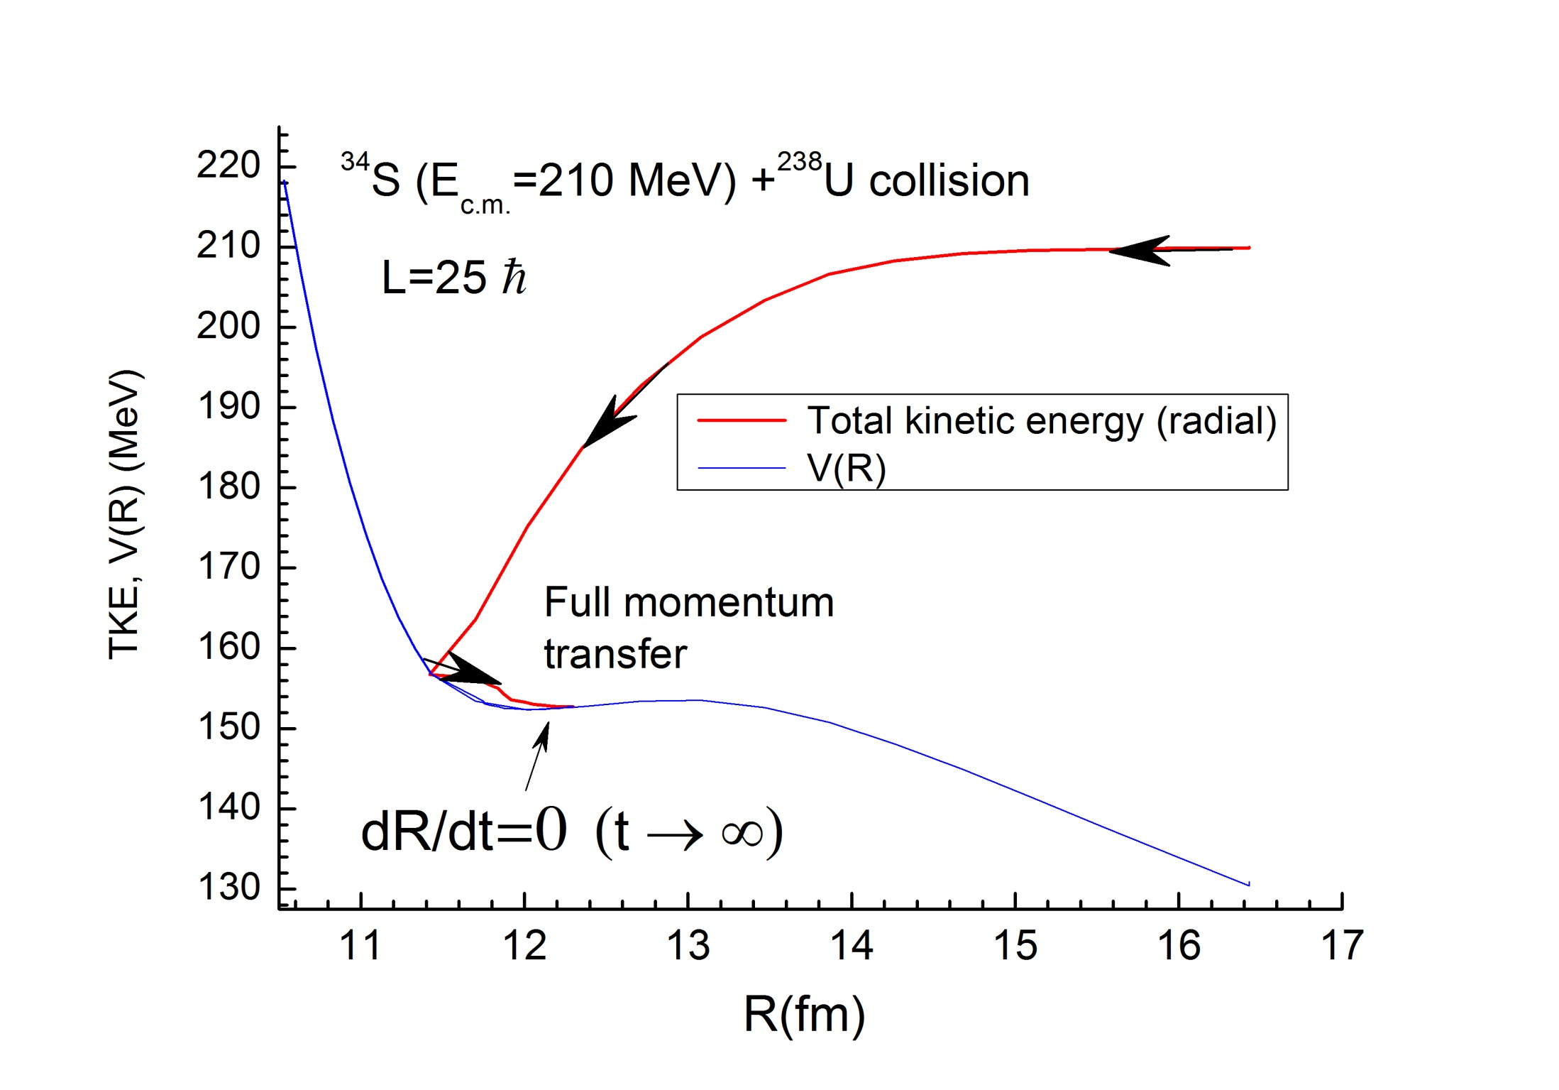
Capture event is full momentum transfer
in the radial motion of colliding nuclei

Slide 20
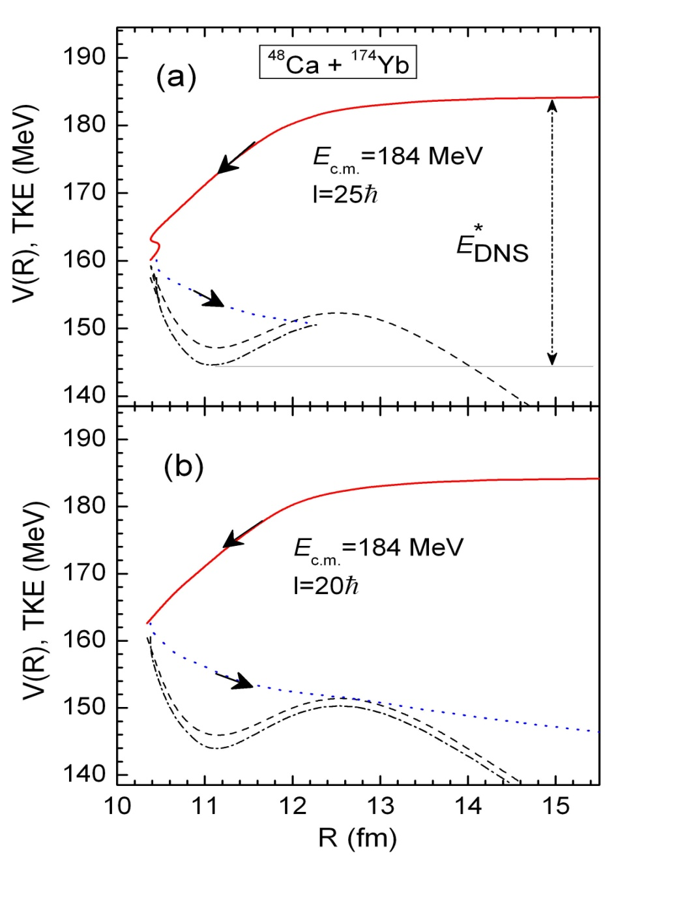
Difference between classical paths of the capture and deep inelastic collisions
ТКЕ-total kinetic energy
V( R ) – nucleus-nucleus
potential
E*_{DNS} – excitation energy of double nuclear system
Full momentum
transfer reactions
Capture=Fusion+Quasifission
+Fast fission
Fusion=Fission+Evaporation residues
Fission >> Evaporation residues

Slide 21
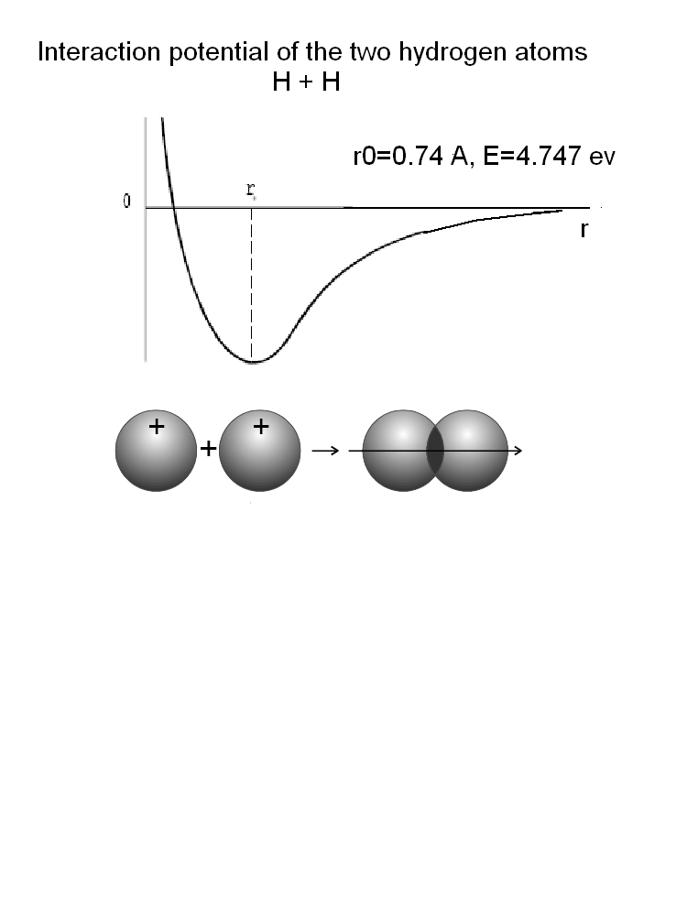
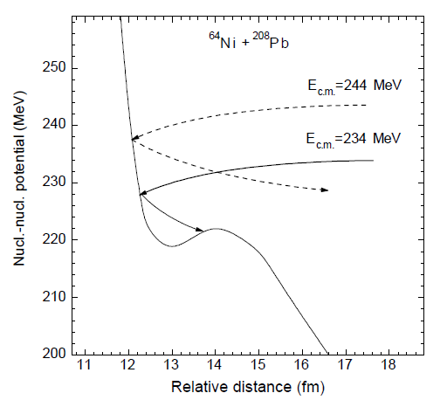
- In the nucleus-nucleus interaction between nuclei of dinuclear system, their neutrons play the same role as the “valent” electrons in atomic interaction similar H + H=>H₂ molecule .
- Beam energy and strength of the radial friction forces determines capture probability, when E_{c.m.} > V_{Coulomb} . About V(R) we dicuss later...

Slide 22
Equations of motion used to find capture of projectile by target

Slide 23
Nucleus-nucleus interaction potential

Slide 24
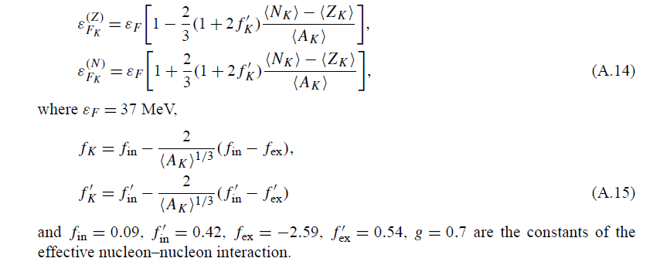
Constants of the effective nucleon-nucleon interaction (Migdal forces)

Slide 25
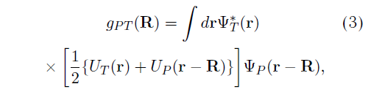
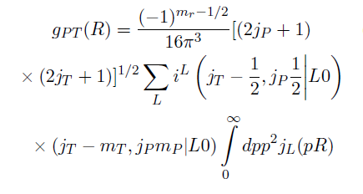

About matrix elements for nucleon exchange between nuclei of dinuclear system

Slide 26
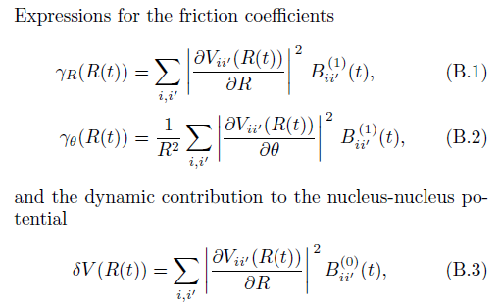
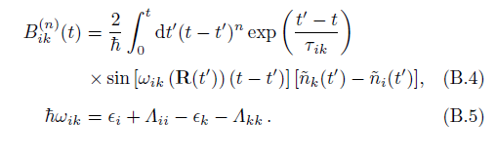

Slide 27
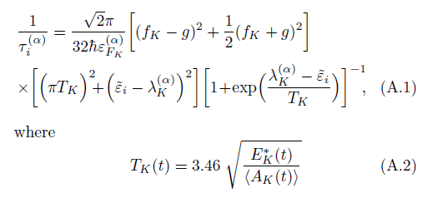
Relaxation time of the occupation numbers of single-particle states

Slide 28
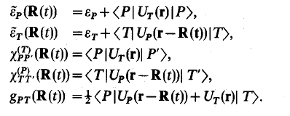
Change of single-particle energies and transition matrix elements of nucleons

Slide 29
Partial cross sections of compound nucleus (CN), fusion-like (FL), damped (D), quasielastic (QE), Coulomb excitation (CE) and elastic (EL) processes.

Slide 30
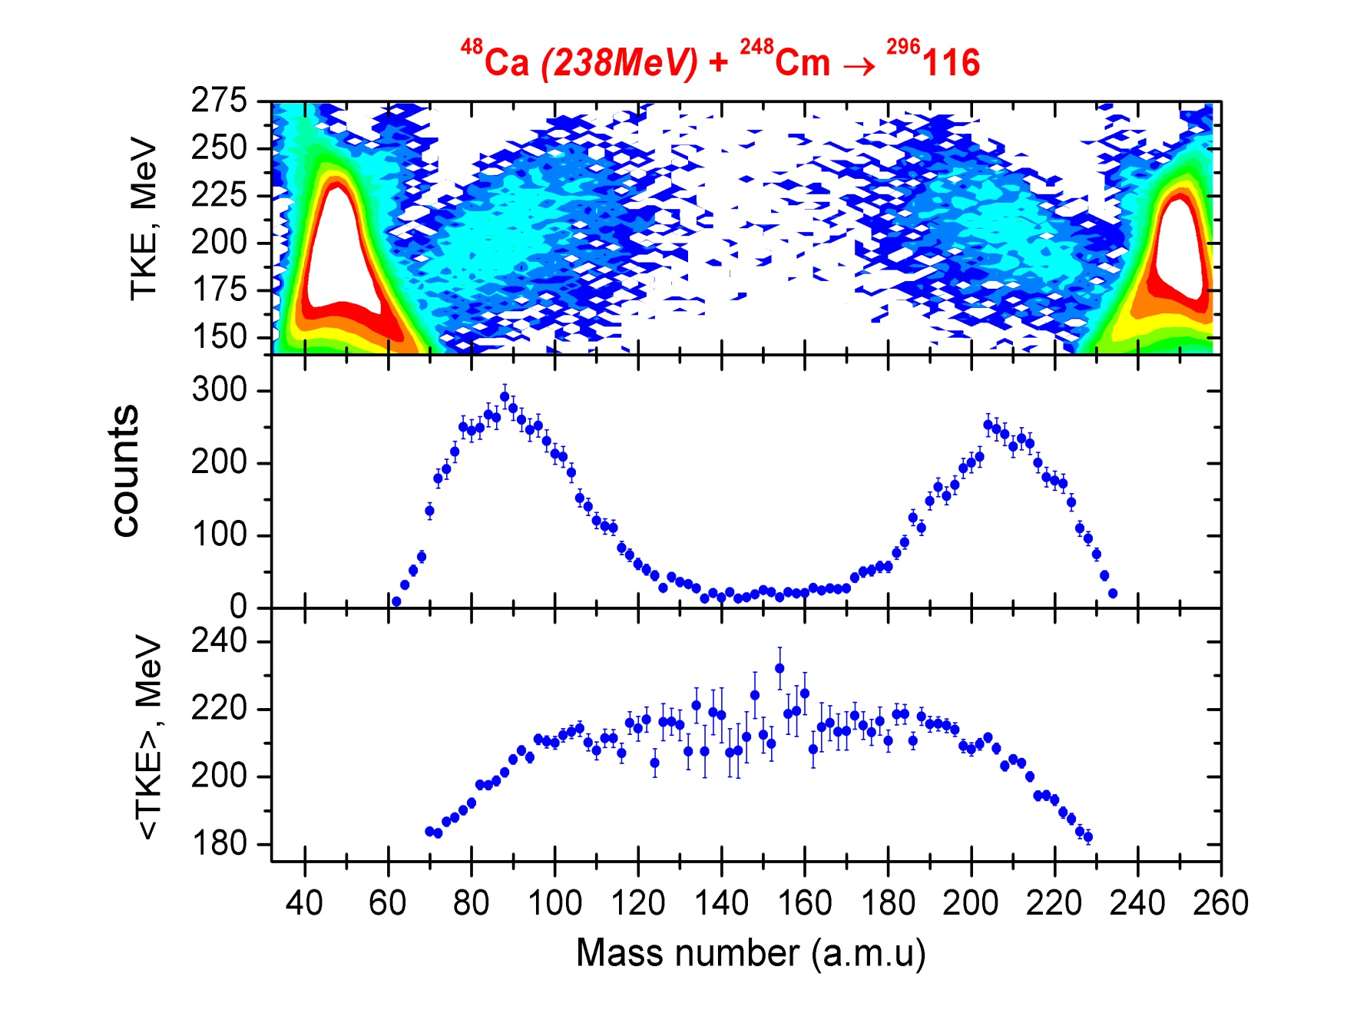
Mass-energetic distribution of the binary products in heavy ion collisions. The N=126 and Z=82 magic numbers responsible for the maximum of quasifission fragments

Slide 31
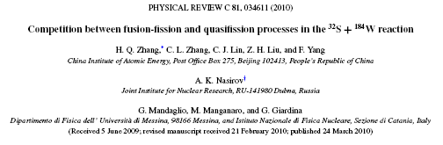
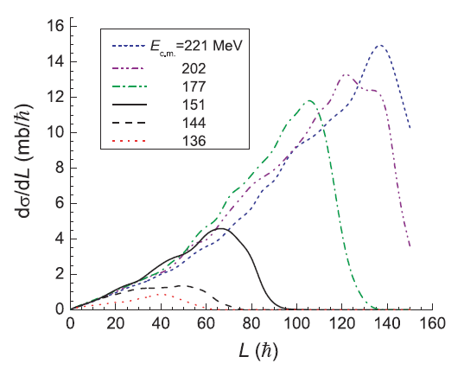
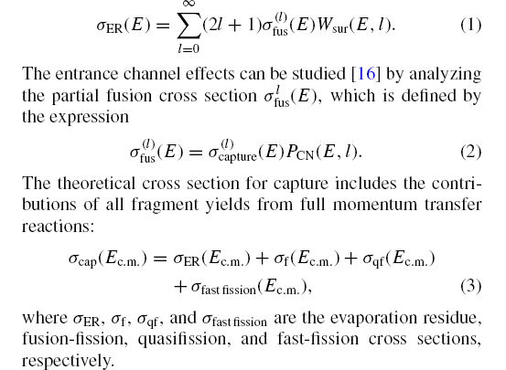
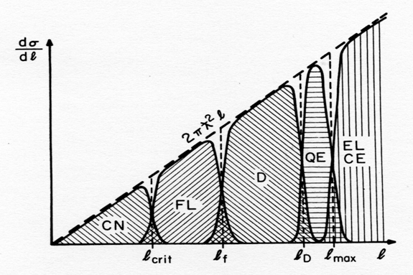

Slide 32
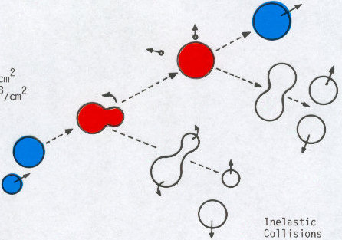
For heavy systems, capture inside of the Coulomb barrier, i.e. formation of a dinuclear system is not the sufficient condition for fusion:
Fast-fission
L>L_{Bf=0}
Neutron
Evaporation residue
3rd stage
Evolution of
Dinuclear system
Compound nucleus
2nd stage
Target
Fusion-Fission
1
1st stage
Γ_{f} /(Γ_{f}+Γ_{n})
Projectile
Quasifission
Capture=Quasifission + Fast-fission + Fusion-Fission + Evaporation residues

Slide 33
Fusion of light nuclei
Light nuclei are fused similar drops of liquid Because Coulomb
forces are not so strong relative to the nuclear forces and the
surface tension energy is much large than shell correction in
nuclei, Capture process is nearly equal to complete fusion: dinuclear system stahe is very short.

Slide 39
Hindrance to complete fusion in the symmetric reactions.

Slide 42
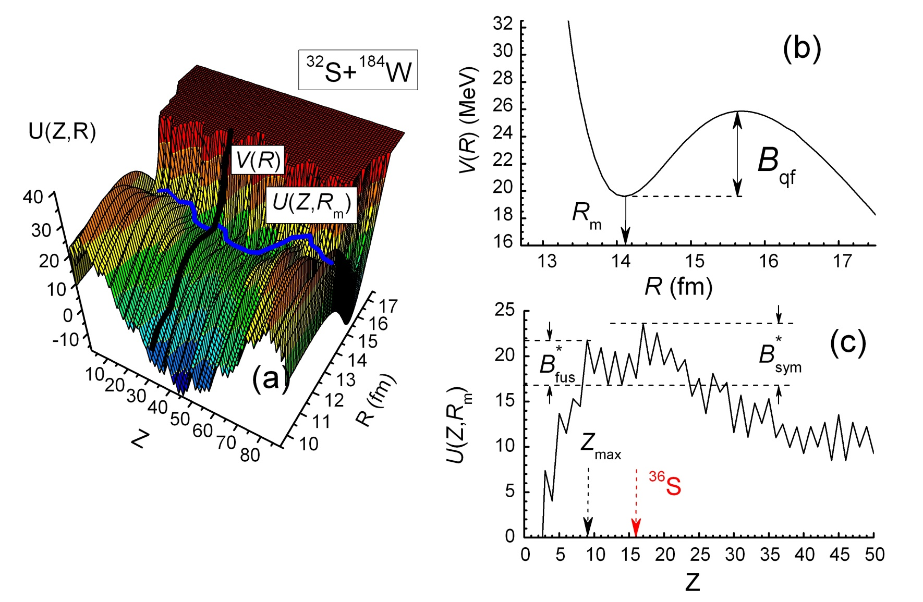
Q_{gg} – balance of reaction energy
B – binding energy
A. Nasirov et. al. Nucl. Phys. A 759 (2005) 342–369

Slide 43
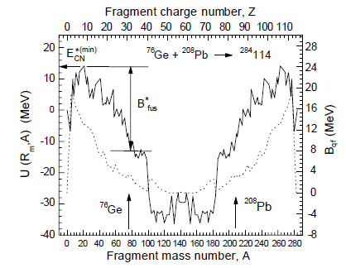
Potential energy surface of dinuclear system
a- entrance channel;
b-fusion channel;
c and d are quasifission
channels
G. Giardina, S. Hofmann, A.I. Muminov, and A.K. Nasirov,
Eur. Phys. J. A 8, 205–216 (2000)
U_{dr} (A, Z, , ß₁ , ß₂ ) = B₁ + B₂ + V (A, Z, ß₁ ; ß₂ ; R) - B_{C N} - V_{C N} (L )

Slide 44

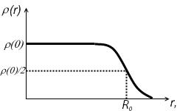
Nucleus-nucleus interaction potential
V_{nuc} – nuclear part
V_{coul} – coulomb part
V_{rot} – rotational energy
R – distance between centers of two nuclei
Z – charge number, A – mass number
β – deformation parameter
l – angular momentum of nucleus
As nucleus-nucleus potential used
double folding potential
As ρ used the Fermi distribution:

Slide 45
- effective nucleon-nucleon potential
- nuclear radius,
- constants of effective nucleon-nucleon potential
- interaction coefficient
density in center of nucleus
diffuseness parameter

Slide 46
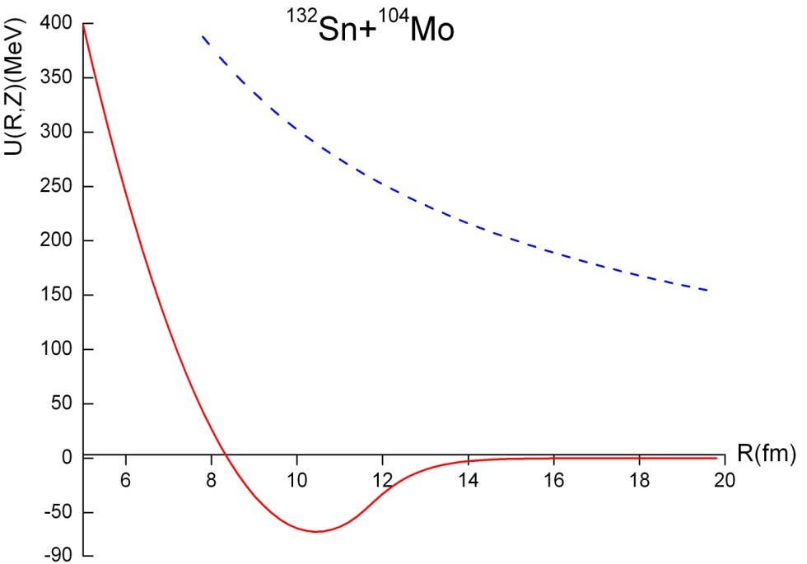
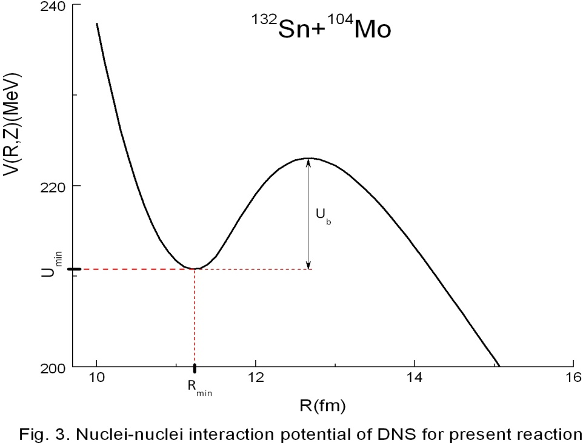
Coulomb potential is of this form:
Thereby, we obtain following pictures for nucleus-nucleus potential:

Slide 47
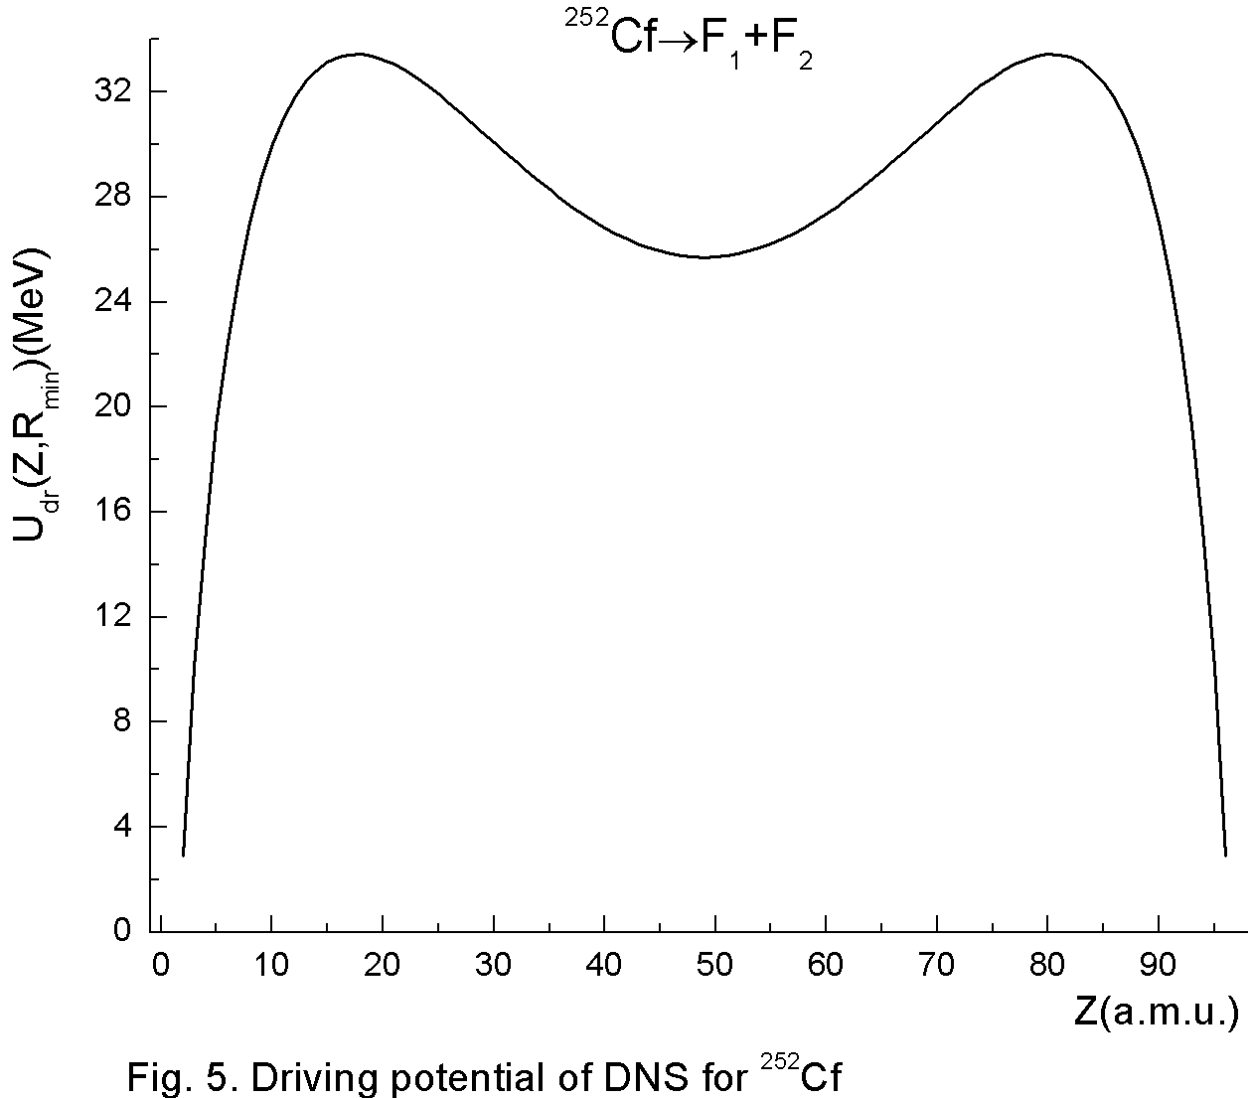
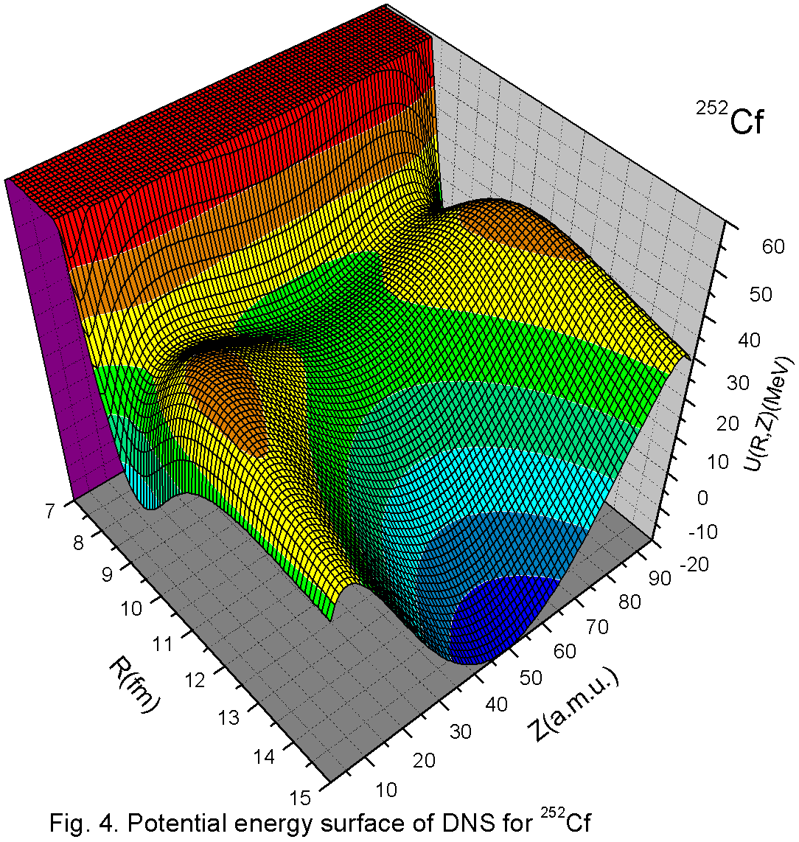
Results of calculation
Driving potential for ²⁵²Cf(sf)
within liquid drop model
Potential energy surface for ²⁵²Cf(sf) within liquid drop model

Slide 48
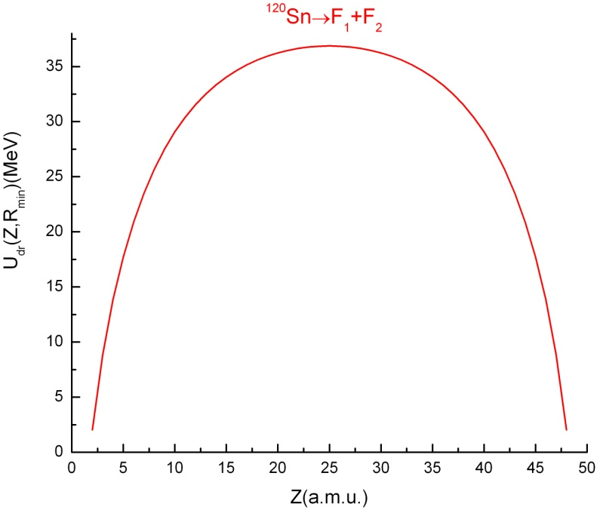
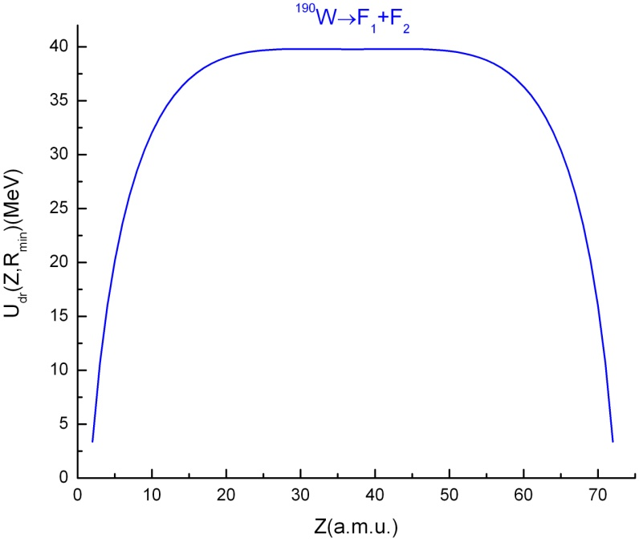
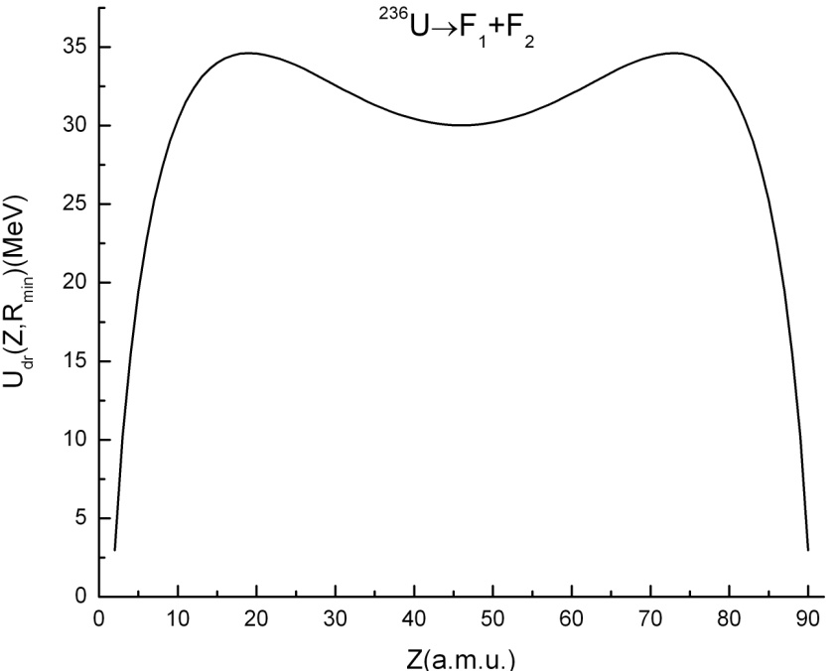
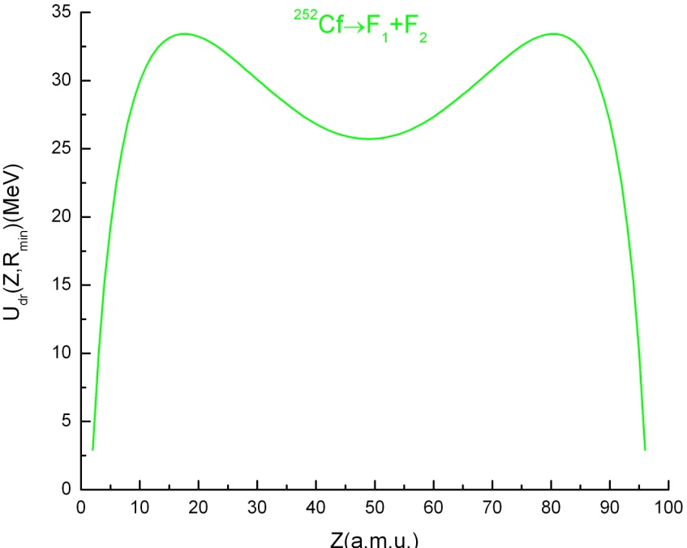
Driving potential within the liquid drop model
for ¹²⁰Sn, ¹⁹⁰W, ²³⁶U and ²⁵²Cf

Slide 49
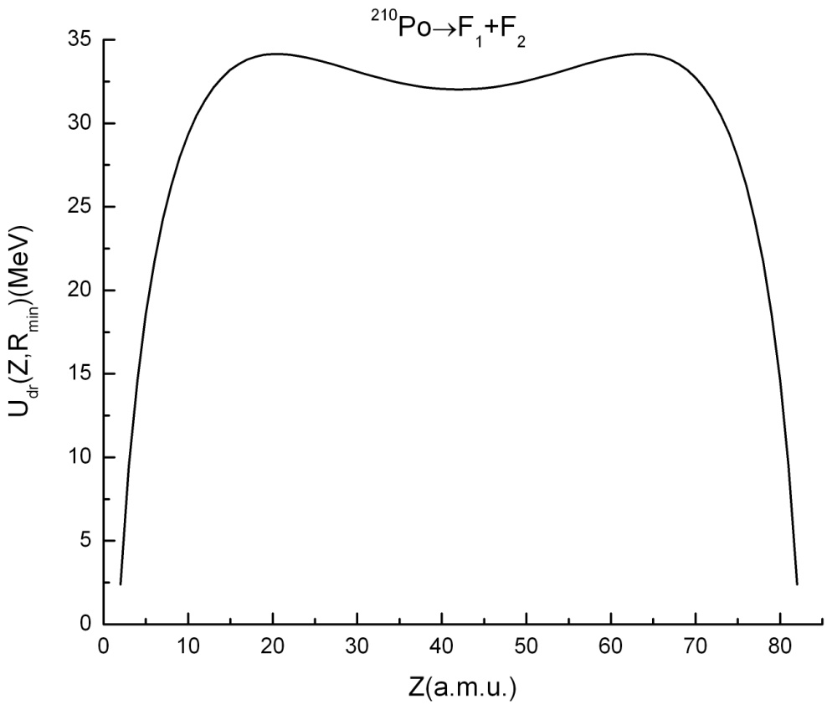
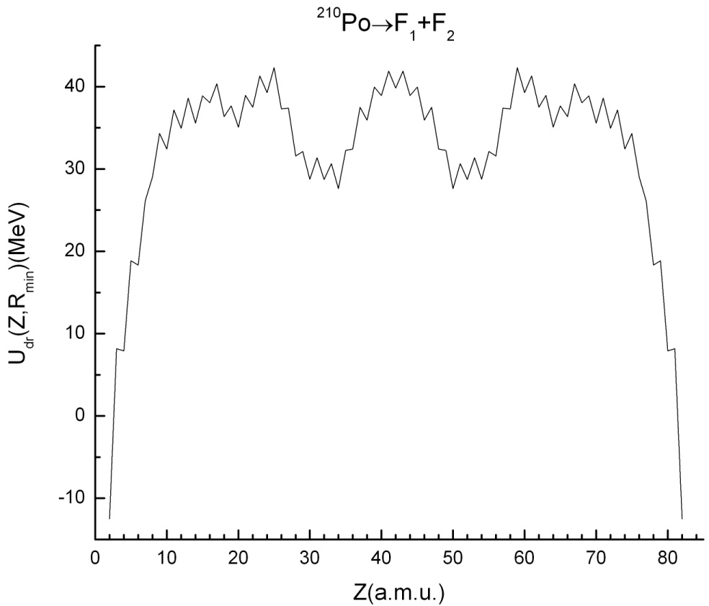
Role of the shell effects in fission
Driving potential for ²¹⁰Po
within liquid drop model
Driving potential for ²¹⁰Po
with shell effects
symmetrical fission
channel is energetically preferable
asymmetrical fission
channel is energetically preferable
In experiment [9] observed symmetrical fission of ²¹⁰Po in ²⁰⁹Bi(p,f) reaction at proton’s energy 36 MeV
[9] Itkis M. G. et. al., PEPAN v. 19, № 4, p. 701 (1988)

Slide 50
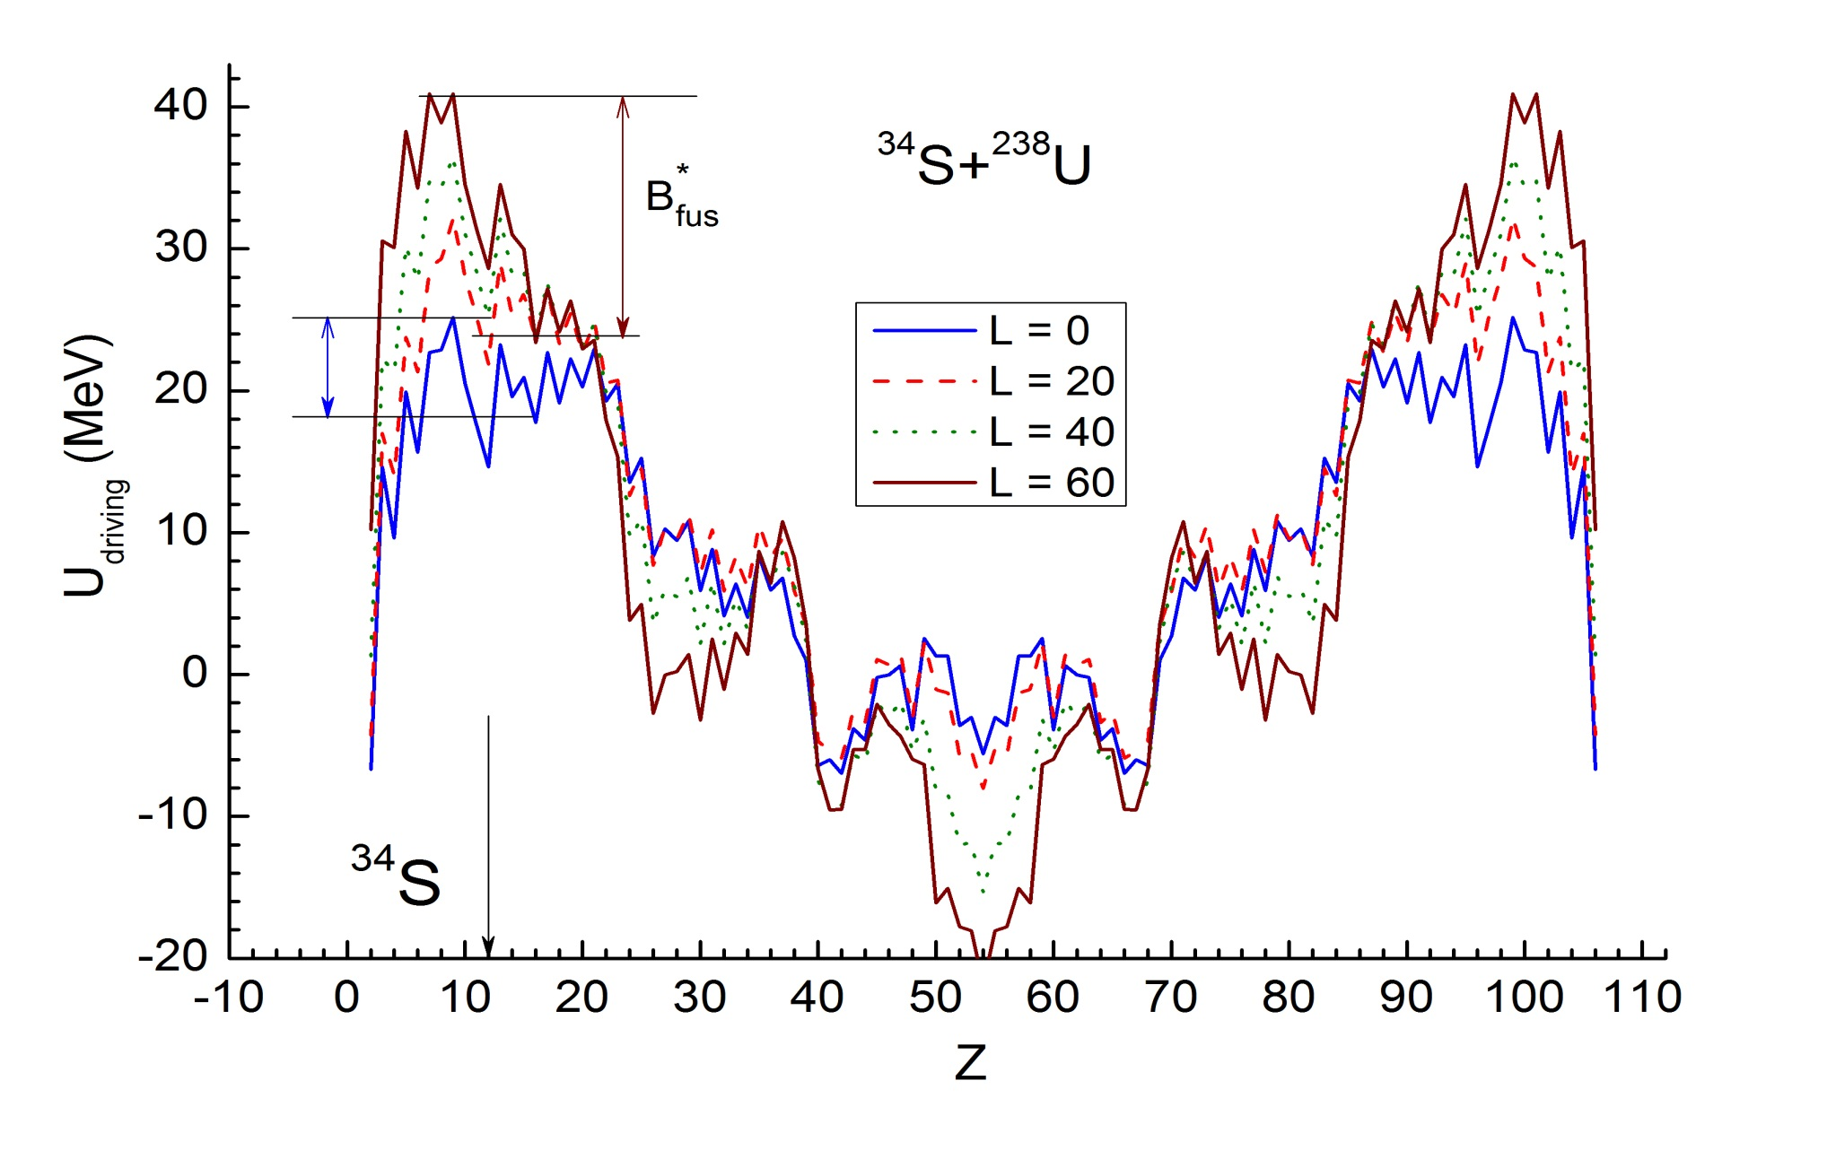
Dependence of the driving potential for the dinuclear system formed in ³⁴S+²³⁸U reaction on the orbital angular momentum L=[b x p]. b-impact parameter, p is momentum

Slide 51
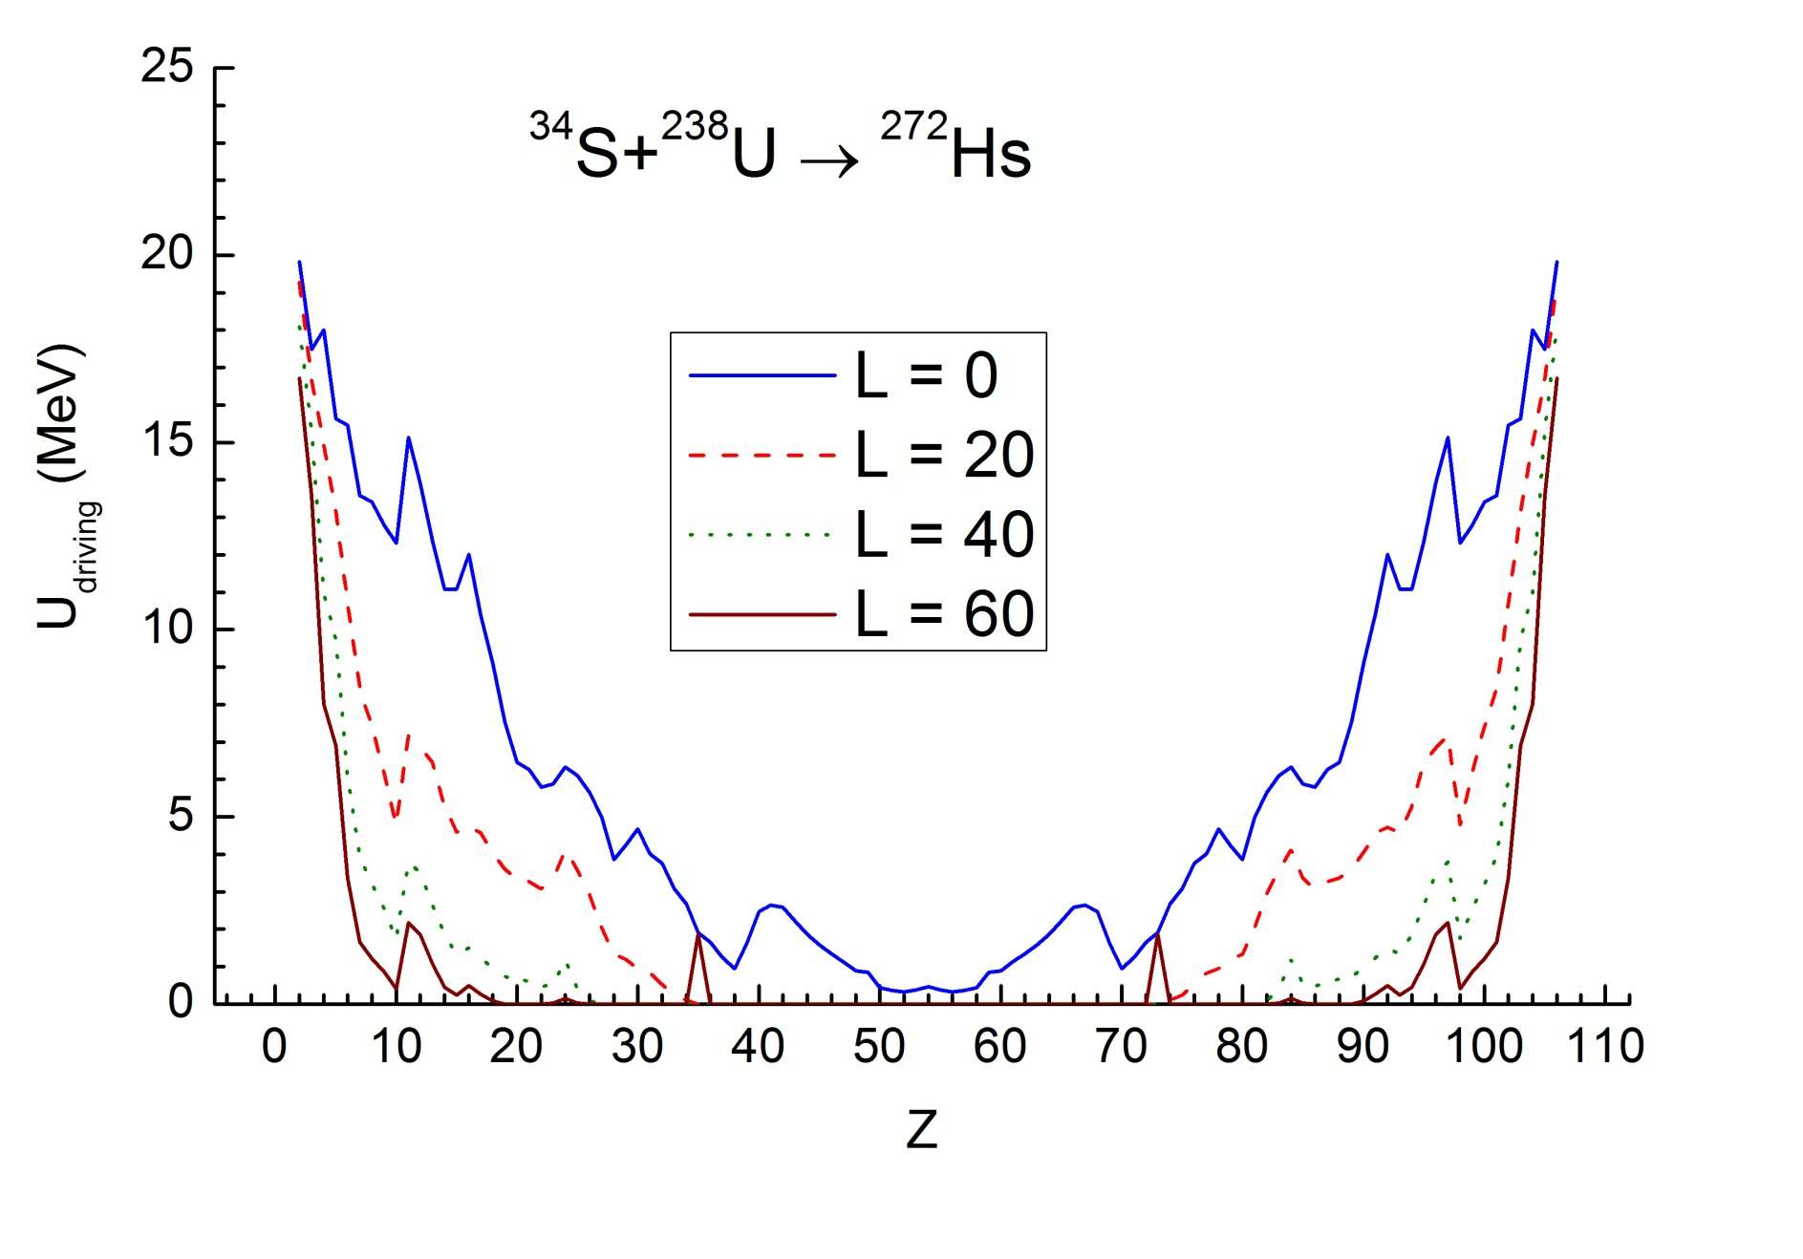
Dependence of the quasifission barrier for the dinuclear system formed in ³⁴S+²³⁸U reaction on the orbital angular momentum L=[b x p]. b-impact parameter, p is momentum

Slide 52
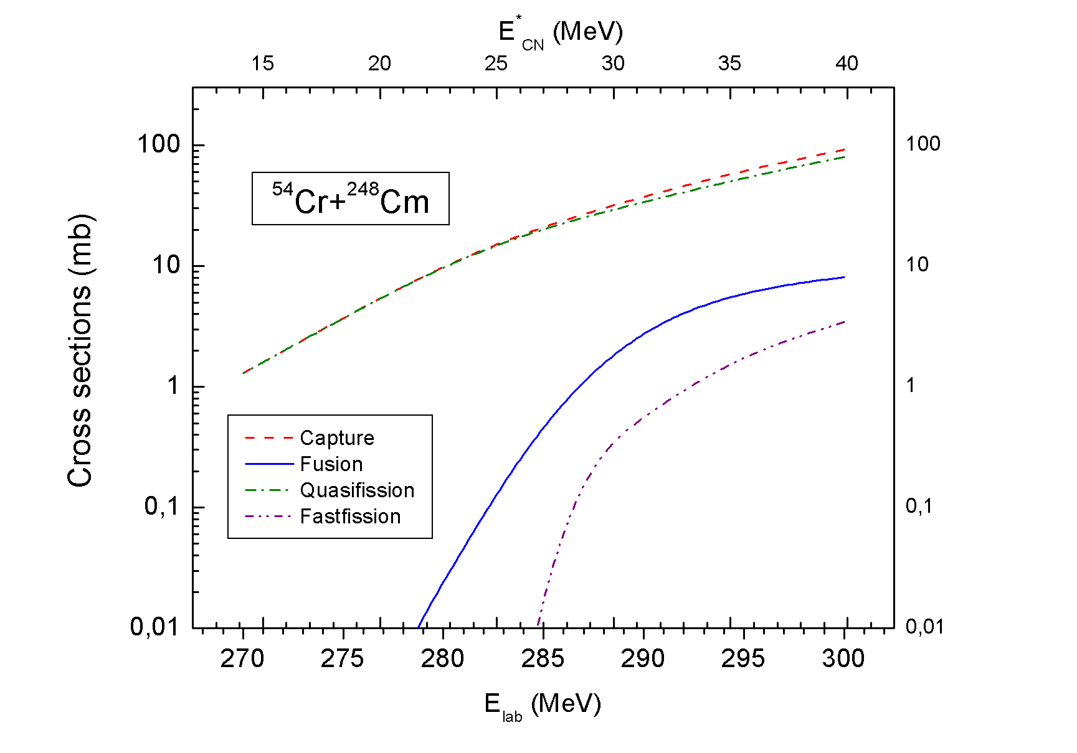
Capture, quasifission, complete fusion and fast fission cross sections

Slide 53
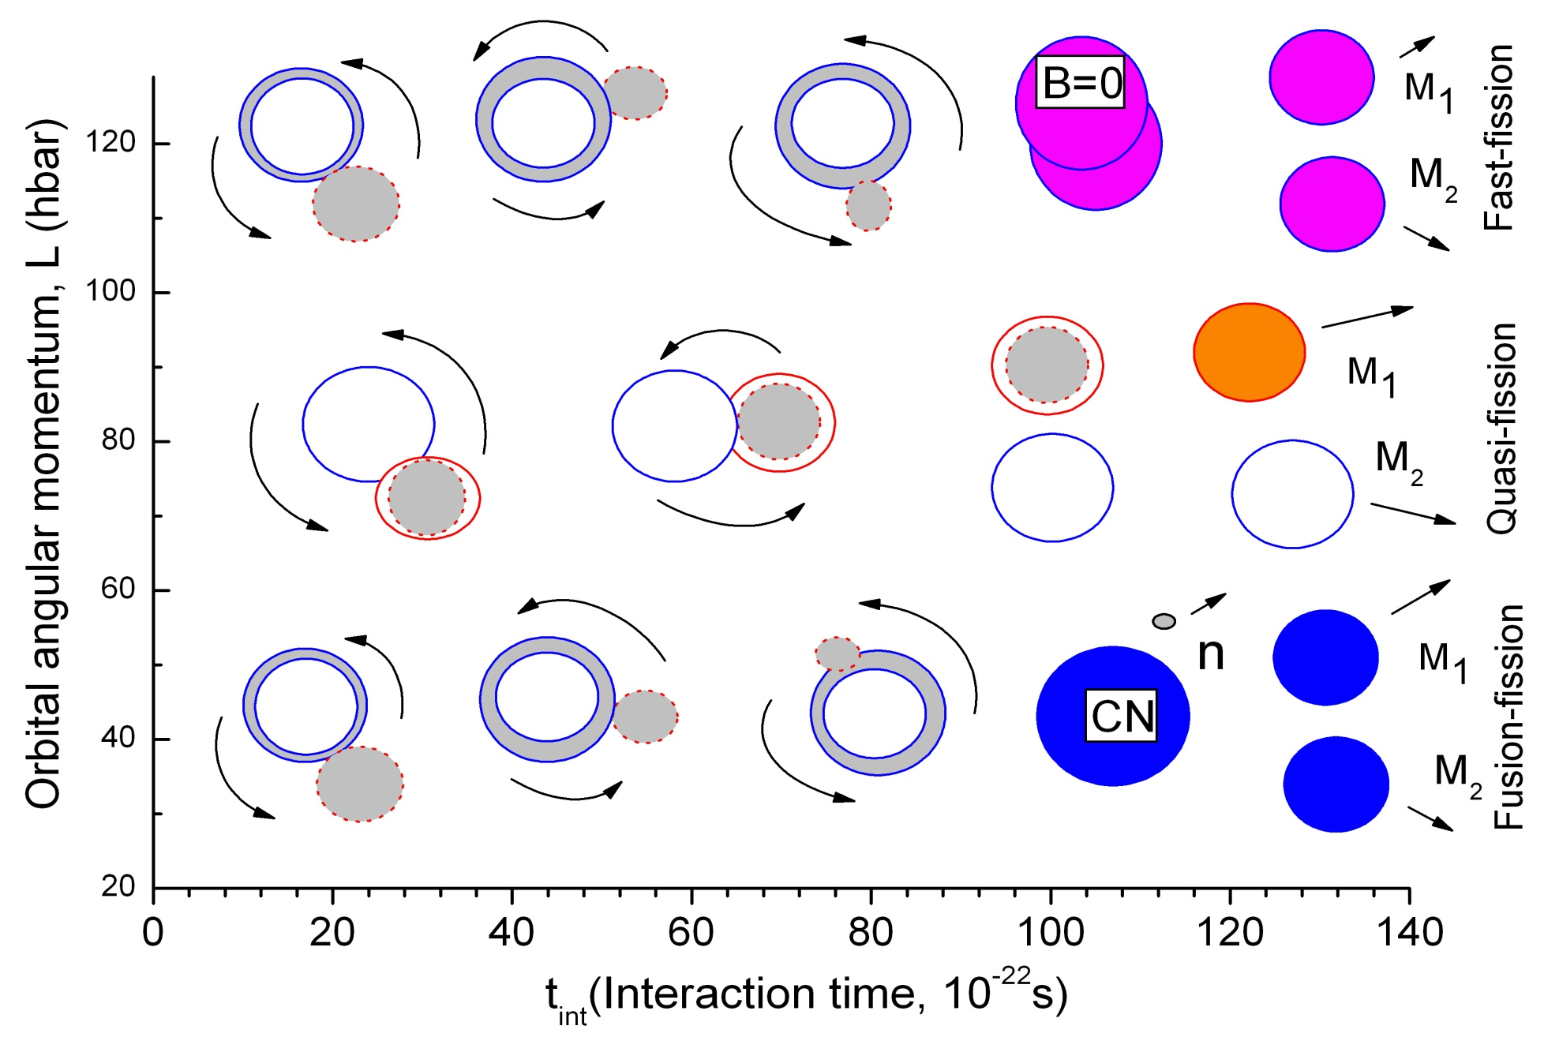
Reaction mechanisms following after capture: fast-fission, quasi-fission and fusion-fission.

Slide 54
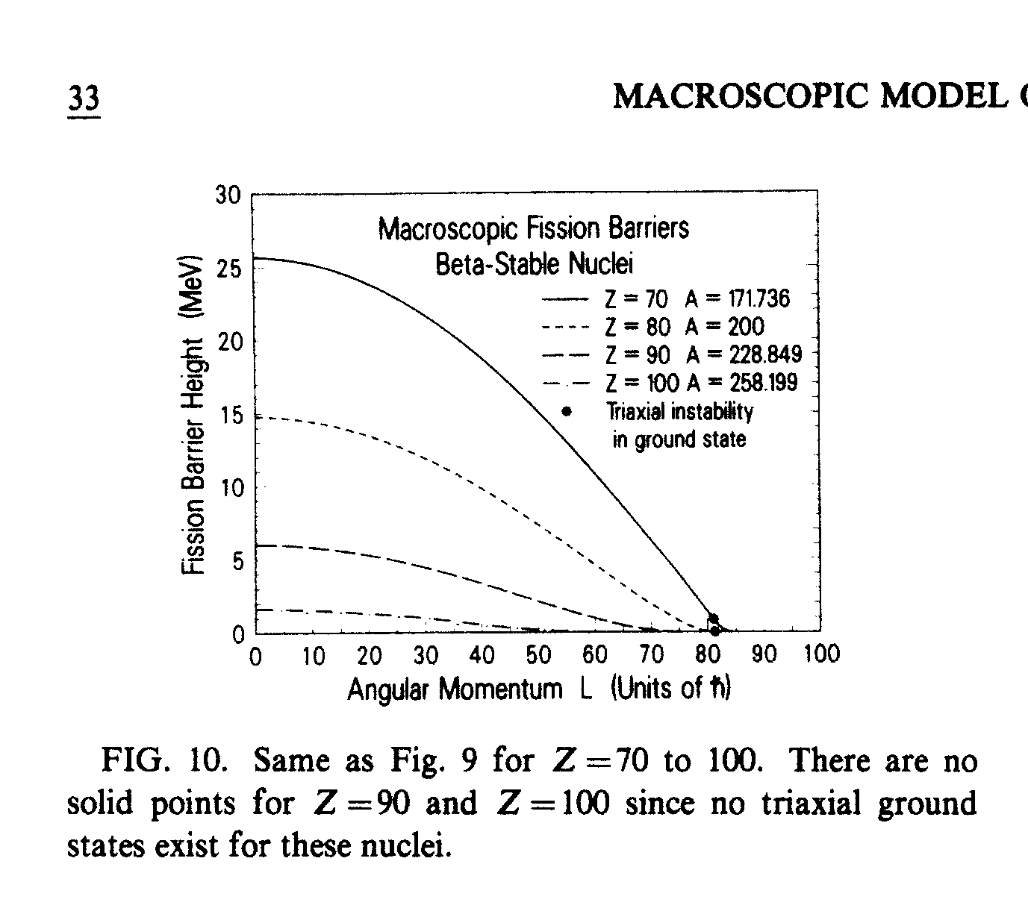
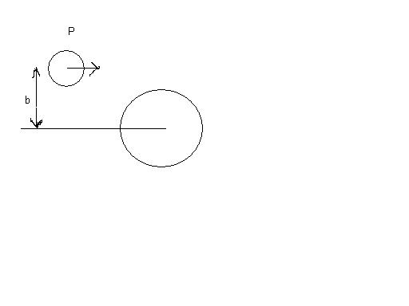
Fast-fission of the mononucleus
L_{fus} > L > L_{fis.bar}
A.J. Sierk, Phys.Rev. C, 33 (1986) 2039

Slide 55
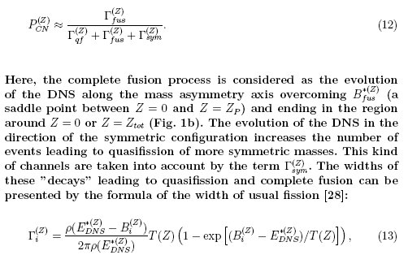
Calculation of Pcn

Slide 56
Calculation of fusion hindrance which is related to competition with quasifission.

Slide 57
About description of the events of the synthesis of superheavy elements
The measured evaporation cross section can be described by the formula:
where
is considered as the cross section of compound nucleus formation; W_{surv} is the survival probability of the heated and rotating nucleus. The smallness of P_{CN} means hindrance to fusion caused by huge contribution of quasifission process:

Slide 58
Calculation of the competition between complete fusion and quasifission: P_{cn}(E_{DNS},L)
Fazio G. et al, Modern Phys. Lett. A 20 (2005) p.391

Slide 59
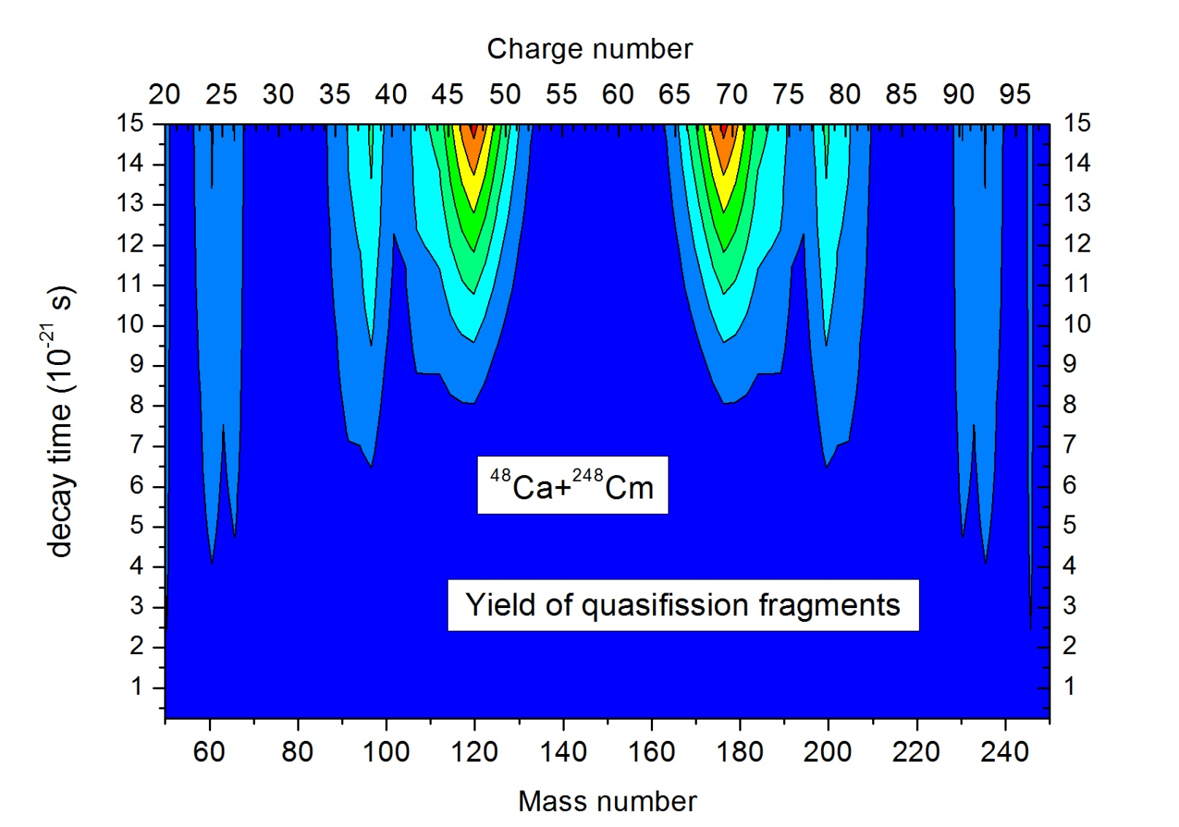
Calculation of the yield of quasifission fragments

Slide 60
Nucleon transfer coefficients for evolution of the charge asymmetry of dinuclear system
G.G. Adamian, et al. Phys. Rev. C53, (1996) p.871-879
R.V. Jolos et al., Eur. Phys. J. A 8, 115–124 (2000)

Slide 61
What is questionable in fusion reactions ?
Dynamics of complete fusion and role of the entrance channel in formation of heavy ion collision reactions are questionable or they have different interpretation still now.
For example,
-- what mechanism is fusion makes the main contribution to formation of compound nucleus: increasing the neck between interacting nucleus or multinucleon transfer at relatively restricted neck size?
-- details of angular momentum distribution of dinuclear system and compound nucleus which determines the angular distribution of reaction products, cross sections of evaporation residue, fusion-fission and quasifission products;
-- separation of fusion-fission fragments from the quasifission and fast-fission products;
-- distribution of the excitation energy between different degrees of freedom, as well as between reaction products. There are exp.results
showing evaporation residues at E*>100 MeV.

Slide 62
3. Yield of quasifission products as a function of shell structure

Slide 63
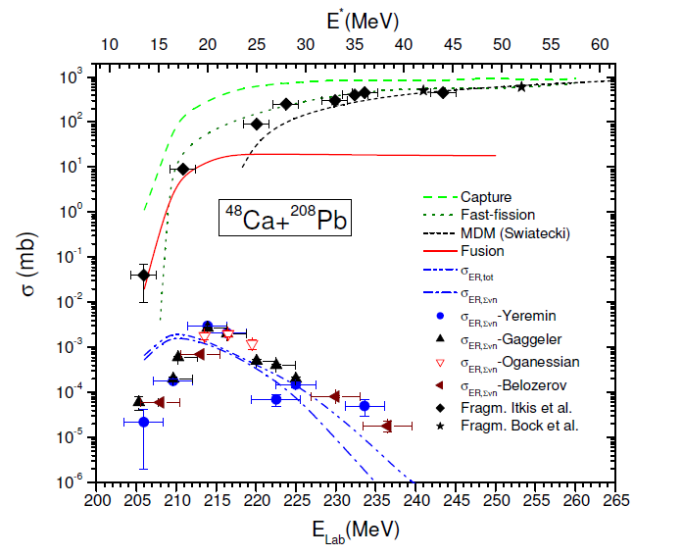
Comparison of the theoretical and experimental results obtained for the ⁴⁸Ca+²⁰⁸Pb reaction. Theoretical values of capture, fast fission, and fusion excitation functions are presented by dashed, dotted, and solid lines, respectively. Capture cross-section calculated by Swiatecki's dynamical model is shown by short-dashed line.
G. Fazio et al., (DNS model)
Modern Physics Letters A
Vol. 20, No. 6 (2005) p.391
M. G. Itkis et al., in Proc. of
the Symposium on Nuclear
Cluster, 2002, Rauischolzhausen
Germany, eds. R. V. Jolos and
W. Scheid (EP Systema, 2003),
p. 315;
Acta Phys. Hung. A19, 9 (2004).
(Experiment)

Slide 64
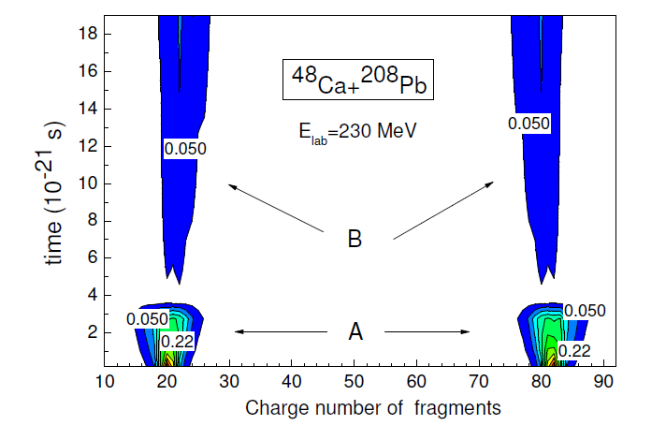
Yield of quafission products is hidden by products of the deep-inelastic collision in case of collision of two double magic nuclei, ⁴⁸Ca and ²⁰⁸Pb.
G. Fazio et al., (DNS model) Modern Physics Letters A Vol. 20, No. 6 (2005) p.391
M. G. Itkis et al., in Proc. of the Symposium on Nuclear Cluster, 2002, Rauischolzhausen, Germany, eds. R. V. Jolos and W. Scheid (EP Systema, 2003), p. 315;
Acta Phys. Hung. A19, 9 (2004). (Experiment)

Slide 66
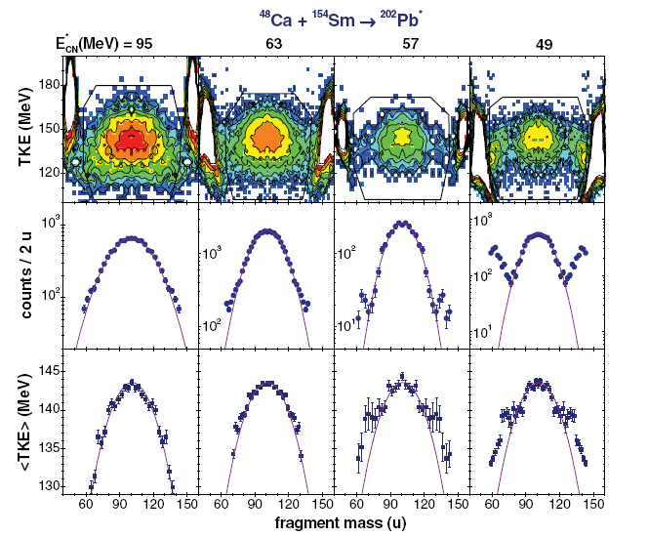
Knyazheva G.N. et al. Phys. Rev. C 75, 064602(2007).

Slide 67
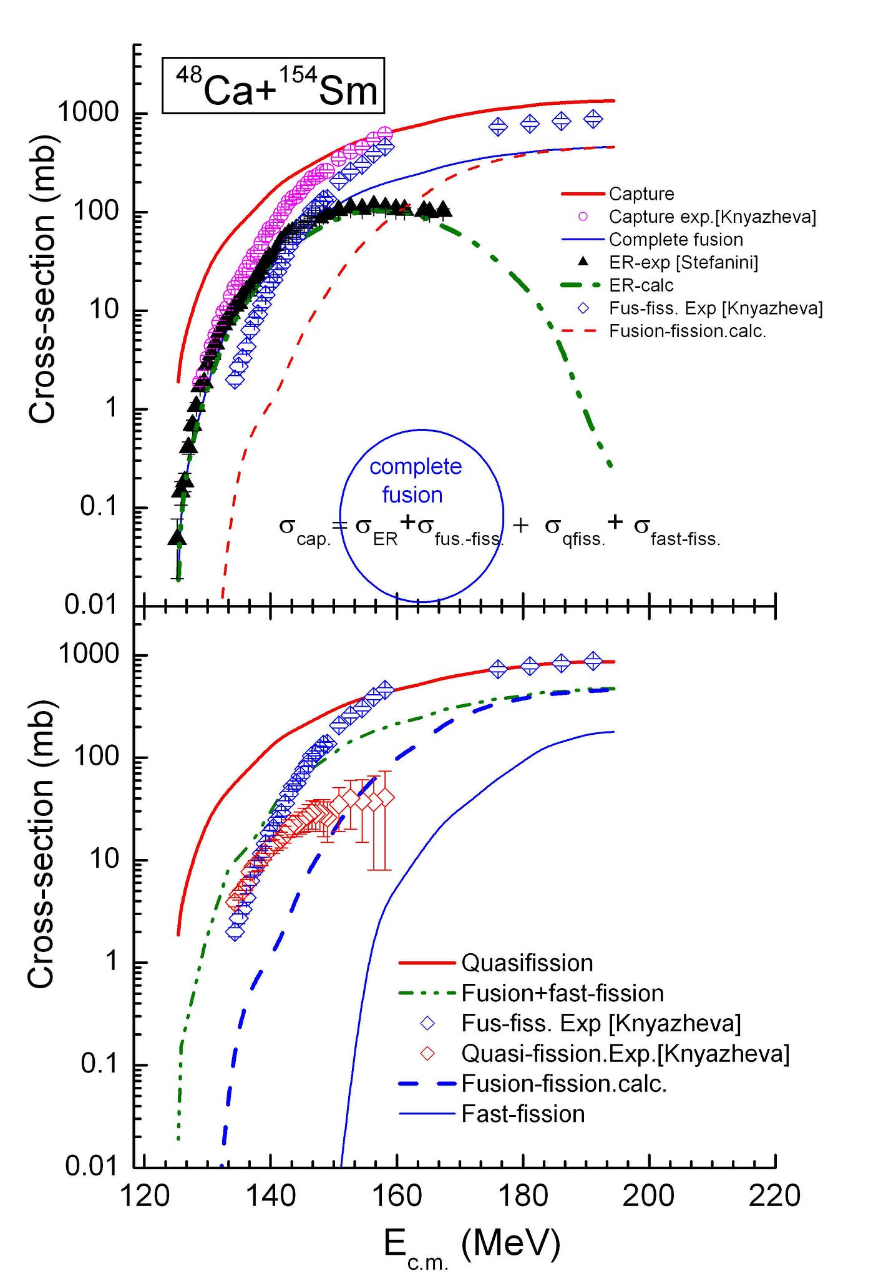
Comparison of the capture, fusion-fission and quasifission cross sections obtained in this work with data from experiments
Knyazheva G.N. et al. Phys. Rev. C
2007. Vol. 75. –P. 064602(13).
and evaporation residues
Stefanini A.M. et al.
Eur. Phys. J. A –2005. Vol. 23. –P.473

Slide 68
Experimental estimation of the capture and fusion-fission cross sections

Slide 69
Angular distribution of the mass symmetric reaction products (experimental)
Setup CORSET to measure mass, energy and angular distributions of the mass symmetric reaction products

Slide 71
Overlap of yields of binary fragments coming from of fusion fission and quasifission channels of reaction
Knyazheva G.N. et al. Phys. Rev. C 75, (2007).064602(13).

Slide 72
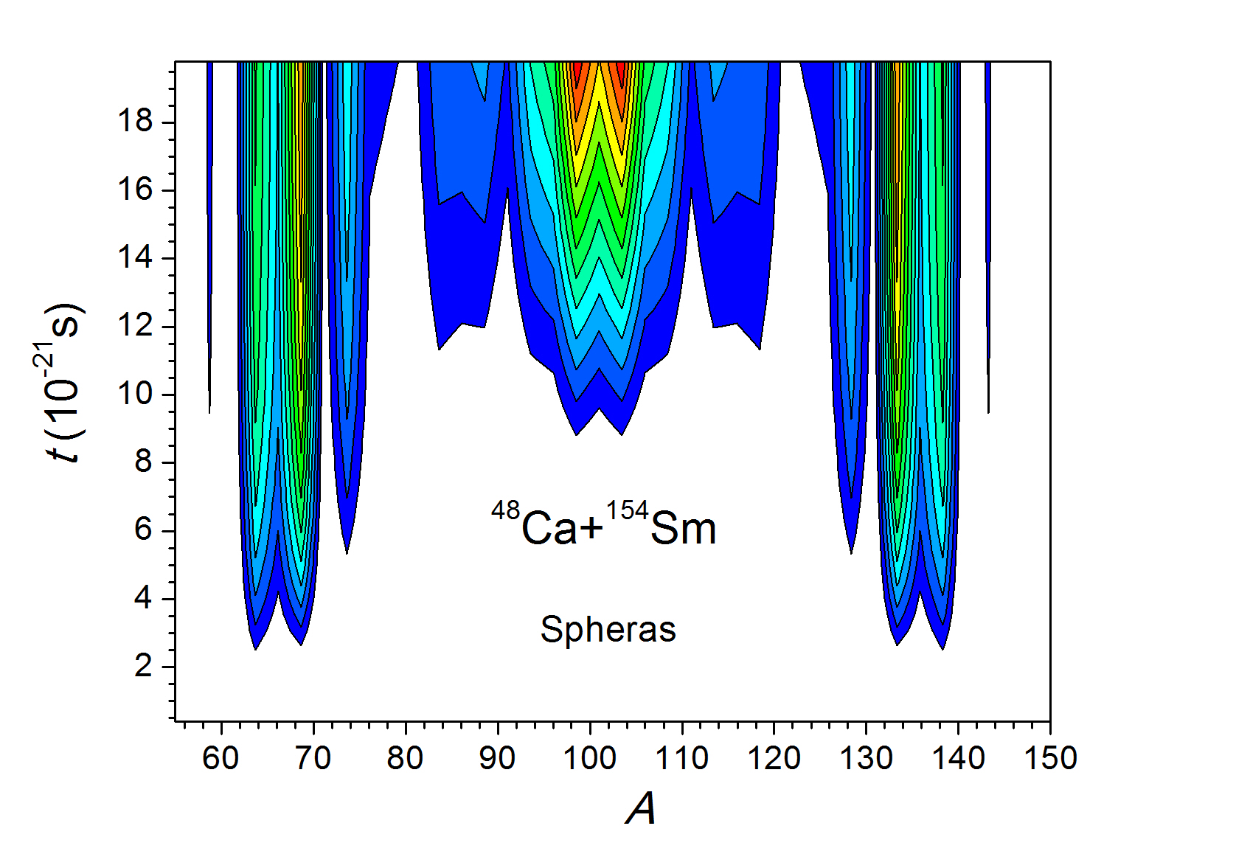
Evolution of the mass distributioin of quasifission fragments

Slide 73

The rotational angle of the dinuclear system as a function of the orbital angular momentum (a) and (b), and angular distribution of the yield of quasifission fragments (c) and (d)
beam
φ

Slide 75

TKE=K₁+K₂
P(M₁,M₂.TKE)
P(M₁,M₂)=
Σ P(M₁,M₂.TKE)
<TKE>=
Σ TKE P(M₁,M₂.TKE)

Slide 76


Explanation of the lack of quasifission fragment yields at the expected place of mass distribution in the ⁴⁸Ca+¹⁴⁴Sm reaction
Evolution of dinuclear system
Decay of dinuclear system

Slide 77

Knyazheva G.N. et al. Phys. Rev. C 75, 064602(2007).
Assumption about the yield of quasifission products appears only between mass symmetric region (A_{tot}/2±20) and initial projectile and target mass region can lead to incorrect conclusion about reaction mechanism.
TKE=K₁+K₂
P(M₁,M₂.TKE)
P(M₁,M₂)=
Σ P(M₁,M₂.TKE)
Due to shell effects and behavior of the quasifission
barrier as a function of the mass asymmetry,
yield of quasifission occurs mainly from mass symmetric
region which strongly overlap with the fusion-fission products.
Counting the quasifission products as the fusion-fission
products lead to overestimation of the experimental fusion
cross section. This circumstance causes confusing at
theoretical analysis.
<TKE>=
Σ TKE P(M₁,M₂.TKE)

Slide 78
Knyazheva G.N. et al. Phys. Rev. C 75, 064602(2007).
“Disappearance” of the quasifission products in the yield of reaction products.

Slide 79


Evolution of mass distributions of in the dinuclear system formed in the ⁴⁸Ca+¹⁵⁴Sm reaction (left panel) and quasifission products at its decay (right panel) .

Slide 80

Calculation of the charge distribtution in the dinuclear system

Slide 81
Calculation of decay of dinuclear system

Slide 82

The strong decrease of the yield of quasifission products by increase of beam energy in the ⁴⁸Ca+¹⁵⁴Sm reaction we explained by strong changing of the angular distribution of quasifission products: increase of beam energy leads to yield of quasifission products at angles close to the beam direction. Another reason is that maximum of mass distribution shifts to mass symmetric region.
Therefore, it is interesting to study mass-angle distribution of the reaction products.
Knyazheva G.N. et al. Phys. Rev. C
2007. Vol. 75. –P. 064602(13).

Slide 83

Where we should look for quasifission fragments?

Slide 84



Mass-angle distribution of the binary products in full momentum transfer (capture) reactions: ¹⁶O+²⁰⁴Pb (a), ³⁴S+¹⁸⁶W (b) and ⁴⁸Ti+¹⁷⁰Er (c,d).
( c )
E_{lab=}126.0 MeV
E_{lab=}245.0 MeV
E_{lab=}188.9 MeV
M_{R}=M₂/(M₁ +M₂)
( d )
Dependence of the mass –angle distribution on
the initial beam energy for the ⁴⁸Ti+¹⁷⁰Er reaction (c,d):
at small energy angular distribution of quasifission
fragments becomes more isotropic. That is reason why
quasifission seemed to be disappear for ⁴⁸Ca+¹⁵⁴Sm reaction in the experiments discussed in Knyazheva et al. Phys. Rev.C 75, 064602 (2007). Our interpretation was
presented in A.K.N. et al. Phys.Rev. C 79 024606 (2009).
E_{lab=}208.0 MeV

Slide 85
Dependence of the capture and fusion cross sections on the orientation angle of the axial symmetry axis of reactants

Slide 86

Nucleus-nucleus potential as a function of the distance between nuclei and orientation their axial symmetry axis

Slide 87

Comparison of the capture and fusion excitation functions with the experimental data and Langevin calculations
S. Mitsuoka, et al.
PRC 62 (2000) 054603.
Y. Aritomo, M. Ohta, Nucl.Phys. A744 (2004) 3

Slide 88


Partial fusion cross section as a function of the orientation of axial symmetry axis reactants
Nasirov A.K. et al.
The role of orientation of nuclei
symmetry axis in fusion dynamics,
Nucl. Phys. A 759 (2005) 342

Slide 89

Dependence of the driving potential (а) and quasifission barrier (b) on the mutual orientations of the axial symmetry axes of nuclei

Slide 90
Conclusions from comparisons
The study of dynamics of the heavy ion collision reactions at low energy and with different mass asymmetries and total masses are important to build whole presentation about capture, quasifission, fusion-fission and evaporation residue formation processes.
The shell structure of interacting nuclei can lead to unexpected phenomena which should be studied by the use of dynamical calculation.
The mutual dependence of the shell structure and deformation parameters of nuclei causes difficulties to make dynamics of collision at different orbital angular momentum.
Dinuclear system model allows us to investigate different aspects of reaction although we use simplifications but keeping information about shell structure of nuclei.

Slide 91
The formation of dinuclear systems
Dinuclear system is formed due to shell effects as the quantum states of the neutron and proton systems of nuclei.
Shell effects is observed as cluster states in the large amplitude collective motions of nuclei.
The observed cluster emission, mass-charge distribution of the quasifission fragments and spontaneous asymmetric fission of Th, U and Cf isotopes proved the strong role of shell structure.
Reactions of heavy ion collisions and fission (spontaneous and induced) processes can be studied well using dinuclear system concept.

Slide 92


Manifestation of shell structure in fission
Z
U 92
Np 93
Pu 94
Am 95
Cm 96
Cf 98
Fm 100
Z=100
I. Tsekhanovich. F. Gönnenwein et al.
Nuclear Physics A 688 (2001) 633–658
J.E. Gindler, Phys.Rev.C 16(1977) 1483

Slide 93

Appearance of shell effects as a heavy cluster at fission of massive nuclei. The cluster and conjugate fragment form dinuclear system.
The group of heavy products
Group of the light products
Averaged mass of group of fission products.
A_{H}=138
Mass of splitting nucleus
A_{L}=F(Z_{fiss})

Slide 94
Conditions allowing long lifetime of dinuclear systems at capture and fission processes
Dinuclear system is formed due to shell effects as the quantum states of the neutron and proton subsystems of nuclei.
Shell effects is observed as cluster states in the large amplitude collective motions of nuclei.
The observed cluster emission, mass-charge distribution of the quasifission fragments and spontaneous asymmetric fission of Th, U and Cf isotopes proved the strong role of shell structure.
Reactions of heavy ion collisions and fission (spontaneous and induced) processes can be studied well using dinuclear system concept.
Presence of the potential well with enough depth (B_{fq}) in nucleus-nucleus potential.

Slide 95


Non-equilibrium processes in heavy ion collisions
At А₁ +А₂ → А₁’ +А₂’ usually Е₁* : Е₂* ≠ А₁’ : А₂’ (even at fission!).
At thermodynamic equilibrium must be Т₁=Т₂ → Е₁* : Е₂* = А₁’ : А₂’
i=P, T
R.V. Jolos, Eur. Phys. Jour. A7, 2000, p.115-224

Slide 96


Potential energy surface of
dinuclear system
U_{dr} (A, Z, , ß₁ , ß₂ ) = B₁ + B₂ + V (A, Z, ß₁ ; ß₂ ; R) - B_{C N} - V_{C N} (L )

Slide 97
Conclusions
The complete fusion mechanism in the heavy ion collisions strongly depends on the entrance channel peculiarities: mass (charge) asymmetry, shell structure of interacting nuclei, beam energy and angular momentum (impact parameter of collision).
The hindrance to formation of the compound nucleus is mainly caused by quasifission and fast-fission processes which are in
competition with complete fusion.
The fission fragments of heavy nuclei (actinides) are mass symmetric or slightly mass asymmetric in dependence on the shell structure of fissioning nuclei and its excitation energy.
Therefore, the complete fusion of the main fission fragments has strong hindrance due to large intrinsic fusion barrier B_{fus} * and small quasifission barrier.B_{qf/} . As a result we have small fusion probability which was obtained in our calculations Increasing the orbital angular momentum lead to increase the capture cross section but not fusion probability.

