Slide 1
IDENTIFIERS & THE DATA CITATION INDEX
DISCOVERY, ACCESS, AND CITATION OF PUBLISHED RESEARCH DATA
NIGEL ROBINSON
17 OCTOBER 2013

Slide 2
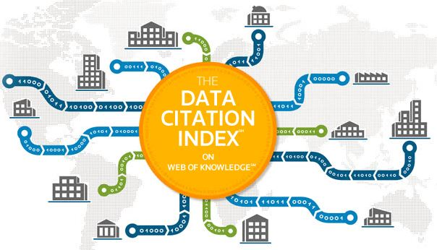
OVERVIEW
What is the Data Citation Index?
Building the Data Citation Index
Integration of identifiers

Slide 3
DEPOSITION OF DATA BY RESEARCHERS
3
Notes:
Data Discovery today:
There is not one comprehensive resource for researchers to easily access data that others have produced, presented as a valid, critical component, supporting research and publication.

Slide 4
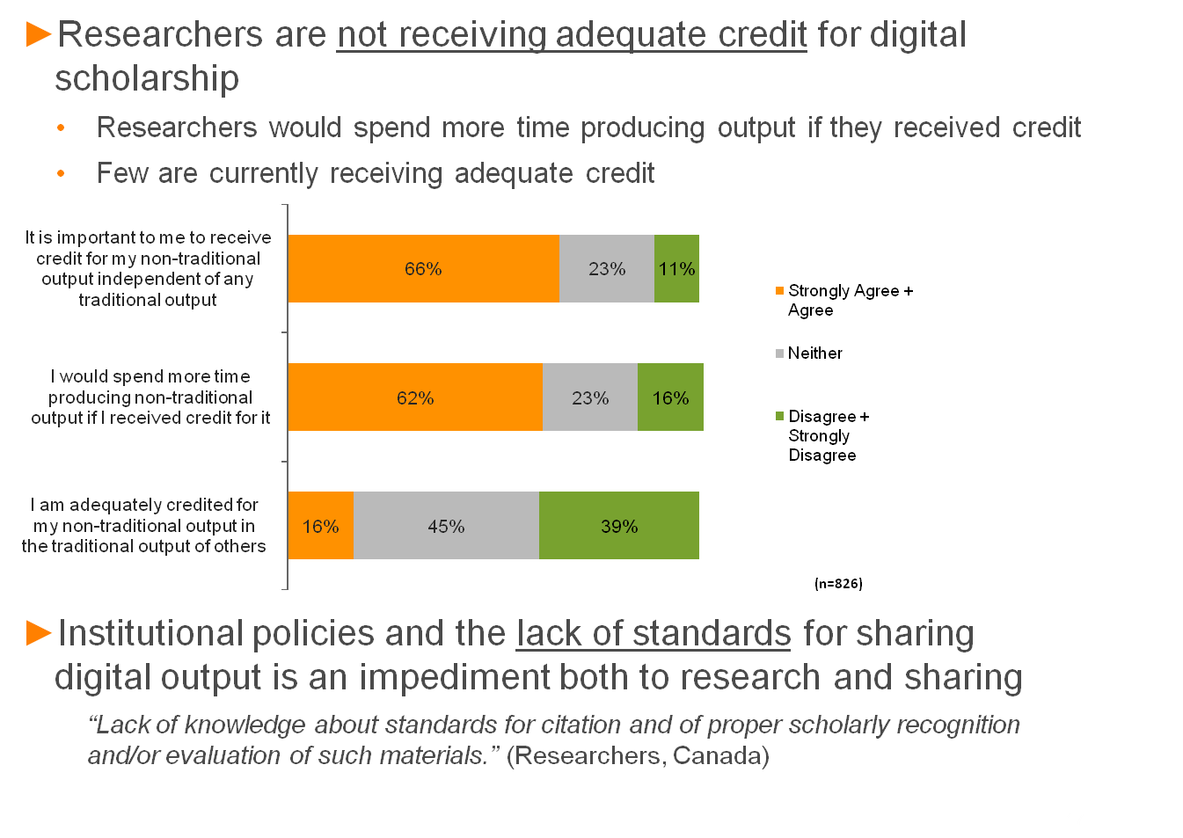
RESEARCHERS NOT RECEIVING CREDIT
Barriers to creating and sharing data:
Researchers are hesitant to spend time and effort to create and share data because they don’t feel the work is adequately exposed or accredited
Researchers find are finding it difficult to expose data they have produced because data repositories do not have clear standards or mechanisms in place for doing so
4
Notes:
Current climate:
Though there are ‘requirements’ for sharing data and acknowledgement NFAIS reports only 15% compliance with requirements; researchers are entrusted by publishers to do this but there is no visibility into whether there is follow up
Evidence that researchers believe in open sharing of data for greater good/good will

Slide 5

RESEARCHER PROBLEMS
Access & discovery
Citation standards
Lack of willingness to deposit and cite
Lack of recognition / credit
Notes:
1) Where can I find data?
While Non traditional scientific output (NTSO) is growing, it remains difficult to find
2) How can I cite data and relate data to the published research literature ?
Most agree that non-traditional scholarly output should be cited, but there is no standard style and fewer than half of university administrators have policies addressing citation of non-traditional scholarly output.
Lack of standards for citing inhibits citing
3) Why should I make my data available for reuse?
Inconsistent credit for non-traditional scholarly output inhibits sharing.
There is agreement between researchers and university administrators on the extent that non-traditional scholarly output is currently being considered for promotion and tenure and other academic rewards.
There is little agreement on the extent that this output should be considered.
The absence of an adequate peer-review process is a primary barrier to both citation and consideration of non-traditional scholarly output in academic rewards.
Use of NTSO as a factor in determining tenure and promotion is a hot topic
4) How can I gain recognition for my data?
Stakeholders across the board show little leadership on how to address the subject of non-traditional scholarly output.
Impetus to change the current system will come from the bottom up.
Lack of peer review is a primary barrier to citation & consideration of NTSO for academic reward
Little leadership in the community – likely change will come from the bottom up

Slide 6
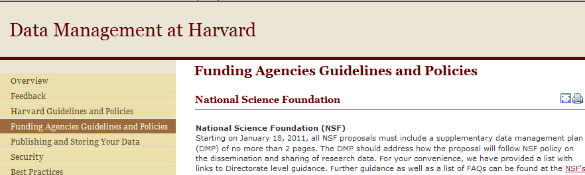
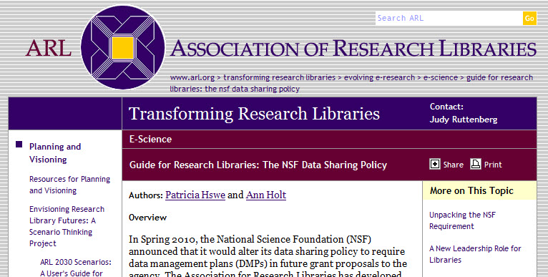
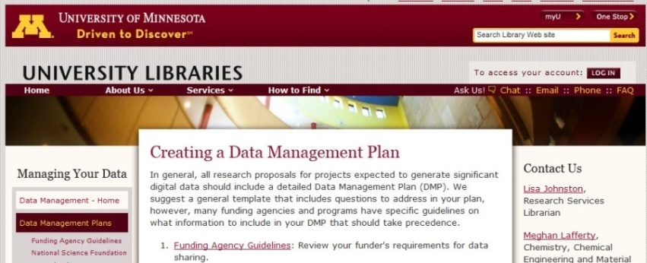
IMPACT ON RESEARCH LIBRARIES
6
Notes:
Increase in data visibility and management requirements impact across the research community:
Researchers
Librarians
Funders
Administrators

Slide 7
DATA CITATION INDEX AIMS
Enable the discovery of data repositories, data studies and data sets in the context of traditional literature
Link data to research publications
Help researchers find data sets and studies and track the full impact of their research output
Provide expanded measurement of researcher and institutional research output and assessment
Facilitate more accurate and comprehensive bibliometric analyses
Launched October 2012
3.5M data records

Slide 8

REPOSITORY SELECTION & EVALUATION
  As we evaluate repositories for inclusion, some of the things we consider are:
  Editorial Content - ensuring that material is desirable to the research community.
  Persistence and stability of the repository, with a steady flow of new information.
  Thoroughness and detail of descriptive information.
  Links from data to research literature.

Slide 9
REPOSITORY EVALUATION
Data deposit
Repository must hold data
Repository must provide access to data
Active
Material added/updated
Provide statistics on deposited data
Actively curate data in the archive
Persistent
Persistent IDs, DOIs or other permanent ID
Contacts available for confirmation of interpretation
Indication of intention to preserve data or provide access over the long term
Contingency if repository was to cease to operate
Make data accessible (or state licensing terms)
Sustainable
Funding information available for repository and deposited data
Proof of reuse
Links to literature
Citation in literature databases

Slide 10
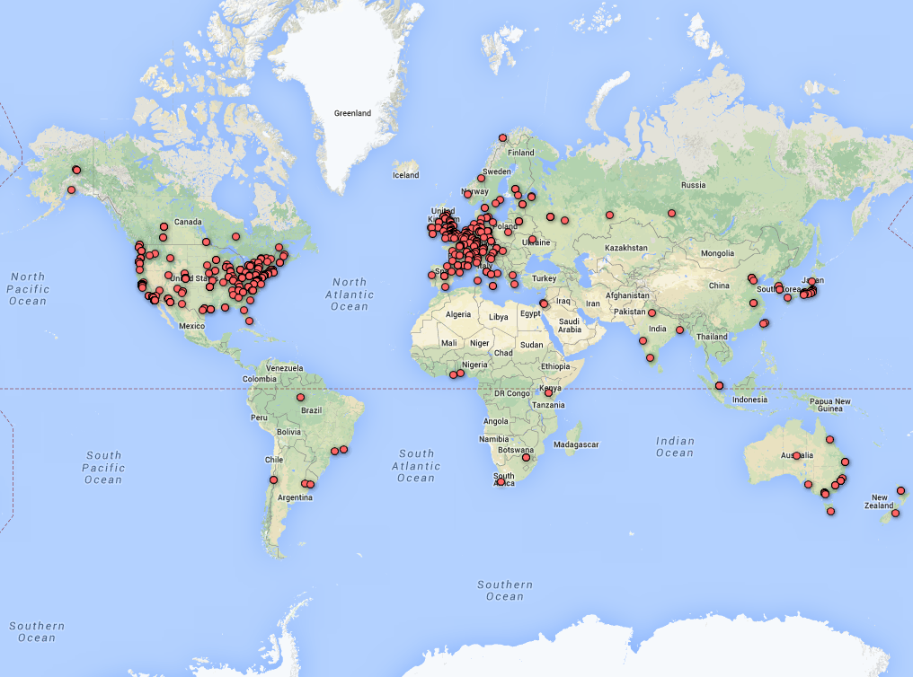
DATA REPOSITORIES
Over 900 repositories identified
Notes:
Lack of repositories from a region does not mean there is no coverage of data from that region. For example, most S American data are deposited in US repositories.

Slide 11
TYPES OF DATA BY DISCIPLINE
ART & HUMANITIES
CULTURAL HERITAGE
LANGUAGE CORPUS
IMAGE COLLECTIONS
RECORDINGS
SOCIAL SCIENCES
POLL DATA
ECONOMIC STATISTICS
LONGITUDINAL DATA
NATIONAL CENSUS
PUBLIC OPINION SURVEYS
SCIENCE & TECHNOLOGY
MAPS
ALGORITHMS
GENOMICS
SKY SURVEYS
ASTROPHYSICS
REMOTE SENSING
MUSEUM SPECIMENS

Slide 12
INDEXING A DATA REPOSITORY
ON WEB OF KNOWLEDGE
Record Types
Repository/Source: Comprises data studies, data sets and/or microcitations. Stores and provides access to the raw data.
Data Study: Descriptions of studies or experiments with associated data which have been used in the data study. Includes serial or longitudinal studies over time.
Data Set: A single or coherent set of data or a data file provided by the repository, as part of a collection, data study or experiment.
Microcitation: (nanopublication) An assertion about concepts that have been found to be linked by scientific enquiry, and can be uniquely identified and attributed to its author. Made up of three separate parts: a subject, a predicate and an object.
Descriptive metadata feed from repository
Repository raw metadata is analysed
Metadata
added
Repository
Data study
Data set
Micro-citation
Notes:
12
In Web of Science, a record= an article. In DCI a record = a repository or a data study or data set or microcitation.
Levels below repository are dependent upon repository content.
Microciation example: mosquitos cause malaria
Thomson Reuters works very closely with each repository to gain a strong working relationship so that the data are well understood and the repository are happy with the way the data are described in DCI
Various tools are used in gathering content. The incoming metadata may need to be cleaned up and normalised so that they have uniform structure for import into the DCI Editorial system and to allow consistent search indexes to be built.
Where metadata are not provided by the repository, manual indexing and some text mining is applied to gain additional terms for discovery and description
For some elements, Thomson Reuters taxonomies/thesauri have been used to provide additional terminology to allow brodening of searches and placement of terms in context which helps with disambiguation. (e.g. organisms, broader Subject Categories and Subject Areas are shared with other WoK products to allow more effective cross search)

Slide 13
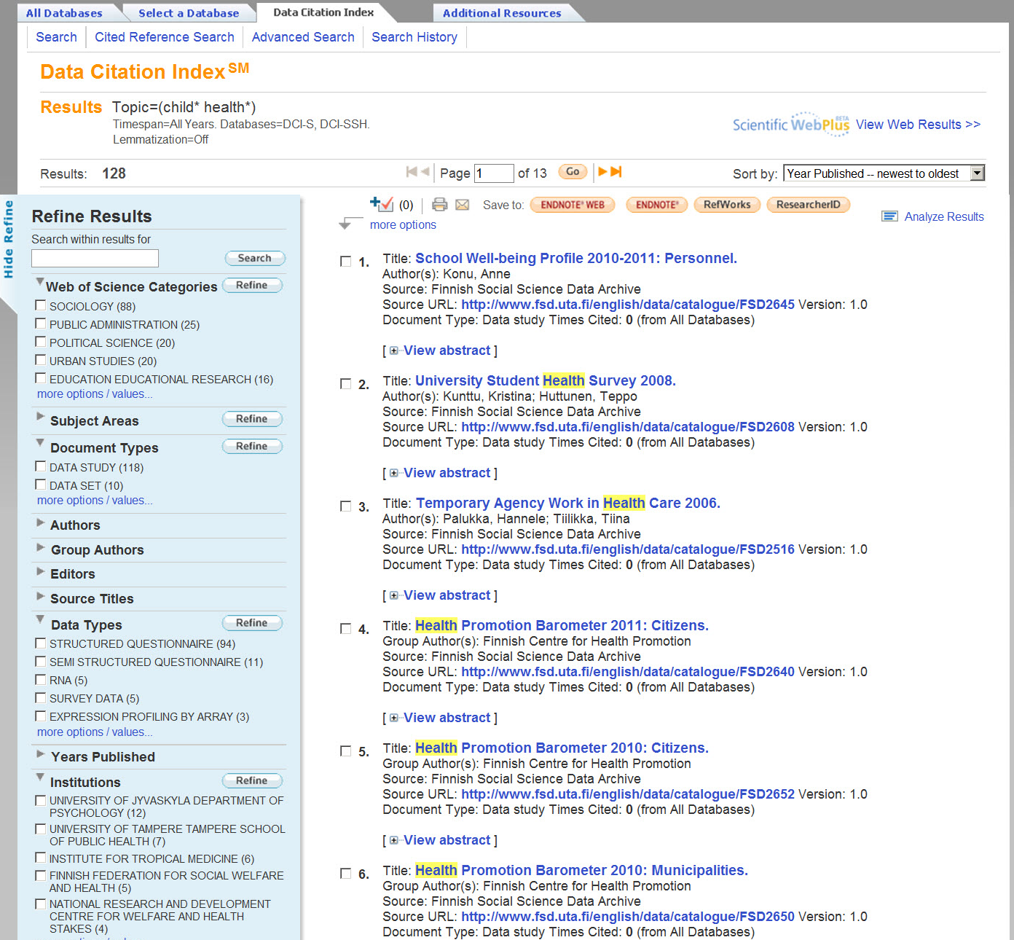
Search Results within the Data Citation Index present the powerful Web of Knowledge options for exploring a body of information.

Slide 14
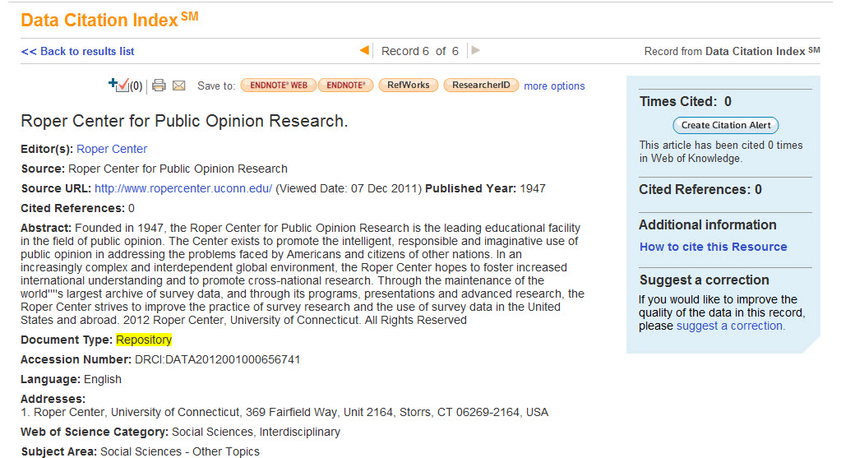
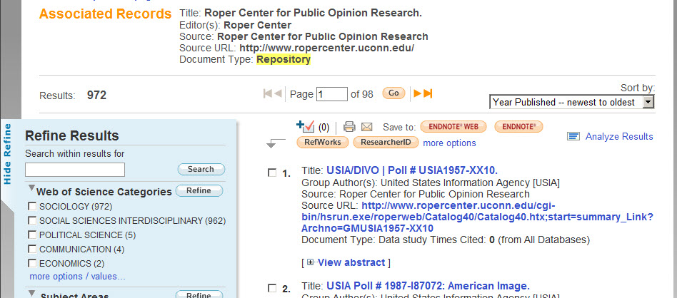
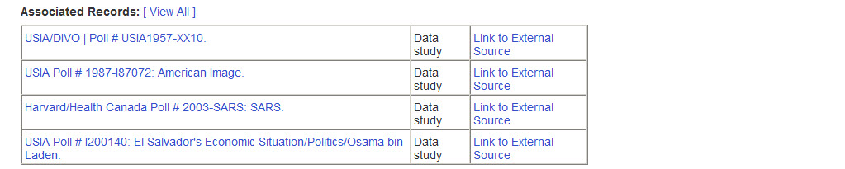
Link to all Data Citation Index content associated with this particular Repository.

Slide 15
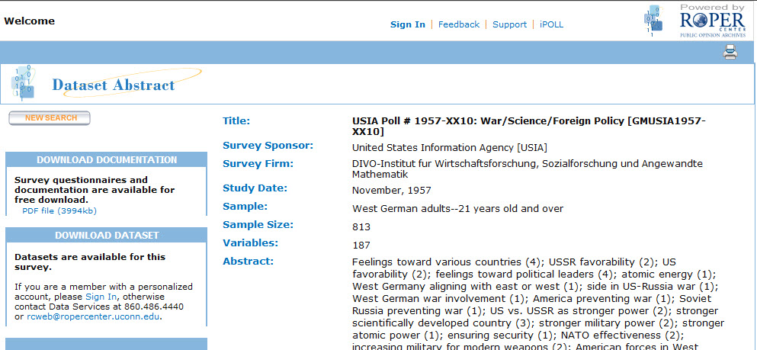
Link out directly to the original item, in this case a Data Study.

Slide 16
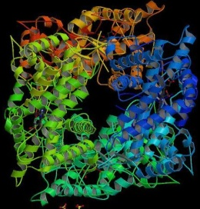
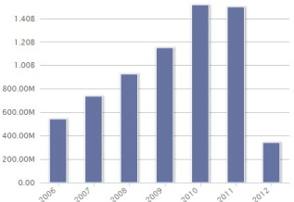
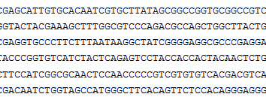
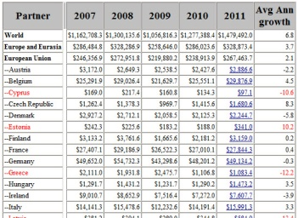
REQUIREMENTS & CHALLENGES
Metadata availability
  Lack of repository resources
  Lack of repository expertise
Citable data source
Metadata quality
  Metadata inconsistencies
  Consistent file format
  Consistent content
Desirable characteristics
  English language for key metadata fields
  Metadata curation and quality control
  Required metadata fields present for citation
  Consistent metadata to allow mapping to DCI fields
  Member of extended network
  Data dictionary and schema available
Data repositories are not static
  How is version control handled?
Partnerships
Notes:
A number of repositories have what appears to be a very detailed web presence, and may have a large amount of data deposited, but they may not have a metadata descriptive output available. These repositories may focus on gaining data depositions and making them available on their website for preservation/access reasons and may not have capabilities or resources to develop metadata output.
Where descriptive metadata are available , we see huge differences in quality. Some repositories curate the metadata, others do not. While most repositories have a standard data format, some deposited data does not conform. At the moment we have taken on the clean up and provide feedback to the repository. Ultimately we may not be able to support that as the content set grows.
Unlike publications, data can be updated after initial publication. Repositories handle this in different ways. Some preserve all versions as numbered versions to allow individual citation; others do not and only preserve the most recent; others accumulate versions in one record. All these scenarios need to be modelled and affect the update process for DCI as we go back to gain new and changed records from a repository. Again there are variations in provision of updates, both in frequency and content. Some repositories provide only updated or new records; others only provide a full content set so we have to filter out records we have seen before and do comparisons to ensure there are no changes.
Some of these anomalies can be combated by creating partnerships

Slide 17
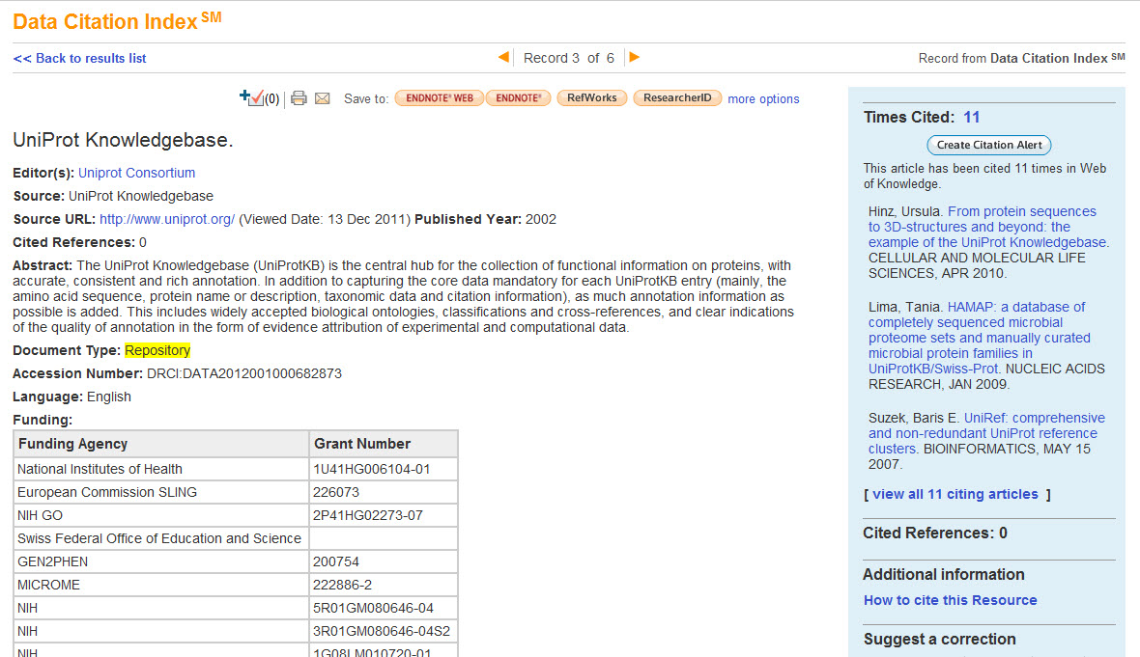
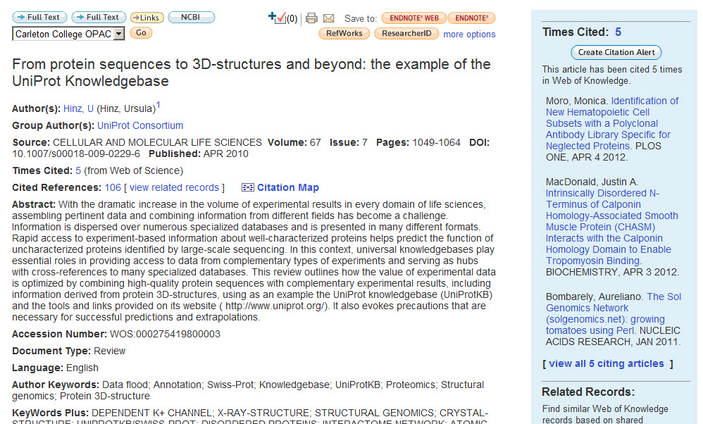

Slide 18
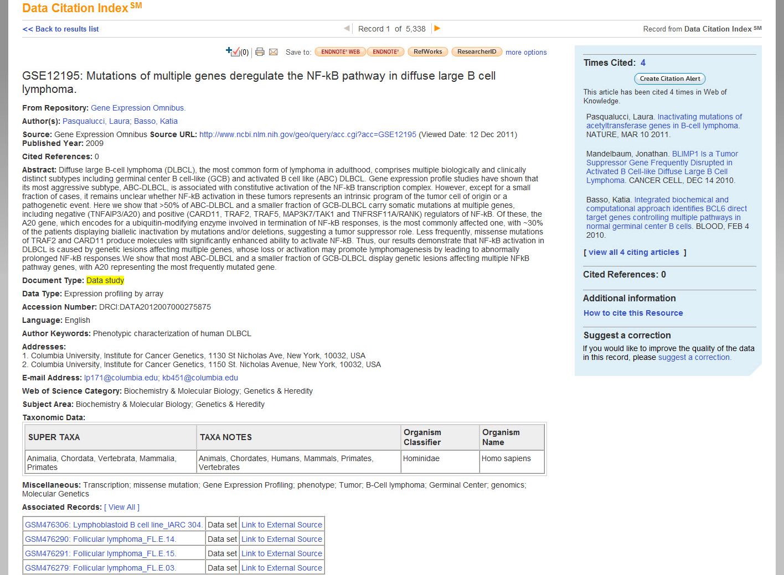
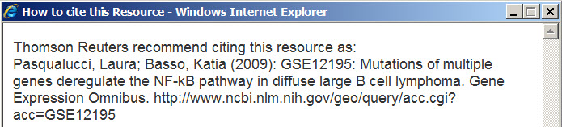

Slide 19

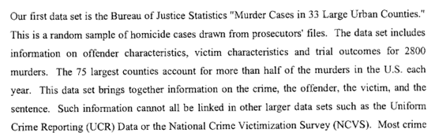
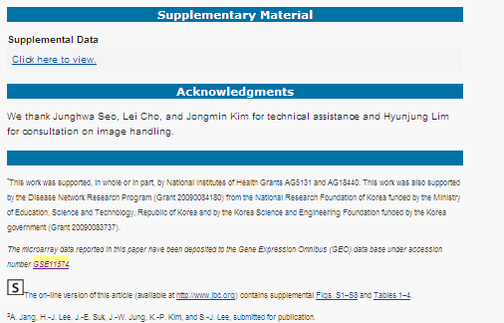
DATA CITATION BEHAVIOUR
Desired/future citation style
(as part of cited references)
Current citation style
(in full text of article)
U.S. Dept. of Justice, Bureau of Justice Statistics (1996): MURDER CASES IN 33 LARGE URBAN COUNTIES IN THE UNITED STATES, 1988. Version 1. Inter-university Consortium for Political and Social Research.
http://dx.doi.org/10.3886/ICPSR09907.v1
Lee, Seung-Jae; Lee, He-Jin; Cho, Ji-Hoon; Rho, Sangchul; Hwang, Daehee (2008): GSE11574: The responses of astrocytes stimulated by extracellular a-synuclein. Gene Expression Omnibus. http://www.ncbi.nlm.nih.gov/geo/query/acc.cgi?acc=GSE11574

Slide 20
INTEGRATION OF IDENTIFIERS
Source
Publisher
Researcher
Transfer
Harvest publisher metadata
Claimed works in ResearcherID
Web of Knowledge
Web of Science
Bibliographic databases
Data Citation Index
Linked ORCID and ResearcherID profiles
Notes:
As well as identifiers for the location of the data themselves which facilitates the tracking of cited data , where DOI is promoted through DataCite, ANDS, California Digital library and others, DOI is only applied to around 20% of data encountered, so this is early days and we are working with DataCite to encourage formal data citation with identifiers.
But author identifiers are also key in the attribution of data to the creator to enable recognition and credit
Thomson Reuters has been using its own identifier (ResearcherID) and more recently ORCID, and has linked the two together. We are in a position to take ORCIDs from publishers and data repositories, and link ORCIDs to ResearcherIDs within products.
So author identifiers can come from the publisher (journal publisher or data repository) and if provided we can integrate them into the Data Citation Index – so far we only have <50,000 ORCIDs in our products and these come from a relatively low number of publishers
For Data Citation Index the ORCIDs integrated so far come from authors claiming their data and relating them to their ResearcherID which in turn is linked to their ORCID. It is possible for authors to claim data just as they can claim publications.

Slide 21
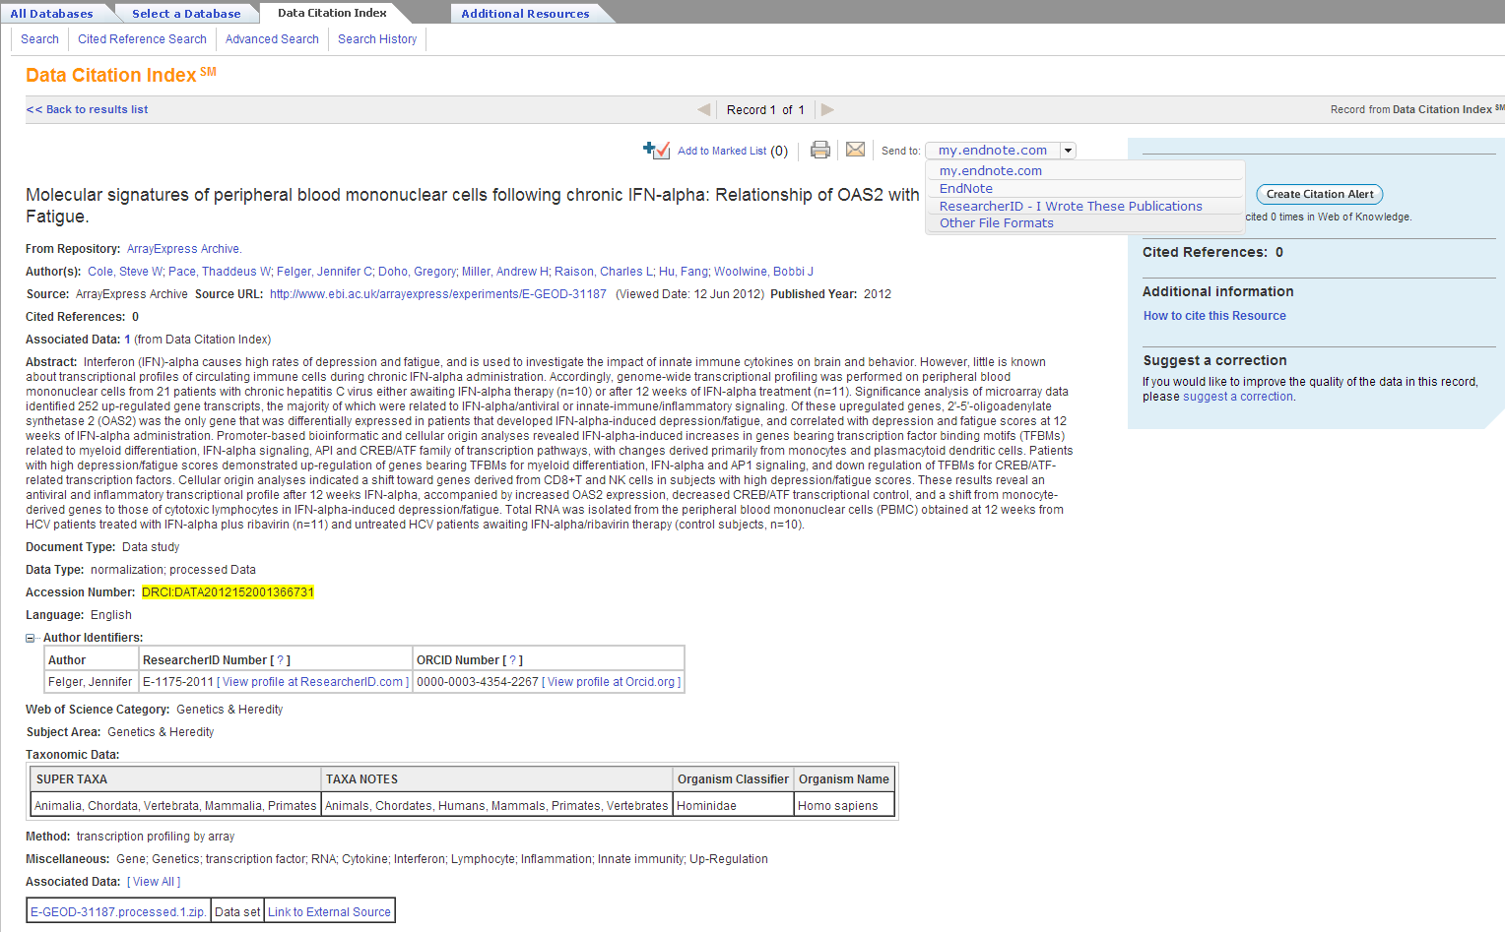
DATA CITATION INDEX RECORD WITH CLAIMED DATA

Slide 22
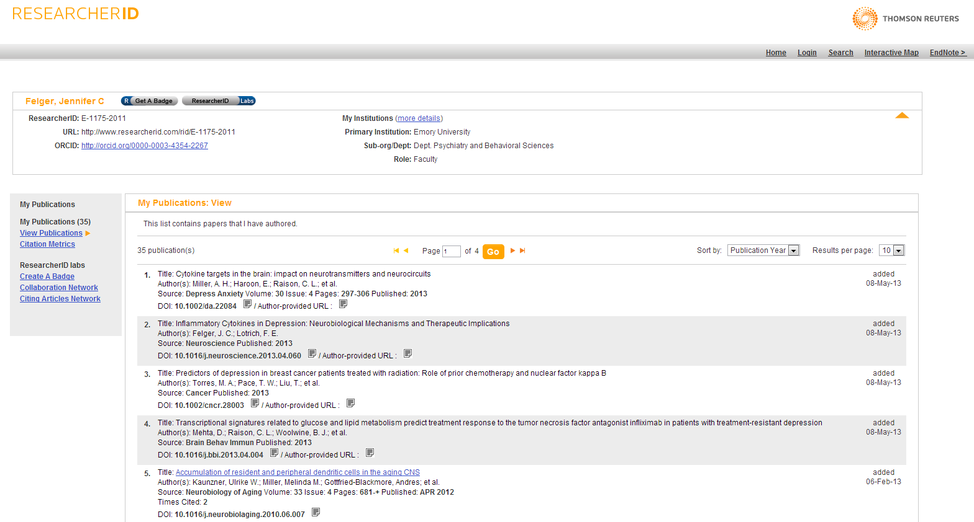
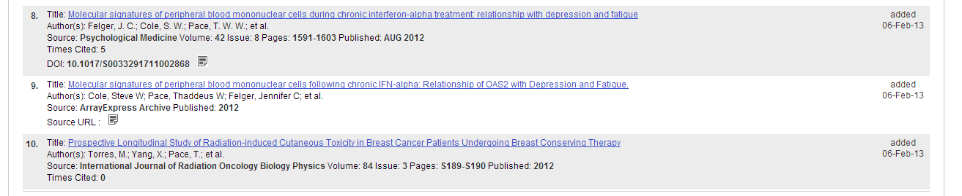
RESEARCHERID RECORD FOR AUTHOR

Slide 23
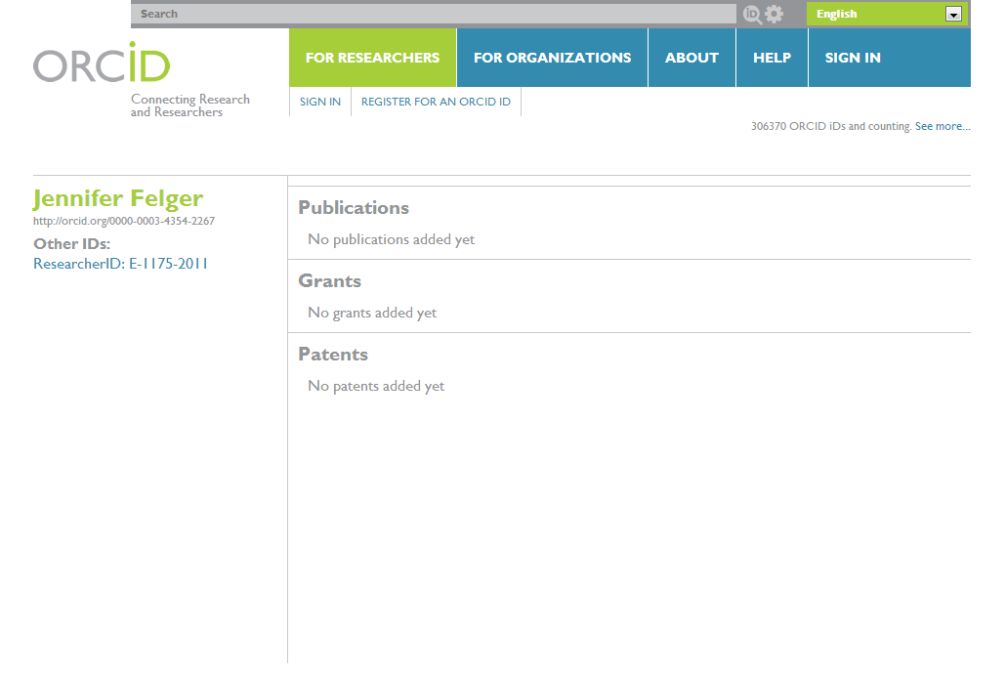
ORCID PROFILE

Slide 24

DATA CITATION INDEX
Discovery of data most important to scholarly research
Data linked to published research literature
Measures of data citation, use and reuse with attribution assisted by identifiers
New metrics for digital scholarship
Notes:
Through powerful Web of Knowledge discovery capabilities the Data Citation Index will expose important research data and drive access to it.

Slide 25

Thank you
Nigel Robinson
nigel.robinson@thomsonreuters.com

