Slide 1

Third Board Meeting
27 February 2013

Slide 2
Third Board Meeting
Thanks for coming!
First board meeting since festival
  Recap our mission and artistic vision
  Summary of 2012 festival
  Feedback and lessons from 2012
  Vision and plans for 2013
We will circulate the festival report and ask for your feedback in the coming weeks

Slide 3
Motivations
Create tangible guidelines for programming and selection processes
Form a more cohesive festival with a genuine flavor
Improve educational and outreach opportunities
Embrace the link between the festival and science
Adhere to CERN’s core values and the spirit of its mission

Slide 4
CinéGlobe Mission
CinéGlobe aims to challenge the perceived divisions between science and the art of cinema by demonstrating that they are both essential to interpreting our world.

Slide 5
Artistic Values
Key Artistic Values
  Imagination
  Exploration
  Discovery
  Innovation
Festival keywords
  Unexpected
  Challenging
  Enlightening
  Different
These values are common to science, art, and cinema – and especially apply to our work at CERN
We want to be a different kind of science festival…. But how?

Slide 6
Artistic Vision
Festival Theme - Infinitely (Inter)connected
“Pick a flower on earth and you move the farthest star.”
When famed physicist Paul Dirac made this statement, he probably never imagined how much it would apply to our modern society. Fueled by science and technology, our world has become connected at a level far greater than we ever thought possible. CinéGlobe seeks to showcase films of all genres that illustrate, probe, and challenge this nearly infinite connectedness of which we are all part – scientists and artists alike.

Slide 7
Festival programming

Slide 8
Programming Strands
Short Film Competition
  Doc <30 minutes
  Fiction <15 minutes
Discussion/Short Programs
Feature Films
Musical/Retrospective Events
Post-Festival

Slide 9
Short Film Competition
7 Programs in all
Grouped thematically
Mix of Fiction/Doc in each program
Grew naturally during the selection process

Slide 10
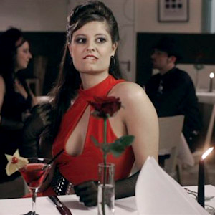
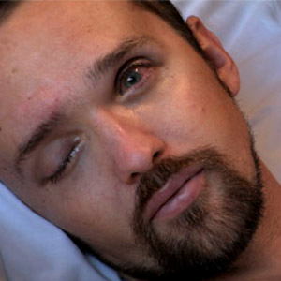
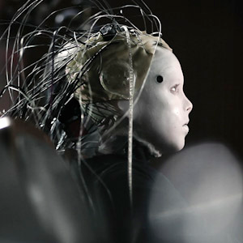
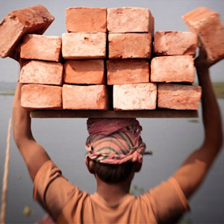
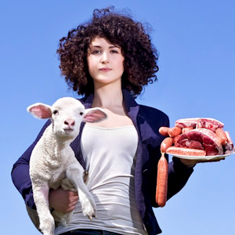
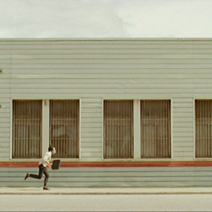
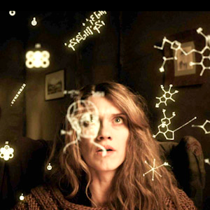
Short Film Programs
Sex and death: Science and technology are constantly changing our lives, but two aspects of human existence remain constant… sex and death, you can’t live without them.
Survival: Evolution used to be simple, if you were too slow you got eaten, can we now contemplate eternal life?
Place in the universe: From time immemorial, man has wanted to understand his place in the grand scheme of things, who are we, what makes us unique, and who are the little green guys?
Progress?: Progress, driven by science and technology, has redefined the way in which we live our lives – is that always a good thing?
Consequences: With our increasing ability to exploit the natural world, what impact has humankind had on our home?
Connected: Technology has revolutionized the way we communicate with and relate to one another, can you keep up?
Reaching Out: Contemporary life has changed the scope and nature of our interactions with other people; we affect those around us in the most profound and unexpected ways and our relationships define who we are.

Slide 11
Short Film Program Popularity
Short Program | Weekday Show | Weekend Show | Program Totals | Ballots | % voted
Connected | 50 | 36 | 86 | 69 | 80%
Consequences | 58 | 18 | 76 | 60 | 79%
Sex and Death | 56 | 45 | 101 | 80 | 79%
Survival | 30 | 49 | 79 | 62 | 78%
Progress | 46 | 22 | 68 | 52 | 76%
Place in the Universe | 55 | 85 | 140 | 117 | 84%
Reaching Out | 48 | 36 | 84 | 68 | 81%
TOTALS | 343 | 291 | 634 | 508 | 80%

Slide 12
Jury
TECH STARTUP FOUNDER - Sunny Bates
  Sunny works with businesses and organisations that thrive in this interconnected world. She was a founding board member of Kickstarter.com, which has revolutionized funding for creative projects, and has been instrumental in the World Science Festival, founded by famed string physicist Brian Green.
DOCUMENTARY PRODUCER - Peter Engel
  A documentary producer with Zentropa Films in Denmark, Peter has worked extensively with Mads Brugger, the well known Danish journalist, to uncover stories from the inside perspective. Peter’s most recent film, The Ambassador, was the opening film at IDFA in Amsterdam, and showed at Sundance.
PHYSICIST - Gian Giudice
  Theoretical physicist at CERN, Gian wrote the book “A Zeptospace Odyssey” which explains for the average reader the complex physics of the LHC. He is often called upon to make complex physics understandable, and seeks to convey not just the content of the fundamental research done at CERN, but also the wonder behind it.
DIRECTOR - Marie-Eve Hildbrand
  Graduate of the ECAL Cinéma School in Lausanne, Switzerland, Marie-Eve has produced both fiction and documentary shorts, as well as co-directing a documentary feature on the Swiss political process, Dans Nos Campagnes, which premiered at the Solothurn Film Festival in early 2012.
ANIMATION SUPERVISOR - Andrew R. Jones
  Animation supervisor for films such as Titanic, Godzilla, I, Robot, and Superman Returns, Andy won both the Oscar and BAFTA awards for best visual effects on Avatar. He recently finished his first short film as writer and director, named Parallel, which will be screened out of competition at CinéGlobe.
FESTIVAL ORGANIZER - Vincent Lamy
  General delegate to the PariScience science film festival in Paris, Vincent is participating in the CinéGlobe jury for the second time. He knows science film and film festivals from the inside out, and has lead an equally eclectic life as host, singer, and actor.

Slide 13

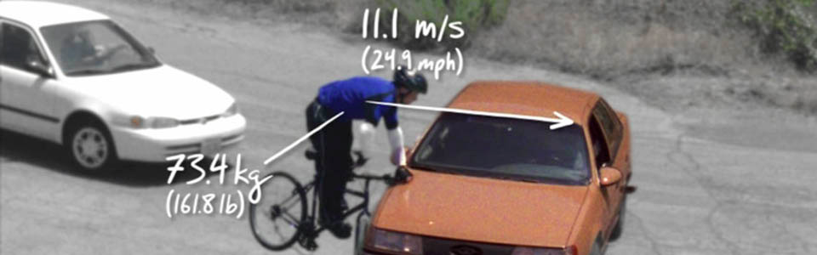
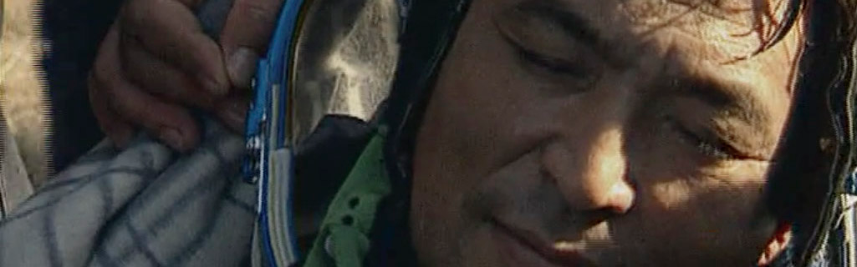
Special Programs, 1/2
Opening
  Address from Cinématheque Suisse Directeur Maire
  “Retrospective” of science in cinema (including CERN)
Youth Program
  “Time travel and multiple dimensions”
  Discussion of science in fiction
Musical Event
  Custom soundtrack to “Into The Present” – Romanian film on space travel to MIR
  Performed by band “British Sea Power”

Slide 14
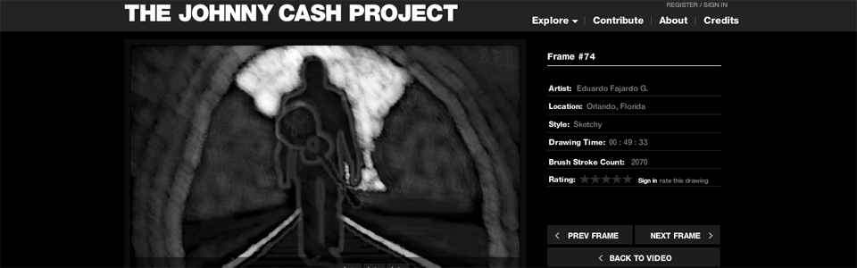
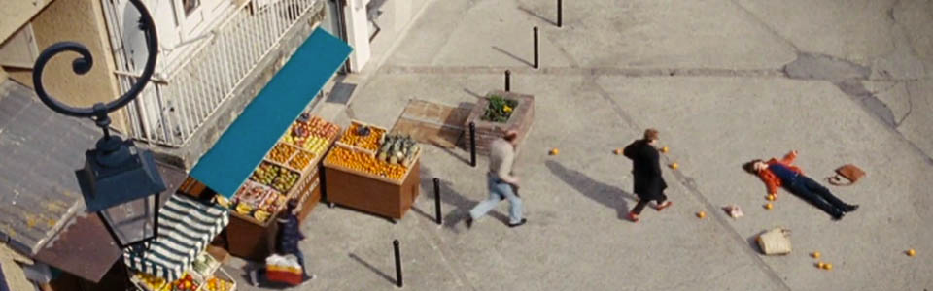
Special Programs 2/2
One Day on Earth
  Feature world premiere, but limited private event
Creative Commons in the Internet Age
  Short film & panel discussion program
  Focus on distributed creation in the internet age
A Beating Heart
  Docu-drama
  Laureate from Pariscience
  With director in attendance for extended QA session

Slide 15
Post Festival Events
One Day on Earth Global Screening
  Simultaneous screening on Earth Day, April 22nd
  ~200 countries participating
  367 attendees for 2 sessions on Sunday afternoon
“British Sea Power” & Out of the Present at BFI in London
  Presented by CinéGlobe at BFI in June

Slide 16
Festival logistics

Slide 17
Logistics
Film Reviewing Platform
Audiovisual Setup
Subtitling/Interpretation
Festival agenda
Film Submission/Selection Summary
CinéGlobe in numbers
Audience Statistics

Slide 18
Film Reviewing
Online platform with dedicated server
  All films viewable with metadata
  Ratings system for distributed reviewing
  Interface to short film depot (SFD)
  Most films uploaded as SFD video files, but still accepted ~1/3 by DVD
Server no longer online
  Management was largely manual and time consuming
  There are security issues with hosting it at CERN
  We are looking at alternatives to bring it back online

Slide 19
Reviewing/Selection Process
First viewing by about 20 volunteers from the film club
  Very general elimination process
  Any eliminated film had to be seen by two people
Pre-selection of about 300 films
Final selection made iteratively by selection committee (3 people)
  Each person watched more than ~500 films

Slide 20
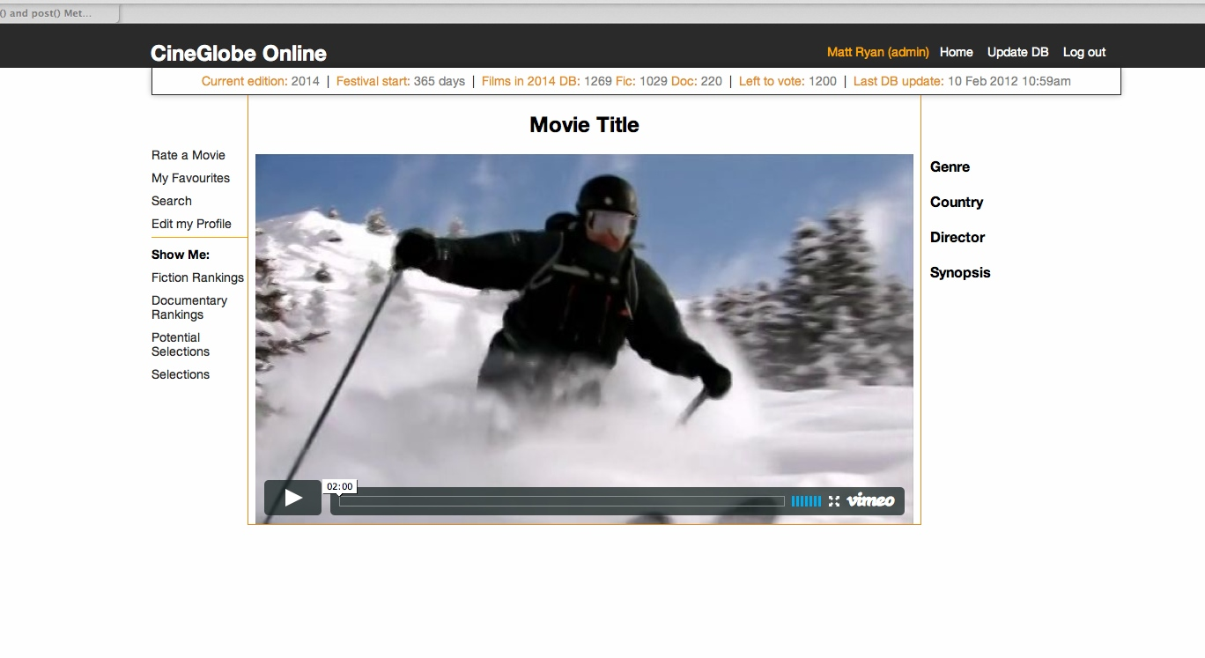
Proposal for CinéGlobe Online
Online archive, voting and film management tool.
Written in-house, from scratch. Work begun.

Slide 21
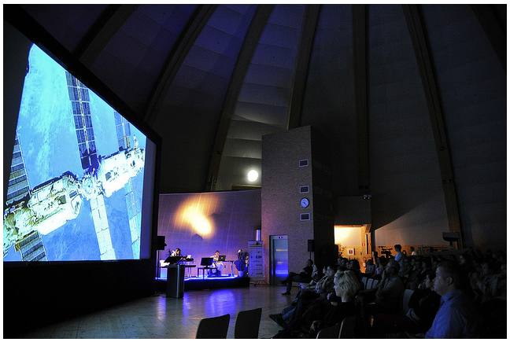
Audiovisual Setup
Provided by Lumens8
  18k projector, Full HD
  6.5m screen
  Real Cinema Experience
Globe will update its current system to more or less these specifications
Only problems during event arose from Globe system and mixing Globe/external systems

Slide 22
Subtitling/Interpretation
Subtitled all films in English and French
  Used film club members to do the brunt of the work
  Burnt in subtitles using FCP and an XML converter
  We were subtitling right up until showtime in some instances (missed a couple of films for first showtime)
Interpretation
  Saturday only (discussion program at Forum and Awards ceremony at Globe)
  Availability was appreciated, but total cost was probably more than 100CHF/person

Slide 23
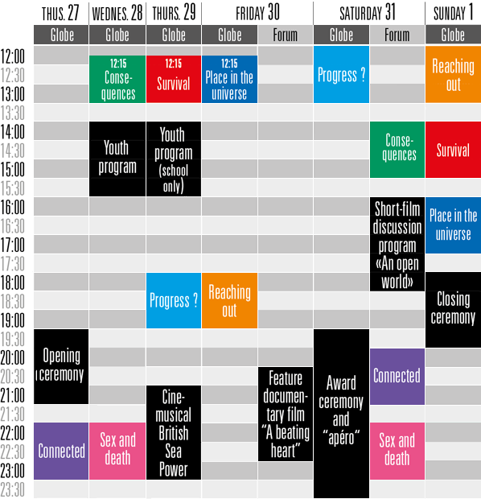
Festival Agenda
Overall rationale
  Short films daytimes and weekend
  Special programs evenings
Short film programs shown twice
  Once during week
  Once during weekend
Used Sunday at Globe

Slide 24
Film Submissions/Selection Summary
Submissions
  Fiction
    1427 Submissions
    1148 Films received
  Documentary
    384 Submissions
    304 Films Received
99 different countries of origin
Formed into 7 mixed programs
  42 Fiction films selected
  13 Doc films selected

Slide 25
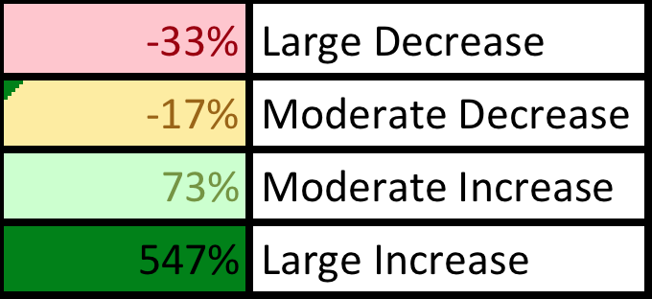
CinéGlobe 2012 in Numbers
Most Troublesome
Intentional
Repositioning

Slide 26
Audience Statistics by Screening

Slide 27
Audience Statistics by Day
Sunday was an important addition overall
Friday ended up a missed opportunity
Thursday, with musical event, was the day of best attendance
Forum Meyrin was very underutilized

Slide 28
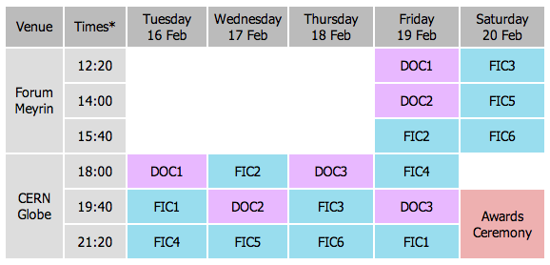
Comparative Schedule 2010-2012

Slide 29
Audience Statistics 2010 vs. 2012
Missed
Opportunity

Slide 30
Logistics Summary
Technically very pleased
  Image good, sound good…
  EXCEPT when mixing with Globe in-house audio system
Submissions management
  Overall worked well
  However, labor intensive and not automated
  May require video uploads for 2014 (no more DVDs)
Subtitling/Interpretation
  Subtitling cheap, but labor INTENSIVE
  Interpretation effortless, but very EXPENSIVE
  Need to find a way to fix both problems
Schedule worked well for us, but didn’t draw the audience we hoped… need to evaluate further
Attendance
  17% drop is disappointing
  Weather probably played a role
    2010 – 4 degrees C, 18h sunset
    2012 – 19 degrees C, 20h sunset
Venues
  Forum Meyrin did not work…
  Do we drop it, or approach in a new way?

Slide 31
Communication

Slide 32
Communication
Slogan/Logo
Web Design
Social Media
Press Campaign
Ad Campaign
Feedback and Publicity Reach

Slide 33

Logo & Slogan

Slide 34
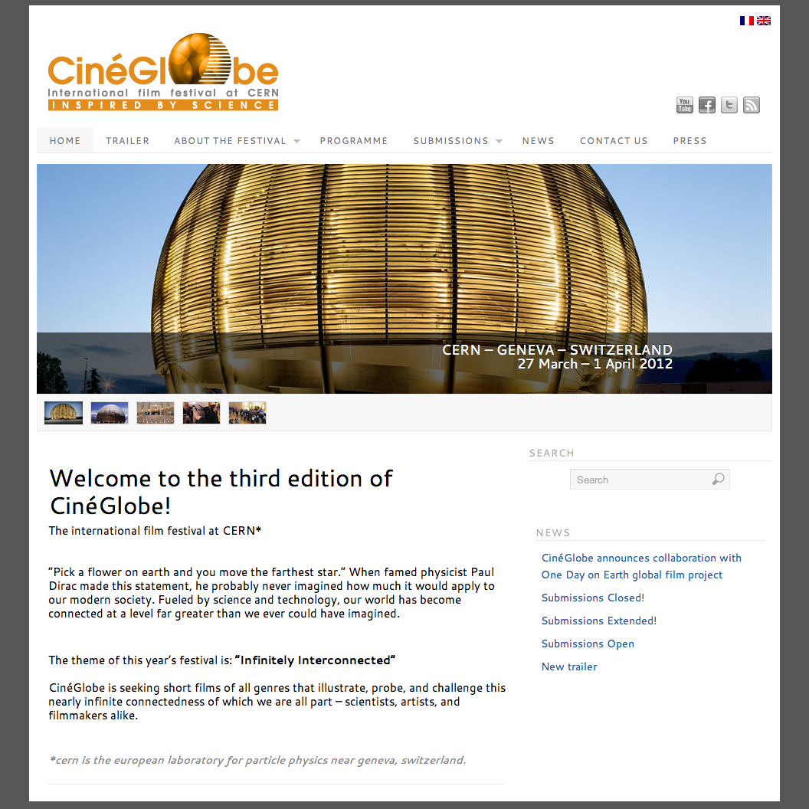
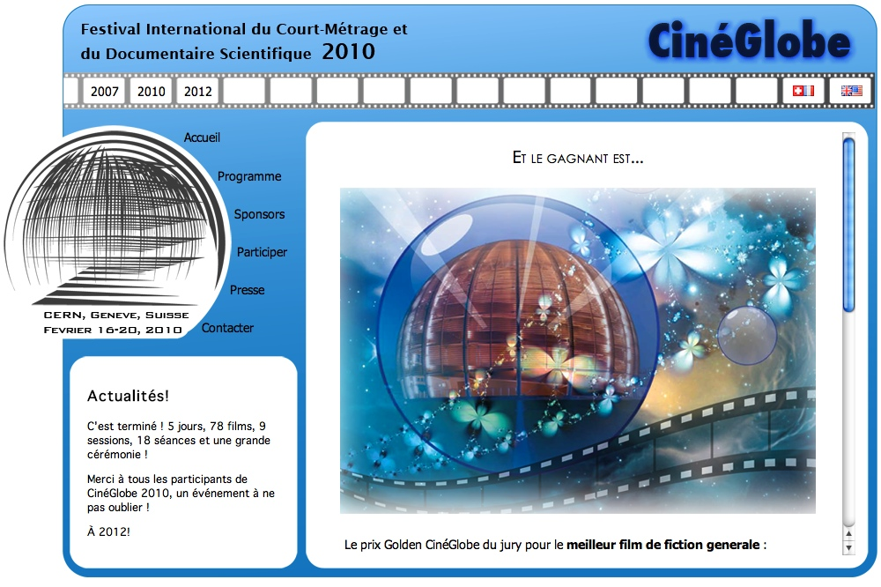
Website Update

Slide 35
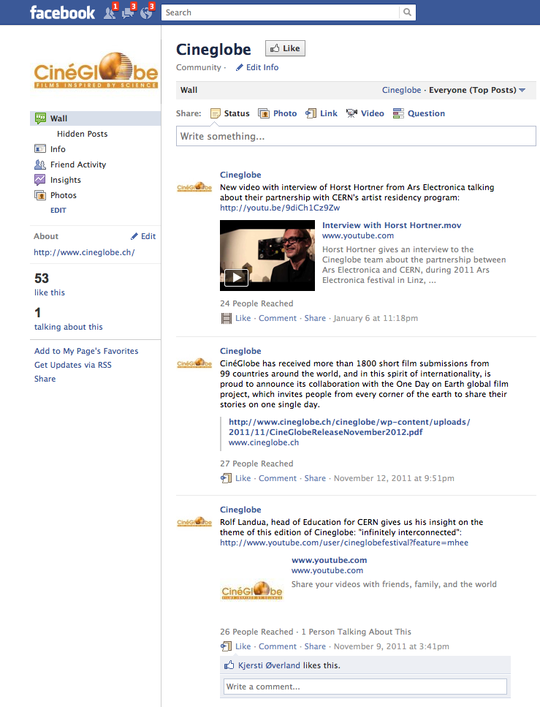
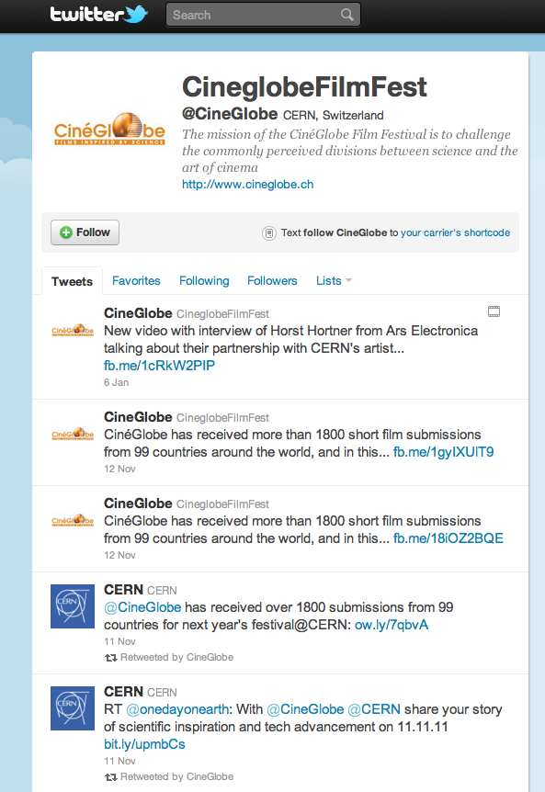
Social Media

Slide 36

Poster Campaign
Designed by agency Leagas-Delaney in London
  Photographs by David Gill (at cost)
  Has won several advertising awards and mentions
  Postering by Affichage Vert/Colonnes Morris
  50 Postcard placements (2 weeks)
  110 Poster placements (week before festival)
  180 Poster placements (week of festival)

Slide 37



Local Ads
Tous Ecrans Program
Cinématheque Program
Daily Movies (+ Article)

Slide 38

Trailer - Cinemas/TPG
Animation (no sound)
  on Tram/Bus screens
  2 weeks (before and during festival)
Animation (with sound)
  in cinemas for entire month of March
    City
    Rialto 3
    Scala 1,2,3
    Rex 1,2,3
    Balexert 3,7

Slide 39
Placements Summary
Poster Campaign
  Affichage Vert
  Colonnes Morris
Local Ads
  Daily Movies
  Cinematheque Suisse/Cinema Tous Ecrans
  Cinemas (Publicitas)
  TPG (Video)
CERN channels
  DG Announcement
  Homepage
  Bulletin
  Posters
  Screens in Resto 1
  Twitter

Slide 40
Press Appearances
Local
  Tribune de Geneve Weekend Special
  GHI, Le Courrier, Le Temps
  Leman Bleu, WRS
  Various web sources
International
  Primarily for British Sea Power musical event
    Journalists from music magazines onsite (The Quietus and Vice)

Slide 41
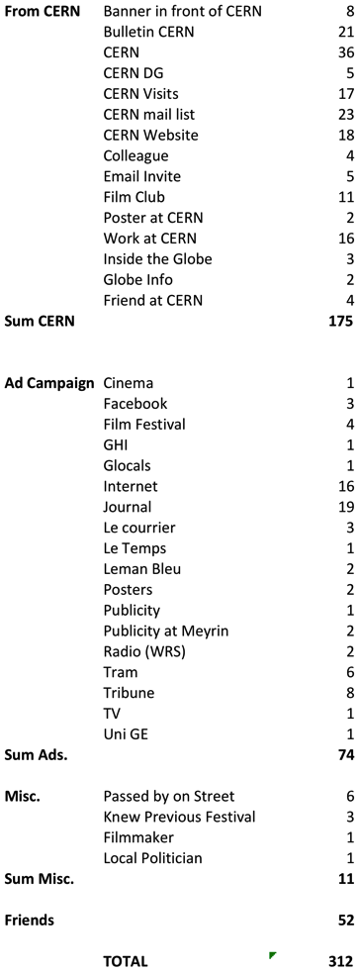
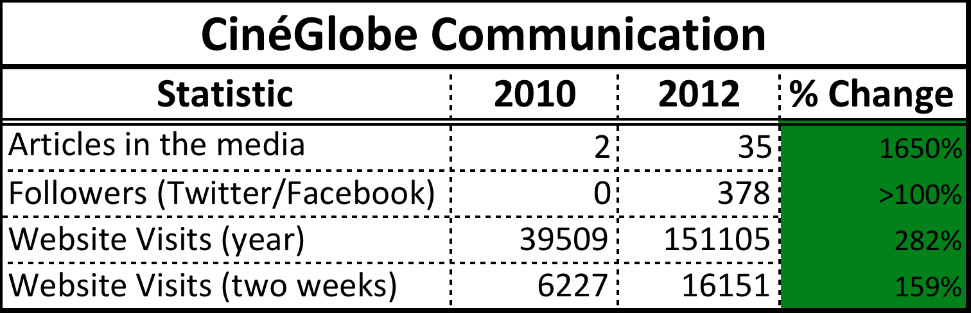
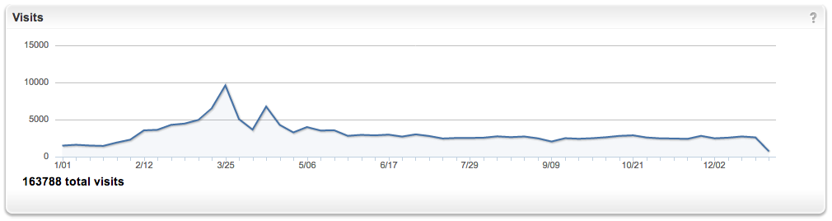
Publicity Numbers
Festival
One Day on Earth

Slide 42
Publicity Reach Overall
312 responses in total to questionnaire:
CERN channels by far the most influential
Lots of word of mouth
Publicity campaign was useful (23% reach) but not staggering
Papers were the most effective outlet in the media
Two most expensive outlets – TPG and Cinemas – were the least effective

Slide 43
Publicity Reach – CERN Channels

Slide 44
Communication Summary
Overall
  Quality of publicity campaign elements was well perceived
  Variety of placements and press was vastly increased from 2010
  Even inside CERN, more varied communication avenues were used compared to last festival
However, audience survey points out interesting issues
  CERN channels reached more than half our audience, but did not increase attendance
  Most expensive placements (cinema / TPG) reached almost no one
  Press (free) was the most effective external support

Slide 45
FUNDraising/partnerships

Slide 46
Financing
Funds raised – 86.5k
  Fondation Meyrinoise – 47k
  CERN Staff Association – 9k + 10k
  Fondation pour le Globe – 9k
  CERN Management – 9k
  Pictet Bank – 2.5k
Existing Funds – 24k
Total Funds available – 111k CHF

Slide 47
Sponsorship Program
Visibility |  | permanently during each event | display on every page on the festival website | mention on every press release | presence on the festival poster | display on the rolling background before each show | display and link on the home page of the festival website | display and link on the sponsors page of the festival website | display on the sponsors acknowlegments of each show | printed on sponsors sections of the program | presence on website event-dedicated pages | individual mention at start of show
partner | > 10000 | x | x | x | x | x | x | x | x | x
prime time sponsor | > 5000 |  |  |  | x | x | x | x | x | x
sponsor | > 2000 |  |  |  |  |  |  | x | x | x
supporter | > 500 |  |  |  |  |  |  |  | x | x
event collaborator | > 2000 |  |  |  |  |  |  | x |  |  | x | x

Slide 48
Partners/Sponsors

Slide 49
Final Budget 2012

Slide 50
Comparison with “Original” Budget
Category | Total |  | Cash Only |  | Savings?
 | Original | Final | Original | Final
Administration | 20002 | 12502 | 6877 | 6693 | None
Publicity & Communication | 43700 | 30008 | 35350 | 20739 | Eliminated PR Firm
Events Acommodation & Travel | 96000 | 16820 | 63700 | 17893 | Eliminated Filmmaker Travel
Technical | 47000 | 26250 | 34000 | 16222 | Reduced Subtitle/Translation Costs
Events | 136500 | 145313 | 12000 | 17813 | Increase
TOTAL | 343202 | 230892 | 151927 | 79360

Slide 51
Audience Feedback
634 People attended short film programs
508 Cast ballots
316 Responded as to where they heard about the festival
81 Left comments on their impressions
  67% were positive or neutral, 33% offered criticisms
  Only a few were outright negative
Comments were mostly about programming
  65% commented on the films
  26% commented on logistics (mostly subtitling)
  9% commented on publicity (mostly encouraging more)
40% of respondents wrote in French
Despite enormous increase in communication, we still received the comment that more publicity was needed

Slide 52
Short Term Goals
Organize a discussion event this spring in collaboration with CERN
  For local schools
  Film “More than Honey” with Director on Skype
Summer musical event
  Reprise Out of the Present
  Potentially during CineTransat
DVD Release of Out of the Present
  Most likely through BFI
CinéGlobe back catalog screenings
  Either in Geneva or at the “CinéGlobe”
  Why not make use of this soon-to-be-upgraded cinema venue on a regular basis?

Slide 53
Collaborations with
Other Science Film Festivals
Already collaborating with Pariscience
Will collaborate this year (co-curation) with Scinema festival in Australia
Have also conditionally agreed to collaborate with
  UC Dublin Science Festival
  Imagine Science Film Festival New York

Slide 54
Plans for 2014 Festival
Dates set for March 17th – 23rd, 2014
Theme and programming in early stages
  Intent to concentrate on concept of innovation in all its forms
  Retain basic format of 2012 edition
    Division between shorts and special programs similar to 2012
  Submissions will begin in July
However, emphasize three (new) elements
  Commissioned work (like Out of the Present)
  Prize money for winners
  Financial support for visiting filmmakers

Slide 55
Road Map for the Future
The festival will not survive without long term investment
  Paying the most highly involved personnel
  Assuring multi-year funding
  Transitioning to a yearly schedule
Goal is to secure a major sponsor or funding commitment in 2013
  Three year engagement
  Festivals planned in 2014, 2015, 2016

Slide 56
Conclusions
Festival in 2012 was a major challenge for us
  Scope of programming
  Media exposure
  Organizational capability of an all volunteer crew
In general, it was successful
  17% decrease in attendance offset by enthusiasm of major stakeholders, general public, and media
However, not so minor changes are needed
  Publicity investment, particularly in Meyrin
  Probable elimination of the Forum Meyrin Venue
  Major capital investment needed to ensure the longevity of the organization

Slide 57
Our Requests for the Committee
Feedback on 2012 festival
  Changes in programming, format, etc.?
  Interpretation of festival performance
  Artistic direction
Feedback on future plans (roadmap)
  Feasibility
  Approach
We will be circulating the draft report for 2012 soon
  Comments needed so that they may be incorporated in the official yearly report
  Need not be detailed, but complete would be great!

Slide 58
As always, Thank YOU!
On behalf of the entire CinéGlobe Team.

