Slide 1



CERN & Computing
Ian Bird, CERN
2nd September 2013
Accelerating Science and Innovation
Notes:
1

Slide 2
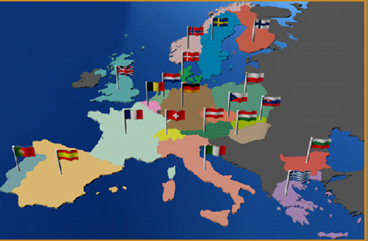
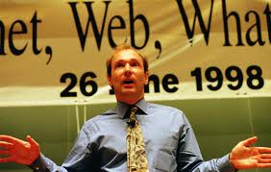
About CERN
CERN is the European Organization for Nuclear Research in Geneva
  Particle accelerators and other infrastructure for high energy physics (HEP) research
  Worldwide community
    20 member states (+ 3 incoming members)
    Observers: Turkey, Russia, Japan, USA, India
    About 2300 staff
    >10’000 users (about 5’000 on-site)
    Budget (2012) ~1000 MCHF
Birthplace of the World Wide Web

Slide 3
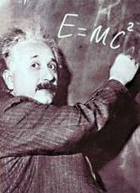

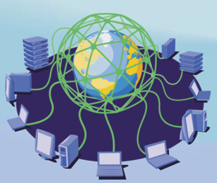

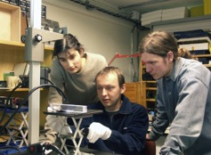
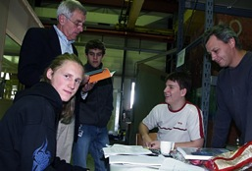
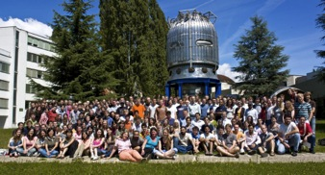
The Mission of CERN
Innovation
Education
CERN
uniting people
Research
Push forward the frontiers of knowledge
  The secrets of the Big Bang
  Origin of mass
Develop new technologies for accelerators and detectors
  Information technology - the Web and the Grid
  Medicine - diagnosis and therapy
Train scientists and engineers of tomorrow
Unite people from different countries and cultures
Notes:
3

Slide 4
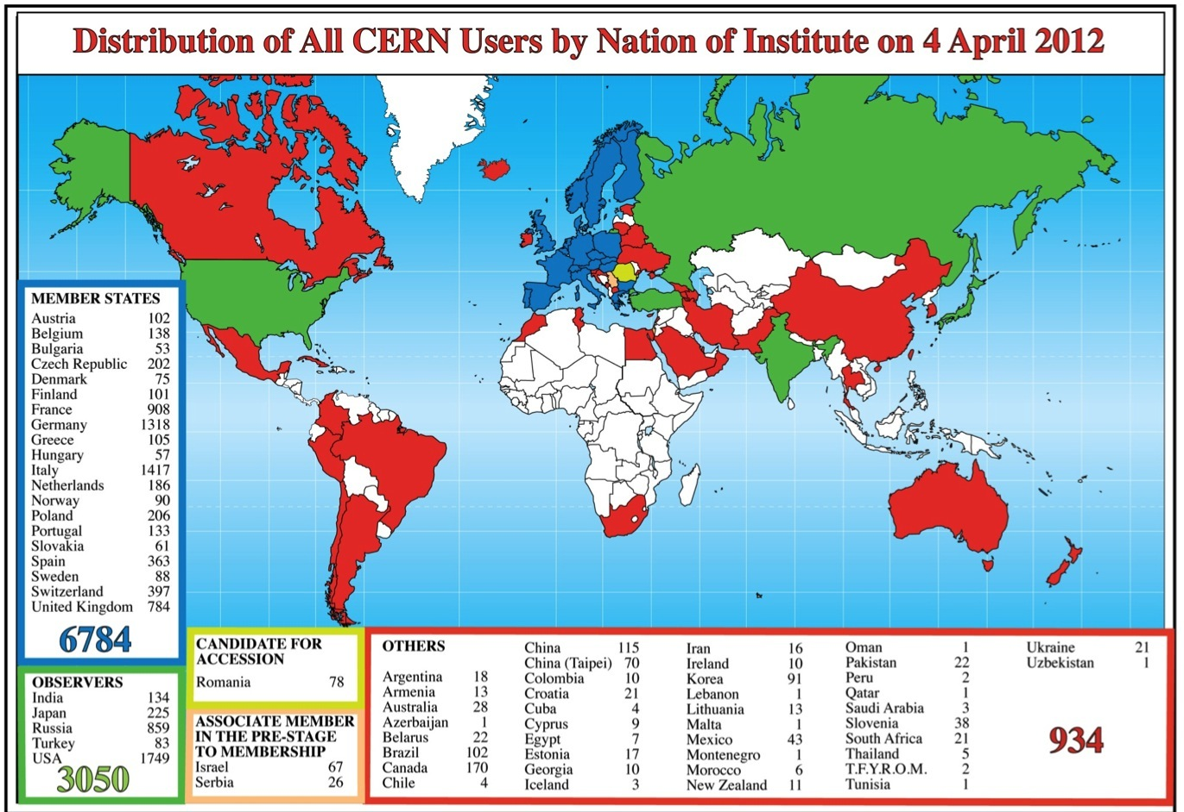
Science is more and more global
Notes:
4
4

Slide 5
CERN Organisation
Several Departments
  Accelerator sector
  Research Sector: Physics Department, IT Dept.
  Administration
Experiments are hosted
  Collaborations formed by MoU
  Collaborations have their own (elected) management
  CERN is host lab and also member of the collaborations
  WLCG is also constructed like the physics experiments

Slide 6
IT Organisation 2013
Director of Research
and
Computing
Sergio Bertolucci
CERN openlab
Bob Jones
Department Head
Frédéric Hemmer
CERN School of Computing
François Fluckiger
Deputy Head
David Foster
Planning Officer
Christian Isnard
Computer Security
Stefan Lüders
EU Projects
Bob Jones
WLCG
Ian Bird
Department Heads Office (DHO)
Communication Systems
(CS)
Jean-Michel Jouanigot
Platform & Engineering Services
(PES)
Helge Meinhard
Database Services
(DB)
Tony Cass
Experiment Support
(ES)
Jamie Shiers
Collaboration
& Information
Services
(CIS)
Tim Smith
Computing Facilities
(CF)
Wayne Salter
Data & Storage Services
(DSS)
Alberto Pace
Operating Systems & Infrastructure
Services
(OIS)
Tim Bell
Grid Technology
(GT)
Markus Schulz
Departmental Infrastructure
(DI)
Christian Isnard

Slide 7
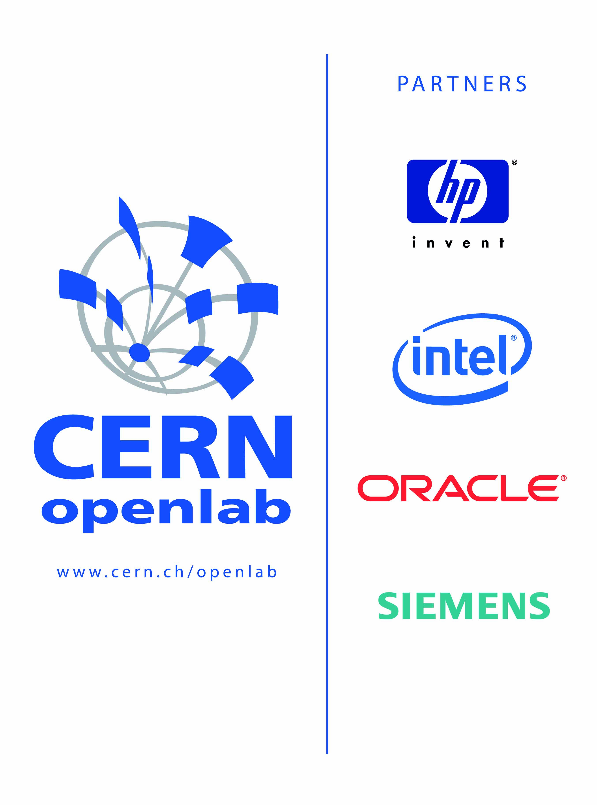

CERN openlab in a nutshell
A science – industry partnership to drive R&D and innovation with over a decade of success
Evaluate state-of-the-art technologies in a challenging environment and improve them
Test in a research environment today what will be used in many business sectors tomorrow
Train next generation of engineers/employees
Disseminate results and outreach to new audiences
Contributor (2012)

Slide 8
The CERN Data Centre in Numbers
Data Centre Operations (Tier 0)
  24x7 operator support and System Administration services to support 24x7 operation of all IT services.
  Hardware installation & retirement
    ~7,000 hardware movements/year; ~1800 disk failures/year
  Management and Automation framework for large scale Linux clusters
Racks | 828
Servers | 8,750
Processors | 15,694
Cores | 68,443
HEPSpec06 | 482,507
Disks | 67,320
Raw disk capacity (TiB) | 97,096
Memory modules | 52,377
Memory capacity (TiB) | 205
RAID controllers | 3,749
Tape Drives | 160
Tape Cartridges | 45000
Tape slots | 56000
Data on Tape (PiB) | 65
High Speed Routers (640 Mbps → 10 Tbps) | 25
Ethernet Switches | 500
10 Gbps/100Gbps ports | 1200/50
Switching Capacity | 6 Tbps
1 Gbps ports | 16,041
10 Gbps ports | 1,884
IT Power Consumption | 2456 KW
Total Power Consumption | 3890 KW

Slide 9
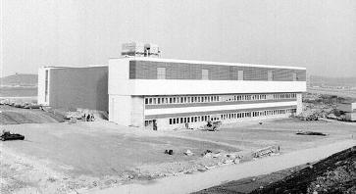
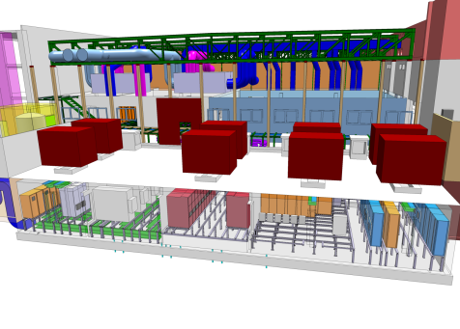
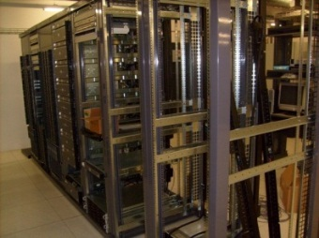
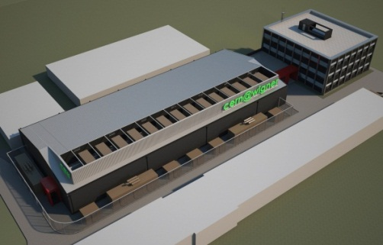
Scaling CERN Data Center(s) to anticipated Physics needs
CERN Data Center dates back to the 70’s
Upgraded in 2005 to support LHC (2.9 MW)
Still optimizing the current facility (cooling automation, temperatures, infrastructure)
Renovation of the “barn” for accommodating 450 KW of “critical” IT loads (increasing 513 total to 3.5 MW)
Exploitation of 100 KW of remote facility down town
Understanding costs, remote dynamic management, ensure business continuity
Exploitation of a remote Data center in Hungary
Max. 2.7 MW (N+1 redundancy)
  Business continuity
100 Gbps connections

Slide 10
Overview of computing

Slide 11
Some history of scale…
Date | Collaboration sizes | Data volume, archive technology
Late 1950’s | 2-3 | Kilobits, notebooks
1960’s | 10-15 | kB, punchcards
1970’s | ~35 | MB, tape
1980’s | ~100 | GB, tape, disk
1990’s | 700-800 | TB, tape, disk
2010’s | ~3000 | PB, tape, disk
For comparison:
1990’s: Total LEP data set ~few TB
Would fit on 1 tape today
Today: 1 year of LHC data ~25 PB

Slide 12
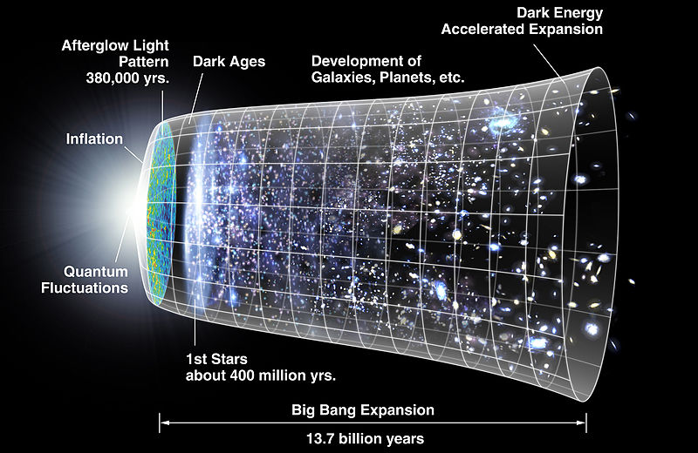
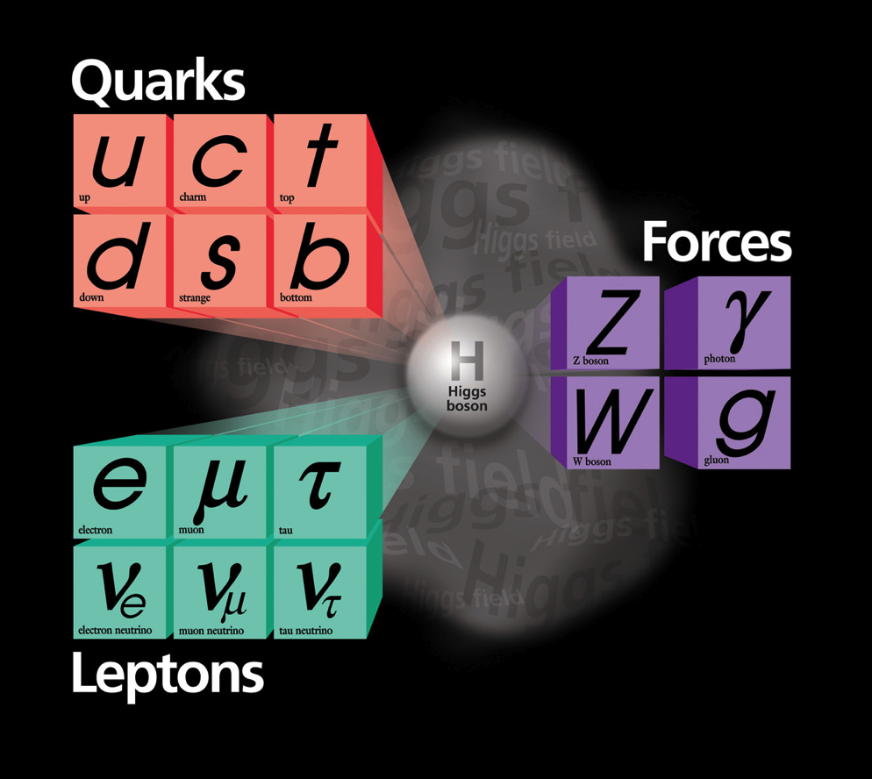
Fundamental questions…
How to explain that particles have mass?
  Theories and accumulating experimental data…getting close
What is 96% of the Universe made of?
  We only observe 4% of the apparent mass
Where is all the anti-matter?
  Why is Nature not symmetric?
What was the state of matter just after the Big Bang?
  “Soup” of quarks and gluons before they condensed into matter?

Slide 13
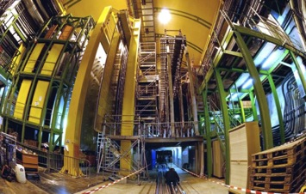
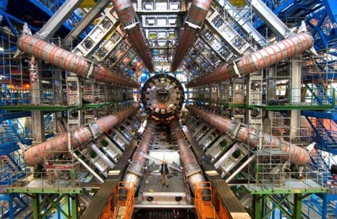
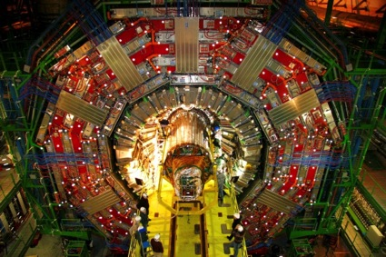
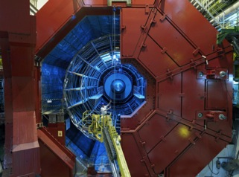
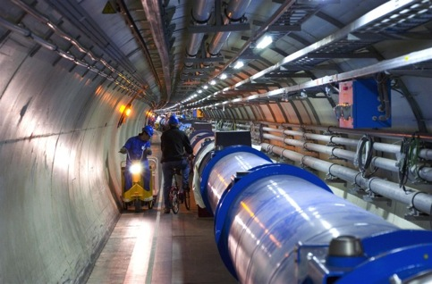

Tools: LHC and Detectors
pp, B-Physics, CP Violation
(matter-antimatter symmetry)
LHCb
CMS
ATLAS
General Purpose,
proton-proton, heavy ions
Discovery of new physics:
Higgs, SuperSymmetry
Exploration of a new energy frontier
in p-p and Pb-Pb collisions
ALICE
LHC ring:
27 km circumference
Heavy ions, pp
(state of matter of early universe)
Notes:
13

Slide 14
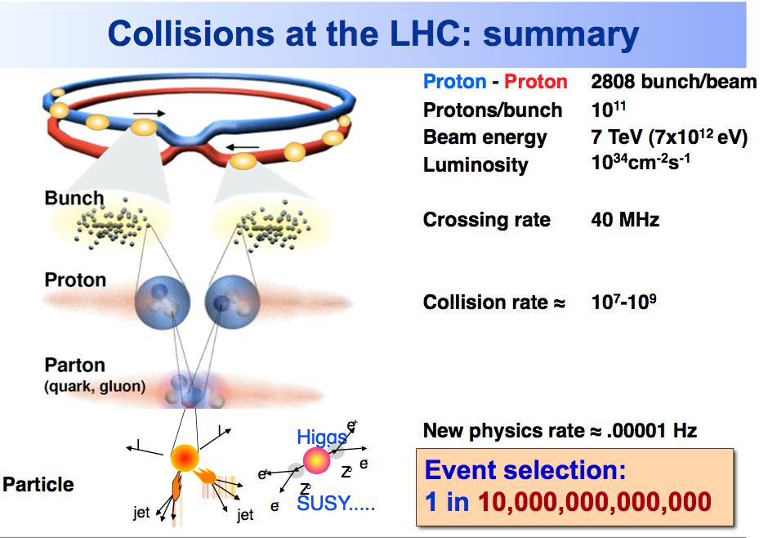

Slide 15
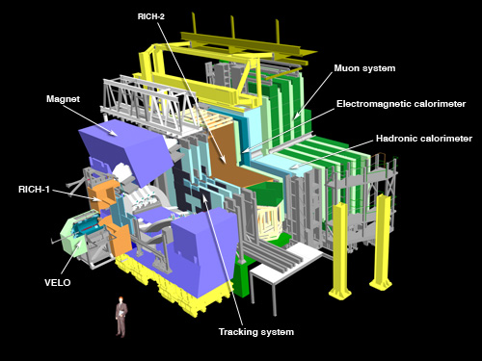
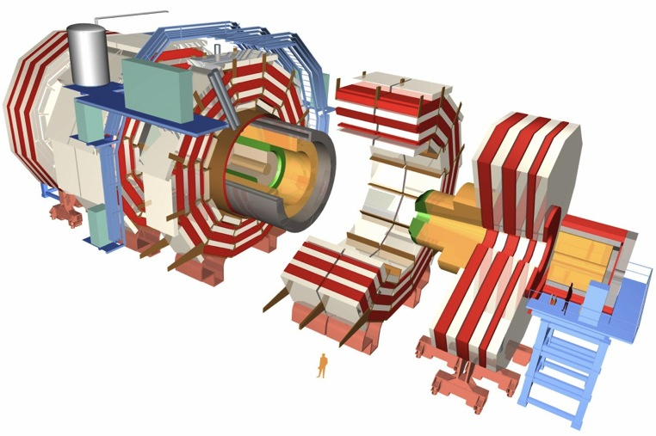
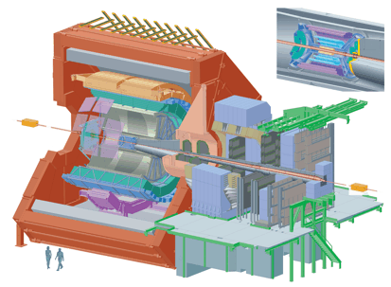
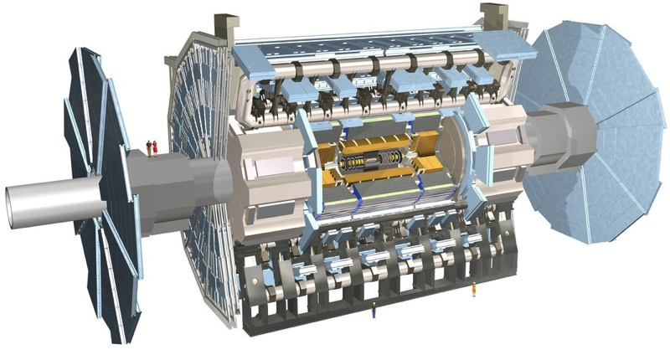
150 million sensors deliver data …
… 40 million times per second

Slide 16
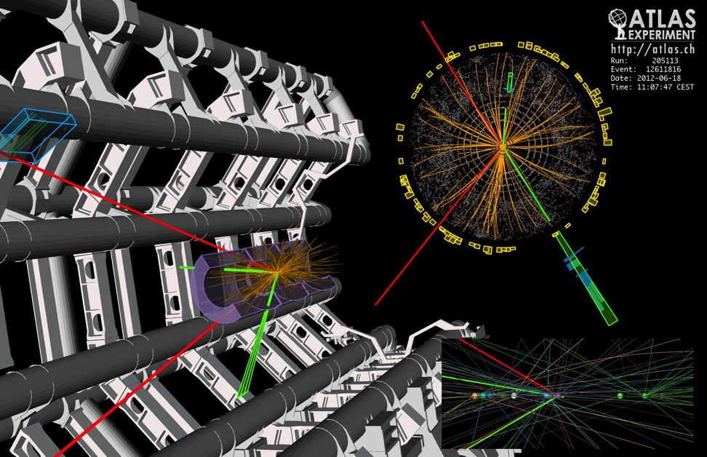
What is this data?
150 Million sensors deliver data … 40 Million times per second
Up to 6 GB/s to be stored and analysed after filtering
Raw data:
  Was a detector element hit?
  How much energy?
  What time?
Reconstructed data:
  Momentum of tracks (4-vectors)
  Origin
  Energy in clusters (jets)
  Particle type
  Calibration information
  …

Slide 17
Data and Algorithms
HEP data are organized as Events (particle collisions)
Simulation, Reconstruction and Analysis programs process “one event at a time”
  Events are fairly independent → Trivial parallel processing
Event processing programs are composed of a number of Algorithms selecting and transforming “raw” event data into “processed” (reconstructed) event data and statistics
RAW
Triggered events
recorded by DAQ
Detector digitisation
~2 MB/event
ESD/RECO
Reconstructed
information
Pseudo-physical information:
Clusters, track candidates
~100 kB/event
AOD
Physical information:
Transverse momentum,
Association of particles, jets,
id of particles
Analysis
information
~10 kB/event
TAG
Classification
information
Relevant information
for fast event selection
~1 kB/event

Slide 18
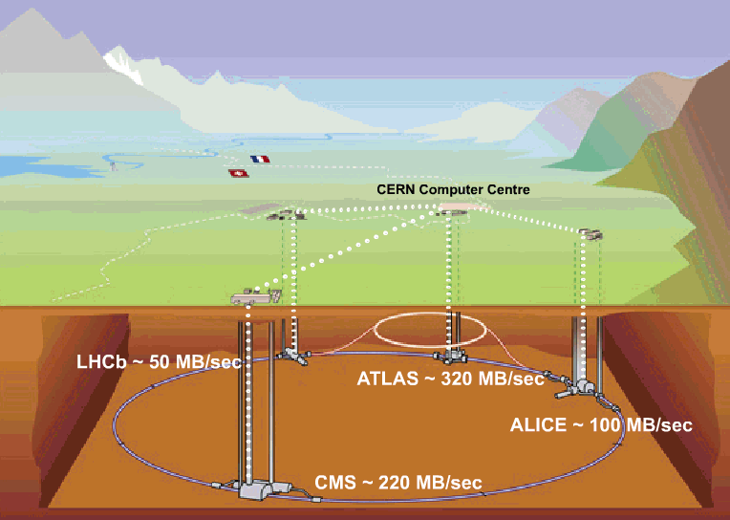
Data flow to permanent storage: 4-6 GB/sec
200-400 MB/sec
1-2 GB/sec
~ 4 GB/sec
1-2 GB/sec

Slide 19
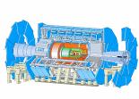

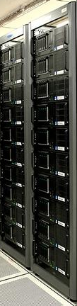

Data Handling and Computation for Physics Analysis
Online
Offline Reconstruction
Online trigger
and filtering
Selection &
reconstruction
detector
Processed
Data (Active tapes)
Event
summary
data
Offline Analysis w/ROOT
Raw
data
10%
100%
Batch
physics
analysis
Event
reprocessing
1%
Offline Simulation
w/GEANT4
Event
simulation
Analysis objects
(extracted by physics topic)
Interactive
analysis

Slide 20
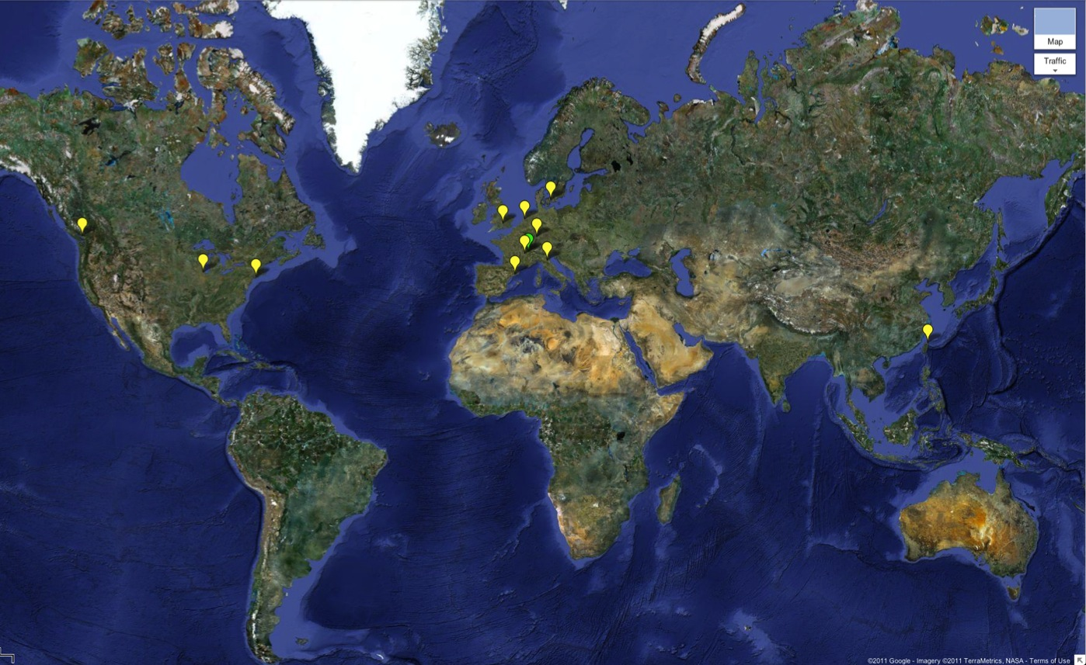

WLCG: A global collaboration…
Tier-0 (CERN):
Data recording
Initial data reconstruction
Data distribution
Tier-1 (11 centres):
Permanent storage
Re-processing
Analysis
Tier-2 (~140 centres):
Simulation
End-user analysis
~150 sites
>250k CPU cores
>150 PB disk
Tier 0
Tier 1
Tier 2

Slide 21
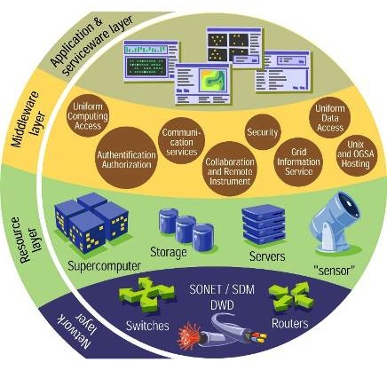






e-Infrastructure: Grids
Notes:
Here we see a schematic of a grid infrastructure. At the lowest level we have the physical networks providing the underlying communication. These are supported by large national or international projects and organisations, such as Geant in Europe, and many National Research and Education Networks (NREN) organisations.
At the next layer we have the resources that are to be shared – these may be computing clusters, storage systems, supercomputers, or even scientific instruments. At the next layer we see the implementation of the “grid” through the layer of software – or grid middleware. This is what binds together the underlying physical resources into a collaborative structure, providing all of the elements necessary to do so. At one extreme we have supercomputer grids such as DEISA or Teragrid that link supercomputers, while at the other we have more general cluster-based grids such as Open Science Grid in the USA and EGI (EGEE) in Europe.
Finally on the upper layer we have the applications – which may or may not need to have been modified to make use of the underlying software. Reliable services, monitoring, etc are also implemented at this layer.

Slide 22
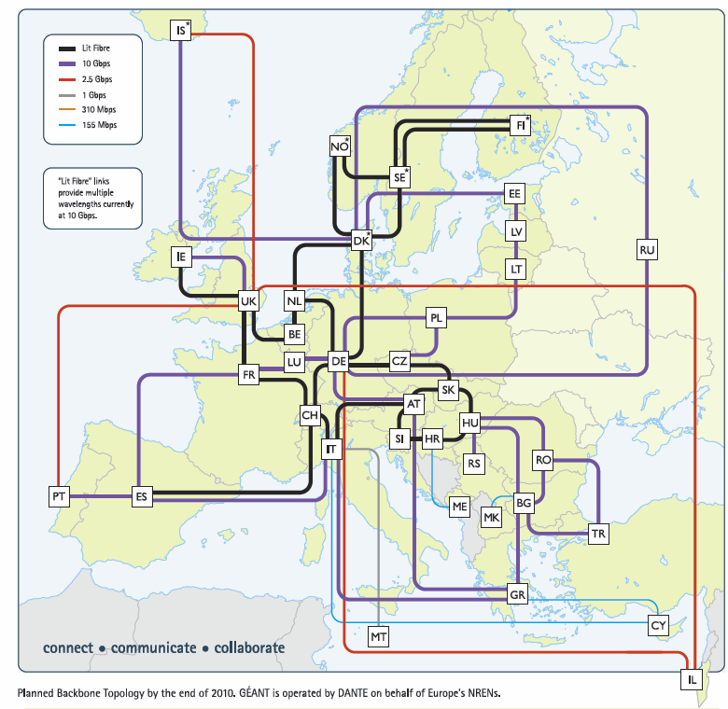
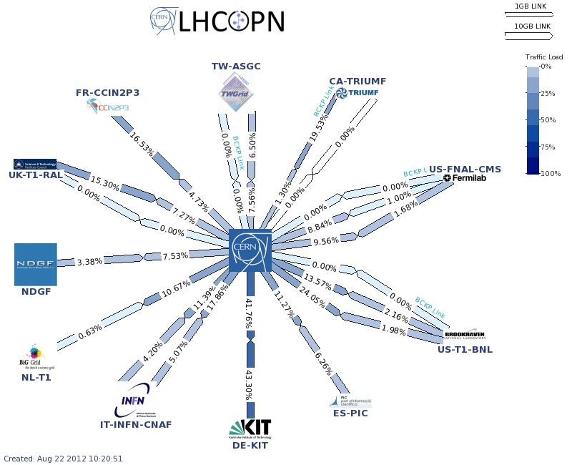
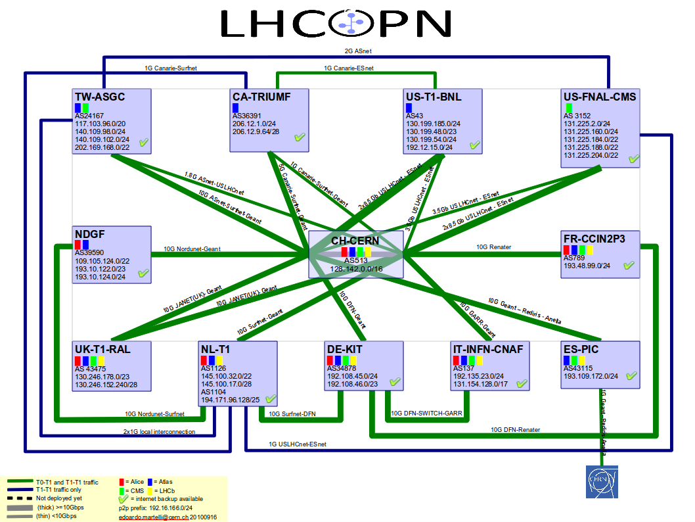
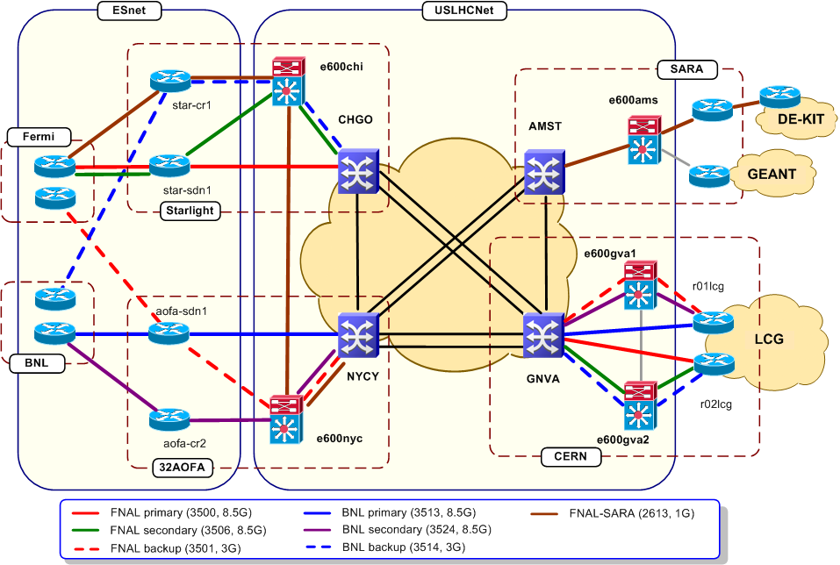
LHC Networking
Relies on
  OPN, GEANT, US-LHCNet
  NRENs & other national & international providers

Slide 23
From testing to data:
e.g. DC04 (ALICE, CMS, LHCb)/DC2 (ATLAS) in 2004 saw first full chain of computing models on grids
Independent Experiment Data Challenges
2004
SC1 Basic transfer rates
Service Challenges proposed in 2004
To demonstrate service aspects:
  Data transfers for weeks on end
  Data management
  Scaling of job workloads
  Security incidents (“fire drills”)
  Interoperability
  Support processes
2005
SC2 Basic transfer rates
SC3 Sustained rates, data management, service reliability
2006
SC4 Nominal LHC rates, disk→ tape tests, all Tier 1s, some Tier 2s
2007
Focus on real and continuous production use of the service over several years (simulations since 2003, cosmic ray data, etc.)
Data and Service challenges to exercise all aspects of the service – not just for data transfers, but workloads, support structures etc.
2008
CCRC’08 Readiness challenge, all experiments, ~full computing models
2009
STEP’09 Scale challenge, all experiments, full computing models, tape recall + analysis
2010
Notes:
To give a sense of how grids have developed over the last 10 years, the testing timeline of WLCG is instructive. Already in 2004 the experiments were using the grid infrastructure as their main means of producing simulated data – relying on it as their main production system. In parallel a series of data and service challenges were proposed and executed, in order to demonstrate increasing levels of performance and service. Two aspects were particularly important for WLCG – data transfers and overall service reliability. Partly the challenges could only be executed once the Tier 1 sites had ramped up their resources to an appropriate level, and partly it was necessary to learn how to manage and schedule data transfers to maximise the throughput. The grid service was continually used for real work – culminating in cosmic ray data and finally real LHC data.

Slide 24
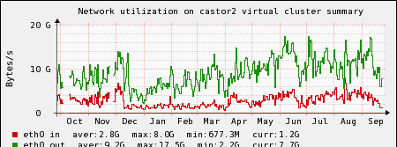
Castor data written 2010-12
p-p data
2010-2012 Data written:
Total ~19 PB in 2012
Close to 4 PB/month now
Pb-Pb data
>30 PB in 2012?
15 PB in 2010
23 PB in 2011
Data rates in Castor increased
3-4 GB/s input
~15 GB/s output

Slide 25
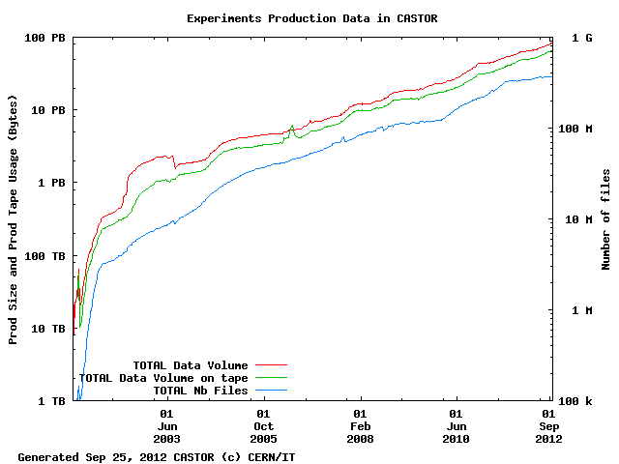
CERN has ~100 PB archive

Slide 26
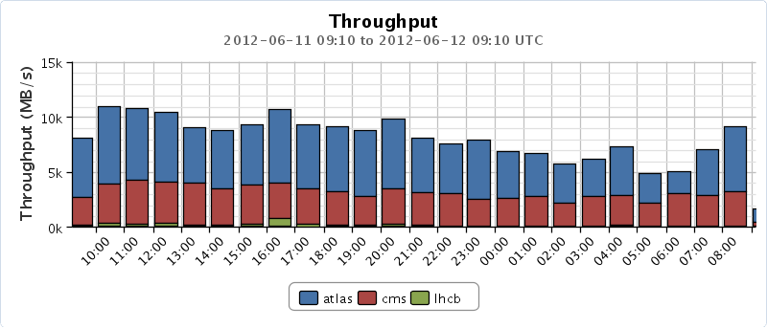
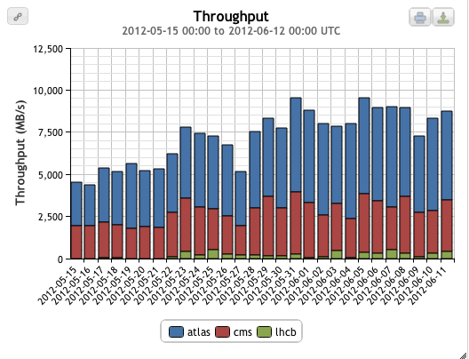
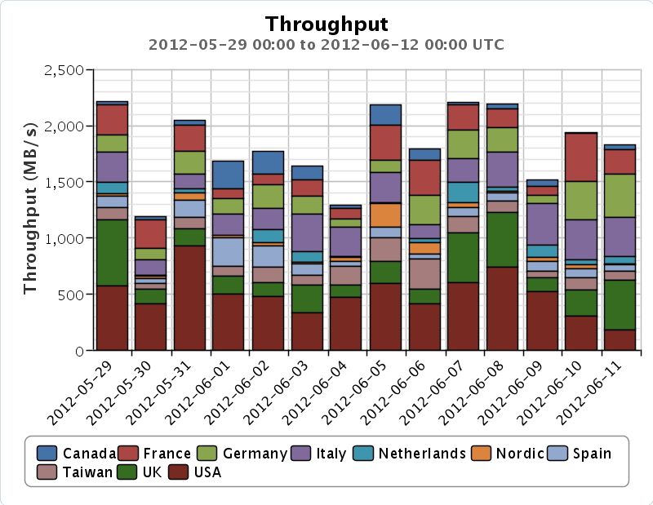
Data transfers
Global transfers (May-June)
Global transfers > 10 GB/s (1 day)
CERN → Tier 1s (with LHC on): 2 GB/s
Planned rates:
Tier 0 – Tier 1: 650 MB/s + margin

Slide 27
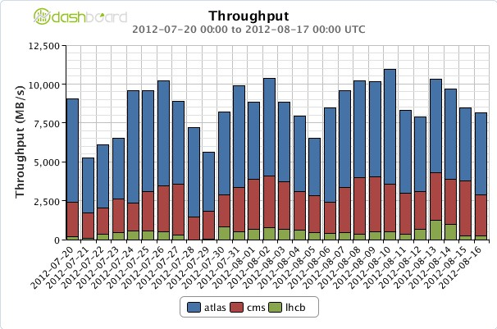
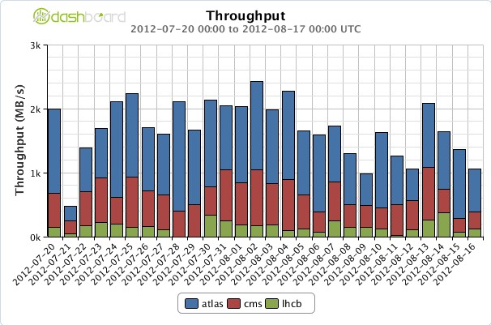
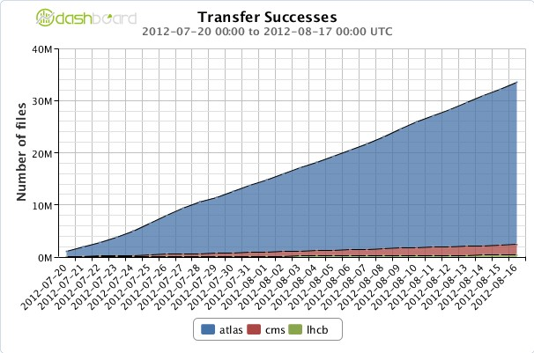
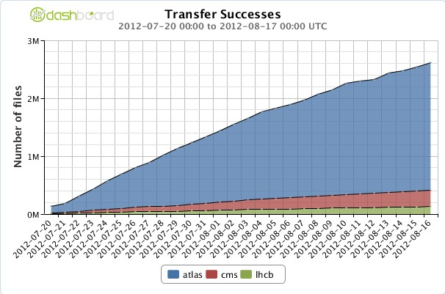
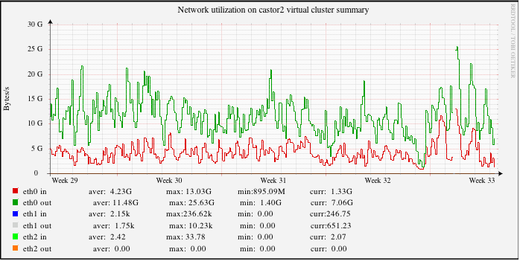
Data Transfers
A key technology for LHC
Worldwide data traffic
Export from CERN data traffic
Total data movement inside CERN
Last month:
4 PB, 2.6M files exported from CERN to Tier 1s
20 PB, 33M files moved worldwide
Data movement inside Tier 0:
Data in: 4.3 GB/s (peak 13 GB/s)
Data out: 11.5 GB/s (peak 25 GB/s)
~1.5 PB/day data movement at CERN

Slide 28
Processing on the grid
Usage continues to grow…
# jobs/day
CPU usage
1.5M jobs/day
2 M jobs/day
~ 150,000 years of CPU delivered each year
10⁹ HEPSPEC-hours/month
(~150 k CPU continuous use)
This is close to full capacity
We always need more!

Slide 29
CPU – around the Tiers
The grid really works
All sites, large and small can contribute
  And their contributions are needed!
Notes:
The distribution of delivered CPU between the various tiers has also been according to the design, with tier 2s providing in excess of 50% of the total. If this is broken down we see that countries deliver close to what they pledged. Thus the grid concept really does work on this scale, and enables institutes worldwide to collaborate, share data, and provide resources to the common goals of the collaboration. Early worries that people would simply ignore the grid and use CERN for analysis were unfounded – Tier 2s are used extensively and exclusively.

Slide 30
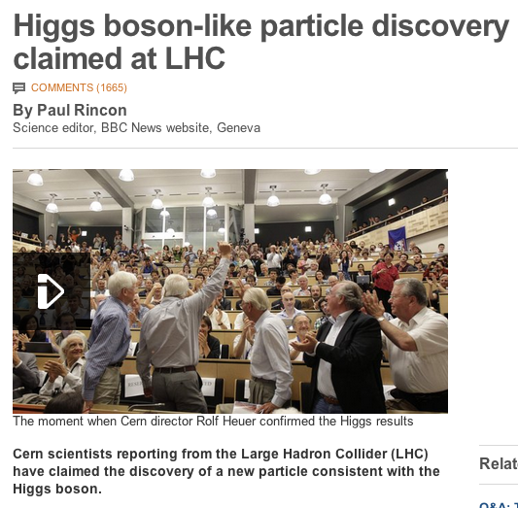
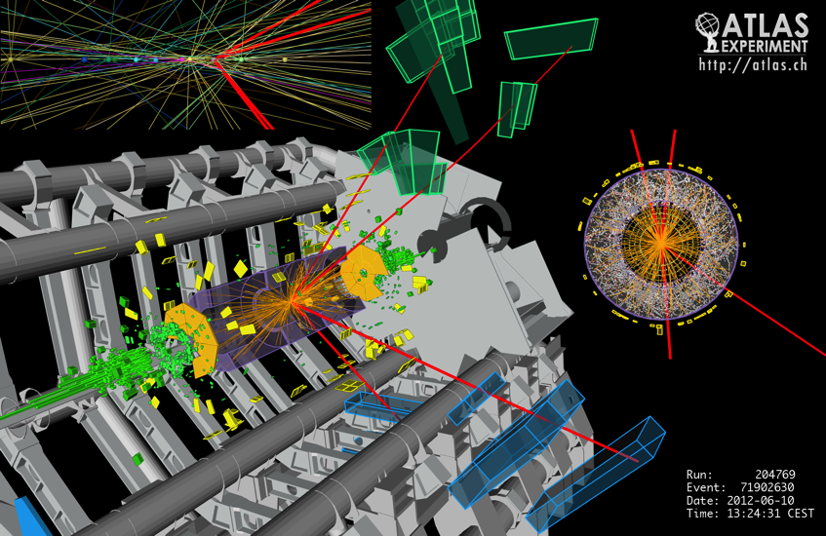
  Grid computing enables the rapid delivery of physics results

Slide 31
Impact of the LHC Computing Grid
WLCG has been leveraged on both sides of the Atlantic, to benefit the wider scientific community
  Europe:
    Enabling Grids for E-sciencE
    (EGEE) 2004-2010
    European Grid Infrastructure
    (EGI) 2010--
  USA:
    Open Science Grid (OSG)
    2006-2012 (+ extension?)
Many scientific applications ➔
  Archeology
  Astronomy
  Astrophysics
  Civil Protection
  Comp. Chemistry
  Earth Sciences
  Finance
  Fusion
  Geophysics
  High Energy Physics
  Life Sciences
  Multimedia
  Material Sciences
  …
Notes:
WLCG has driven the development of multi-science grids in Europe and in the US. In Europe the EGEE projects, followed recently by EGI support very many different applications other than LHC, while in the US the Open Science Grid has played a similar role, although also with LHC as a main stakeholder. In both cases many different application communities have benefitted from the advent of grid infrastructures.

Slide 32
Growth and evolution
WLCG – a 10 year program of development and implementation
Today the WLCG grid has delivered on its promise and LHC is producing unprecedented physics output
BUT: challenges remain:
  We have a >20 year program for the LHC and experiments
  Technology evolves: grids, clouds, CDN’s etc
  Physics hunger for resources continues to increase

Slide 33
Evolution of capacity: CERN & WLCG
Modest growth until 2014
Anticipate x2 (?) requirement >2015
Anticipate x10-100 after 2018 ???
What we thought was needed at LHC start
What we actually used at LHC start!

Slide 34
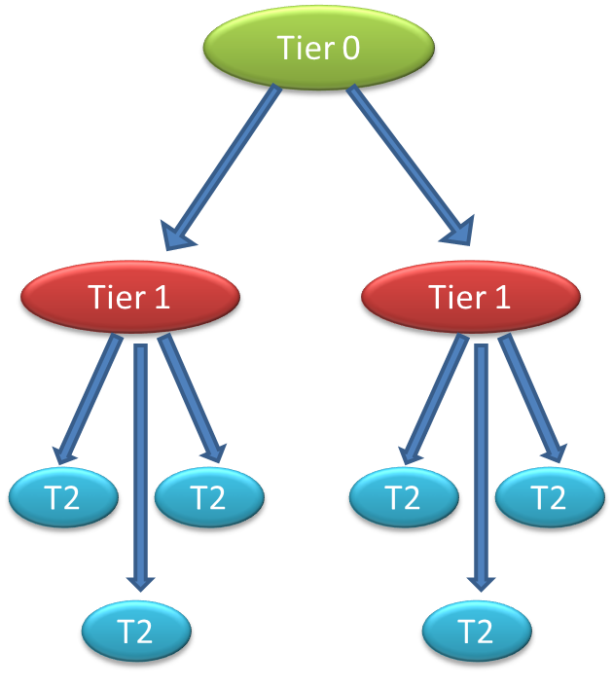
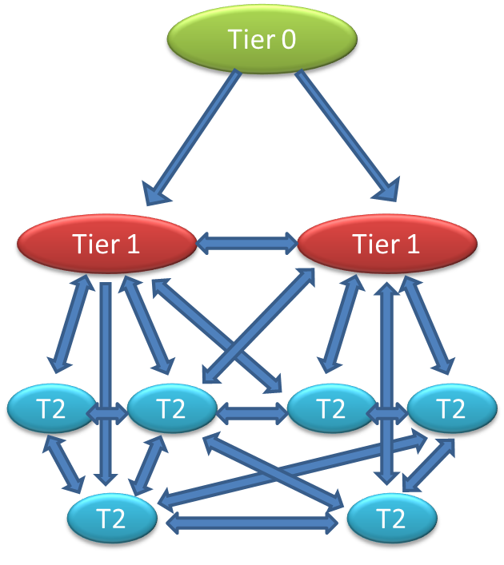
Computing model evolution
Evolution of computing models
Hierarchy
Mesh

Slide 35
Original Grid Services
Data Management Services
Security Services
Job Management Services
Storage Element
Certificate Management Service
VO Membership Service
Compute Element
File Catalogue Service
Workload Management Service
Authentication Service
Grid file access tools
VO Agent Service
Authorization Service
File Transfer Service
Application Software Install Service
More complex than (eventually) really needed
GridFTP service
Information Services
Database and DB Replication Services
Information System
Messaging Service
Experiments invested considerable effort into integrating their software with grid services; and hiding complexity from users
POOL Object Persistency Service
Accounting Service
Site Availability Monitor
Monitoring tools: experiment dashboards; site monitoring
Notes:
Overview of what is included today in “grid middleware”
Experiments invested significant effort in their software frameworks to hide this complexity from their users

Slide 36
Consolidation & evolution
WLCG is an ongoing (and successful) operation, but:
Computing models have evolved
Far better understanding of needs now than 10 years ago
  Significant experience with data now
Experiments have developed workarounds to manage weaknesses in middleware
Pilot jobs and central task queues (almost) ubiquitous
Operational effort often too high; lots of services were not designed for redundancy, fail-over, etc.
Technology evolves rapidly, rest of world also does (large scale) distributed computing – don’t need entirely home grown solutions
Must be concerned about long term support and where it will come from

Slide 37
WLCG will remain a Grid
We have a grid because:
  We need to collaborate and share resources
  Thus we will always have a “grid”
  Our network of trust is of enormous value for us and for (e-)science in general
We also need distributed data management
  That supports very high data rates and throughputs
  We will continually work on these tools
How much can come from open source community (or …)?
  We should determine what we can actually take from the open source (or commercial) world
  Focus our (shrinking) efforts on the areas that we must develop ourselves
    But continue to question when/why we need to do that

Slide 38
The promise of cloud technology …
Use of technology
  Virtualisation
  New “standard” interfaces (well, maybe one day)
Services
  Academic clouds
    Grid → cloud? (or grids & clouds co-exist)
  Commercial clouds
    Outsourcing of services
    Use for data processing, storage, analysis
New types of services, new ways of providing services

Slide 40
Conclusions
First years of LHC data – WLCG has helped deliver physics rapidly
Just the start of a >20 year exploration of new physics
Entering a phase of consolidation and evolution
  LS1: opportunity for disruptive changes and scale testing of new technologies
Challenges for computing – scale & complexity – will continue to increase dramatically

