Slide 1
ALICE ITS Upgrade –
Module development and construction
P. Riedler/CERN-PH

Slide 2
ALICE ITS Working Group 3 – Work Package 4
Activities are part of Working Group 3: Study and implementation of the silicon detector technologies for the ALICE ITS upgrade
Bi-weekly meetings since January 2011, WG3 Indico page:
  https://indico.cern.ch/categoryDisplay.py?categId=3308
Work package 4 - key topics:
Wafer thinning, dicing and post-processing
Chip testing and verification
Flip chip mounting on module flex cable
Design and production of the module flex
Starting from March 2013
INDICO: WG3 section WP4

Slide 3
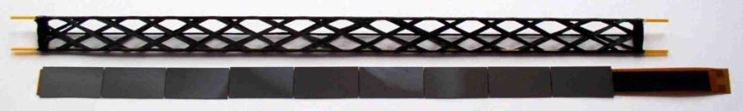
1. Thinning and Dicing
Thinning – requirements and specifications:
Std. wafer thickness 8”: 725 um, thinning routinely in MPW runs to 300-400 um
Target thickness for the ALICE ITS upgrade driven by the material budget limitations AND feasibility (example from STAR): 50 um ± 5 um
Total material budget per layer | 0.3% X₀
Silicon (50 um) | 0.054 % X₀

Slide 4
1. Thinning and Dicing
Thinning and dicing of blanks, test wafers and CMOS wafers carried out with commercial wafer service supplier (Rockwood, France)
Process used so far: pre-dice wafers, then back-grind
Assumed die size: 15 mm x 30 mm
Wafers thinned and diced since beginning of 2012:
 | # of wafers | Die size |  | Yield (# chips/# chips expected)
Blank wafers | 13 | Various die sizes | Mechanical and assembly tests | -
Blank wafers | 5 | 15 mm x 30 mm | Mechanical and assembly tests | 96% (263/275)
Al pattern wafers | 5 | 15 mm x 30 mm | Interconnection tests | 89% (244/275)
Ni/Au pattern wafers | 5 | 15 mm x 30 mm | Interconnection tests | 77% (211/275)*
MIMOSA20 wafers | 2 | 10 mm x 20 mm | Real CMOS wafers | 100% (216/216)
Total | 30 |  |  | 91%

Slide 5
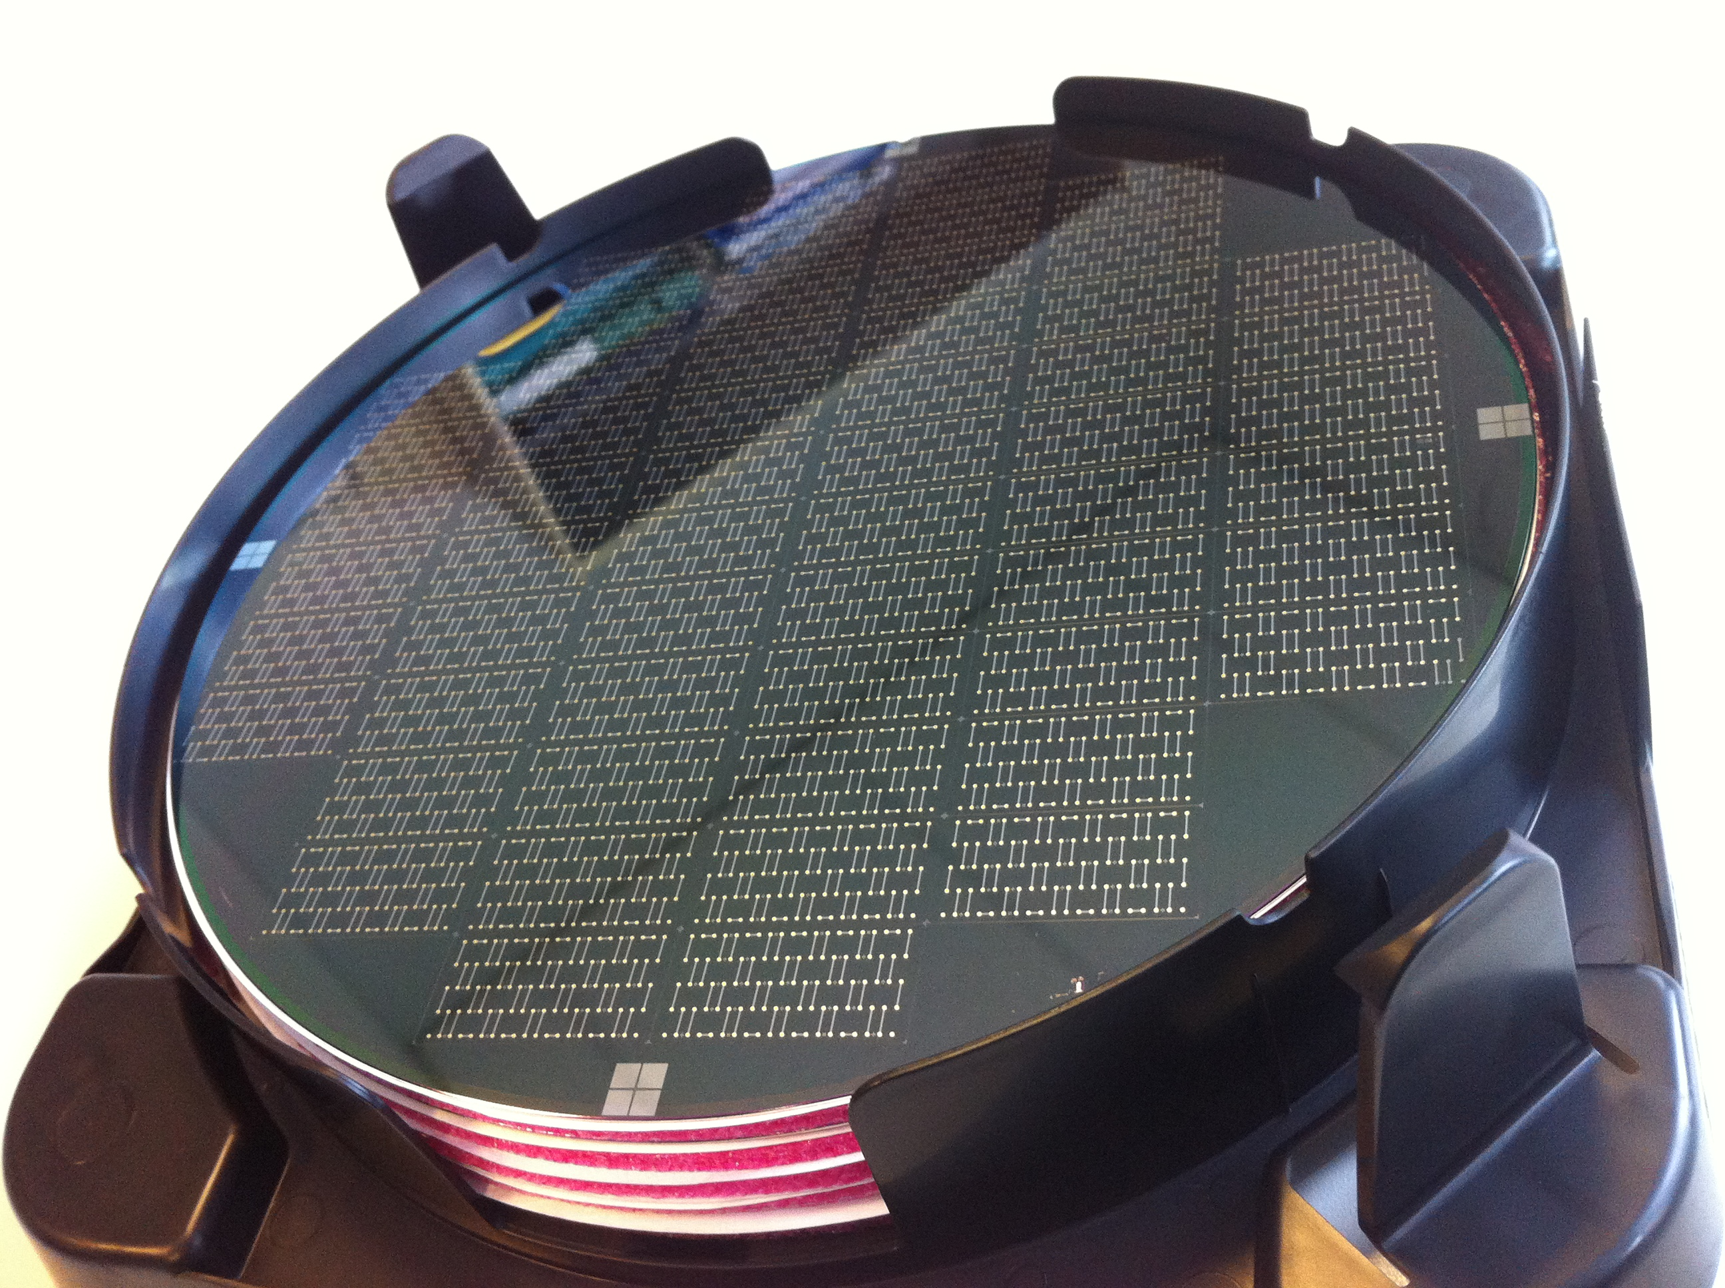
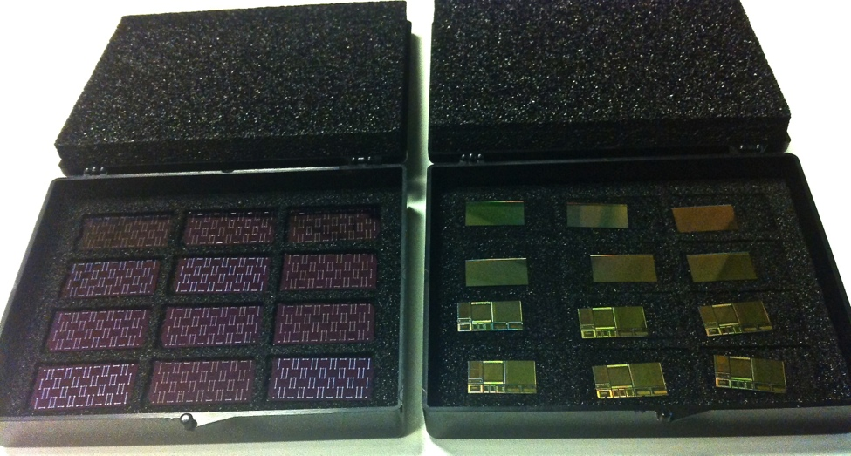
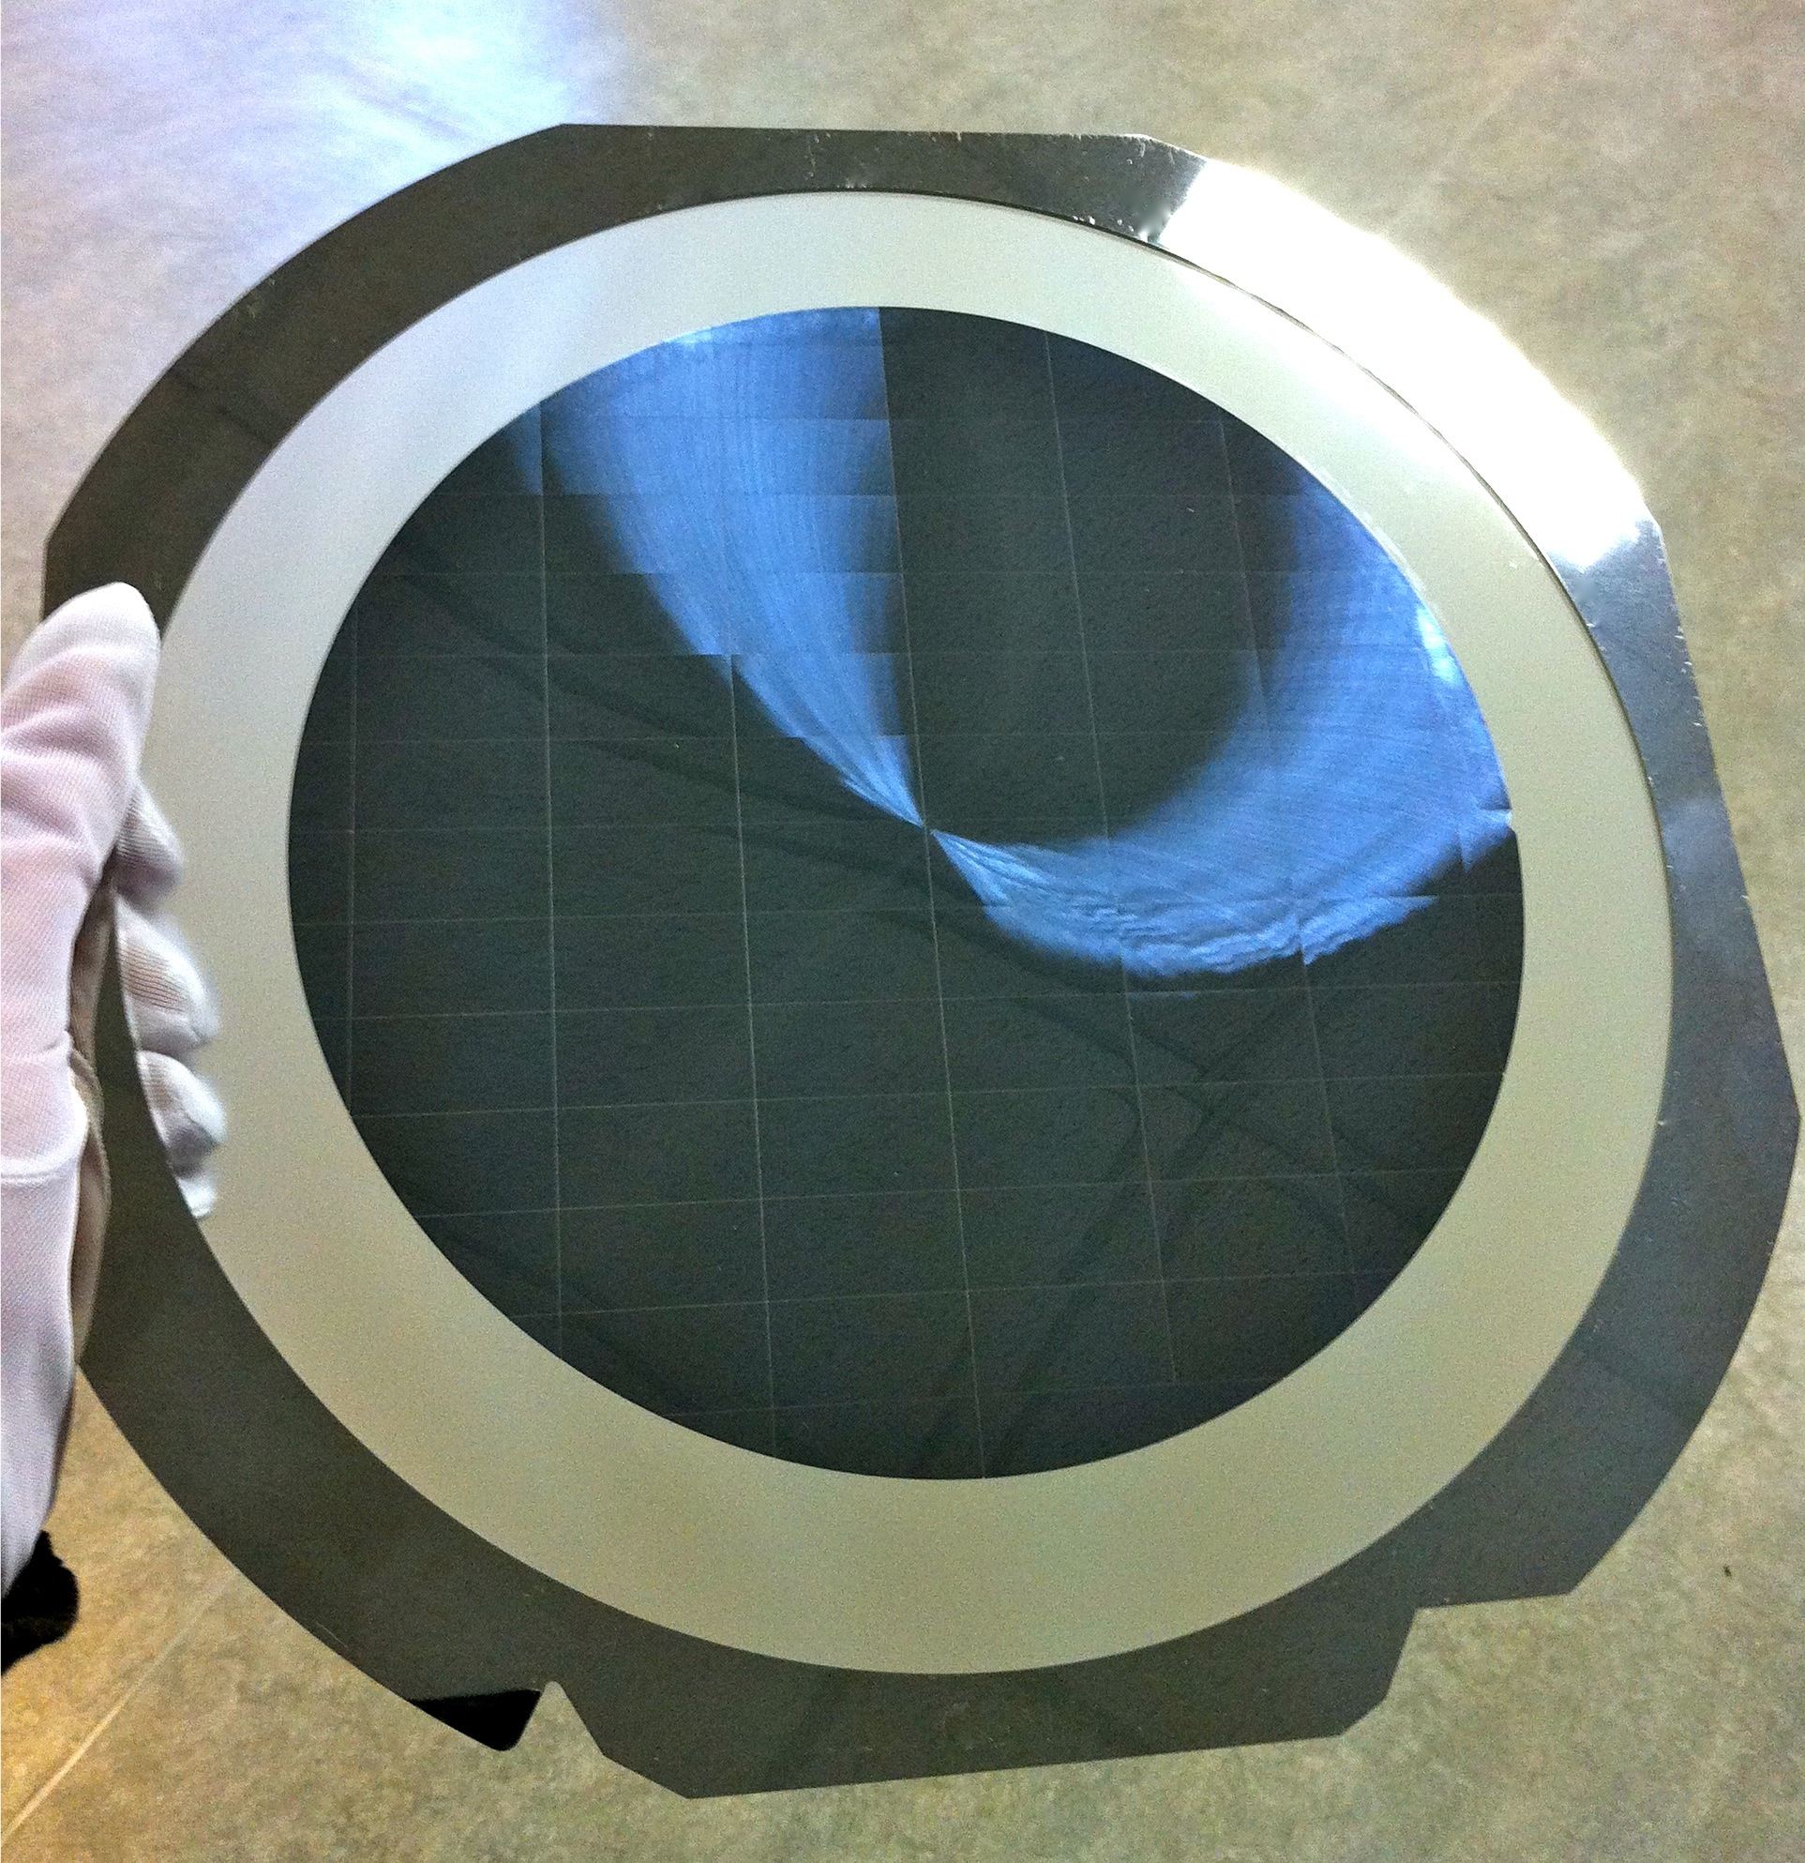
1. Thinning and Dicing
Thinning of blank wafers, patterned wafers (Al and Al/Ni/Au), real CMOS wafer

Slide 6
1. Thinning and Dicing
Optical metrology: IR measurement of the thickness on each die (108/wafer, MIMOSA20)
Avg | 40.39
Median | 40.40
Min | 38.10
Max | 43.16
Quartile 1 | 39.68
Quartile 3 | 41.17
TTV | 5.06
IR measurement does not take into account metal and inter-metal layers of the chip
MIMOSA20: 6 metal layers (~ 10 um offset)
Median: 40.4 um >> 50.4 um
Min: 38.1 um >> 48.1 um
Max: 43.2 um >> 53.2 um

Slide 7
1. Thinning and Dicing – next steps
Dicing of engineering run wafers (23 dies per reticle) at full thickness (prototype chip tests) – June 2013
Dicing and thinning of at least 1 engineering run wafer – provide prototype chips with final thickness – summer 2013
Study to optimize dicing quality:
  Investigate alternative dicing techniques to reduce edge damage (brittle) and eventually reduce dicing street width: laser dicing, stealth dicing, eventually plasma dicing
  First discussions with Rockwood to carry out tests using different dicing techniques
QA procedures: metrology measurements (edge quality, flatness, ..) – will become part of the large production testing!
Tuning of process procedures with Rockwood (wafer QA sheet with thickness measurement, loss analysis, …) – ongoing

Slide 8
2. Chip Verification & Testing
Assume chip size of 15 mm x 30 mm
 | Modules | Chips
Layer 4 | 48 | 2688
Layer 5 | 52 | 2912
Layer 6 | 96 | 9600
Layer 7 | 102 | 10200
Total | 298 | 25400
 | Modules | Chips
Layer 1 | 12 | 108
Layer 2 | 16 | 144
Layer 3 | 20 | 180
Total | 48 | 432
~ 26 000 good chips
Yield factors (assumptions):
Wafer yield: 0.6
Thinning and dicing: 0.9
Post processing (metallisation): 0.95
0.52
➔ Test ~ 50 000 chips

Slide 9
2. Chip Verification & Testing
The chips will have to be tested at several instances:
A.Wafers from foundry
Test of chips on subset of wafers
B. Post-processing (metallisation, bumping?)
Test of (few) chips on subset of wafers, Visual inspection!
C. Dicing and Thinning
Test and inspection of individual chips
Mass testing !
X 50 000

Slide 10
2. Chip Verification & Testing
  A. Wafers returned from foundry:
  Select sub-set of the wafers from the production quantity and thin and dice them
    select 10-25% of the production wafers throughout the production
    Monitoring of the production quality and in case of problems intervene
  Test these chips using the characterization test system to monitor any problems in the production

Slide 11
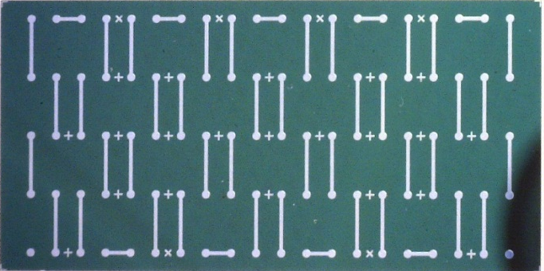
2. Chip Verification & Testing
B. Wafers back from post-processing (metallisation, bumping)
  Parameters to be tested:
  Basic electrical test - on sub-set of chips, verification of functionality
  Visual inspection: contact pad integrity; any other damage – all wafers!!
  Test system (automatized):
  Visual inspection system
  Electrical tests done with characterization system on small set of chips
  System located in a clean environment (class to be defined)

Slide 12
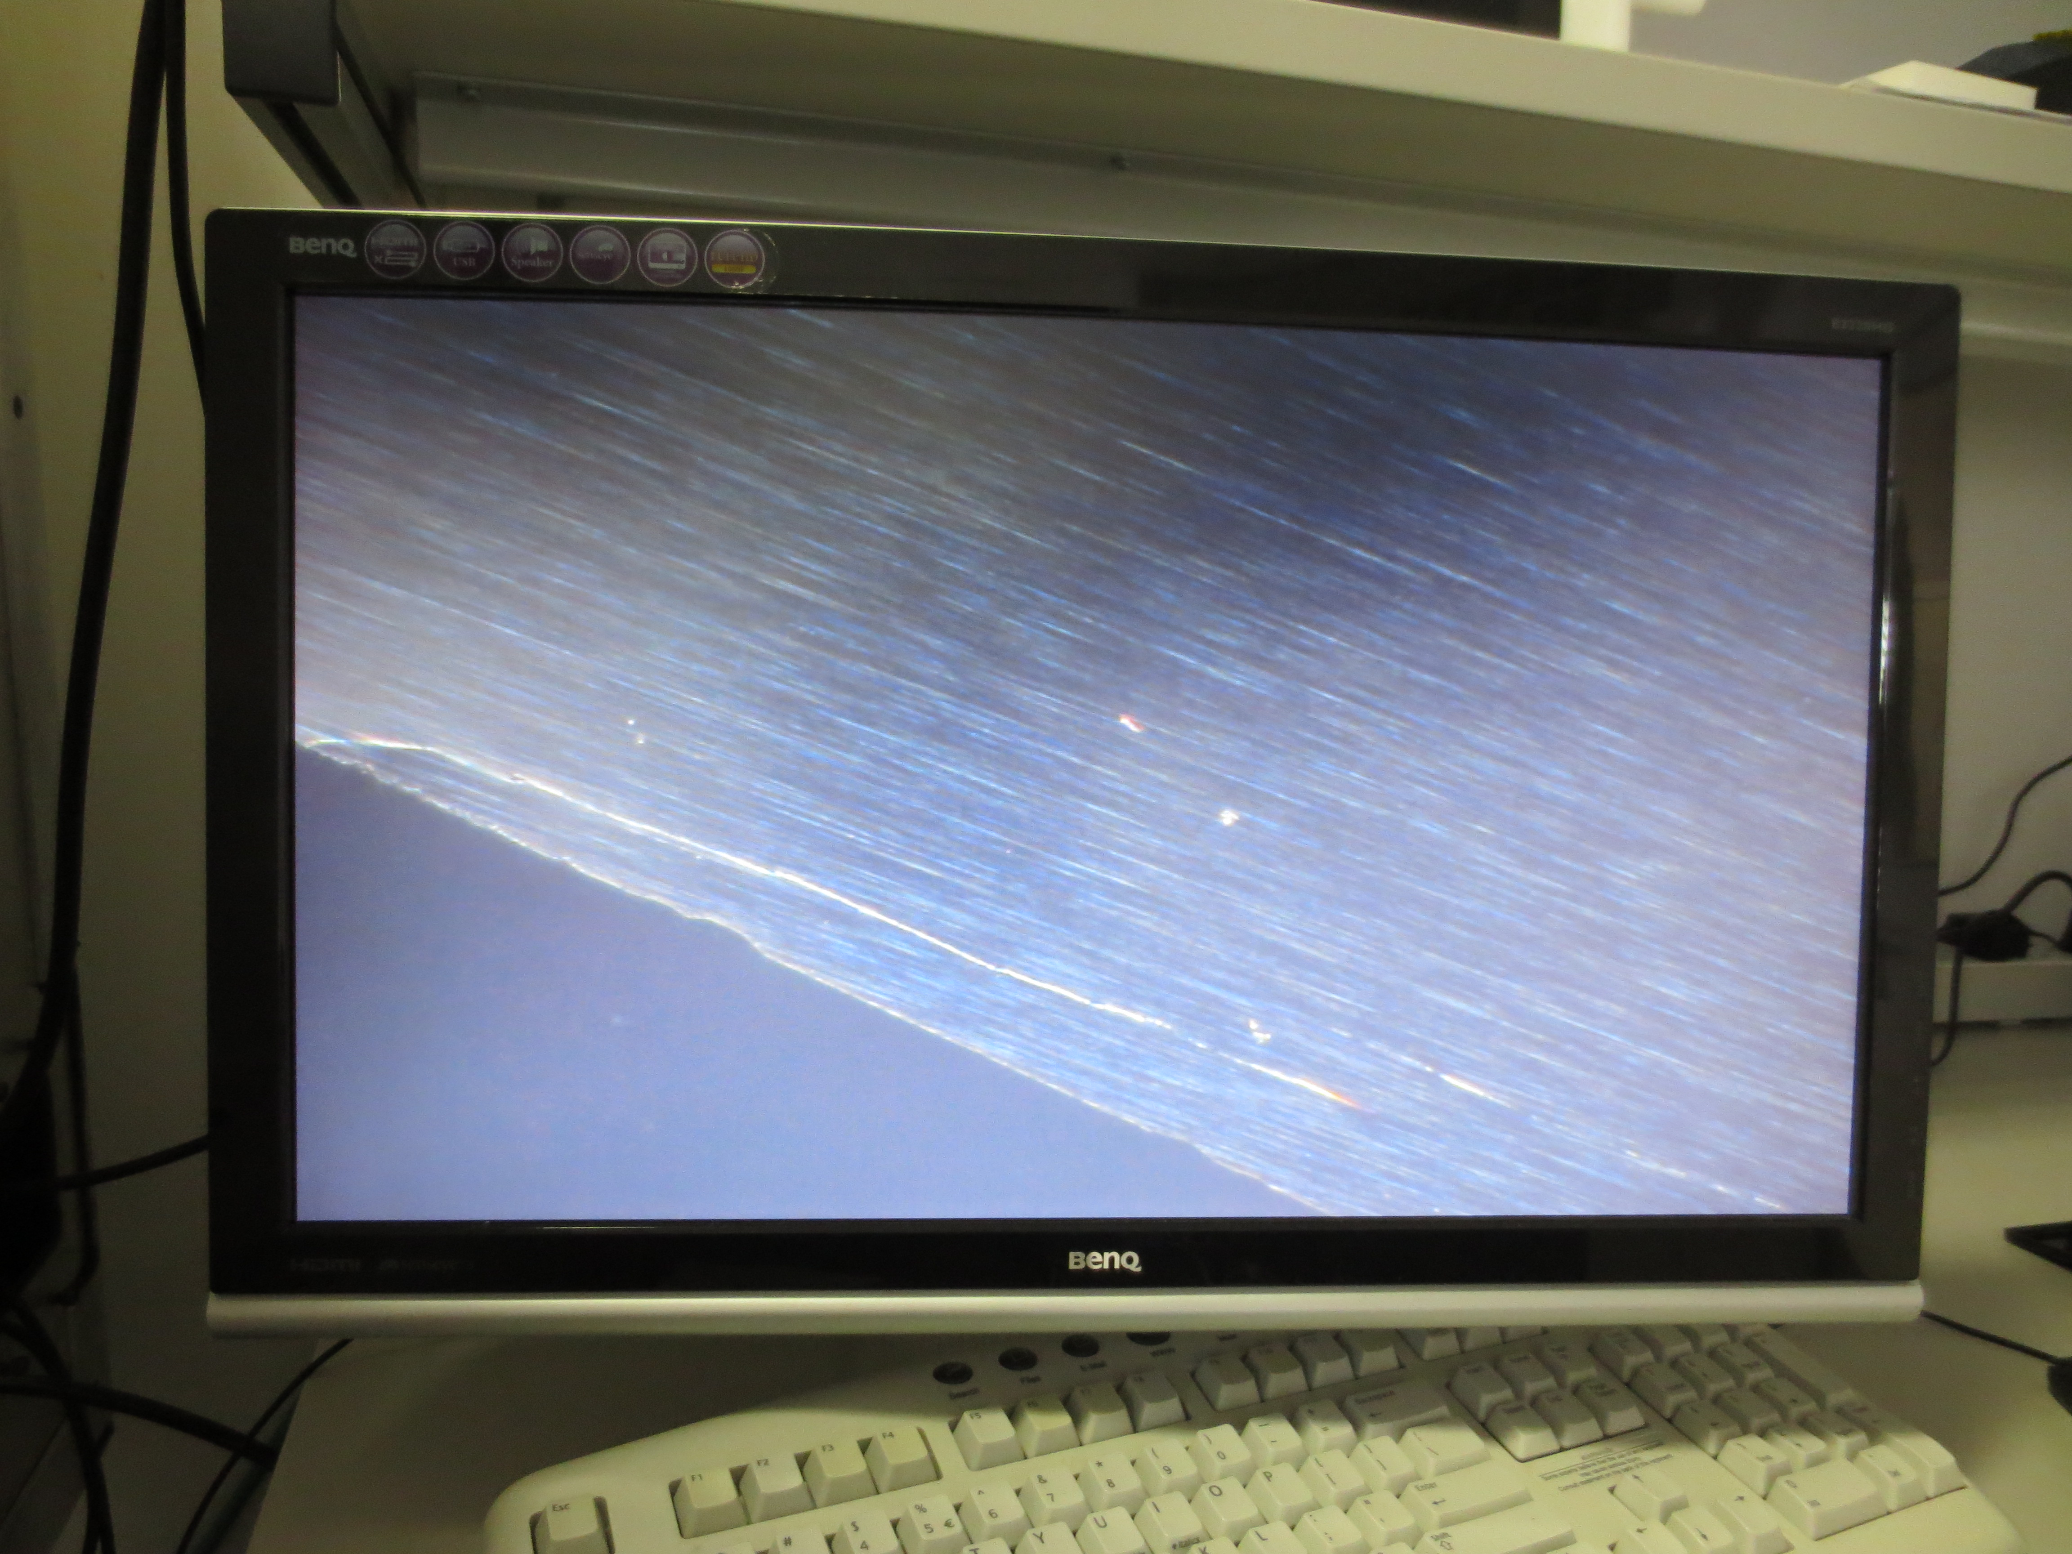
2. Chip Verification & Testing
3. Testing of chips after dicing and thinning
  Parameters to be tested:
  Basic electrical test – on all chips, full verification of functionality
  Visual inspection: contact pads; any other damage – on all chips
  Final selection of good chips for modules
  Test system (automatized):
  Contact by needle bed or BGA type test box ?
  Visual inspection system
  Test system (readout system)
  System located in a clean environment (class to be defined)

Slide 13
2. Chip Verification & Test – General points
Each chip should be tested according to a defined test-procedure following a protocol
The results of each test should be recorded and stored in a commonly accessible data-base
At every test instance the new results have to be added to the previous test-results (create chip history)
According to the test-results the chips will be classified. Only good chips will be used for module mounting
Every tested chip should be trace-able, either/or electrically or visual (ID on chip and/or marking)

Slide 14
2. Chip Verification & Test – next steps
Define first test procedure (based on current knowledge) – electrical tests, visual inspection
Start to work on test environment preparation:
  Chip contacting (including mechanical tooling, probe-card or needle bed, …)
  Visual inspection system
  Define test areas (clean room)
Automatisation of test-system: movements, pattern recognition
Define database for test-results
Component tracking – investigate technical options

Slide 15
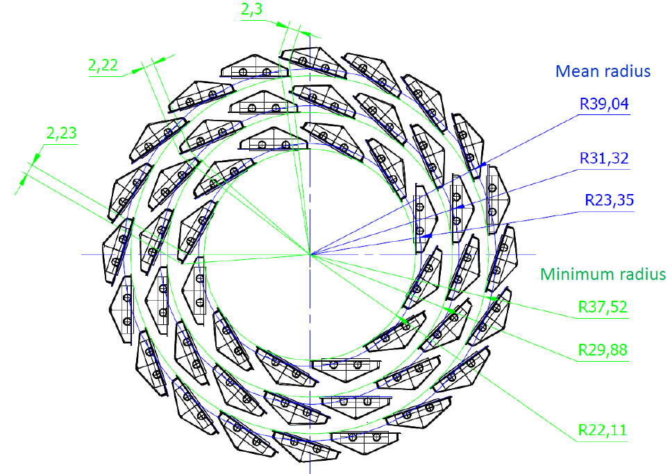
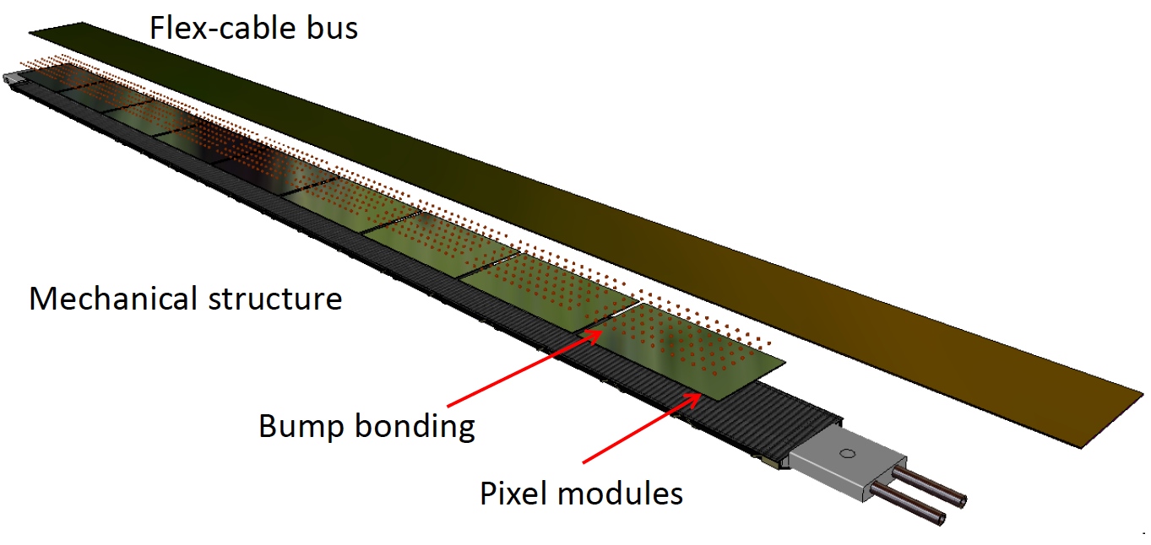
Inner Barrel Layers
3 innermost layers at r= 22, 28 and 36 mm
Same z-length: 27 cm
Assumed chip size: 15 mm x 30 mm >> 9 chips/module
X/X₀≤ 0.3%
 | Modules | Chips
Layer 1 | 12 | 108
Layer 2 | 16 | 144
Layer 3 | 20 | 180
Total | 48 | 432
BGA type connection

Slide 16
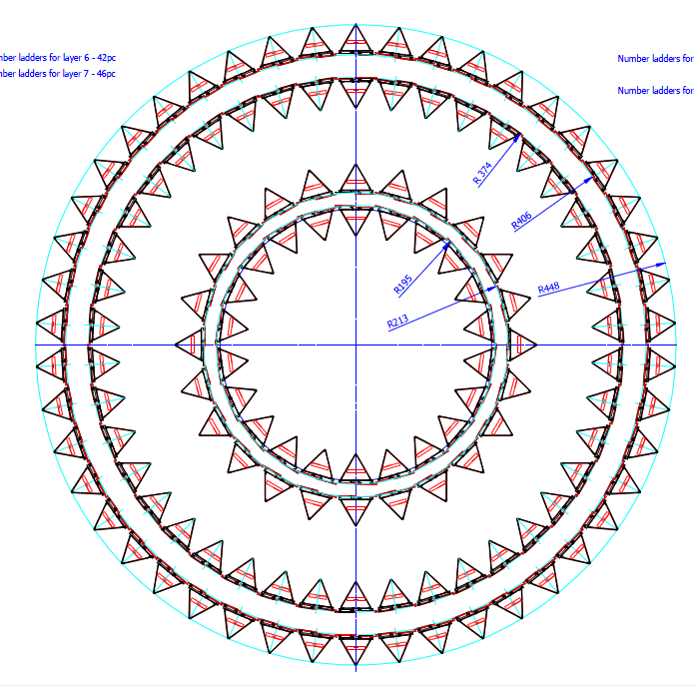
Middle and Outer Barrel Layers
4 outermost layers at r= 48, 52, 96 and 102 mm
84 cm < z-length < 150 cm
Double chip rows per module
X/X₀≤ 0.8%
 | Modules | Chips
Layer 4 | 48 | 2688
Layer 5 | 52 | 2912
Layer 6 | 96 | 9600
Layer 7 | 102 | 10200
Total | 298 | 25400
Z=84 cm
Z=150 cm
Chip
Chip
Chip
Chip
……..
Chip
Chip
Chip
Chip
Chip
Chip
Chip
Chip
Chip
……..
Chip
Chip
Chip
Chip
Chip

Slide 17
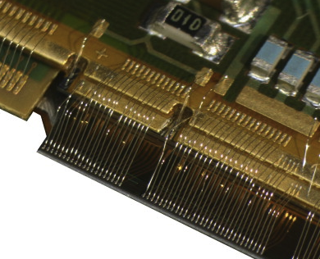
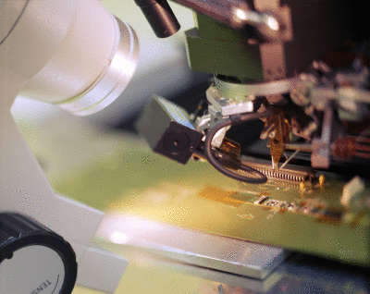
3. Flip-chip Mounting on Module
Present pixel detectors use Aluminum wedge wire bonding
  Typical pad sizes: ~ 80 µm x 80 µm
  Al wire diameter: 25 µm
  Mostly no encapsulation is used
  All detectors operated in magnetic field
Example: present ALICE pixel detector with modules of 14 cm active area along z >> ~ 1000 wire bonds

Slide 18
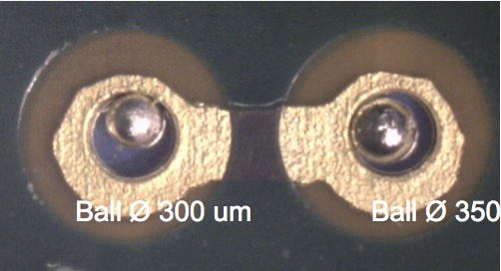
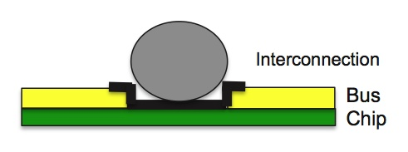
3. Flip-chip Mounting on Module
Wedge wire bonding is one option for the interconnection between ASIC and the module PCB
Alternatives are under study to:
  Reduce the insensitive area at the end-of-column
  To build highly compact modules
  To have a robust and high quality electrical connection

Slide 19
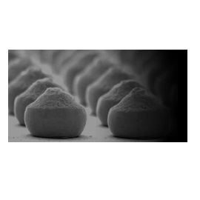
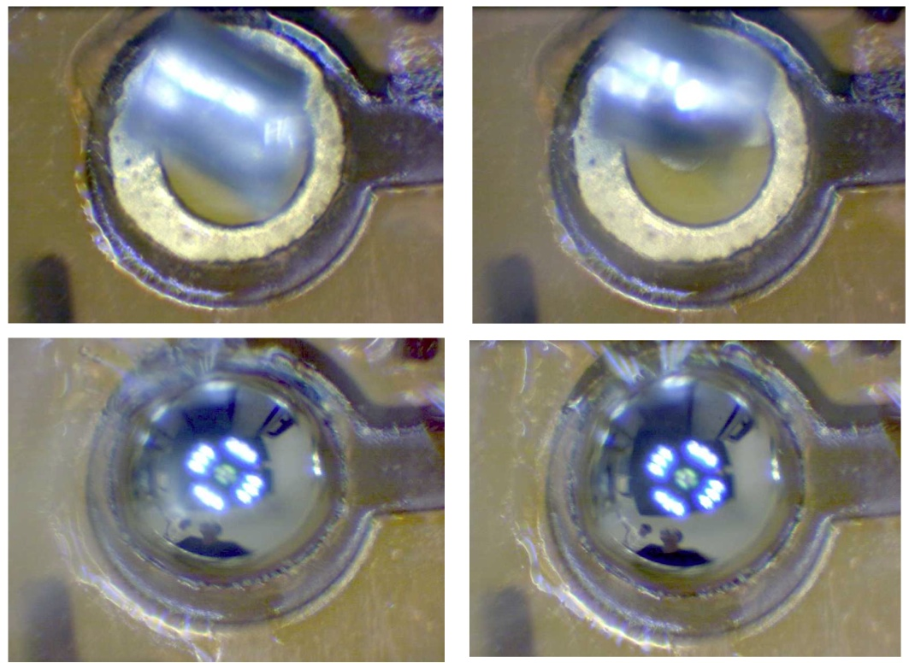
Techniques under Study
2 main techniques: Au-stud bonding and Laser soldering
www.electronicsarena.co.uk
 | Material | Ball diameter | Temperature
BGA ball soldering | Sn-Ag | 100-300 | 220 °C
Laser soldering | Sn-Ag | 100-300 | 280 °C (localized on solder spot only)
Au stud bonding | Au | 80 | 80°C

Slide 20
Laser Soldering
Short temperature step (500 ms, 280°C)
Localized thermal impact
Localized mechanical deformations
Laser power used 45 W (laser max. 250W)
Laser Soldering

Slide 21
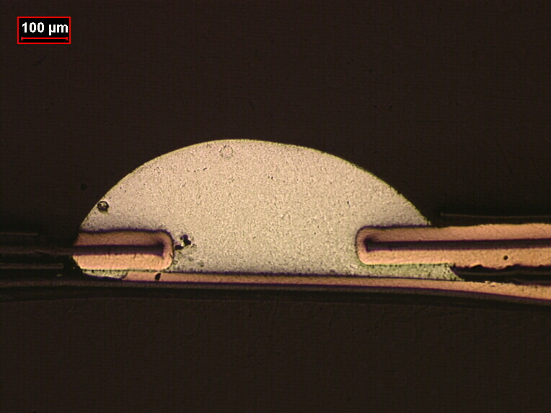
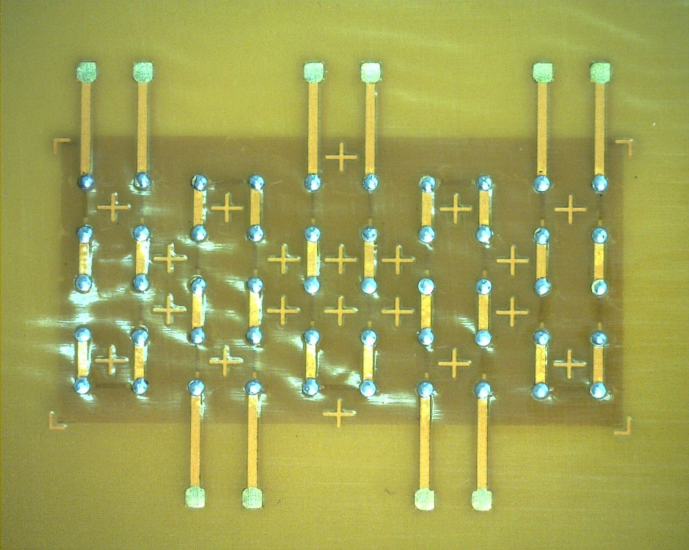
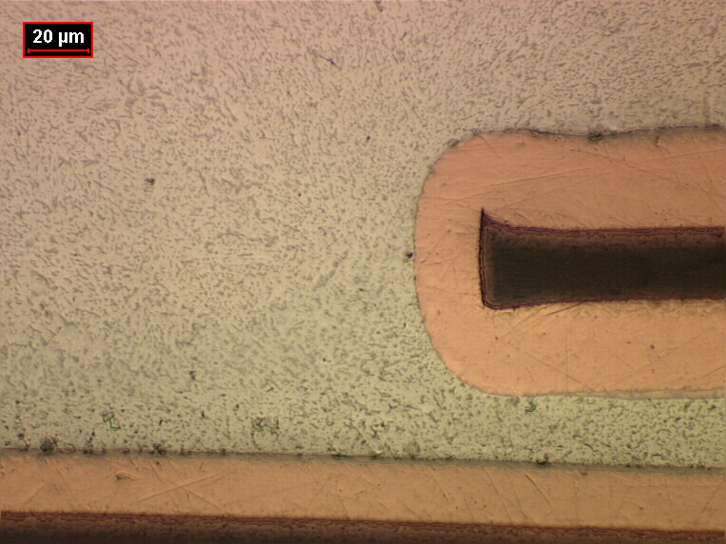
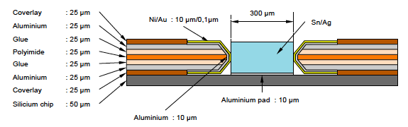
Laser soldering
First validation of the technique by soldering kapton-kapton assemblies

Slide 22
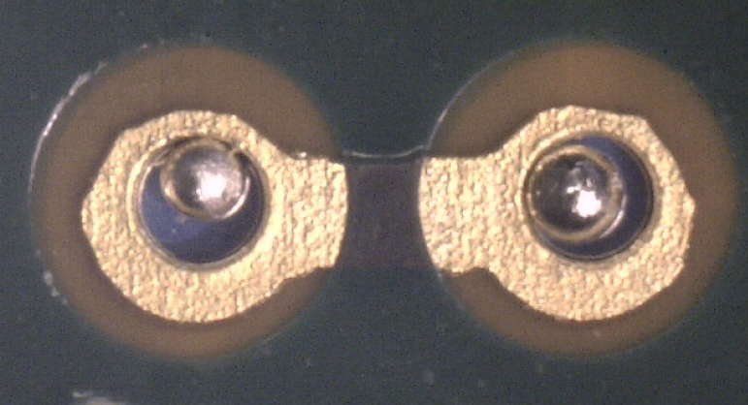
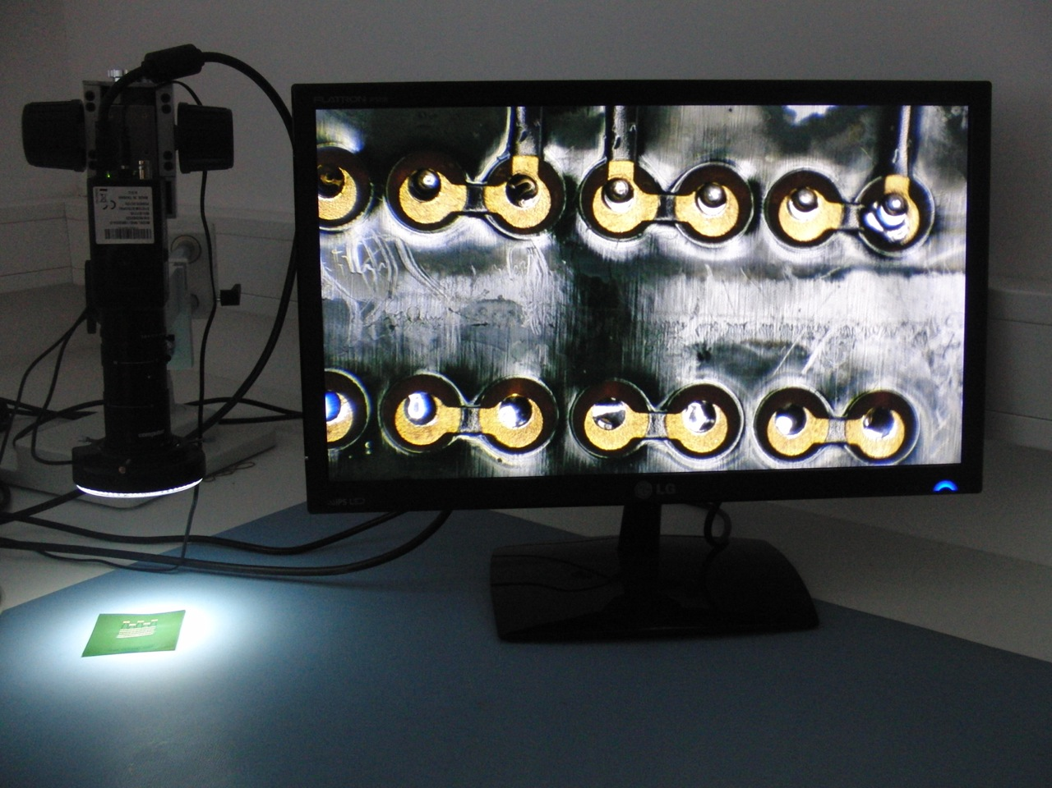
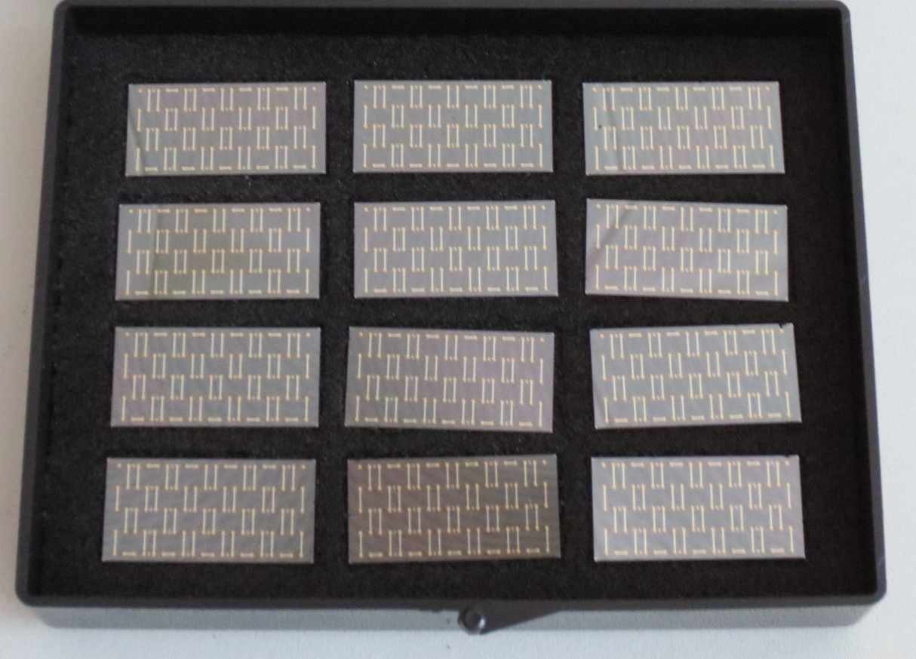
3. Flip chip mounting on module
Solder 50 um silicon die to polyimide foil representing the module PCB
Tests ongoing with different solder ball sizes
Ball Ø 300 um
Ball Ø 350 um
Pad on Si chip
Polyimide
Test chips thinned to 50 um (Al/Ni/Au pads)

Slide 23
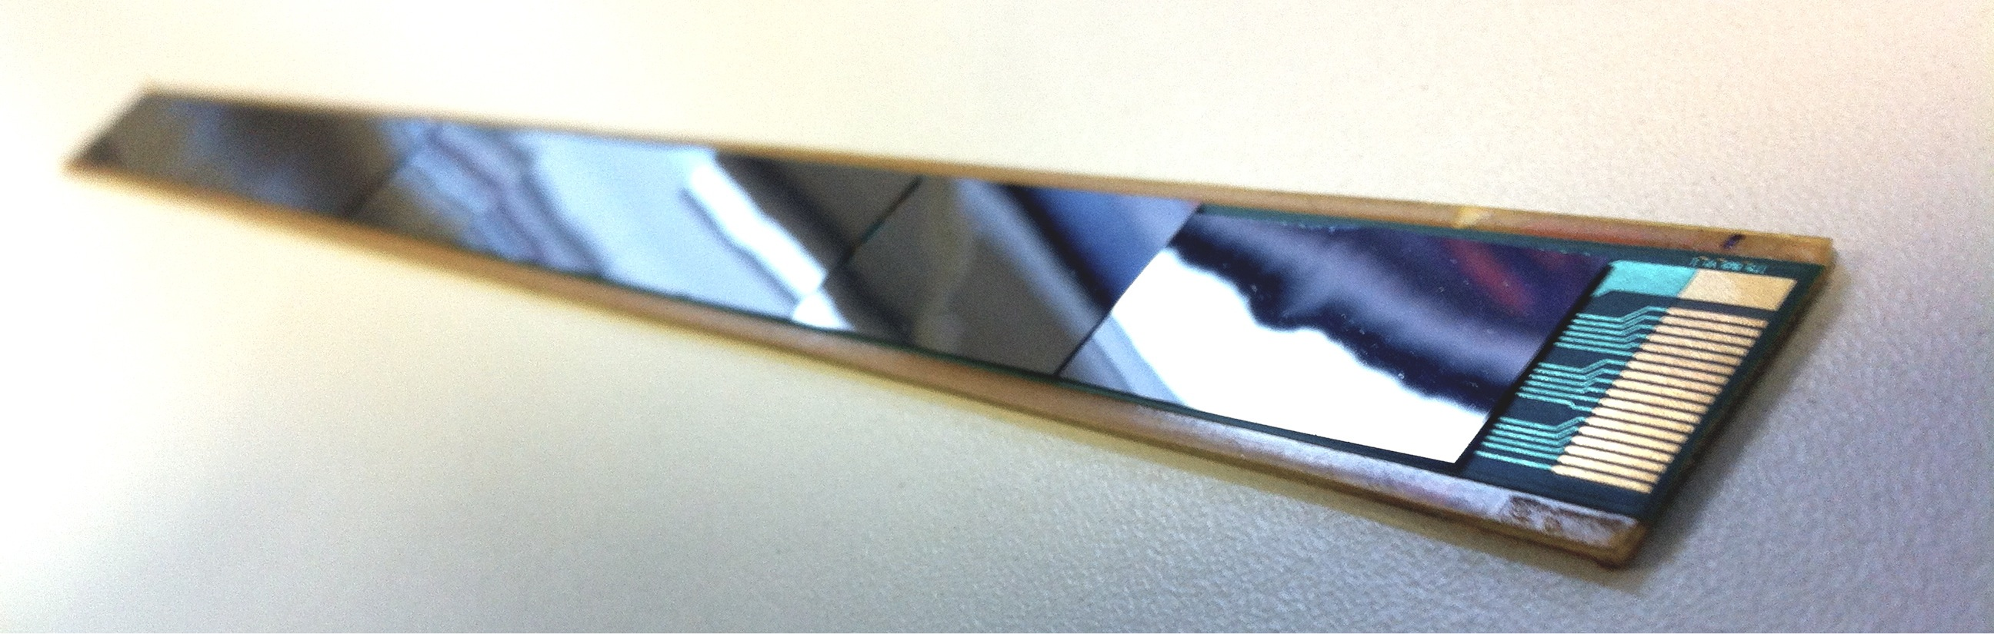
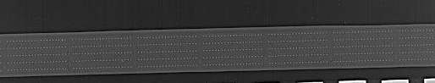
Au stud bonding
First dummy module produced using silicon chips (50 um) and a polyimide PCB (27 cm long, 9 chips)
Au stud bonding using 80 um diameter stud on chip (100 contacts per chip, 400 um diameter pads)
Bus connected using conductive glue drop (glue polymerized at 80°C)
Further optimization of the bus layout and study of the polymerization temperature needed
Radiography of the module

Slide 24
3. Flip chip mounting on module
Flip chip mounting on module presents a novel approach in building pixel detector modules for experiments.
Laser soldering will require to post-process the wafers to make the pads solderable: Ni/Au finish (including seed layer)
Test chips with Al pads with Ni/Au finish

Slide 25
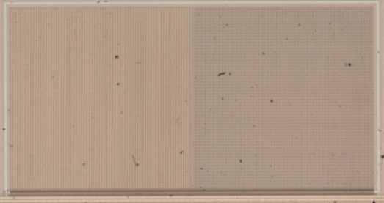
3. Flip chip mounting on modules
Impact of pads distributed over the chip surface on the chip performance needs to be studied
One Explorer1 chip will have pads for VDD and GND distributed over the matrix (pad diameter: 300 um), submission March 2013
PCB
4 mm
Bus (VDD/GND)
GND
2.2 mm
VDD
Explorer1
Wire bonds
VDD
GND

Slide 26
3. Flip chip mounting on modules
The assembly of the large number of fragile components requires special considerations:
Handling of thin components: tools, transportation, storage
Temperature steps in the assembly process to be kept as low as possible together with best possible matching of thermal expansion coefficients of different materials
Re-workability of individual chips to be maintained for as late as possible in the process
Traceability of components (database, labeling, etc.)

Slide 27
Flip chip mounting on module – next steps
Development phase:
Validate and select laser soldering or Au stud bonding as an adequate technique (mechanically, electrically by tests of prototypes, material budget, ..)
Study different ball sizes and deposition techniques
Pre-prototype an IB module
Production phase:
Prepare mechanical setup for module construction
Automatize and develop metrology and inspection system for large scale production
Develop QA procedure for the production assembly

Slide 28
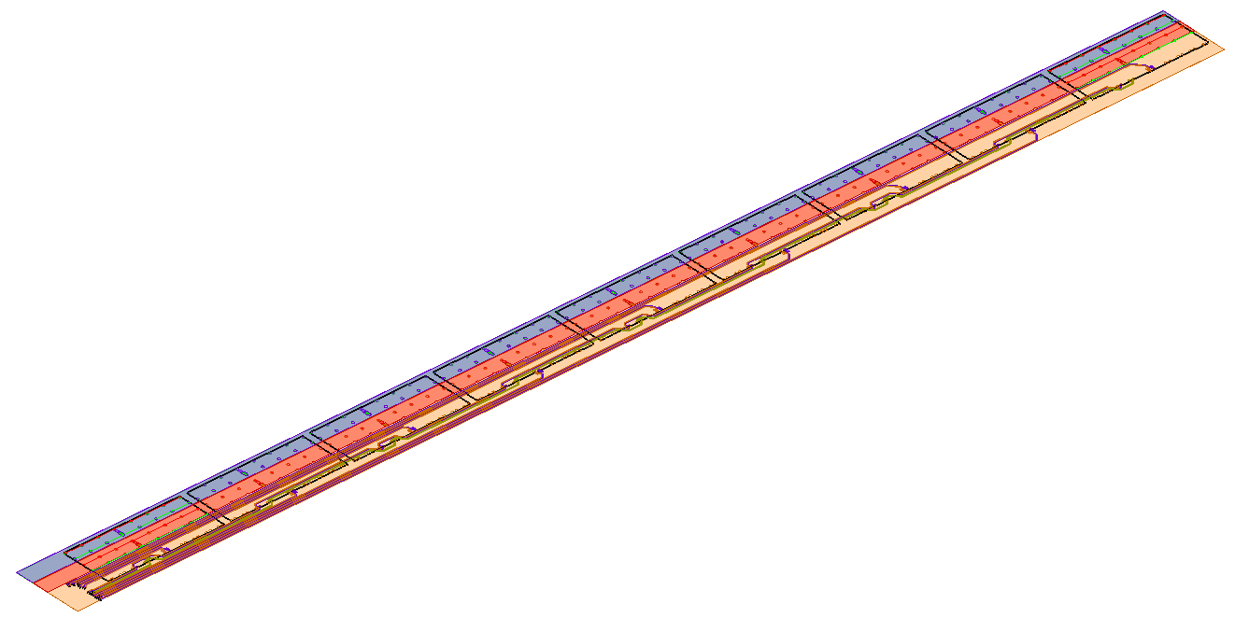

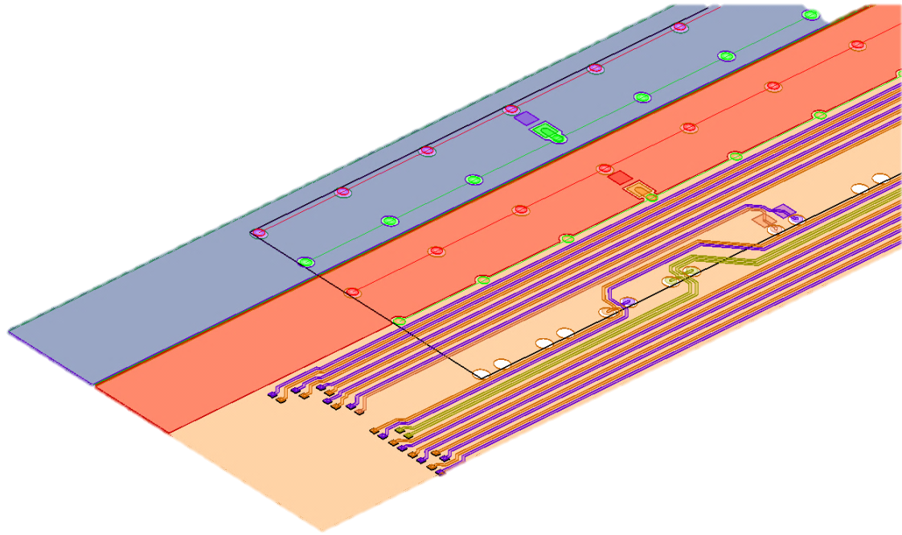
4. PCB design – inner layer modules
First design studies and simulation of an inner layer bus (9 chips, 27 cm)
CHIP 9
CHIP 8
CHIP 7
CHIP 6
CHIP 5
CHIP 4
CHIP 3
CHIP 2
AVDD
SIGNALS
DVDD
CHIP 1
AGND
DGND

Slide 29
4. PCB design – inner layer modules
Signal name |  |  | PINS / CHIP
CLK | IN | M-LVDS | 2
DATA IN/OUT | IN / OUT | M-LVDS | 2
DATA OUT | OUT | LVDS 1Gb/s | 2
DGND |  |  | 8
DVDD |  |  | 8
AGND |  |  | 8
AVDD |  |  | 8
NC |  |  | 12
ITS_CHIP
CLK
DGND
DVDD
AGND
AVDD
NC
DATA OUT
DATA IN / OUT

Slide 30
4. PCB design – inner layer modules
Contact pads distributed over chip surface:
30 mm
CLK
DATA IN/OUT
DATA OUT
3.5 mm
2 mm
1 mm
Ø 0.2 mm
6 mm
15 mm
DGND
2.2 mm
DVDD
2.2 mm
Tab 1:
AGND
2.2 mm
AVDD
Fig 2: ITS silicon chip, bottom view
ITS_CHIP_V3_3 (ITS_15_30_HOLE_02MM_V2)
4 mm

Slide 31
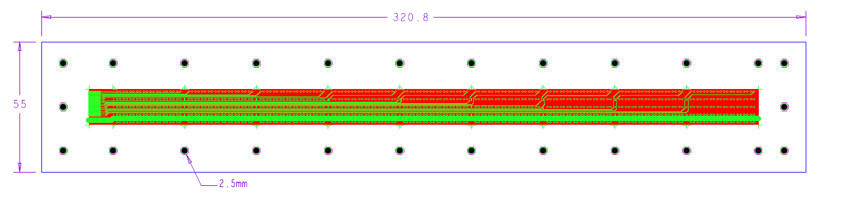
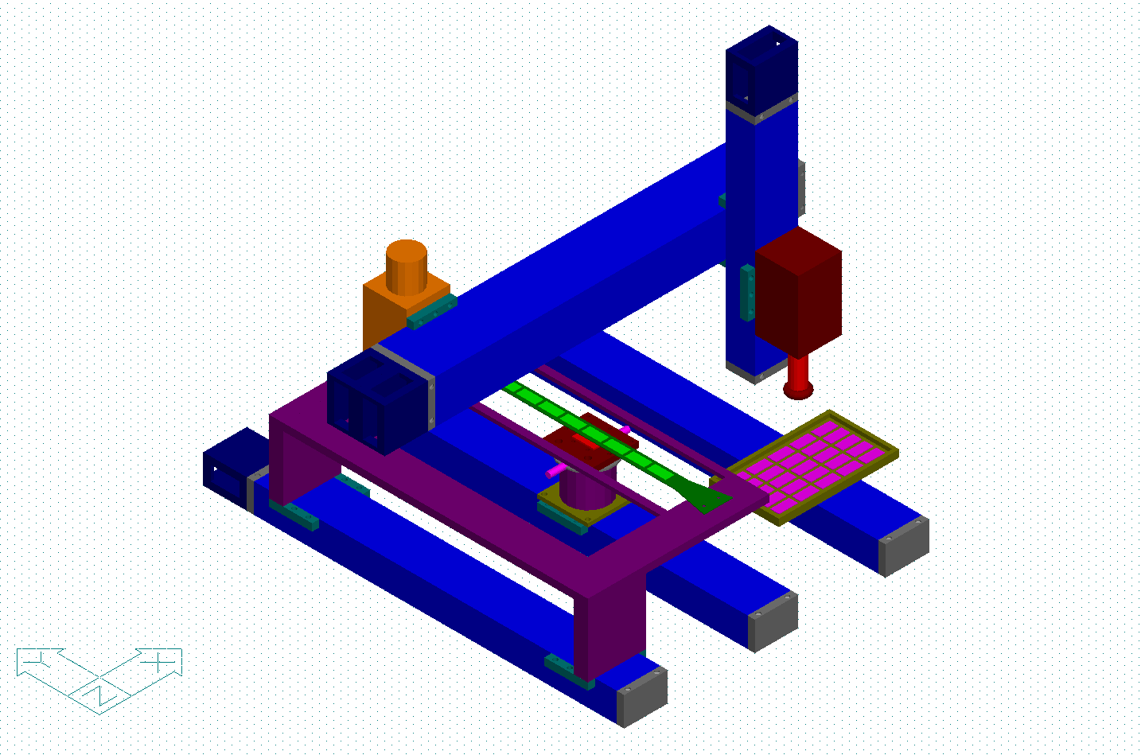
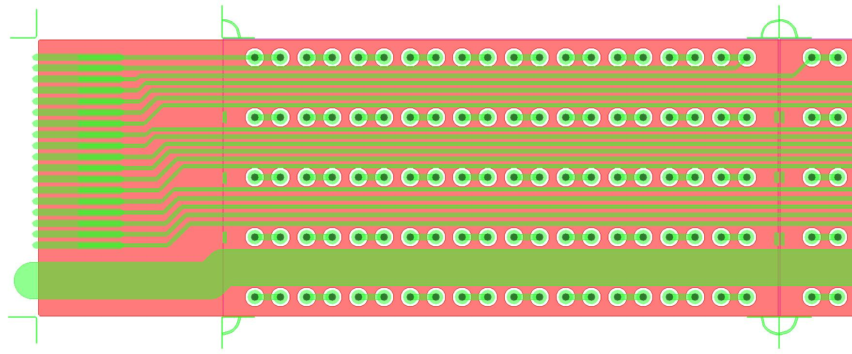
Inner layer module
Preparing to build one inner layer module using silicon dummy test chips
Laser
Vacuum tool
Chip tray
Bus cable
Green : top layer with daisy chain connection
Red : bottom layer
Hole diameter : 400 um
Line width : 200 um
Line spacing : 200 um

Slide 32

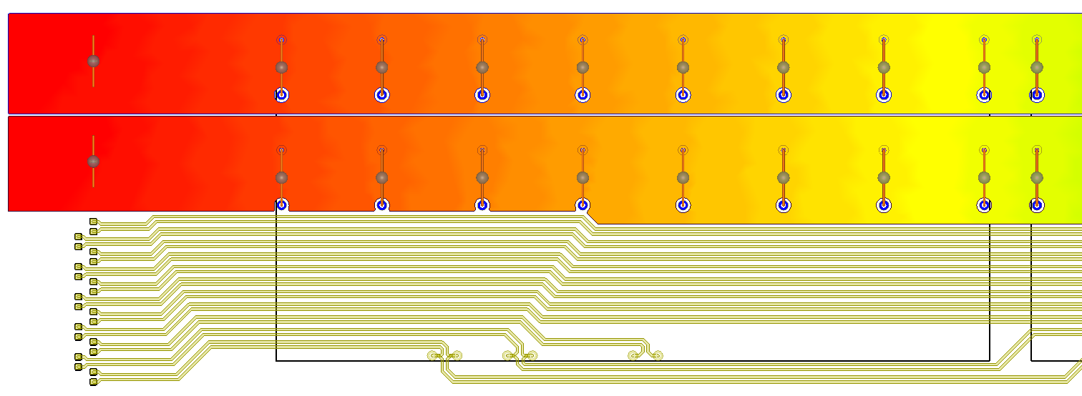
Simulation studies
1.8v
1.78v
1.77v
1.75v
1.72v
1.69v
AVDD & DVDD DC Voltage drop
Voltage sources 1.8V
AVDD
Current sinks 39 mA
DVDD
Power plane, AVDD & DVDD
A. Junique, CERN

Slide 33
Simulation studies
Chip1
Chip2
Chip3
Chip5
Chip4
Chip6
Chip7
Chip8
Chip9
A. Junique, CERN

Slide 34
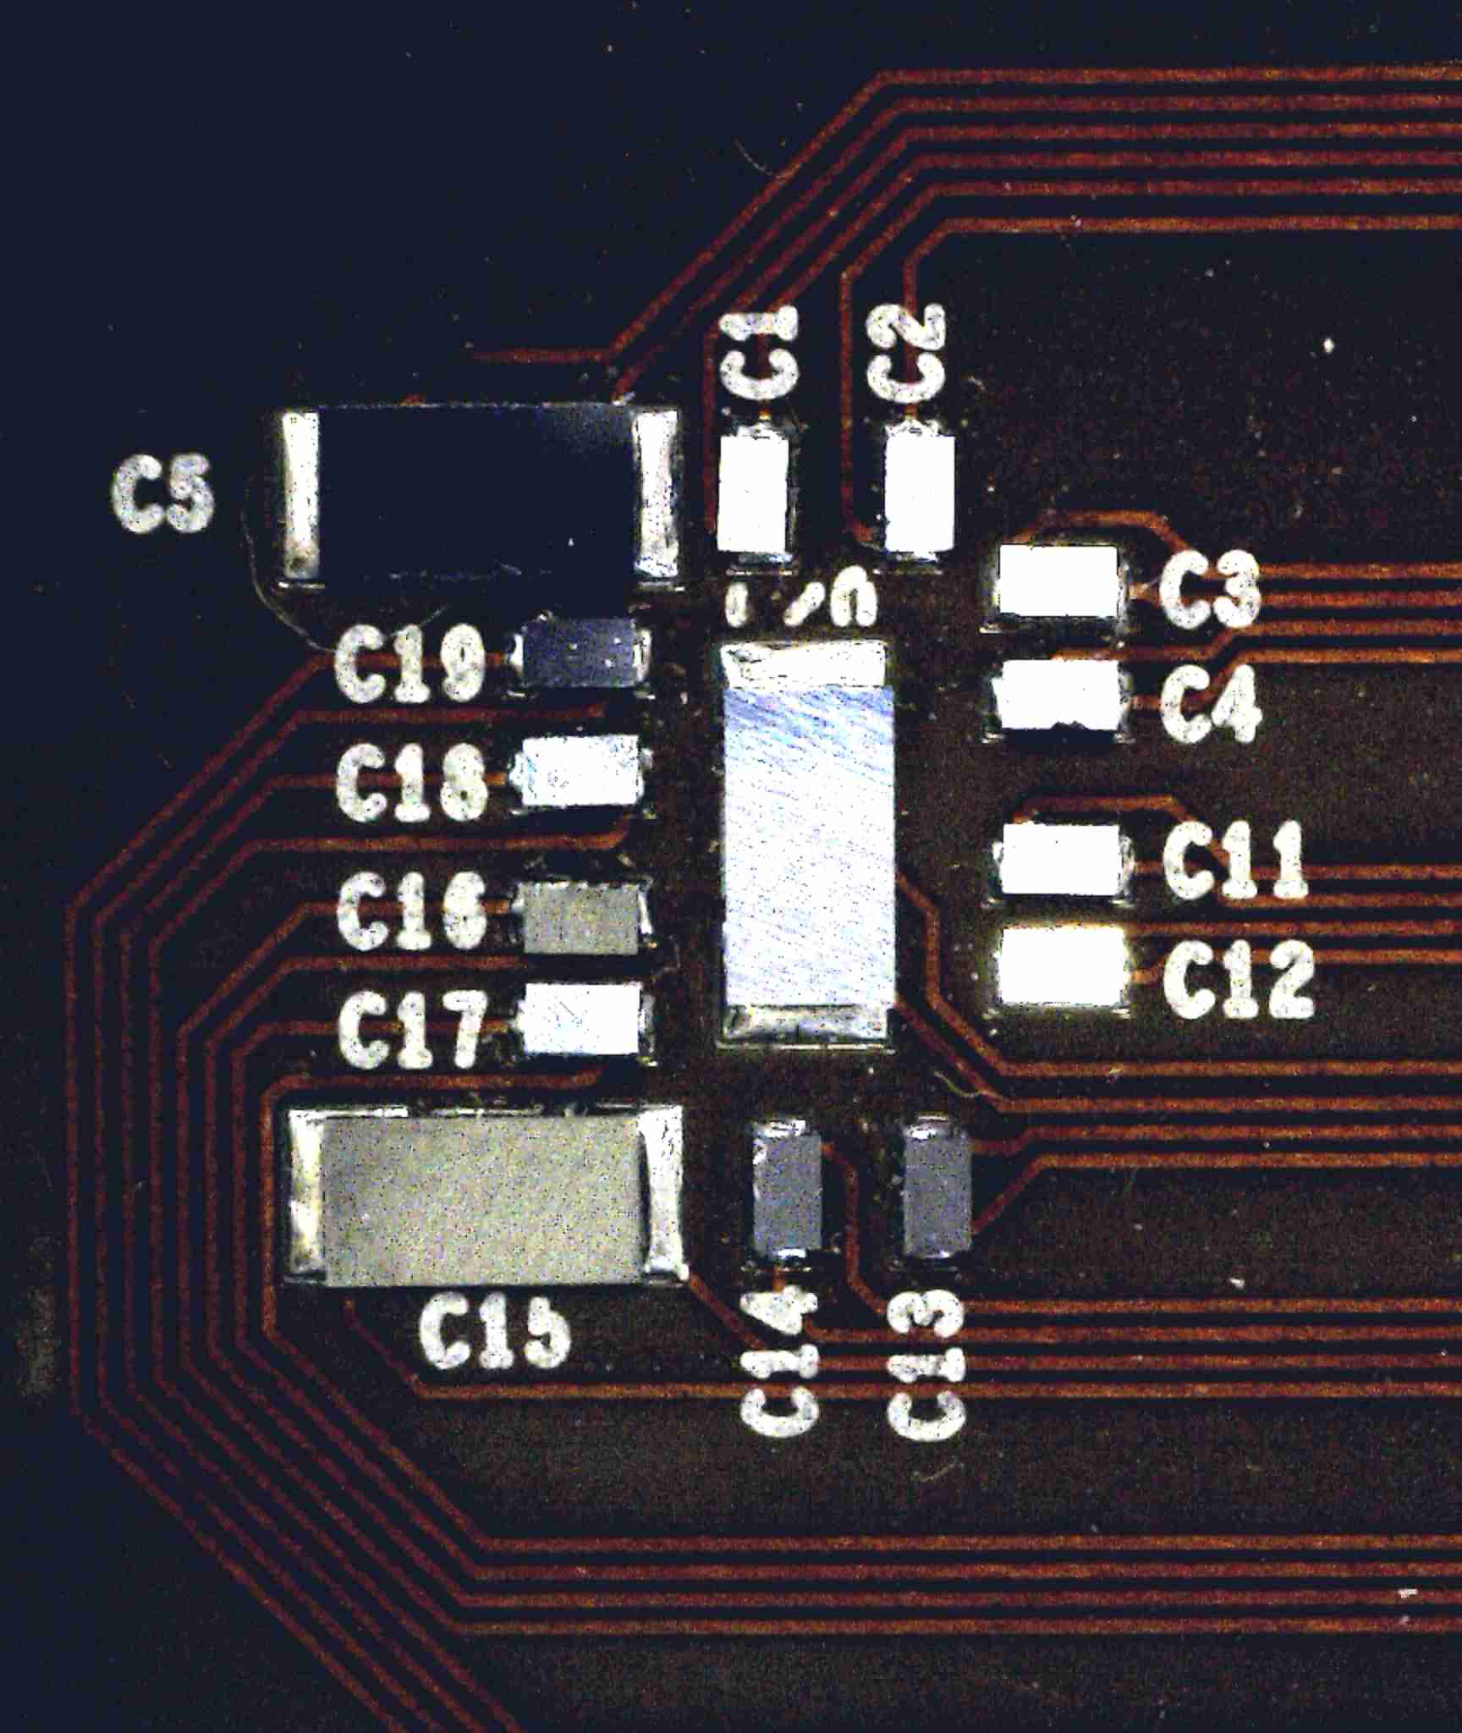
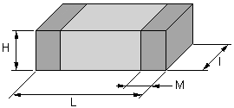
Decoupling capacitors for the IB module
Investigating low mass decoupling capacitors (Silicon):
Simulation of the impedance of the DVDD as seen from the chip9 w/o decoupling capacitor
Capacitance value | Size (L x I) mm | Die thickness
10pF > 10nF | 0.8 x 0.6 (0201) | 100µm
10pF > 100nF | 1.2 x 0.7 (0402) | 100µm
10pF > 100nF | 1.8 x 1.1 (0603) | 100µm
10pF >100nF | 2.2 x 1.4 (0805) | 100µm
10pF > 1µF | 3.4 x 1.8 (1206) | 100µm

Slide 35
4. PCB design inner layer modules – next steps
First design study ongoing for the inner barrel modules, however many items on the to-do list:
Testing of prototype PCBs
Optimisation of the layer stack-up and production of Aluminum-polyimide PCBs
Qualification of passive components
Development of production test and QA procedure
Similar effort for the outer layer needs to be started NOW!

Slide 36
Conclusion
Many areas in the field of module development and construction are requiring immediate efforts to conclude the development phase and to prepare for the production.
This presentation gave an overview of the developments done in context with the module development, i.e. thinning and dicing, chip test and verification, flip chip assembly of module and development of a module PCB for the inner barrel.
The large number of components will require specific efforts to automatize process steps and to log test data as well as tracking components.

Slide 37
Task list
Wafer thinning and dicing:
QA procedures: metrology measurements (edge quality, flatness, ..) – will become part of the large production testing!
Chip testing and verification:
Start to work on test environment preparation:
  Probing (including mechanical tooling, probe-card design, …)
  Visual inspection system
  Define test areas (clean room)
Automatisation of test-system: movements, pattern recognition?
Define database for test-results
Component tracking – investigate technical options

Slide 38
Task list
Flip chip mounting on module:
Prepare mechanical setup for module construction
Automatize and develop metrology and inspection system for large scale production
Develop QA procedure for the production assembly
Flex PCB:
Optimisation of the layer stack-up and production of Aluminum-polyimide PCBs
Qualification of passive components
Development of production test and QA procedure
Work on outer layer flex PCB needs to be started

