Slide 1
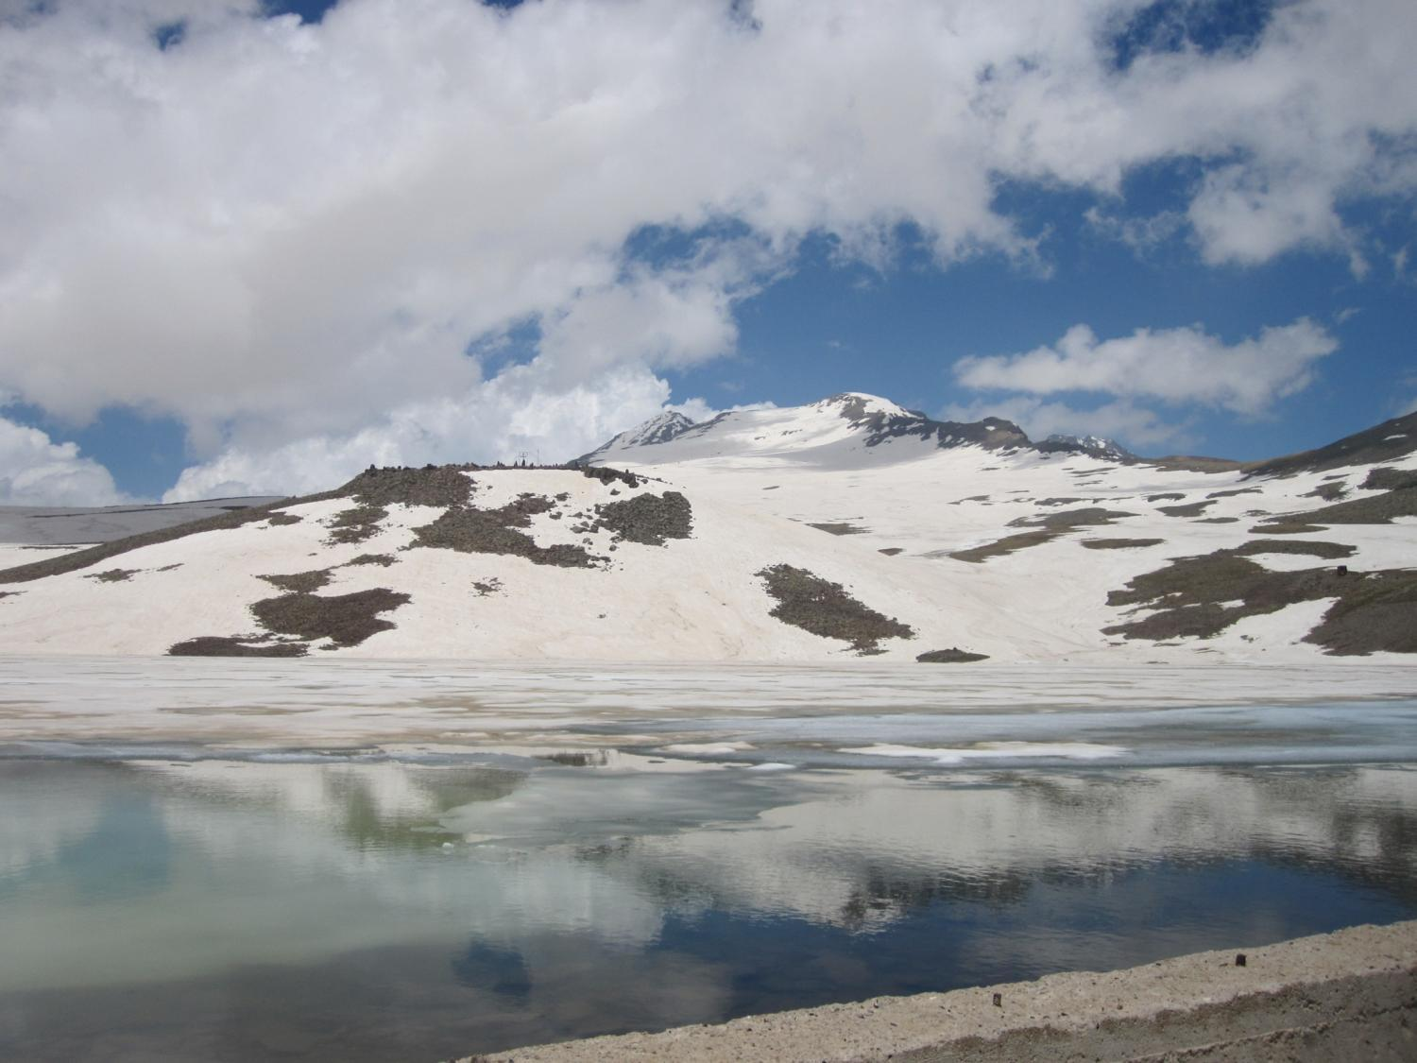
New source of high-energy gamma radiation in atmosphere
Ashot Chilingarian
Artem Alikhanyan National Laboratory (Yerevan Physics Institute)
chili@aragats.am
Notes:
----- Meeting Notes (9/2/13 13:43) -----

Slide 2
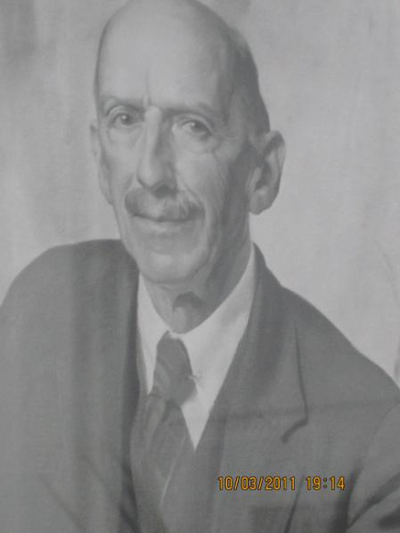
CTR Wilson, 1924: prediction of high-energy phenomena in thunderclouds
Cosmic rays – Atmospheric electricity
Particle detectors
“In a field of 20 kV/cm the energy supplied to β-particle will exceed the average loss; so that particle will be continuously accelerated until some accident occurs”
“There is, as well known, some evidence of the existence of penetrating radiation in the atmosphere; possibly some portion of it may originate in the electrical fields of thunderclouds.”
Despite numerous negative results by Bazil Schonland, Edward Halliday and others in searching of energetic particles from thunderclouds (as a result of using inadequate equipment) Wilson supported the idea till his last publication in 1956.
C. T. R. Wilson, the acceleration of β-particle in strong electrical fields of thunderclouds, Proc. Cambridge Philos. Soc. 22, 534, (1925).
E.R.Williams, Origin and context of C.R.T. Wilson’s ideas on electron runaway in thunderclouds, JGR, 115, A00E50, 2010.

Slide 3
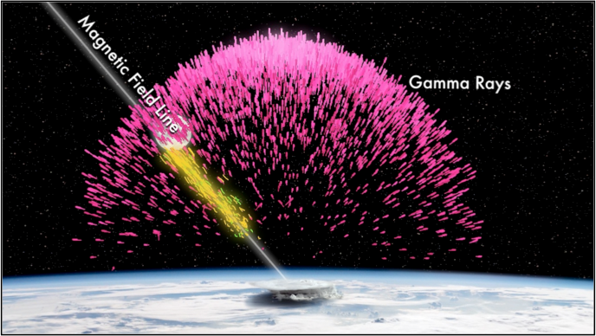
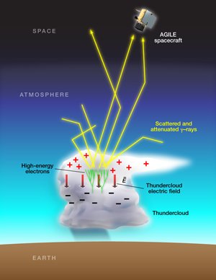
Terrestrial Gamma flashes
(TGFS) – since 1994

Slide 4
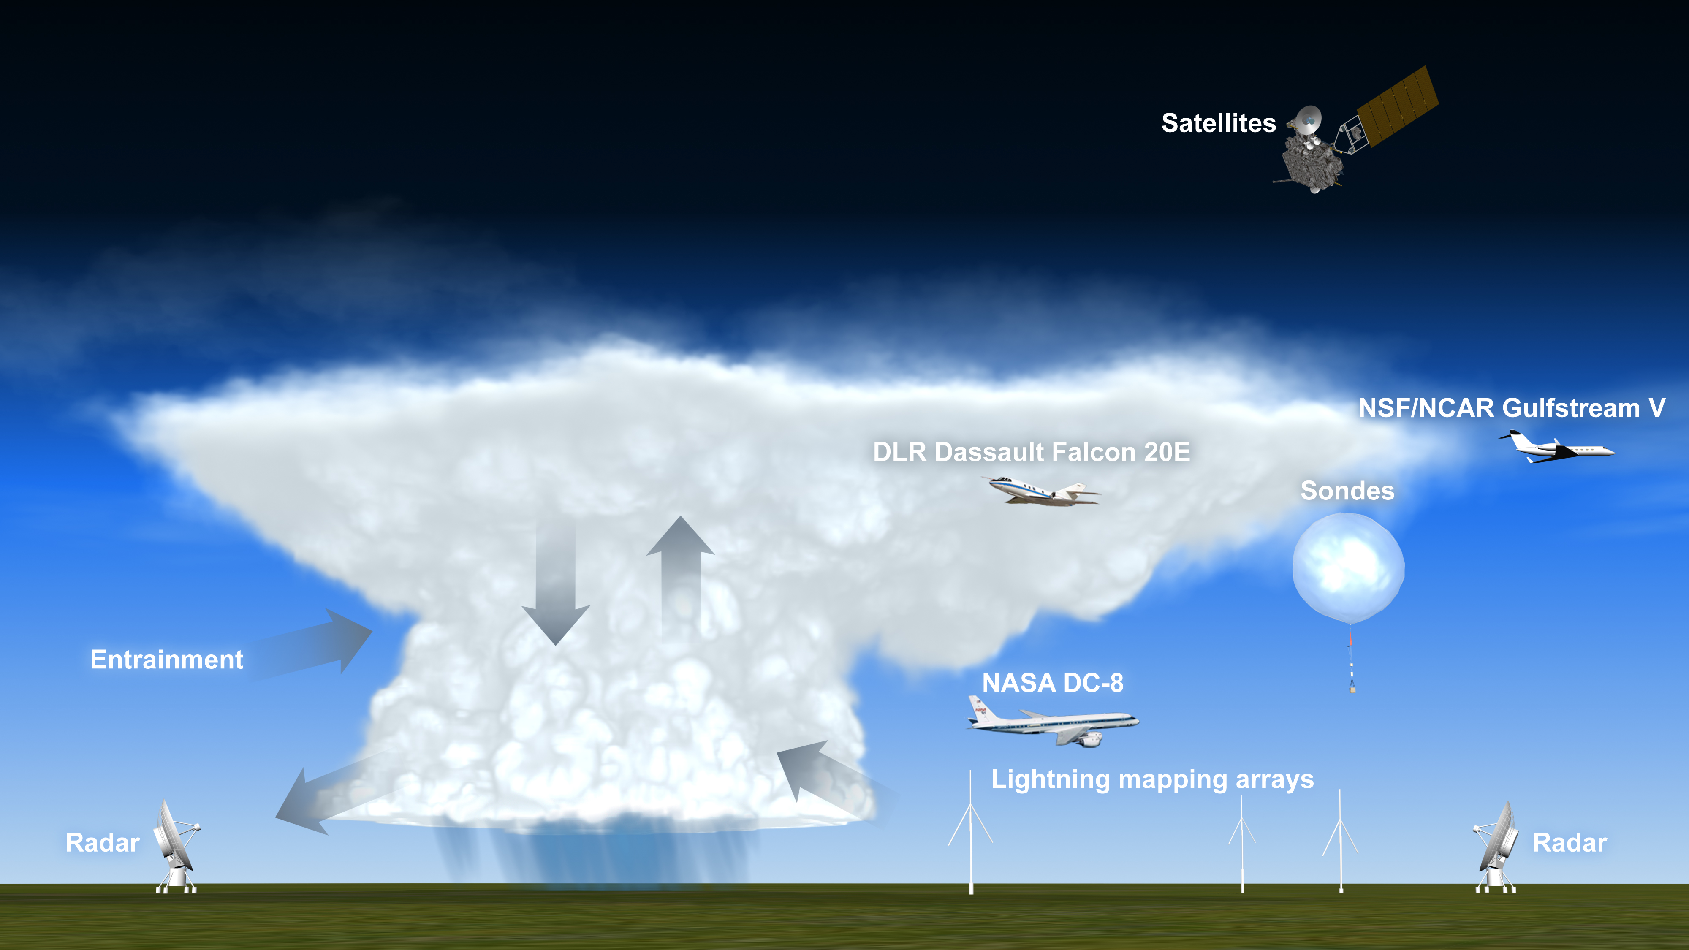
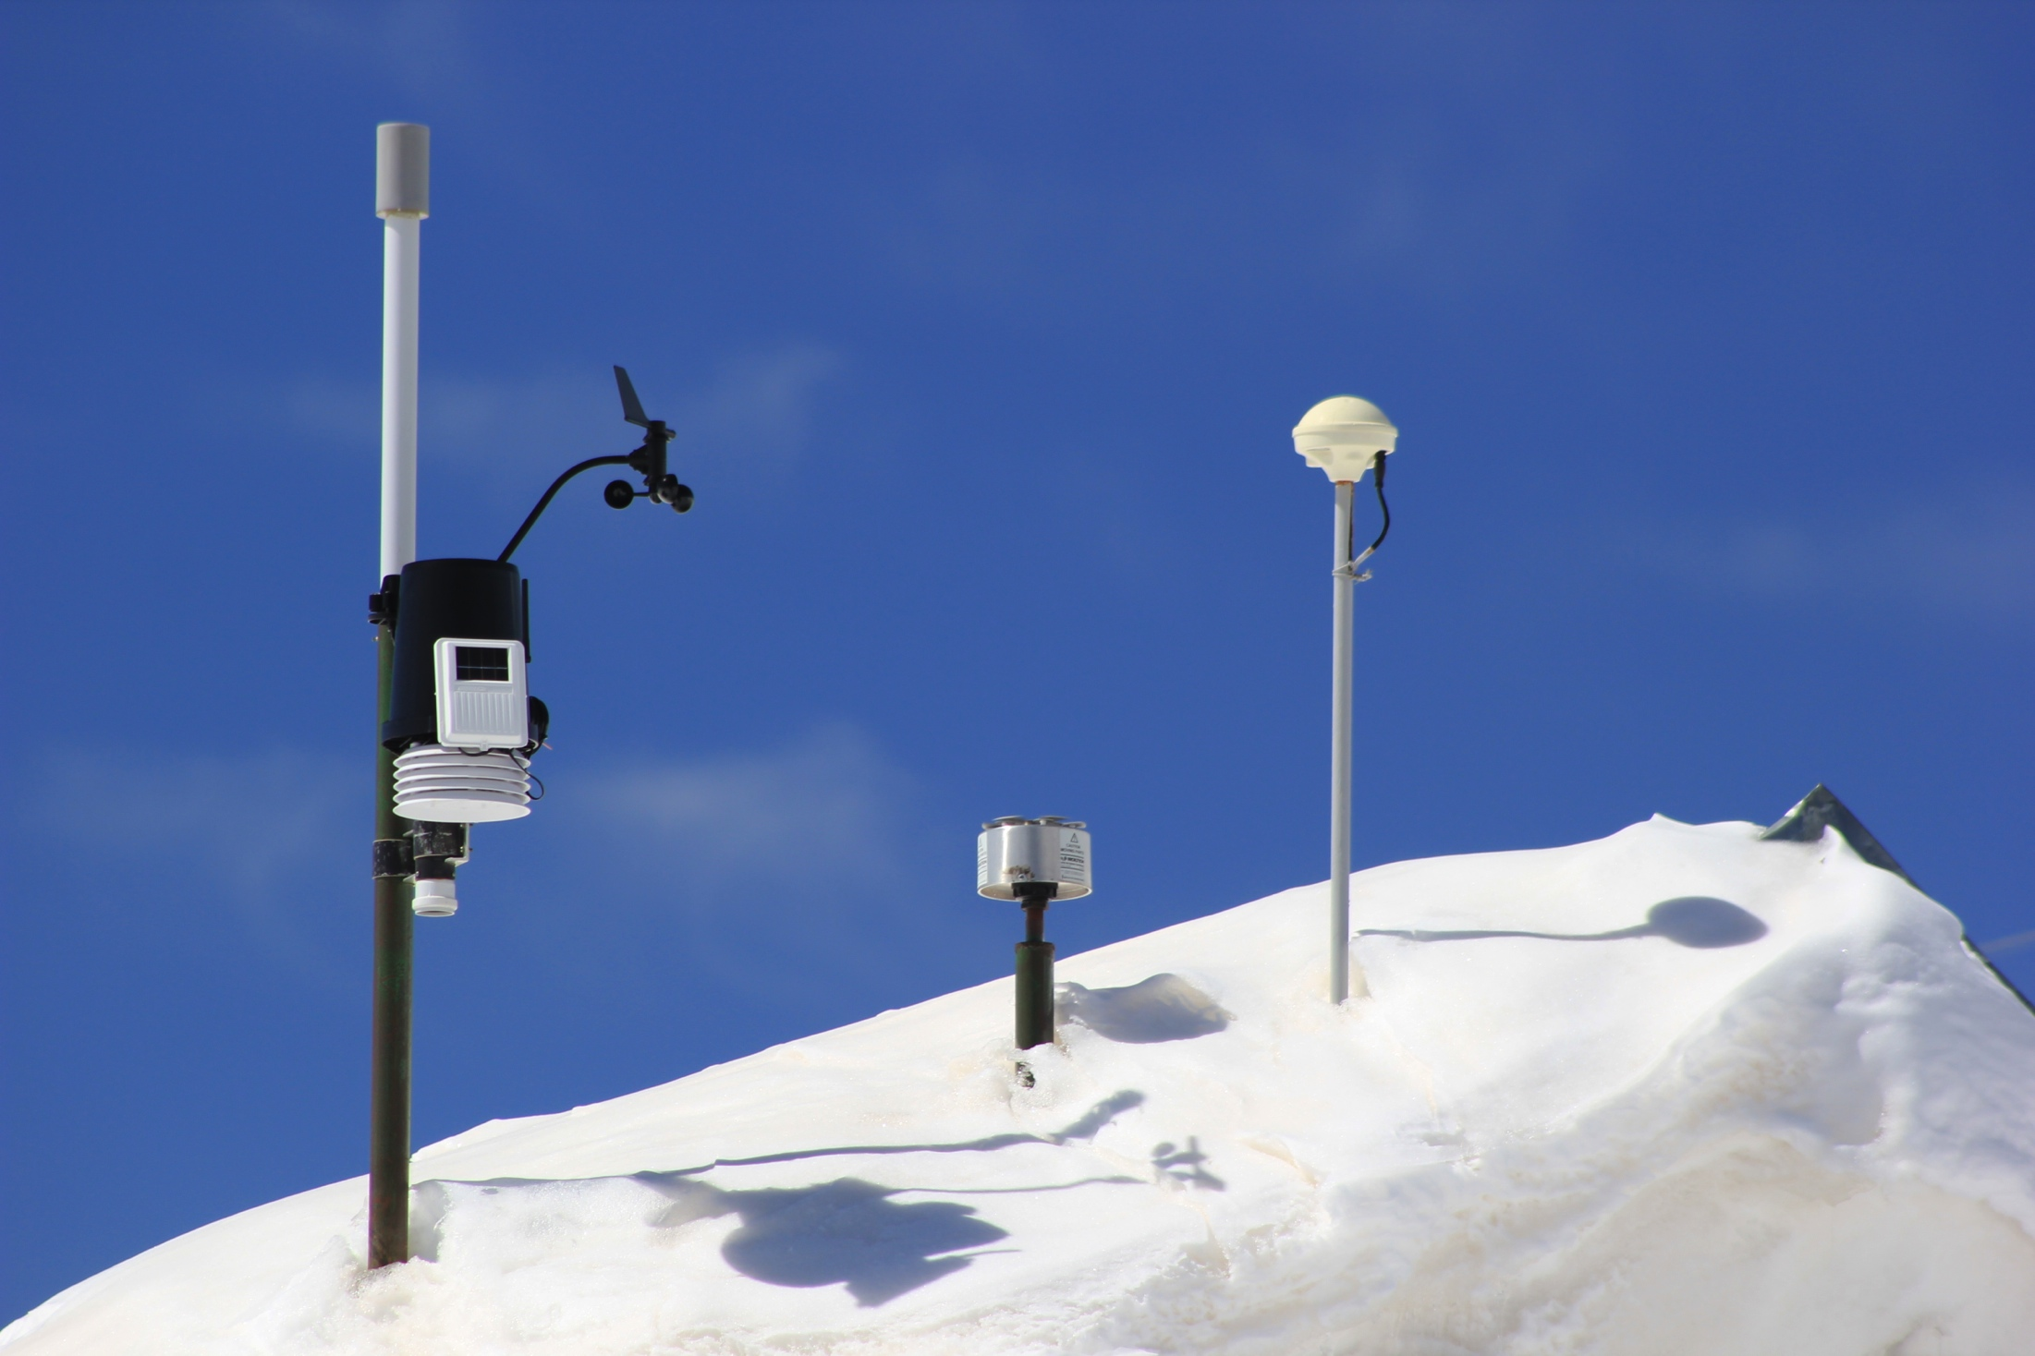
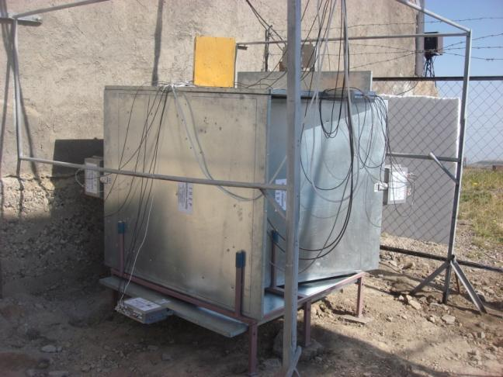
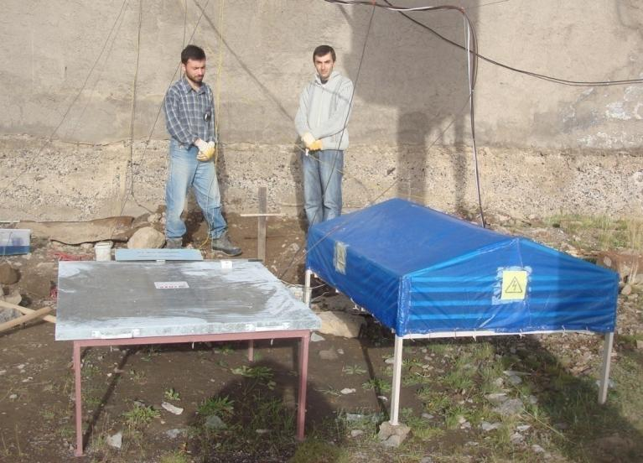
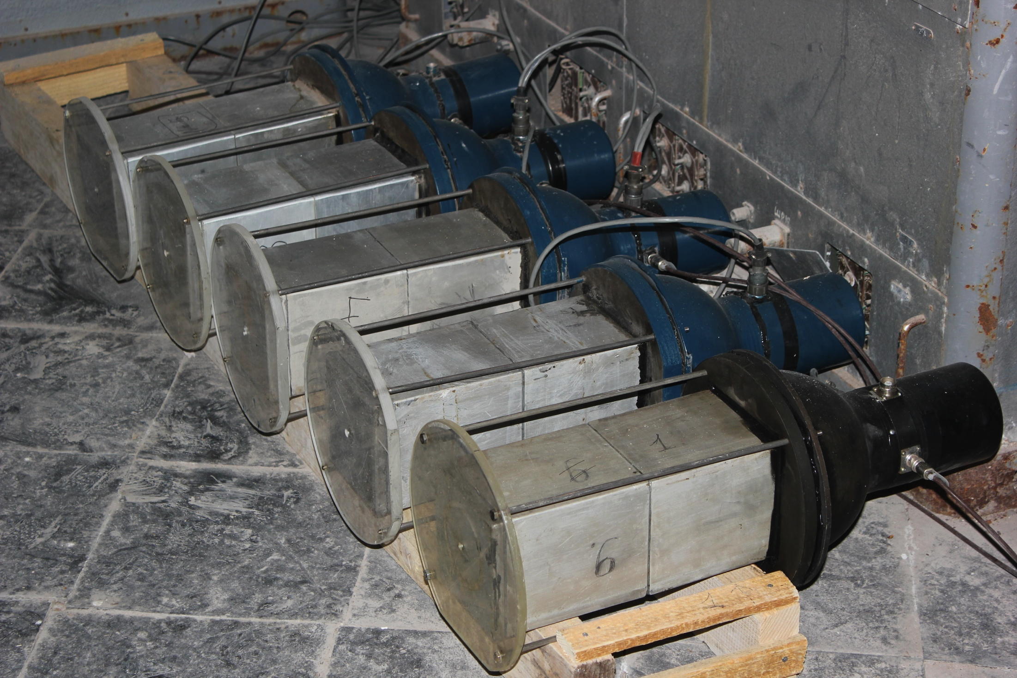

Slide 5
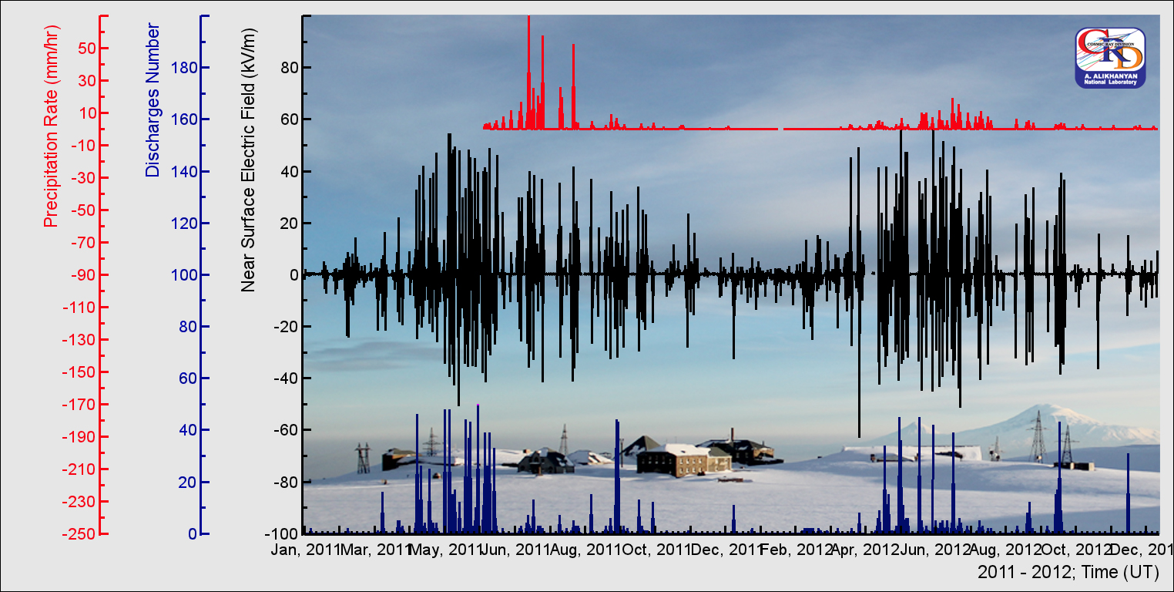
Aragats - meteorology 2011-2012

Slide 6
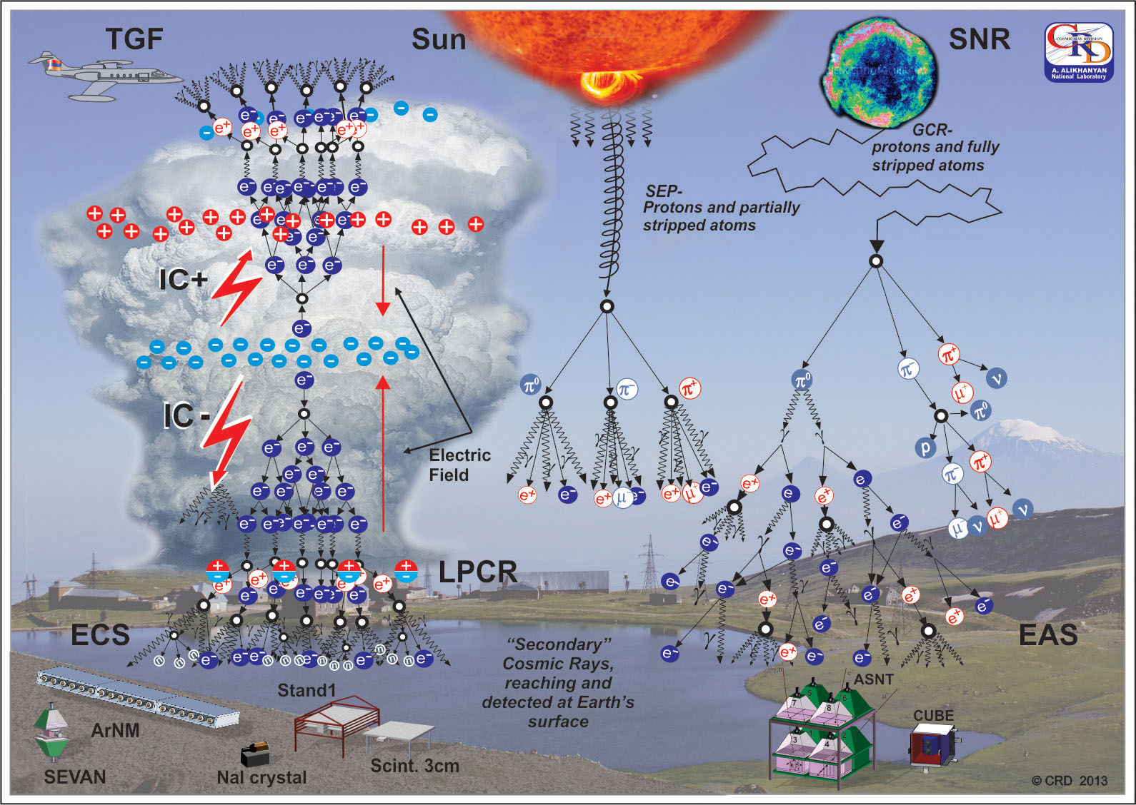
TGE/TGF - most energetic natural electron-photon phenomena on Earth

Slide 7
Vocabulary of abbreviations
GLE – Ground Level Enhancement solar modulation of surface flux;
TGF – Terrestrial Gamma Flashes – atmospheric modulation of space flux;
TGE – Thunderstorm Ground Enhancement – atmospheric modulation of the surface flux;
TLE - Transient Luminous Events;
RREA – Relativistic Runaway Electron Avalanches – “electromagnetic” and “short” version of EAS!
MOS – MOdification of Energy Spectra;
EAS – Extensive Air Shower;
ECS – Extensive shower spectra;
LPCR – Lower positive charge region
RFD - Relativistic feed- back discharges

Slide 8
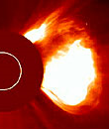

Aragats Space Environmental Center (ASEC) aims to detect the Solar Modulation effects: Ground Level Enhancements, Forbush decreases, Geomagnetic effects; At quit Sun (2007-2011) ASEC measure hundreds of Thunderstorm ground enhancements (TGEs)
M3.2
X20

Slide 9
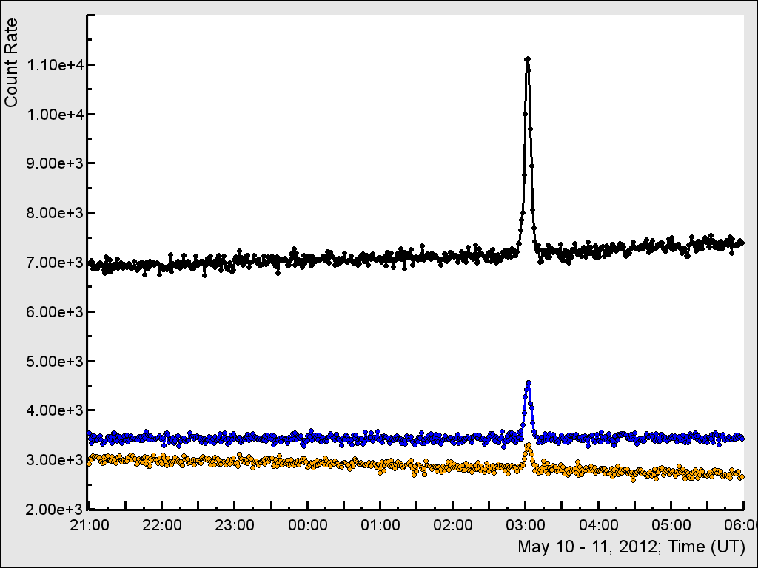
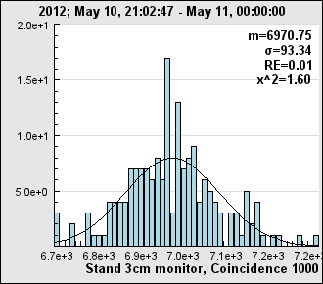
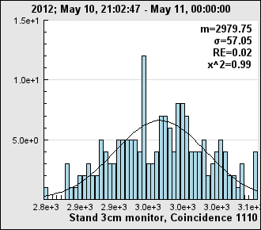
STAND 3 cm thick
plastic scintillator 1000.
Enhancement ~60%,
corresponding to ~45σ.
Mean and variance were estimated by time series at 21-24 UT, 10 May 2012.
Combinations 1100 and 1110 Enhancement ~33% and 10%,
Corresponding to 20σ and 5σ.

Slide 10
Thunderstorm Ground Enhancements TGEs
The boost of the secondary cosmic ray flux observed during thunderstorms, so-called Thunderstorm Ground Enhancements (TGEs, Chilingarian et al., 2010, 2011), is the manifestation of high-energy processes in the terrestrial atmosphere (Dwyer et al., 2012). Origin of TGE is the strong electrical field in the thundercloud, giving rise to rather complicated physical phenomena, including at least 6 physical processes:
Relativistic Runaway Electron Avalanches (RREA, Wilson, 1925, Gurevich et al., 1992, Babich et al., 1998, Dwyer, 2003, Khaerdinov et al., 2005, Chilingarian et al., 2010);
Modification of the secondary Cosmic ray (CR - electrons, muons, protons and charged mesons) energy spectra (MOS, Dorman et al., 2005, Muraki et al., 2004, Chilingarian Mailyan and Vanyan,, 2012);
Photonuclear reactions of the RREA gamma rays (Chilingarian et al., 2012a and 2012b, Tsuchiya et al., 2012, Babich et al., 2013);
Attenuation of the cosmic ray muon flux (Lidvansky and Khaerdinov, 2009, Chilingarian et al., 2010);
Roentgen and gamma radiation from the lightning (Dwyer et al., 2012b);
Prolonged (2-3 hours and more) enhancement of the low energy (1-2 MeV) cosmic ray flux (Germanenko et al., 2011).

Slide 11
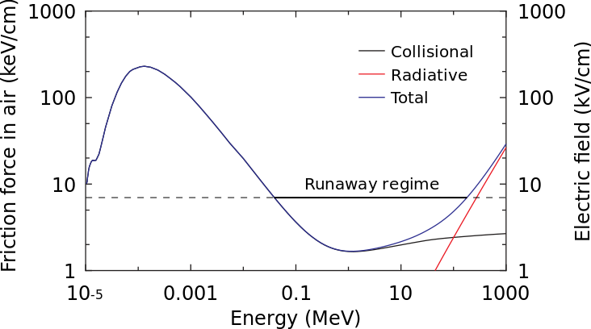
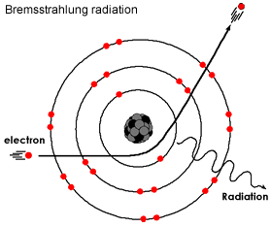
RREA – Bete-Bloch equation + electron acceleration

Slide 12
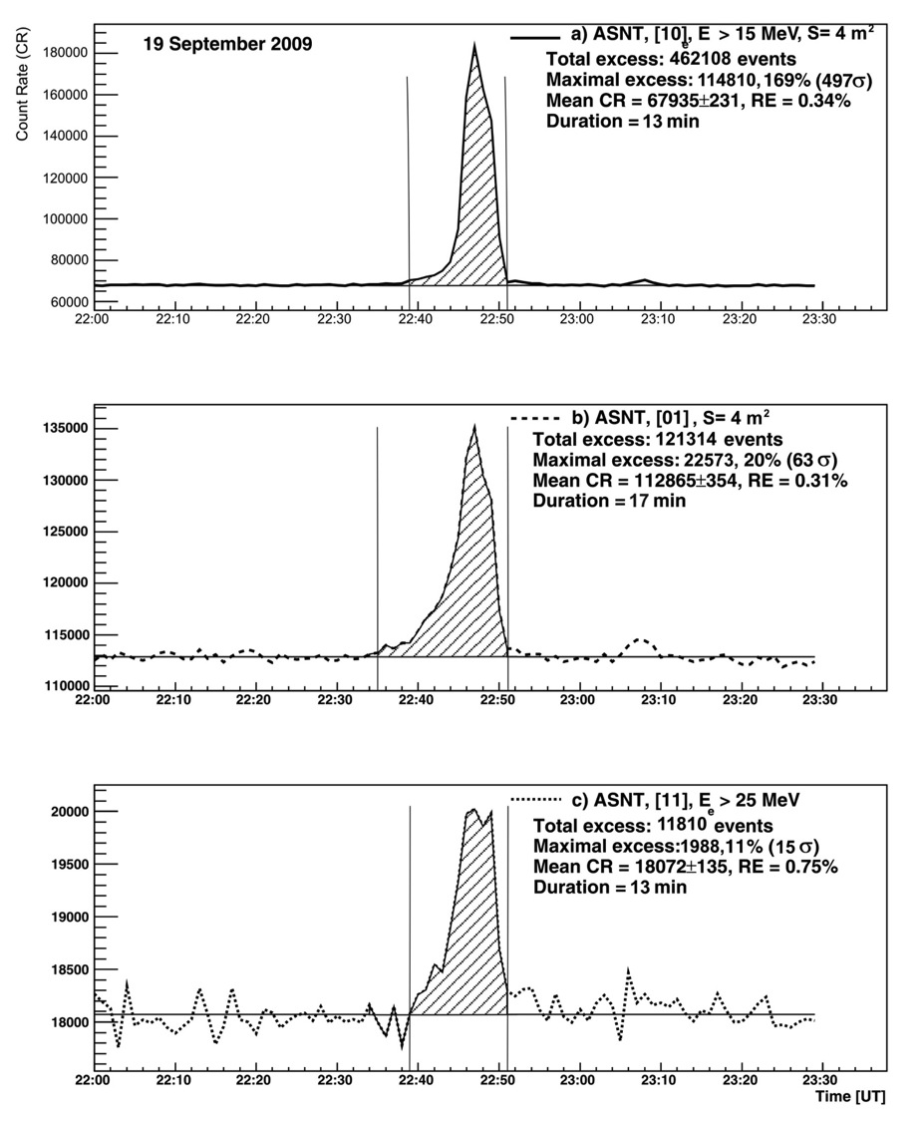
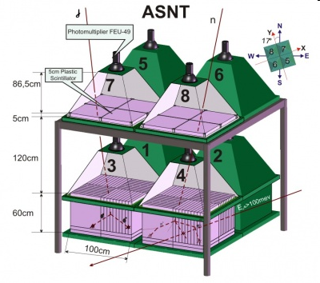
Huge TGE of 19 September, 2009 was detected by all ASEC monitors :
ASNT consists of 5 cm and 60 cm thick scintillators (4 modules each 1 m.sq. area;
ASNT (11) – electrons E ~ 30 MeV -
A. Chilingarian, A.Daryan, K.Arakelyan, et al., Ground-based observations of thunderstorm-correlated fluxes of high-energy electrons, gamma rays, and neutrons, Phys.Rev. D., 82, 043009, 2010

Slide 13
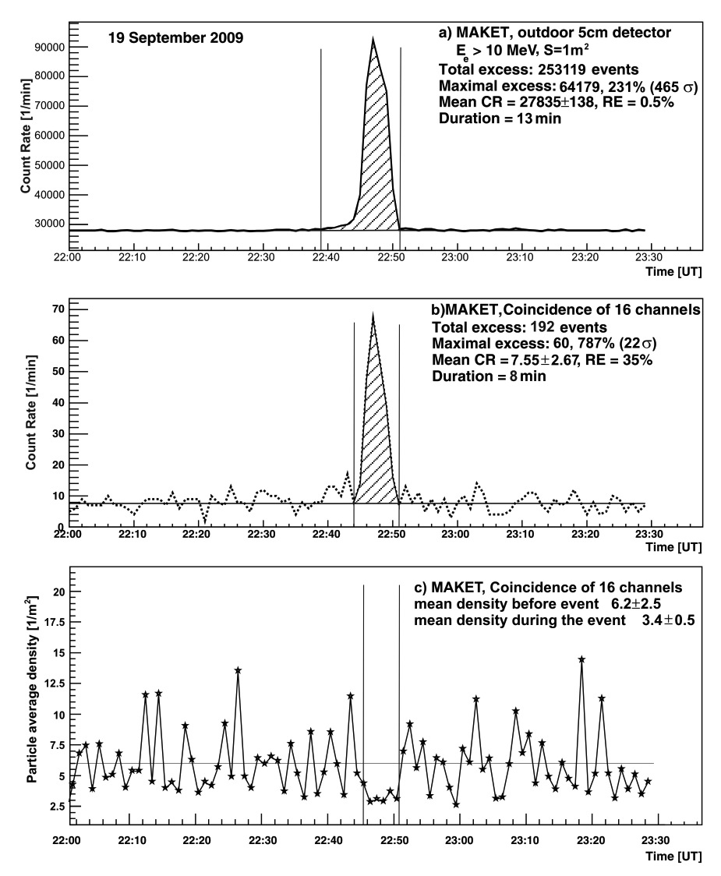
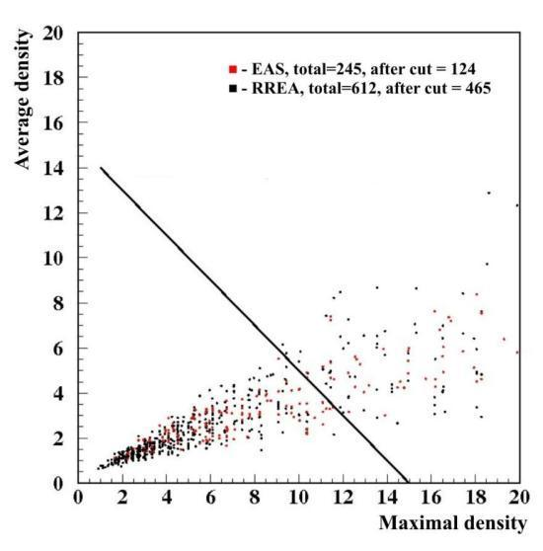
First RRE avalanches detection. New type of particle showers – Extensive Cloud Showers (ECS);
50 MeV electrons comes from thunderclouds!
MAKET detect short coherent bursts of electrons/gamma rays (within 1 µsec);
ECS counts 7 times more than EAS!
ECSs have smaller densities – can be distinguished from CR EAS.

Slide 14
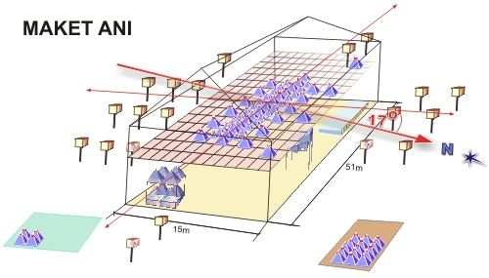
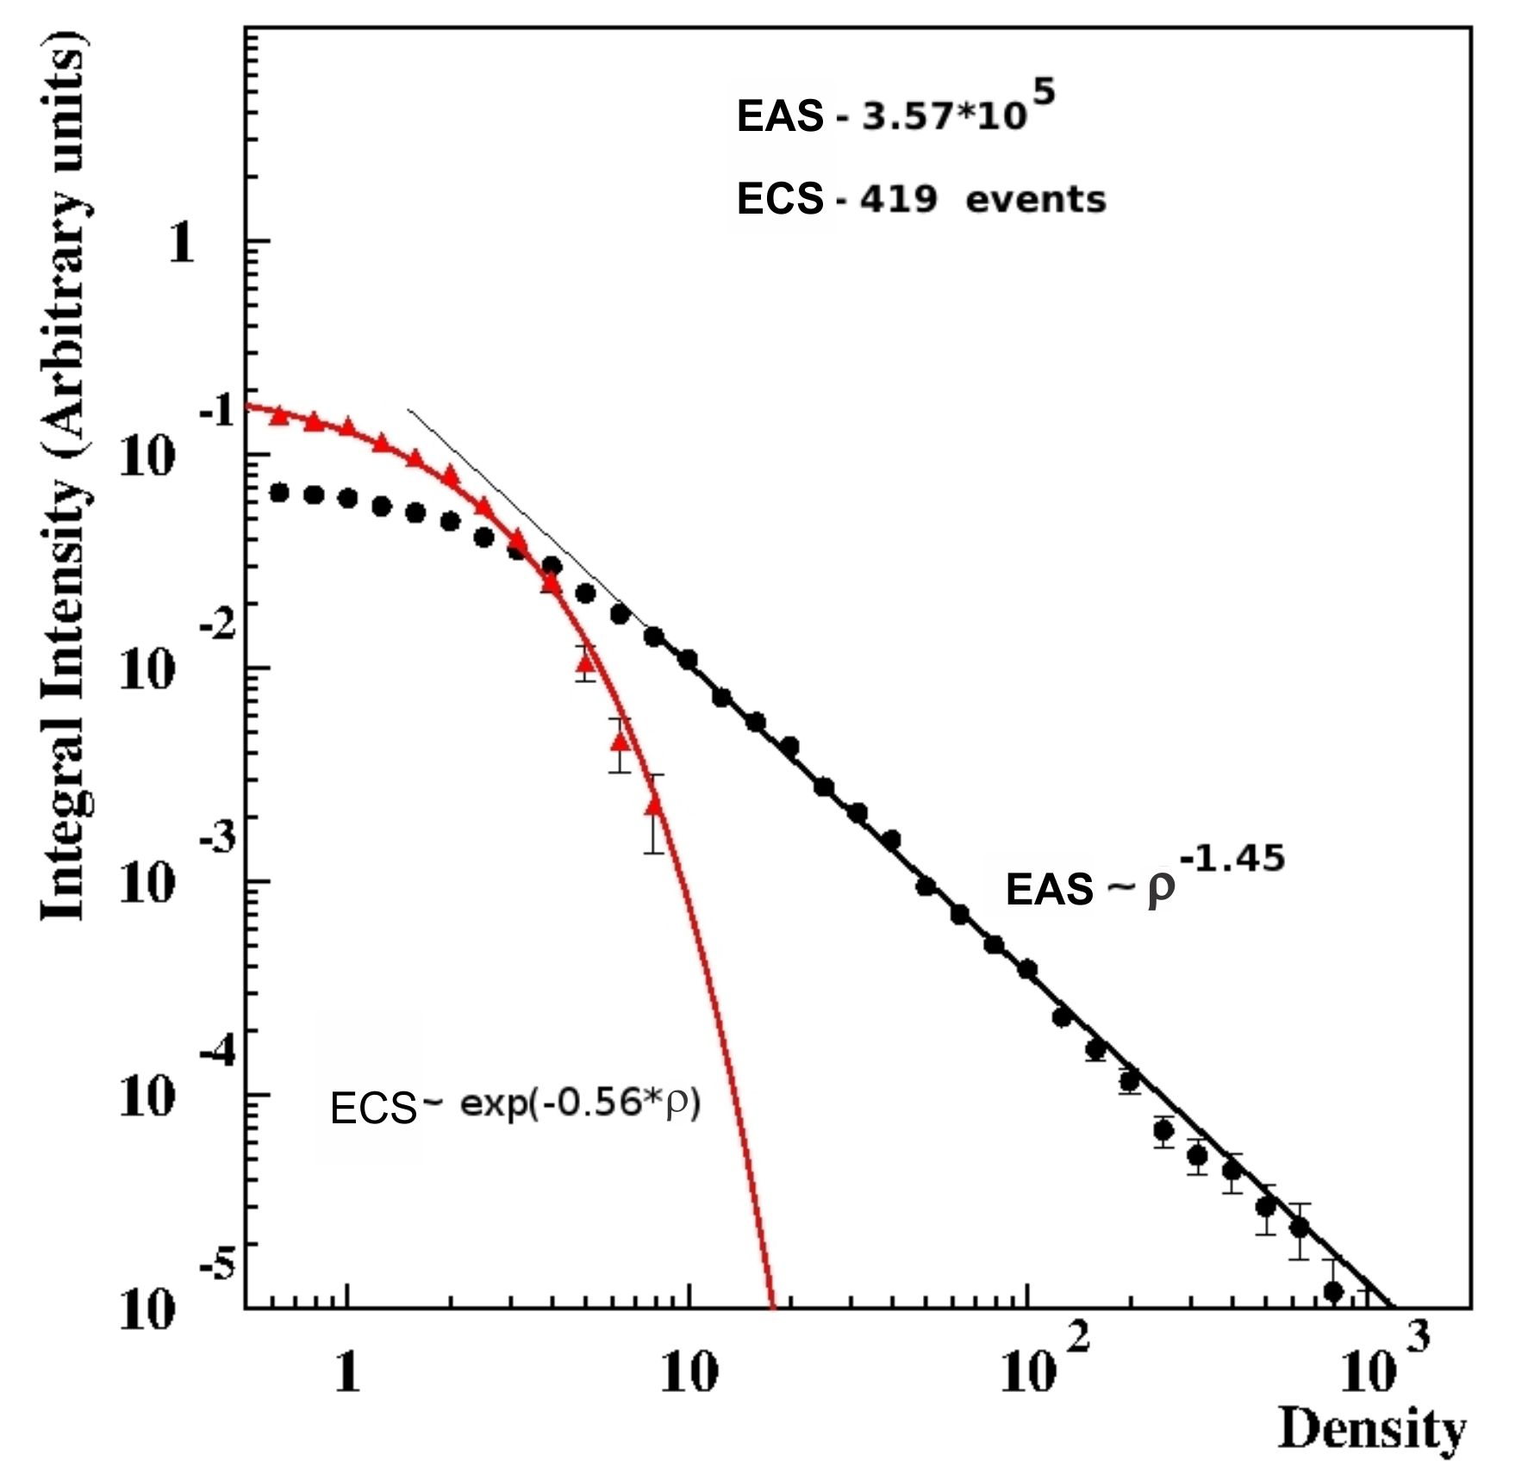
Spectra of Extensive Air Showers (EAS) and Extensive Cloud Showers (ECS)

Slide 15
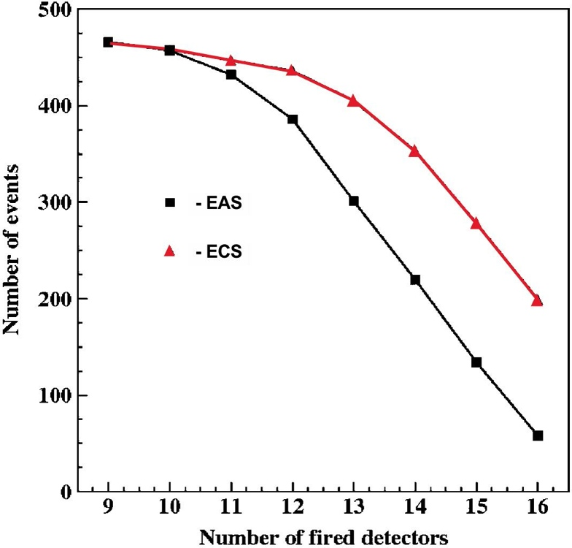
Extensive Cloud Showers (ECS) extended more than Extensive Air Showers (EAS)

Slide 16
RREA - MOS processes

Slide 17
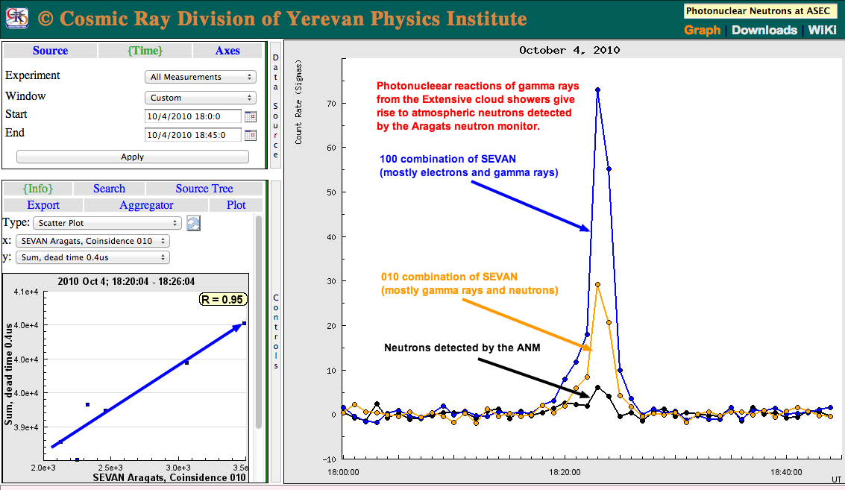
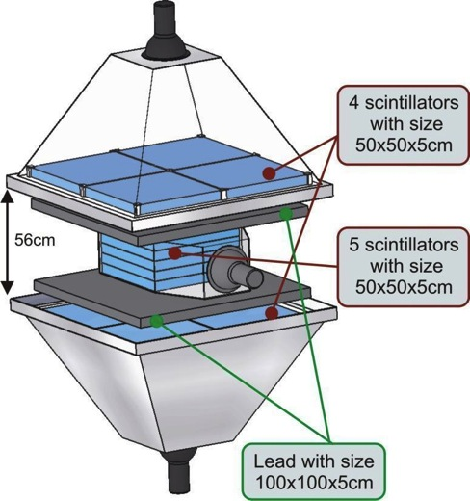
Detection of TGE neutrons

Slide 18
Muon flux depletion simultaneously with electron flux enhancement

Slide 19
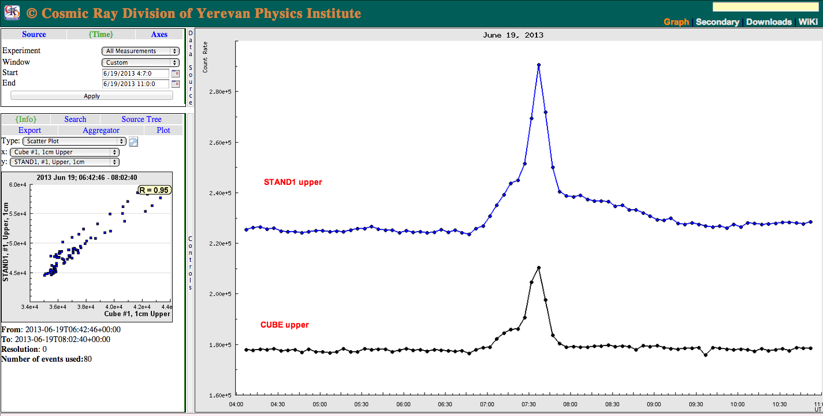
Long duration low energy TGE tails

Slide 20
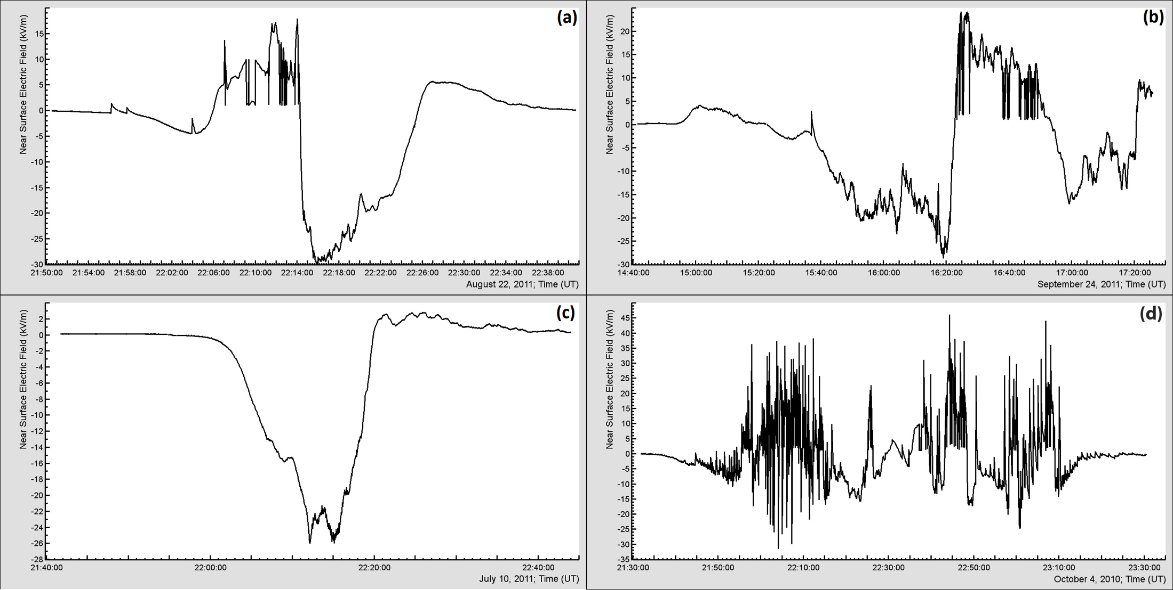
Four Main Patterns of Surface Electrical Field Disturbances

Slide 21
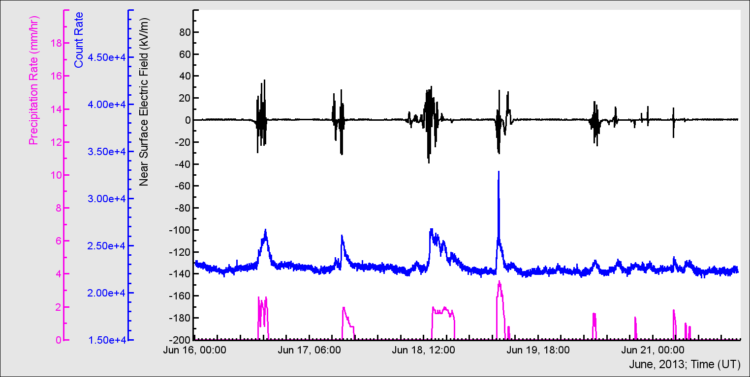
Charge reside on rain droplets

Slide 22
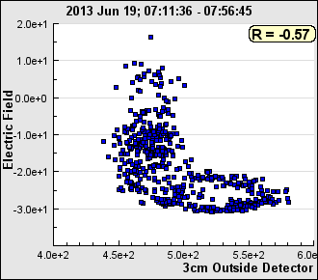
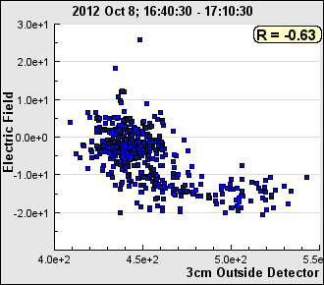
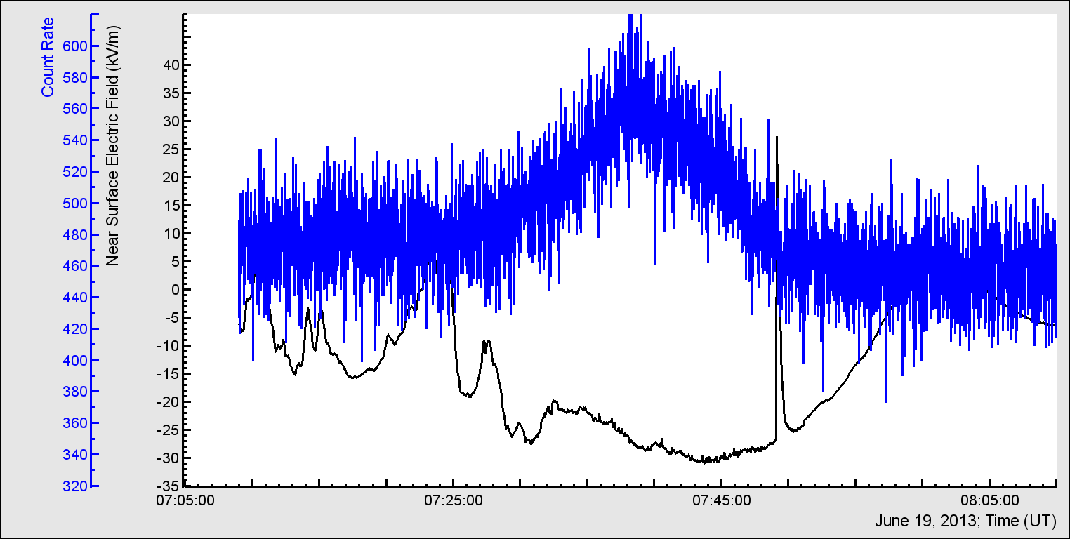
One second time series of EFM-100 and 3 cm outdoor scintillator – correlation of electric field and TGE flux

Slide 24
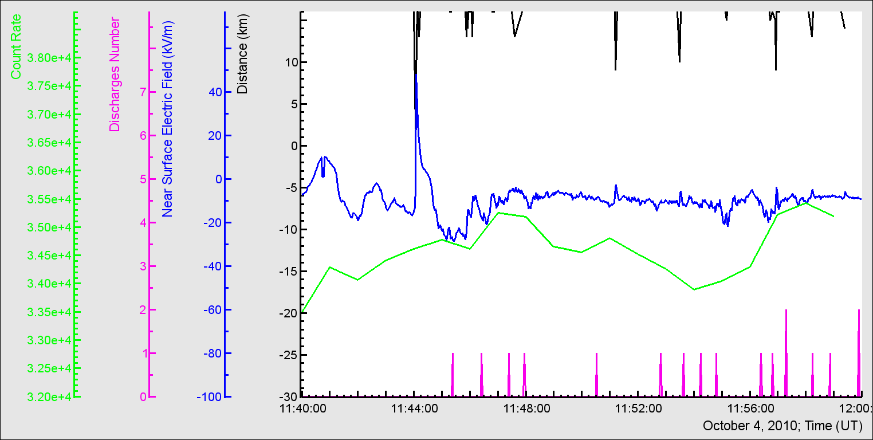
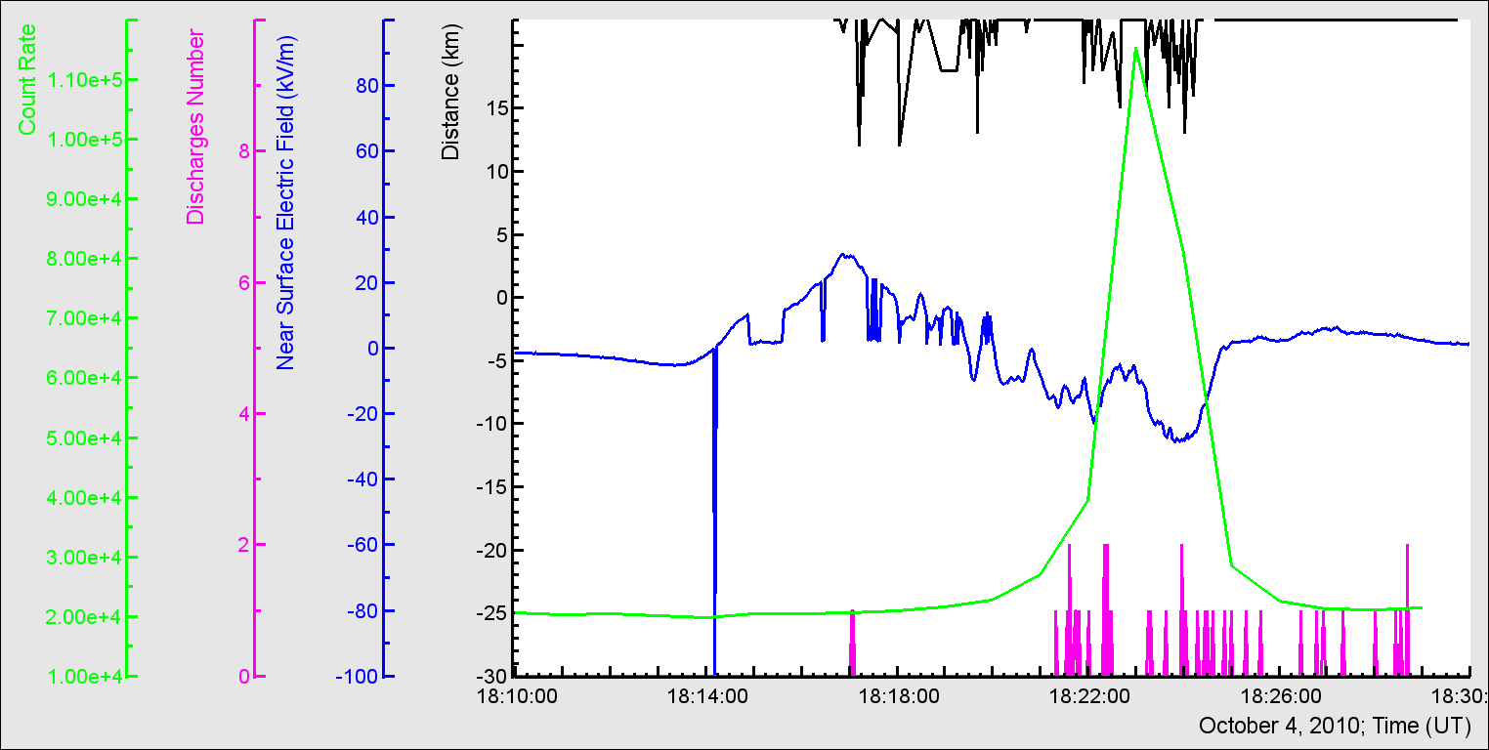
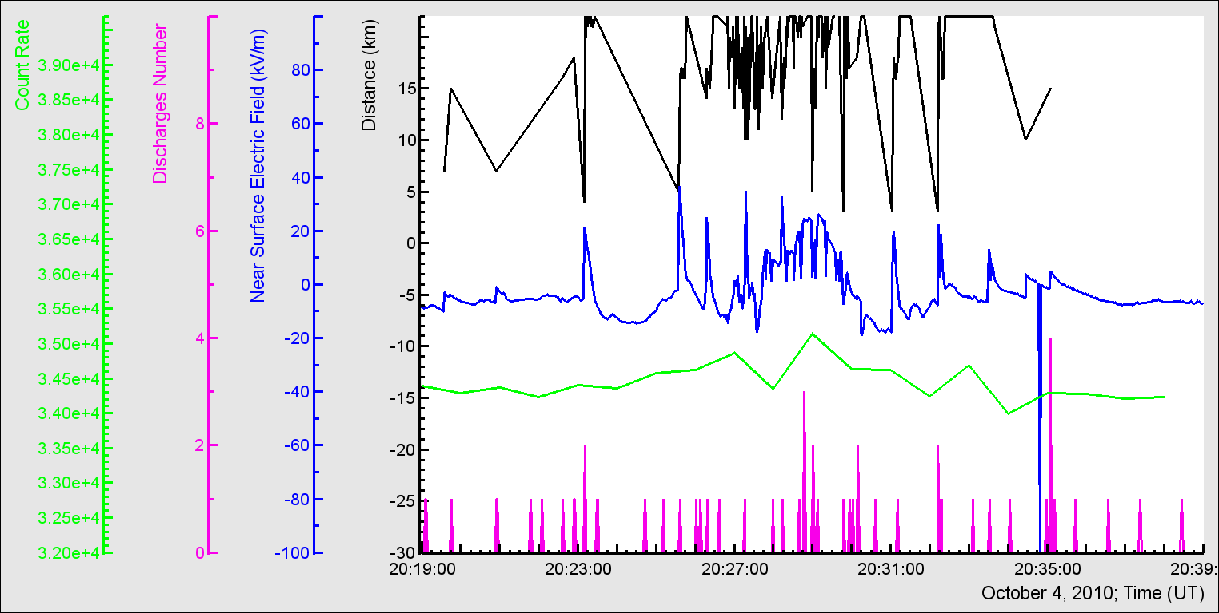
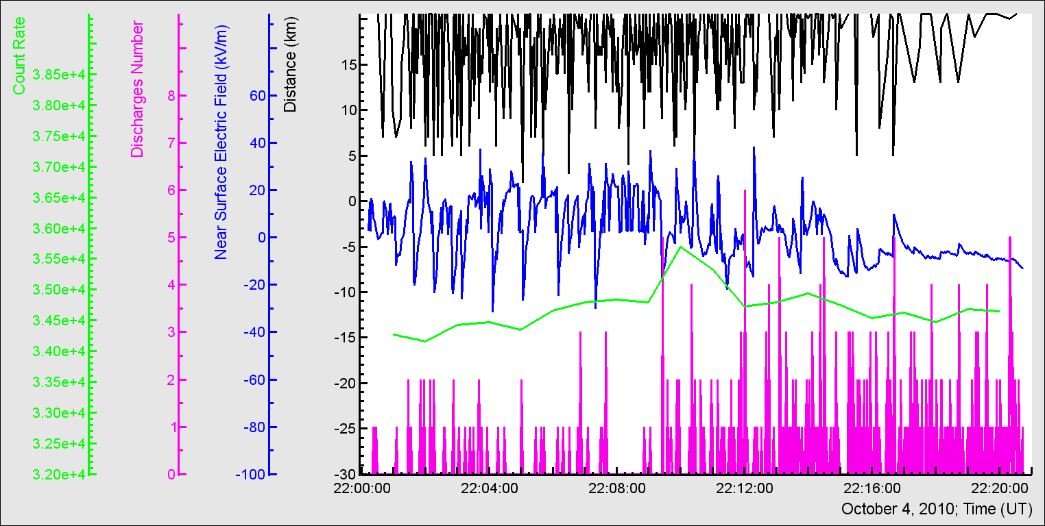
October 4, 2010 – super storm- lightning is not cause of GLE!

Slide 25
What we know about TGEs?
Lower dipole in thunderclouds transfer effectively field energy to electrons; electrons generate gamma rays and gamma rates by photo-nuclear reactions born neutrons detected on earth’s surface;
Origin of TGE is mainly mixture of 2 processes RREA (1 -40 MeV, enhancement up to 10 times above CR flux) and modification of CR energy spectra MOS (1- 100 MeV enhancement only few % of CR flux).
RREA generates particle bursts with duration less than 1 μsec (ECS – “downward” TGFs); overall duration of TGE is ~ 10 minutes, during 10 minutes large amount of ECSes occurs ;
Largest TGE events allows to estimate energy spectra: energy spectra of electrons are exponential, of gamma rays - power law in overall;
Simultaneously with boost of electrons and gamma rays high energy muon flux attenuates;
TGEs usually occurs during negative near surface electrical field varied from -10 to -30 kV/m; TGE flux correlate with strength of electric field and – with spectral index of gamma ray energy spectra;
During TGEs only IC- lightning can occur; CG- lightning are suppressed – LCPR stops lightning leader.

Slide 26
Miscellaneous slides

Slide 27
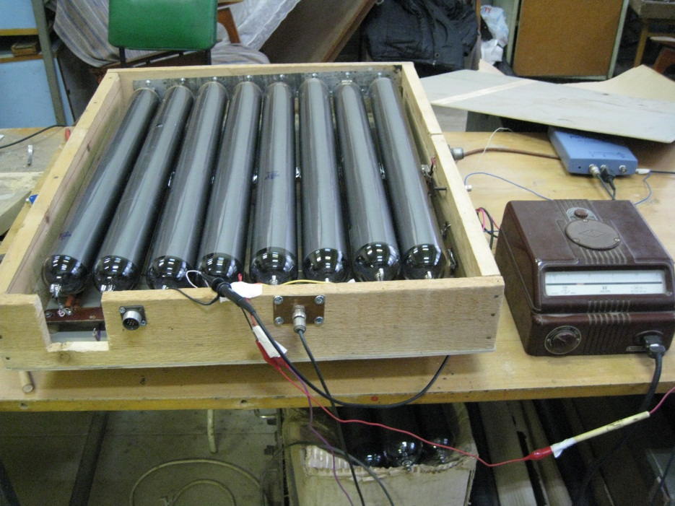
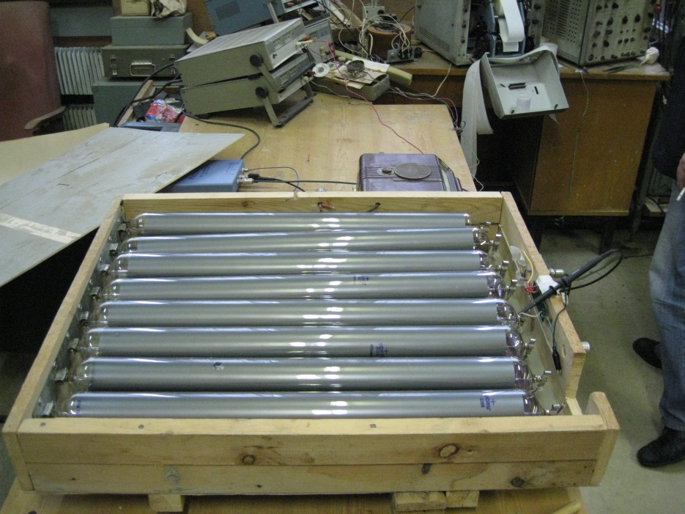
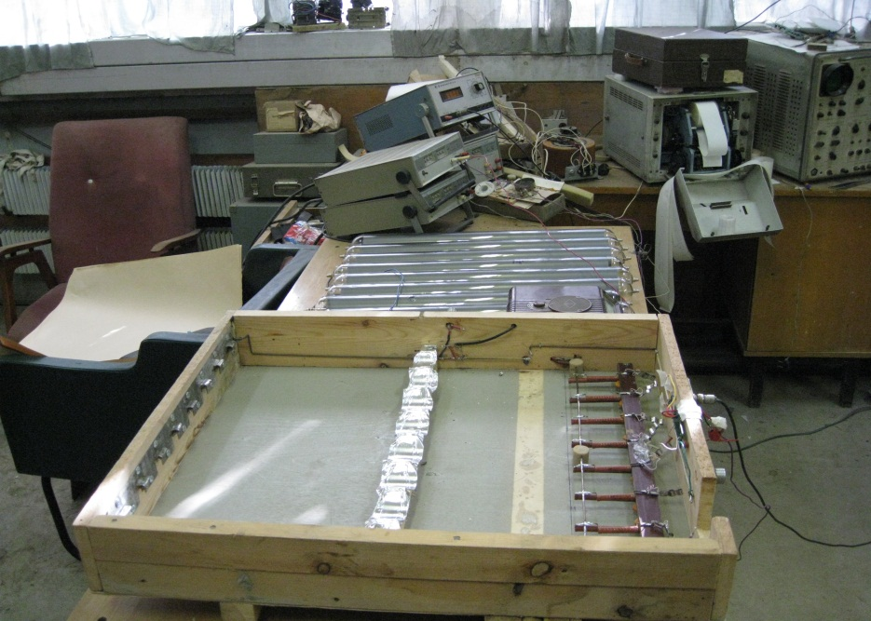
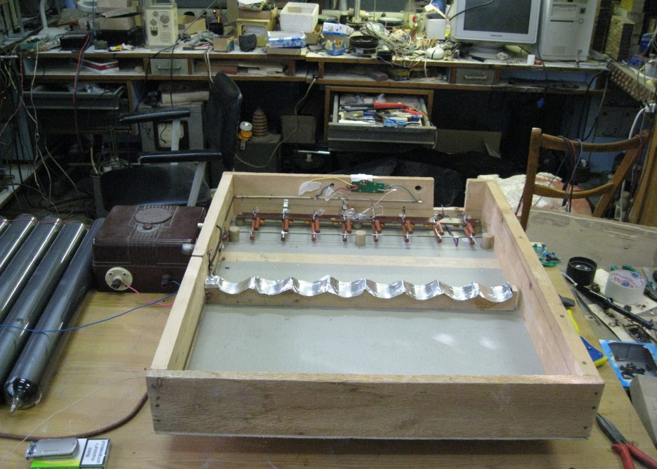
Tray of Geiger counters installed on Aragats in 2012;
Energy threshold 1.5 – 2 MeV

Slide 28
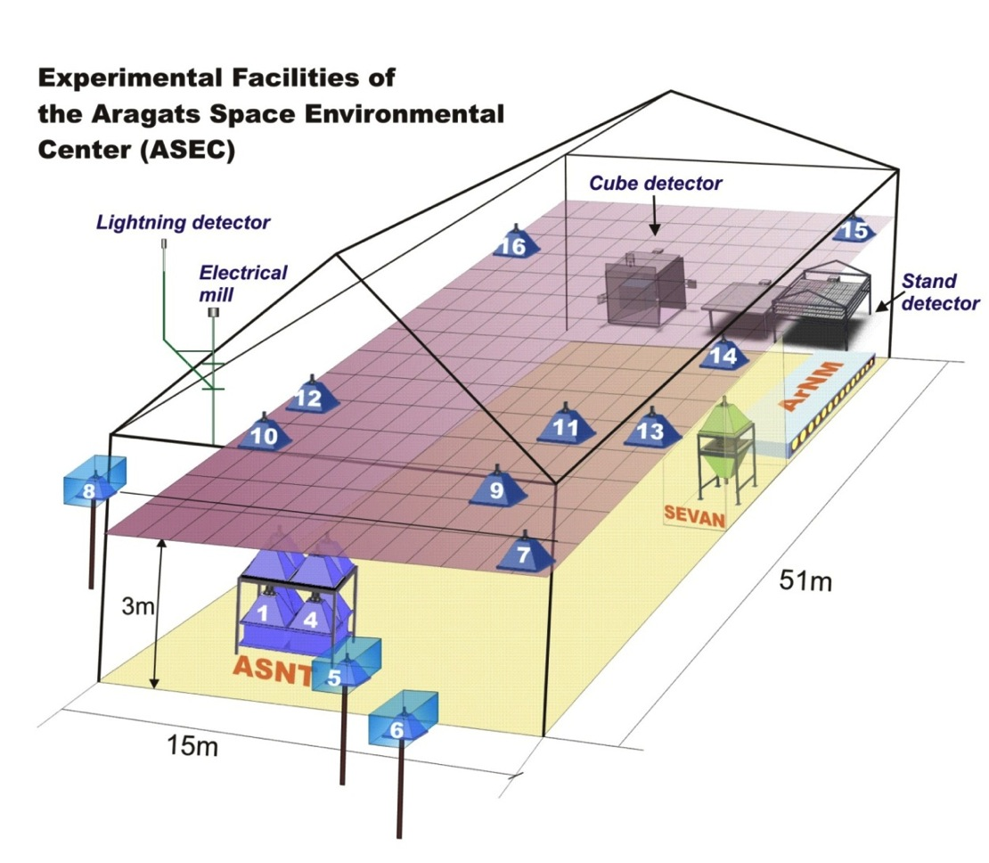
Monitoring of fluxes, fields, meteorological conditions
Boltek EFM 100 electrical mill and Lightning tracer; Davis instr. weather station

Slide 29
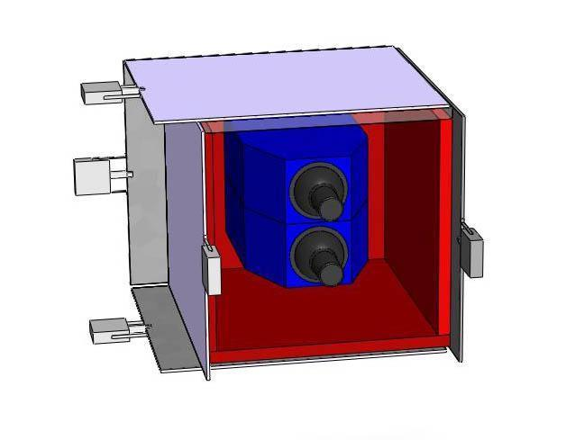
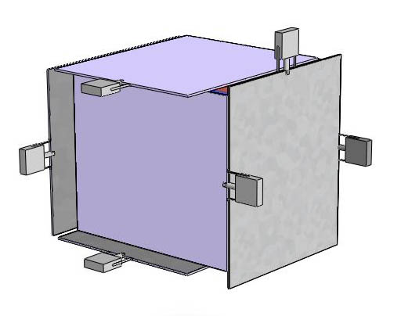
Cube Detector for detection of Neutral particle

Slide 30
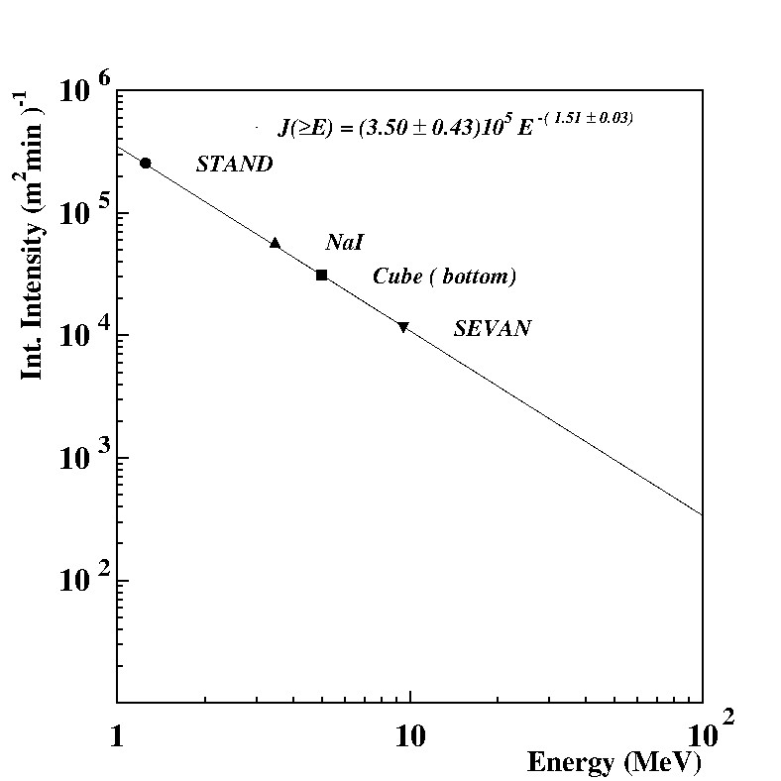
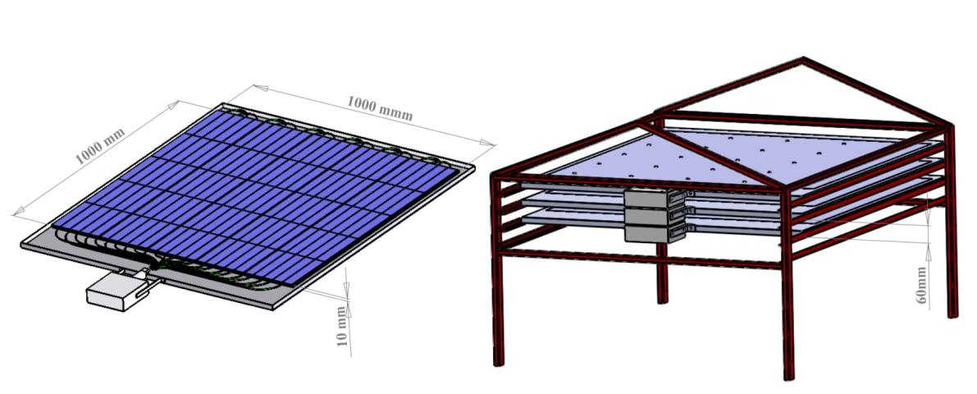
STAND multilayered Detector

Slide 31
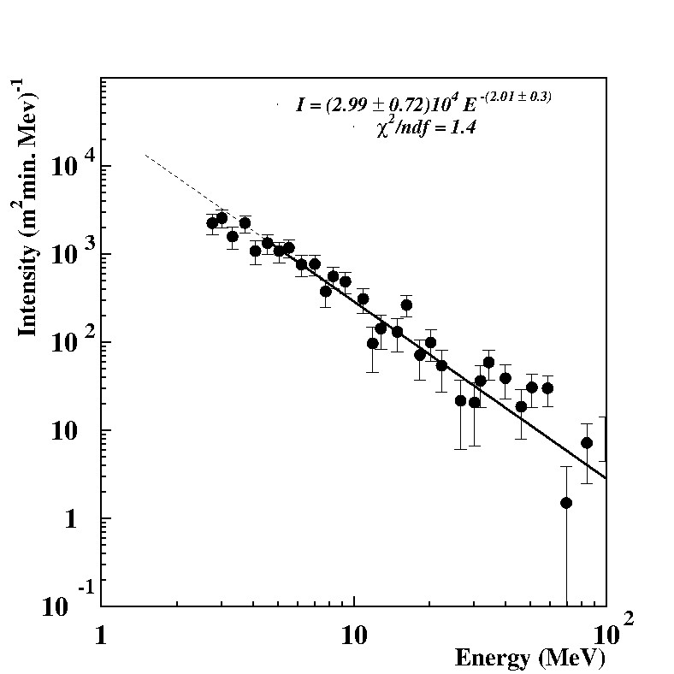
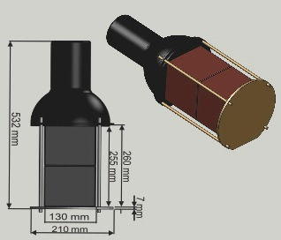
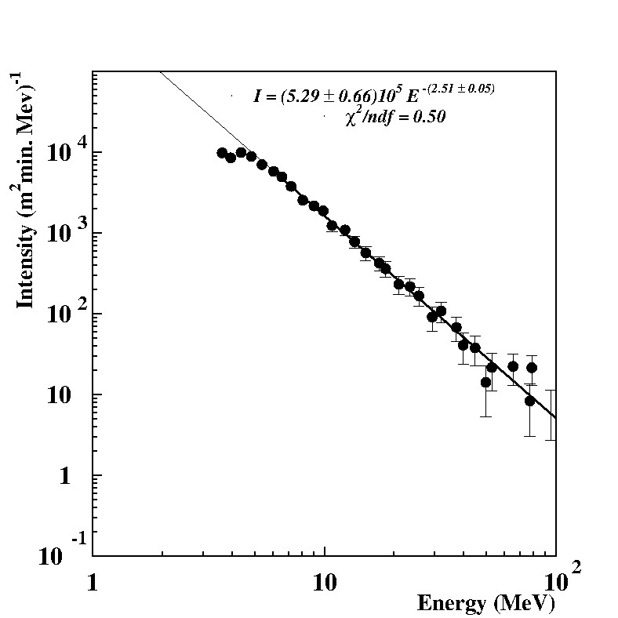
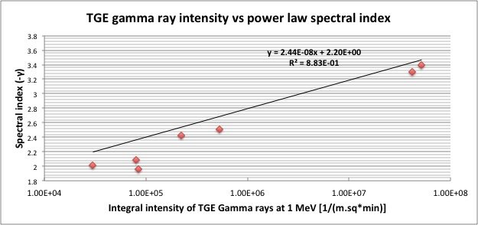
NaI network 5 detectors 12.5 x 12.5 x 25 each

Slide 32
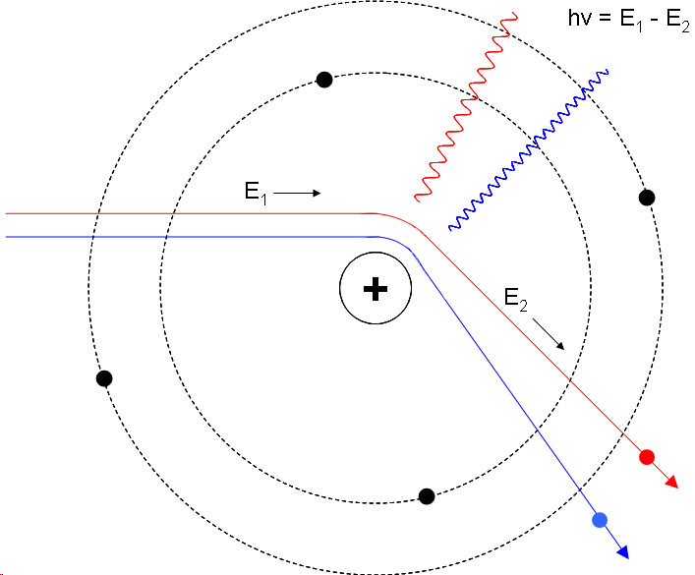

MOS process

Slide 33
EAS cannot provide RREA with additional seed electrons to enhance ECSs 7 times
A V Gurevich, et al., 2013, Cosmic rays and thunderstorms at the Tien-Shan mountain station, Journal of Physics: Conference Series 409 (2013):
“At the extensive atmospheric showers (EAS) the number of CR secondaries is growing strongly. As they serve the seed electrons for the RB that naturally leads to a strong amplification of RB avalanche -RB EAS effect. This effect being generated by the energetic CR particles of 10¹⁵ eV and 10¹³ eV has been observed in [2] and [6].”
[2] Gurevich A V, Mitko G G, et al. 2009 Phys Lett. A 373 3550
[6] Chilingaryan A, et al. 2011 Phys Rev. D 83 062001
Mean EAS number was rather constant and equal ~10;
ECS number peaks on ~ 80; there are absolutely no correlation between EAS and ECS! And only nearby Supernovae, or super powerful solar flare can enhance EAS number.

Slide 34


TGE –– no lightning occurrences

Slide 35

TGE are detected at large negative near-surface electrical field; at the same time CG- are suppressed.

Slide 36
TGF - TGE(ECS) relation
The generation mechanisms of the space TGFs and downward TGFs (ECSes) share some common features: runaway electron avalanches in lower dipole and in upper dipole. TGEs happen in series – hundreds of Extensive Cloud Showers in a second. TGFs represent few RREA cascade lasting milliseconds.
ECSes are very rare events (detected at Aragats about once a year); number of detected TGFs detected by RHESSY, FERMI LAT and GBM is much larger - reaching hundreds per year. Nonetheless, because of closeness of the particle beam, the number of detected TGEs in 3 series of detection is comparable with number of yearly detected TGFs ~500.
Recently FERMI confirms that sferics detected in correlation with TGFs are due to TGF itself and not lightning!

Slide 37
Relations between Lightning- radio signals – particle fluxes
Particle fluxes start before lightning flashes;
Lightning flashes are numerous and strong without any relation to particle fluxes;
For initiation of TGE we need electric field, rain droplets and maybe definite relations of other meteorological parameters (humidity-temperature)
Development of LPCR may accompanied by HF radio emission – coherent discharges of stretched HM with CR (RREA) electrons;
For TGE we do not need additional seed electrons, do lightning provide seed electrons to TGF?
Particle fluxes and lightnings are alternative processes – both are initiated by strong electric fields in thunderclouds

