Slide 1
ON ELECTROMAGNETIC RADIATION IN THE ATMOSPHERE OF THE EXCESS
NEGATIVE CHARGE IN THE NUCLEAR-ELECTROMAGNETIC CASCADE
(and related topics)
V.S. Malyshevsky, G.V. Fomin
Southern Federal University, 344090, Rostov-on-Don, Russia
E-mail address: vsmalyshevsky@sfedu.ru

Slide 2
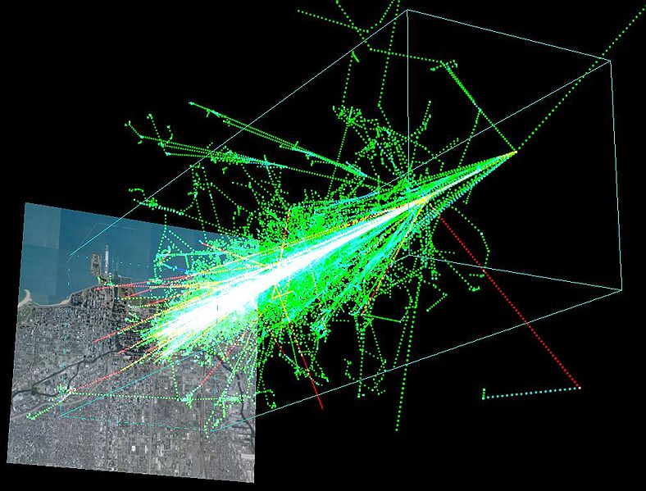
G.A. Askariyn. Sov. Phys. JETP, v.41, 616 (1961).
The excess negative charge electron-photon shower and coherent radio emission from it

Slide 3
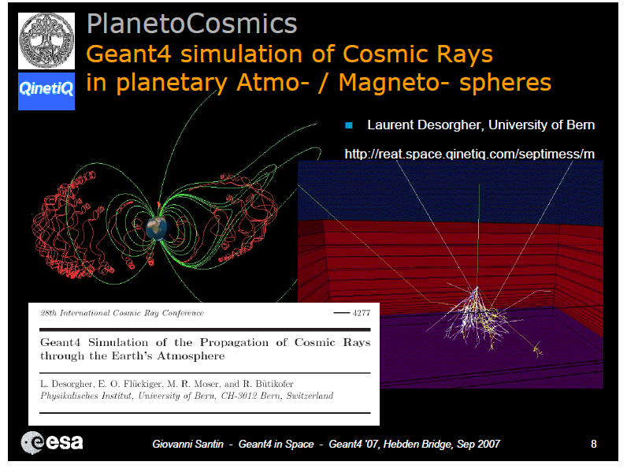
L. Desorgher, E.O. Fluckiger, M. Gurtner, et. al.,
Int. J. Mod. Phys. A 20, 6802 (2005).
PLANETOCOSMICS:
Geant4 application for simulating the interaction of cosmic rays with the Earth, Mars and Mercury.

Slide 4
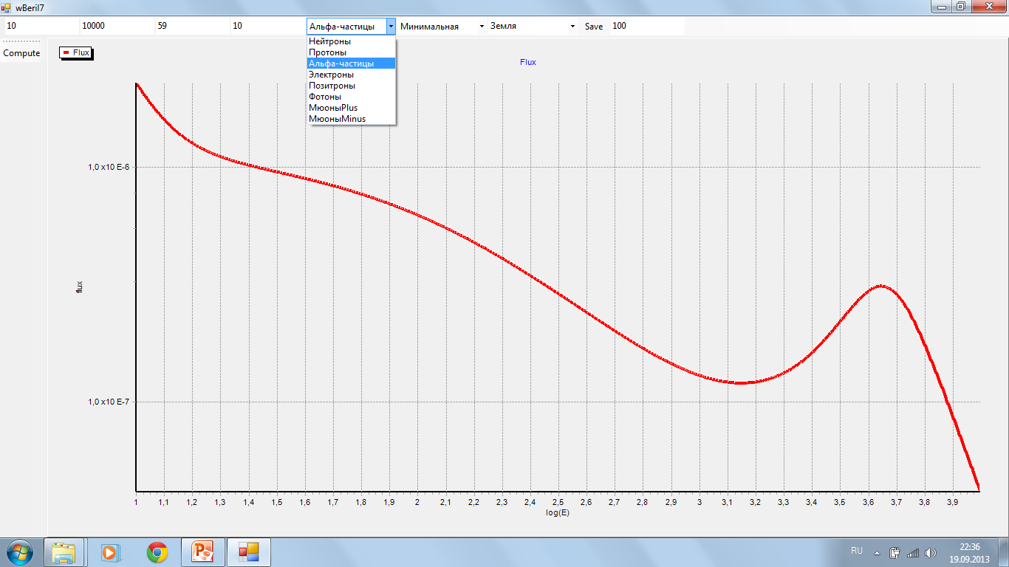
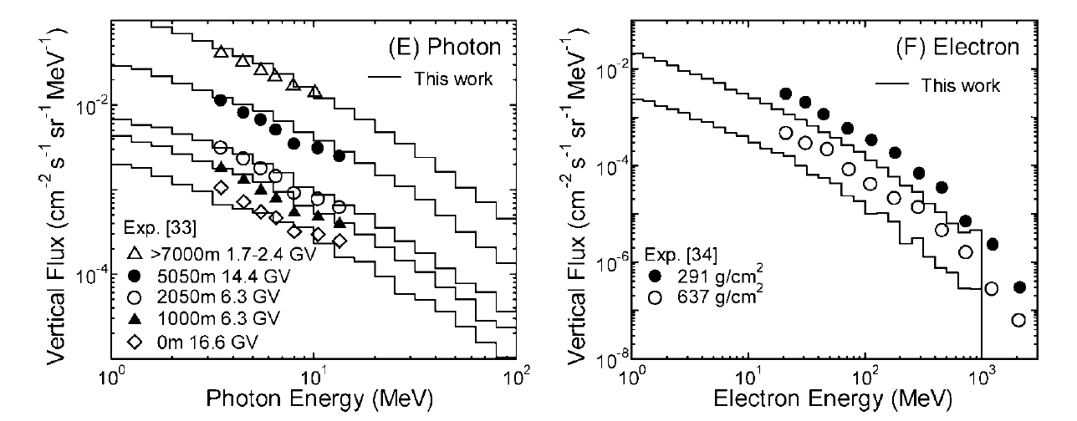
Tatsuhiko Sato, Hiroshi Yasuda, Koji Niita, et.al.,
Radiation Research 170, 244 (2008).
Development of PARMA:
PHITS-based analytical radiation model in the atmosphere

Slide 5
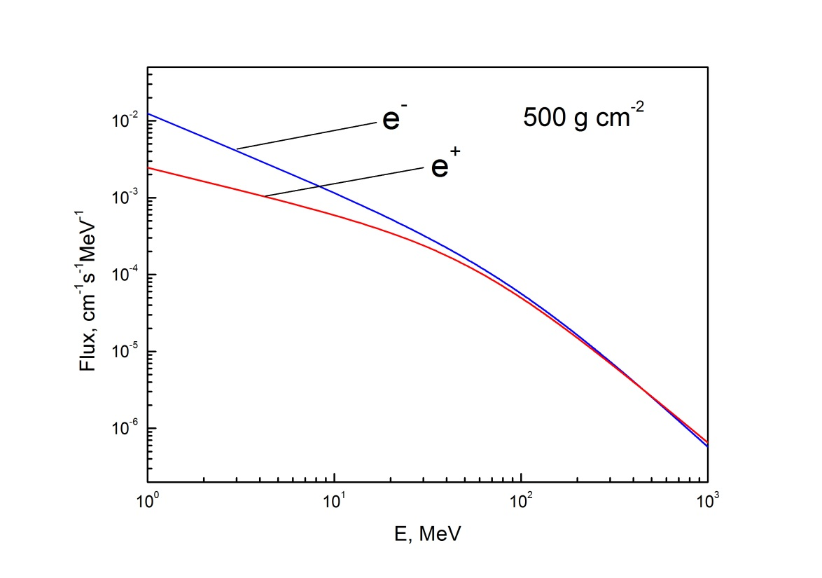
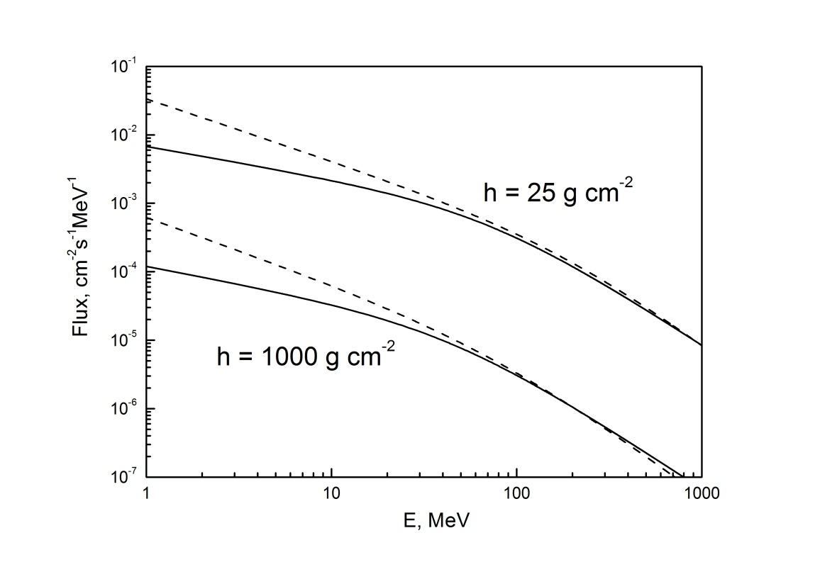
The flux density of electrons and positrons
PARMA

Slide 6
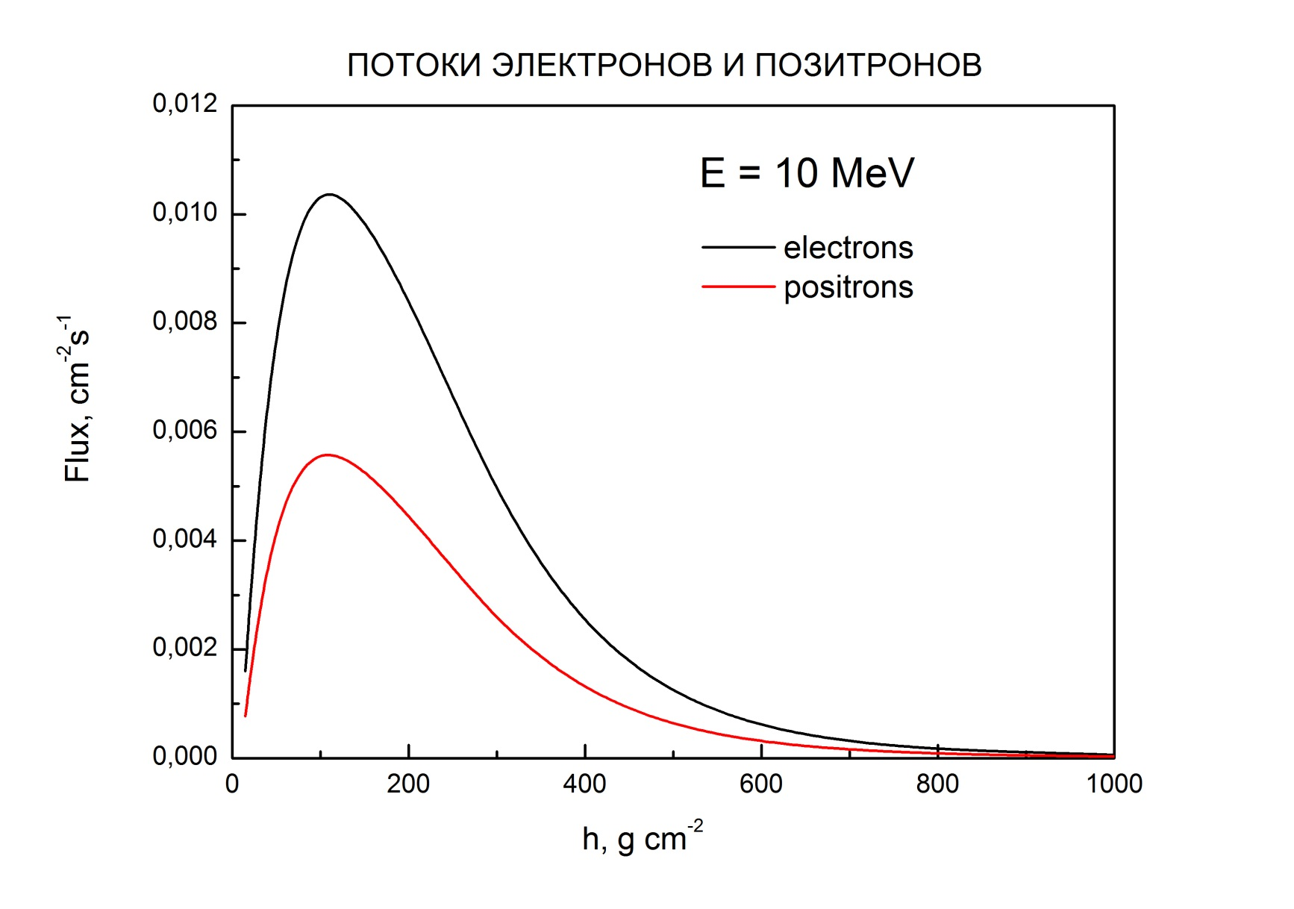
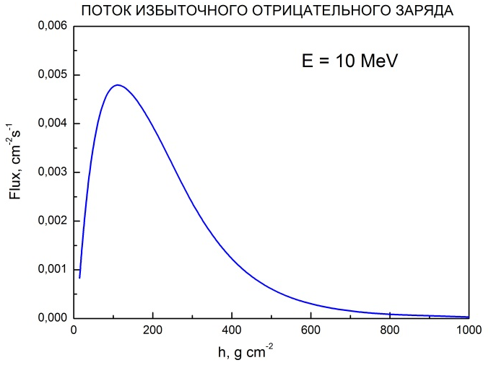
The flux density of electrons and positrons
depending on the depth of the atmosphere
PARMA

Slide 7
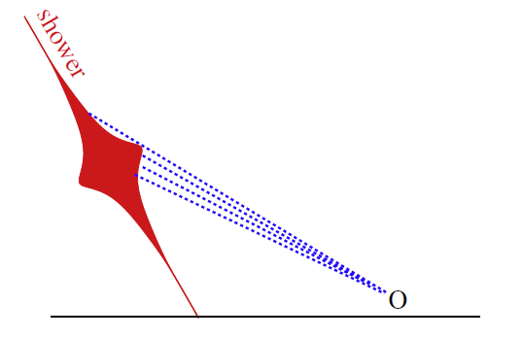
A realistic treatment of geomagnetic Cherenkov radiation from cosmic ray air showers
Klaus Werner, Krijn D. de Vries , Olaf Scholten
Astroparticle Physics 37 (2012) 5–16
Whether we can use a macroscopic electrodynamics for the calculation of electromagnetic radiation from a shower ?
10 km
16 km

Slide 8
33-rd International Cosmic Ray Conference, Rio De Janeiro 2013
The EVA code: Macroscopic modeling of radio emission from air showers
Krijn D. De Vries¹, Olaf Scholten², Klaus Werner³,
1 - Vrije Universiteit Brussel (VUB), dienst ELEM, Pleinlaan 2, B-1050 Brussels, Belgium
2 - Kernfysisch Versneller Instituut, University of Groningen, 9747 AA, Groningen, The Netherlands
3 - SUBATECH, University of Nantes – IN2P3/CNRS– EMN, Nantes, France
arXiv:1107.1189v2 [astro-ph.HE] 16 Apr 2012
Monte Carlo simulations of radio pulses in atmospheric showers using ZHAireS
Jaime Alvarez-Muniz¹, Washington R. ², Carvalho Jr.,¹ Enrique Zas¹
1 - Depto. de F´ısica de Part´ıculas & Instituto Galego de F´ısica de Altas Enerx´ıas,
2 - Universidade de Santiago de Compostela, 15782 Santiago de Compostela, Spain
ЯДЕРНАЯ ФИЗИКА, 2010, том 73,№7, с. 1231–1242
Радиоизлучение широких атмосферных ливней
как метод регистрации космических лучей
Н. Н. Калмыков, А. А. Константинов, Р. Энгель
Научно-исследовательский институт ядерной физики Московского государственного университета, Россия

Slide 9
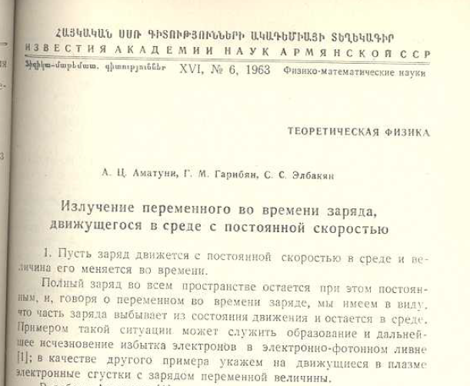
Justice must be restored !
Аматуни А.Ц., Гарибян Г.М., Элбакян С.С. //
Известия Академии наук Армянской ССР.
1963. Т. XVI. №6. С. 101-112.
Излучение переменного во времени заряда движущегося
в среде с постоянной скоростью
The radiation of a time-varying charge moving
in a medium with a constant speed

Slide 10
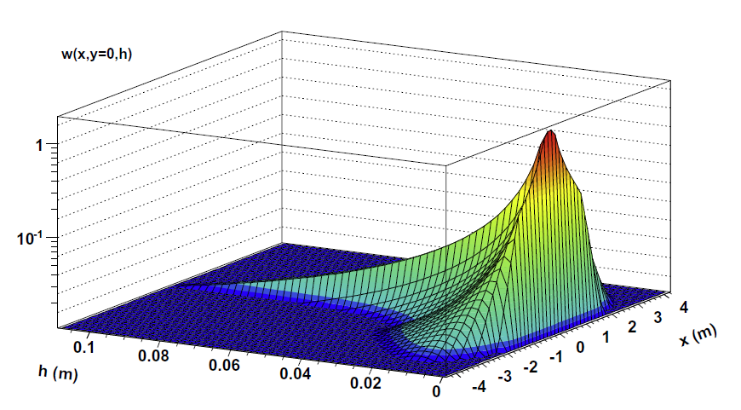
Point-like approximation
Аматуни А.Ц., Гарибян Г.М., Элбакян С.С. Известия Академии наук Армянской ССР. 1963. Т. XVI. №6. С. 101-112.
4 m
Z(t)
1 m
Klaus Werner, Krijn D. de Vries , Olaf Scholten
Astroparticle Physics 37 (2012) 5–16

Slide 11
Point-like approximation
Аматуни А.Ц., Гарибян Г.М., Элбакян С.С. Известия Академии наук Армянской ССР. 1963. Т. XVI. №6. С. 101-112.
4 m
Z(t)
1 m
L~10 km

Slide 12
Condition of the Point-like approximation
Аматуни А.Ц., Гарибян Г.М., Элбакян С.С. Известия Академии наук Армянской ССР. 1963. Т. XVI. №6. С. 101-112.
Longitudinal "point"
Z(t)
Transverse "point"
If = 45º
<< 200 MHz
Аматуни А.Ц., Гарибян Г.М., Элбакян С.С. Известия Академии наук Армянской ССР. 1963. Т. XVI. №6. С. 101-112.

Slide 13
Instead of the conclusion for young colleges
If you start to solve some problem look carefully around previous results.
May by 20 or 30 years ago Armenian physicist already have solve it.
Thank you for your attention !

