Slide 1

Magnet powering for Hi-Lumi LHC
4th LHC Parameter and Layout Committee
26/03/2013
Ballarino, TE-MSC-SCD
With input from:
J.P. Burnet, S. Fartouk, E. Todesco, G. Arduini

Slide 2
Outline
Powering layout of the LHC Triplets
Proposed powering layout for the Hi-Lumi Triplets
Modifications in the Matching Sections
Conclusions
4th LHC Parameter and Layout Committee
A. Ballarino

Slide 3
Powering of LHC Triplets
∼3.6 m
DFBL
11 × 7500 A
12 × 120 A (MCBY)
4.5 K
4.5 K
1.9 K
DFBA
Q6
Q5
Q4 D2
D1
DFBX
Q3,Q2,Q1
Q11, Q10…Q7
TAN
TAS
IP1
IP 8
∼12 m
∼3 m
RR 13
UJ 13
4th LHC Parameter and Layout Committee
A. Ballarino

Slide 4
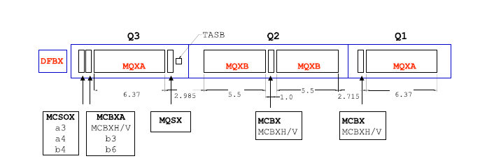
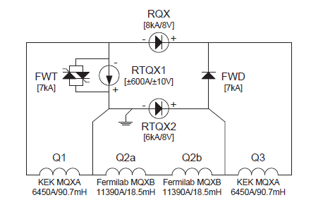
Powering of LHC Triplets
Distances in m
Nested circuits
One trim power converter (6 kA) on Q2
One trim power converter on Q1 (0.6 kA)
F. Bordy et al.
4th LHC Parameter and Layout Committee
A. Ballarino

Slide 5
Powering of LHC Triplets
D1 resistive magnet
Q1, Q2 and Q3: four leads, each rated at 7500 A DC
Corrector magnets: quadrupole, sextupole and octupole (120 A/600 A)
DFBX
N. of leads | Rating (A)
10 | 120
14 | 600
4 | 7500
Itot from DFBX ∼ 40 kA
4th LHC Parameter and Layout Committee
A. Ballarino

Slide 6
Baseline for powering the Hi-Lumi Triplets:
DFBX moved to the surface;
DFB and power converters in surface building;
SC link transferring the current from the surface to the
tunnel
Cooling of DFB and SC link using new refrigerators
4th LHC Parameter and Layout Committee
A. Ballarino

Slide 7
Powering of LHC Hi-Lumi Triplets
∼3.6 m
DFBL
11 × 7500 A
12 × 120 A (MCBY)
4.5 K
4.5 K
1.9 K
DFBA
Q6
Q5
Q4 D2
D1
DFBX
Q3,Q2,Q1
Q11, Q10…Q7
TAN
TAS
IP1
IP 8
∼12 m
∼3 m
RR 13
UJ 13
4th LHC Parameter and Layout Committee
A. Ballarino

Slide 8
Powering layout 1 – past proposal, not retained
D1 Q3 Q2b Q2a Q1
SC Link
Dipole
Quads
Trim
Q3
Trim
Q2b
Trim
Q1
Leads
11 kA
17.3 kA
1 kA
0.2 kA
1 kA
+
-
+
-
Equipment
for energy
extraction
and fast
de-excitation
-
+
-
+

Slide 9
Powering layout 1 – original baseline, not retained
All quadrupoles in series with trims
Trims on Q3, Q1 and Q2b
τ for fast discharge < 7 s
+ Least investment for powering equipment
- Quench of all quadrupoles if one magnet quenches -unless use of cold diodes installed in non-radiation area or specifically developed with radiation hard characteristics
- Feasible, but more complicated for power converters (regulation and diagnostic)
4th LHC Parameter and Layout Committee
A. Ballarino

Slide 10
Powering layout 2 –proposed baseline
D1 Q3 Q2b Q2a Q1
SC Link
Quads
Q1
and Q3
Quads
Q2a
and Q2b
Dipole
Trim
Q3
Trim
Q2b
Leads
11 kA
17.3 kA
2 kA
0.2 kA
17.3 kA
+
-
+
-
-
+
-
+

Slide 11
Powering layout 2 – proposed new baseline
Two pairs of quadrupoles in series with trims
This layout assures:
Full flexibility for the optics
When compared to Powering layout 1:
Reduced constraints for magnet protection;
Reasonable compromise for cold powering system
(+ 2×17.3 kA);
Preferred solution for the power converters
Final location of 2 kA trim - Q3 or Q1 – to be defined at later stage
4th LHC Parameter and Layout Committee
A. Ballarino

Slide 12
Corrector magnets
Nine circuits of non-linear correctors (MQSX)
9 PCs
18 leads, 18 SC cables in the link
Imax=100 A
Three times two circuits of dipole correctors (MBCX)
6 PCs
12 leads, 12 SC cables in the link
Imax=2400 A
4th LHC Parameter and Layout Committee
A. Ballarino

Slide 13
Maximum Operating Current of
Magnets and Powering Equipment*
Magnet type |  | Magnet current |  | Powering equipment current
Quadrupoles | MQXF | 17.3 | kA | 20 | kA
Trim on Q3 | Trim | ± 2 | kA | ± 2.4 | kA
Trim on Q2b | Trim | ± 0.2 | kA | ± 0.24 | kA
Dipole | D1 | 11 | kA | 13 | kA
Non linear Correctors | MQSX | 0.1 | kA | 0.12 | kA
Dipole Correctors | MBCX | 2.4 | kA | 3 | kA
Powering layout 2 –proposed baseline
* Current Leads, HTS cables in SC link and power converters
4th LHC Parameter and Layout Committee
A. Ballarino

Slide 14
Hi-Lumi DFB and SC Link HTS cables
DFBX
N. of leads | Rating (A)
10 | 120
14 | 600
4 | 7500
N. of leads | Rating (A)
18 | 120
12 | 3000
2 | 2400
2 | 400
2 | 13000
4 | 20000
Itot ∼ 40 kA
Itot ∼ 150 kA (!)
4th LHC Parameter and Layout Committee
A. Ballarino

Slide 15
Powering of the Matching Sections
∼3.6 m
DFBL
11 × 7500 A
12 × 120 A (MCBY)
4.5 K
4.5 K
1.9 K
DFBA
Q6
Q5
Q4 D2
D1
DFBX
Q3,Q2,Q1
Q11, Q10…Q7
TAN
TAS
IP1
IP 8
∼12 m
∼3 m
RR 13
UJ 13
Operating currents in phase of being defined
D2, Q4, Q5, Q6 > 7500 A ? Powering via DFBL
Q7 = ? Powering via DFBA
Implications of any change are huge
4th LHC Parameter and Layout Committee
A. Ballarino

Slide 16
Conclusions
The proposed powering layout for the Hi-Lumi Triplets meets requirements from optics, magnet and powering systems
With a baseline for the powering layout, we (WP6) can start the design of the SC-link system
In the meantime, we developed a round MgB₂ superconducting wire (CERN/Columbus Superconductor), tested first short lengths of MgB₂ cables at up to 10 kA @ 4.2 K, and developed, assembled and commissioned in the SM-18 a novel test station incorporating a 20 m long SC-link cryostat – for the measurement of superconducting HTS lines operated up to 20 kA in He gas at variable temperatures
Changes in the MS – operating currents- have strong implications on the system (DFBA and DFBL)
4th LHC Parameter and Layout Committee
A. Ballarino

Slide 17
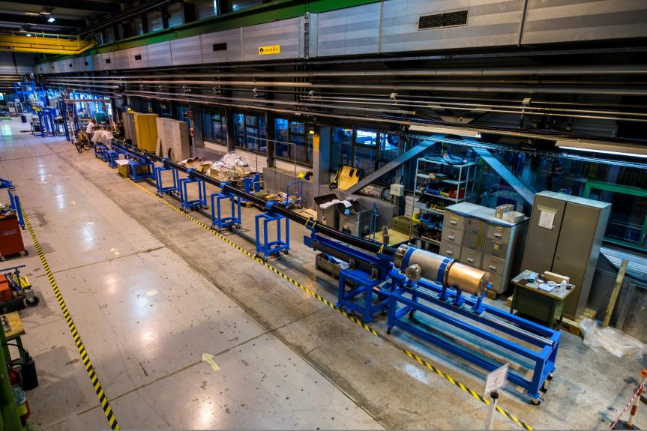
SC-Link Test Station (SM-18)

Slide 18
D1 Q3 Q2b Q2a Q1
SC Link
Dipole
Q3
Q2b
Q2a
Q1
Leads
14.2 kA
17.3 kA
17.3 kA
17.3 kA
17.3 kA
14.2 kA
17.3 kA
17.3 kA
17.3 kA
17.3 kA

