Slide 1

HL-LHC
Configuration Management
Keywords : HW Baseline, Naming, Parameters, Layout DB, Change Control
The HiLumi LHC Design Study (a sub-system of HL-LHC) is co-funded by the European Commission within the Framework Programme 7 Capacities Specific Programme, Grant Agreement 284404.

Slide 2
HL-LHC Configuration Management
This presentation addresses the configuration management of HL-LHC and places it in perspective of a future merge with LHC. Compatibilities, proposals and issues are presented.
It is structured as follows:
LHC Project and LHC Machine
Handling concurrently HL-LHC and LHC
Names, parameters, layout, slots, HW Baseline
Activity and HW Baseline/Parameters
What’s next

Slide 3
LHC Project and LHC Machine
LHC Project (prior to its installation) was handled through configuration management to allow
A clear view on the state of the project – in a HW Baseline, LHC Equipment Catalog for Parameters, Layout DB for MAD/X
A common view on the state of the project – Approval of parameters and documents (PLC, TCC, LTC, LMC, Maric,…)
LHC Machine (in operation) follows the same rules, with configuration management and change control (ECRs).
Every step/stop is traced – changes from TS/LS to TS/LS

Slide 4
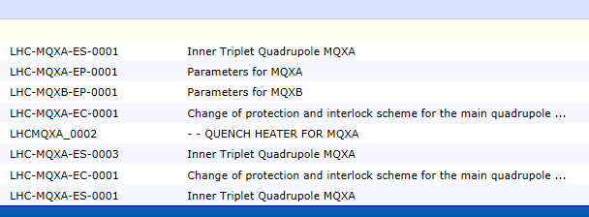
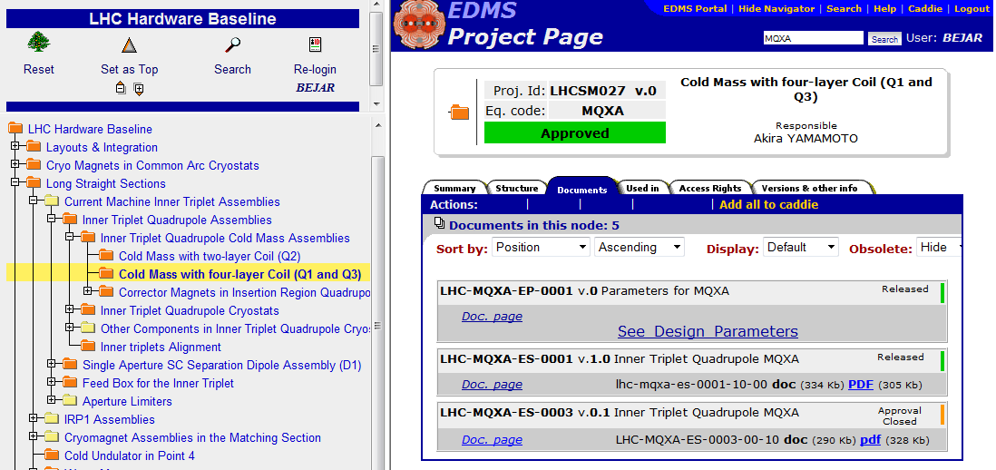
LHC Project and LHC Machine
Documents were stored in the Hardware Baseline
From Isabel’s presentation to HLTC

Slide 5
Handling concurrently HL-LHC and LHC
Several aspects to consider:
Names
Parameters of magnets
Layout drawings
Functional positions - Slots
HW Baseline

Slide 6
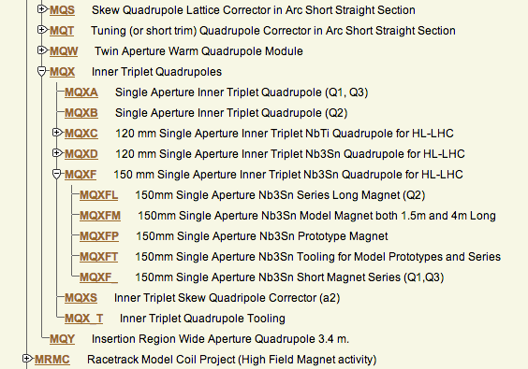
Names
The Naming portal now covers all accelerators

Slide 7
Names
Names have to be compatible with existing ones and properly declared in Naming, e.g. MQXF.
Proposal :
Use Accelerators-naming.Service@cern.ch address
Get a reference person in the Magnets group with an overview of all the codes
Issue :
Might be necessary to update to 8 characters for the equipment codes. QA-WG issue

Slide 8
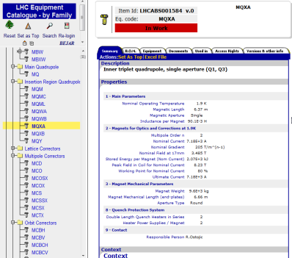
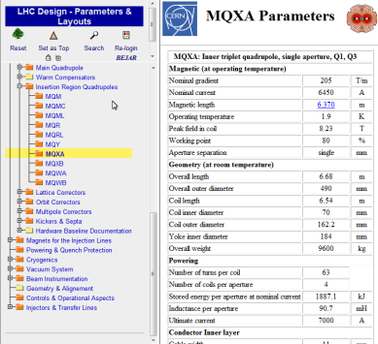
Parameters
From Isabel’s presentation to HLTC

Slide 9
Parameters
As a reminder, the equipment catalogue is fully integrated into the Layout and actively used today by operations, MAD generation files, ELQA campaigns, HWC tests
Proposal :
Use the LHC equipment catalogue
Issue :
Approve the parameters

Slide 10
Layout Drawings
These are conceptual drawings LHCLSX and LHCLSXG, LHCLSS, LHCLSA and electrical drawings LHCLSD, cryogenic P&ID LHCLSQR
These names are the ones of the current LHC machine.
Proposal :
Use new names for the drawings with a lifetime up to LS3
Issue :
Maintain several sets of drawings: LHC vs HL-LHC, Multi-branching inside HL-LHC
Maintain and modify by hand (trial and error), maintain and modify with a DB input (with approval and versioning)

Slide 11
Functional Positions - Slots
Functional Positions, Types, and Regions are going to change heavily. Still some internal mechanisms in the Layout DB help in checking integrity of the data.
Proposal :
Use the layout DB for defining configuration of assemblies, e.g. LQXDA, functional positions e.g. LQXDA.3R5, regions e.g. 4R5
Introduce validity dates for all elements handled in the layout DB
Issue :
Availability of such a modification is mid-LS1 or end-LS1
Checking and re-checking coherence once data is updated

Slide 12
HW Baseline
The HW Baseline is the place were long-term documents are stored. By long term documents, it is meant
  Procurement (Technical Specifications for MS, IT, PI)
  Engineering Specifications, Change Requests
  Manufacturing (Drawing folders, Assembly Procedures, Test Procedures, Installation Procedures, etc.)
Proposal :
Rename nodes with a ‘Current Machine’ prefix
Duplicate the nodes with ‘HL-LHC’ prefix
This eases the attachment to the activity structure (see next slide)
Issue:
The overall baseline becomes unreadable
Re-work the baseline to suppress nodes at LS3

Slide 13
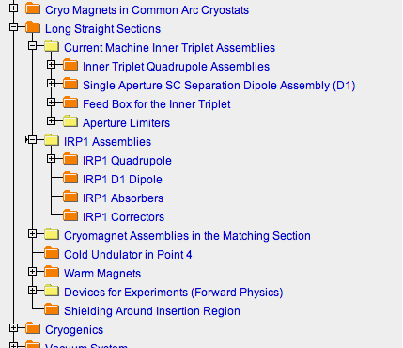
HW Baseline
This is a sample of the HW Baseline with the first upgrade project

Slide 14
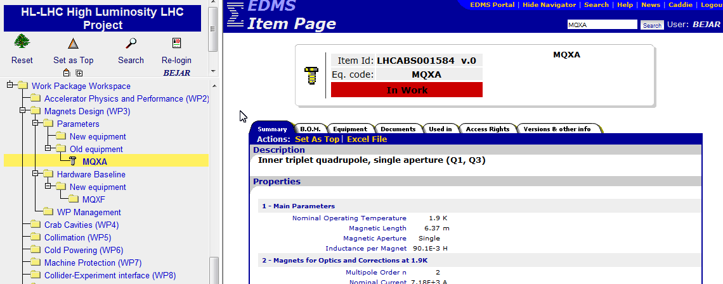
Activity and HW Baseline/Parameters
To be able to continue storing information on the official systems but be able to find HL data without navigating
From Isabel’s presentation to HLTC

Slide 15
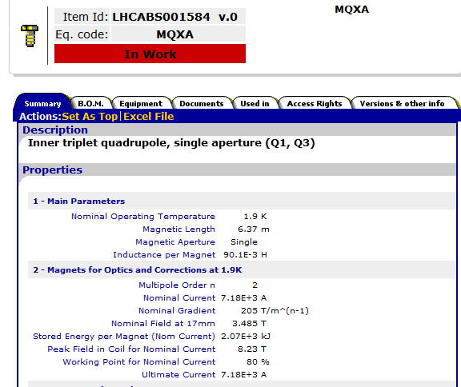
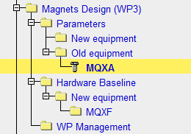

Activity and HW Baseline/Parameters
Parameters will be a mirror of the LHC equipment catalogue
Documents will be updated automatically by any document introduced in the hardware Baseline with the same equipment code but you will be able to create documents that are not “compulsory” and that will have a normal EDMS numbering
MQXF
From Isabel’s presentation to HLTC

Slide 16
What’s next
Getting an overview on the needed codes (Naming) : correctors, dipoles, cavities, DFB…, and work with all the link persons from the groups and the PE. Already started with MQXF for example.
Prepare the HW baseline by separating nodes where adequate
Prepare the set of drawings handling the conceptual layout. And define methodology with the layout DB.
Collect the parameters of the magnets approved by the PLC and insert in EDMS

