Slide 1


Survey aspects in the HL-insertions
OUTLINE
Alignment achieved on the low beta quadrupoles
Lessons learnt
Survey needs
Conclusion: actions to be undertaken
26/03/2013
4th HL-LHC PLC meeting

Slide 2
Alignment achieved on the low beta quadrupoles (point 1 & point 5)
Monitoring of the relative position
Re-adjustment if needed
Fiducialisation
Initial alignment (absolute position)
Smoothing
Within +/- 0.1 mm ? (1σ)
Beam
Within +/- 0.1 mm (1σ)
Within a few µm
Fiducialisation
Determination of the magnetic axis / geometric axis with respect to external fiducials
What was achieved:
Cold measurements performed at Fermilab
Warm measurements performed at CERN, with an uncertainty of measurement of ± 0.05 mm
Stability of the cold mass inside the cryostat ????

Slide 3
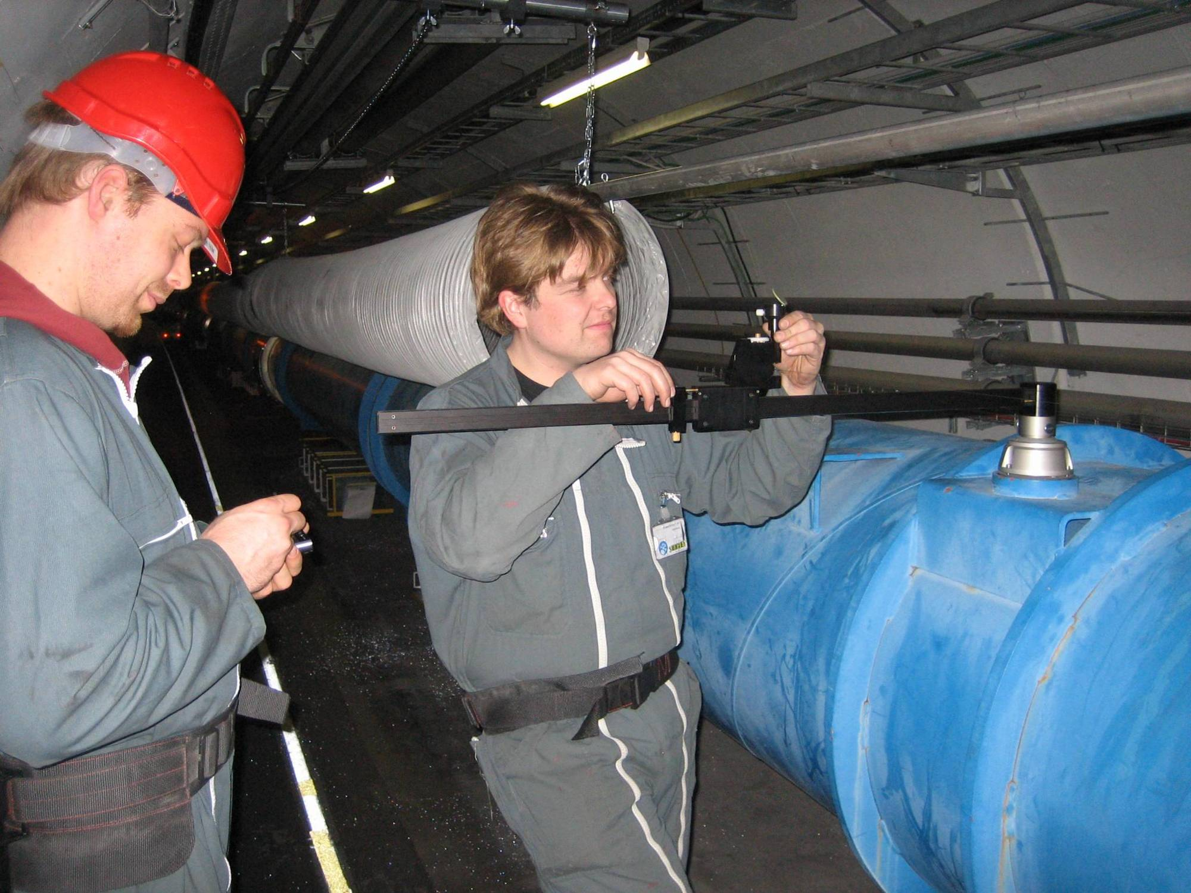
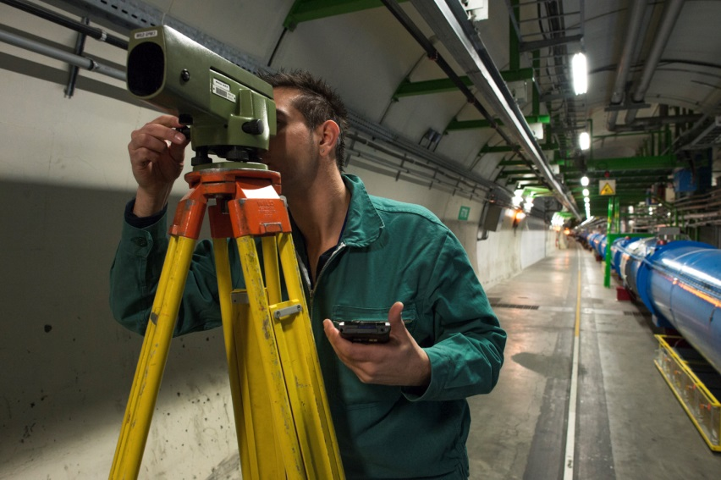
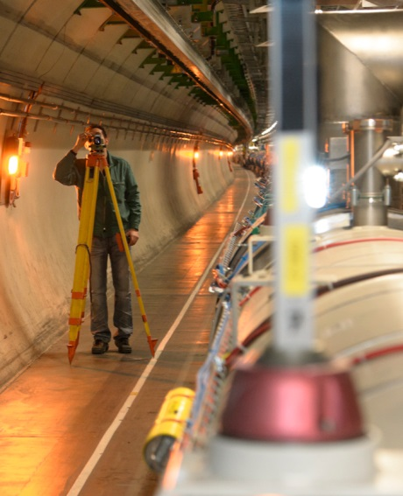
Alignment achieved on the low beta quadrupoles (point 1 & point 5)
Initial alignment
Alignment of the fiducials of each quadrupole with respect to the geodetic network
Smoothing
Alignment of the fiducials of each component with respect to the fiducials of the other components of the LSS:
Radially using offsets w.r.t. a wire : uncertainty of measurement of ± 0.2 mm
Vertically by leveling : uncertainty of measurement ± 0.1 mm
Alignment of each triplet w.r.t other one
Using alignment systems through galleries and boreholes: uncertainty of measurement: ± 0.15 mm

Slide 4
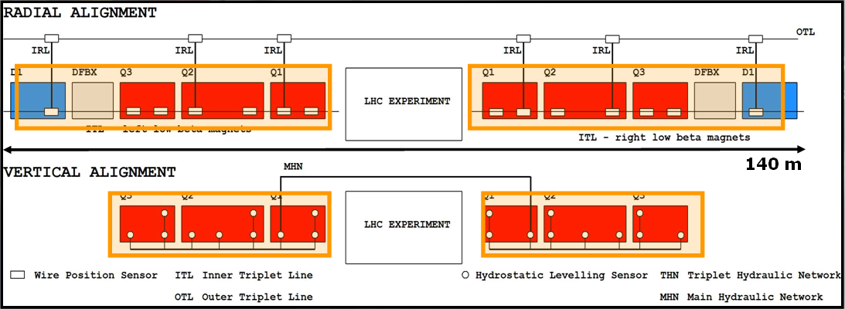
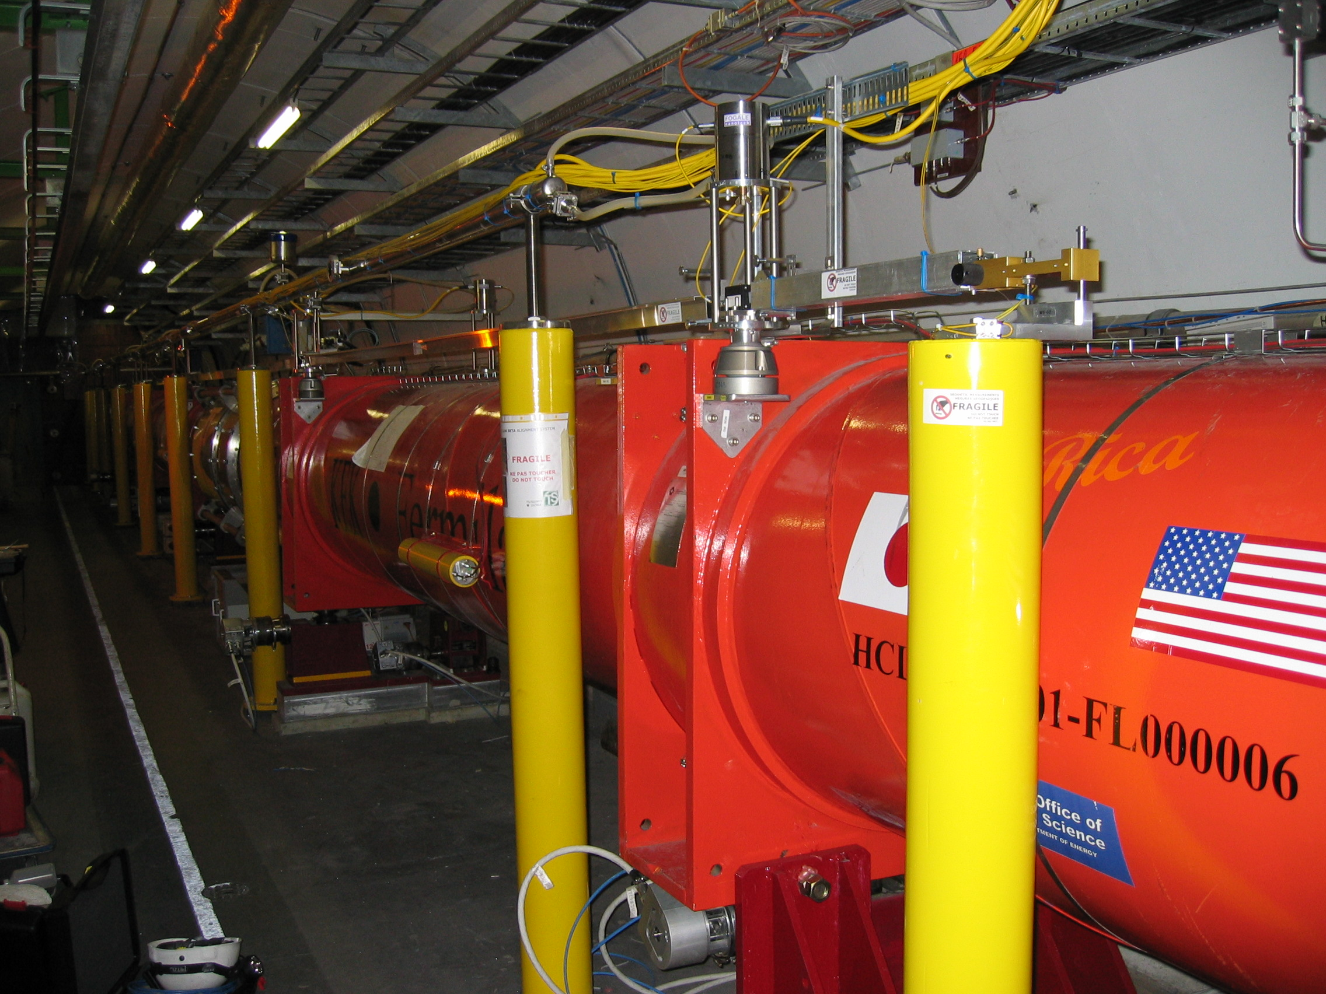
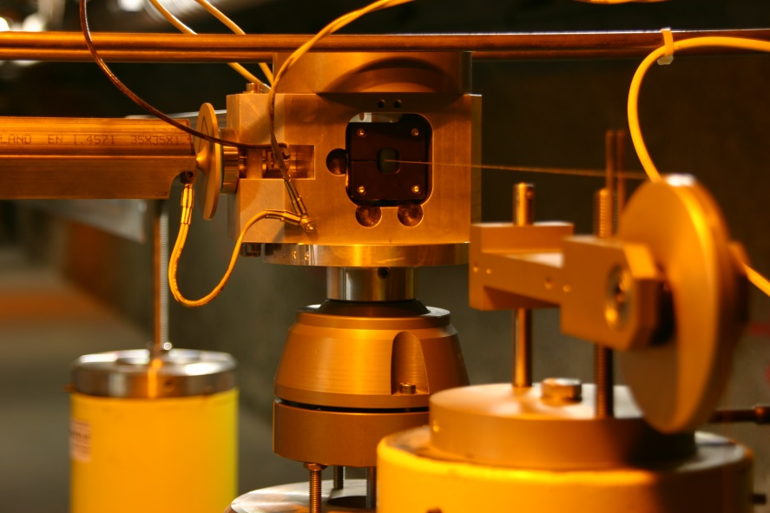
Alignment achieved on the low beta quadrupoles (point 1 & point 5)
Monitoring of the position of the fiducials
Re-adjustment if needed
What was achieved:
Monitoring within a few microns accuracy
Adjustment: resolution < 10 µm

Slide 5
Lessons learnt
Fiducialisation
Warm and cold measurements should be performed at CERN
As it seems difficult to develop a supporting system of cold mass + transport restraints for the magnet guaranteeing no displacement of the cold mass during transport, the monitoring of the position of the cold mass inside the cryostat w.r.t the fiducials will be needed.
Straightness of the cold mass, position of vacuum pipe and position of fiducials have to be controlled during the manufacturing
Initial alignment and smoothing
Smoothing difficult to perform due to shieldings, ventilation, permanent systems in the area
Taking into account the environment during LS3, it will be necessary to:
  Extend the permanent wire up to Q5, so that the smoothing is performed by alignment systems
  Extend the HLS system in a safer area, so that the smoothing is performed by alignment systems
  Develop remote methods to transfer the position of the quadrupoles to the geodetic network (dismounting of the triplet) and for the initial alignment
Left/right alignment : to be controlled by a direct line of sight, through the vacuum pipe if possible

Slide 6
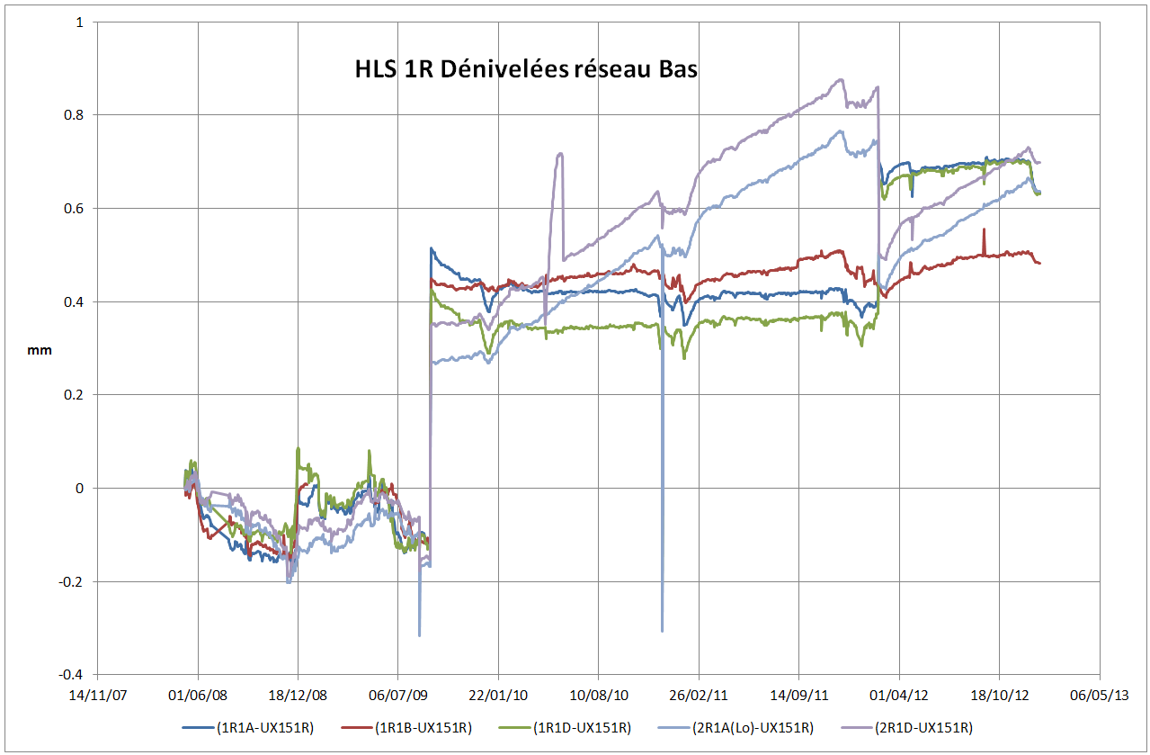
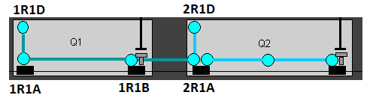
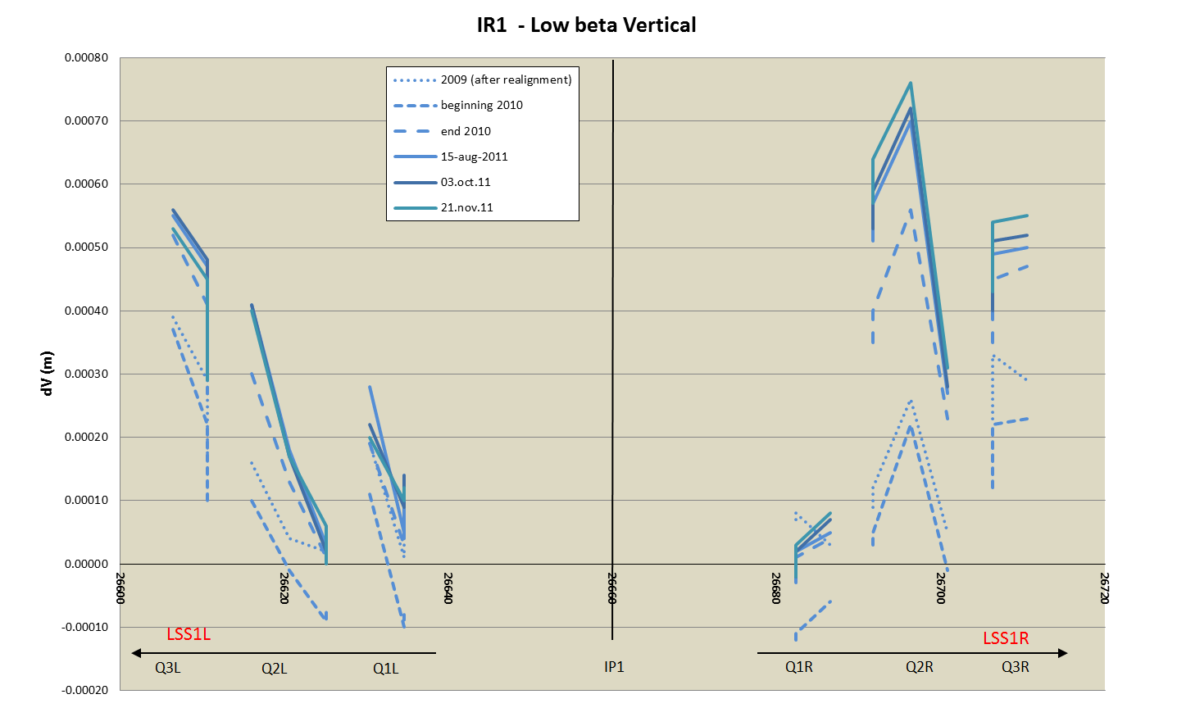
Lessons learnt
Monitoring

Slide 7
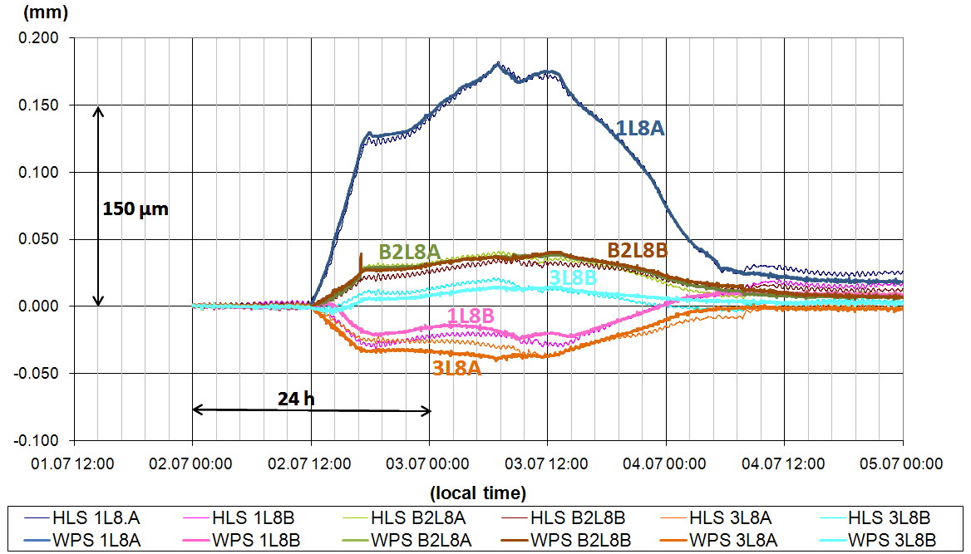
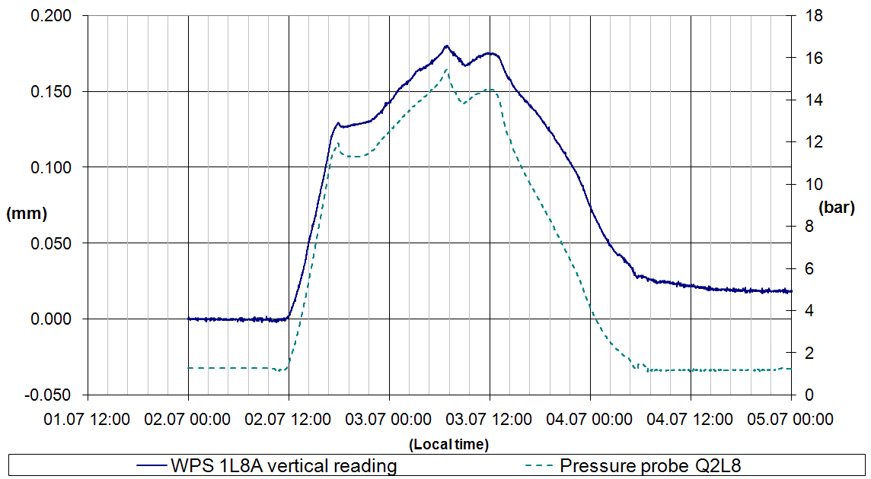
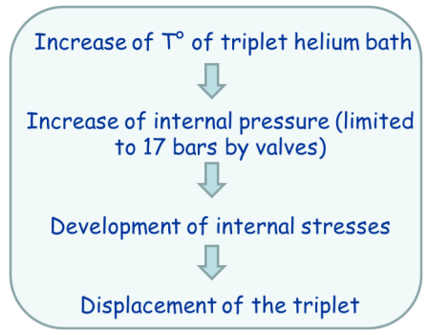
Lessons learnt
Monitoring
A lot of data recorded
Redundancy of the alignment systems needed, preferably with alignment systems based on different measurements principle.
Remote maintenance of the systems is mandatory
During LS1, remote maintenance of alignment systems will be installed in points 1 and 5
Longitudinal monitoring of the position of the fiducials to be added, as a lot of longitudinal measurements were asked

Slide 8
Lessons learnt
Performance of the alignment systems:
  Only 1 wire (out of 10 installed in the LHC) was broken in more than 4 years (because of cabling team)
  Some problems of inductive leaks were met but are now understood (thanks to the CLIC studies) and will be corrected in LS1 or LS2.
  A lot of progress was achieved on the WPS sensors thanks to the CLIC studies where «absolute» sensors are needed: e.g. the position of the sensor coordinate system is known with respect to the component to be aligned.
3D models of this area absolutely needed
A place of training before going down is needed too.

Slide 9
Survey needs → fiducialisation
Development of a system monitoring the position of the cold mass with respect to fiducials
  Concept to propose
  To be integrated in cryostat and cold mass of components
  Validation through irradiation tests, magnetic tests, long term tests to be performed
Be associated in the design of all components: crab cavities, quadrupoles, dipoles, TAN, TAS, etc., in order to:
  Define the strategy of fiducialisation
  Define the fiducials to be used according to the methods of measurements and space available
  Prepare the strategy of alignment in the tunnel
  Protect the lines of sight needed
  Define and chose the appropriate adjustment system

Slide 10
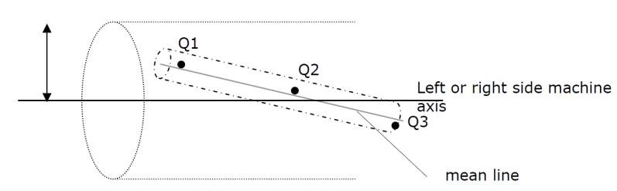
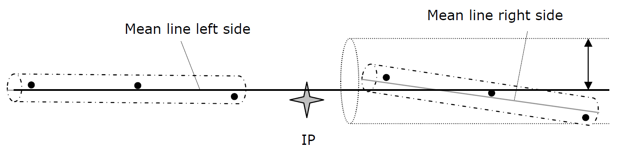
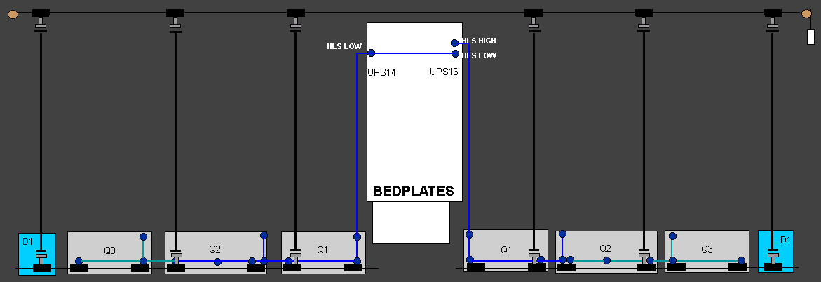
Survey needs → initial alignment
For each component, SU needs to know its tolerance of alignment, and prepare its associated budget of error
Because of radiations, access to LSS will be more and more restricted, with shielding added along the tunnel around the components, which will complicated the standard measurements. It is proposed to extend the stretched wire (or alternative solution) from Q3 to Q5, and the same for the HLS system.
Develop another solution to link radially the tunnel references on both sides of ATLAS and CMS experiments through the UPS galleries. The same problem is raised for CLIC and ILC: two collaborations are under preparation with JINR and NPL

Slide 11
Survey needs → Monitoring & smoothing
Taking into account the level of radiations, it will be necessary to limit as far as possible all work near the low beta quadrupoles and first elements of the LSS (up to Q5) including stand alone components, which means:
  The monitoring of the position of the components by alignment systems according to 6 DOF.
  The remote positioning of the components by motorized jacks.
The only alignment systems that are radiation hard are the WPS, HLS and DOMS systems currently installed in the LHC: the sensor is passive and its electronics is installed remotely in the UPS galleries of points 1 and 5 (maximum distance between the sensor and its electronics: 30 m).
  What will be the residual dose rates in UPS galleries during LS3 and after?
  At which length from the sensors could we find a safer place? (A length above 30 m would imply new developments concerning the electronics of the sensors)
  Sensors were validated at a total dose of 200 kGy, further tests need to be undertaken for HL-LHC.
Some alternatives are under study for the CLIC project, with smaller space constraints than WPS, HLS and DOMS systems, so the most constraining requirements will be taken into account.
Install deep leveling references in a safer area of the LHC and link them permanently to the HLS system, by a system to be developed.

Slide 12
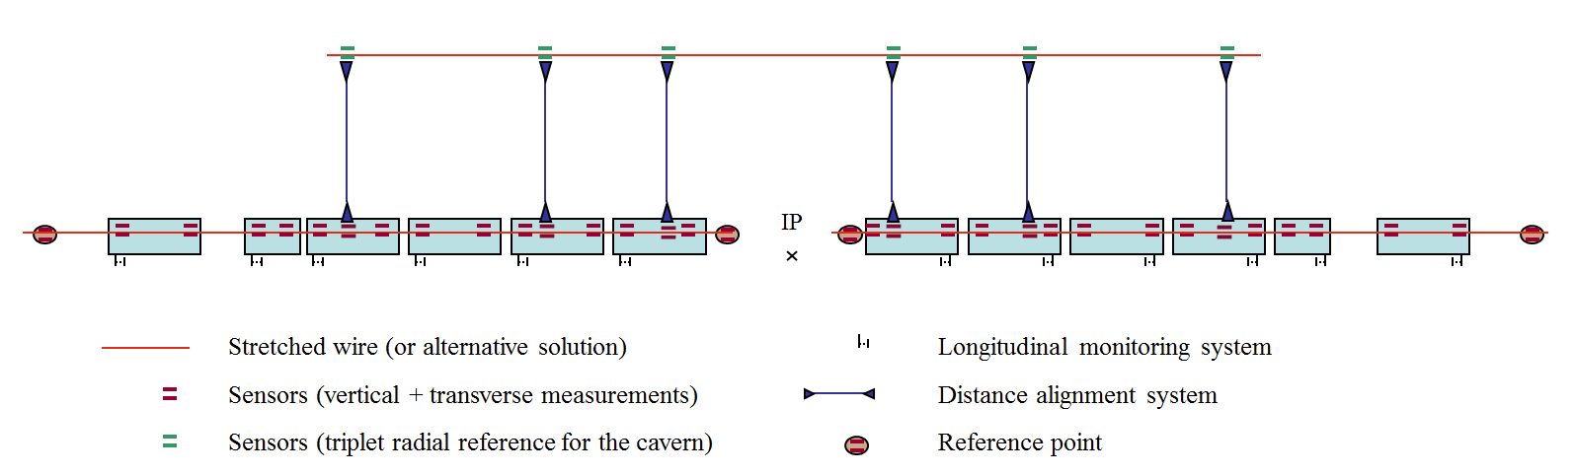
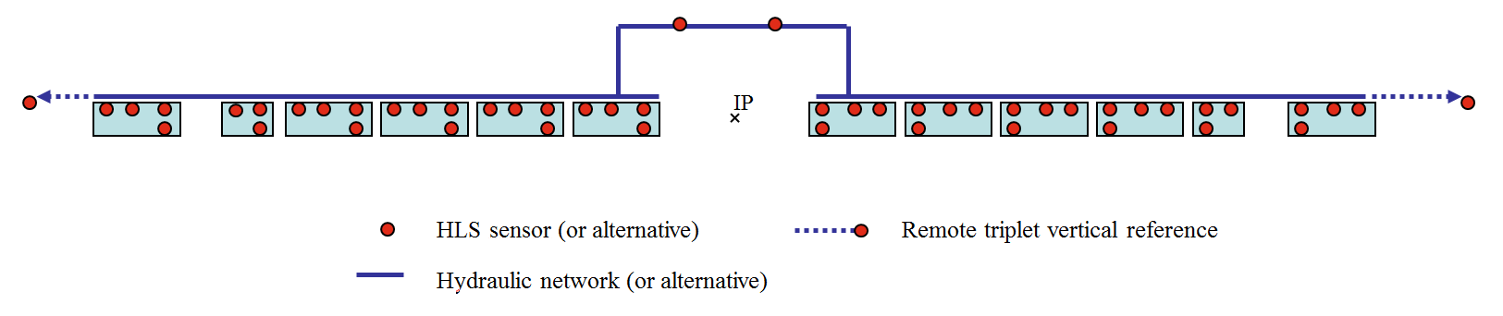
Survey needs → Monitoring & smoothing
Space requirements:
  [Stretched wire and associated sensors] : Integration of a continuous straight line (cylinder dia. 100 mm), straight above fiducials of components, on the transport side (for an easy access in case of maintenance), plus space for wire stretchers along Q1 and the last component.
  [left / right link]: one additional fiducial on the cryostat in front of each boreholes coming from the UPS galleries, and a continuous line between the borehole and associated fiducial.
  [Water surface and associated sensors]: horizontal lines (cylinder dia. 100 mm), by levels (as the tunnel is in slope) linking from time to time fiducials on the cryostats

Slide 13
Open points
Monitoring of the cold mass w.r.t. external fiducials
Link between left/right sides of experiments
Study of fiducialisation strategy for all components
Study of alignment strategy for all components
Special case of the collimators
Special case of the TAS
Development of alternative solutions of alignment systems
Upgrade the current solution to high radiation level (remote installation, remote maintenance, electronics at a distance above 30 m from the sensor)
Development of remote adjustment systems
Integration of lines of sight
Specific HL-LHC
CLIC, ILC, HL-LHC
Specific HL-LHC
Specific HL-LHC
Specific HL-LHC
Specific HL-LHC
CLIC, ILC, HL-LHC
CLIC, HL-LHC
Specific HL-LHC
Specific HL-LHC

Slide 14
Summary
Survey needs to be integrated ASAP in the design of all types of components (from the TAS to Q5), knowing the alignment tolerances that are asked:
  Define an error budget
  Define a strategy of fiducialisation and alignment
  Chose the fiducials and their location
  Chose/develop the remote adjustment system
  Reserve space allocated for the alignment /adjustment systems
First lines of sight need to be integrated in the overall design ASAP
R & D is needed concerning the systems described below, and should start this year (additional manpower needed):
  Longitudinal position monitoring system
  Cold mass monitoring system
  Link between alignment references of both sides of tunnel through the survey galleries
  Remote maintenance
A first budget (and associated ressources) was provided in 2009 for the old layout, but should be revised, taking into account the new schedule, the additional components to be aligned and adjusted remotely
What about a WP for survey and alignment in the list of HL-LHC activities?

