Slide 1
CRISTAL
Andrew Branson
University of the West of England

Slide 2
Introduction – What is CRISTAL ?
A long-running research project (1997-present) between UWE, CERN and CNRS (France).
That has developed data models and software using state-of-the-art technologies.
To address the data management and process control needs of a distributed community of experimental physicists.
Which has yielded academic output and software that is being commercially exploited.

Slide 3
Requirements – CMS ECAL at CERN
Electromagnetic CALorimeter: Scintillating PbWO₄ crystals to measure energy of charged particles.
Crystals characterized during decade-long construction schedule. Final calibration data is generated from construction data for running detector.
Production process nor data schema were finalized when production began.

Slide 4
Our solution: CRISTAL
CRISTAL is a flexible platform for collecting data managed through execution of object lifecycles (workflows).
All workflow and data structures defined at run-time: ‘Descriptions’
  Workflow: XML-marshalled Java objects
  Data format: XML Schema
  Application logic: Scripts, wrapped in XML with metadata.

Slide 5
Object Oriented Workflows
Each workflow is executed in a context that collects its resulting data: an ‘Item’.
All descriptions are also Items, and have their own lifecycles, which manage development and maintenance.
All change of state in the system mediated by activities, all recorded in events.
Full traceability of development and execution.

Slide 6
Data Management
CRISTAL object model for lifecycles, activities, events and event data: ‘Outcomes’
Fixed model for all objects but Outcomes, which conform to activity defined XML Schema.
Pluggable persistency:
  Read and/or write for each object type.
  Original: LDAP (index) RDBMS (query) XML Files
  Latest: LDAP + eXist XMLDB

Slide 7
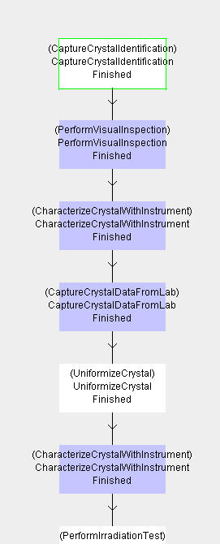
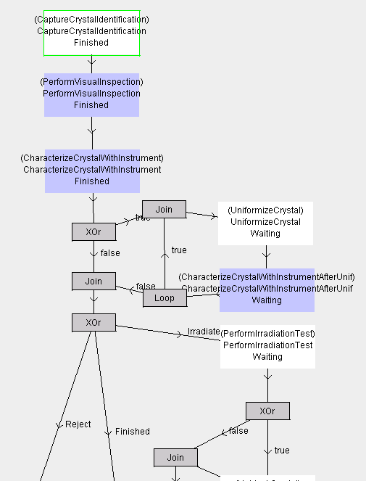
Result – CMS ECAL
All product lifecycles evolved considerably during execution (2003-2008)

Slide 8

Result – CMS ECAL
Calibration data was generated from all crystals, across process and schema versions.

Slide 9
Current usage
Commercial:
  Agilium: since 2003.
    Focus on process. Advanced BPM design tool.
    FP7 IAPP to improve CRISTAL expertise
  Technoledge: since 2011
    Data integration
    Data stream archival
    Research Resource Planning

Slide 10
Current usage
Academic
  Neugrid & N4U: Analysis service
    Managing neuroimaging analyses on the Grid.
    “Data Atlas”: Catalogue of datasets & pipelines
  CERN
    More crystal characterisation for PET scanners
Future: LGPL

Slide 11
End

