Slide 1
Laurenz WIDHALM
1973- 2012
Physics was his Calling

Slide 2
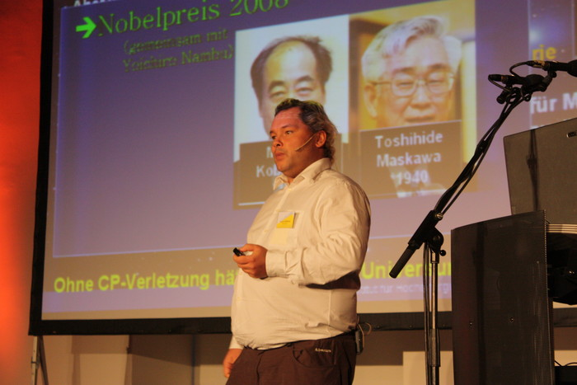

Slide 3
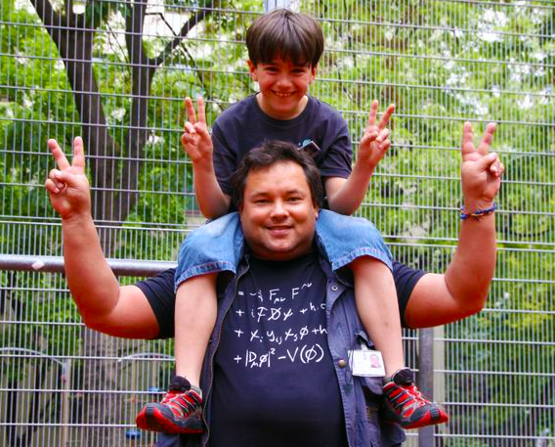

Slide 4
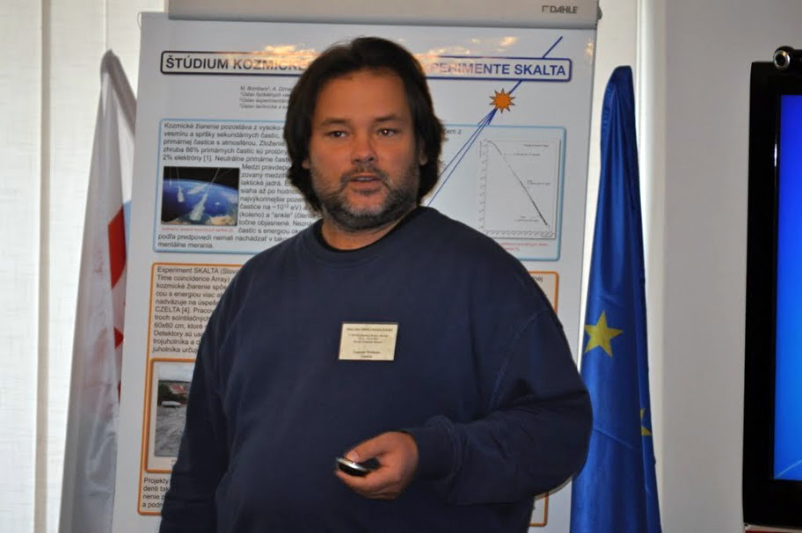

Slide 5


Slide 6
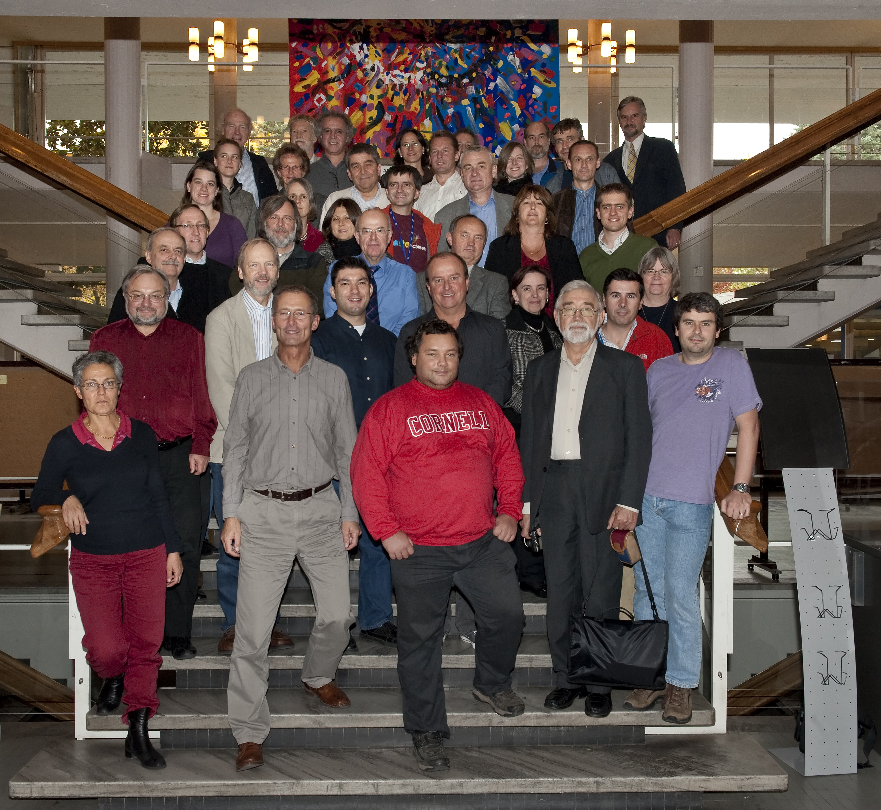
DANKE, LAURENZ !

