Slide 1
Virtual Visits & Google Hangouts
Dynamic Interactive Media for HEP
Steven Goldfarb
IPPOG / Media Panel Discussion
Scenic Batavia IL, USA
5 April 2013

Slide 2
The Challenge
Letter from a Slightly Disappointed CERN Visitor
I went to Cern because I wanted to see how such an endeavor works.
There are two special reasons. The first, to understand how humans can
work together to create new technologies in an international
collaboration system. The second, to learn more Physics. I wanted also
to talk with some of the researchers, but unfortunately I could not.
[…]

Slide 3
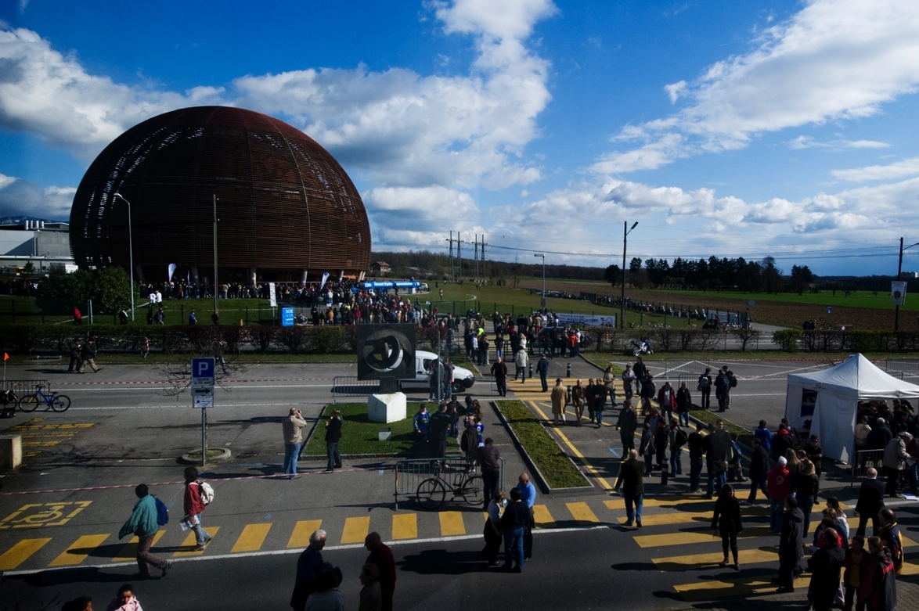
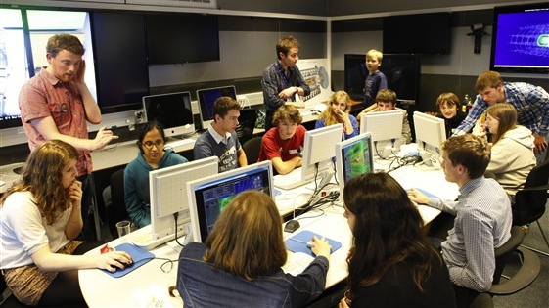
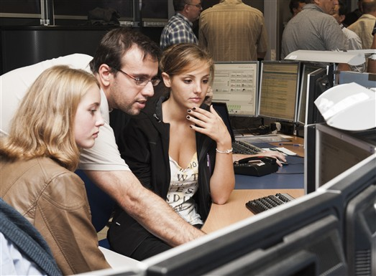
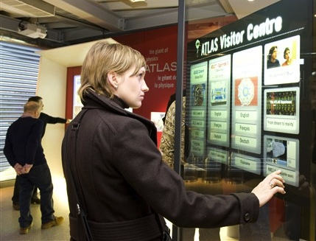
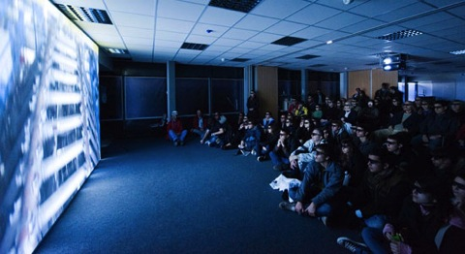
Local & Interactive
Guided Visits
Researcher Night
Open Days
Special Events

Slide 4
Remote & Passive
http://atlas-live.ch

Slide 5
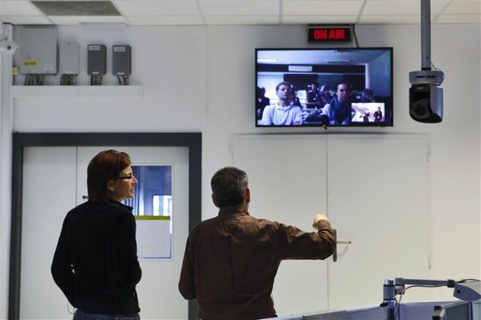
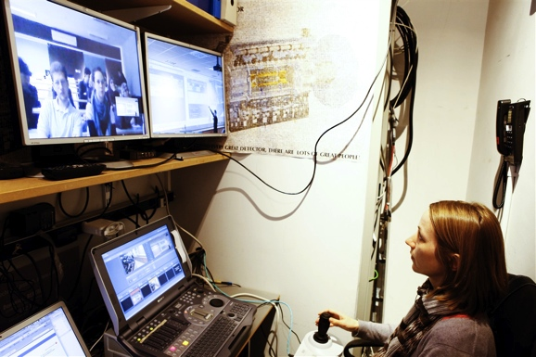
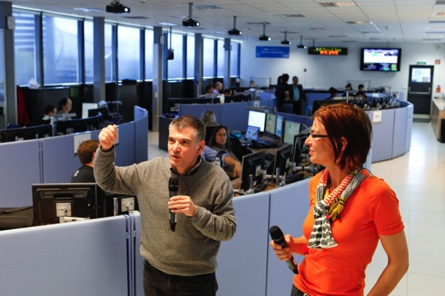
Remote & Active

Slide 6
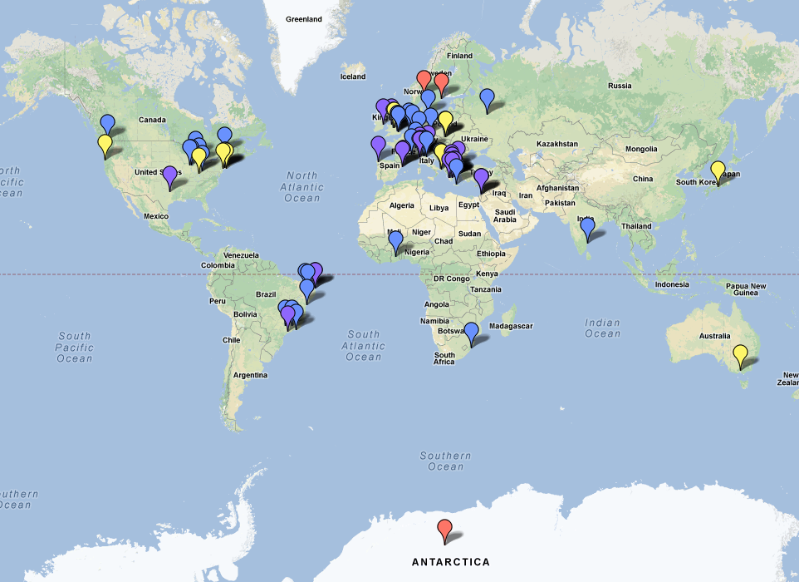




From the Seven Continents
2010
2011
2012
2013
(South Pole)
http://maps.google.com/maps/ms?ie=UTF&msa=0&msid=203960621818449997662.0004d3cb959d09c1862cb

Slide 7
From the Seven Continents

Slide 8
From the Seven Continents

Slide 9
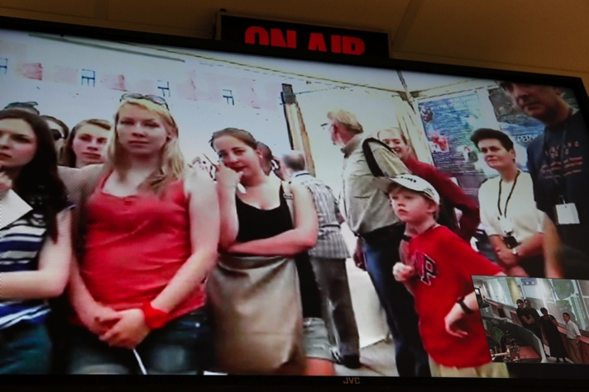
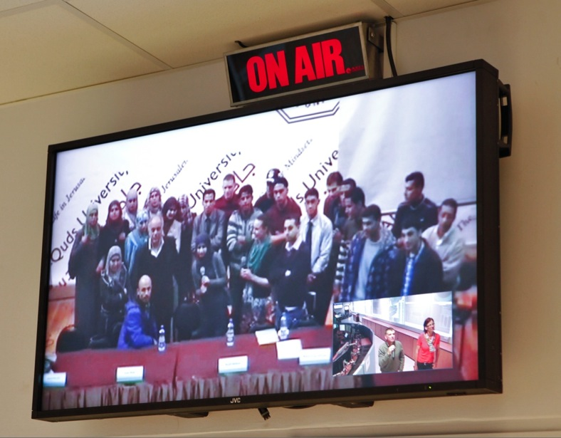
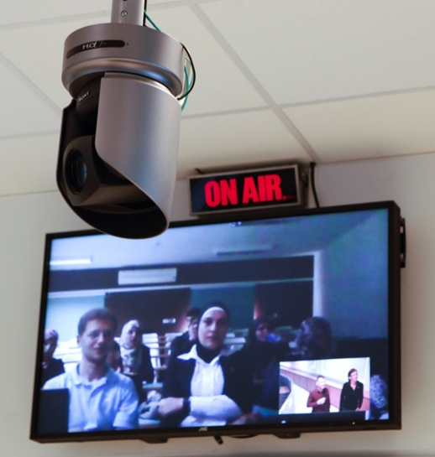
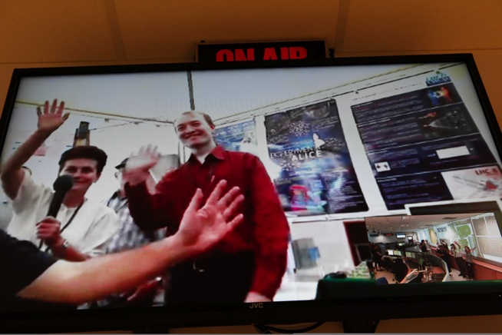
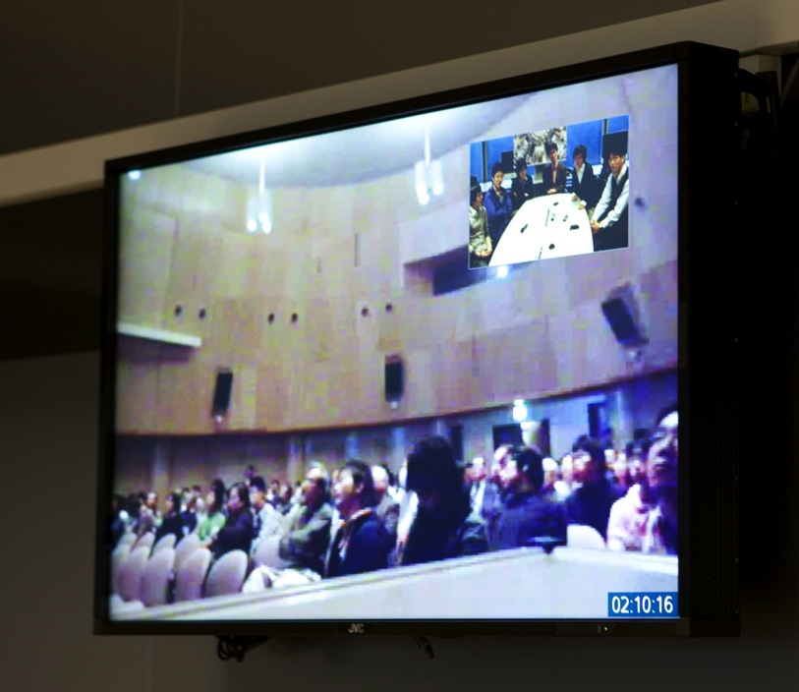
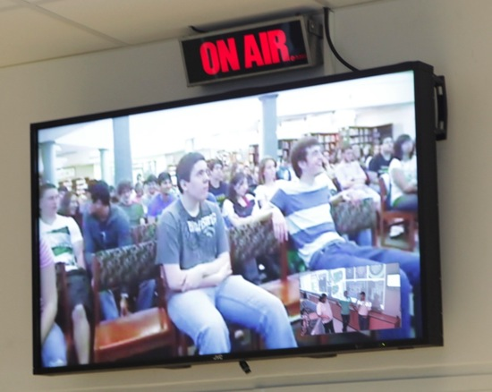
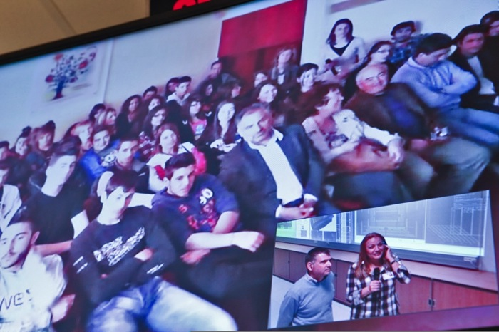

Slide 10
Hangout With CERN
Weekly Topical Content
Guest Speakers (Theorists, Specialists)
Guest Audience (Taken from Social Media, Visits, Classrooms,...)
A LOT of Interaction!

Slide 11
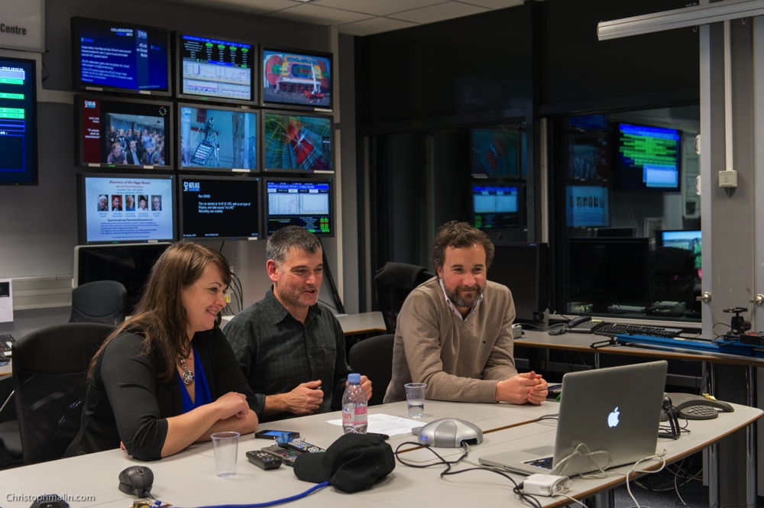
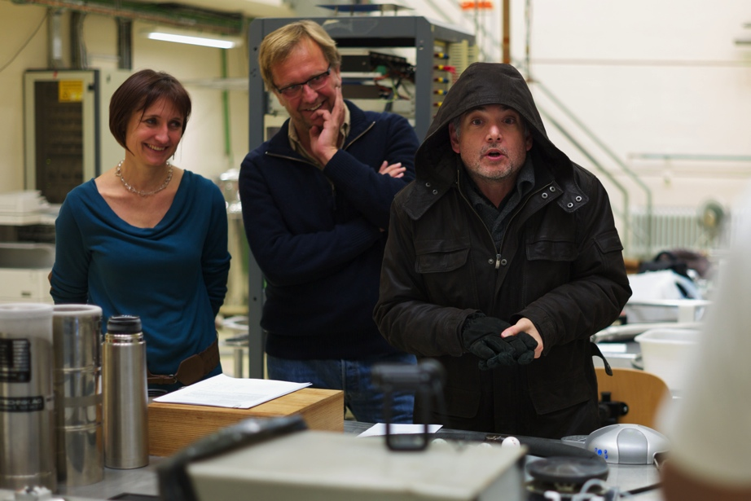
Hangout With CERN

Slide 12
Every Thursday, 17:00 CET

Slide 13
References
ATLAS
Public Home Page | http://atlas.ch
ATLAS Virtual Visits | http://cern.ch/atlas-virtual-visit
ATLAS Live | http://cern.ch/atlas-live
CERN
Hangout with CERN | http://cern.ch/hangouts
CERNTV on YouTube | http://www.youtube.com/user/CERNTV

