Slide 1
PROTOTYPE DEVELOPMENT ISSUES AND ACTIVITIES
Francisco García
Helsinki Institute of Physics – University of Helsinki

Slide 2
OUTLINE
GEM FOILS FRAMING
HV FILTERS
MBS-GO4 STANDALONE TEST
SUMMARY
2

Slide 3
GEM FOILS FRAMING
Foils leakage current was done
(Jouni Heino has reported already)
Super Frame adapter is ready
(Raimo Turpeinen will report)
GEM foil F1DM was scanned
(Aneliya Karadzhinova will report)
Frascati foil stretcher will be shipped back at the end of April
This week the foil framing will start
3

Slide 4
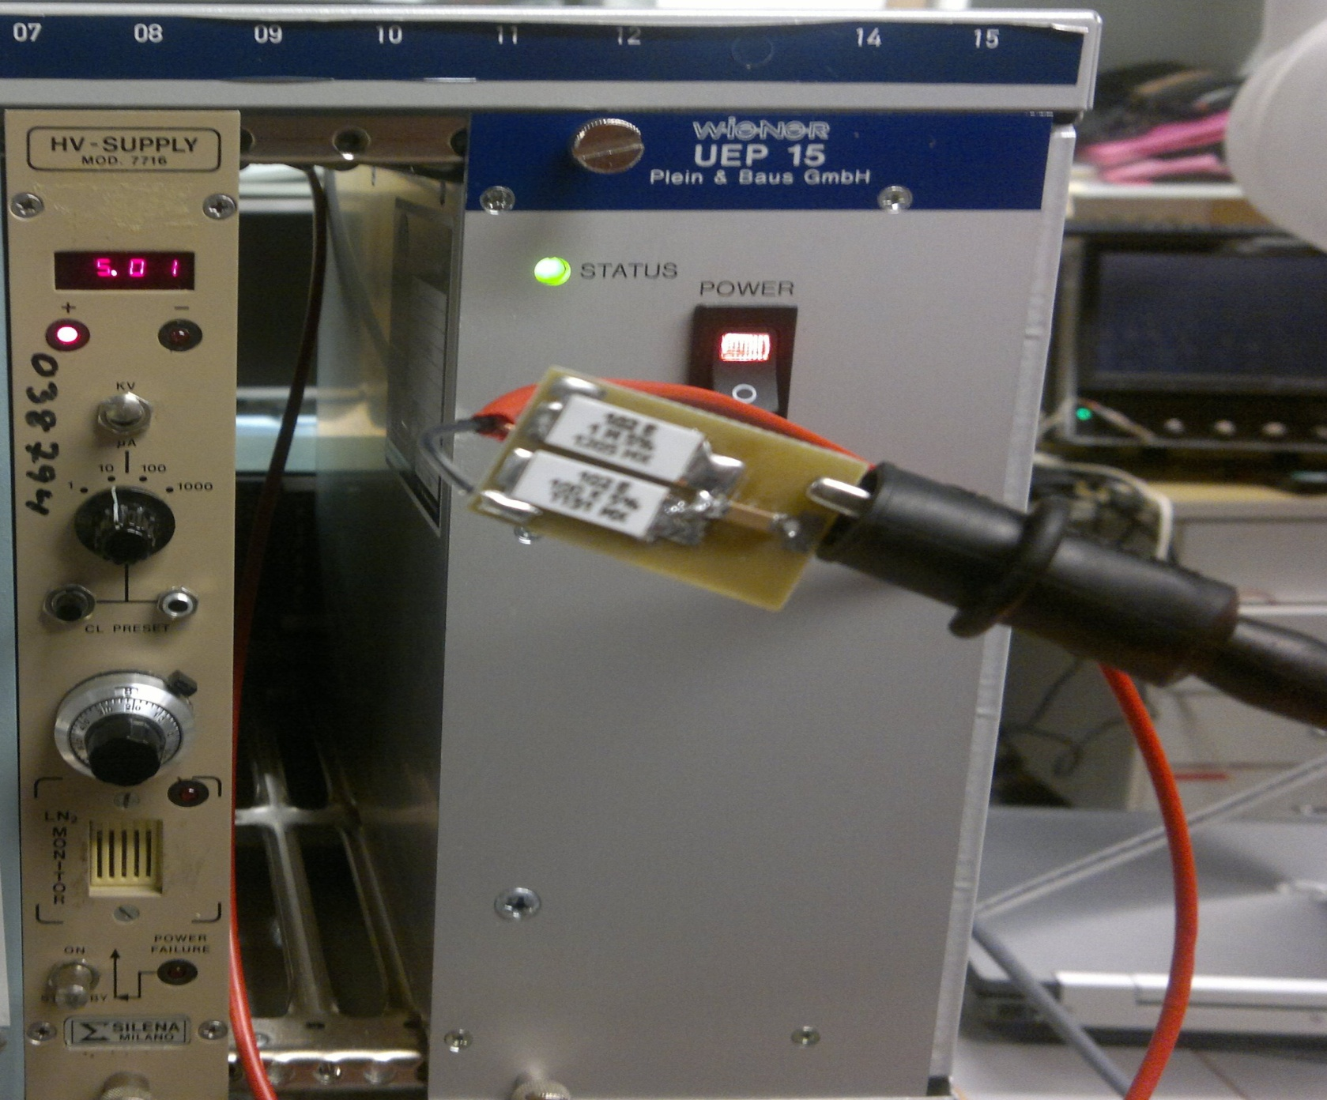
HV FILTERS
A total of 6 (six) High Voltage filters has been built, cleaned and tests.
All withstand 5 kV and the current was of 1 nA
4

Slide 5
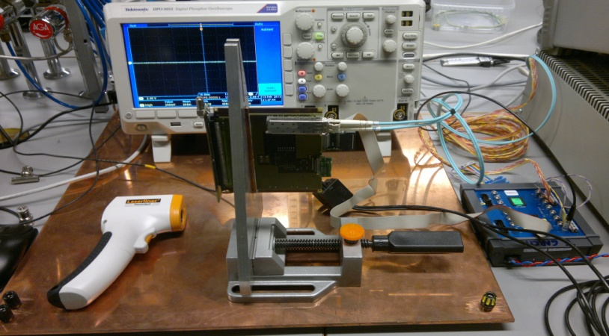
MBS-GO4 STANDALONE TEST
The MBS-GO4 standalone has been tested. All the functionalities are working well, but only on one SFP at the a time.
Working is on going in the cooling part of the system and a new cooler will arrive next week.
5

Slide 6
SUMMARY
The GEM foils Framing must be finished during April
→ The Frascati foil stretcher will be shipped on week 13
The Leakage current will start after framing and cutting
The design of the Box for the GEM stack test will start on week 11.
→ Will be used polycarbonate for the inner box and aluminum for the outer
→ The final design of the Readout Pad plane is required
→ Production estimate between 6 to 8 weeks
A total of 18 HV filters are needed
→ The ones connected to the bottom electrode will be without the 1 MOhm
Analysis of the scanned images from the high resolution scanner
→ Will be done in parallel with all the activities
The In-Kind review board meeting has welcomed our proposal
6

