Slide 1
Aluminum plate for foil stretcher
Raimo Turpeinen.

Slide 2
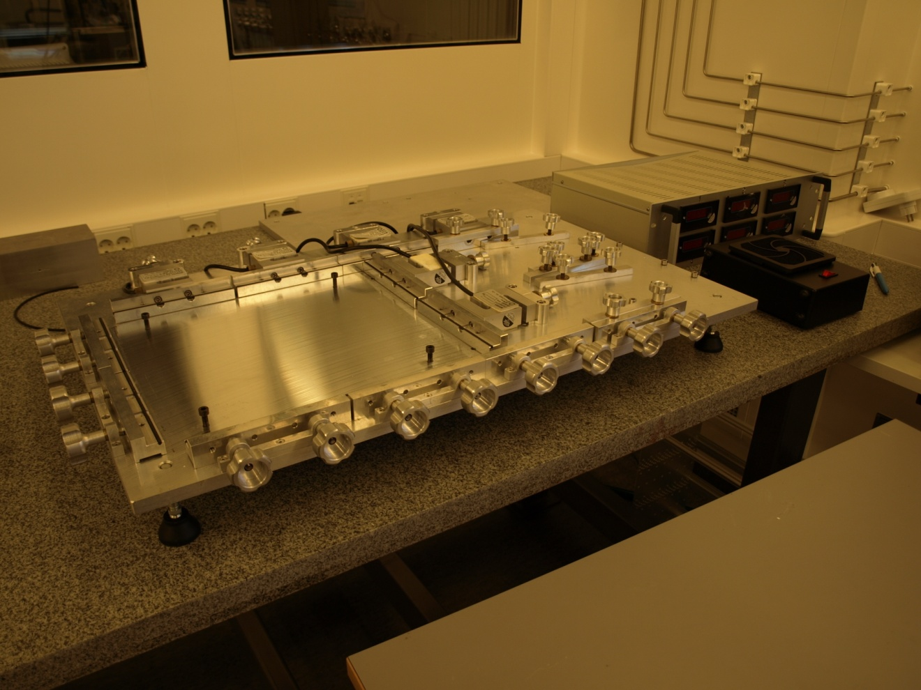
Foil strecher.
-New modified aluminum plate is located between the streching screws.
-Status: Plate is ready to be tested.

Slide 3
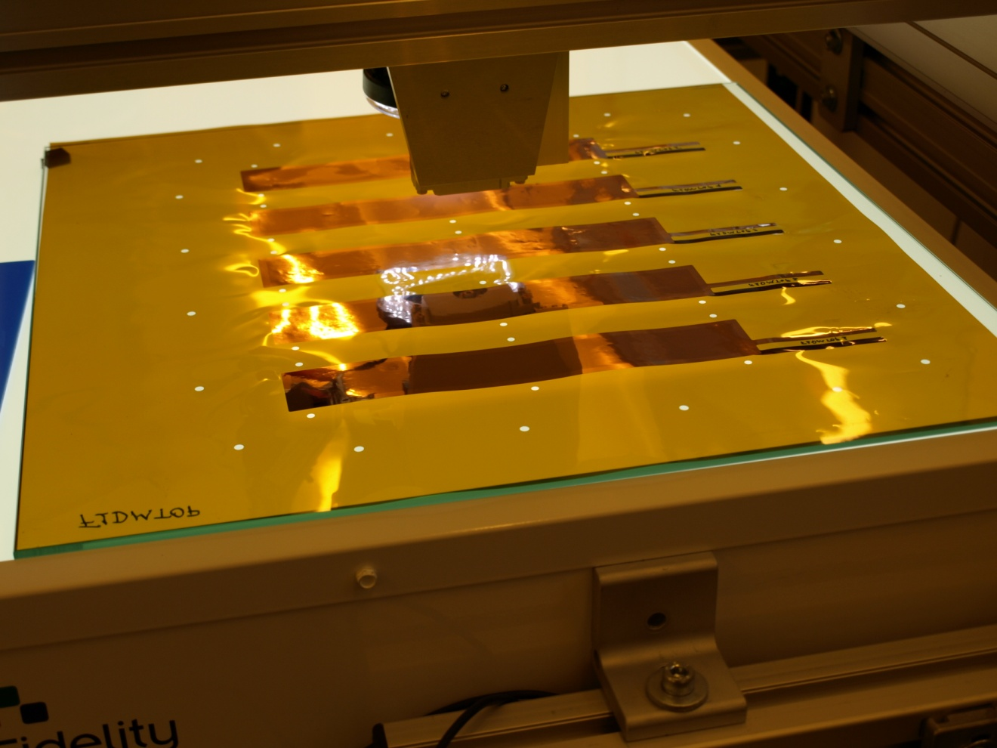
GEM Foil.
-New aluminum plate is designed to help centering foil and the frame to the strecher.

Slide 4
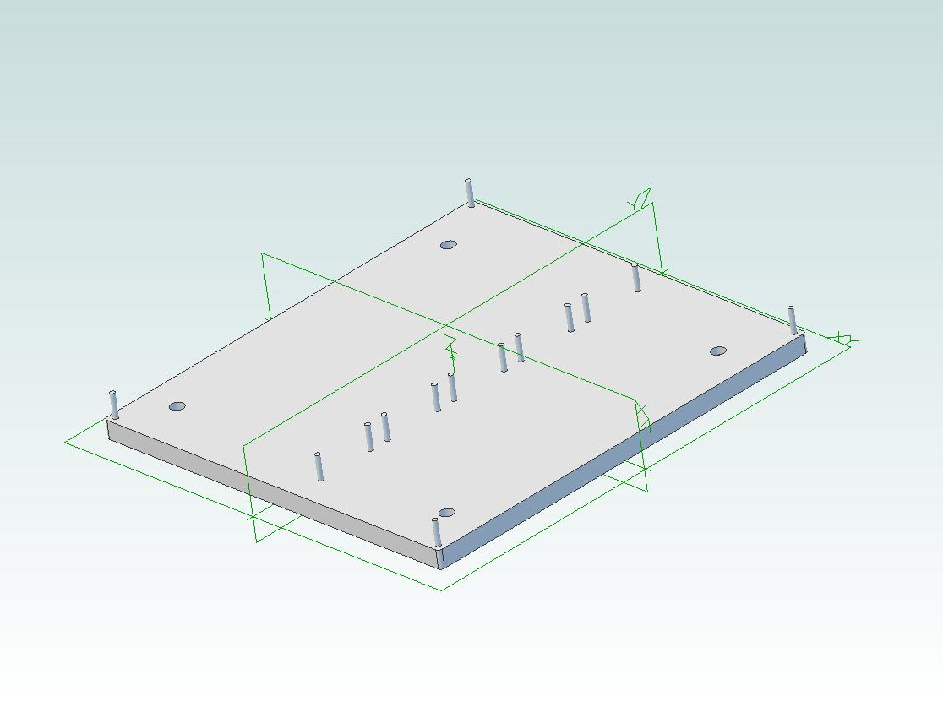
Designed plate
-This is designed with Alibre CAD- software.

Slide 5
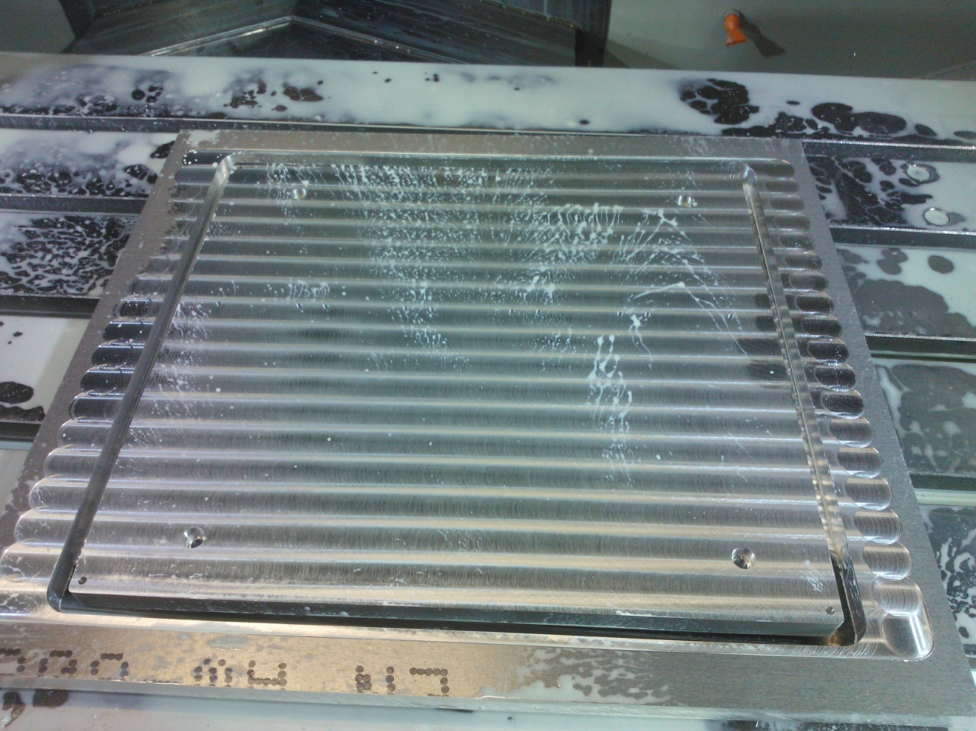
Modified aluminum plate
-Just machined plate at our mechanic shop.
-Executed by nc-machine Dugard.
-Material is 6082 aluminium alloy.

Slide 6
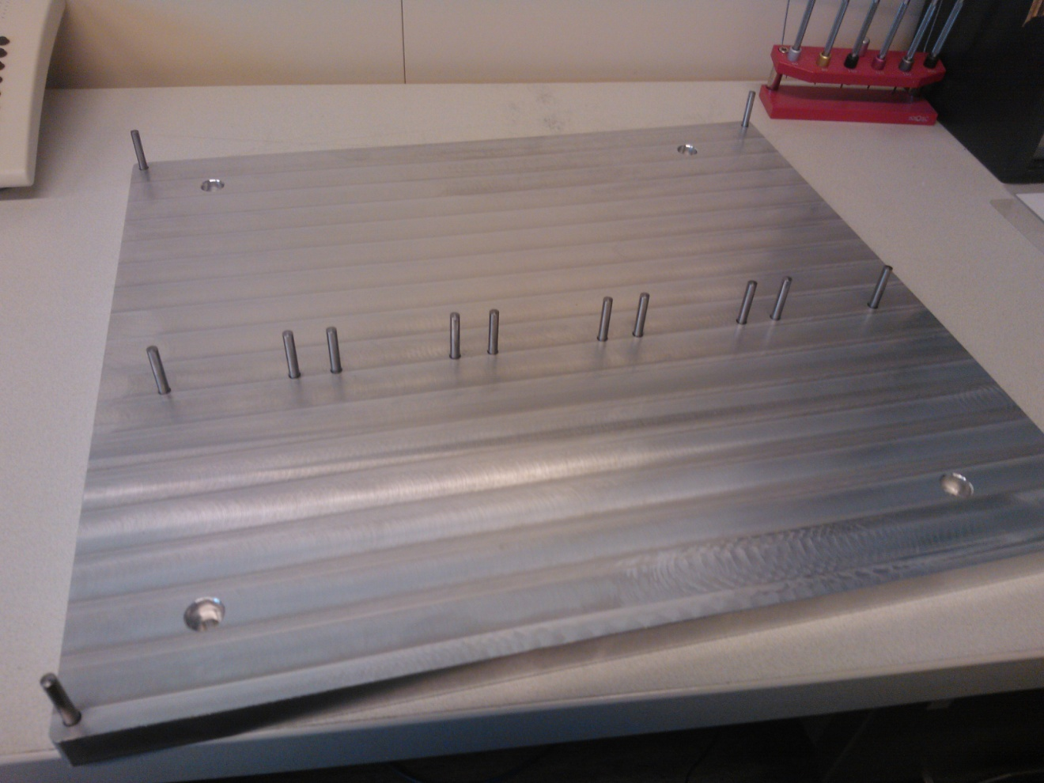
Finished plate
-Here is finished plate with centering pins.
-Pins are easy to remove by plugging out after frame is glued to the foil.

