Slide 1



Flow harmonics in ATLAS
Sasha Milov
for the ATLAS Collaboration

Slide 2
Outline
Introduction
The ATLAS apparatus
    Event samples
    Heavy Ion event environment
Measurement of flow harmonics
Event by event method
Average flow method
Event plane correlations
Two particle correlation
Cumulant method
Integrated flow
Summary

Slide 3
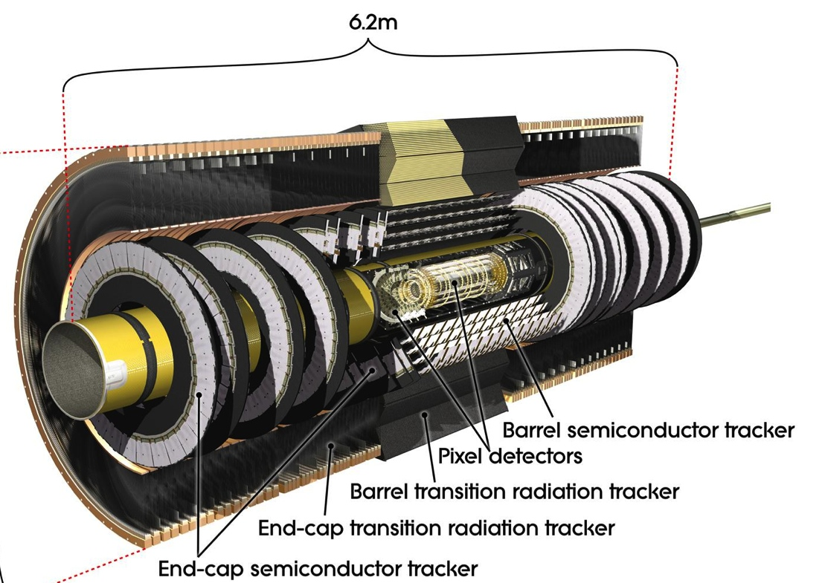
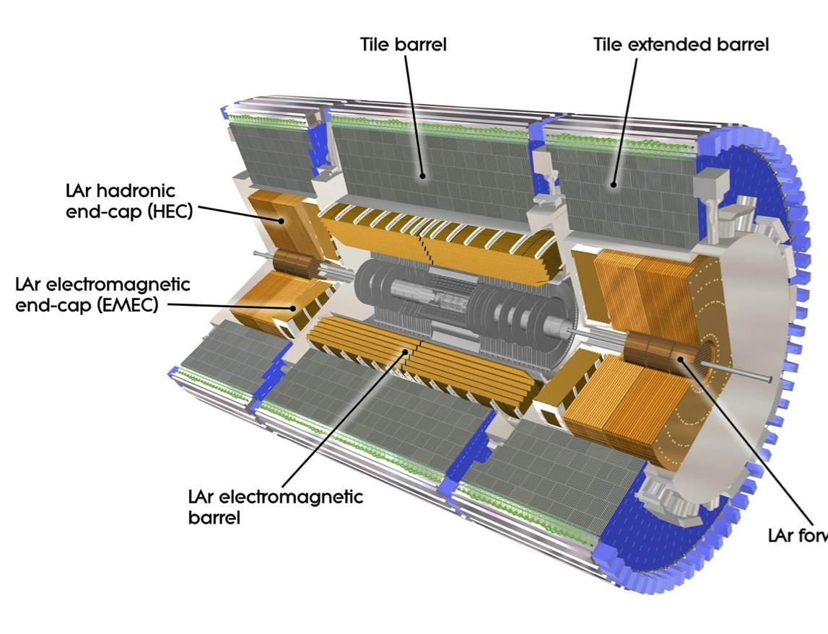
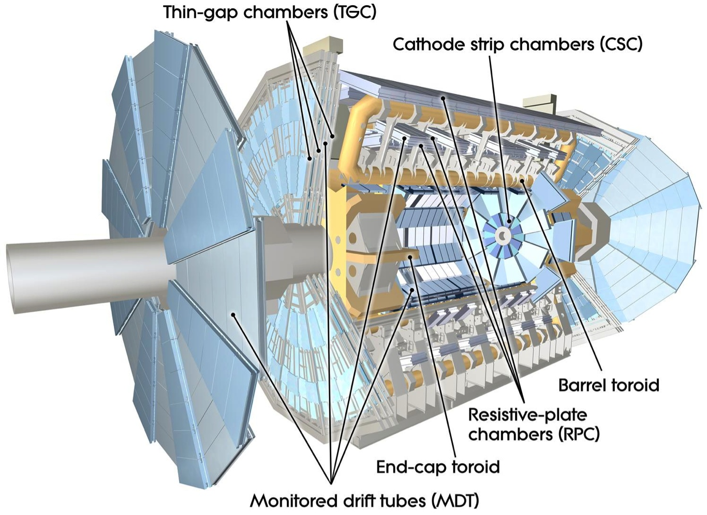
The ATLAS detector
EM calorimeter (LAr)
|η|<3.2, 3 layers + presampler, 22X₀
e/γ trigger, identification;
Granularity: 0.025x0.025 180x10³ chan.
Muon spectrometer (MS)
|η|<2.7
Shielded by Calorimeter
Tracking in torroidal B field
Inner Detectors (ID)
|η|<2.5 B (axial) =2T
Pixels (Si): σ = 10 μm [rφ]
80M channels; 3 layers and 6 disks;
SCT (106 Si strips ): σ = 17 μm [rφ]
4 double layers, 18 disks
FCal: 3.1<|η|<4.9 centrality
MBTS: 2.1<|η|<3.9 timing
ZDC: 8.1<|η| trigger

Slide 4
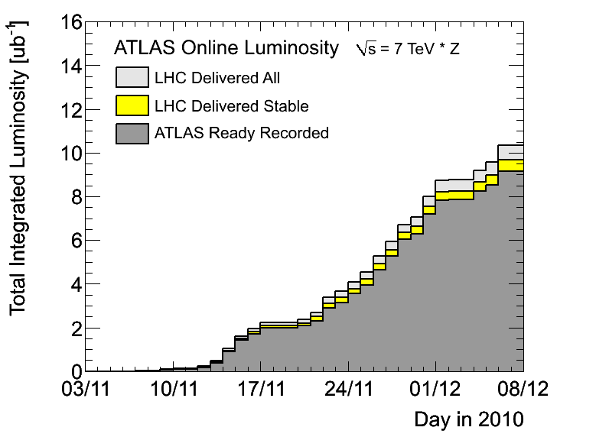
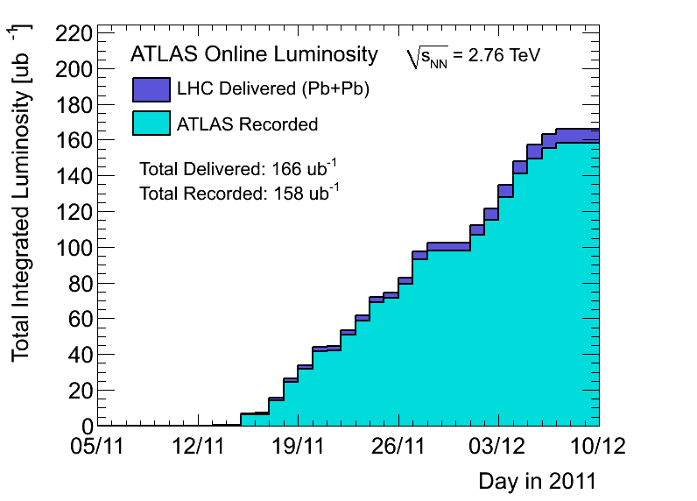
Data samples
2010
2011
Run: | 2010 | 2011
L_{int} | 8ub⁻¹ | 0.15nb⁻¹
Triggers | Min Bias | γ, μ, jets, Min Bias, UPC
N_{events} (0-80)% | 30-40M | 750-800M

Slide 5
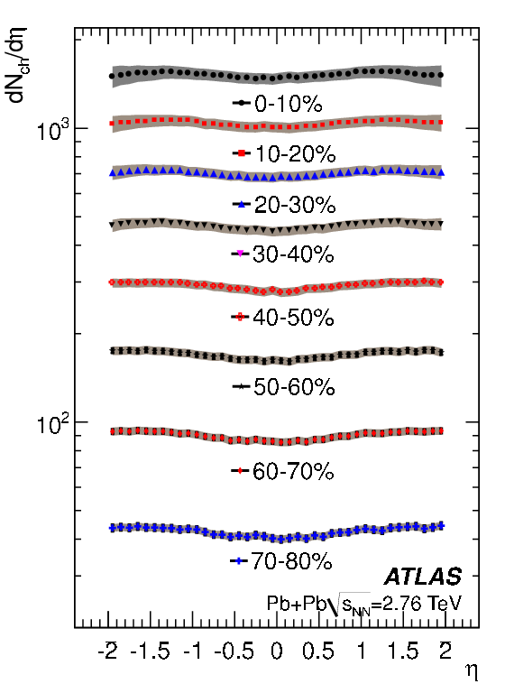
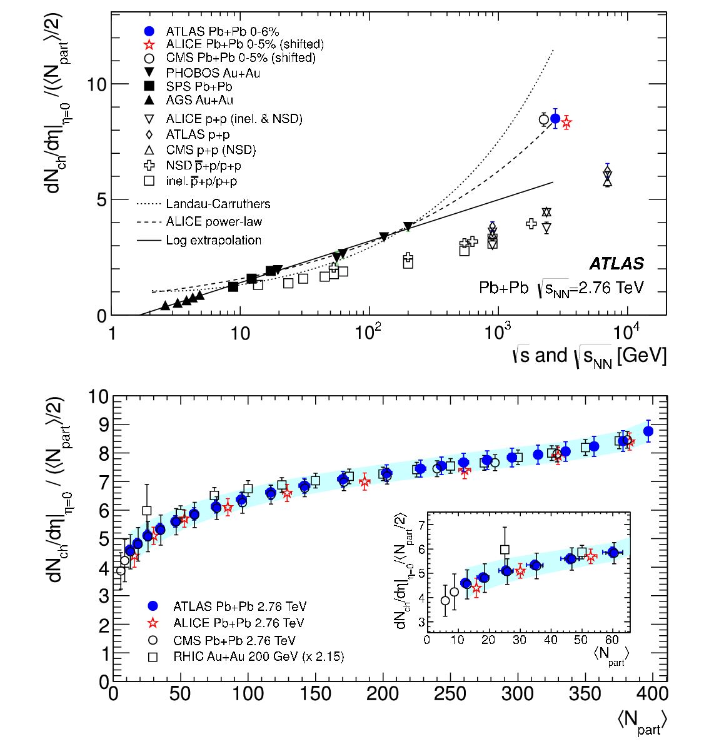
Multiplicity
Phys.Lett.B710 (2012) 363-382
Up to 8,000 charged particles in ATLAS tracking @ √s_{NN}=2.76 TeV
Flat in rapidity within |η|<2, similar to p+p
Twice more particles per participant pair compared to p+p

Slide 6
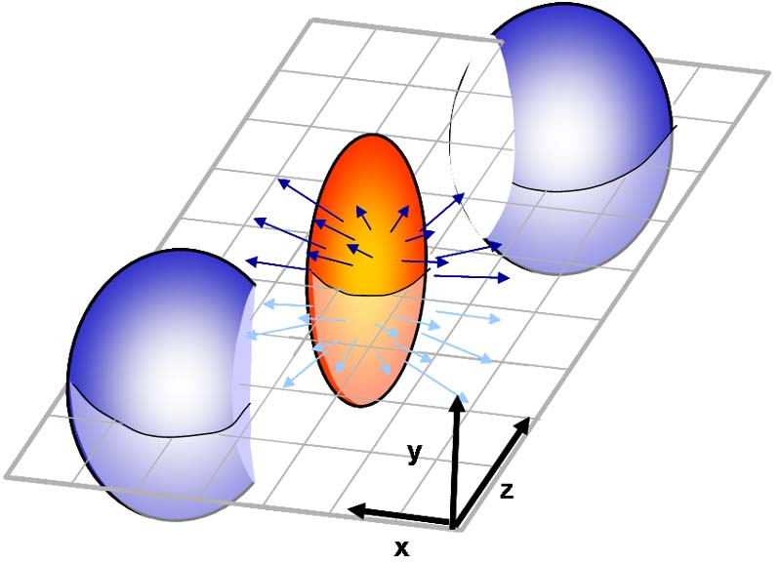
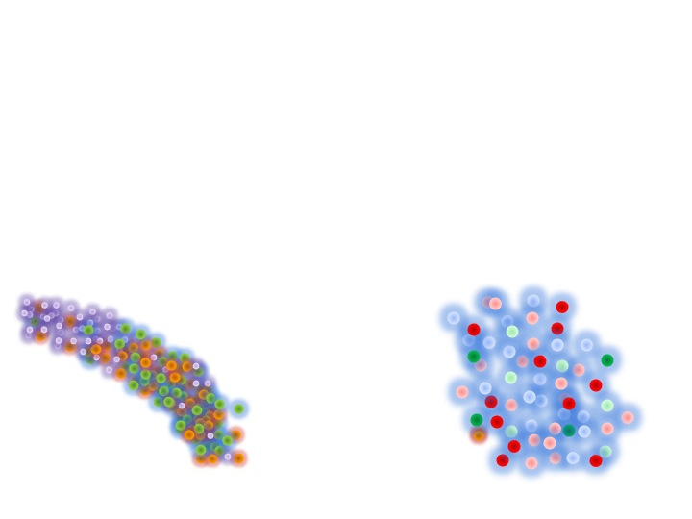
Initial geometry
Φ₂
Φ
Φ₄
Φ₃
Simplified
Realistic

Slide 7
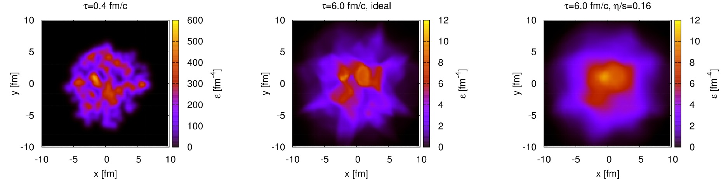
Initial → Final
Hydrodynamic evolution of the system
Natural parameter: viscosity scaled with the particle density (entropy density, s)
low η/s means strong coupling
Ideal
6 fm / c
viscose
Phys.Rev.Lett.106, 042301 (2011)

Slide 8
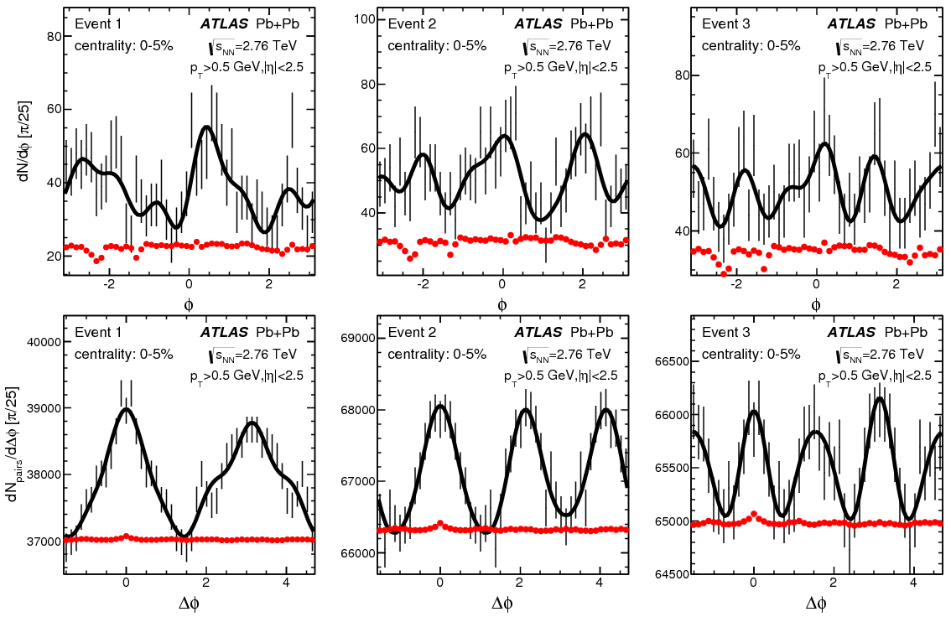
Fluctuations event-by-event
arXiv:1305.2942
Significant fluctuations, factor of ~2
Cannot be explained by detector effects
Shall be corrected for:
efficiency
acceptance
limited statistics

Slide 9
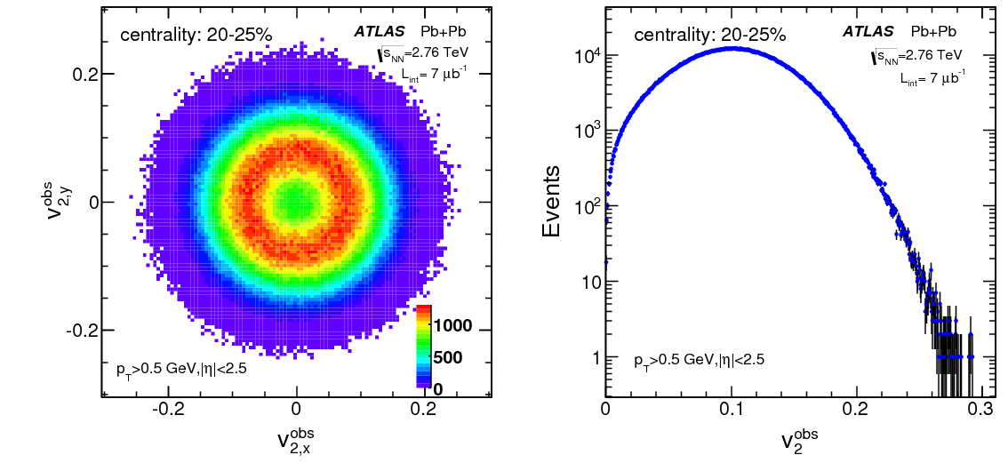
Flow vector and smearing
arXiv:1305.2942
?

Slide 10
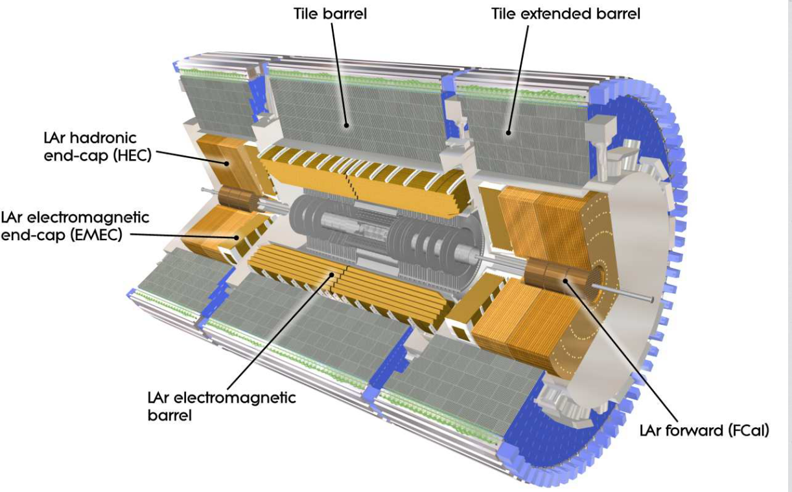
Split event into two
Signal: subtracted
Fluctuations: √2 larger
Sub-event “A” – Sub-event “C” =

Slide 11
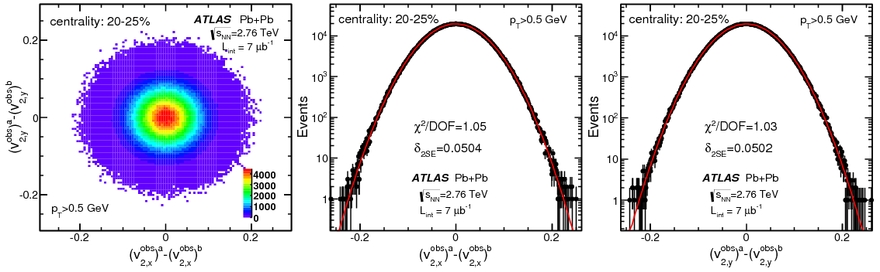
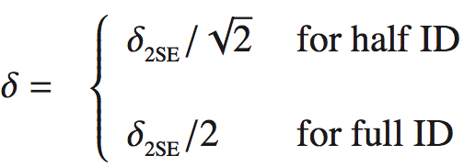
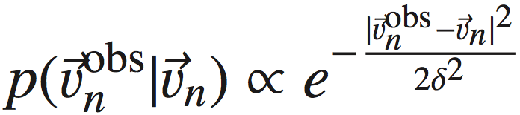
Getting the response function
2D response function is a 2D Gaussian
arXiv:1305.2942
Done by iterations, convergence after N_{iter}=8, some require longer.
Data driven method, no additional assumptions are required

Slide 12
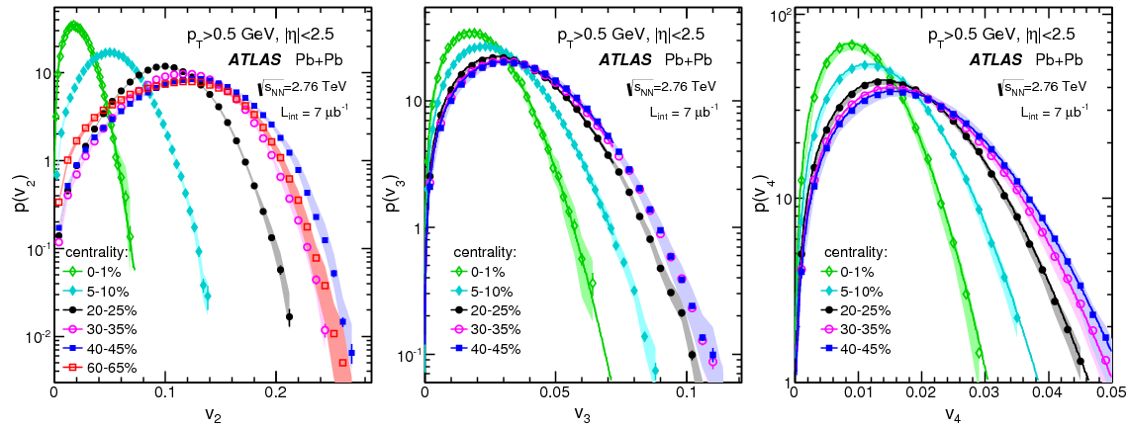
Flow probability distributions
v₂
v₃
v₄
arXiv:1305.2942
v_{n} distributions in p_{T} and centrality
Fully corrected for detector effects an unfolded for limited statistics

Slide 13
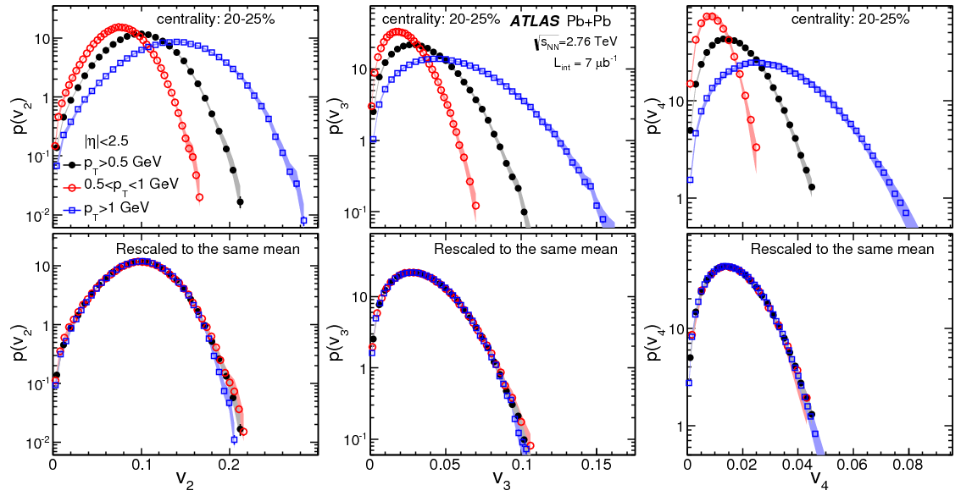
p_{T} scaling
arXiv:1305.2942
v₂
v₃
v₄
All p_{T} bins have similar shape
Holds for all measured n

Slide 14
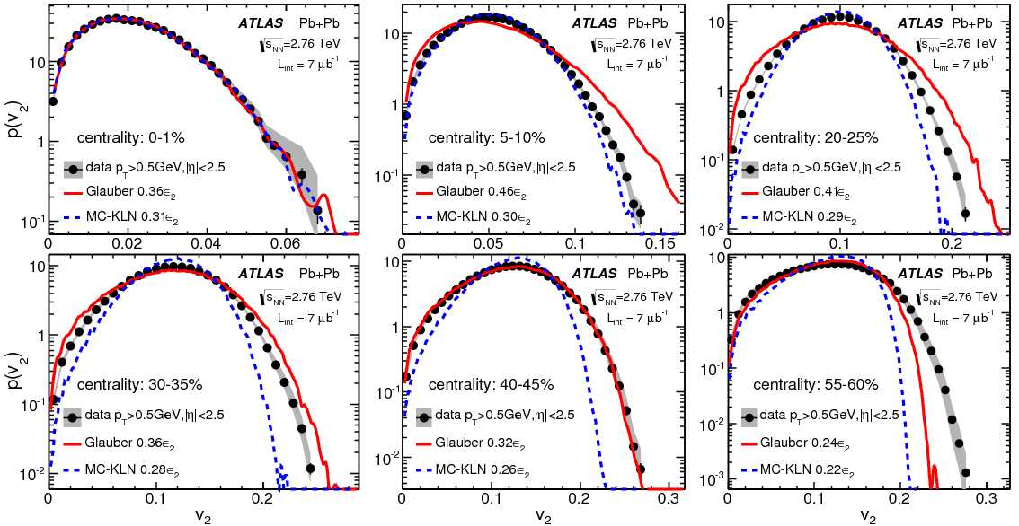
Comparison to models
arXiv:1305.2942
Glauber model describes the data well, except in peripheral events
MC-KLN is less accurate even in mid-central collisions

Slide 15
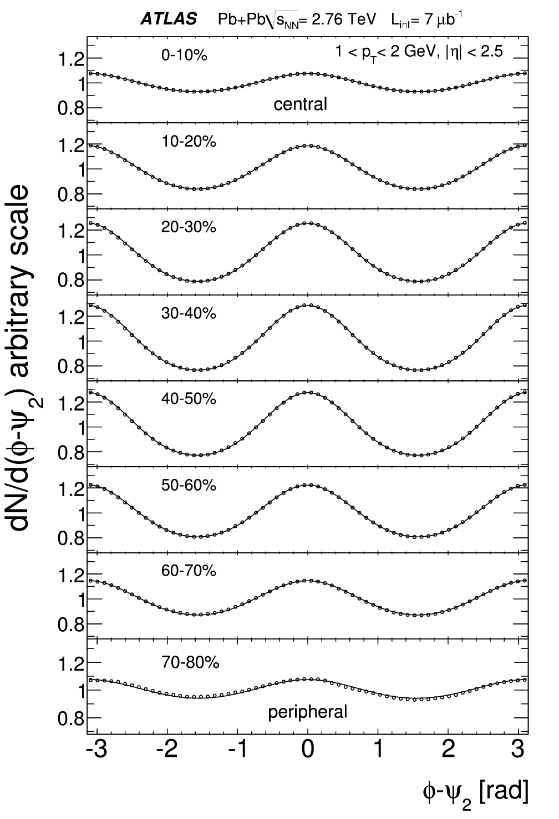
Fluctuations event-by-event
PLB707 (2012) 330-348
Φ₂
Φ₂
Φ₂

Slide 16
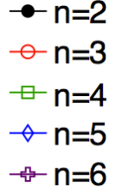
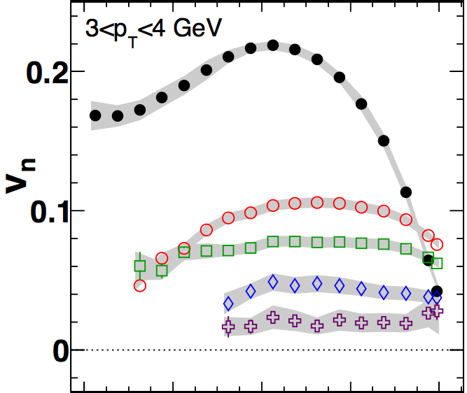

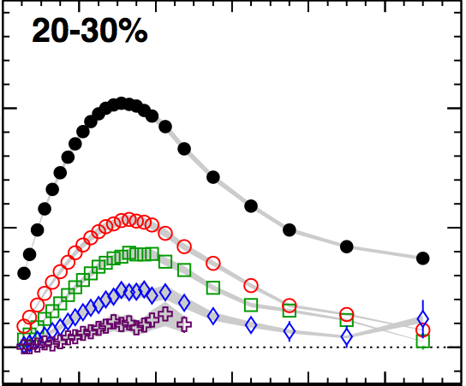
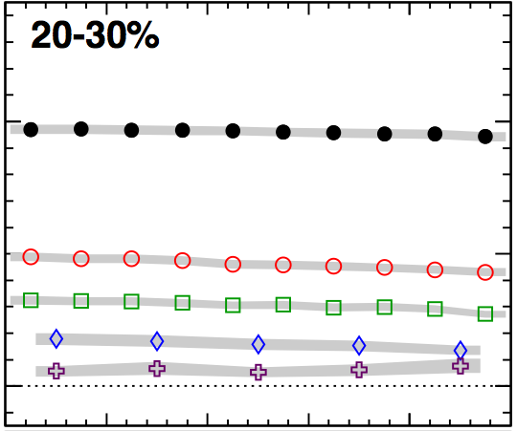





Averaged flow
Phys. Rev. C 86, 014907 (2012)
Features of Fourier coefficients
  v_{n} coefficients rise and fall with centrality.
  v_{n} coefficients rise and fall with p_{T}.
  v_{n} coefficients are ~boost invariant.
Caveat: Event planes are correlated

Slide 17
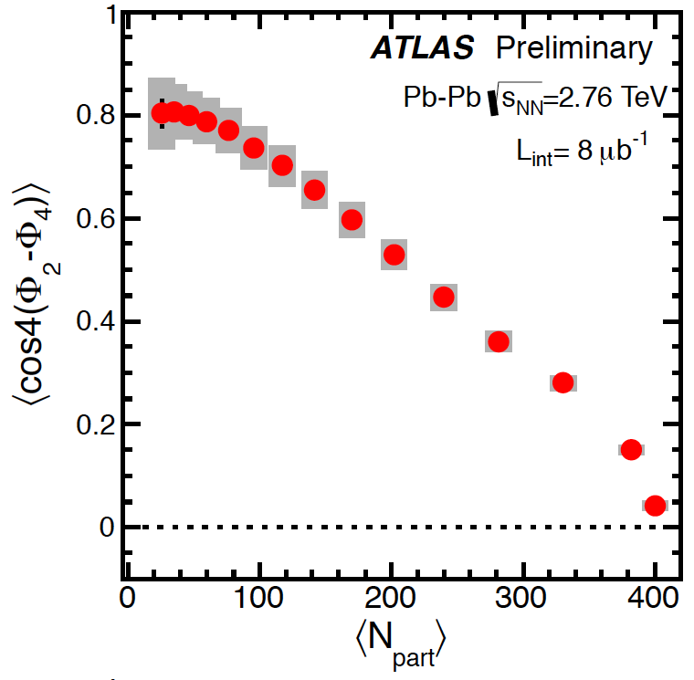
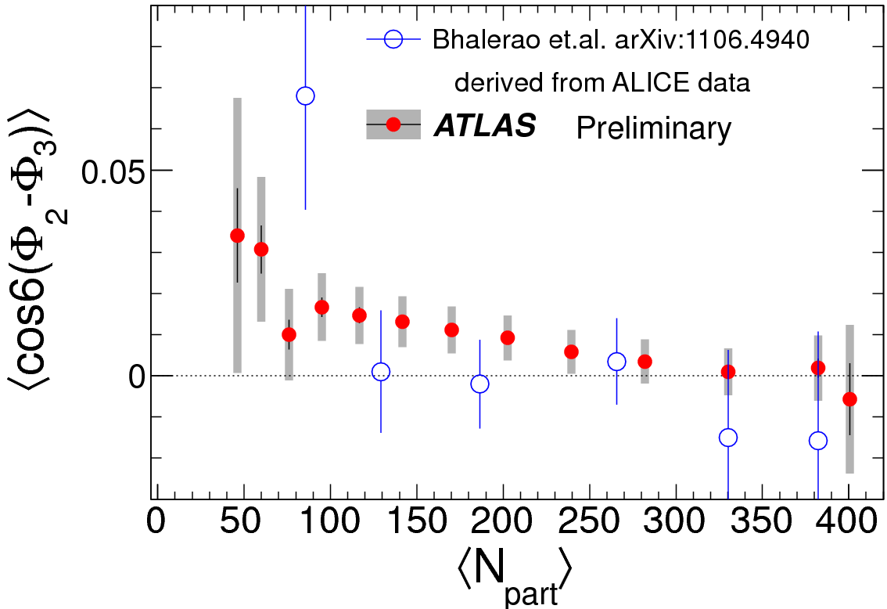
Event plane correlations
Φ₂
Φ₄
Φ₃
ATLAS-CONF-2012-049
Model predicts even planes to be correlated.
Data shows strong correlation of Φ₂ and Φ₄, stronger than expected
Correlations between even and odd planes is not expected
Data shows significant correlations between Φ₂ and Φ₃

Slide 18
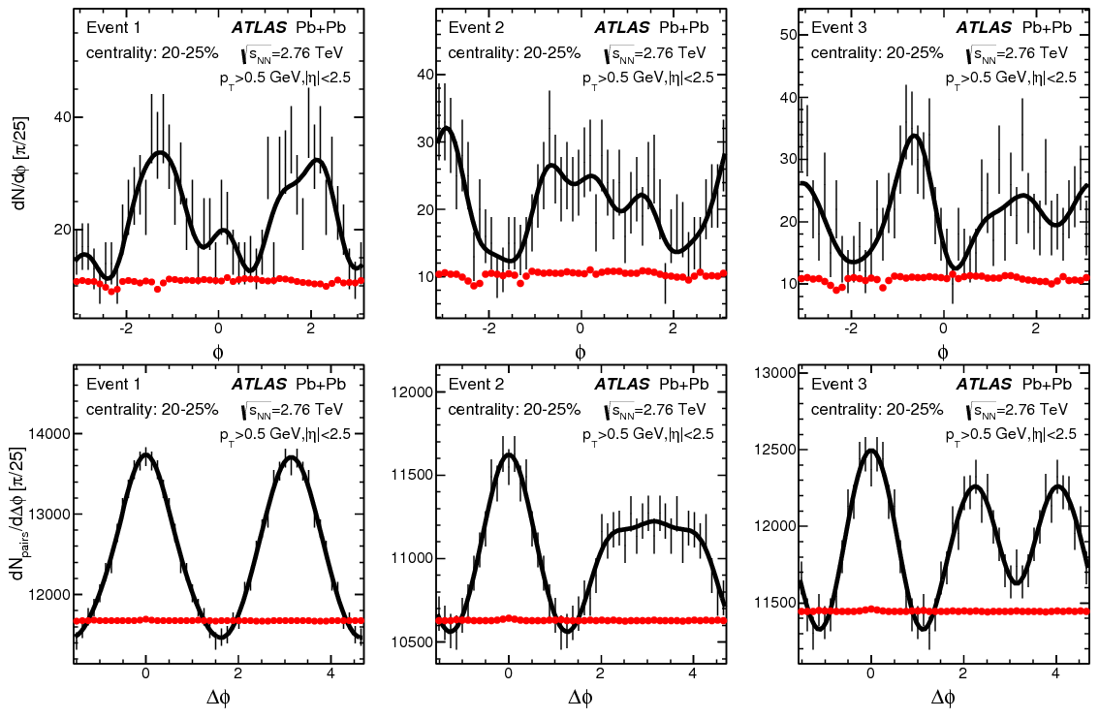
Shape, event-by-event
arXiv:1305.2942

Slide 19
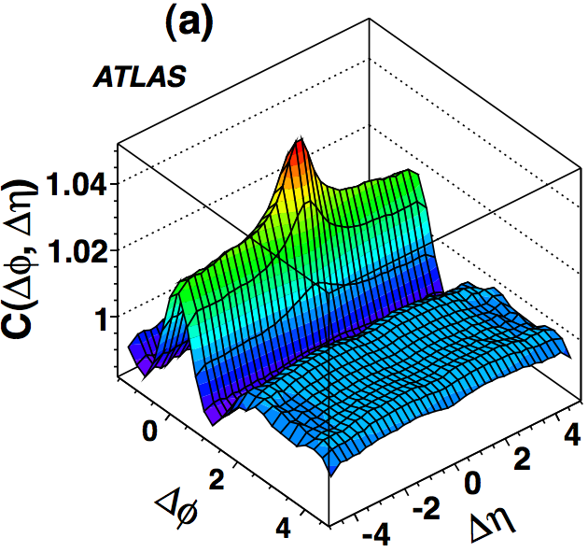
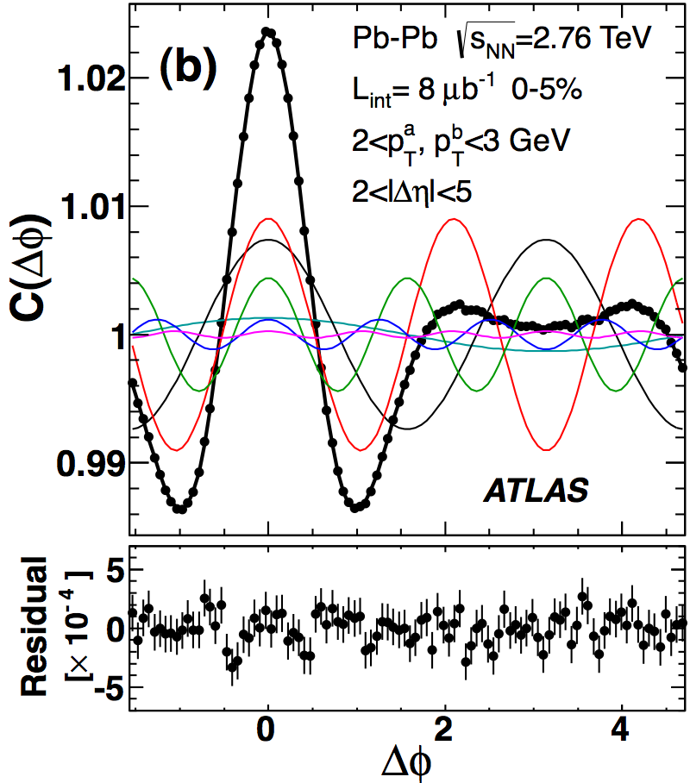
Shape via two particle correlations
Phys. Rev. C 86, 014907 (2012)
|Δη|>2
Long range structures (“ridges”) described by harmonics v_{1,1}-v_{6,6}
However, one assumption is needed, for n=1

Slide 20
Dipolar flow
Directed (odd component) flow
vanishes at η=0
Dipolar (even component) flow
~boost invariant in η
Φ₁
Dipolar flow must be affected by global momentum conservation

Slide 21
Dipolar flow
Phys. Rev. C 86, 014907 (2012)
Similar magnitude as triangular flow
Negative at low p_{T}

Slide 22
Cumulant method
arXiv:1305.2942
2PC → 2k particle correlation, cumulant method

Slide 23
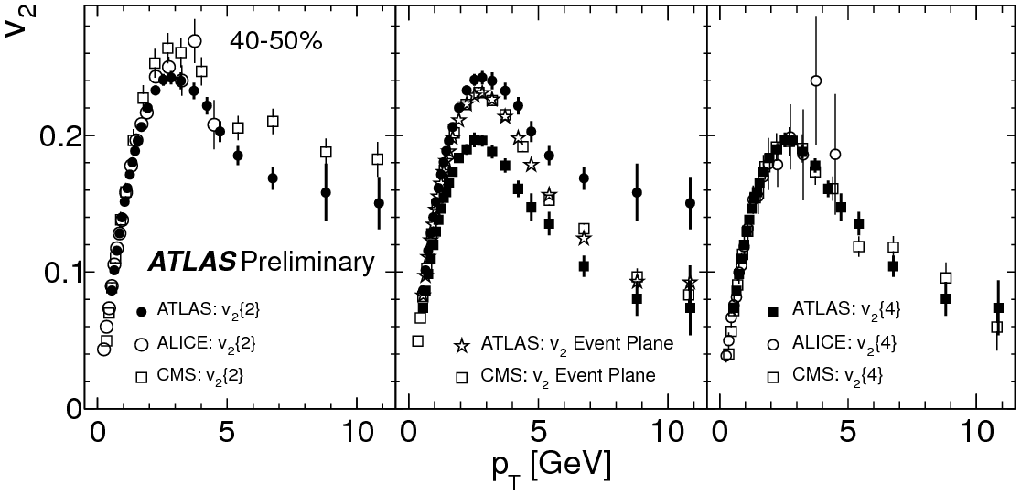
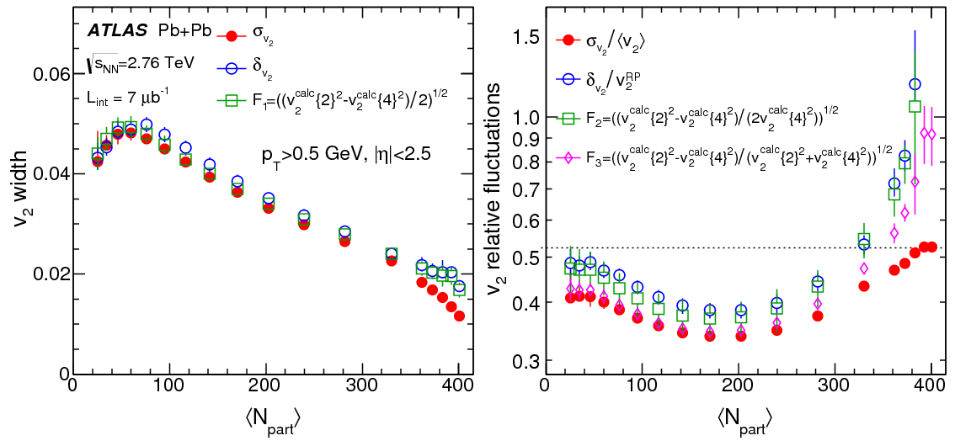
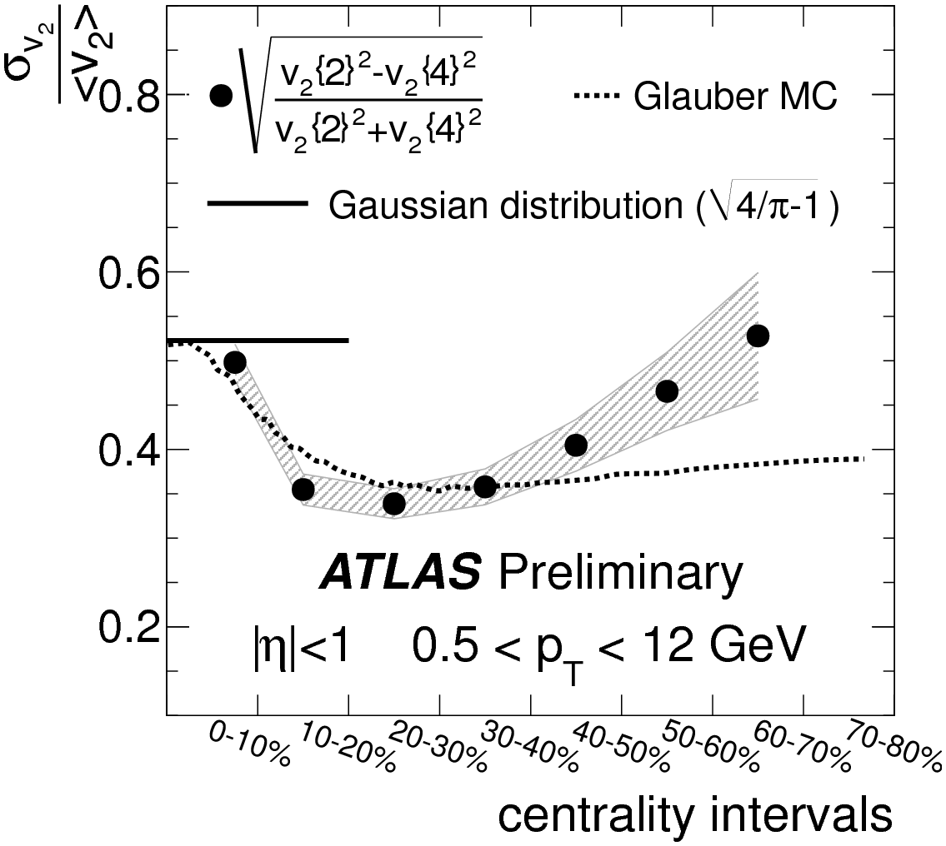
Relative fluctuations
v₂{2}
v₂{4}
v₂{4} < v₂(EP) < v₂{2}
Behavior expected from non-flow contributions
v₂(RP)
ATLAS-CONF-2012-118
Relative fluctuation of v₂ are Gaussian-like in central
& everywhere for higher n
Event-by-event method and cumulants agree.
arXiv:1305.2942

Slide 24
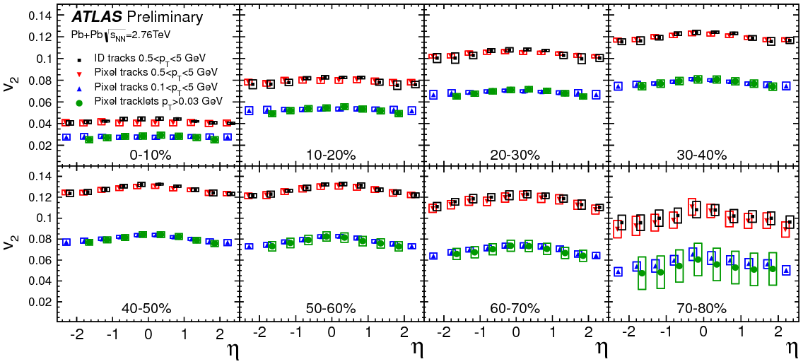
Integrated (averaged) v₂
ATLAS-CONF-2012-117
Significant elliptic flow, reaching 0.12.
Weak pseudo-rapidity dependence

Slide 25
Summary
ATLAS provides a widest spectra of correlation and fluctuation analysis measuring event-by-event, averaged, cumulant, integrated two-particle correction harmonic analysis.
Complete study of v_{n} in p_{T}, rapidity and centrality for v₂-v₆ and beyond, first measurement of v₁
2 particle correlations decomposition into Fourier coefficients of harmonic flow.
v₂{2} and v₂{4} cumulant analysis, understanding of fluctuations in comparison to other methods.
First measurement of event plane correlations
High multiplicity and wide pseudo-rapidity coverage allows measuring event-by-event fluctuations using ATLAS detector

Slide 26
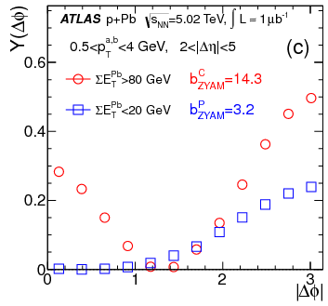
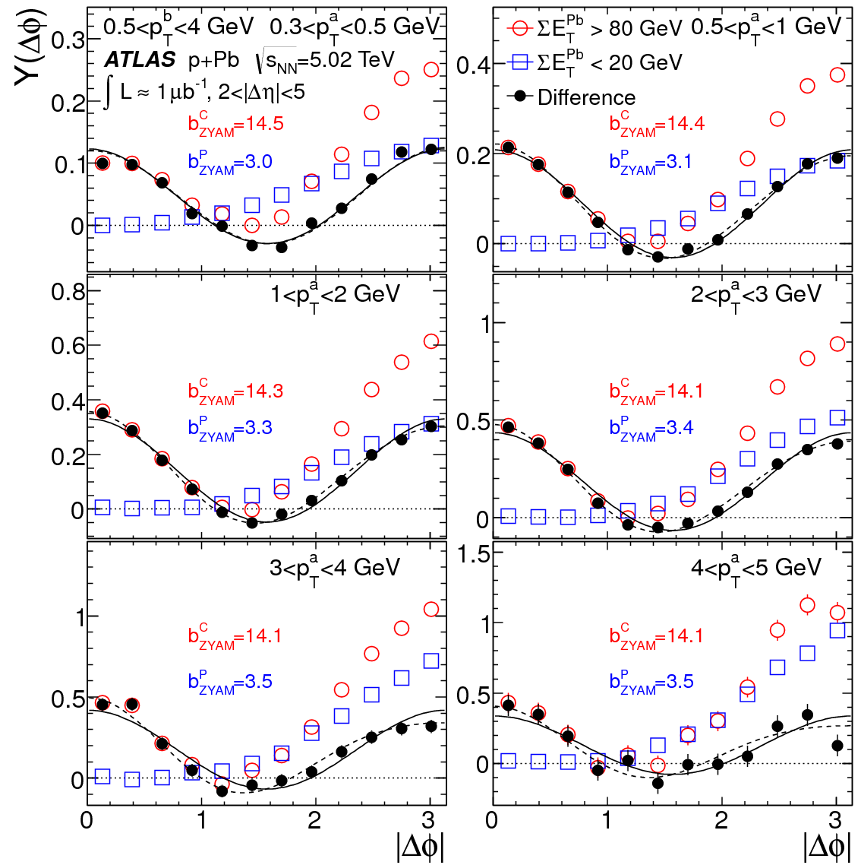
Two particle correlations in p+Pb
PRL 110, 182302 (2013)
Near side Away side
Long range component:
Recoil + Δφ-Symmetric

Slide 27
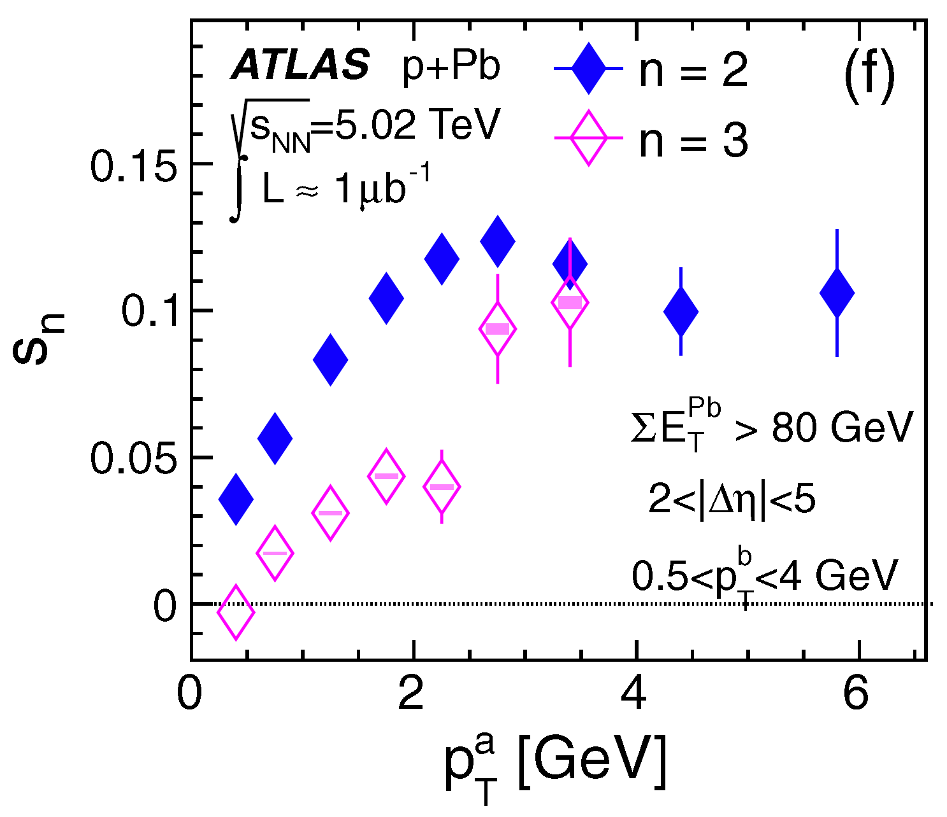
Two particle correlations in p+Pb
PRL 110, 182302 (2013)
Convert to a single particle level
assuming factorization:
c_{n}(p_{T}ª,p_{T}^{b}) = s_{n}(p_{T}ª)s_{n}(p_{T}^{b})
s_{n}(p_{T}ª) = c_{n}(p_{T}ª,p_{T}^{b}) / √c_{n}(p_{T}^{b},p_{T}^{b})
s_{n}(p_{T}ª) ⬄ v_{n}{2PC}
s₂ increases with p_{T} up to 3 GeV and than drops
s₃<s₂ over the measured p_{T} region

Slide 28
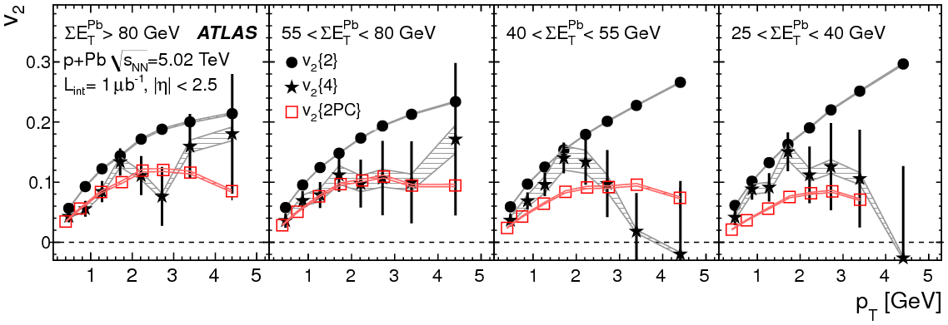
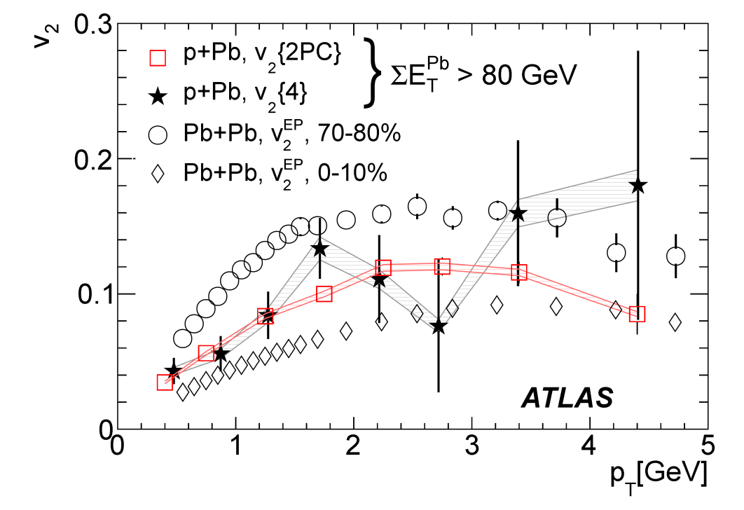
p_{T} dependence of cumulants in p+Pb
PLB 725, 182302 (2013) 60
Strong reduction of v₂ when using 4-particle cumulants
Good agreement with v₂{2PC} for 0-20% central
Large difference in more peripheral events

Slide 29
Backups

Slide 30
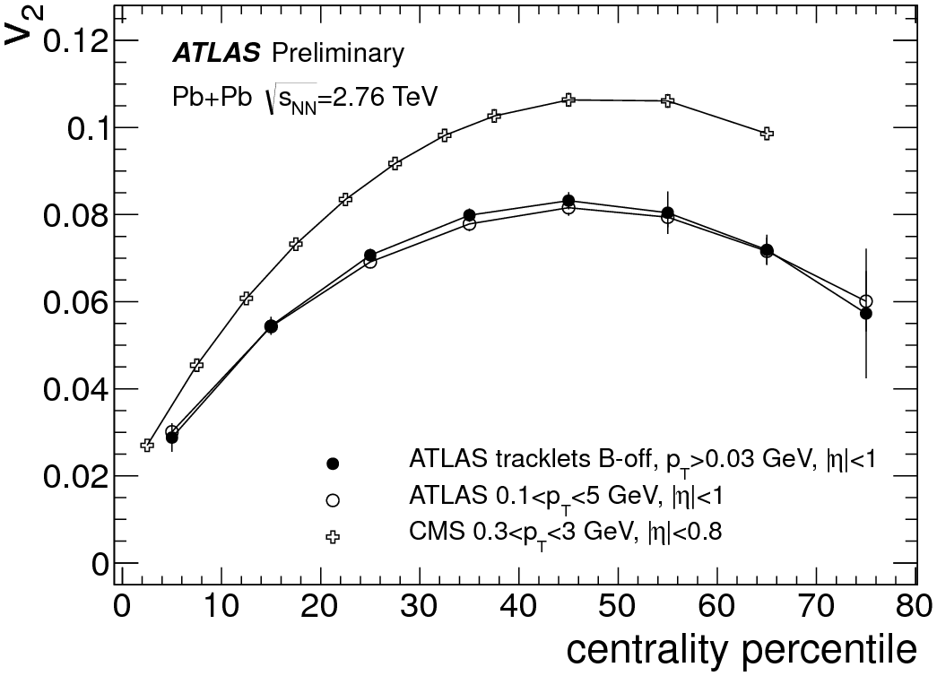
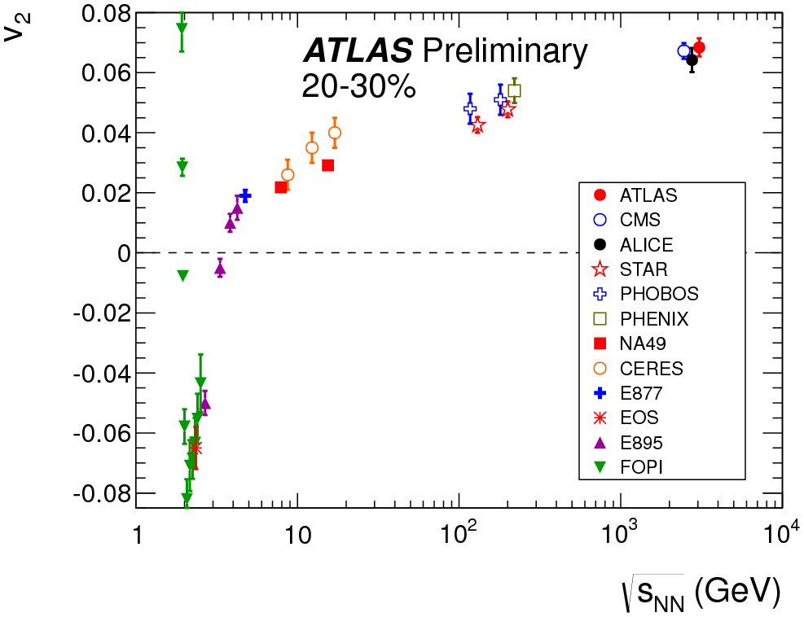
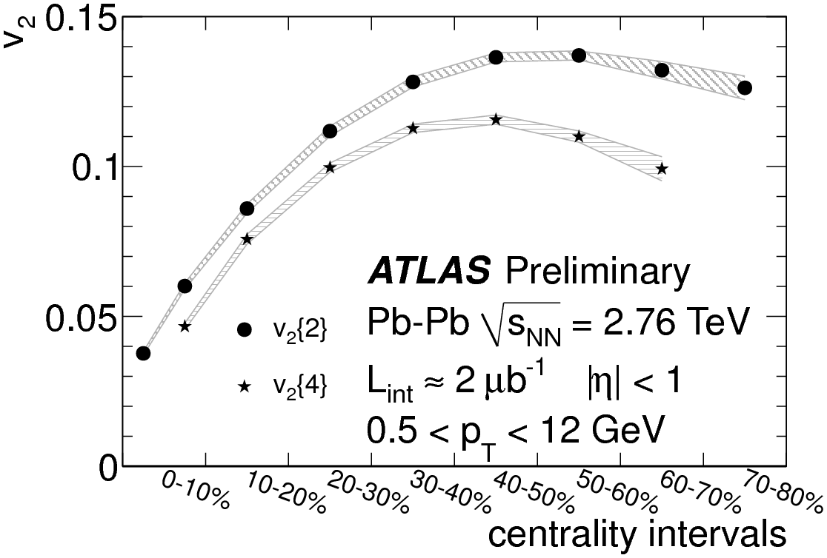
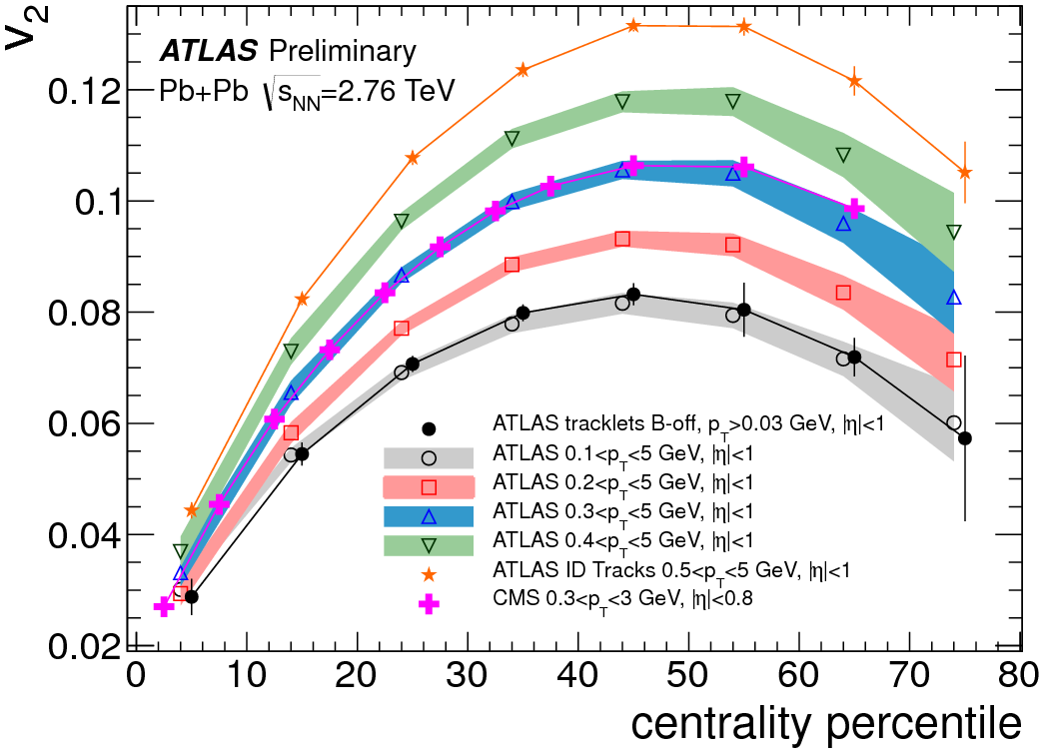
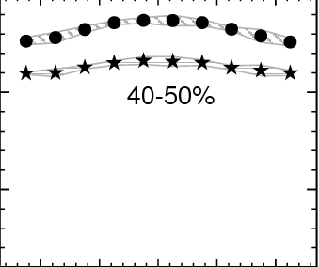
Summary

Slide 31
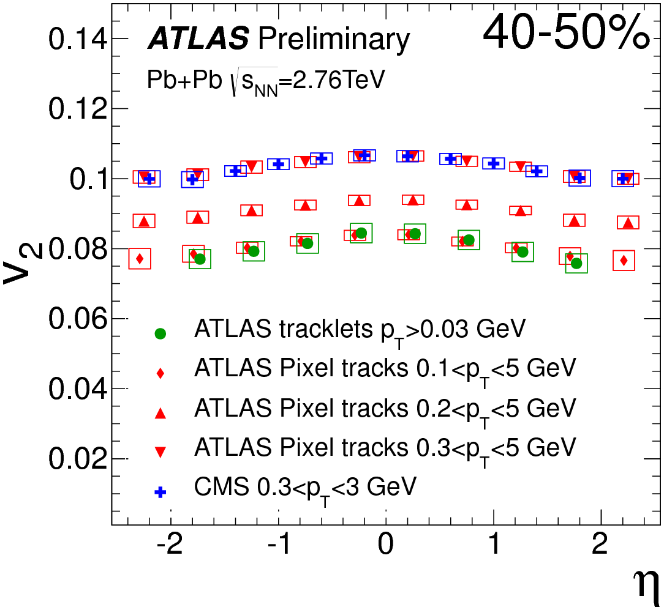
Summary

Slide 32
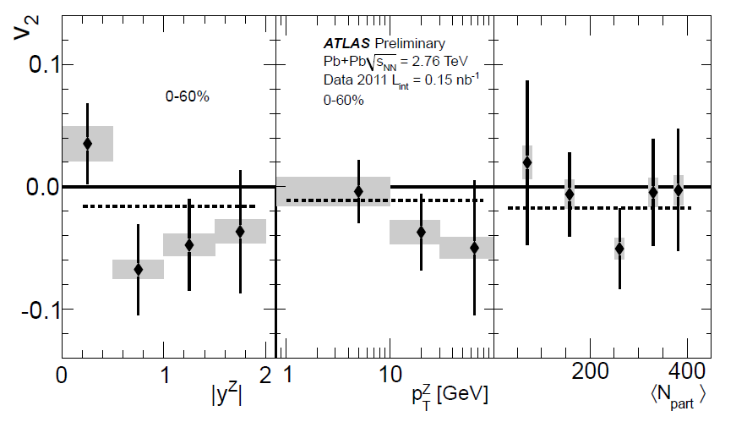
Z azimuthal anisotropy
v₂ = −0.015 ± 0.018(stat.) ± 0.014(sys.)

Slide 33
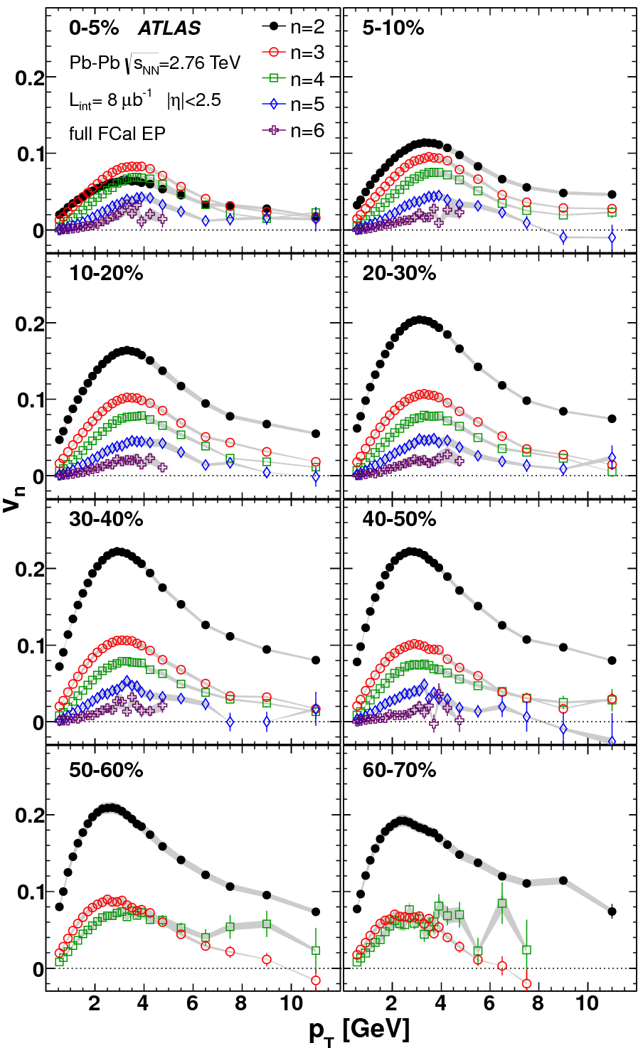
Higher order flow.
Phys. Rev. C 86, 014907 (2012)
ATLAS measures higher order flow.
Harmonics up to 6th show significant amplitudes.
In the most central the 3rd harmonic is stronger than the elliptic (2nd) harmonic.
v₂ varies with centrality much stronger compared to v_{n} (n>2)
Consistent with elliptic flow being driven by geometric shape whereas higher order harmonics coming from fluctuations.

Slide 34


Particle flow (integrated)
ATLAS-CONF-2012-117
Good agreement with the CMS results [arXiv:1204.1409]
All LHC experiments agree for data η=0 [ALICE: Phys. Rev. Lett. 105 (2010) 252302]
Integrated flow grows with incident energy. More particle or more flow?

Slide 35
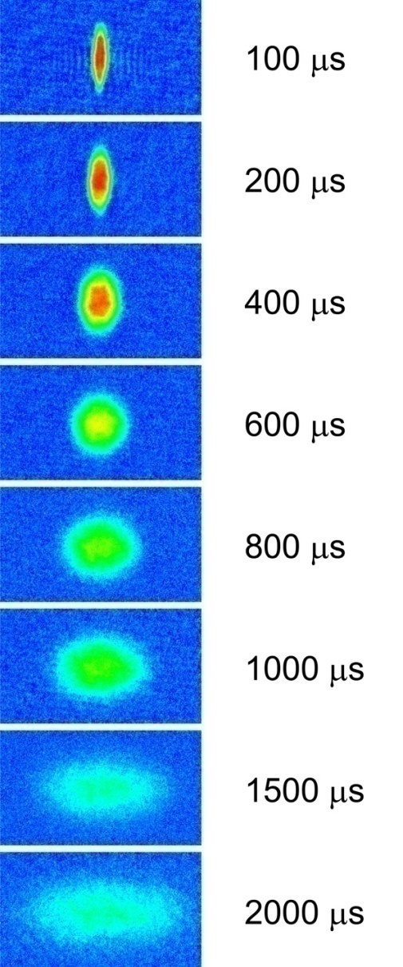
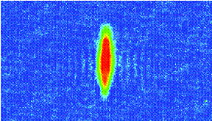
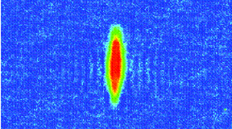
Analogy in Atomic System
Same phenomena observed in gases of
strongly interacting atoms
The RHIC fluid behaves like this,
that is, a strongly coupled fluid.
~10 fm/c

Slide 36
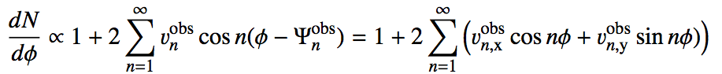



Distribution of a single event.
Ideal detector:
Correct for acceptance & efficiency:
Efficiency weight applied track by track as function of p_{T} and η

Slide 37

The probes
Center at a high-p_{T} particle
2PC in p+p show both sides of a jet
The same in d+Au
Near-side jet in Au+Au
And no back-to-back partner

Slide 38

Shape, event-by-event
ATLAS-CONF-2012-114

Slide 39



Centrality
Phys.Lett. B707 (2012) 330-348
Spectators
Participants
Binary
Collisions
 | <N_{part}>
0-5% | 382 ± 1%
5-10% | 330 ± 1%
10-20% | 261 ± 2%
20-40% | 158 ± 3%
40-80% | 46 ± 6%
<N_{coll}>
1683 ± 8%
1318 ± 8%
923 ± 7%
441 ± 7%
78 ± 9%

