Slide 1
Plasma instabilities and particle production in Glasma
Shoichiro Tsutsui (Kyoto Univ.)
In collaboration with
Hideaki Iida, Teiji Kunihiro (Kyoto Univ.)
Akira Ohnishi (YITP)
International Conference on the Initial Stages in High-Energy Nuclear Collisions
Illa da Toxa, Spain, 13 September 2013

Slide 2
Contents
Introduction: Early thermalization problem
Formalism: 2PI effective action
Glasma Instabilities
  Primary --- Nielsen-Olesen instability
  Secondary instability
Summary and future work

Slide 3
Motivation
Early thermalization problem
？
time evolution
QGP
local equilibrium

Slide 4
Motivation
Early thermalization problem
？
time evolution
Color Grass
Condensate
unknown process
QGP
local equilibrium
Glasma
thermalization = particle production in quantum field dynamics
under the time dependent classical background fields

Slide 5
Motivation
Early thermalization problem
representative approaches
Bottom–up thermalization scenario
  solve the Boltzmann eq.
  2->2 , 2->3 processes
Classical statistical simulation
  including nonlinear effects
  appropriate to glasma instabilities
Baier, Mueller, Schiff, Son (2001)
Rommatschke, Venugopalan (2006)

Slide 6
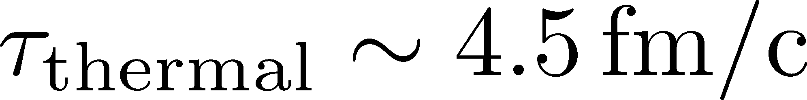
Motivation
Early thermalization problem
representative approaches
Bottom–up thermalization scenario
  solve the Boltzmann eq.
  2->2 , 2->3 processes
Classical statistical simulation
  including nonlinear effects
  appropriate to glasma instabilities
no background
classical fields
Baier, Mueller, Schiff, Son (2001)
does not reproduce
the Bose-Einstein
distribution
Rommatschke, Venugopalan (2006)
the 2PI formalism can overcome these weak points

Slide 7
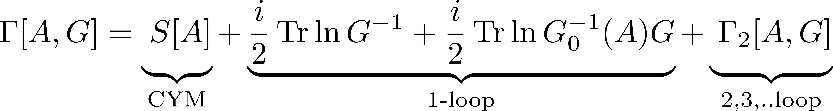
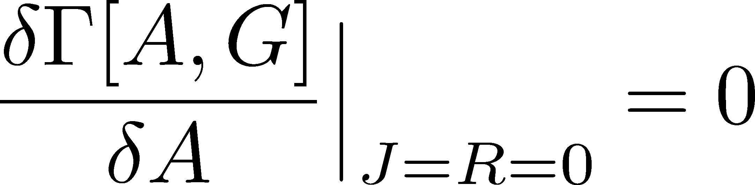
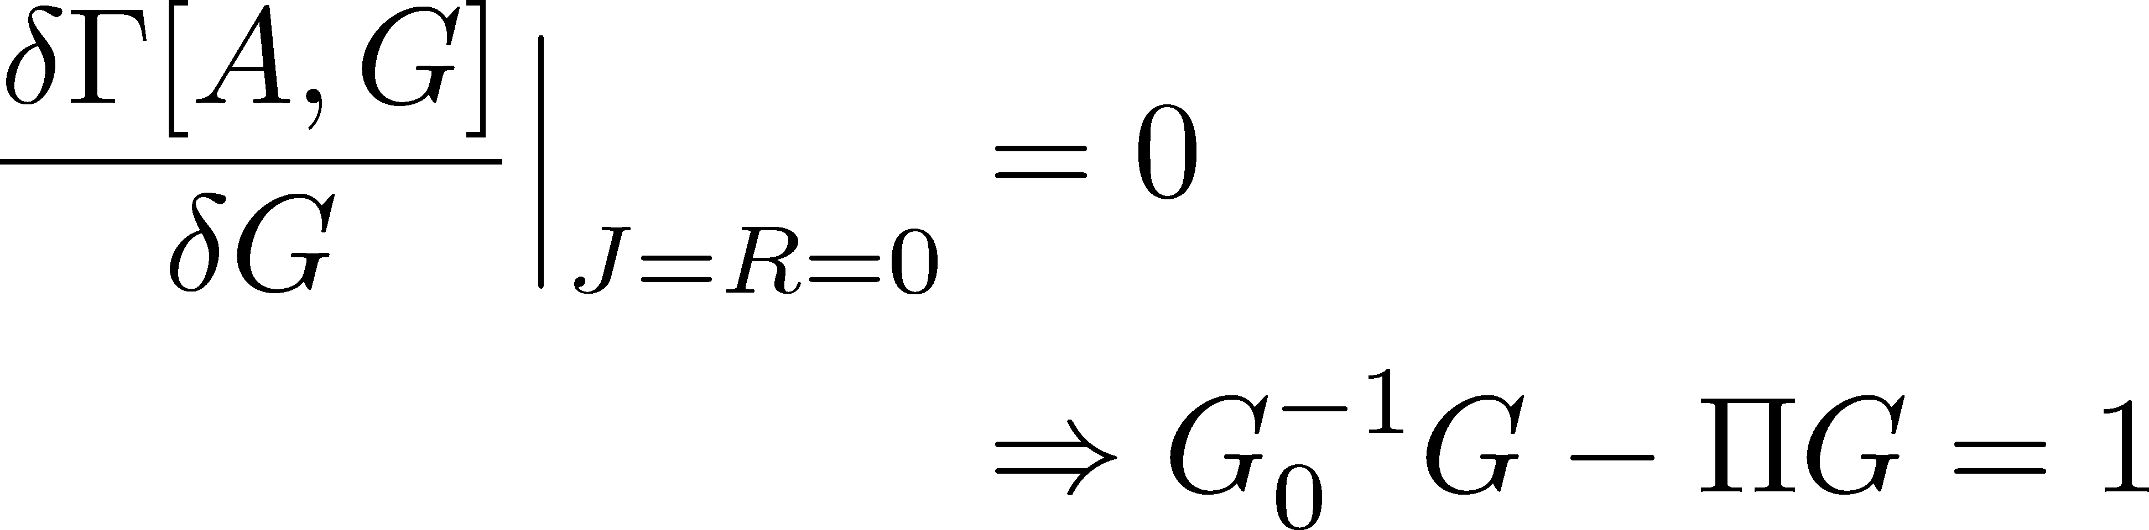
Formalism
2PI effective action
a review: Berges (2004)
EOM of classical gluon fields
KB-CJT eq (Schwinger-Dyson eq)
Kadanoff, Baym (1962)
Cornwall, Jackiw, Tomboulis (1974)

Slide 8
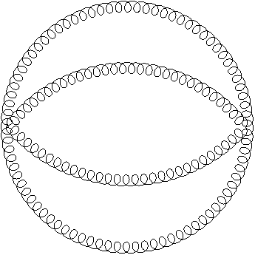
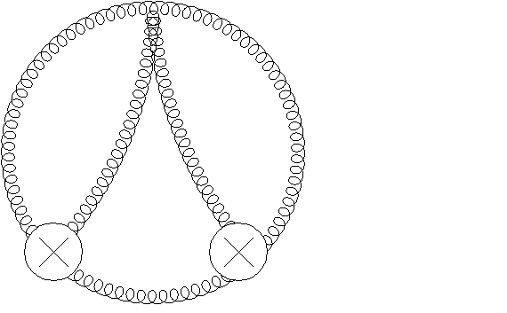
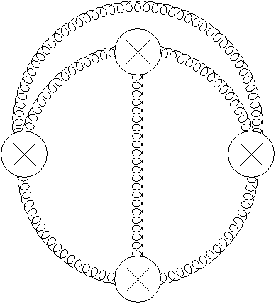
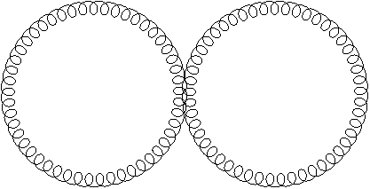
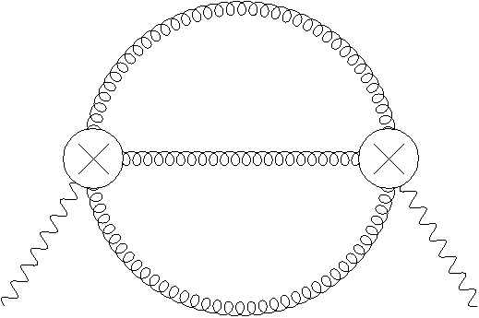


EOM of classical gluon fields
loop expansion of the 2PI action
EOM of classical gluon fields
Classical Yang-Mills eq.
quantum corrections

Slide 9


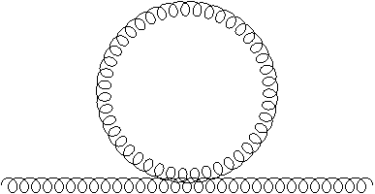
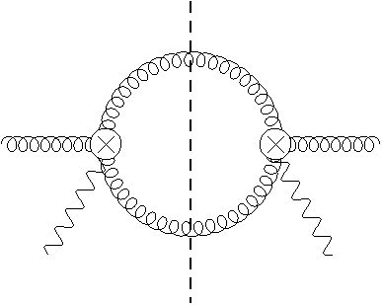
EOM of correlation functions
KB-CJT eq (Schwinger-Dyson eq)
is the real part of
1 to 2 process is possible
in an expanding geometry: Hatta, Nishiyama(2012)

Slide 10
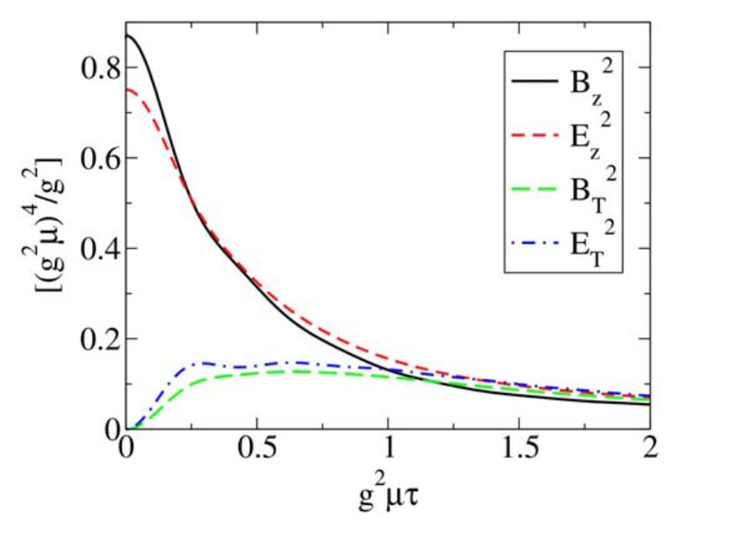
Comparison with Classical Stat.
Lappi, McLerran (2006)
equilibrium
the range of
applications
classical stat.
2PI
2PI (n-loop)

Slide 11
Comparison with Classical Stat.
Lappi, McLerran (2006)
equilibrium
linear analysis of
EOM of classical
gluon field
glasma instabilities
play crucial roles
2PI (n-loop)

Slide 12
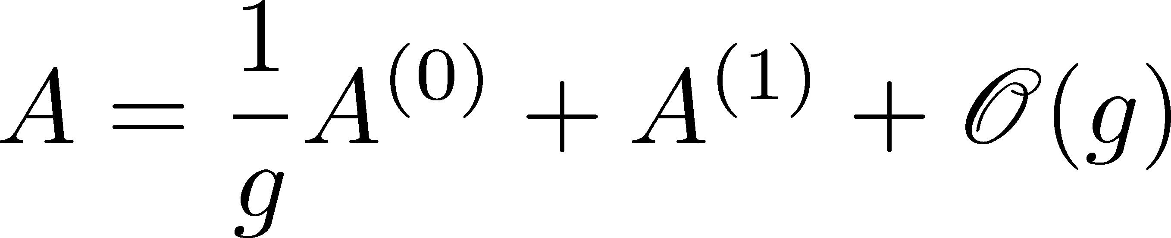
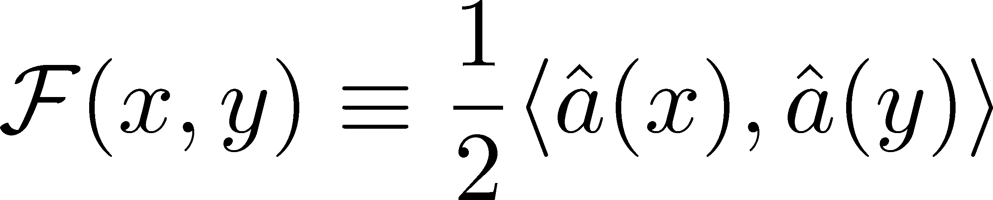
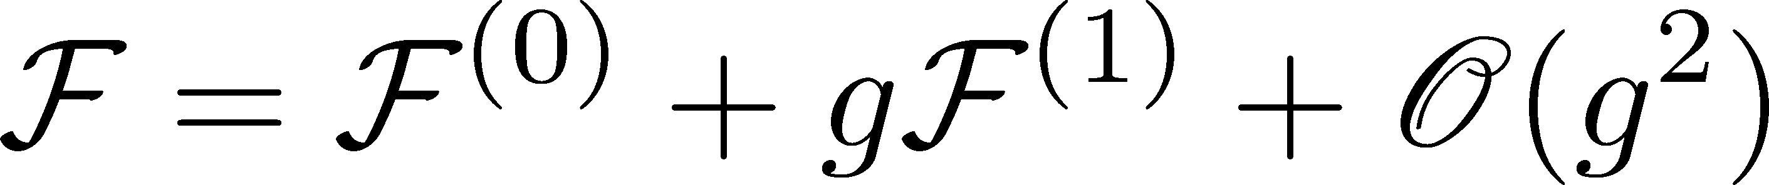
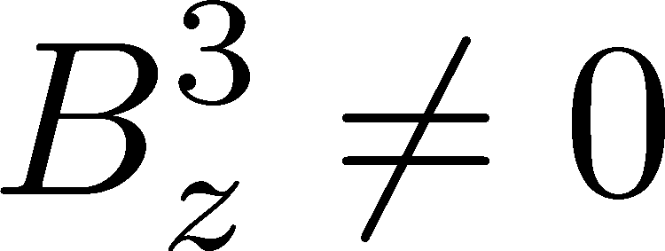
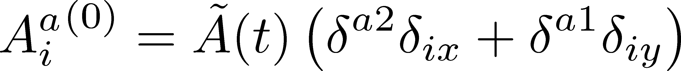
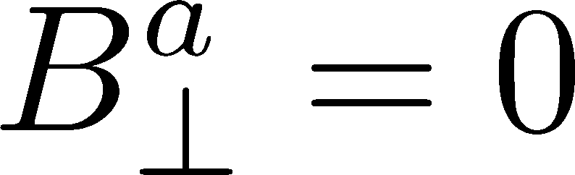
Glasma instabilities
perturbative expansion of g
suppose that there is a background color magnetic field

Slide 13
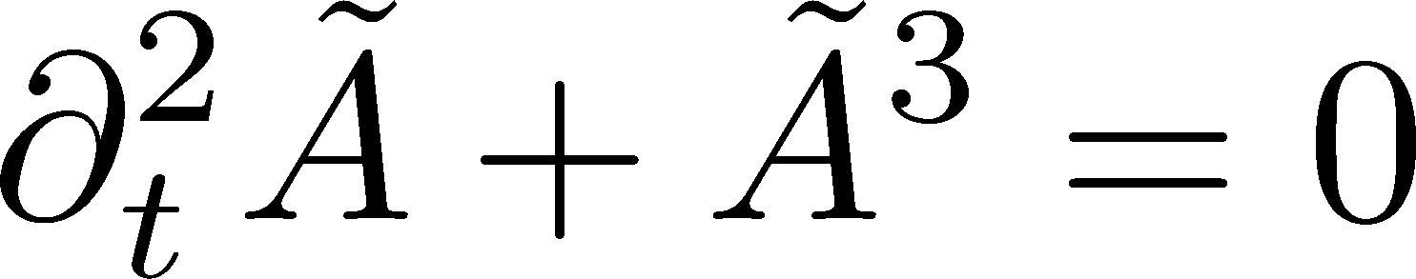
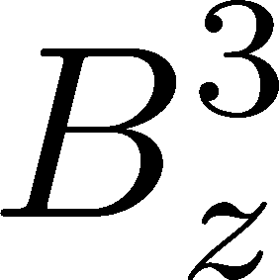
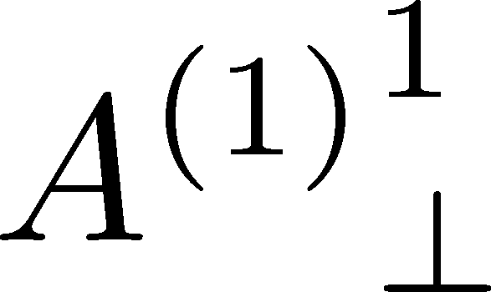
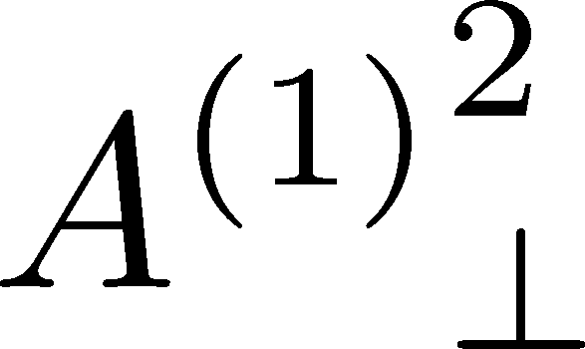
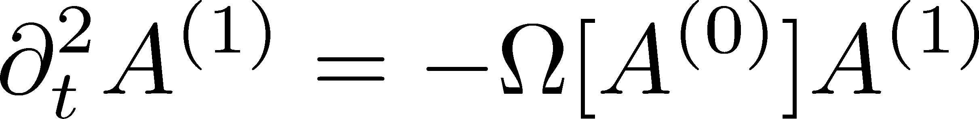

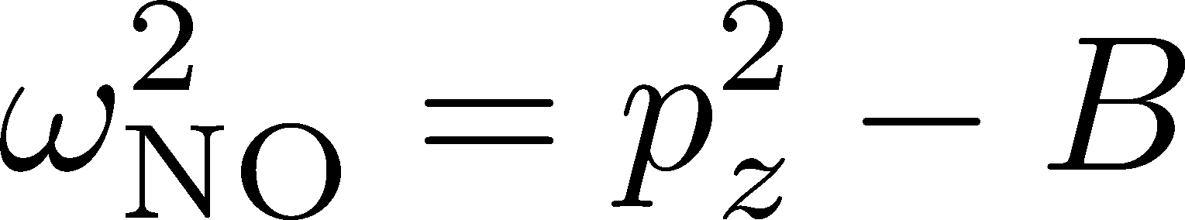
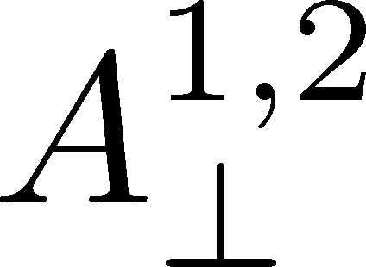
Glasma instabilities (primary)
LO EOM
Fujii, Itakura(2008)
Berges,Scheffler,
Schlichting,Sexty(2012)
NLO EOM
Nielsen-Olesen instability
one of the eigenvalues of is
lower momentum modes are unstable
are unstable

Slide 14
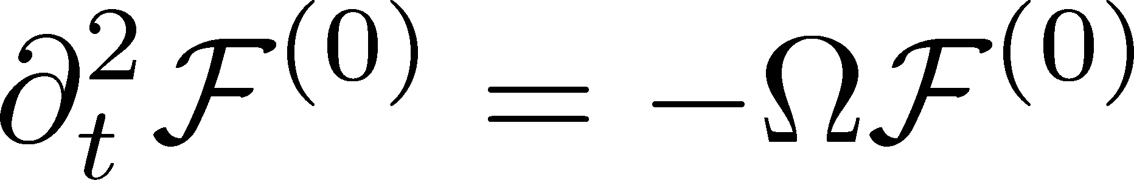
Glasma instabilities (secondary)
NNLO EOM (beyond linear analysis)
induced current
LO KB-CJT
quantum effects become
relevant to NNLO

Slide 15
Properties of the 1-loop current (1)
classical part
quantum part
・quantum effects affect the amplitude of the current

Slide 16
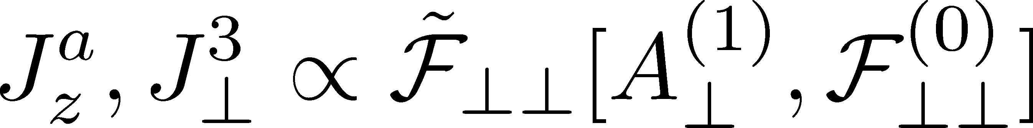
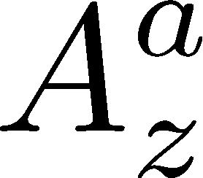
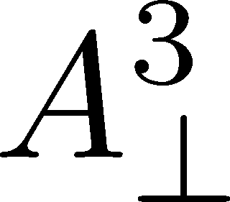
Properties of the 1-loop current (2)
the current triggers
secondary instabilities
primary
secondary
are unstable
are unstable
are stable
can be unstable

Slide 17
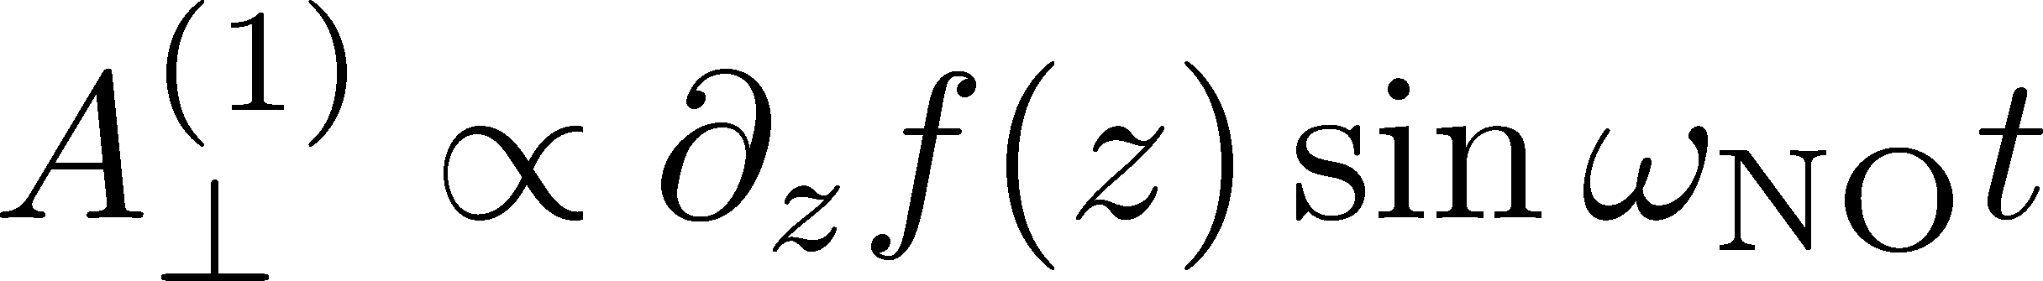
Properties of the 1-loop current (3)
solve the NLO EOM and LO KB-CJT
consistent with Gauss’s law
the size of fluctuations
secondary instabilities
does not occur
no initial longitudinal fluctuations

Slide 18




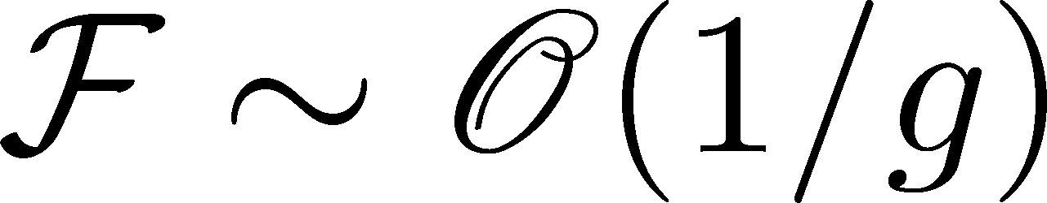
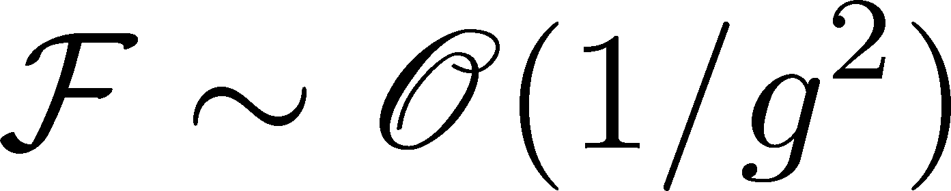
Summarizing Picture
Nielsen-Olesen instability
sequential instabilities
suggested by 2PI formalism
isotropization
primary mode
secondary mode
growth rate
consistent with previous
numerical results
Romatschke,Venugopalan (2006)
Berges (2012)
Iida, Kunihiro, Müller,
Ohnishi, Schäfer, T. Takahashi (2013)

Slide 19
Summary
The particle production in quantum field dynamics under the time dependent classical background fields plays an important role in thermalization
2PI formalism is best suited
We applied the 2PI formalism to the early stage of dynamics
Quantum effects affect the amplitude of the induced current
The induced current triggers the secondary instabilities
The induced current is sensitive to initial fluctuation

Slide 20
Future work
take a realistic initial condition into account
solve EOM of classical gluon fields and KB-CJT eq. numerically to investigate the later stage of thermalization process
check the gauge dependence (numerically)
Thank you for your attention!

Slide 21
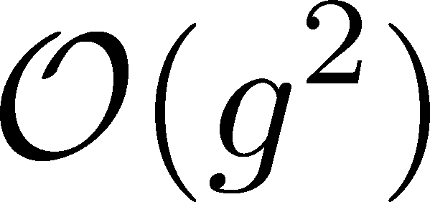
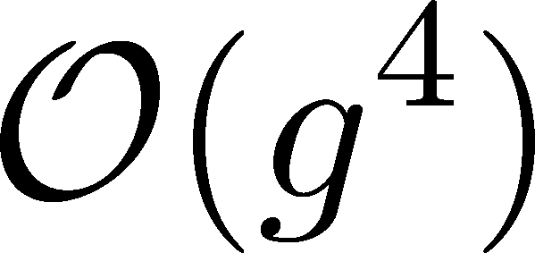
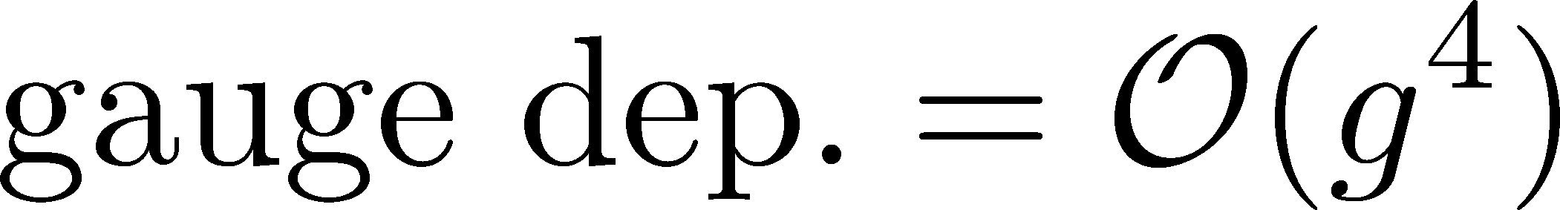
Controlled gauge dependence
truncation
A. Arrizabalaga, J. Smit (2002)
M.E. Carrington, G. Kunstatter, H. Zaraket (2005)
the gauge dependence appears at higher order than the truncation order

Slide 22
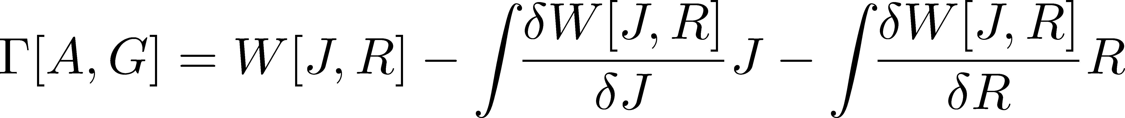
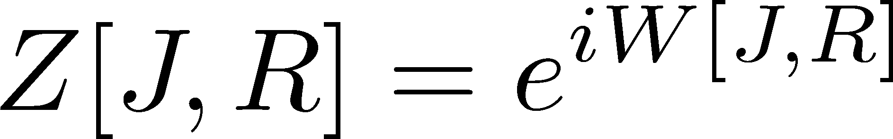
Formalism
2PI effective action with CTP
2 Particle Irreducible (2PI) effective action
Defined as Legendre transform of generating functional
with respect to the sources J, R

Slide 23
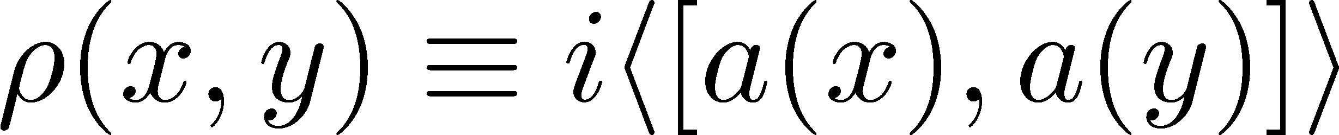
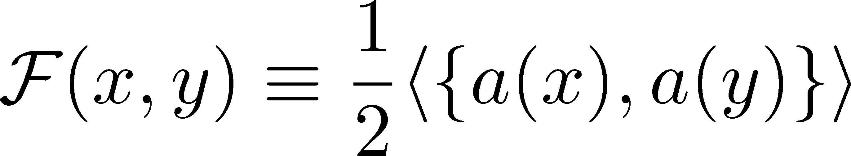
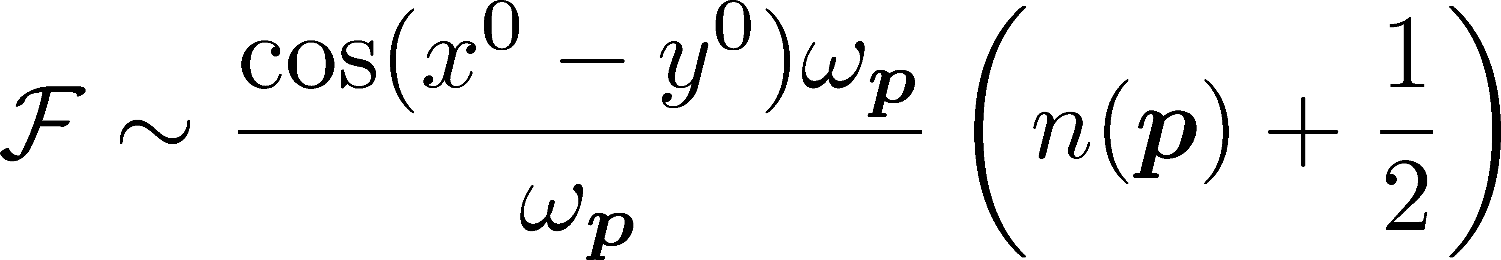
Formalism
Statistical function
decompose the Keldysh Green function
spectral function
statistical function
statistical functions have information
about particles
occupation number
(converge to the BE distribution)

