Slide 1




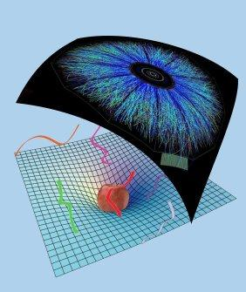
From Full Stopping To Transparency In holography
Towards more realistic models of the QGP thermalisation
Work with Michał Heller, David Mateos, Jorge Casalderrey, Paul Romatschke and Scott Pratt
References: 1305.4919, 1307.2539
Wilke van der Schee
Supervisors: Gleb Arutyunov,
Thomas Peitzmann and Raimond Snellings
Conference on initial stages of heavy-ion collisions, Ila de Toxa, Spain
September, 2013

Slide 2
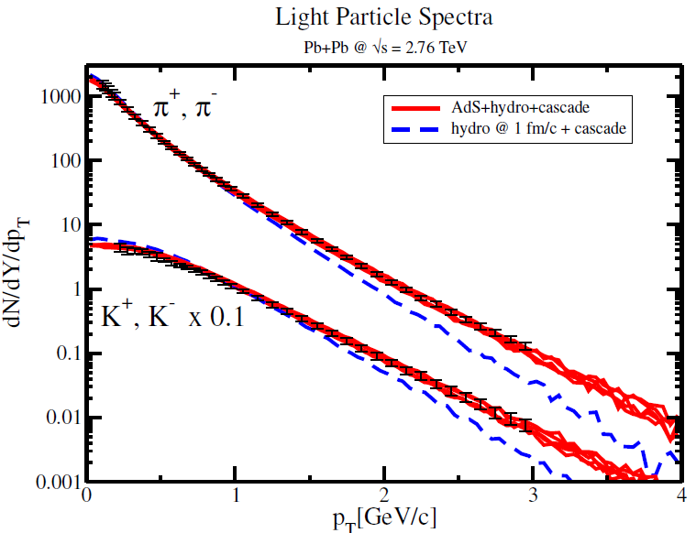
Outline
Wilke van der Schee, Utrecht
Motivation: AdS/CFT
Gravitational shock waves in AdS
Towards experiments: boost-invariant radial flow
  Combination of AdS/CFT+viscous hydro+cascade
Notes:
Many states + linearized

Slide 3
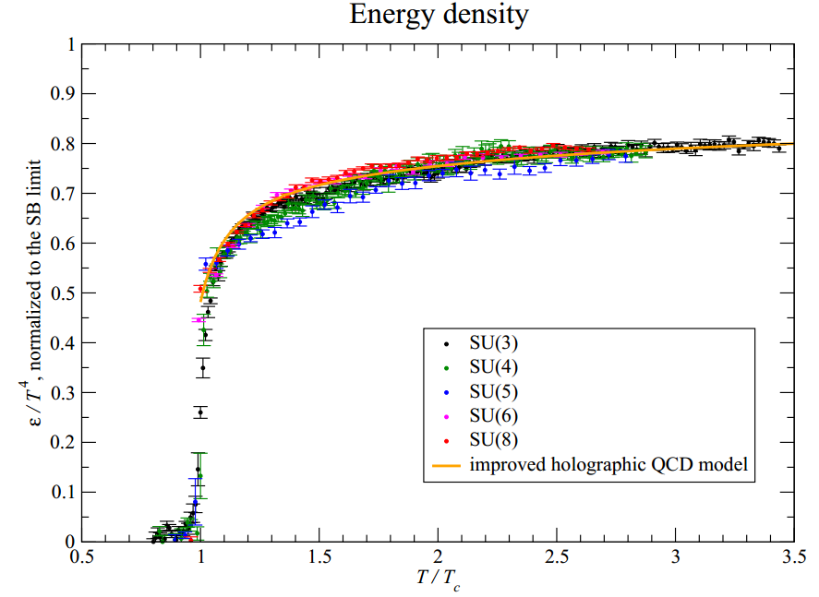
Are we cheating with =4 SYM?
SU(N): 3 ≈ ?
  Good for thermal
SUSY?
  Supressed with temperature
Quarks?
  Replaced by (dominant) gluons
Infinite coupling strength?
  But coupling runs only logarithmically…
So maybe not too bad; and with room for improvement ☺
M. Panero, Thermodynamics of the QCD plasma and the large-N limit (2009)
Notes:
Note ihQCD: is possible to change from N=4 SYM

Slide 4
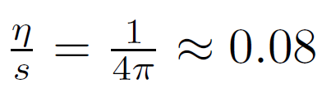
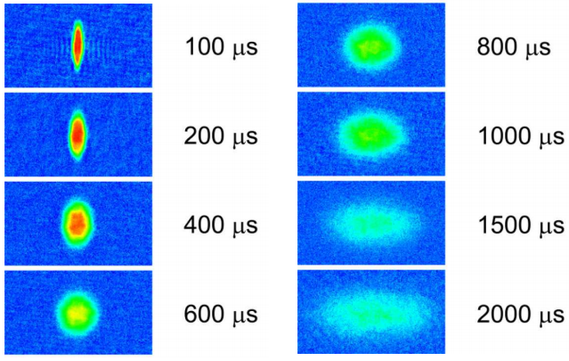
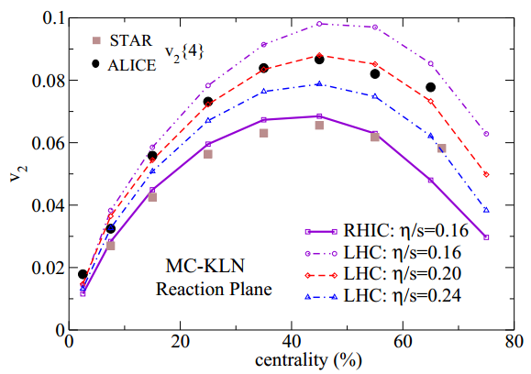
The most perfect liquid?
Wilke van der Schee, Utrecht
Famous viscosity:
Fermions at unitarity Quark-gluon plasma
K. O'Hara, S. Hemmer, M. Gehm, S. Granade and J. Thomas, Observation of a Strongly-Interacting Degenerate Fermi Gas of Atoms, 2002
U. Heinz, C. Shen and H. Song, The Viscosity of Quark-Gluon Plasma at RHIC and the LHC, 2011

Slide 5
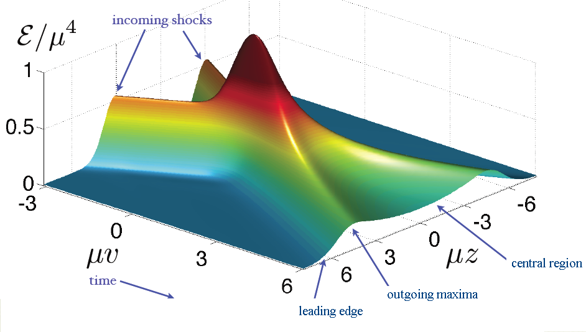
Shock waves – initial conditions
Wilke van der Schee, Utrecht
Famous example:
Homogeneous in transverse plane (‘infinite nucleus’)
Energy density moving at speed of light: initial conditions fixed
  Two scales: width + total energy
Only gravity: dominant force at high energy
Extra AdS direction
P.M. Chesler and L.G. Yaffe, Holography and colliding gravitational shock waves in asymptotically AdS₅ spacetime (2010)

Slide 6
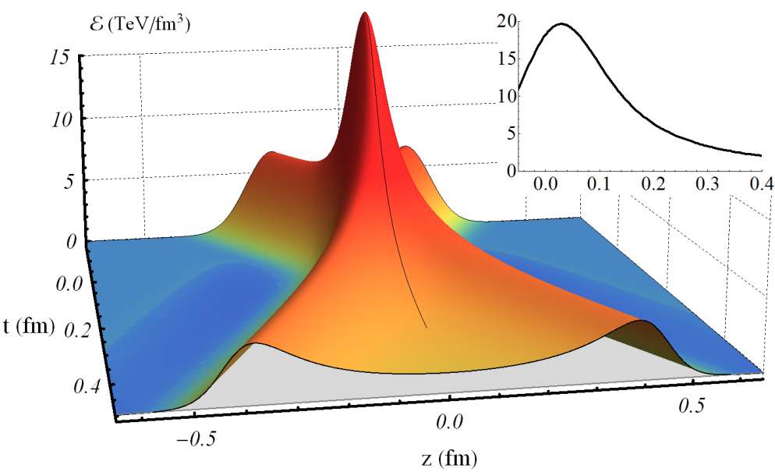
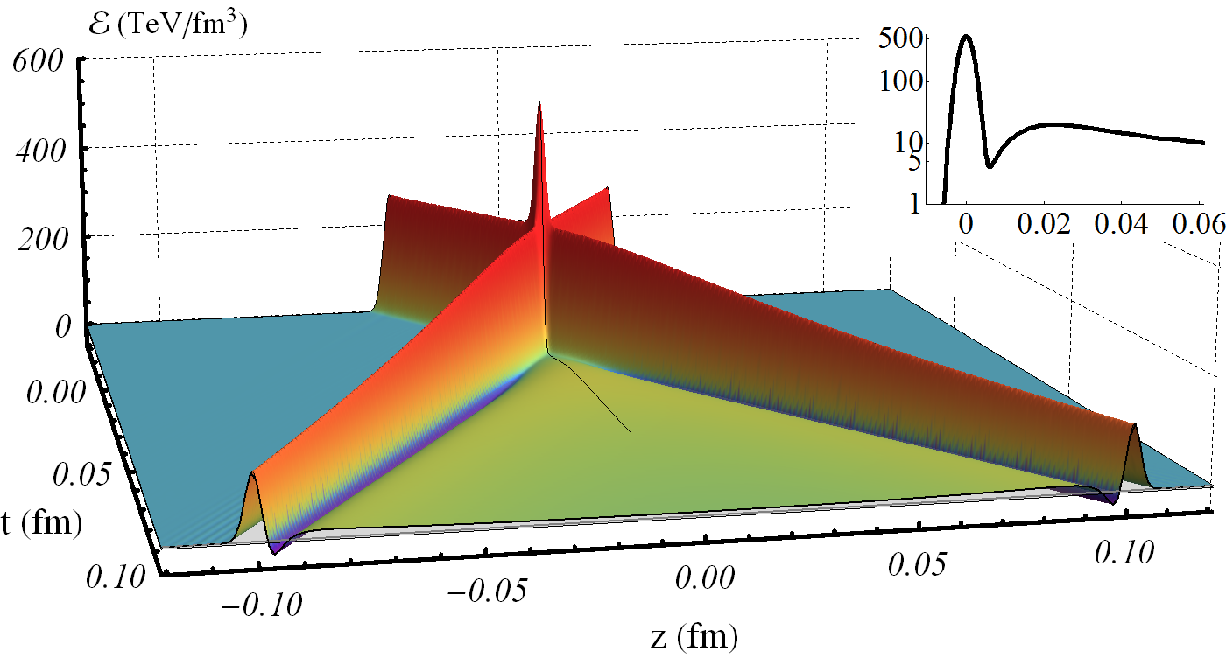
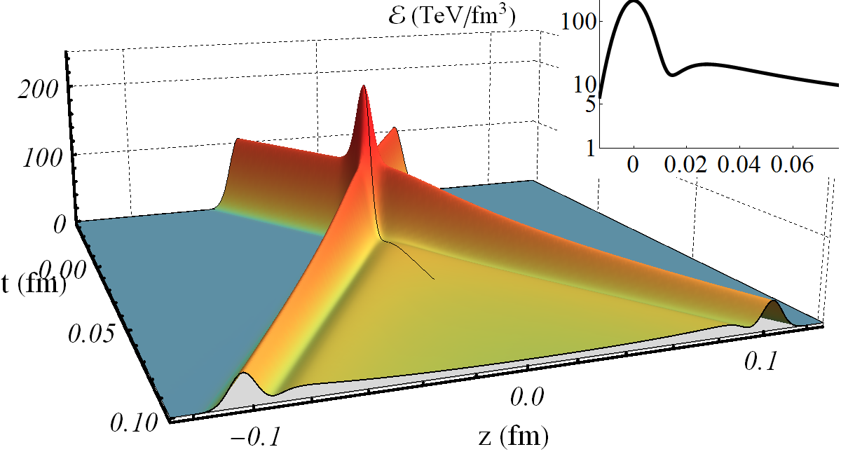
Shock waves – varying the width
Wilke van der Schee, Utrecht

Slide 7
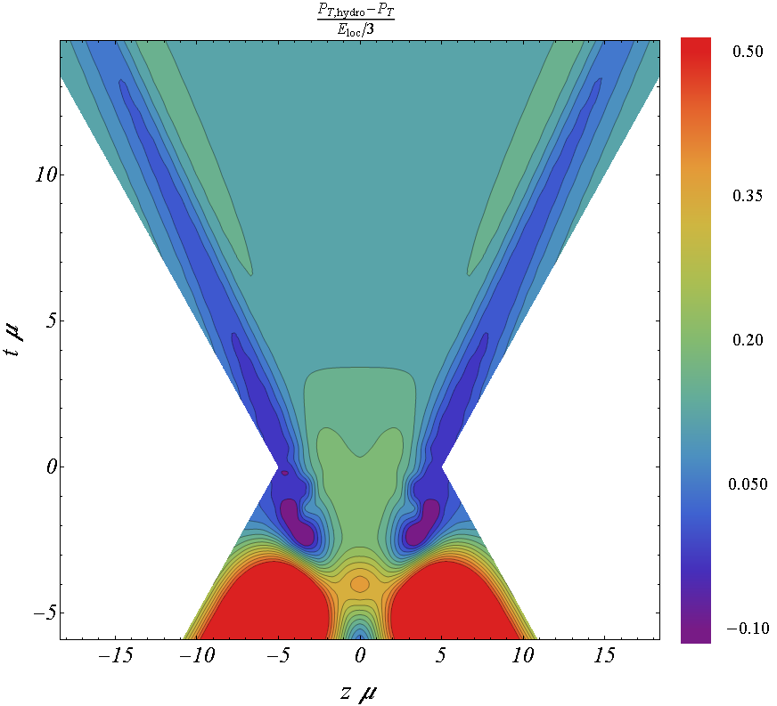
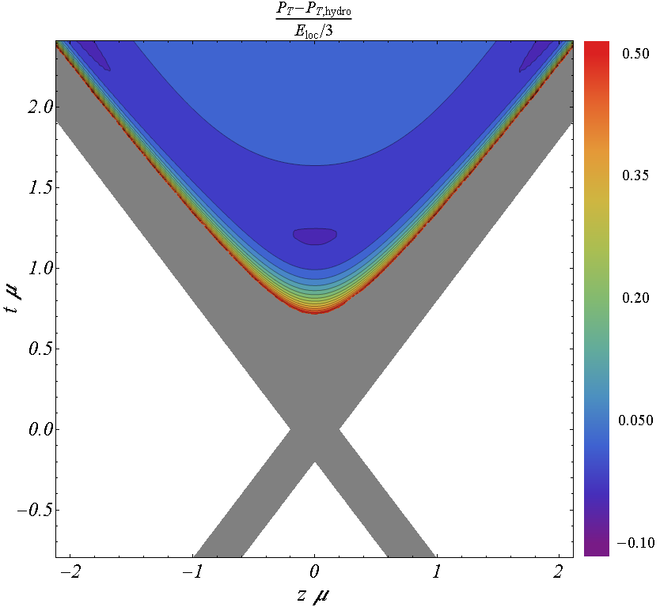
A dynamical cross-over
Low energy:
  Stopping, piling up of energy
  Expansion by hydro
  Compressed Landau model
RHIC energy
  Landau model
High energy:
  no stopping
  plasma forms slowly
  negative energy

Slide 8
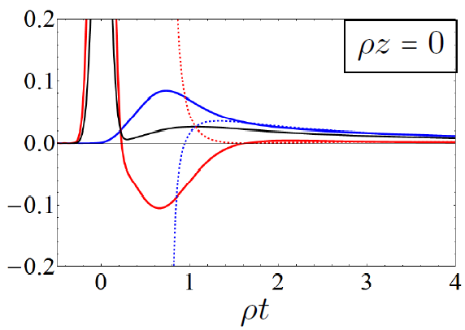
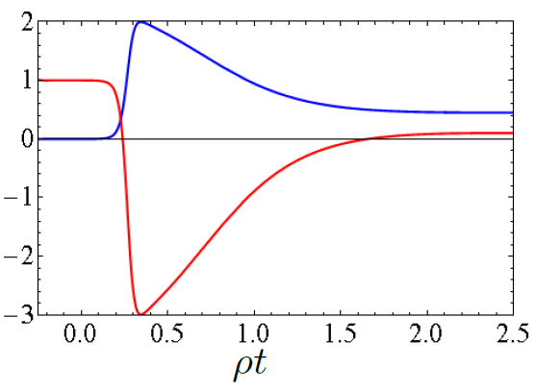
Pressure anisotropy
Pressure & energy starts at zero, grows
Can give large negative longitudinal pressure:

Slide 9
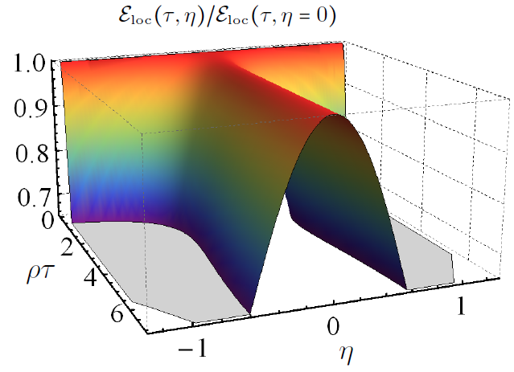
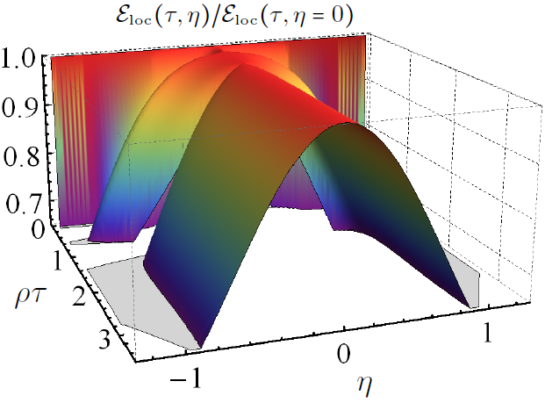
Shock waves – boost-invariance
Wilke van der Schee, Utrecht
No boost-invariance
  Profile approx gaussian with slightly increasing width
Low energy:
High energy:

Slide 10
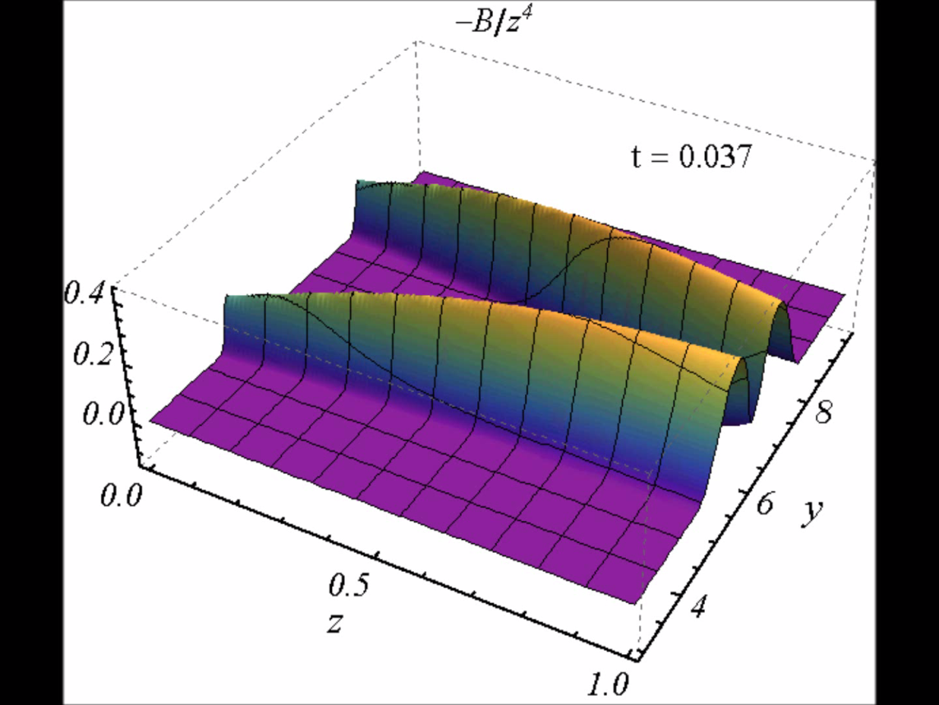
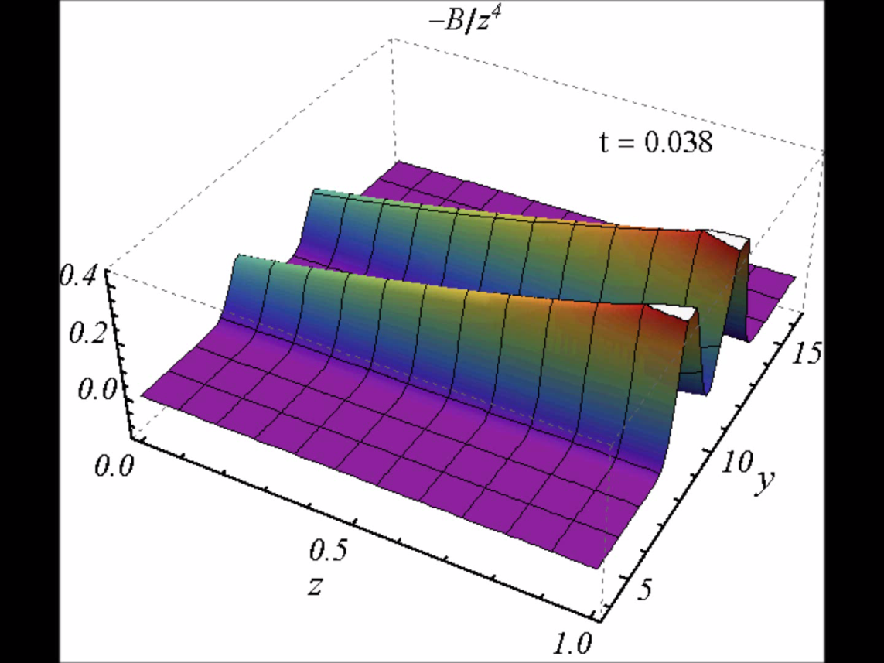
Dynamics in AdS – in movies
Intuition: compare scales 1/Temperature and width
  Perhaps pancake at RHIC is not so thin?

Slide 11
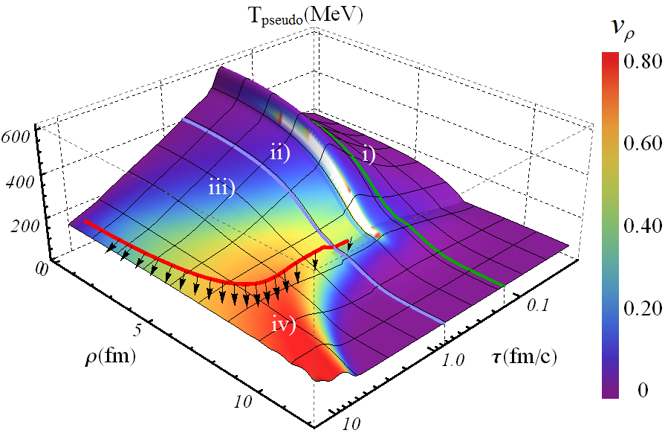
A fully dynamical model of a HIC
Work with Paul Romatschke and Scott Pratt
i) Small time expansion of colliding shocks (central)
ii) Numerical GR (extra parameter)
iii) Viscous hydro
iv) Hadronic
cascade
Boost-invariant
P. Romatschke and D. Grumiller, On the collision of two shock waves in AdS₅ (2008)
WS, Holographic thermalization with radial flow (2012)

Slide 12
Radial flow – initial conditions
Wilke van der Schee, Utrecht
Spectra ☺

Slide 13
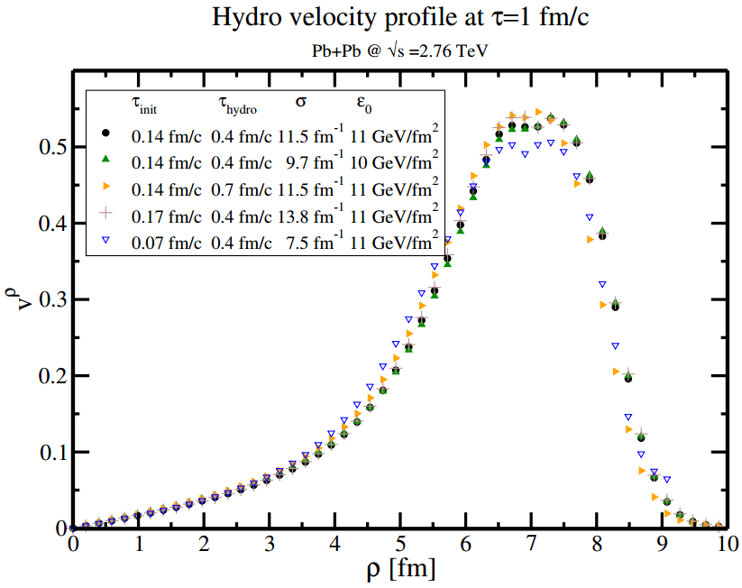
Results – approach to hydro
Fixing total multiplicity, velocity @ 1 fm/c:
Velocity profile approx universal; little depedence on initial AdS time, extra AdS parameter

Slide 14
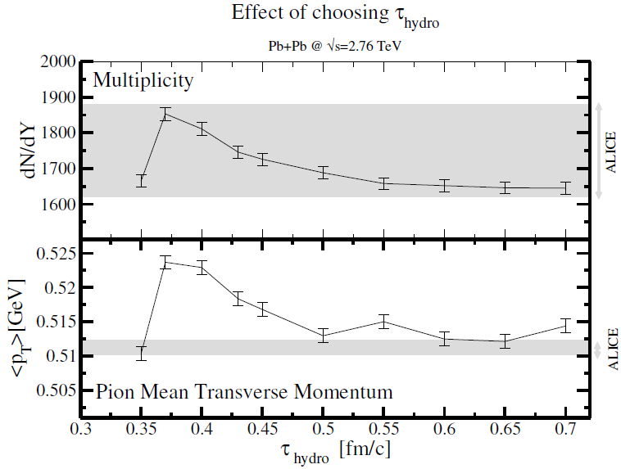
Results – approach to hydro
Not too early: far-from-equilibrium
  Rest frame does not even exist!
Not too late: AdS = conformal  QCD
  In practice: 15% discontinuity in pressure

Slide 15
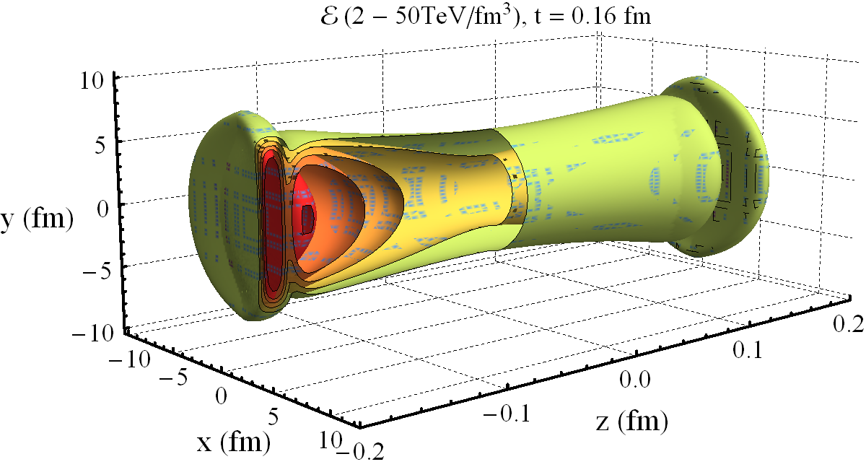
Prospects: a combination
Need hydro, freeze-out etc..

Slide 16
Discussion
Speculative
Wilke van der Schee, Utrecht
Disclaimer
  Modeling at infinite N and infinite coupling, at all scales
  Colliding ‘blobs of plasma’ = nuclei?
  Shock waves: Strong coupling ≠ full stopping
  Working hypothesis: shocks provide good model for HIC
Lessons towards experiments
  Pre-flow can be produced dynamically
  Perhaps higher temperatures (1.8 TeV/fm³ @ t=0.25 fm?)
  Perhaps faster thermalisation (0.25/T~0.25/GeV~0.05 fm)
  Energy density grows initially?
Curious: shocks give Landau model precisely at RHIC!
Notes:
Future: obvious

Slide 17
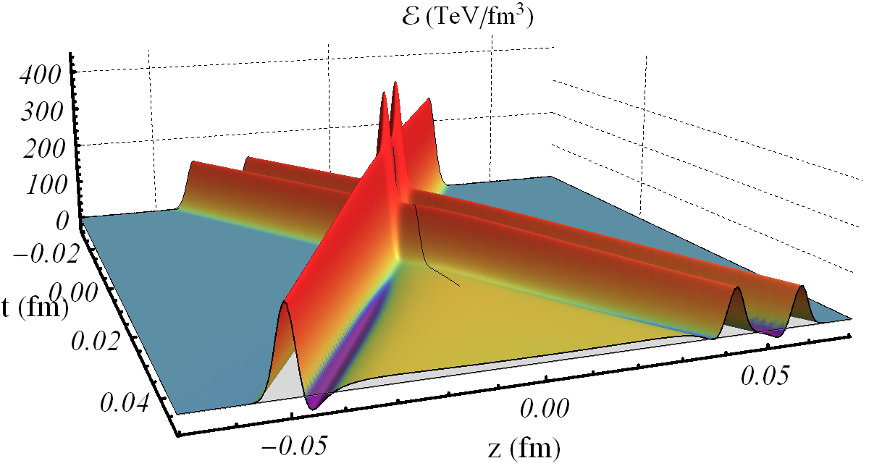
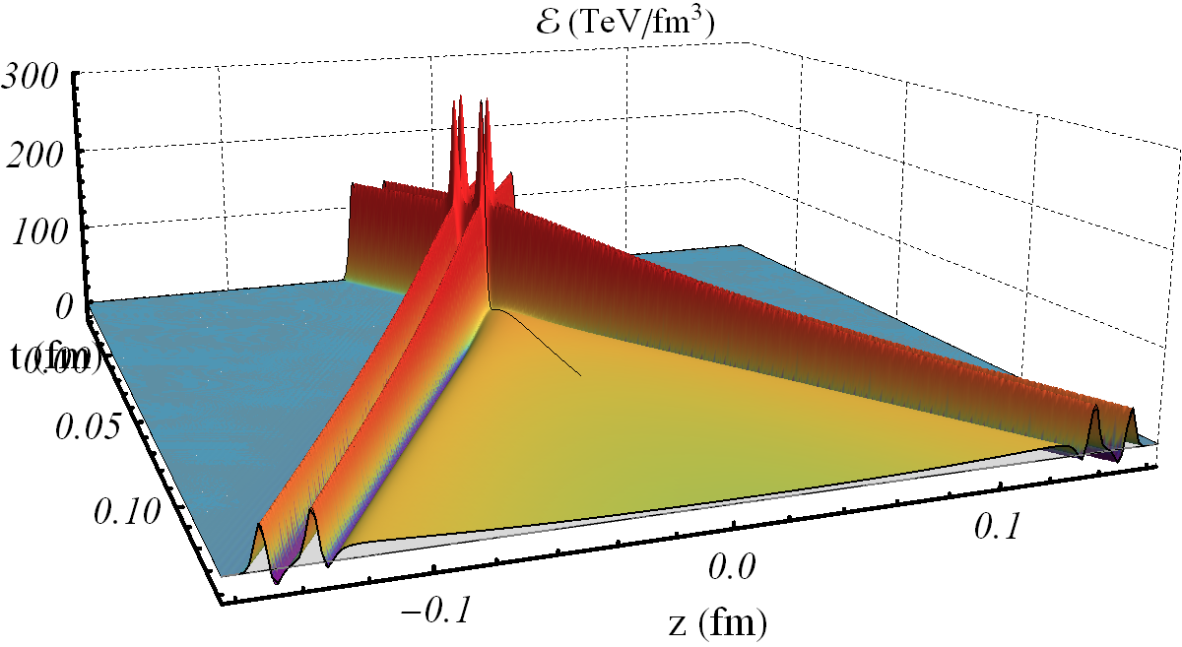
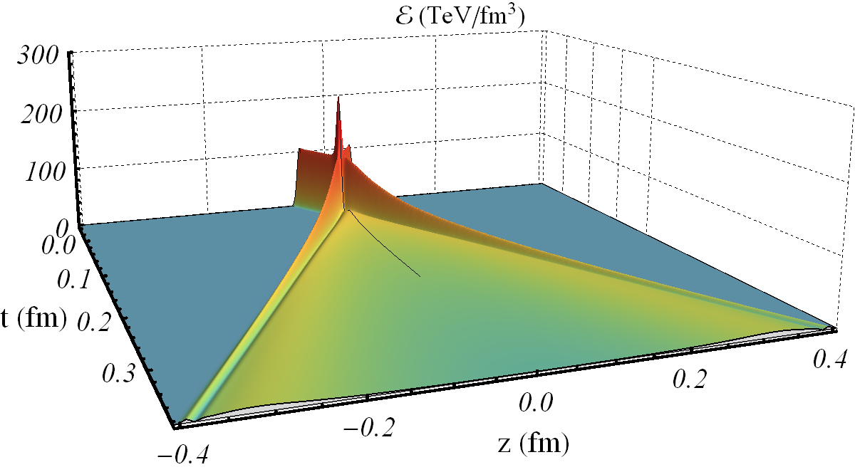
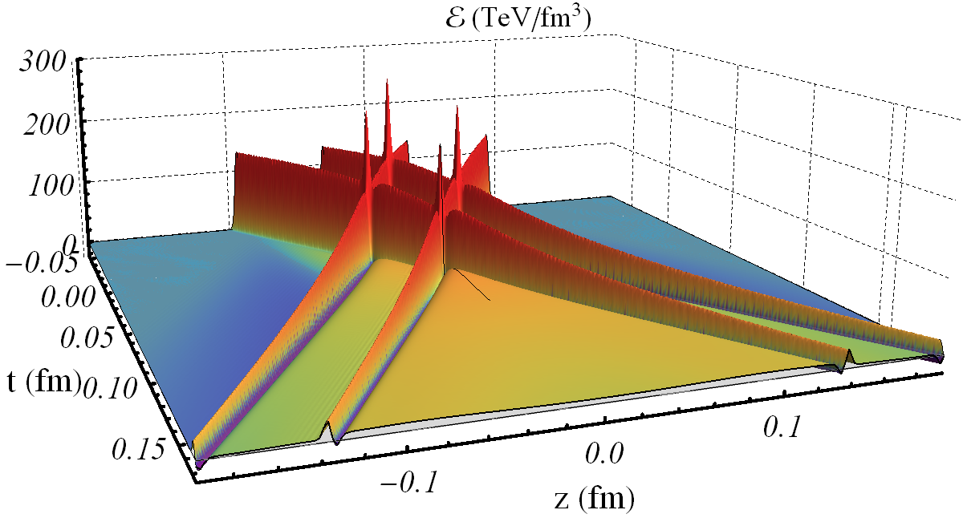
Prospects: microstructure, p-Pb, longer runs
More shocks ☺

Slide 18

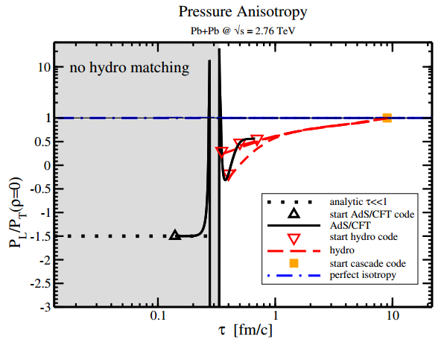
More anisotropy
Boost-invariance with 0 initial energy:
Anisotropy P_{L}/P_{T} in radial flow:

