Slide 1
System-II Update
12/03/2013
Tomoko Muranaka

Slide 2
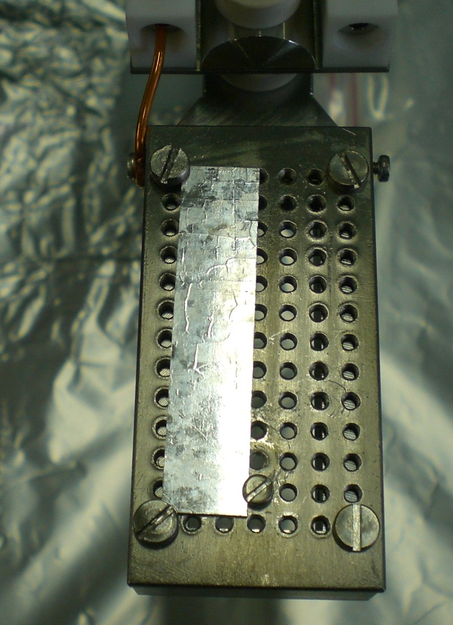
Iridium Sample
Provided by Vladimir Vogel, DESY (presented 19/04/2012, HG2012, KEK)
One of possible materials for the 20K cold RF-photo Gun.
Crystal structure: FCC
Melting point: 2739K
Work function: 5.27eV

Slide 3
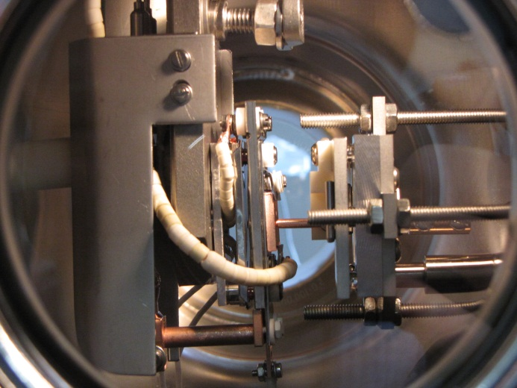
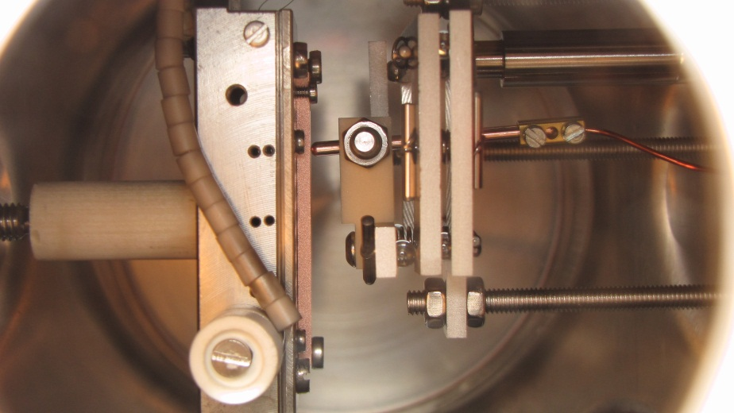
System setup
Cathode holder: conventional one w/o temperature control
Anode: step-motor (Capacitance measurement system can be tested)
Tip is mounted on the holder with
longer “nose” to be close enough to the cathode.
(the position of the L-plates for the old cathode
holder and T-control holder are different)
All devices have been re-cabled.
Four test run have been done. (Two FE
Runs up to 6kV, two others up to 10kV).
No FE, BD has been measured.
Devices should be checked one by one.

Slide 4
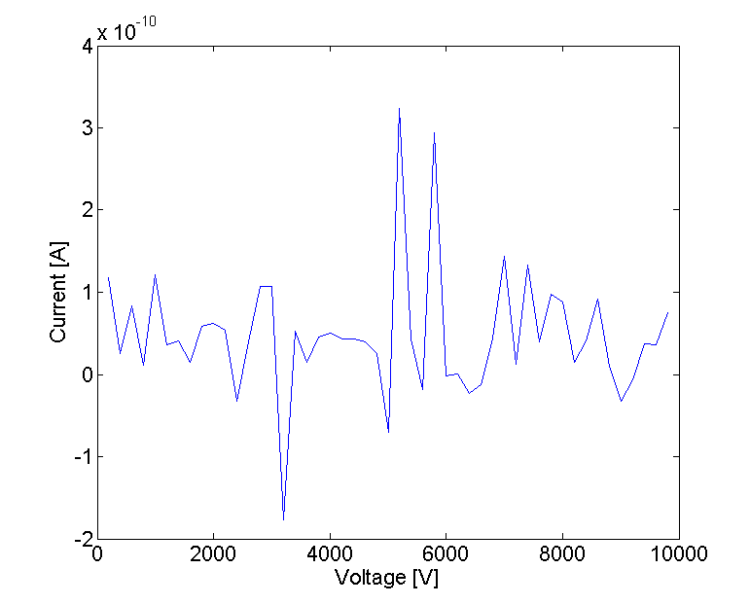
FE measurement

Slide 5
FYI
Two filaments and a ceramic kit (nuts, insulation rods, etc) has been delivered.
Two AlN plates have been made by CERN central workshop. Need to be cleaned and annealed.
LN2 supply tubes have been installed. Users should pass the Cryogenic safety training L1.
Faya Wang is going to ship his “pins” to us. Tip holder modification is required.

Slide 6
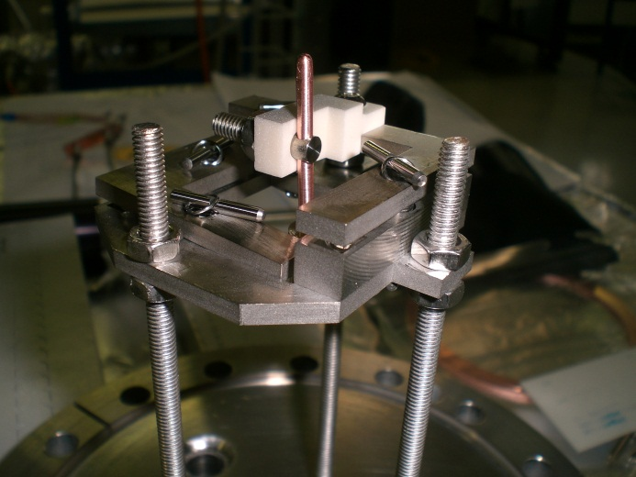
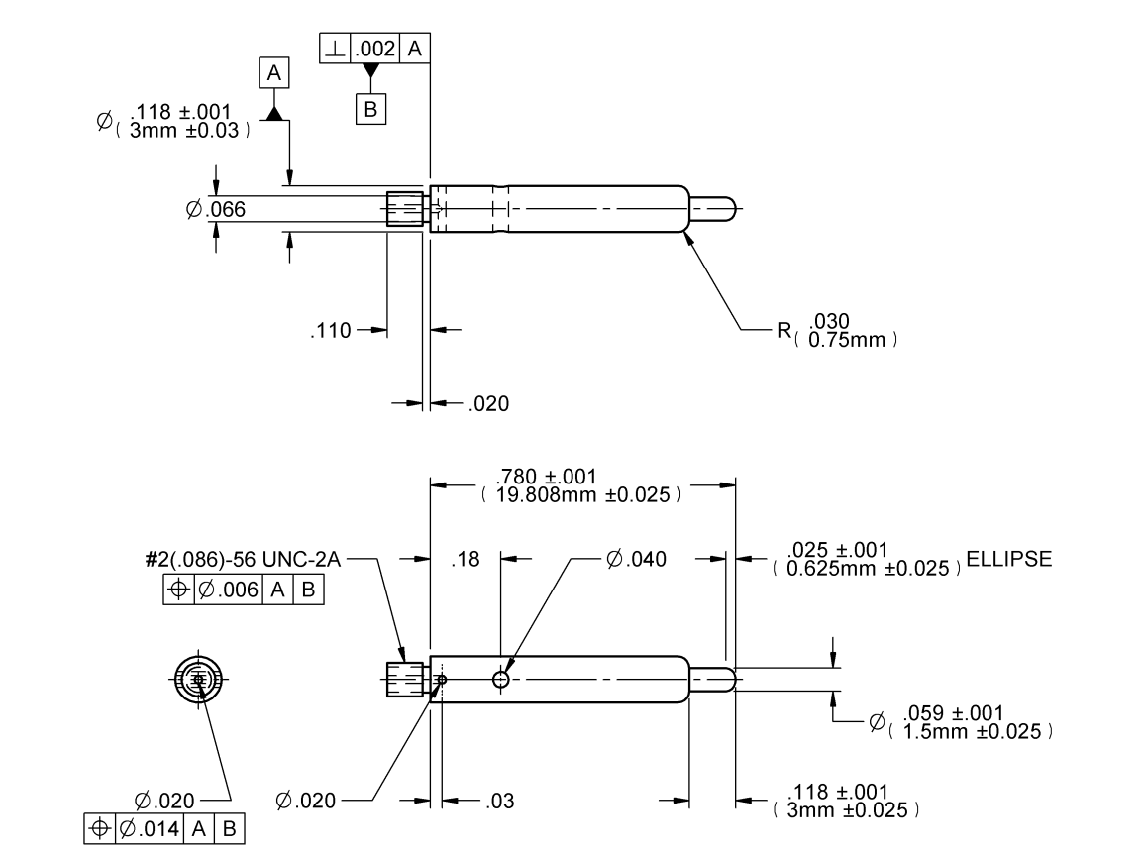
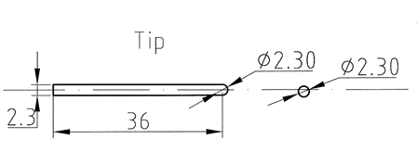
Tip holder modification
Ceramic holder
+
Screw
HV supply
Faya’s pin
Our tip

Slide 7
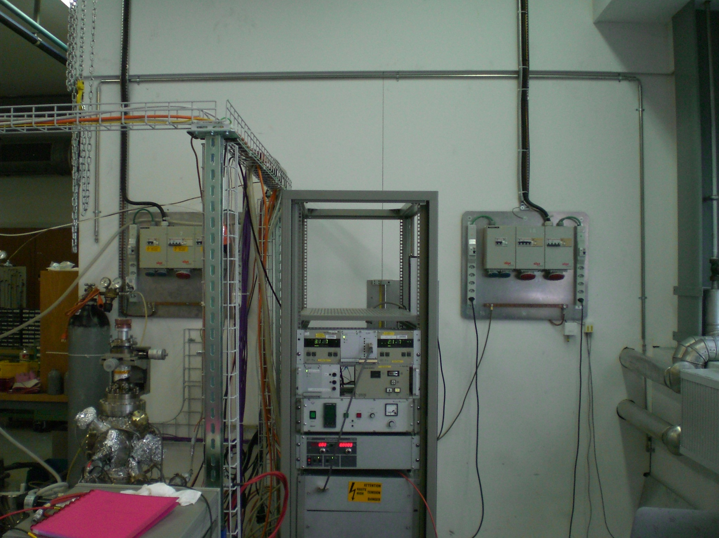
LN2 supply lign

