Slide 1



Stefano Profumo
University of California, Santa Cruz
Santa Cruz Institute for Particle Physics
Searching for Dark Matter from the Sky
Cosmic Rays, Gamma Rays, and the Hunt for Dark Matter
41st SLAC Summer Institute
April 25, 2013

Slide 2
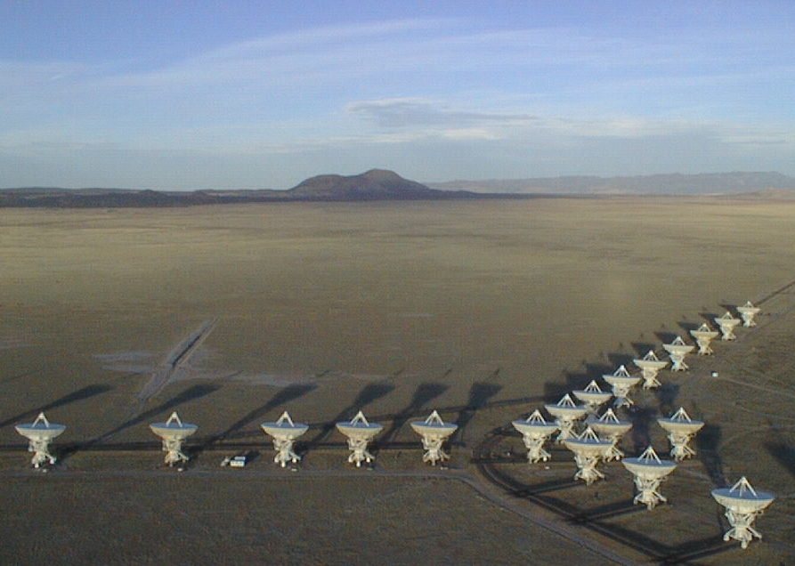

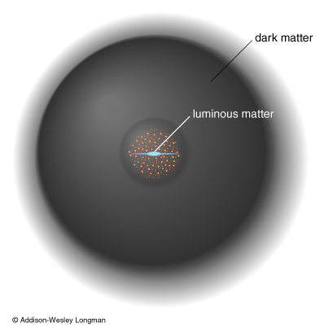
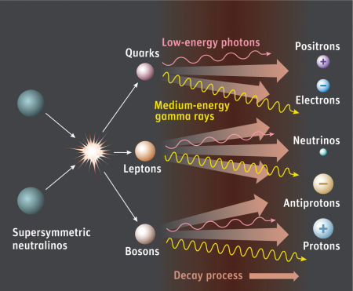

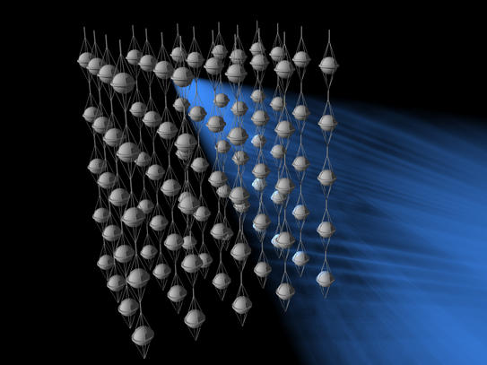
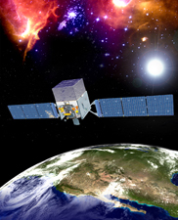



“Indirect” Dark Matter Detection
Can we do fundamental physics
with indirect DM detection?
Radio
Synchrotron
Inverse Compton
HE Neutrinos
X-ray
Neutrinos
Gamma Ray
Gamma Rays
Antimatter

Slide 3
“Indirect” Dark Matter Detection
Can we do fundamental physics
with indirect DM detection?

Slide 4
“Indirect” Dark Matter Detection
Can we do fundamental physics
with cosmic-ray/gamma-ray data?
Notes:
this is a particular aspect of a broader question:

Slide 5
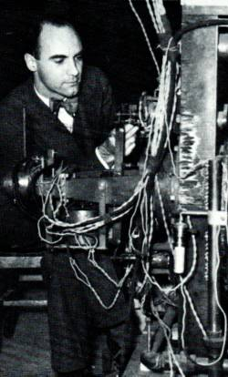
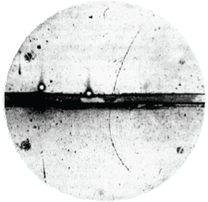
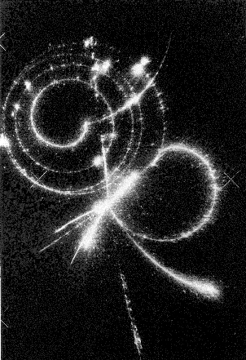
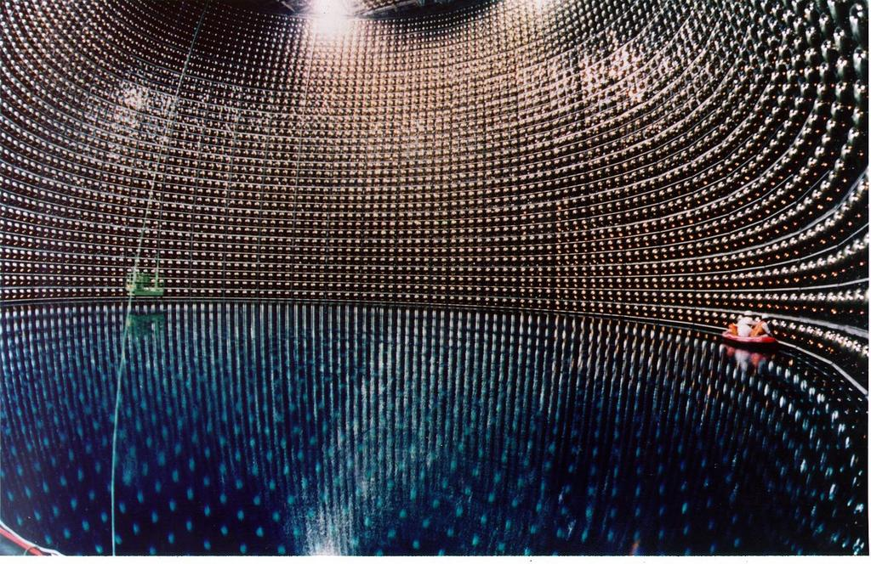
Antimatter
(positron, Anderson, 1932)
“Second Generation
(muon, Anderson, 1936)
Pions (“Yukawa” particles)
(Lattes, Powell and
“Beppo” Occhialini)
Neutrino Masses

Slide 6
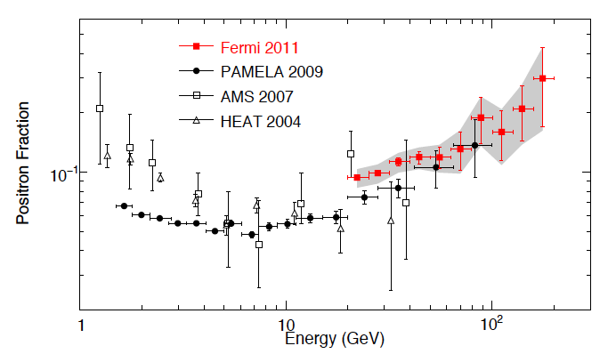
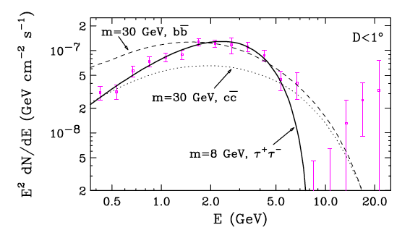
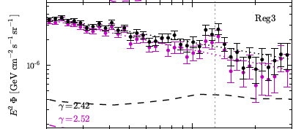
3 tantalizing results might start delivering
fundamental physics from the sky
Cosmic-Ray
Positron Excess
Gamma-ray excess in
the Galactic Center?
A 130 GeV line
Notes:
over the last 2-3 years, the field of high-energy astro-particle physics has witntessed 3 tantalizing results that might be connected to new physics

Slide 7
Cosmic-Ray Positron Excess

Slide 8
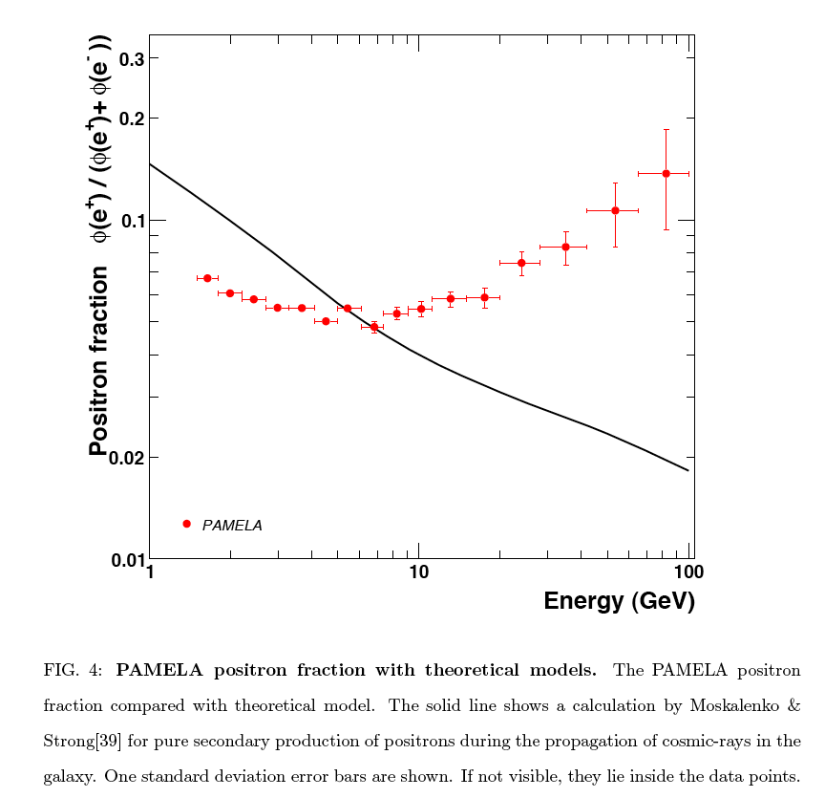
Theory Prediction*
Adriani et al, Nature 458 (2009) 607, arXiv 0810.4995
*I.V. Moskalenko and A.W. Strong Astrophys. J. 493, 694-707 (1998).
Notes:
In the Fall of 2008 the italian-russian Collaboration PAMELA presented this result

Slide 9
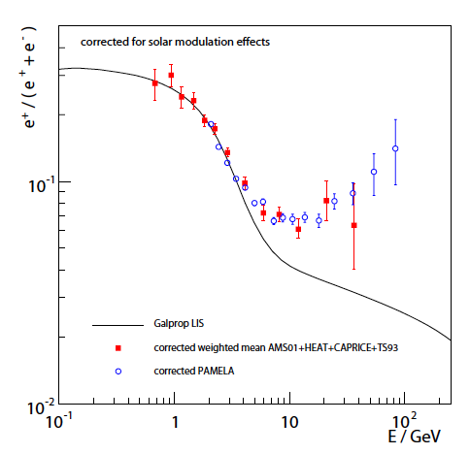
Low-Energy: correct for
(charge-dependent)
solar modulation
22 years full cycle (max every 11 years, with polarity reversal)
previous data: solar polarity favored positively charged
particles, opposite for PAMELA
Gast & Schael, ICRC Conference, Lodz, 2009
Notes:
the low energy “deficit” is not an issue: once corrected for charge-dependent solar modulation the PAMELA results agree with theory and with other experiments, that took data during an opposite polarity period of the Sun’s cycle

Slide 10
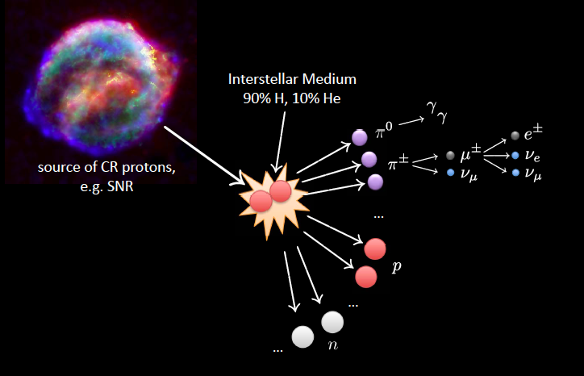
Cosmic Ray Secondary-to-Primary ratio
High-energy protons diffuse
before producing secondaries
Diffusion “softens” the proton spectrum;
secondaries inherit a softer spectrum
sources of Cosmic Ray
protons and electrons,
e.g. SNR
~ any cosmic ray model predicts
a declining slope for high-energy
secondary-to-primary ratios
image credit: Philip Mertsch

Slide 11
is the positron excess real?

Slide 12
Experimentalists get ignored if they are right,
and hugely cited if they are wrong.
Theorists get ignored if they are wrong,
but a Nobel Prize if they are right.*
Superluminal Neutrinos @ OPERA:
>200 theory papers
* quoted from the Guardian

Slide 13
How does Fermi tells e⁺ apart from e⁻?
Fermi-LAT Collaboration, 1109.0521

Slide 14
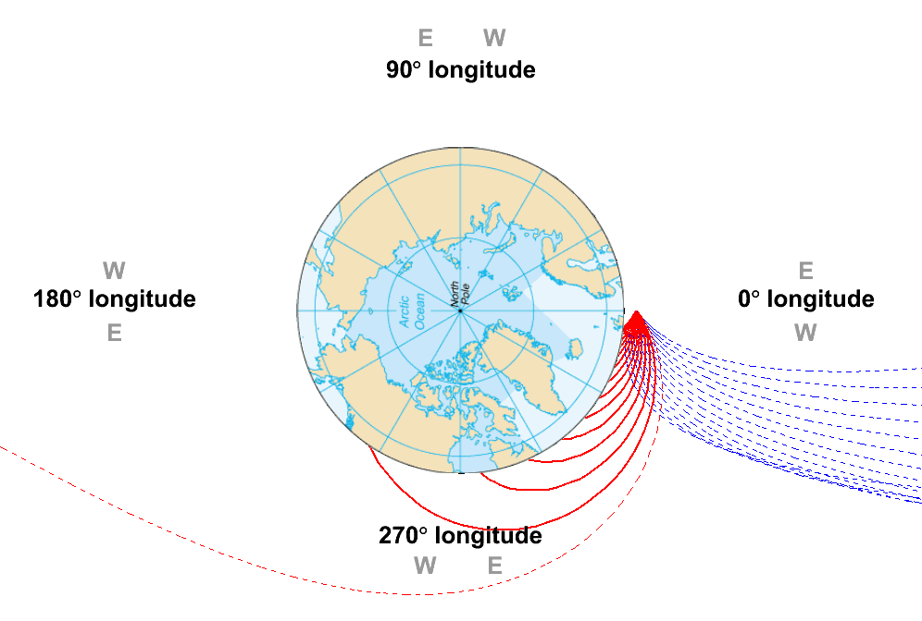
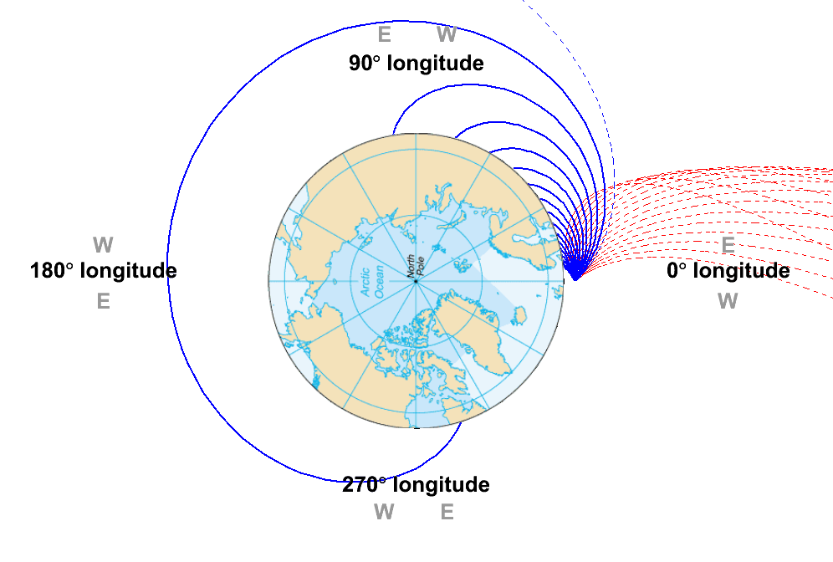
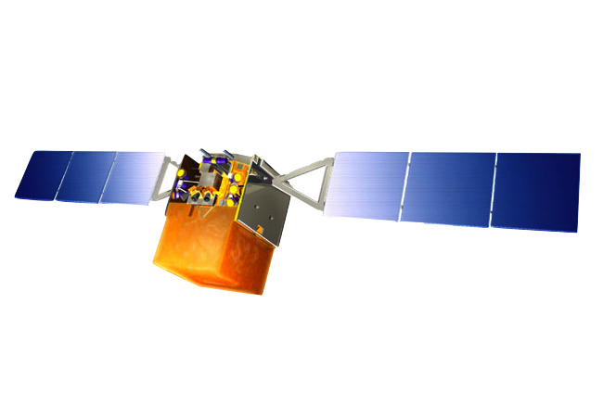
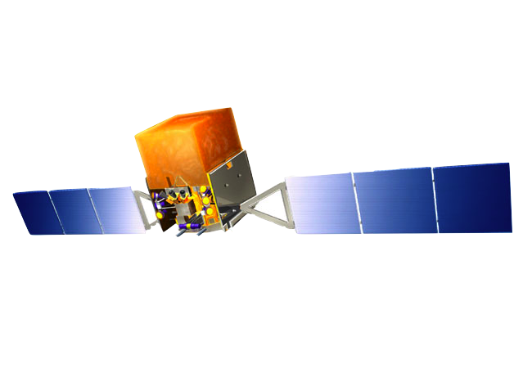
Geomagnetic field + solid Earth shadow = directions from which only electrons or only positrons are allowed
e⁻ blocked while e⁺ allowed from West
e⁺ blocked while e⁻ allowed from East
For particular directions, electrons or positrons are completely forbidden
Pure e⁺ region looking West and pure e⁻ region looking East
Regions vary with particle energy and spacecraft position

Slide 15


Slide 16

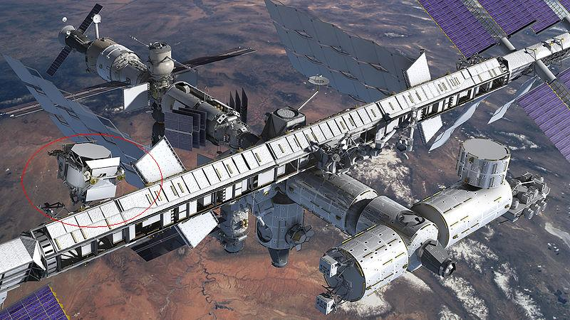
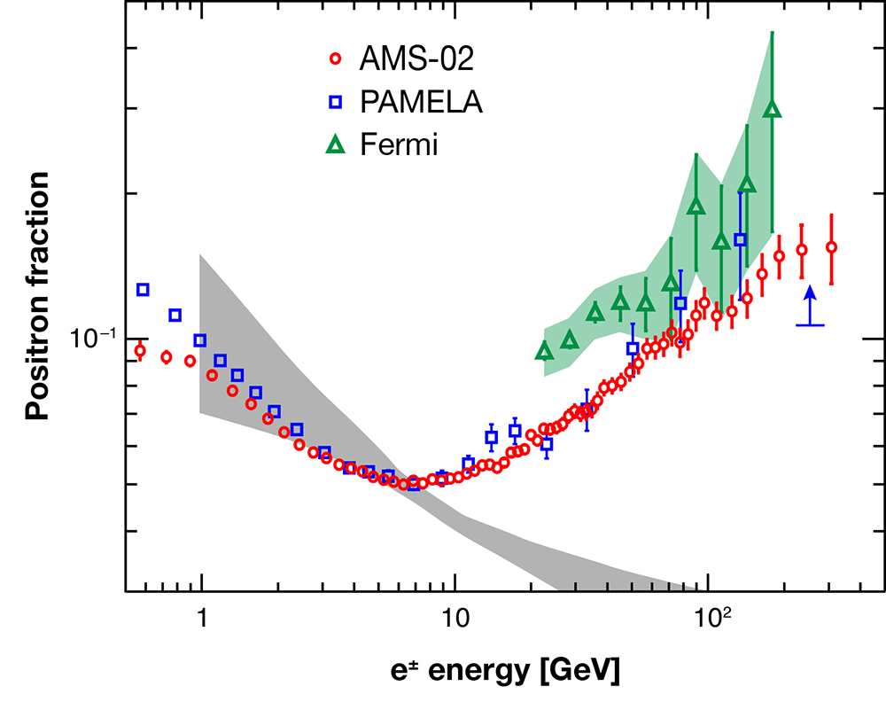
April 3, 2013
AMS-02 first results confirm
positron excess with very high statistics (x100)
PRL, 110 (2013) 14

Slide 17
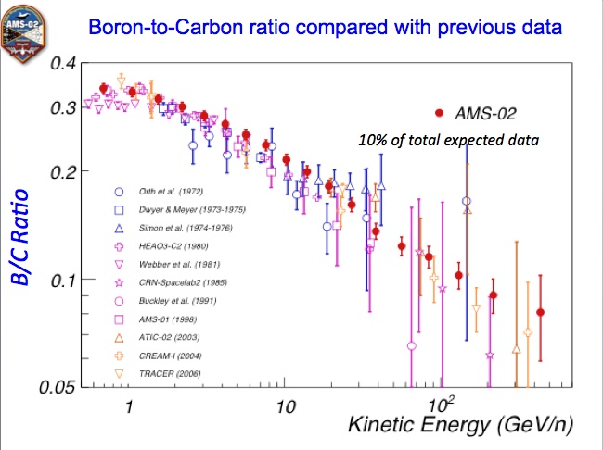
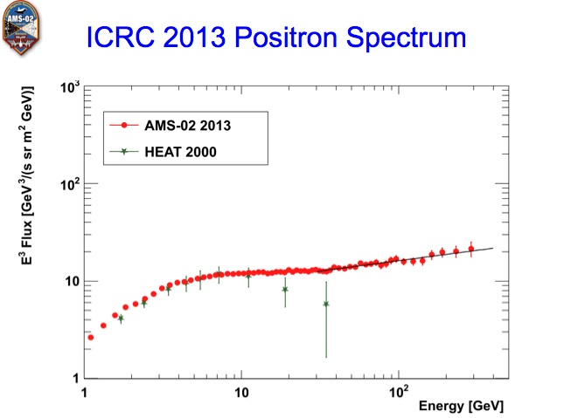
July 8, 2013
Very recently: results on other cosmic-ray species
and detailed, separate positron and electron spectra
PRL, 110 (2013) 14

Slide 18
…better take seriously
the excess of HE positrons
Can we determine the source?

Slide 19
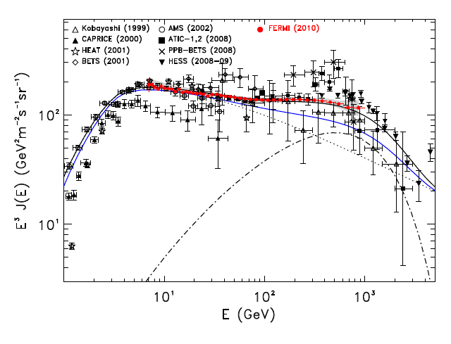
key piece of the puzzle:
the Denominator (e⁺ + e⁻)
Galactic Cosmic Ray
acceleration should
produce a power-law
e+e- injection spectrum
with a high-energy cutoff
Fermi/HESS data compatible
with an additional
high-energy source
Fermi-LAT Collaboration, Phys Rev D 82 (2010) 092004, arXiv:1008.3999
Notes:
a key piece of the puzzle is the total electron plus positron spectrum, which was accurately measured by both Fermi and ground based telescopes
this spectrum, which should naively follow a simple power-law, also exhibits an interesting structure in the 100 GeV to a TeV range

Slide 20
Solution: postulate additional source
of (high-energy) electrons and positrons:
What is the nature of this
new powerful electron-positron source??

Slide 21
Exciting!
It could be New Physics:
Dark Matter Annihilation!
Image Credit: NASA/GLAST collaboration

Slide 22
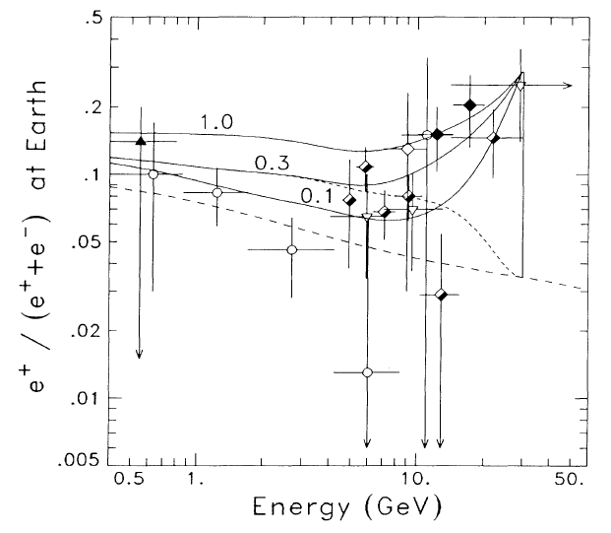
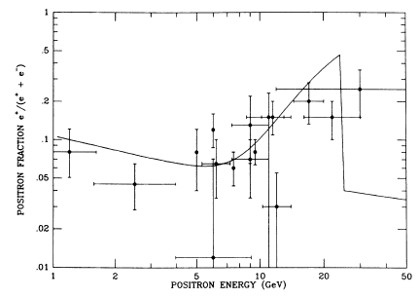
Exciting!
It could be New Physics:
Dark Matter Annihilation!
Dark Matter
particle mass
M. Turner and F. Wilczek,
Phys Rev. D 42 (1990) 1001.
A. Tylka, Phys. Rev. Lett.
63, 840-843 (1989)

Slide 23
Exciting!
It could be New Physics:
Dark Matter Annihilation!
…or it could not…

Slide 24
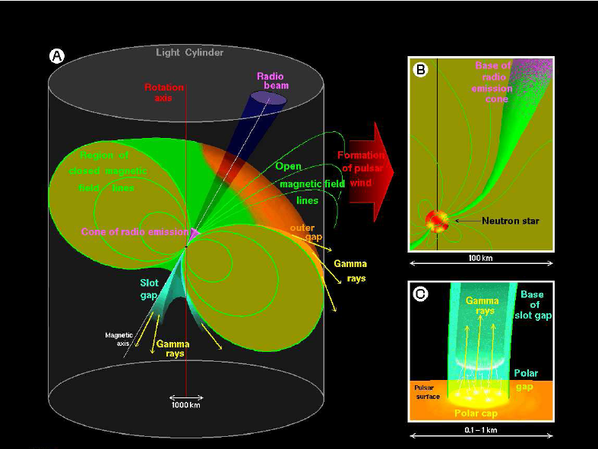
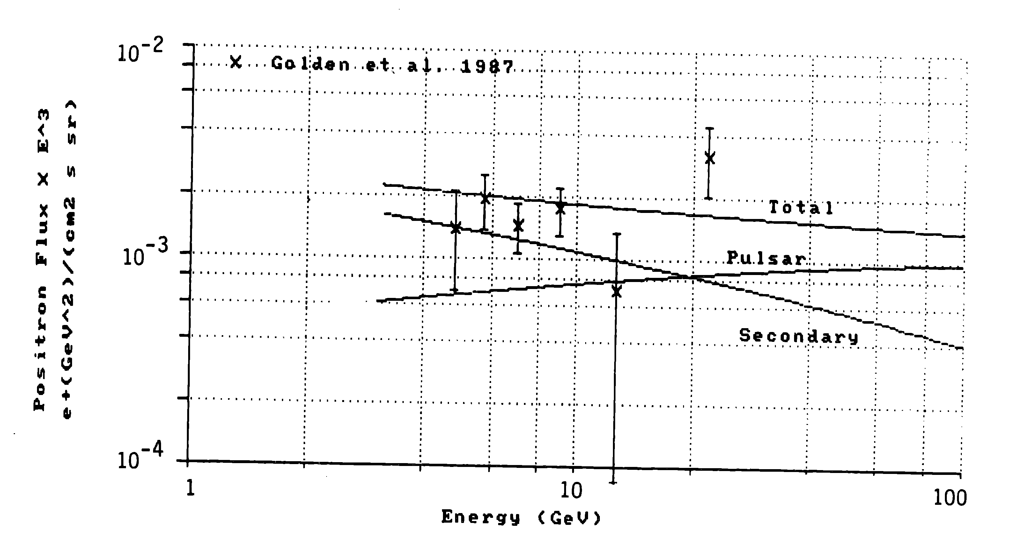
Pulsar Magnetosphere
Rotation-powered Neutron Stars radiate
energy by producing e+e- pairs,
injected in ISM when out of
Pulsar Wind Nebula
Harding, A. K. & Ramaty, R. The pulsar contribution to galactic cosmic-ray positrons. Proc. 20th ICRC, Moscow 2, 92-95 (1987).

Slide 25
~ 900/1000 papers advocate Dark Matter
…despite some obvious and significant issues:
Need very large annihilation rates
(<σv> ~ 10²-10³ x 10⁻²⁶ cm³/s)
Need rather large masses (~TeV)
Need special annihilation or decay modes
(suppress antiprotons + have a hard spectrum)
e.g.: μ⁺μ⁻, or 4μ (even worse post-AMS: ππ)
interesting riddle to test a theorist’s creativity!

Slide 26
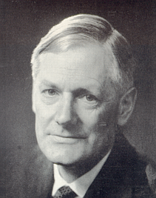
Redman’s Theorem
“Any competent theoretician
can fit any given theory
to any given set of facts” ^{(*)}
(*) Quoted in M. Longair’s
“High Energy Astrophysics”, sec 2.5.1
“The psychology of astronomers
and astrophysicists”
Roderick O. Redman
(b. 1905, d. 1975)
Professor of Astronomy
at Cambridge University

Slide 27
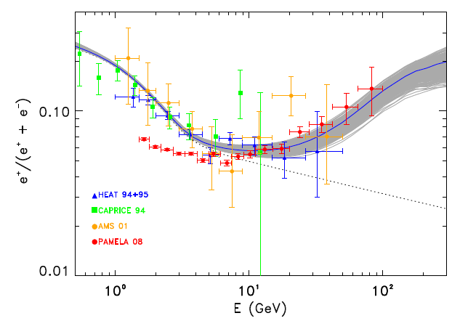

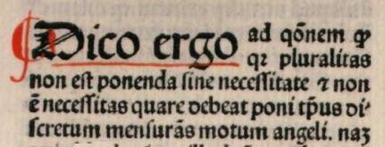
“Dissecting Pamela with Occam's Razor:
existing, well-known Pulsars naturally account for the
"anomalous" Cosmic-Ray Electron and Positron Data”*
*Profumo, 0812.4457

Slide 28
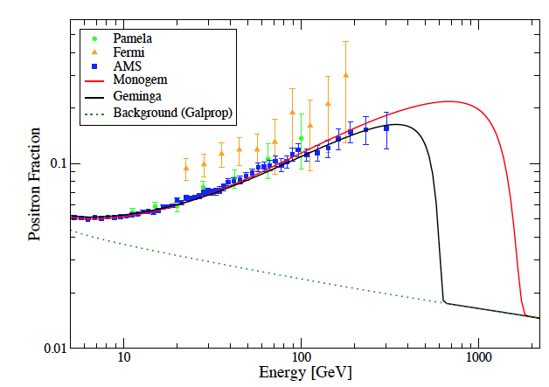
…Pulsars
Post AMS
Distance and Age from observation (set the cutoff)
Normalization: 1-10% spin-down luminosity
Injection Spectrum: ~ E⁻² (Fermi 1st order)
Linden and Profumo, 1304.1791

Slide 29
can we discriminate between
dark matter and pulsars?

Slide 30
Anisotropy in the
arrival direction
(sufficient, not necessary)
Nearby Pulsar
Diffuse
secondary
component
Dark Matter

Slide 31
Diffuse
secondary
component
Dark Matter

Slide 32
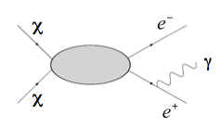
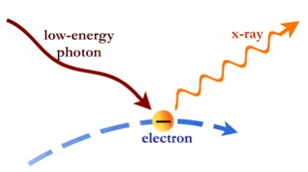
Dark Matter: a “Universal” Phenomenology
Large annihilation rates
Large masses
Hard charged leptons
Final State Radiation
Inverse Compton

Slide 33
Gamma-Ray Searches from Galaxy Clusters
Jeltema, Profumo & Fermi-LAT Collaboration, JCAP 2010, arXiv: 1001.4531

Slide 34
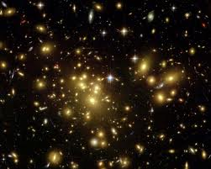
Gamma-Ray Searches from Galaxy Clusters
…ruled out!
no substructure
galaxies only
AMS
(best fit)
AMS
No cutoff
Fermi
Jeltema, Profumo & Fermi-LAT Collaboration, JCAP 2010, arXiv: 1001.4531

Slide 35
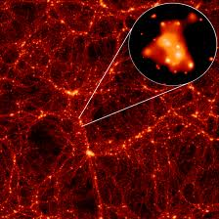
Gamma-Ray Searches from Galaxy Clusters
no substructure
galaxies only
AMS
(best fit)
substructure
with M > 10⁻⁶ M_{Sun}
Additional constraints from CMB,
extragalactic gamma-ray background
Jeltema, Profumo & Fermi-LAT Collaboration, JCAP 2010, arXiv: 1001.4531

Slide 36
Anisotropy in the
arrival direction
(sufficient, not necessary)
Nearby Pulsar

Slide 37
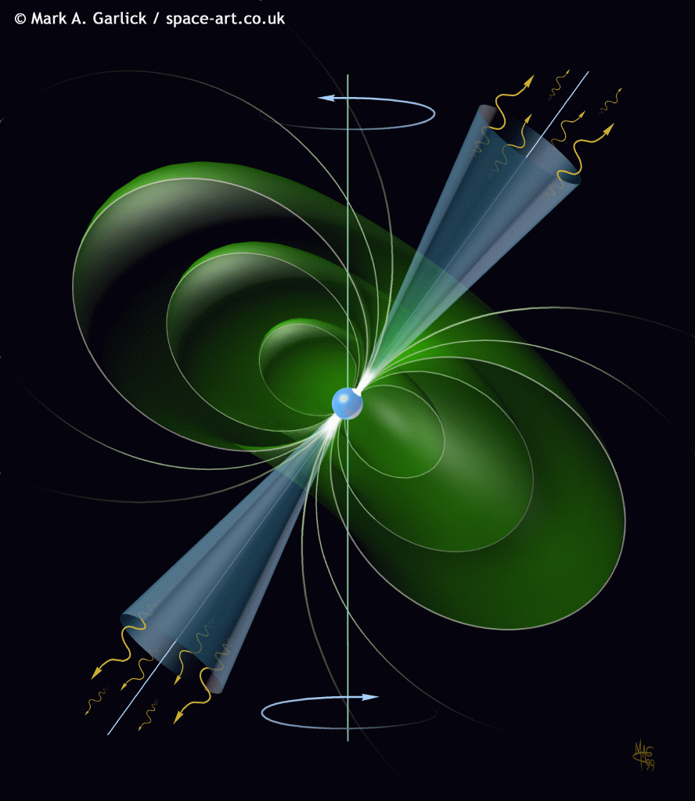
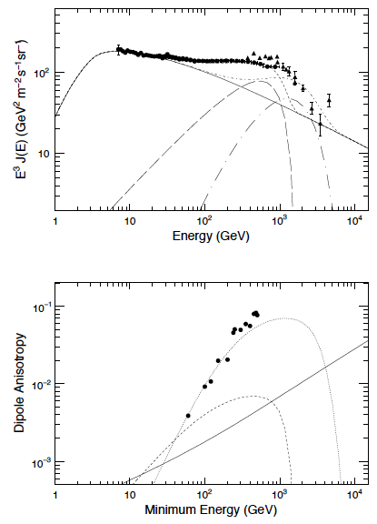
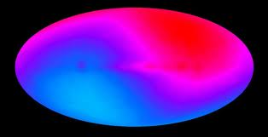
Pulsars
Monogem
Vela
Excluded
by AMS data
Excluded
by Fermi data
No Anisotropy observed
in the Fermi e⁺e⁻ data,
or in the AMS data
Vela
Pulsar interpretation
entirely consistent
with all data!!
Monogem
Fermi-LAT Collaboration, PRD, 1008.5119
AMS-02 Collaboration, PRL, 110, 141102

Slide 38
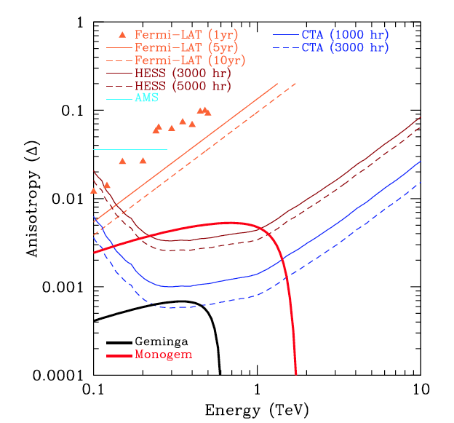
Way forward: Cherenkov Telescopes
sensitive to predicted anisotropies at VHE!
Linden and Profumo, Astroph. J (2013) 1304.1791

Slide 39
we are closing in on the
dark matter interpretation
AMS-02 positron fraction data
“favor” PSR’s over dark matter
Conclusive argument against
dark matter: anisotropy (ACTs!)

Slide 40
Dark Matter annihilation
in the Galactic Center?

Slide 41
the problem with the Galactic Center:
“under-fitting” versus “over-fitting”
Dark Matter annihilation
in the Galactic Center?

Slide 42
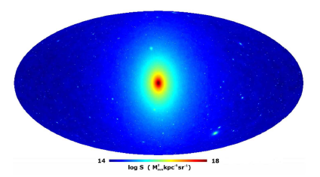
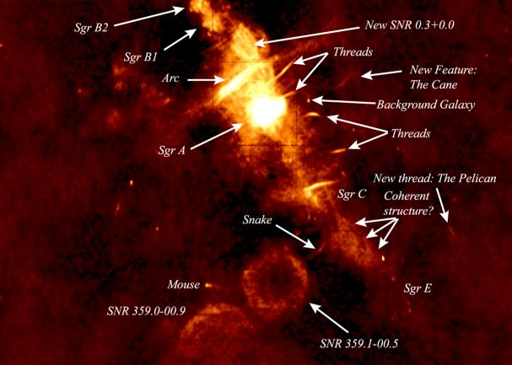
The Galactic Center Region:
a Holy Grail or a Hornet’s Nest?
Largest (known) Galactic
Dark Matter Density
There appears to be an
excess of soft gamma rays
Largest Cosmic Ray Density
Largest Gas and Radiation Densities
Largest concentration of
Galactic Gamma Ray sources
Springel et al, 2009
Kassim et al, 1999

Slide 43
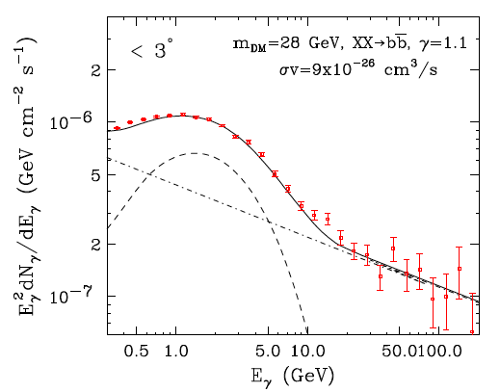
Background
Dark Matter particle
Oct. 2009
Exponential angular fall-off
Power-law spectrum
28 GeV, bb quark
Goodenough, Hooper

Slide 44
Background
Dark Matter particle
Oct. 2009
Exponential angular fall-off
Power-law spectrum
28 GeV, bb quark
Goodenough, Hooper
Oct. 2010
r ^{-1.55} fall-off
Spectrum: extracted
from >2deg region
8 GeV, τ ⁺τ ⁻
Hooper, Goodenough

Slide 45
the danger of background “under-fitting”:
may end up with a “Goodenough Hooperon”
Notes:
apologies for the intended pun

Slide 46
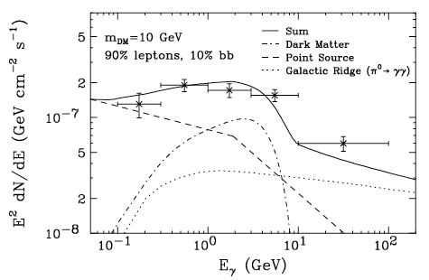
Background
Dark Matter particle
Oct. 2009
Exponential angular fall-off
Power-law spectrum
28 GeV, bb quark
Goodenough, Hooper
Oct. 2010
r^{-1.55} fall-off
Spectrum: extracted
from >2deg region
8 GeV, τ ⁺τ ⁻
Hooper, Goodenough
Several recent studies confirmed
the 2011 Linden-Hooper excess
(Abazijian and Kaplinghat, 2012;
Hooper and Slatyer 2013)
~10 GeV,
⁺τ – or bb,
or generic
diffuse excess
Oct. 2011
Angular distrib: gas maps
Spectrum from: π⁰ decay
plus point-source
Linden, Hooper
Very intriguing mass range
(see CDMS+CoGeNT ~ 10 GeV mass WIMPs)

Slide 47
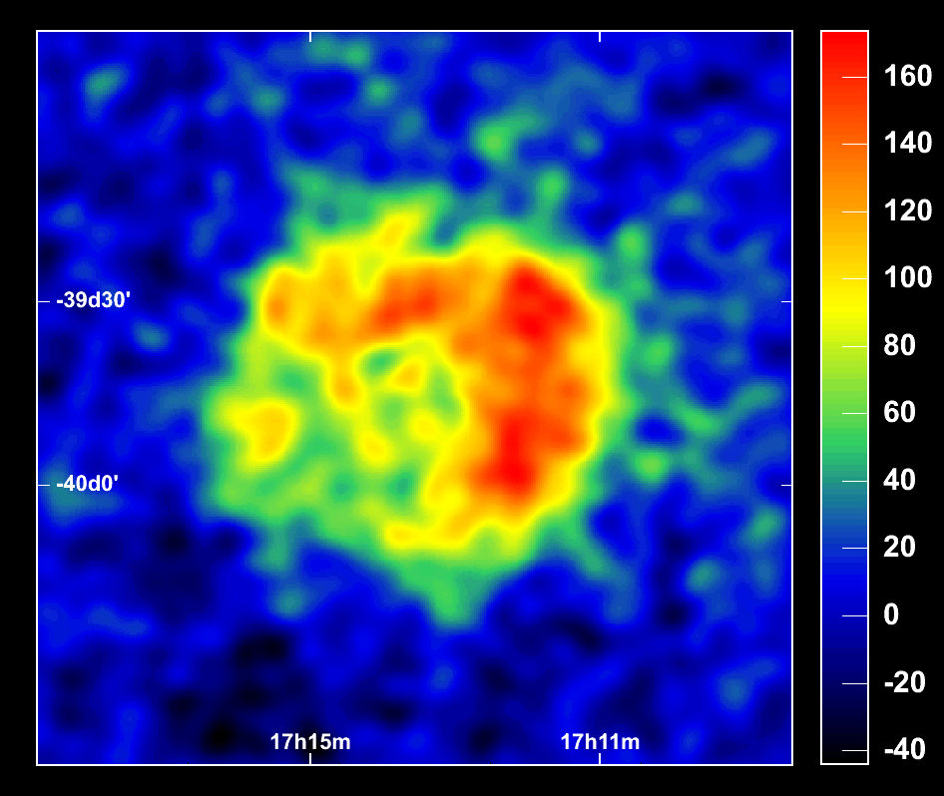
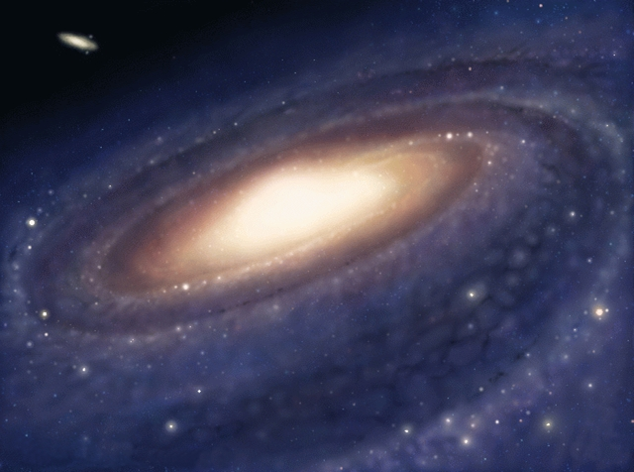
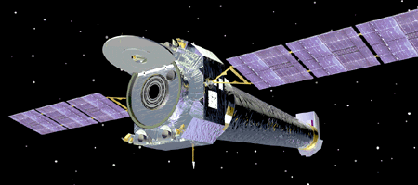
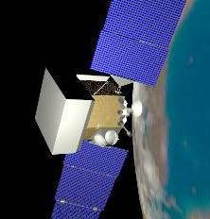
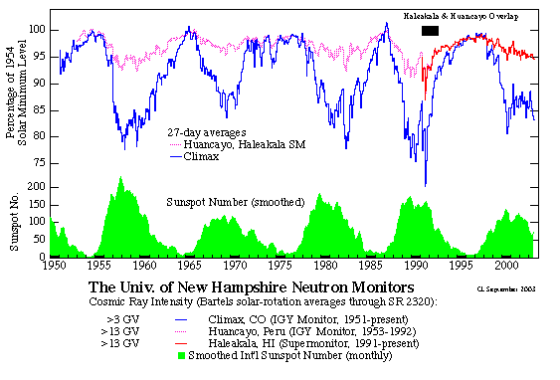
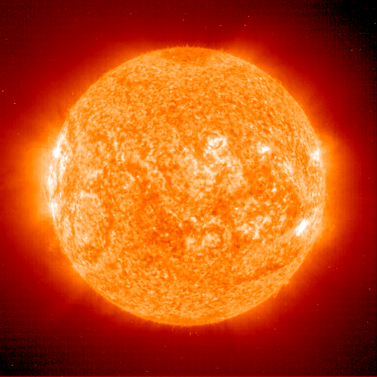




“Over-fitting”
SNR RX J1713-3946
ISM
X,γ
+
synchrotron
-
e
Chandra
B
HESS Preliminary
ISRF
IC
P
He
CNO
diffusion
energy losses
reacceleration
convection
etc.
PSF
Fine-tune the model
Gobble up any signal!
bremss
gas
+
π
-
0
e
+
-
Fermi-LAT
π
gas
_
+
-
π
P
p
Flux
LiBeB
+
He
CNO
-
e
20 GeV/n
BESS
CR species:
Only 1 location
modulation
PAMELA
ACE
AMS
helio-modulation
[slide from Igor Moskalenko]

Slide 48
“Over-fitting”
SNR RX J1713-3946
ISM
X,γ
+
synchrotron
-
some diffuse models designed to deal optimally with point sources:
“over-fitting” is welcome in that case!
e
Chandra
B
HESS Preliminary
ISRF
IC
P
He
CNO
diffusion
energy losses
reacceleration
convection
etc.
PSF
bremss
gas
+
π
-
0
e
+
-
Fermi-LAT
π
gas
beware of how any “no-residuals”
conclusion is obtained!
_
+
-
π
P
p
Flux
LiBeB
+
He
CNO
-
e
20 GeV/n
BESS
CR species:
Only 1 location
modulation
PAMELA
ACE
AMS
helio-modulation
[slide from Igor Moskalenko]

Slide 49

One of the elephants in the room: Sgr A*
We know little about cosmic rays in the GC
CR power: ~10⁴¹ erg/s; Sag A* Eddington lum.: >10⁴⁴ erg/s
While very quiet now, Sag A* likely accelerates and has accelerated protons: study the gamma-ray properties
Linden, Lovegrove and SP, 1203.3539 and in prep.

Slide 50


One of the elephants in the room: Sgr A*
If source is hadronic,
GALPROP likely is the wrong tool
Need detailed modeling of gas distribution
Our approach: Monte Carlo
K. Ferrere, 2012; Linden and Profumo, 2012

Slide 51

One of the elephants in the room: Sgr A*
transition between diffusively
trapped behavior and
rectilinear propagation
Linden, Lovegrove and SP, 1203.3539, ApJ 753 (2012) 41

Slide 52
One of the elephants in the room: Sgr A*
Key diagnostic: source morphology
secondary (leptonic) emission
transition between diffusively
trapped behavior and
rectilinear propagation
key diagnostics:
circum-nuclear ring!
Chernyakova et al, 2011; Linden, Lovegrove and SP, 1203.3539, ApJ 753 (2012) 41

Slide 53

Galactic Center: the way forward??
seek a “golden mean” between over-
and under-fitting
detailed cosmic ray and target
density models
data-driven backgrounds
Linden, SP,…, in progress

Slide 54
The Gamma-Ray Line

Slide 55

“Troubling and
Inconclusive”
Steve Ritz
Fermi-LAT Deputy PI
Notes:
Somebody much wiser than me defined the tentative evidence for a 130 GeV Gamma-Ray line as “troubling and inconclusive”
Steve looks very troubled in this picture; he’s probably emailing somebody very important

Slide 56


If confirmed, huge impact on particle physics!
DM particle at rest, so χχ → γγ implies E_{γ}=m_{χ}!
m_{χ} sets the missing energy
scale for collider studies
…and the target mass for
direct detection experiments!

Slide 57

Weniger (1204.2797)
Key novelty: optimized Regions of Interest
Signal: ~(ρ_{DM})²
Noise: (1-20 GeV sky)^{1/2}

Slide 58

(almost) 3σ effect, E_{γ}=130 GeV
look-elsewhere effect accounted for
3σ
2σ
1σ

Slide 59

Two remarks*
ROI’s overlap with
Fermi bubbles: photons
from bubbles are
important background
* Profumo and Linden, “Gamma-Ray Line in the Fermi Data: is it a Bubble?”, JCAP 2012

Slide 60

Two remarks*
ROI’s overlap with
Fermi bubbles: photons
from bubbles are
important background
(2) broken power-law
could be mistaken for
a line - Fermi bubbles
have broken power-law spectrum
* Profumo and Linden, “Gamma-Ray Line in the Fermi Data: is it a Bubble?”, JCAP 2012

Slide 61
could it be an
instrumental effect?
One culprit could be energy reconstruction:
E>130 GeV mis-read as E=130 GeV event!
Instr. effects under investigation by Fermi Collaboration,
including troubling Earth’s Limb feature!
[Pass 8: currently being tested internally/public in ~1yr]
If not instrumental, potentially very interesting
wait for more statistics (so far ~50 photons)!

Slide 62

can we hope for more statistics with
other existing/near future telescopes?
Fermi: A_{eff}xT_{obs} = (1 m²) x 4πx10^{7 x} (1/6) s ~ 2x10⁷ m² s
ACT, with 100h: (10⁵ m²) x 100x60x60 s ~ 3x10¹⁰ m² s
e.g., HESS: promising,
but A_{eff} rapidly declining
in energy region of interest
Figure credit: Benow, for HESS collaboration

Slide 63


CTA: superior energy resolution,
angular resolution, energy threshold
and effective area
130 GeV
Cherenkov Telescopes will be key
for further studies of the line

Slide 64

Astrophysical backgrounds?
Always keep Occam in mind!
Klein-Nishina regime: almost all energy
transferred from e to γ → E_{e}~ 130 GeV
Need~ mono-chromatic electrons and
target photons with ω₀ >> m_{e}²/E_{e} ~ 2 eV
Both OK with electron pulsar wind
Aharonian et al, 2012; image credit: NASA

Slide 65

This is not a POST-diction!
Bogovalov and Aharonian, 2000

Slide 66

Energetics works out fine!
130 GeV line luminosity ~ 3x10³⁵ erg/s
Crab luminosity in shock-acc. e⁺e⁻ ~ 3x10³⁸ erg/s
[spin-down luminosity~ 5x10³⁸ erg/s ]
efficiency to produce gamma rays??
Aharonian et al, Nature 2012

Slide 67
Many open questions…
how many point sources are needed?
if more than one astrophysical source is needed,
do we expect 130 GeV to be a special universal value?

Slide 68

Applied a clustering algorithm (DBSCAN) and
demonstrated one needs at least 5 pulsars (@90%CL)
actual data
3 pulsars
simulation
Astrophysical backgrounds are unlikely, given current data!
Carlson, Linden, Profumo and Weniger, 1304.5524 (2013)

Slide 69
130 GeV line “troubling and
inconclusive”, yet exciting!
low statistics, perhaps instrumental,
but unlikely “astrophysical”
look forward to: Fermi’s Pass8 and ACT

Slide 70
A (dark matter) model that does everything?
Positron Excess
mass ~ 1 TeV,
μ⁺μ⁻ (more likely ππ)
Galactic Center
mass ~ 10 GeV,
bb or τ⁺τ⁻
130 GeV line
mass = 130 GeV,
enhance line, no continuum

Slide 71


A model that does everything
Line with right cross section
Suppressed GR continuum
Right Higgs mass
Right Thermal Relic Density
Successful EW Baryogenesis
Strongly first order EWPT
OK with direct detection
OK with SUSY searches
OK with EDM searches
Weniger, 2012; Kozaczuk, Profumo and Wainwright 2013
Notes:
since I AM a competent theorist, by Redman’s theorem I can explain any given set of facts

Slide 72




A model that does everything
Kozaczuk, Profumo and Wainwright, 2013

Slide 73

A model that does everything…
…across all three frontiers!

Slide 74

A model that does everything…
…across all three frontiers!
Higgs
(too much)
Higgs
Death by
EDM
Death by
Direct
Detection
Higgs
Kozaczuk, Profumo and Wainwright, 2013

Slide 75

A model that does everything…
…across all three frontiers!
Tunneling
Direction
in field space
Effective potential at critical temperature
(all NMSSM degrees of freedom included!)
CosmoTransitions
Kozaczuk, Profumo and Wainwright, 2013

Slide 76

Positron excess, Galactic Center excess, “The Line”
Is this all “chasing ambulances”?
“Ambulance chasing OK,
as long as the patient is not dead”
Notes:
I recently became a US citizen, but certain aspects of american culture escaped me until very recently, e.g. the expression “ambulance chasing”
Somebody told me something very wise about ambulance chasing: it’s OK, as long as the patient is not dead

Slide 77

an appropriate adage for
indirect dark matter detection :
“Everything we see
hides another thing,
we always want to see
what is hidden
by what we see”
R. Magritte
The promenades of Euclid
[slide concept: Pasquale Serpico]

Slide 79
…plus, radio-quiet gamma-ray pulsars!
Gendelev, SP and Dormody
JCAP 1002 (2010) 016

Slide 80

Spectral information key, but not sufficient…
Borla-Tridon (MAGIC Coll.) 1110.4008 (ICRC)

Slide 81
Why is this
measurement
important?
(i) For every (50 GeV) cosmic-ray positron,
10 electrons and 10,000 protons!
important confirmation that the extra positrons
measured by Pamela are not mis-ID protons!

Slide 82
Why is this
measurement
important?
(ii) Extends Pamela results
to higher energy, E=200 GeV
consistent spectrum, no turnover
More to come soon
from AMS-02!

Slide 83

One of the elephants in the room: Sgr A*
CTA: ability to discriminate
point source versus diffuse
hadronic emission
CTA key to understand
physics of Galactic Center
at high energies!!
Linden and SP, 1206.4308

Slide 84


A “Cosmic Ray Primer”
Particle scattering on random
MHD waves and discontinuities in the
tangled Galactic magnetic fields
is modeled as a diffusive process
Associated Diffusion Time Scale:

Slide 85

A “Cosmic Ray Primer”
For electrons and positrons,
main energy losses:
Inverse Compton + Synchrotron
Associated Energy-Loss Time Scale:

Slide 86

A “Cosmic Ray Primer”
Diffusion-loss equation then reads (neglecting reacceleration, convection…)
Averaging over diffusive halo – steady-state solution
Sources of Cosmic Rays?
SNR – Fermi acceleration

Slide 87
Energy Spectra
primary electrons
production: E^{-2.2}
propagation: min [τ_{esc}, τ_{loss}]~E^{-0.6}, E⁻¹
ambient: E^{-2.8}, E^{-3.2}
(energy-loss-dominated !!!)
E^{-2.8}
E^{-2.8}
primary protons/nuclei
log Flux
ambient: E^{-2.8}
E^{-3.2}
E^{-2.2}
(diffusion-dominated !!!)
E^{-3.4}
secondary e+e-
production: E^{-2.8}
propagation: min [τ_{loss},τ_{esc}]~E^{-0.6}, E⁻¹
E^{-3.8}
ambient: E^{-3.4}, E^{-3.8}
log E
slide concept: Philip Mertsch

