Slide 1
LS1 schedule status
LHC
K. Foraz

Slide 2
LHC LS1 schedule
Schedule under approval – EDMS 1274997
Detailed schedule on our LS1-LHC sharepoint

Slide 3
LHC LS1 schedule –Important maintenance dates
Demi. water production stopped from mid May to end of July 2013
400kV substation from mid May to end of July 2013
  possible problem between electrical power & end of warm-up
  Electrical maintenance - No access from mid-arc to mid-arc
  P1: from 02/05/13 to 05/05/13 ̶ P2: from 03/03/14 to 07/03/14
  P3: from 14/10/13 to 19/10/13 ̶ P4: from 27/08/13 to 30/08/13
  P5: from 22/03/13 to 25/03/13 ̶ P6: from 09/12/13 to 12/12/13
  P7: from 16/12/13 to 19/12/13 ̶ P8: from 22/04/13 to 25/04/13

Slide 4
General Organization
Weekly meetings on Thursdays morning (30-07-11)
LHC phone = 16 16 69
Access
  General access mode (Except UL55 – t.b. discussed)
  IMPACT is filtering access (Δt = 6 min. max)
  “Piquet” activities will be activated by TI operators / LHC coordination
Visits : no visit authorized except VIPs, Press or professional visits

Slide 5
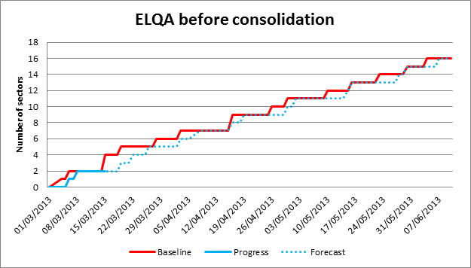
Progress
Hardware commissioning finished
  Few days of delays in the first sectors
ELQA before warm-up
  Finished in sectors 56 and 45
  In progress
  in sectors 23, 67 and 78

Slide 6
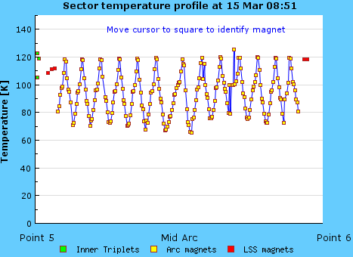
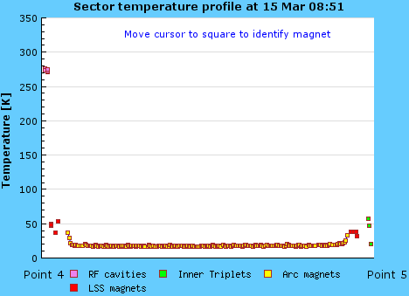
Progress
Warm-up in progress in sectors 56 and 45

Slide 7
Progress
Survey : Fast leveling & Deep reference measurements
Installation of optical fiber’s ducts in pits
RF: Klystrons replacement and ADT
MKD-MKB: overhaul of generators
Beam vacuum in LSS (A5R2, A4L3, A5L5, A5R5, A6R5)
Maintenance, consolidation and new cooling-towers started
Inspection, check and tests of different equipment: collimators, ALPHA, BTVS, ACS, BQS, TCDQ,

Slide 8
Global status in the arcs
 | Powering Tests |  | ELQA Before warm-up |  | Fast leveling |  | Warm-up |  | SMACC Open |  | R2E
 | End |  | End |  |  |  | End |  | Start |  | Start
Sector 12 | 28/02 (+2d) |  | 05/04 (+4d) |  |  |  | 08/05 (+7d) |  | 17/07 (-)
Sector 23 | 28/02 (-) |  | 20/03 (+3d) |  |  |  | 16/05 (-) |  | 07/08 (-)
Sector 34 | 28/02 (-) |  | 16/04 (-) |  |  |  | 16/05 (-) |  | 20/11 (-)
Sector 45 | 22/02 (+1d) |  | 08/03 (+2d) |  |  |  | 05/04 (-) |  | 06/01 (-)
 |  |  |  |  |  |  |  |  |  |  | 13/03 (-) But …
Sector 56 | 22/02 (+2d) |  | 06/03 (+2d) |  |  |  | 03/04 (-) |  | 19/04 (-)
Sector 67 | 25/02 (+2d) |  | 20/03 (+1d) |  |  |  | 19/04 (+1d) |  | 14/05 (-)
 |  |  |  |  |  |  |  |  |  |  | 13/05 (+3d)
Sector 78 | 27/02 (+2d) |  | 21/03 (+4d) |  |  |  | 22/04 (+3d) |  | 05/06 (-)
 |  |  |  |  |  |  |  |  |  |  | 04/04 (-) Small impact later
Sector 81 | 28/02 (+2d) |  | 12/04 (+8d) |  |  |  | 16/05 (+8d) |  | 26/06 (-)
 |  |  |  |  |  |  |  |  |  |  | 26/04 (-) (+8 days later)
Actual date (Δ/baseline)

Slide 9
Forecast of main activities (next 3 weeks)
Sector 56
  Warm-up in progress
  Leak detection under vacuum (~80K) starting next week
Sector 45
  Warm-up in progress
  Fast leveling ending next week
  Leak detection under vacuum (~80K) starting wk.13
Sector 23
  ELQA finishing next week
  Fast leveling starting next week
  Warm-up starting end of next week
Sector 67
  ELQA finishing next week
  Warm-up starting week 13

Slide 10
Forecast of main activities (next 3 weeks)
Sector 12
  Fast leveling ending next week
  ELQA starting next week
Sector 34
  Fast leveling straing next week
Sector 78
  ELQA finishing next week
  Warm-up starting week 13
Sector 81
  ELQA starting next week

Slide 11
Conclusions
Very good start
Few days of delays which should be coped during warm-up
Massive arrival of workers end of April

