Slide 1
Long Shutdown Committee
Presentation
F. Bordry
15th March 2013

Slide 2
Objective and Scope
The LS1 Committee (LSC) is
- THE executive committee concerned with all technical and organisational aspects of the Long Shutdown 1 (LS1) for the CERN accelerator complex.
- This includes the accelerators themselves as well as all the associated transfer lines and facilities but not the experimental areas.
LSC reports to the Director for Accelerators & Technology and to the Enlarged Directorate.

Slide 3
The mandate
The LSC will:
Monitor all LS1 activities, including powering tests and hardware commissioning
Closely examine and define the safety conditions taking into account co-activities
Follow up the Quality Control
Examine and decide change of activities and priorities
Closely monitor the LS1 schedule
Evaluate the schedule delays and endorse new global optimisation of the schedule

Slide 4
Interfaces
LSC is THE information channel for all LS1 activities towards all the departments, groups and experiments concerned by the LS1.
The LSC shall assess any new proposal recommended by the LMC or IEFC which involves work during LS1 in order to decide if this can be incorporated into the overall shutdown schedule and if, as a result, it is necessary to suppress or delay other activities.

Slide 5
The Membership 1 of 2
Director for Accelerators & Technology
BE, EN, TE and GS department Heads
HSE unit head and group leaders (SEE and RP)
Group Leaders (or Deputy) of the A&T sector
LHC, SPS and PS complex technical coordinators
LHC experiments technical coordinators
SMACC project leader, QA and CSI (Coordination Support Infrastructure) persons

Slide 6
The Membership 2 of 2
R2E project leader
GS-ASE Group leader or representatives for personnel safety and access control
DSOs of BE ,EN , GS and TE departments
CSAP (LHC, SPS and PS) chairpersons
IT representative(s) for Communication Systems and databases
Layout Database responsible person
Survey unit responsible person

Slide 7
Meetings & Organisation
LSC will meet weekly on
Friday from 10h00 to 12h00.
LHC machine and LHC injectors will be discussed on alternate weeks.
- Complex Safety Advisory Panels (CSAPs) will report to the LSC for the safety issues related to the LS1.
- Technical coordination meetings (LHC, SPS, PS) will report directly to the LSC.

Slide 8
Chair
Frédérick Bordry
Deputy Chair
Roberto Saban
Scientific Secretaries
Marzia Bernardini
Marco Calviani
Matteo Solfaroli
Website manager
Evelyne Delucinge
https://espace.cern.ch/te-mgt-administration/LSC/SitePages/Home.aspx

Slide 9
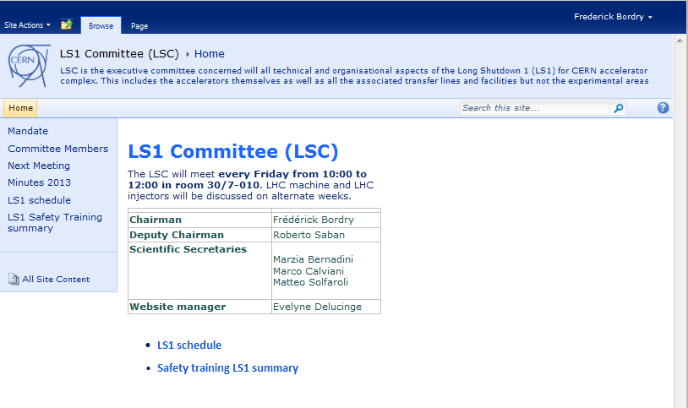
LSC Website

Slide 10
Recurrent points on the agenda
Safety matters
Global Schedule Status
SMACC status with Dashboards
R2E status with Dashboards
Cabling status with Dashboards

Slide 11
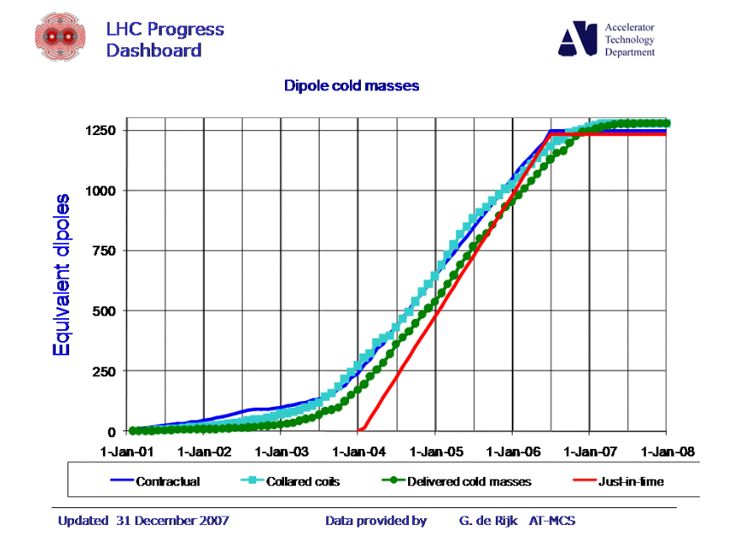
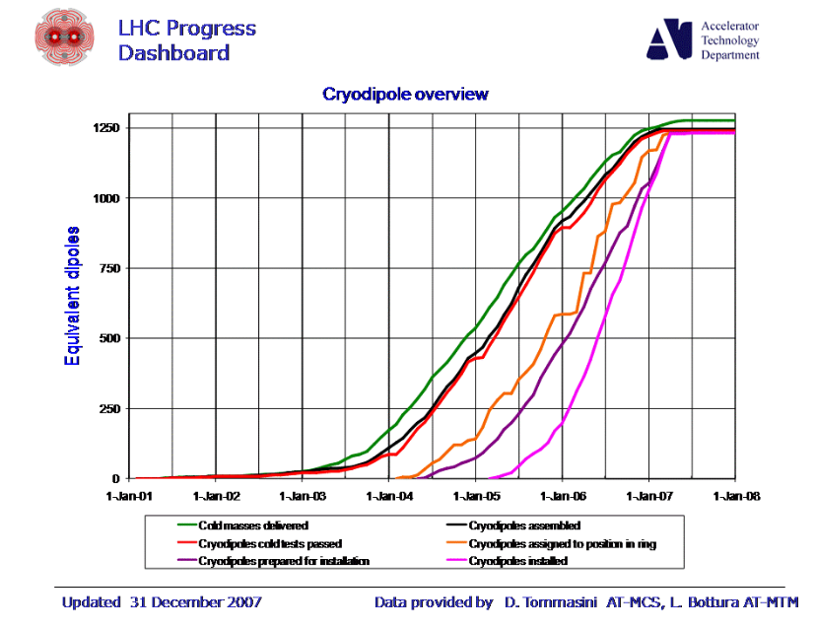
LHC Progress Dashboard (examples)

Slide 12
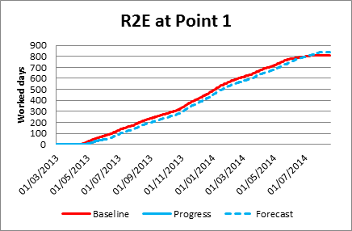
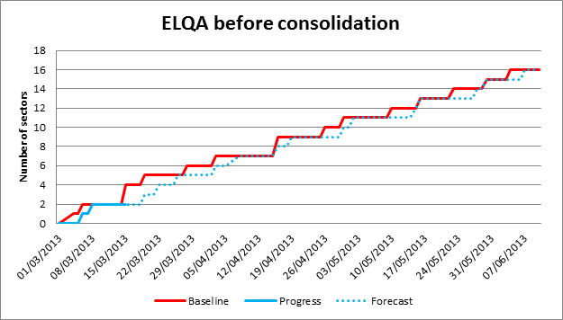
LS1 Progress Dashboard (examples)
LS1 page status and dashboards
under preparation

