Slide 1
LS1 tests and inspections of the Booster and AD magnets
A. Newborough
15th March 2013

Slide 2
Outline
Introduction
Booster
High voltage test
Power test and thermal inspection
Visual inspection
AD
Power test and thermal inspection
Main bending coil movement measurement
Visual inspection
Other work
Conclusion

Slide 3
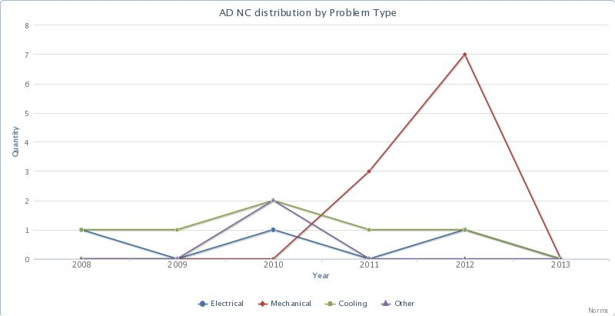
Introduction
The reliability of the magnets in the injector chain is maintained through:
Regular tests & inspections
Routine maintenance
Both general and specific consolidation
The Booster and AD are both very reliable machines (No down-time due to magnets during the previous run!)
All of the 2012 NC were reported as a result of the shutdown inspections!
Statistics available at: http://norma.web.cern.ch/norma/site/index.html

Slide 4
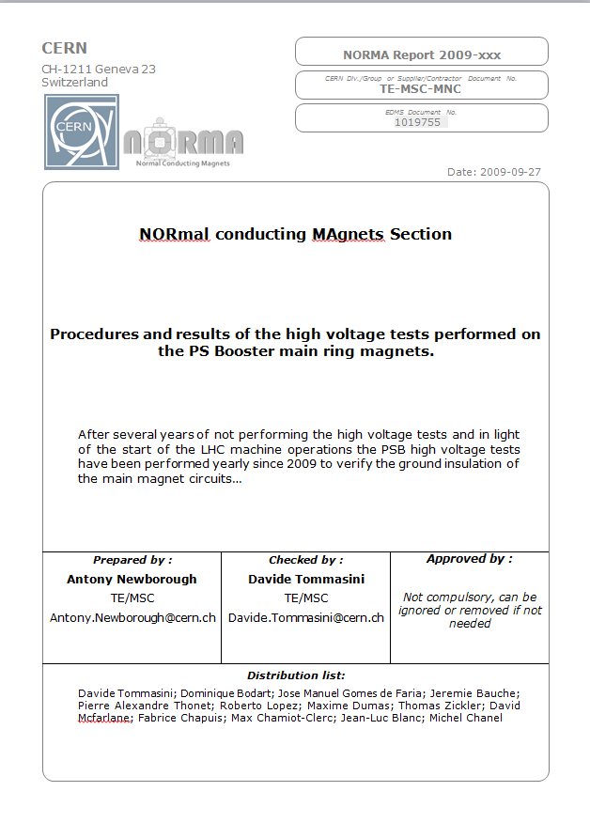
Booster – High voltage test
The high voltage test concerns the 33 main dipoles & 48 main quadrupoles
The tests have been performed annually since 2009 to the procedure, edms: 1019755
13 individual circuits are tested including:
  Main circuit (>5 kV)
  BDL correction (per ring >1.3 kV)
  QF & QD correction (per ring >1.2 kV)
  Since 2009 the only issue has been at the reference magnet – the results are comparable every year - including this year!

Slide 5
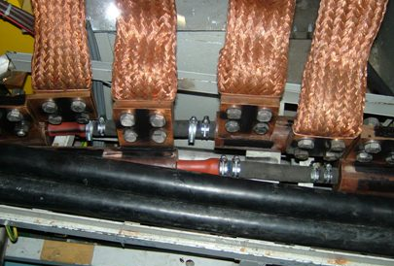
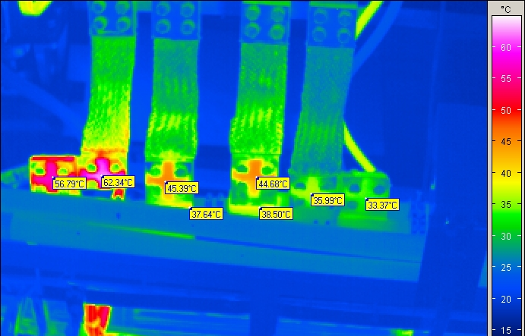
Booster – Power test & thermal inspection
The power test concerns all of the booster ring and most of the transfer line magnets
The main ring magnets are inspected every year without covers, the transfer line every few years
Several issues have been found in the previous years, which has led to magnet changes and repairs
  This year a few minor issues have been found
PSB - 2007 Inspection

Slide 6
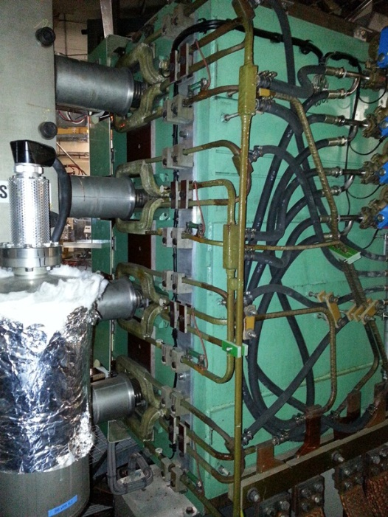
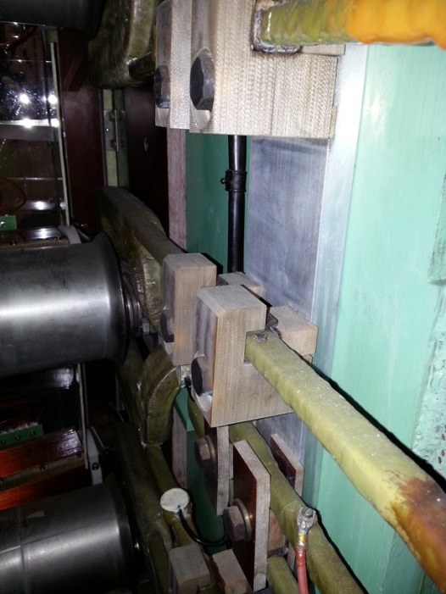
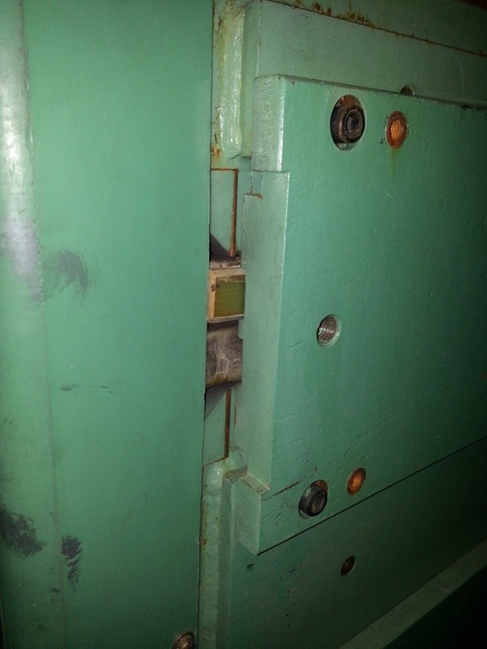
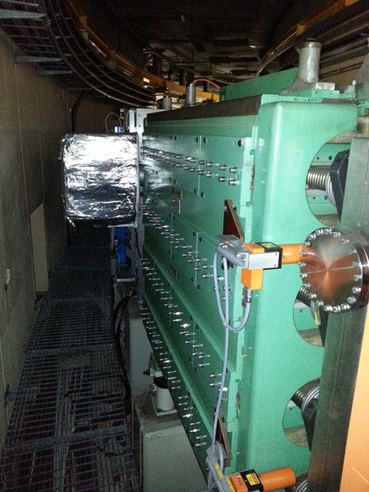
Booster – Power test & thermal inspection
Degradation of the conductor supporting material for the special injection and extraction bending magnets allowing the conductors to move.
Coil movement (knocking) seen from the outside of the ring, coil shims found out of position (major renovation is planned as part of the LIU-PSB during LS2)

Slide 7
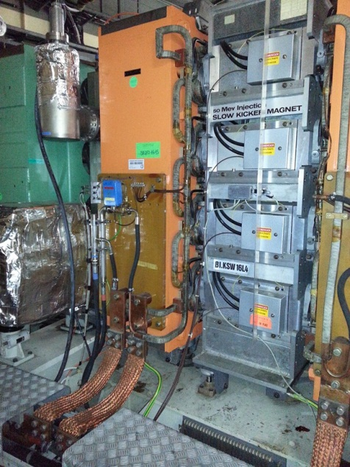
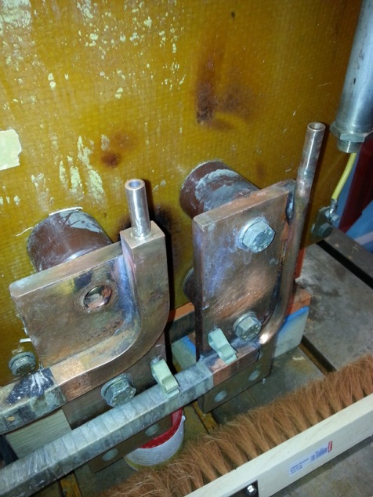
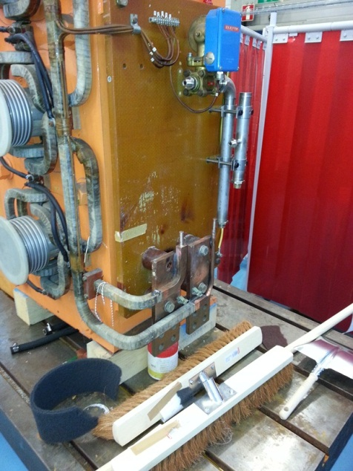
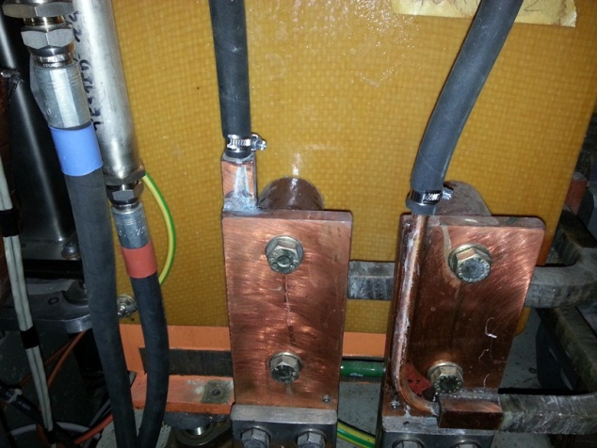
Booster – Visual inspection
Water leaks on the main quadrupole connection:
A few leaks are found during most technical stops, only one at the beginning of LS1 (The circuits were originally operated at less than half of todays pressure)
Modifications to the circuits will be made towards the end of the shutdown

Slide 8
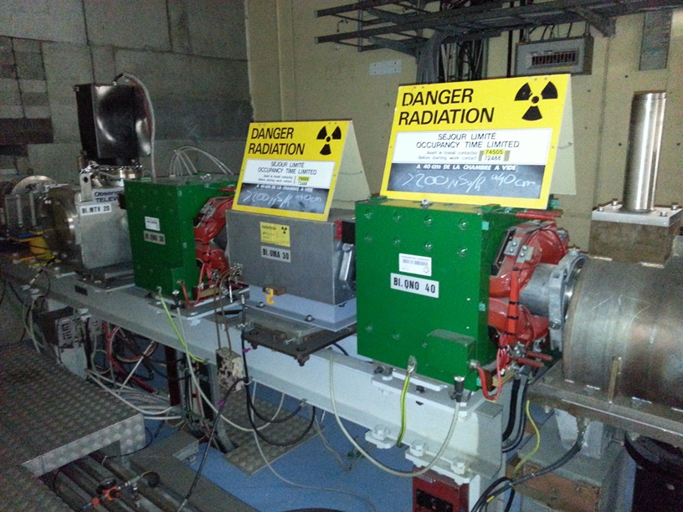
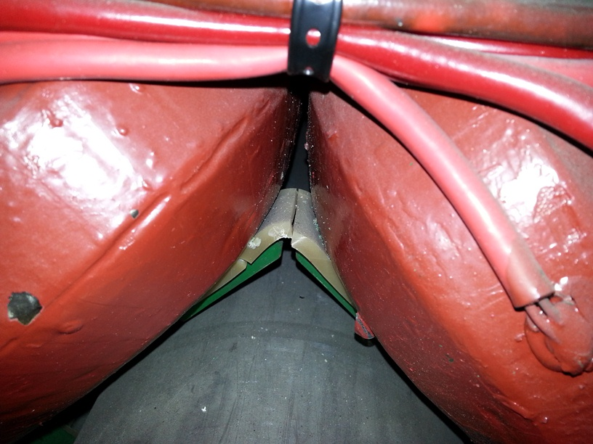
Booster – Visual inspection
Degraded shimming material on the booster injection quadrupoles, a consolidation program is planned during the connection of the LINAC 4 where the magnets will be renewed by a compact pulsed version.

Slide 9
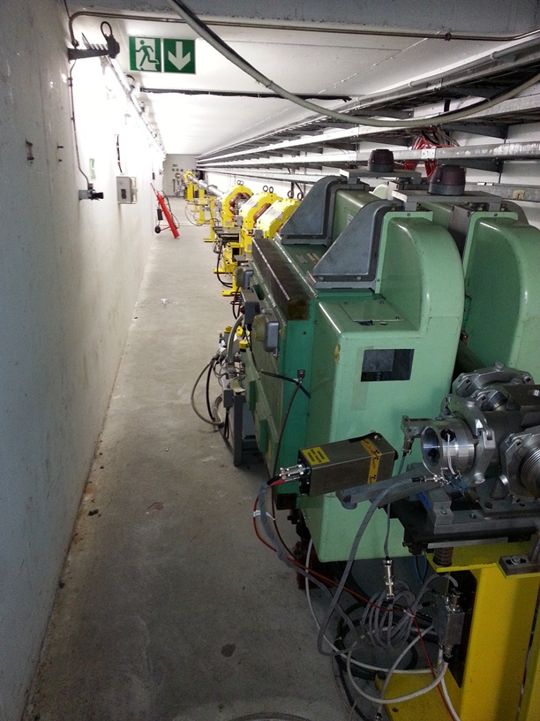
Booster – To be completed…
A few inspections are still to be completed.
Powering of the BTY line could not be performed due to a lack of water – the magnets are to be checked by hand (connections verified and filters inspected). The part of the BTY line near the targets will only be completed after a much longer cool down time.
The BTP line in the PS could not be inspected again due to a lack of water. Again they will be inspected manually after a longer cool down time.
Total dose to date 0.5 mSv between 6 persons

Slide 10
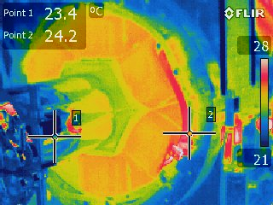
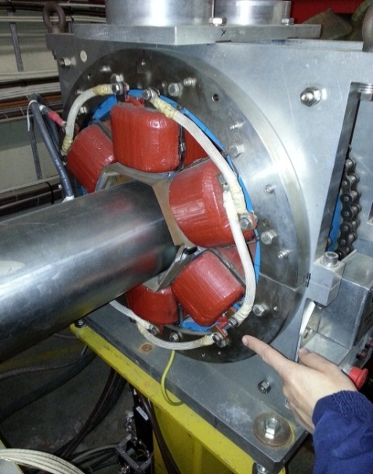
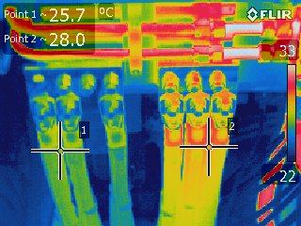
AD – Power test and thermal inspection
The power test includes all of the magnets in the ring and some of the injection / extraction lines.
The target and experimental areas were inaccessible and will be inspected manually later in the year.
Only a few issues have been identified including loose connections, corrective actions have already been completed.

Slide 11
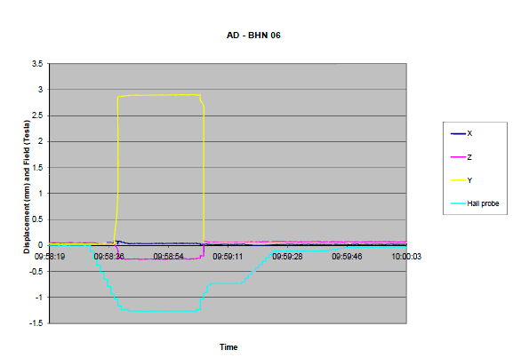
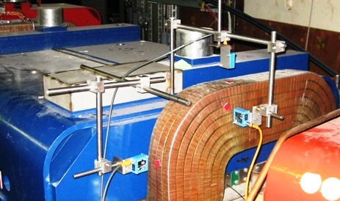
AD – Main bending coil movement measurement
In 2009 a series of measurements was made to identify the extent at which the main bending magnet coils were moving due to the poor shimming. The upper 1.2 T coil of the worst magnet was moving by around 3 mm for which a temporary repair was made. During the LS1 this magnet will be removed from the machine and refurnished. Now with the construction of ELENA a consolidation action is being planned to refurbish all of the magnets by the end of LS3.

Slide 12
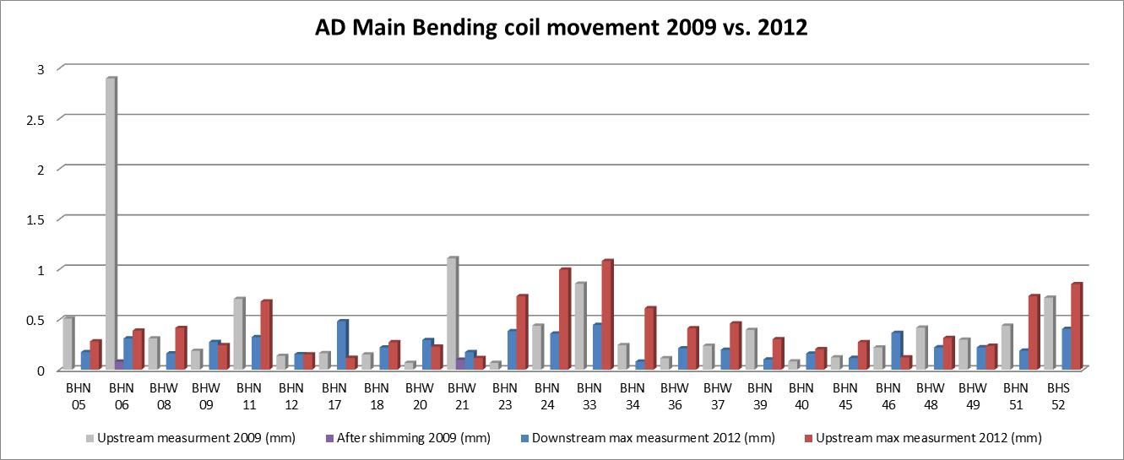
AD – Main bending coil movement measurement
The measurement campaign has been repeated in 2012, the situation is not improving. There are a few magnets approaching 1 mm of movement, the temporarily repaired BHN 06 is on the move again!

Slide 13
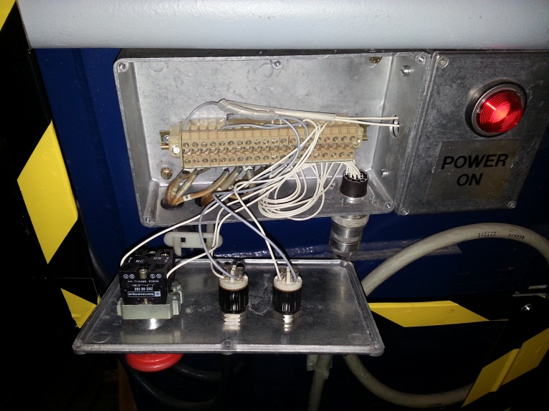
AD – Visual inspection
Several magnets have been identified with poor shimming, and could be considered for refurbishment in the future
The water filters have been checked through out the whole of the AD ring – no issues to report
During the coil movement measurement campaign the machine was tripped due to loose wiring within the magnet interlock box. All of the connections have already been verified with many loose connections found.

Slide 14
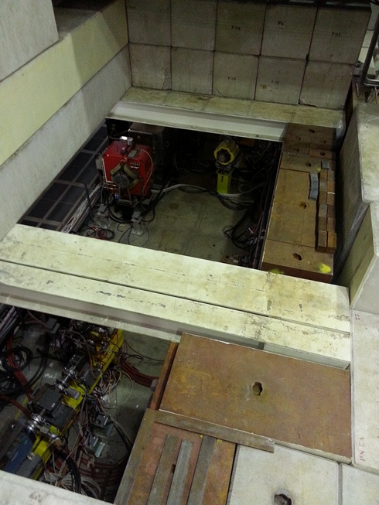
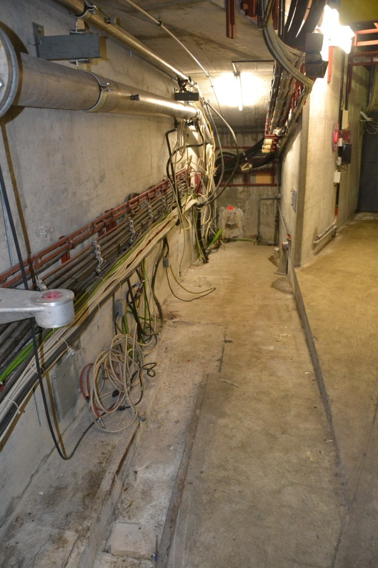
AD – General
In preparation for ELENA and machine tidying over 35 tonnes of unused magnets have already been removed from the AD ring.

Slide 15
Conclusion
Several ‘unknown’ minor non conformities have been discovered during the LS1 inspection, ‘known ones’ have been monitored
Specific concerns
  PSB – The main quadrupole magnet hydraulic connections often leak (A definitive repair is planned for LS1)
  PSB – The main bending magnet shimming needs monitoring until modifications are made during LS2. Problems found during the LS1 inspections will be addressed after further cool down
  AD – The situation with the main bending magnet coil movement is deteriorating, the first magnet has to be refurbished during LS1
The BTY and BTP lines in the Booster and experiment transfer lines in the AD are still to be inspected, as well as the target areas

Slide 16
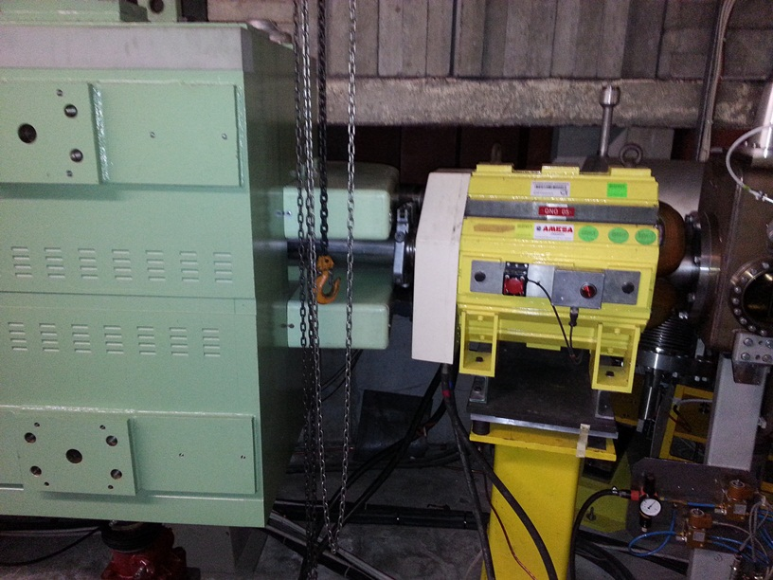
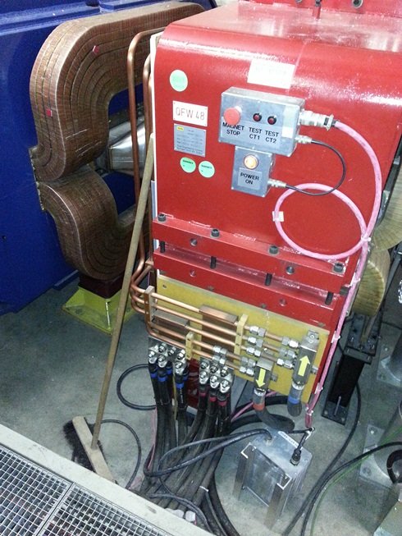
QUESTIONS?

