Slide 1
ECR Template
Unifying for all accelerators and projects

Slide 2
Purpose and scope
Purpose
Practices
Rel. Proc.
Versioning
Template
ECO
Conclusions
The ECR holds the impact analysis and the traceability of requested changes
  Authors and originators cannot foresee all the consequences of changes
Machines in operation
  LHC and SPS. Submitted to ECRs for changes
  PS Complex catching up. Only a few ECRs up to now
Projects submitted to changes once a baseline is established
  LHC (past !), HL-LHC (already asking) and L4
  HIE-Isolde, Elena
  LIU Projects

Slide 3
Different practices
Purpose
Practices
Rel. Proc.
Versioning
Template
ECO
Conclusions
Statuses and Release Procedures
  LHC: Released or Accepted
  SPS: Under Implementation and Implemented
Post-Release actions (ECO)
  was a weak point on the ECR follow-up in LHC (budget oriented)
  was a strong point in SPS (activity oriented)
Versioning
  v1, v2, v3 (EDMS default value)
  v0.1, v0.2, v1.0, v1.1 in Departments and LHC

Slide 4
Release Procedure
Purpose
Practices
Rel. Proc.
Versioning
Template
ECO
Conclusions
There will be only one associated release procedure for all accelerators/projects
  Instead of 4 different ones available at present (AT, LHC, BL, SPS)
It allows to :
  Launch or not the Eng. Check stage
  So it could work for ES as well
  Follow or not the Under Implementation stage
  Force the versioning by creating a new version/revision to avoid 2 documents with the same version/revision and not the same contents

Slide 5
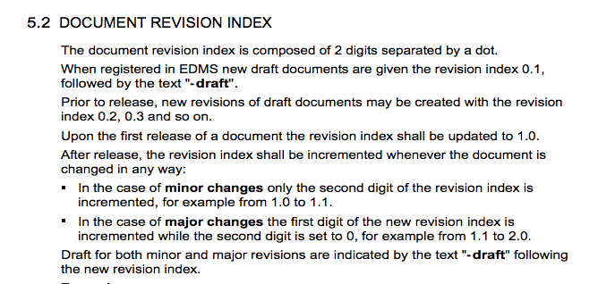
Versioning
Purpose
Practices
Rel. Proc.
Versioning
Template
ECO
Conclusions
From the LHC QAP, versions/revisions follow strict rules
What is proposed is to extend these rules to all accelerators and departmental ECR and ES

Slide 6
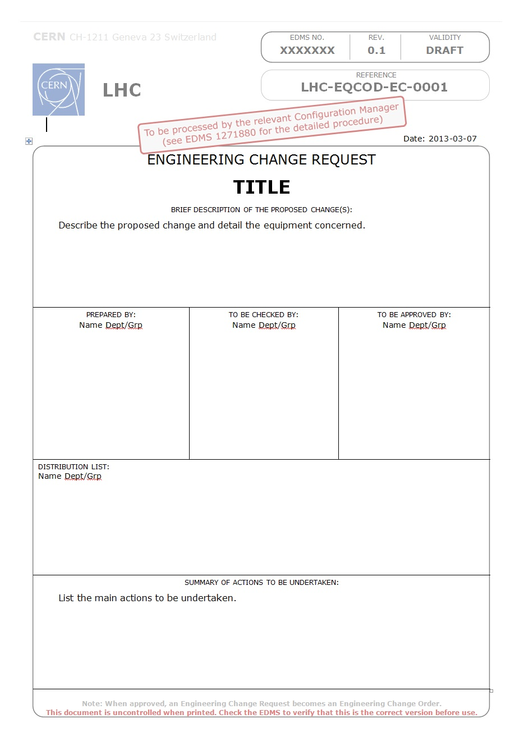
Purpose
Practices
Rel. Proc.
Versioning
Template
ECO
Conclusions
Instructions
Names or Bodies
Summary only. Details in last paragraph of the document

Slide 7
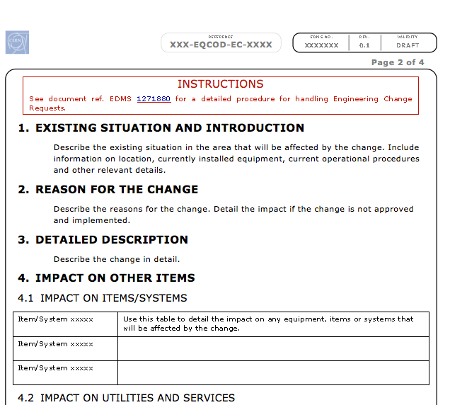
Purpose
Practices
Rel. Proc.
Versioning
Template
ECO
Conclusions
Complete Instructions in a
Poster (thanks to P. Bonnal)
Impact analysis

Slide 8
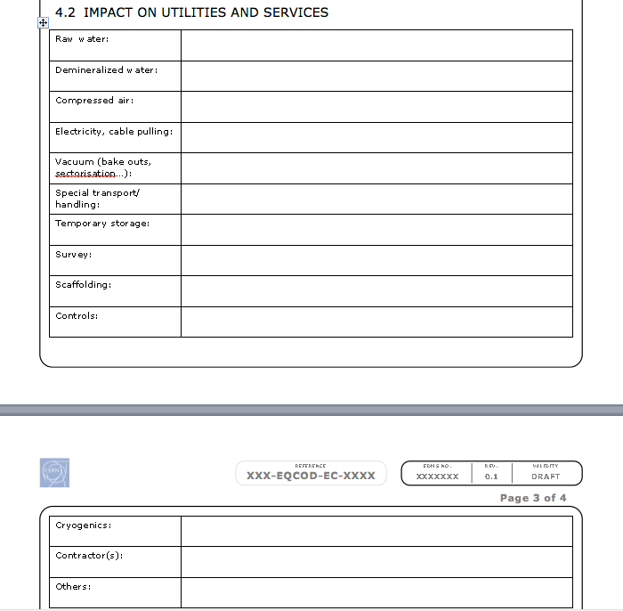
Purpose
Practices
Rel. Proc.
Versioning
Template
ECO
Conclusions
To be considered as hints when filling in the ECR

Slide 9
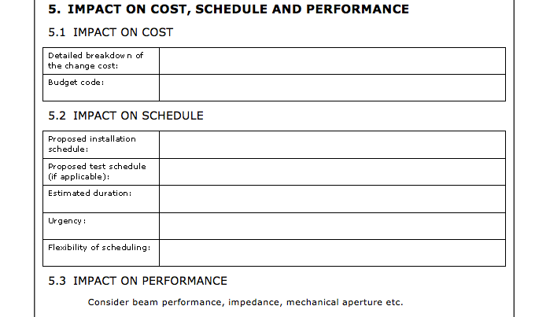
Purpose
Practices
Rel. Proc.
Versioning
Template
ECO
Conclusions
Budget code
or
Statement indicating which group/project is in charge

Slide 10
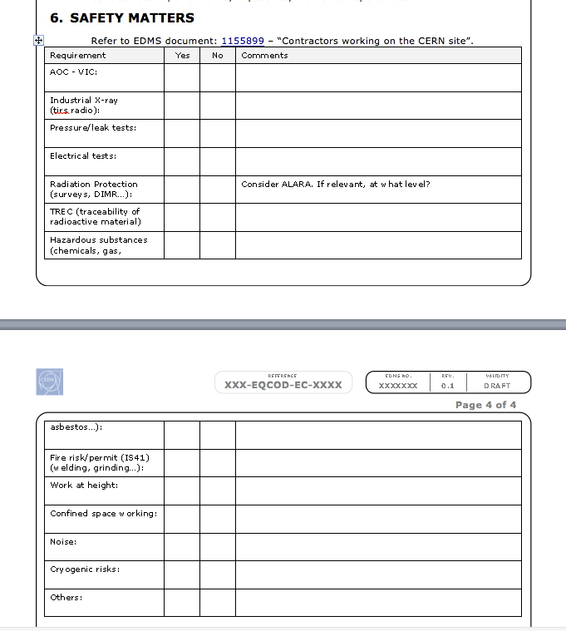
Purpose
Practices
Rel. Proc.
Versioning
Template
ECO
Conclusions
Needs to be reviewed with HSE, DSO’s and safety coordinators.
At the agenda of a CSAP meeting.
(this part of the template might evolve slightly)

Slide 11
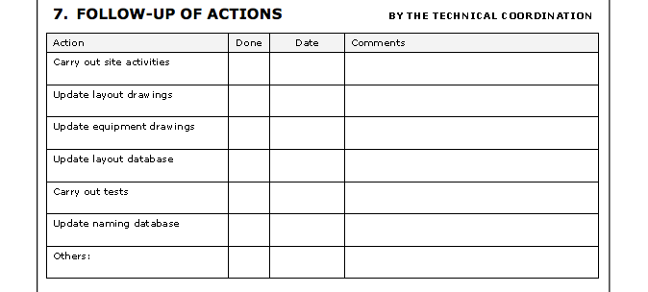
Purpose
Practices
Rel. Proc.
Versioning
Template
ECO
Conclusions
To collect key information before changing into the final Implemented status…

Slide 12
Follow-up (ECO)
Purpose
Practices
Rel. Proc.
Versioning
Template
ECO
Conclusions
Analysis work required to define interactions between Impact and ECR/ECOs.
  Under Implementation and Implemented statuses are linked to the planning and the activities
  Only a ‘ECR’ checkbox in the Impact tool for today
It is foreseen to have a special tab in EDMS pages dedicated to ECO follow-up. To be implemented by GS/ASE

Slide 13
Conclusions
Purpose
Practices
Rel. Proc.
Versioning
Template
ECO
Conclusions
Still a few points to clear out
  Safety chapter
  Instruction poster to be made available
In production in a few weeks time
  Cleaning some templates in Word Windows and some web sites
  Trying to make it available also on Mac OSX

