Slide 1
LS1 Cabling Strategy
LS1 Committee (LSC) – 15 Mar 2013
Daniel RICCI
on behalf of the Cabling and Optical Fibre Section (EN-EL-CF)

Slide 2
Outline
What is « Cabling »
LS1challenge
The strategy
The performance
Conclusion

Slide 3
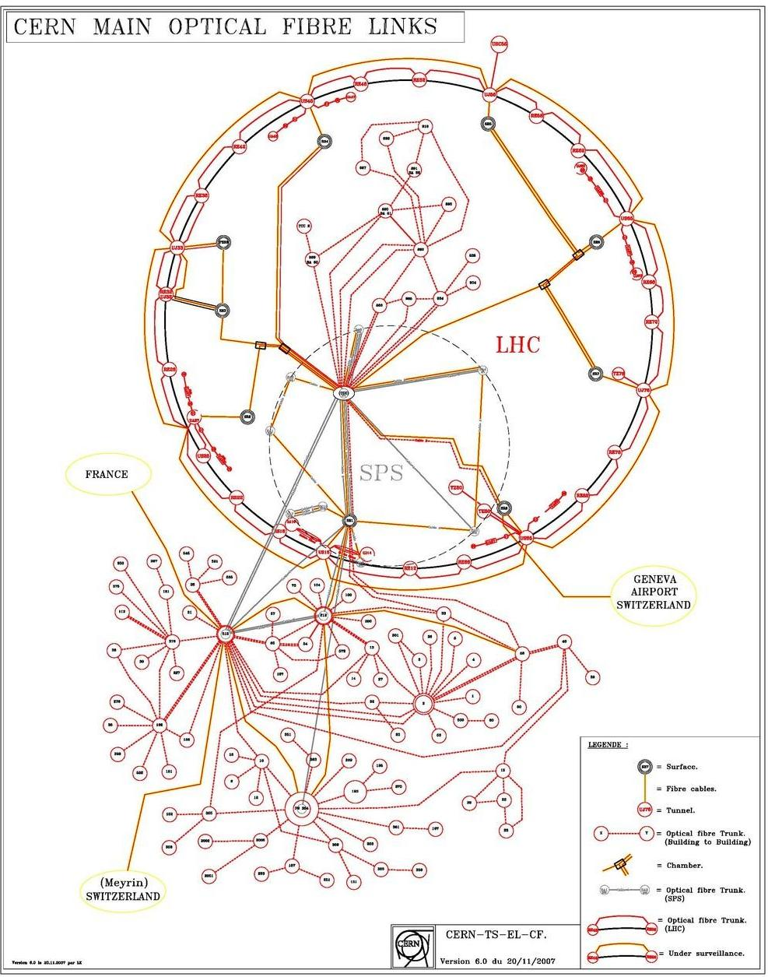
What’s Cabling ?
Cabling = copper cables AND optical fibres
More than just « pulling cables »
Engineering support:
  Participate in the definition of the cable cross-sections (under the responsibility of the owners) & manage cable tray infrastructure (350 km)
  Procure and standardise cables, optical fibres and connectors for CERN users
    233 orders in 2012 (including 39 new contracts) – Average investment per year: 3.5MCHF
    managing cable parc: ~4200 drums for LS1
  Manage the optical fibre infrastructure
    Design, reconfiguration, maintenance
    Qualify and procure radiation resistant optical fibres
  Monitor aging and steer the cable/fibre replacement campaigns
    ~10.000 km copper cables, ~3.000 km optical cables
Notes:
Cabling is a word for an activity concerning copper cables and optical fibres

Slide 4
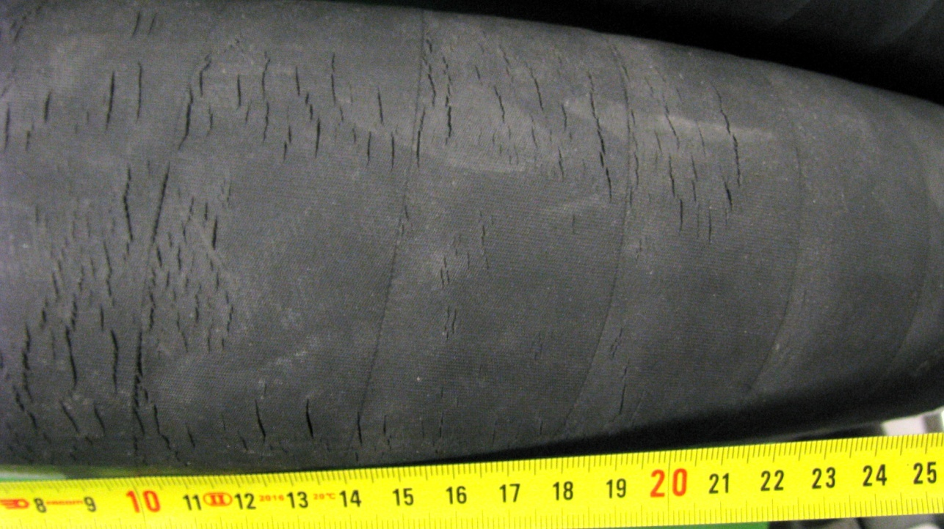
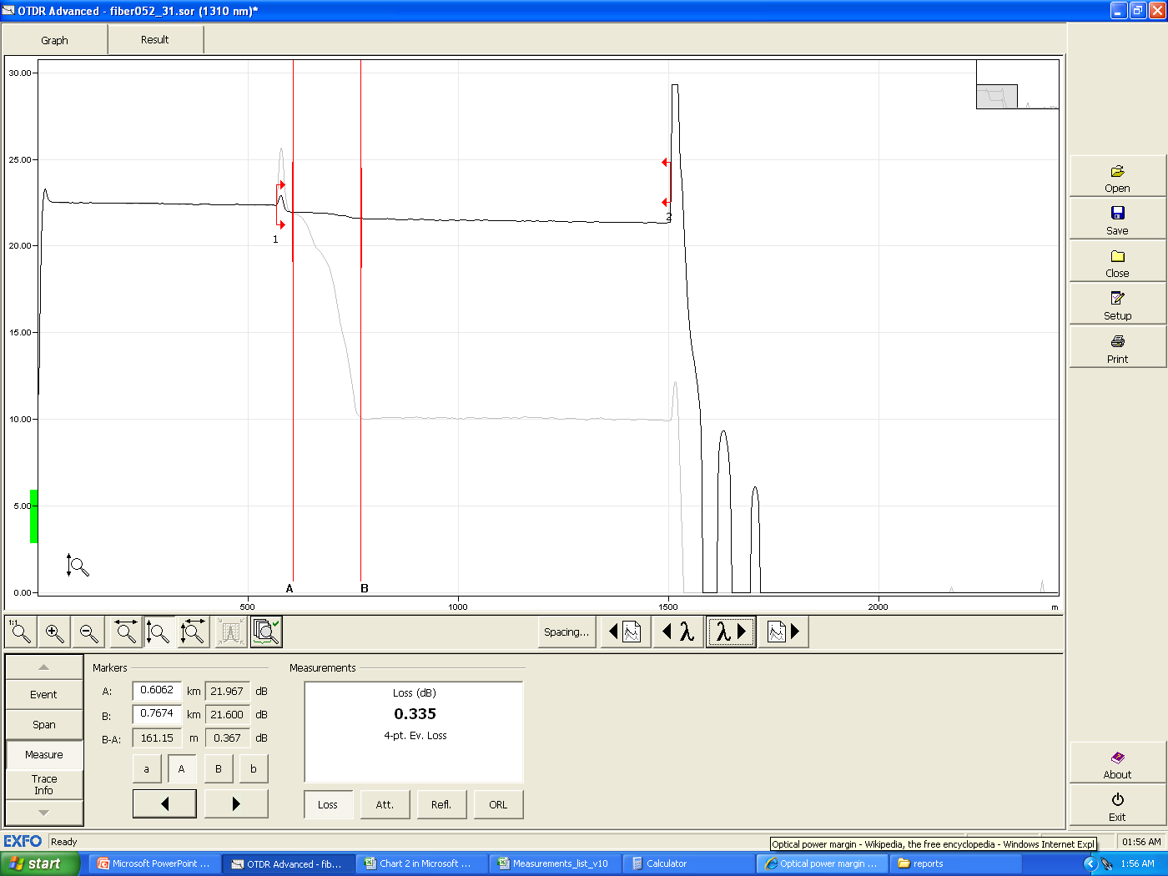
What’s Cabling ?
Two typical consequences of missing engineering support
Water Cooled Cables
Radiation Sensitive Fibres
Standard fibre
Attenuation
Rad-sensitive fibre
≈11dB
Distance
Standard fibre → RIA < 0.4dB
Rad-sensitive fibre → RIA > 11dB
Compelling consolidation activity in LHC
  2 MCHF project (LS1 portion)
  10 contract people for 1 year work
  7 groups involved (EN-EL, EN-MEF, EN-HE, EN-CV, TE-EPC, TE-MPE, RP)
Follow up of legal issues (since ~10 years)
Critical consolidation activity in LHC
  1 MCHF project
  all LHC points are concerned
Again follow up of legal issues
  Being successfully closed in 2013 !
Notes:
We started having problems in the past with the WCC hoses which contain halogen and started to develop cracks. This generated a compelling LHC project for their replacement.
There are two cases that represent well what can happen when the section is understaffed (as it was in the past) and has to drop the engineering support, corresponding in these cases to missing quality control on the supplied products.

Slide 5
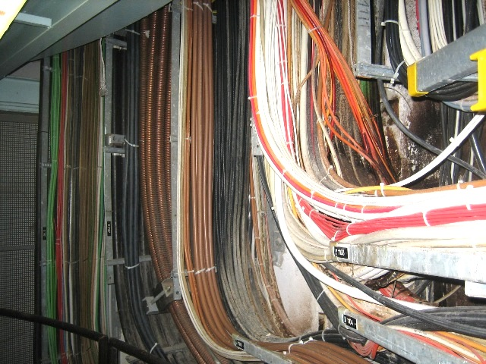
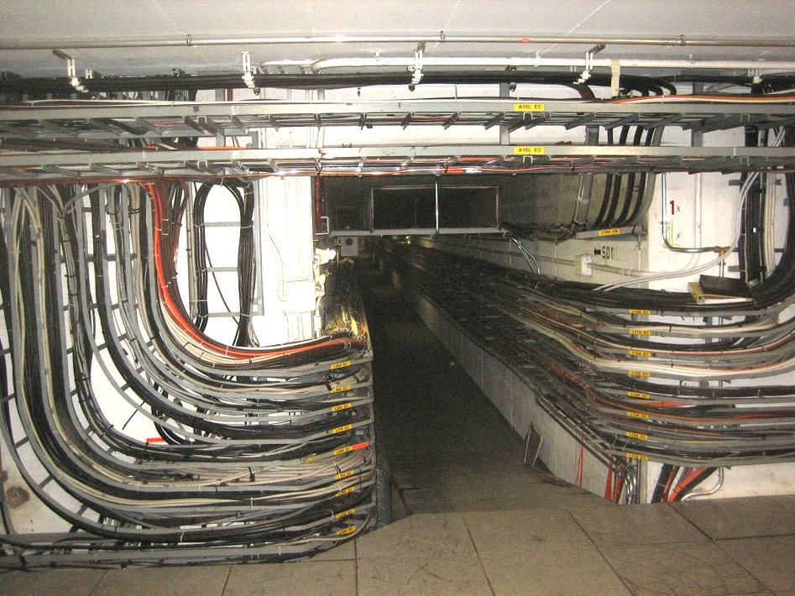
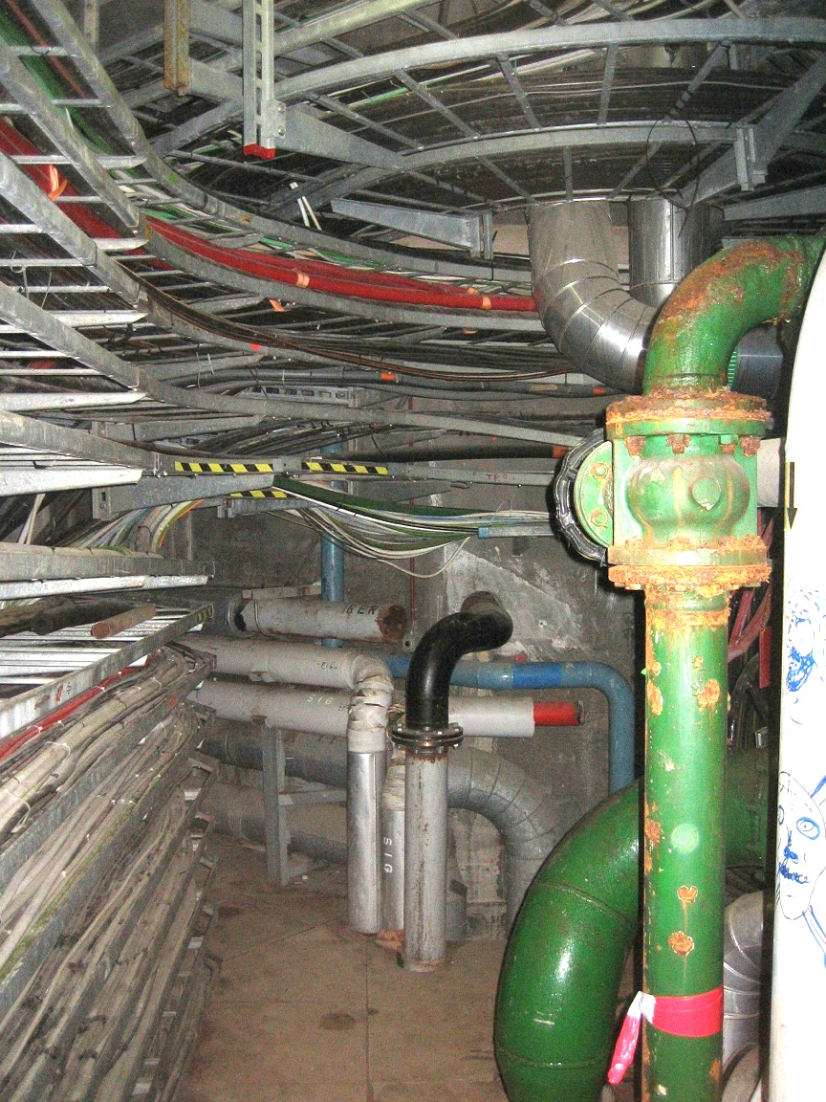
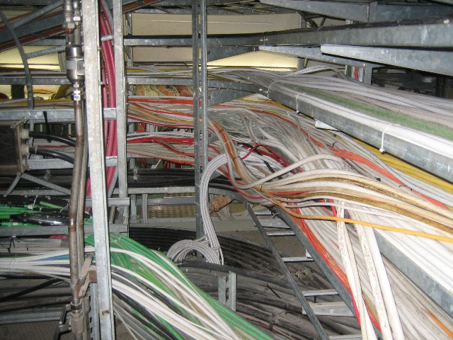
What’s Cabling ?
…and another one
Overloaded areas
Rest of PS-complex and Meyrin technical galleries
SPS: class1976 (36 years old)
PS: class 1959 (53 years old)
Shafts
Galleries
PS ring centre
Gallery TP9
Intersection Linac2-Linac4-PSB
Cables installed before ’80s are with halogens (risk in case of fire accidents)
Notes:
Large clean-up campaigns shall be organized
Our service supports on this.
However, when we cannot do engineering support for preparing these large project, the consequence is that cables cannot be pulled anymore for the users (eg. SPS-P5, SPS-BA3)

Slide 6
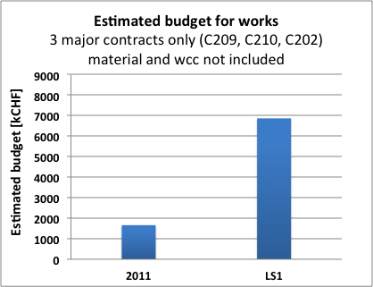
LS1 challenge
Extraordinary increase of cabling projects
  CF workload is circa 4 times more the load of 2011 despite priorities were set
Volumes:
  37 projects to carry on (+ daily works)
  75 % of the project requests were accepted by LS1 management (rest is postponed to after LS1)
  Among the postponed:
    50% EL-CF projects (mainly consolidations & upgrades), 50% users
  1000 km of copper and optical cables will be installed
Still growing
Budget is not representative of the section workload
Major projects for LS1
Cabling
R2E
LHC & SPS cabling campaigns (all users)
Consolidation of water-cooled cable hoses in LHC Points P8, P6 , P4right
Consolidation SPS irradiated cables BA
PSS, LINAC4
Optical Fibres
R2E & consolidation LHC infrastructure
Replacement of radiation sensitive fibres
New SPS fibre infrastructure (BI & others)
Computer centre extension (B513)
PSS, LINAC4, Experiments (CMS & others)
Notes:
LS1 represents a big challege for us with an extraordinary increase of cabling projects.
The graph give an indication of how the budget related to contractor services grew up since 2011.
In terms of volumes…
The extension of computer centre for which we had to qualify and supply new cutting edge cables and components capable to sustain high data throughput (100 Gb/s)

Slide 7
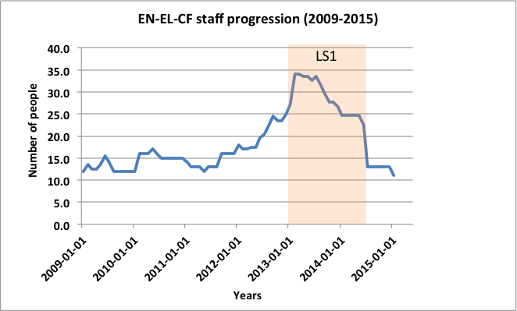
LS1 challenge
Increase of section manpower …
… and further preservation following LS1
  LD&IC, fellows, PJAS, UPAS, VIA, user support
Prepar.
LS1
Adequate staff level
Adequate staff level
Understaffed
Understaffed
CF section doubled in just 1 year + high turnover since 2009 (35 different people alternated)
Challenging technical training and know-how transfer
  only 1 person experienced in large cabling campaigns
Challenging management/supervision (second level coordination need boosting)
Notes:
Take advantage of the expertise acquired and try to not loose it.
Staff: we compensated the work increase for LS1 by removing all the engineering works and focusing the staff only on pulling cables (as a result, we cannot do preparation for the future projects)
Managing: it is challenging becase, being all people newcomers, they are not yet expert and trained enough to coordinate efficiently other people or small teams.

Slide 8
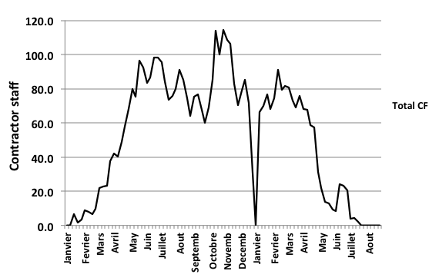
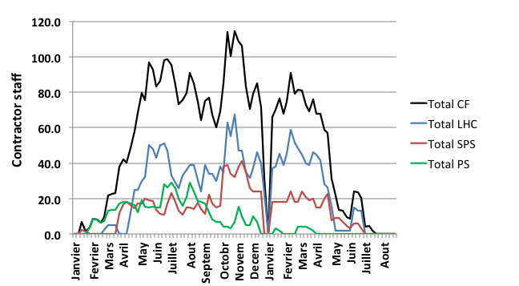
LS1 challenge
Increase in contractor staff
  Two electrical contracts instead of one
Curves do not contain FSU contracts
Contractors are relatively new:
  Need to acquire deep knowledge of CERN infrastructure, rules, working methods
  Need to acquire technical knowledge of CERN-specific connectors
  Need to cope with abrupt staff recruiting
Notes:
To cope with this we:
Section:
Put in place a new seciton structure
Asked « expert » help to the other groups
Contractors:
Anticipate contractor needs (planning and load curves) and organise training courses
Increased the number of work supervisors

Slide 9
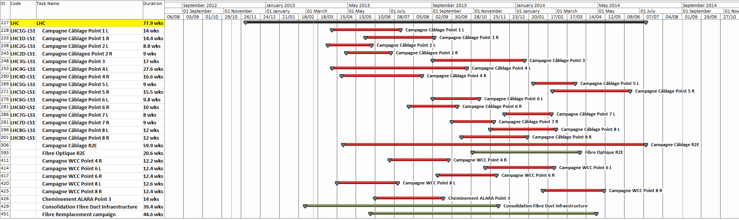
LS1 challenge
Planning: how to fit everything?
  machine priorities vs users’ wishes
  increasing parallelism of cabling activities
  increasing co-activity with other groups/contractors
Example cabling projects LHC
K. Foraz
Notes:
The increase in co-activity load once more the engineering part of the section (managerial+coordination)

Slide 10
The strategy
Facing technical challenges:
  Anticipate qualification and procurement of material
  Optimize work organisation and resource distribution by working by geographical campaigns
  Anticipate financial engagements
Facing increasing staff challenge: enhanced section structure
Facing contractor challenge: promoting training, boost project preparation and supervision
Facing project planning challenge: assignment of working time-slots to contractors & schedule monitoring
Notes:
The strategy is summarized in this slide.

Slide 11
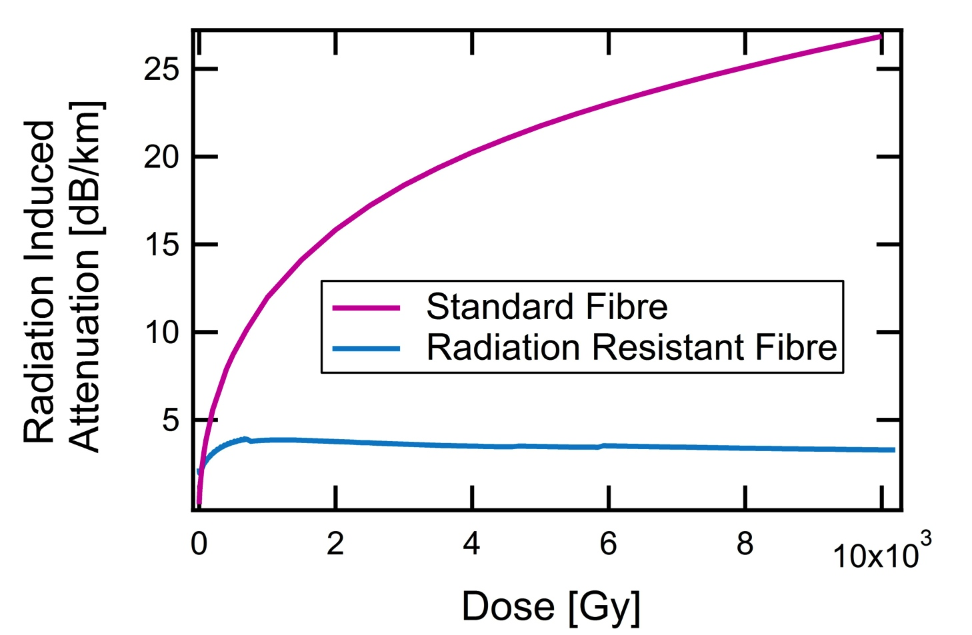
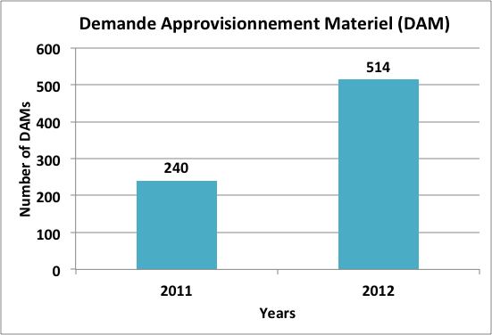
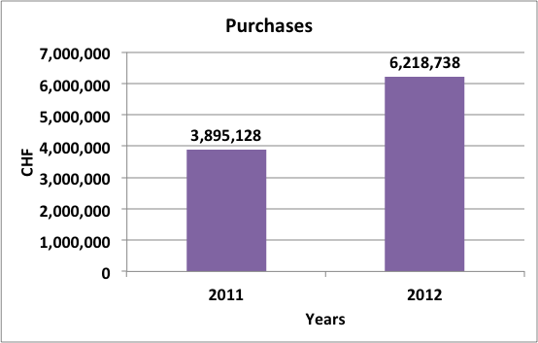
The strategy
Facing technical challenges: anticipate qualification and procurement of material
  Some special cables/fibres require 6 months to be procured
  Early processing of the user’s needs (deadline June 2012)→ orders placed
  All cables/connectors defined by Oct 2012 → last orders finalised
Qualification of RRF
Procurement copper cables & connectors
More than 20 irradiation tests
2400 km procured in 2012/13
LHC consolidation + upgrade
SPS new Beam Instrumentation
Doubled the requests of 2011
+ fibres…
Notes:
In the case of Fibres, the procurement of material is included in the contract

Slide 12
The strategy
Facing technical challenges: optimize work organisation and resource distribution by working by geographical campaigns
PROJ 1 Various works for TE/ABT
Campaign Booster
Case 1
PROJ 2 LIU
Campaign SPS-BA1
PROJ n Various works for BE/BI
Campaign LHC-Point1
Case 2
PROJ x Repl. Irradiated cables TS1+
Campaign SPS-TS1+
Campaign LHC-Point 5
Case 3
PROJ y R2E
Campaign LHC-Point 8
~700 cables/fibres work orders for LS1
Campaign LHC-Point 1
Notes:
All project requests are constituted for us of several work orders for installing cables in different machine ares. The concept of campaign consists of decomposing and re-organizing these works by geographical areas allowing to optimize the intervention time in that area, the necessary resources and the overall plannning to fit all campaigns.

Slide 13
The strategy
Facing technical challenges: anticipate financial engagements
  70% of work orders (OSVCs) sent before Dec 2012
  30% orders used for granting flexibility between contractors
  Contractors well balanced financially so far
    working for having equal weight
Notes:
Balancing the contractors is important to guarantee that they are both motivated to invest their efforts in the LS1 activities.

Slide 14
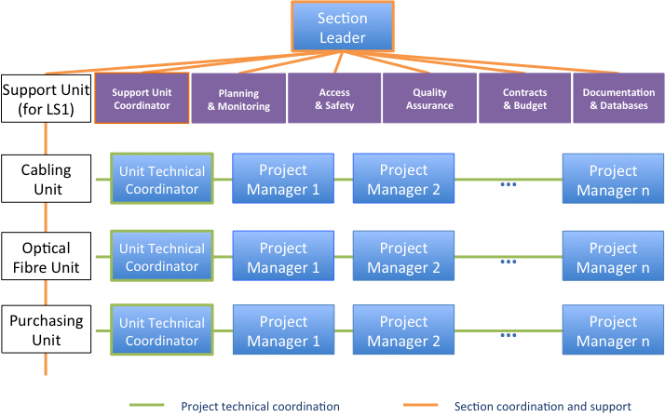
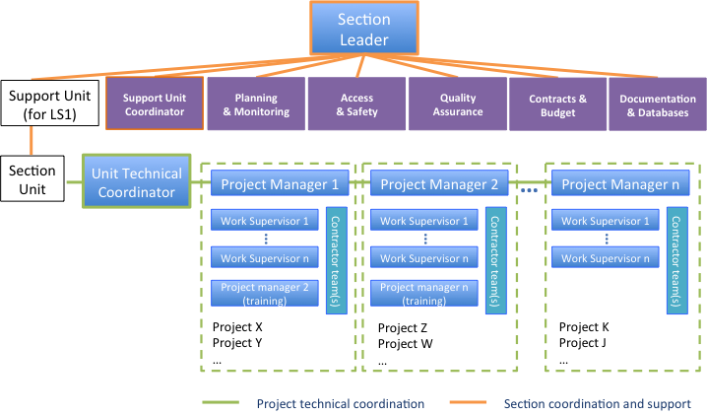
The strategy
Facing increasing staff challenge: enhanced section structure
Support Function Unit with Support Manager
Structure by project cells
EDMS 1245913
Notes:
We introduced a new support unit with the task to assist and help to manage very delicate aspects of the work such as planning & monitoring, …..
The support unit is coordinated by a support manager which is much more than just a unit coordinator: is a senior manager working together with the section leader in running the whole activities of a section that became the size of a group.
The support unit is not the only enhancement. We also reorganized the technical block to work by project cells.
The idea is to delegate the supervision of work surveyors and contrator team to the project manager responsible for one or more activities. At the same time the experienced project manager can partially train a less experienced one.
In practice with the abrupt injection of newcomers in the section this mechanism is not yet perfectioned with a huge training load falling on the unit coordinators. However, we believe that this mechanism can become really efficient also for the future shutdowns if we manage to stabilize the technical block with enough experienced staff.

Slide 15
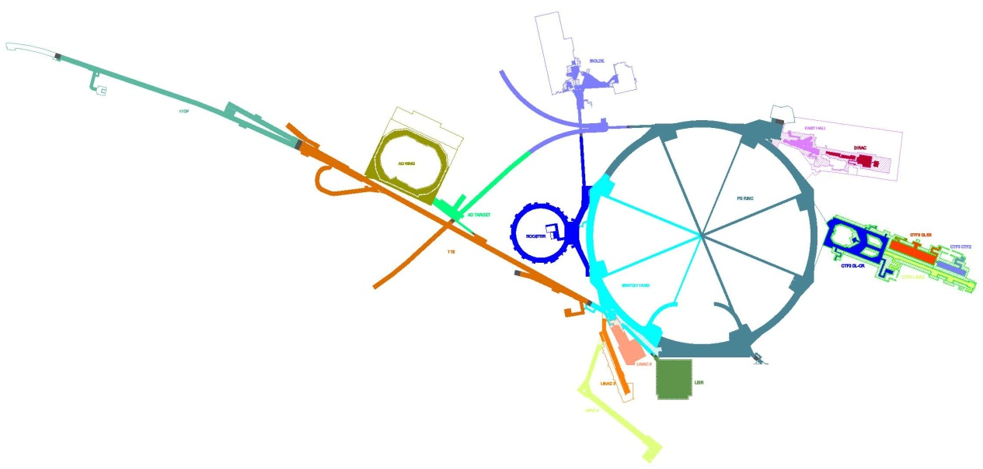
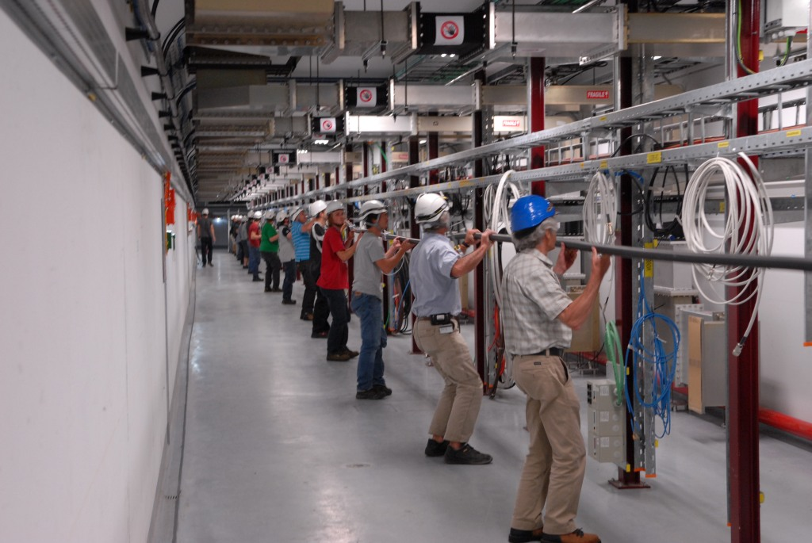
The strategy
Facing contractor challenge: promoting training
  12 trainings on connectors organized by CF (+suppliers, users) during 2012/13
  14 special procedures written and distributed to the contractors
  Two large pilot projects in 2012 for contractor’s training
PS-PSS (~ 3 MCHF)
ISOLDE
NTOF
LINAC4 (~ 1.4 MCHF)
AD
HALL EST
PS
PSB
TT2
CTF
LINAC’s
28 new access points:
~ 160 km copper (ctrl) cables
~ 456 km optical fibres (3000 connectors)
~ 2 km new cable trays
~ 2.5 km ducts
~ 85 km copper cables (~ 2200 cables)
~ 80 km optical fibres (1000 connectors)
~ 1 km new cable trays
~ 1.5 km ducts
Notes:
LINAC4 was so far successful and this gives us good hope for the future

Slide 16
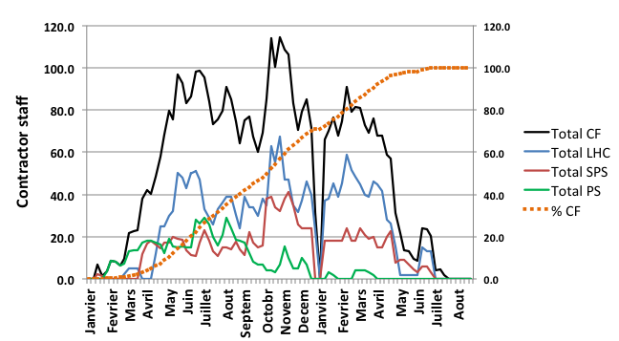
The strategy
Facing project planning challenge: assignment of working time-slots to contractors & schedule monitoring
  Negotiation of working time slot with machine & project coordinators since Sep 2012
  Optimal shaping of workload curves for contractors w.r.t. co-activity constraints
  Strengthen working method for contractors: weekly activity performance reporting
Notes:
Note: LHC dominates the planning →
critical not to change accessibility for CF,
PS and SPS load curves compensate each other

Slide 17
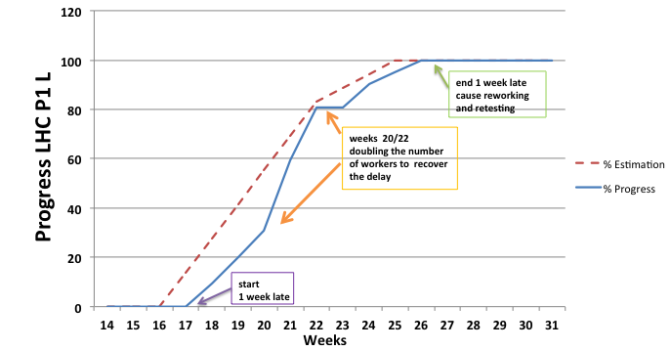
The performance
Project follow up and monitoring:
  Weekly meetings with contractors: detailed follow up of planning progress, solve punctual problems, anticipate issues
  Prototype monitoring tool (will be tested during first campaigns)
Simulation
EDMS 1245912
Current LS1status:
  All cabling campaings/projects are assigned to project managers
  All work supervisors are defined (including those joining in 2013/14)
  Integrating new RP procedures for contractors (unforeseen)
  Work started in EastHall, LHC fibre cons. and first big campaign in PSB (in schedule so far)
Notes:
This tool will be also used to report to the LSC meetings

Slide 18
The performance
Facing unforseen circumstances: contingency plan
  Missing external resources: 3rd contractor
  Loosing internal resources: staff with interchangeable expertise
  Missing material: not an issue (procured/in schedule)
  Quality issues and schedule delay:
    Organise work in 2 shifts in case of low yield on connectivity
    Planning agility: anticipate installations when opening « holes » in the planning
    Monitor schedule systematically (use the first workload « peak » to asses the monitor tool and the future trend)
Notes:
Material: procured for copper, procured 60% for fibres, the rest of the production in schedule so far

Slide 19
Conclusion
Cabling = strategical activity for CERN functioning (supports all depts.)
EL-CF increased staff and adopted enhanced structure to prepare to LS1
The cabling method based on geographical campaigns is the key approach to optimize work organisation and resource distribution
Appropriate monitoring tool is being applied
The working method of CF is solid and technically proven. Therefore the Section is on very good asset to succeed in this project.
Many thanks to all user groups for their valuable support !
Notes:
Cabling is a strategical activity for CERN functioning providing support to all departments which is presently facing big challenges for LS1.
To cope with these challenges, EL-CF icreased…..

Slide 20
Backup slides

Slide 21
The strategy
Cabling Campaigns: work distribution
Cables (copper)
Cable clean-up /installation of cable trays/racks (variable)
Cabling campaign
Reprises
(variable)
Cable pulling (60%)
Connectors (30%)
Test (10%)
4 or 5 people
3 people
2 people
Optical fibres
Cable clean-up / installation of cable trays/racks (variable)
Fibre campaign
Reprises
(variable)
Tube laying (40%)
Microduct & microcable blowing (40%)
Splicing & Test (20%)
4 or 5 people
4 people
2 people

