Slide 1

CMS Safety, LS1
Proposed Evacuation exercise in USC55/UXC55
Austin BALL – CMS Technical Coordination
Safety is job # 1

Slide 2
Reminder
CERN Safety Code E:
  “Evacuation exercises must be arranged on the initiative of Division Leaders in consultation with the TIS commission, at regular intervals depending on the level of hazard and in the light of previous evacuation exercises”
  “Evacuation exercises must be well prepared so as to obtain the maximum information while causing the minimum disruption to current activities.”
French “Code du Travail”, art. R4227-39
  “La consigne de sécurité incendie prévoit des essais et visites périodiques du matériel et des exercices au cours desquels les travailleurs apprennent à reconnaître les caractéristiques du signal sonore d'alarme générale, à localiser et à utiliser les espaces d'attente sécurisés ou les espaces équivalents à se servir des moyens de premier secours et à exécuter les diverses manœuvres nécessaires. Ces exercices et essais périodiques ont lieu au moins tous les six mois.”
2 real evacuation incidents at CMS (out of ~10 CERN wide) since LHC started

Slide 3
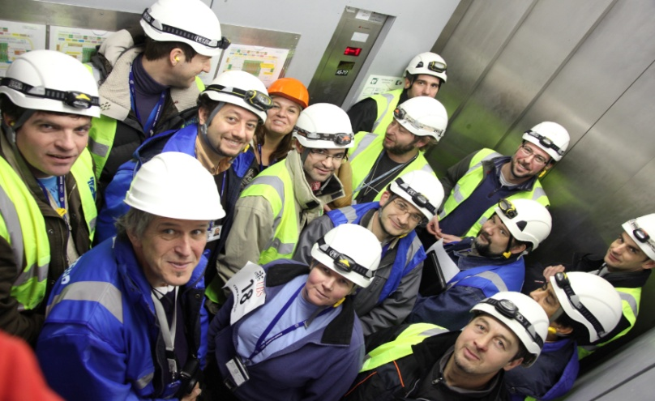
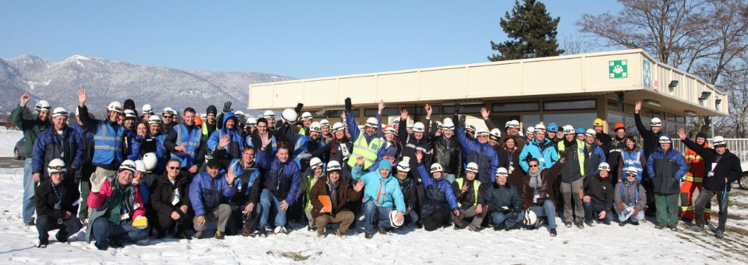
CMS 2012 Evacuation drill
Pre-planned and announced. Cavern full
of “representative” teams, one at max height
in a nacelle.
In reality an organised rehearsal (with
prompters and critics )for an impromptu
performance.…much learned nonetheless.
http://cdsweb.cern.ch/journal/CERNBulletin/2012/06/News%20Articles/1421593?ln=en

Slide 4
What did we learn from the previous ones?
Last drills in 2007 and 2012:
  Need for regular drills in order to train workers and emergency guides, to avoid
  hazardous or ill-conceived reactions.
  New equipment/ features:
    Flashing light on top of the shafts PM54/PM56
    Personnel counting system
    Additional sirens
    Additional signalling
    Material in the SCX5
    Modification of the evacuation matrix
    Public address system
  New factors to study/develop
    Additional CCTV (assembly point, lifts, etc.)
    Possible CSAM improvements
    Awareness, correct reaction of all personnel/ groups underground
    Visitor handling
    Enhanced collaboration with CERN Fire and Rescue Service

Slide 5
What will we test?
Evacuation in the presence of (the limit of) 100 people in both caverns combined.
- expected to be approached frequently in LS1 - - including groups of (simulated) visitors
Training/procedure awareness of the workers, of the guides, of the emergency guides, of the first-aiders, etc.
Verify the implementation of previous exercise feedback/corrections
Check emergency preparedness and collaboration with FRS

Slide 6
Why on 16 May 2013?
Why May?
  Exercise much more valuable for safety if done:
    before peak activity starts (of all personnel who evacuate through PM54/(PX56).
    before the Open days in September
    in both cases, sufficiently “before” in order to be able to implement the corrections needed.
Why Thursday 16 May?
    best choice matching availability of limited monitoring/simulation resources from CERN-FRS and CMS.

