Slide 1
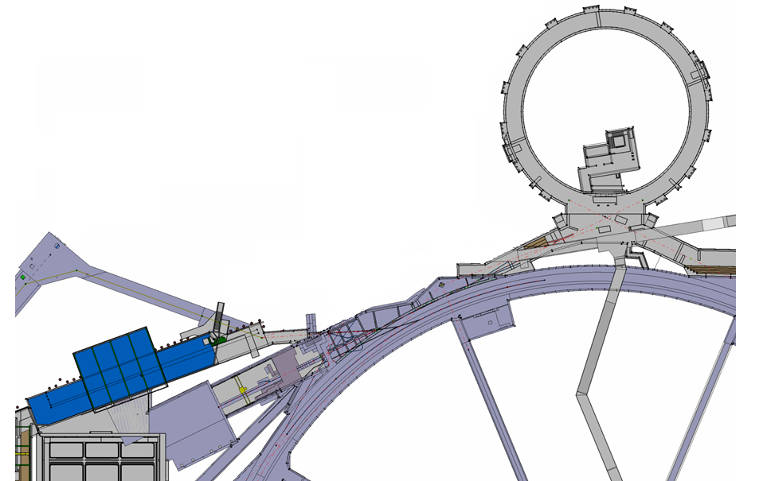
A new trajectory measurement system for LT, LTB and BI lines
PSB
Linac4
Linac2
PS
J. Tan, M. Sordet, M. Ludwig, F.G. Guillot-Vignot, L. Søby, D. Gerard, M. Wendt
BE/BI
MSWG - 15 March 2013

Slide 2


Content
Old magnetic BPM versus the striplines
The new trajectory system
Commissioning with 50MeV Linac2 beams
Status and Planning
Conclusion

Slide 3
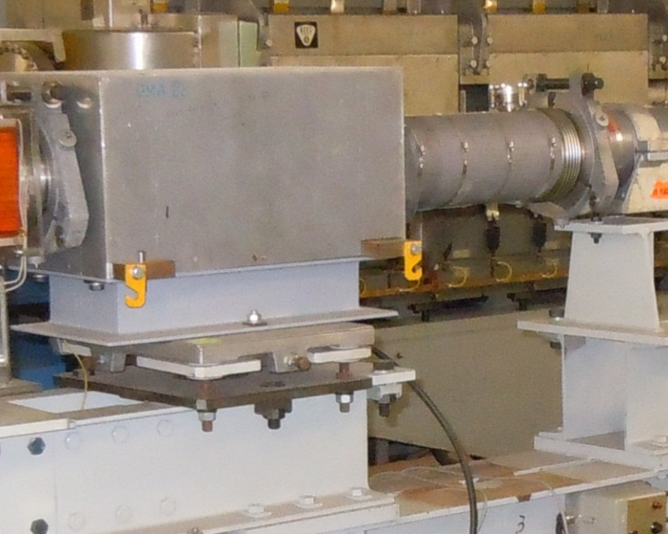
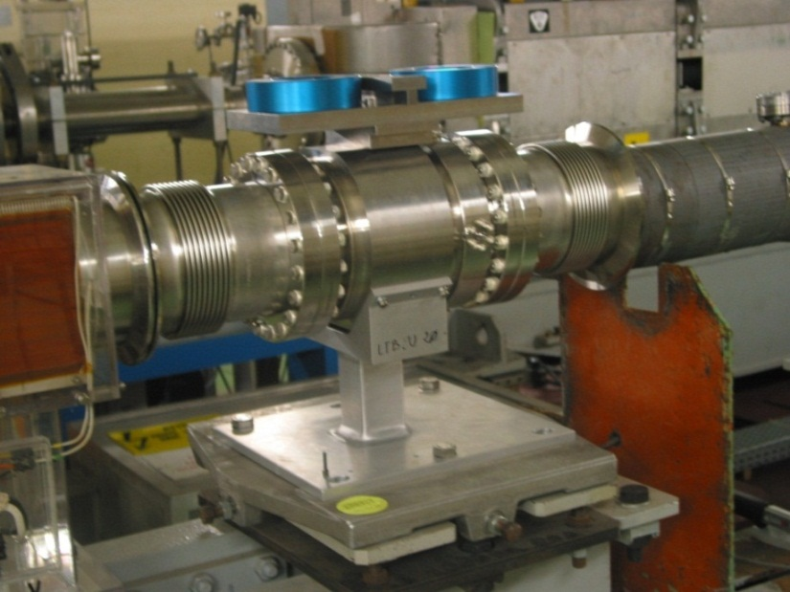
The Linac2 to PSB trajectory system: dated mid 70’s
LT Line
3 BPMs
PSB
LTB Line
5 BPMs
BI Line
12 BPMs
Linac4
Linac2
Injection lines
PS
 | UMA | STRIPLINE
Beam aperture | 120 mm | 140 mm
Overall length | 596mm | 250 mm
Interaction | Magnetic | Image current
Beam pipe | Braised Ceramic | Stainless Steel 316LN
spares | 1 | 3

Slide 4
UMA versus Striplines
 | UMA | STRIPLINE
Beam loss perturbation | N | N
Magnetic field perturbation | Y | N
Head Amplifiers | Y | N
BLR module | Y | N (AC-coupled)
Σ normalisation | with BCT | with FESA
Maintenance HW | Obsolete | Compatible w/ L4
Resolution | > 0.1mm | More on slide #13

Slide 5
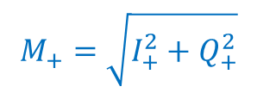


Linac4-based monitor and Acq. system
Acquisition system
BPM
202 MHz
LO
177 MHz
FESA
Calibration
Position
Options:
Intensity, ϕ, TOF
F_{ADC}
4x25 MHz
IF
25 MHz
ADC
25 MHz
Machine
BOR
Network
FESA Class
M_{R}-M_{L}
M+
0
M-
ΔH =
M_{R}+M_{L}+M_{U}+M_{D}
I+ Q+
I+ Q+
25MHz ADC input
time
ϕ = ϕ_{beam} - ϕ_{LO}
I- Q-
I- Q-
$$M_{+}=\sqrt{I_{+}^{2}+Q_{+}^{2}}$$
I ∝ M_{R}+M_{L}+M_{U}+M_{D}
$$M=\frac{M_{+} +{ M}_{−}}{2}$$
$$φ_{+}=arctan\left(\frac{Q_{+}^{}}{I_{+}^{}}\right)$$
TOF = ϕ_{PU2} - ϕ_{PU1}

Slide 6
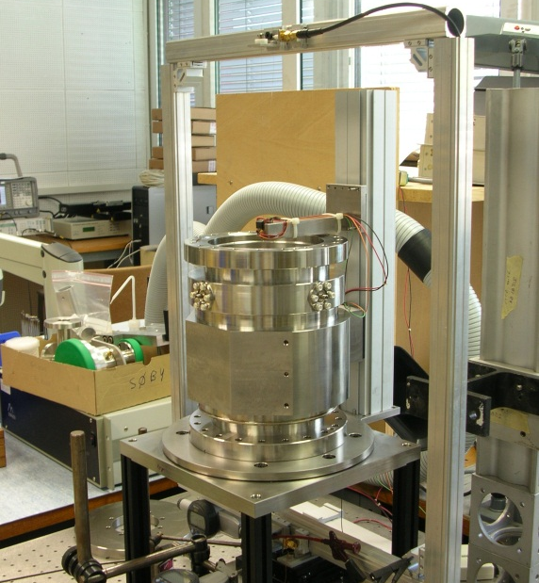
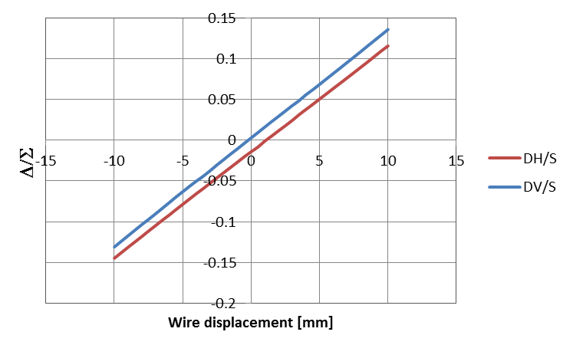
Lab characterization
Wire technique with standing waves
Optical sensor for mechanical centering : ±0.01mm precision
352MHz sine wave with a Network Analyser
Data acquisition by steps of 0.2mm
 | THEORY (CST) | Meas. @ 352MHz H plane | Meas. @ 352MHz V plane
Slope [mm] | 74.3 | 76.76 rms σ=0.36 | 75.06 rms σ=0.12
Elec. Offset [mm] | - | 1.04 σ=0.05 | 0.35 rms σ=0.16
Slope error | - | 3.27% | 0.98%

Slide 7
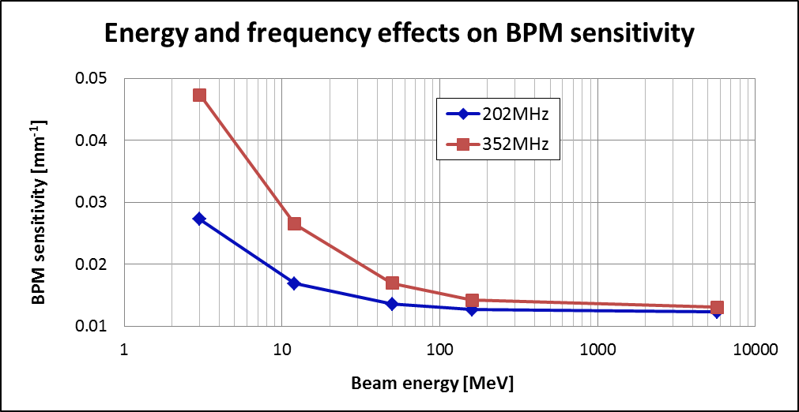
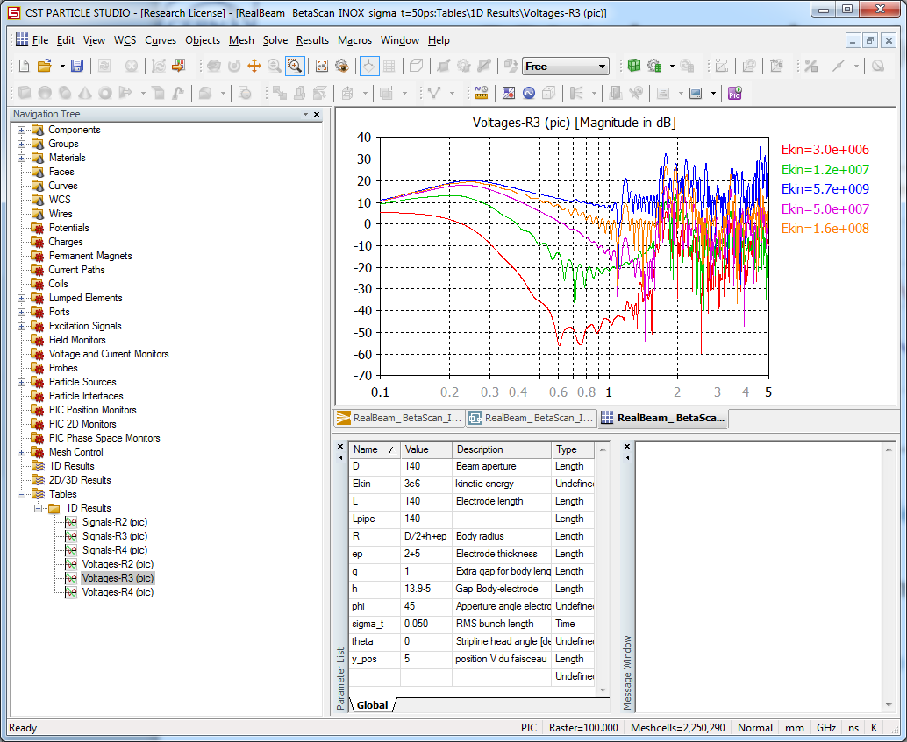
BPM dependencies
Frequency domain response
5.7GeV
160MeV
50MeV
12MeV
3MeV
Amplitude [dB]
Frequency [GHz]
Plot obtained from simulations with CST Particle Studio
Gaussian bunch, σ_{t}=50ps, Np = 4.63x10⁹ protons (150mA)
For β <1, the calculated value corresponding to the bunching frequency, and to the Linac energy.
The β-dependency of the present Magnetic BPM is unknown !!

Slide 8
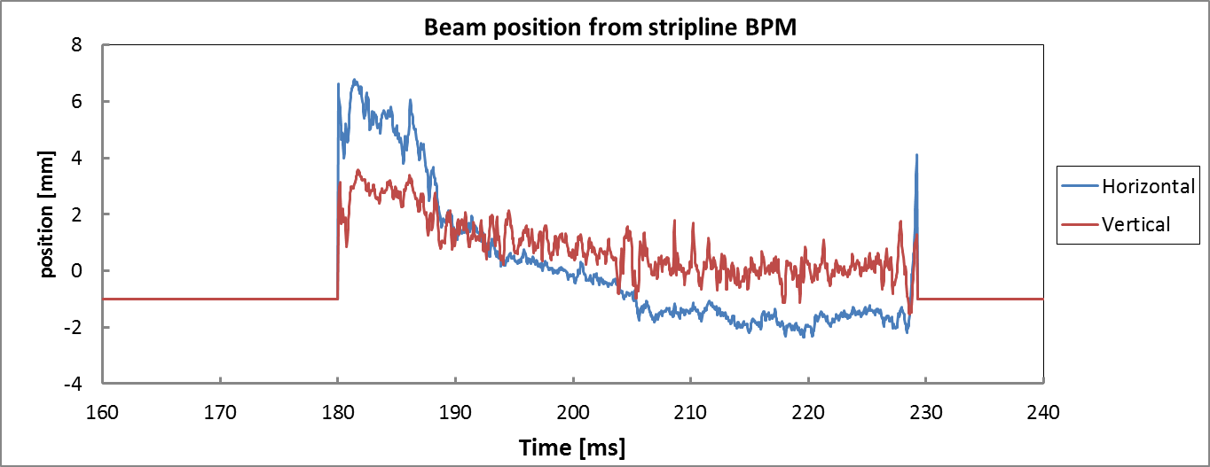
Software analysis in Linac2 beams
FESA basic features
BPM sensitivity at 50MeV and 202MHz
timing to start the acquisition : BX.SGUN-BPMI1
Position by ring
Average position for all rings
Calibration : Quick (default), Precision (later) , Theoretical (back-up)
List of settings under OP’s responsibility
Ring delays, ring durations
Head delay
Head/Tail duration : gate length for head/tail beams
R4 duration R3 duration R2 duration R1 duration
Head delay
Head duration
Tail duration

Slide 9
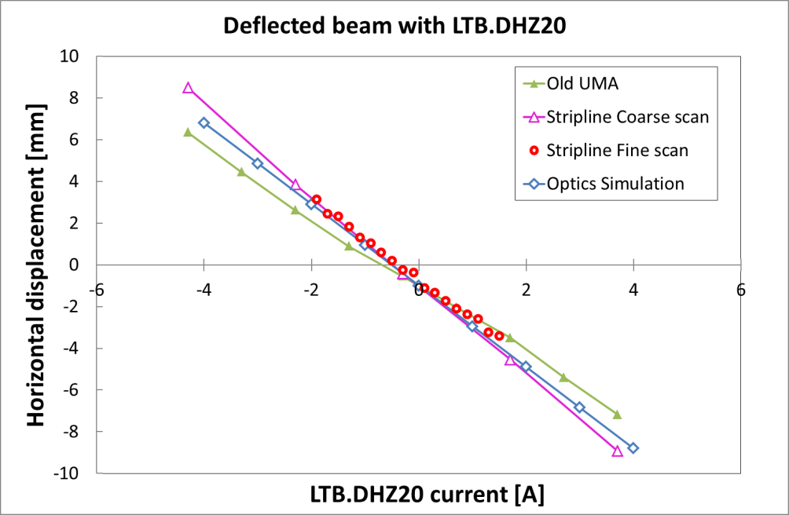
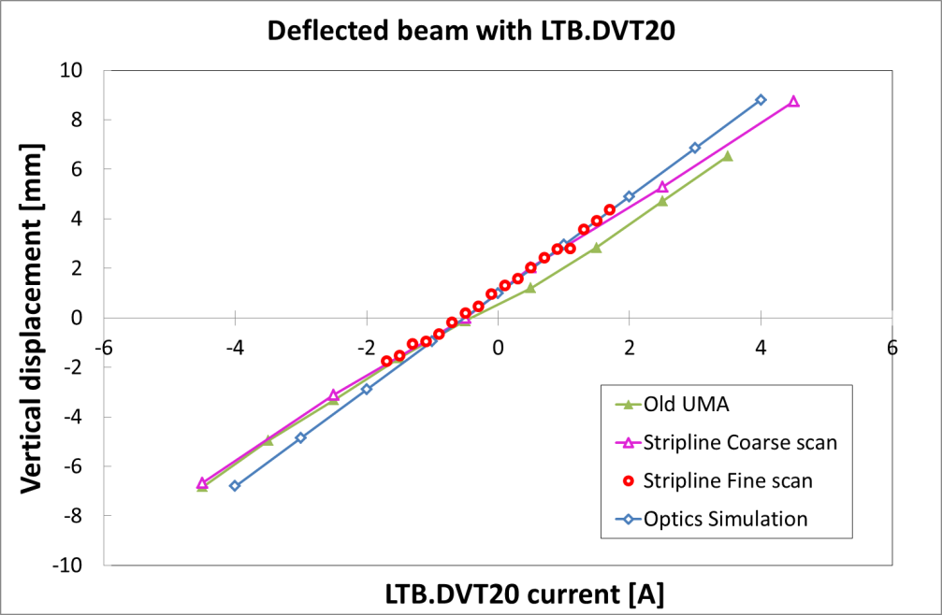
Linac2 beams : Local bump
MD with ISOGPS beam
Number of PSB turns = 12
Useful pulse length = 20μs
Average Linac2 current = 150mA
Measurements taken with
1/old UMA before its removal
2/new stripline : coarse and fine scan
Position are average values over 3-4 meas.
Comparison with optics simulations
(courtesy of A. Lombardi)
Good agreement with optics simulations, better than the UMA of unknown : β-dependency

Slide 10
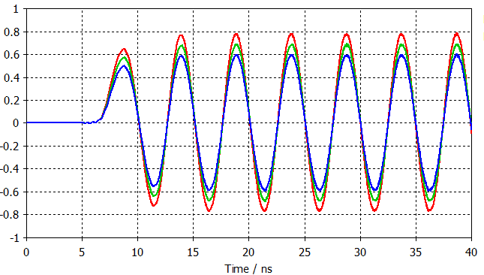
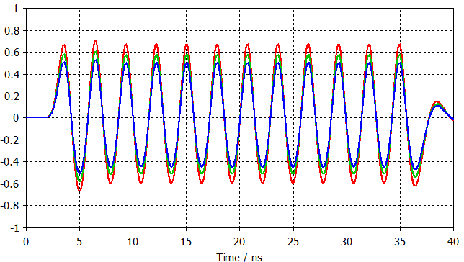
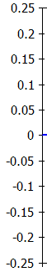
Unexpected result
Missing signal in LTB.UMA20
  In real life, the beam-induced signal onto the electrodes is 40 to 50% lower than the simulations : ~0.8V_{peak} measured, for ~1.6V_{peak} expected
Checks
  CST simulation with two independent solvers.
  Impedance matching : Time Domain Reflectometry
  Measurement of the beam phase in LBS.
  De-convolution of coaxial cable effect : 6dB attenuation (150m-long cable) and dispersion effects.
  Bunch population
Downstream BPMs with larger longitudinal beam phase : BI.UMA50
Theoretical signal level in the transfer line for a 5mm off-centered beam
Expected with 50% missing at analog front end input (before amplification)
Linac2: 150mA, beam phase = 92°RMS
Linac4: 65mA, beam phase = 55°RMS
Front end input signal [V]
Front end input signal [V]
Electrode signal [V]
Electrode signal [V]
Up
Down
Left/right

Slide 11
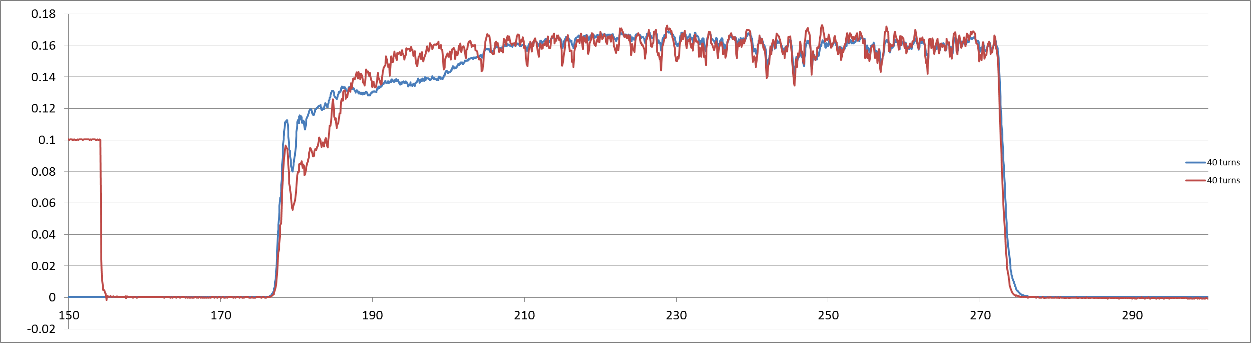
Unexpected result (cont.)
40 turns = 67μs
Linac intensity [A]
Time [μs]
LTB.BCT50 : red curve
Stripline : blue curve
Difference between the 2 monitors in the time structure of the beam head
The new BPM system follows the BCT reading only from ~2-turn injection
After that : the two signal are strongly correlated
Investigation on going

Slide 12
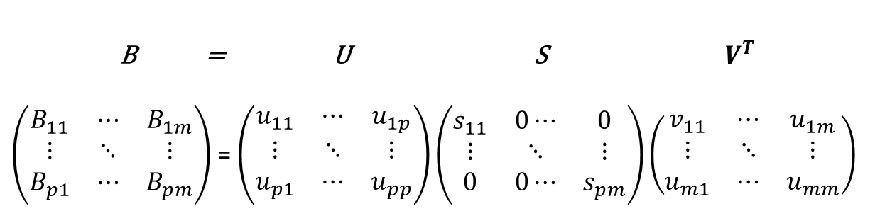
Stripline Resolution with SVD
Singular Value Decomposition (SVD)
B = U S ${ V}^{T}$
$\left(\begin{matrix}B_{11} & ⋯ & B_{1m} \\ ⋮ & ⋱ & ⋮ \\ B_{p1} & ⋯ & B_{pm}\end{matrix}\right)$ = $\left(\begin{matrix}u_{11} & ⋯ & u_{1p} \\ ⋮ & ⋱ & ⋮ \\ u_{p1} & ⋯ & u_{pp}\end{matrix}\right)\left(\begin{matrix}s_{11} & 0⋯ & 0 \\ ⋮ & ⋱ & ⋮ \\ 0 & 0⋯ & s_{pm}\end{matrix}\right)\left(\begin{matrix}v_{11} & ⋯ & u_{1m} \\ ⋮ & ⋱ & ⋮ \\ u_{m1} & ⋯ & u_{mm}\end{matrix}\right)$
Matrix B :
  matrix lines = number of shots (several hundreds)
  matrix columns = number of BPMs (20)
U and V are orthogonal matrices
S is a diagonal matrix, with non-negative values : s_{ii} is the i-th largest singular value of B
Procedure
Analyses BPM readings for a large number of pulses, and a large number of BPMs
The method does not rely on any particular machine model
Setting the highest values of s_{ii} =0 (with great care), and re-compute the BPM standard deviation.
Removes coherence effects due to betatron motion, cavity phase/energy errors…
Gives an estimate of the resolution the individual BPMs.

Slide 13
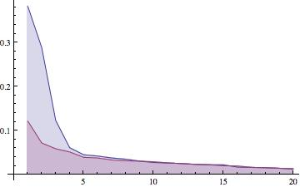
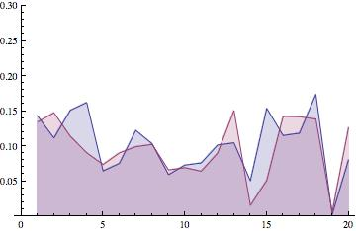
Stripline Resolution with SVD
Diagonal values of the matrix S
Low 50 mA Linac2 beam, 485 shots
Diagonal values of the matrix S gives the correlation between U and V matrices
Large values (max. 1) mean strong correlation
Small values (min. 0) mean uncorrelated noise
Preliminary (hot!) resolution for both planes : below 10 μm - even with 50% of missing signal.
blue: horizontal
red: vertical
Correlation [a. u.]
Courtesy of M. Wendt
Standard deviation of BPM 1…20
(After SVD, reducing modes 1…4)
blue: horizontal
red: vertical
Resolution BPM #19 (stripline)
2.6μm horizontal
6.1μm vertical
BPM resolution [mm]
BPM #14 = M. Gasior’s inductive pick-up
Courtesy of M. Wendt

Slide 14
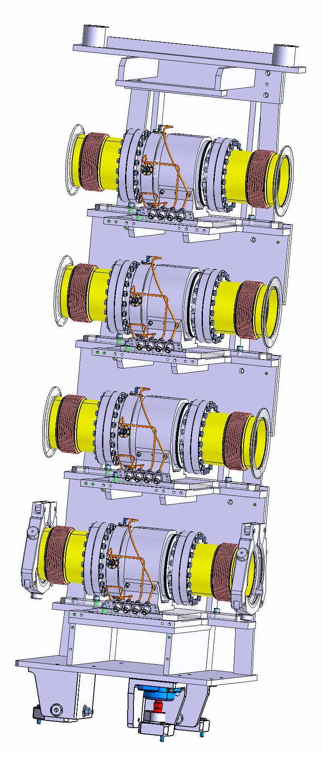
Status and Planning
BPM production: Departmental request, tech. specification, call for tender
Commissioning with Linac2 beams
Integration drawings in the transfer lines completed
Cabling: approved and planned for LS1
2013
March
  ECR
  Commissioning of the Movable Test Bench ⇒ Solving teething issues
  Cable works
  IPAC’13 paper
July-Nov.
  New acquisition system in BOR, and above Linac2 tunnel
  Monitors production and qualification
Nov. – Jan.
  Machine installation
2014-end of LS1 cold check out
BI.U40 and 50

Slide 15
Conclusion
BI proposes a new stripline-based BPM system for the Linac2 transfer lines.
It provides un-preceded low resolution,
Features good agreement with machine optics,
Adopts the Linac4 system: standard HW and SW,
Complies with OP’s specs.
Software has potential to give much more…
No machine access for electronics maintenance.
Not sensitive to beam loss or magnetic field.
Wider beam aperture.

Slide 16
Acknowledgement
U. Raich, as Instrumentation Project Leader for the Linac4
J. Belleman for many fruitful discussions
A. Lombardi for prompt machine optics simulations
R. Scrivens for strong support (advices, special Linac2 setting for 50mA operation)
EN/EL : J.C. Guillaume, P. Lelong for their best effort in the cabling work
Drawing office/Workshop : A. Dallocchio, D. Steyaert, A.P.G. Demougeot, P. Moyret, L. Prever-Loiri, N. Favre, A. Cherif
K. Hanke and B. Mikulec for supporting this prototype test
L. Jensen for the project SW support.

